Slide 1
Government Preference in Former Gran Colombia
Luke Maloney

Slide 2
## Scale for y is already present. ## Adding another scale for y, which will replace the existing scale. ## Scale for y is already present. ## Adding another scale for y, which will replace the existing scale.

Slide 3
Government Preference
Do the citizens of the countries of the Former Gran Colombia share similar views on governance?
Does opinion vary more based on politics?

Slide 4
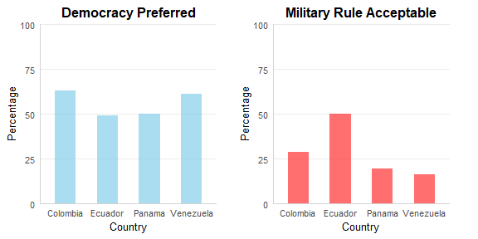
Opinions by Country

Slide 5
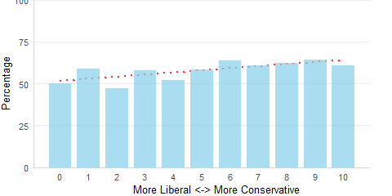
Opinions of Democracy by Political Leaning

Slide 6
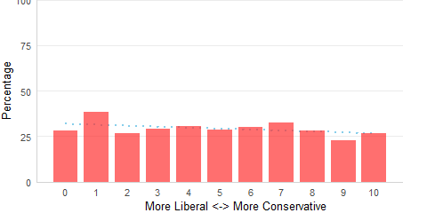
Opinions of Military Rule by Political Leaning

