Slide 1
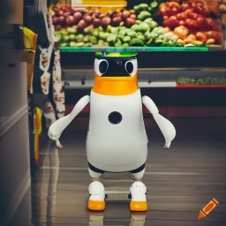
ECE4078 Intelligent robotics
AI art generated by https://www.craiyon.com/
(prompt: “a penguin robot shopping for fruits and vegetables in a supermarket”)
Lab 4-2: Auto Navigation

Slide 2
ECE4078 Intelligent robotics
Week | Objectives | Milestones
1: C1-1 | Introduction and setup
2: M1-1 | Calibration, ARUCO markers | C1 due
3: M1-2 | SLAM
4: M1-3 | SLAM
5: M2-1 | Object recognition & localisation | M1 due
6: M2-2 | Object recognition & localisation
7: M3-1 | Navigation & Planning | M2 due
8: M3-2 | Navigation & Planning
9: C2 | Integration & Improvement | M3 due
10: Final | Trial run of final demo | C2 due
11: Final | Final demo | Final demo due
12: No lab | N/A | N/A
*

Slide 3
M3: Navigation and Planning
M3 focuses on navigation and planning
PenguinPi now knows where things are and needs to plan its way around the supermarket and get fruits&vegs on its shopping list
Your task will be to semi OR fully autonomously navigate and path plan around the arena to targets in a specified order. For level 4, you do not need to follow the specified order
The arena will always contain:
10 ArUco markers
10 Fruits&Vegs
Groundtruth maps are given for M4 ONLY (practice map in repo)
You will be given a shopping list that contains 5 targets in the order for the robot to navigate to
The 5 targets will be unique, the 5 obstacles may contain duplicates of other types
To “pick up” a target you must stop the robot for 2 seconds (doesn’t need to be exact) whilst being within 0.25m of the target. Intention of picking up the fruit needs to be shown in the GUI or terminal.

Slide 4
M3: auto nav
Level 1:
semi-auto navigation with manually given waypoints and known
Level 2:
auto navigation with known map (waypoints produced by your path planer)
Level 3:
auto nav with partially known map (use M3 to detect obstacles and replan once an obstacle is seen)
Level 4:
auto nav with partially known map (use M3 to detect targets/obstacles and replan once those objects are seen). You will also need to explore the arena
You can do this by modifying “auto_fruit_search.py” or write your own scripts

Slide 5
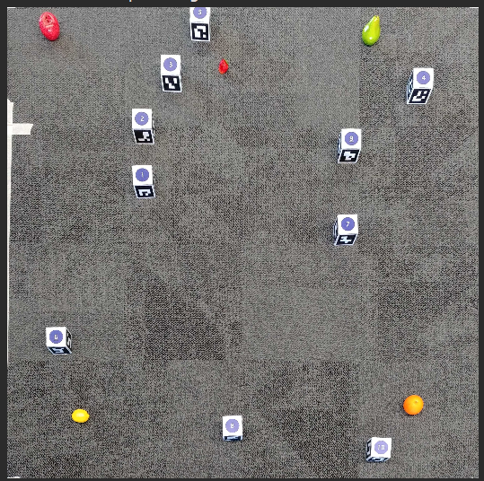

M3: Occupancy Map
In order for our robot to autonomously plan a path it first needs to build an occupancy map
To do this we can voxelise the true map given to us where a 0 represents a free space and 1 an obstacle
Using the OpenCV cv2.circle() function we can draw obstacles with a given safety radius
Below is an example, note that different fruits are used in this example
Apple is the goal therefore not counted as an obstacle
Arena
Occupancy map
Be careful when selecting the radius of the circles, too small and you run the risk of crashing into obstacles while too large can make some areas of the map unreachable

Slide 6
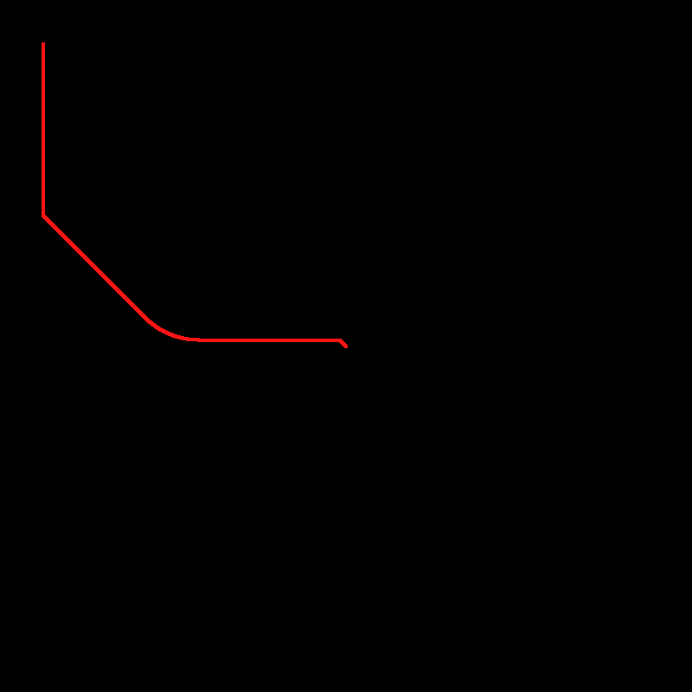
M3: Path Planning
Once an occupancy map is created you can then implement a path planning algorithm of your choice
If you want to generate the shortest path possible then you can use Dijkstra algorithm
Step 1: Generate a distance map from the goal point
Starting from the goal location, propagate the distance from the goal until
the whole map is filled
Selecting any point in this image will tell you the shortest distance to the
goal point
Step 2: Generate the shortest path
Select a starting point on the image, look at the point’s nearest neighbors
and then select the neighbor with the smallest distance value.
Continue selecting the nearest neighbors with the smallest distance value
until you reach the goal point

Slide 7
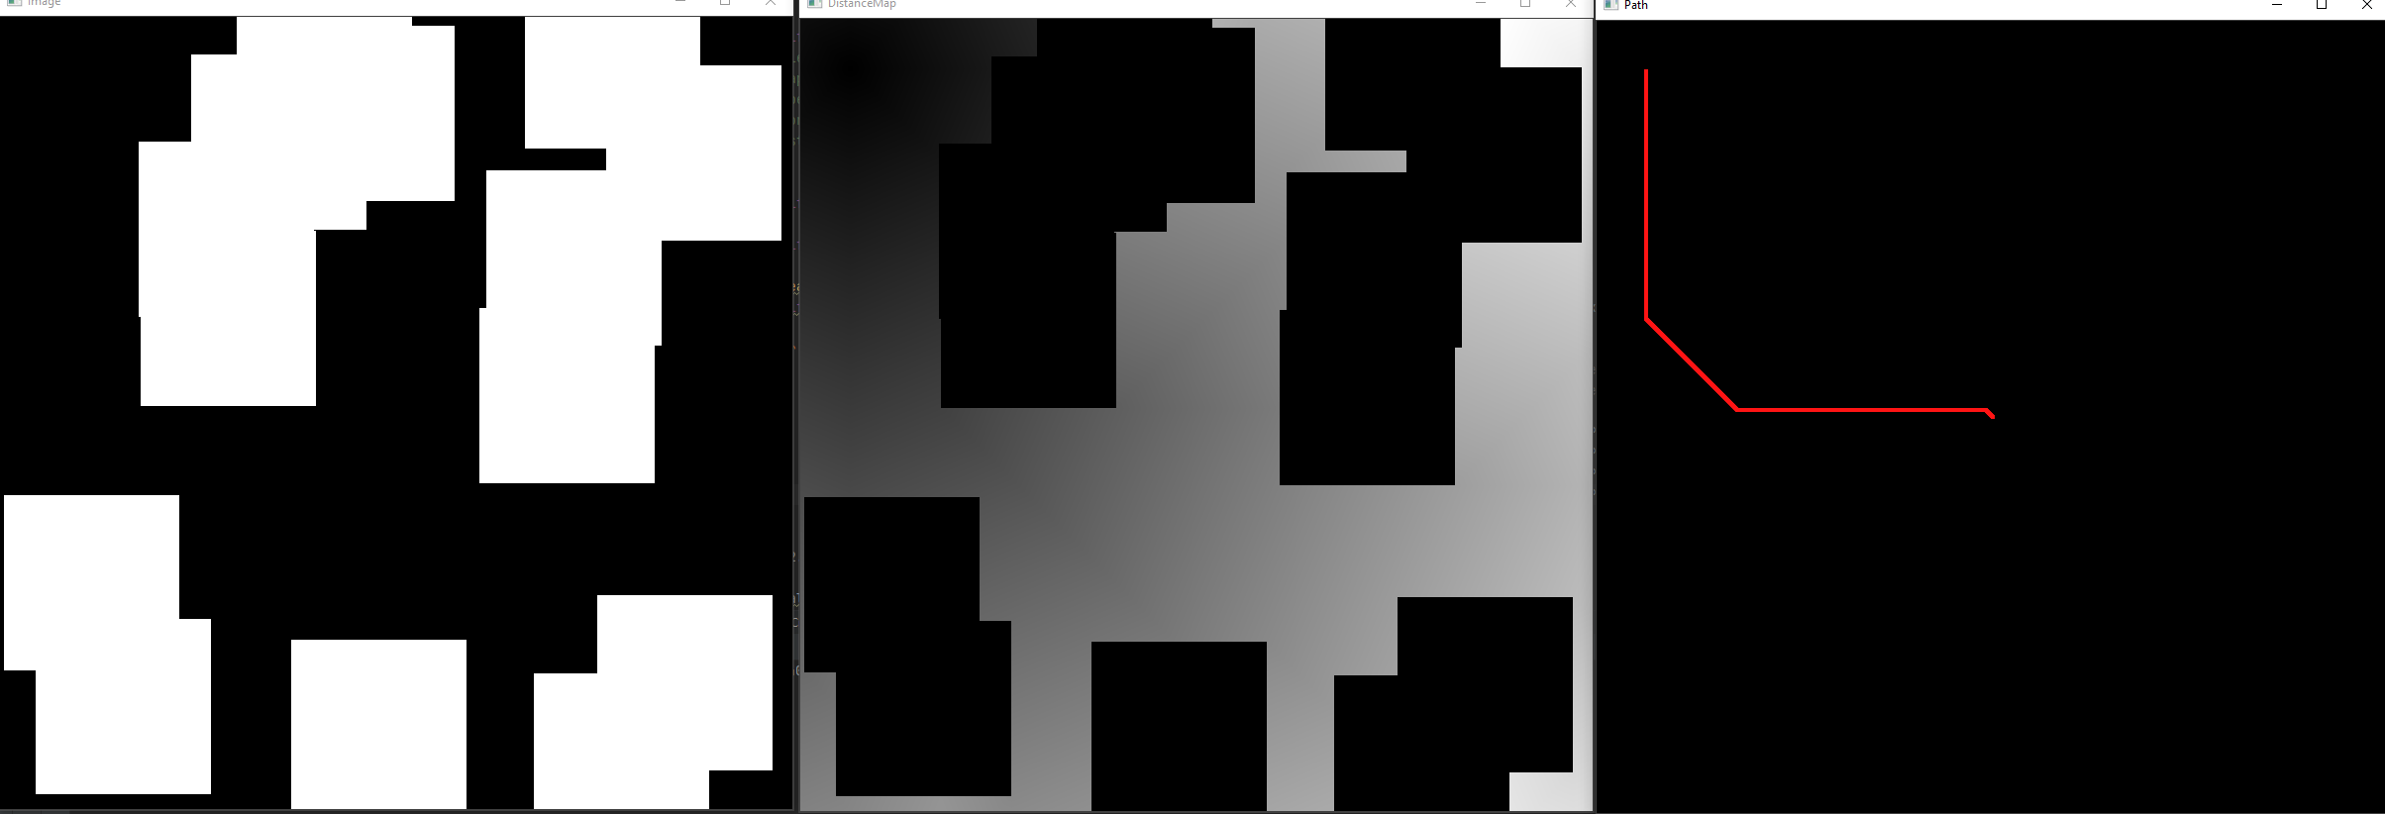
M3: Path Following
Now that we have generated a path, how do we get the robot to follow it?
We can copy what we did in “auto_fruit_search.py” and set waypoints along the generated path
Dijkstra algorithm may generate the shortest path to goal, however it may not be the easiest and reliable path to follow
Getting the robot to follow curves is difficult, ideally the most optimal path to follow in terms of reliability is one that uses the minimum amount of strait lines.
We can make the path following aspect easier by:
- Generate the occupancy map with cv2.rectangle() instead of cv2.circle()
- Simplify the curve by using cv2.approxPolyDP()
- Use rapidly-exploring random tree (RRT) instead of Dijkstra to generate straight line paths only (however RRT may use many zig-zagged strait lines to get to the goal)

Slide 8
M3: Evaluation
Live demo marking in wk9 using new arena
Each of the 3 levels have different marks associated
Level 1: (Total marks: 50pt)
For each successful navigation in order +10pts
Level 2: (Total marks: 20pt)
You get the Lv1 50pt if you can achieve a qualified run in Lv2
For each successful navigation in order +4pts
Level 3: (Total marks: 15pt)
You get the Lv1+Lv2 70pt if you can achieve a qualified run in Lv3
For each successful navigation in order +3pts
Level 4: (Total marks: 15pt)
You get the Lv1+Lv2+Lv3 85pt if you can achieve a qualified run in Lv4
For each successful navigation in order +3pts
You will receive penalties if:
Robot collides with marker/object (-5pt)
Robot touches the arena boundaries (-5pt)
Max 5 penalties allowed: third time a penalty happens that run is disqualified and gets 0pt

Slide 9
M3: Marking Rules
(see M3_marking.md for more info)
No more than 4 penalties (collision) applied in a run and no more than 5 penalties allowed. After the 5th time, the run is stopped and marks are awarded if run is qualified.
End condition to achieve a qualified run:
Your robot attempts to navigate to (drive past within 0.5m radius) 3 targets in order (skips allowed)
(You will only get marks for targets navigated in order and if it is a qualified run or level 1)
You have to show a qualified Lv2/Lv3/Lv4 run to get marked by the Lv2/Lv3/Lv4 formula
The entire robot needs to stop within the 0.25m radius to count as successful navigation to that target
If we don’t see appropriate implementation of navigation and path planning in your codes for the level you are attempting you’ll get 0pt for M4
If we find that your Level 3 (auto nav with partial map) made use of the full map you’ll get 0pt for M4. The same goes for level 4.
You are only allowed ONE COMMAND to launch auto nav in Lv2&Lv3&Lv4. No teleoperation allowed in any levels (you’ll get 0pt for M4 if you are suspected of teleoperating during the demo). Once you have a qualified run, you are allowed to stop the robot at any time.
Successful navigation / collision avoidance by luck will not give you marks for those targets

