Slide 1
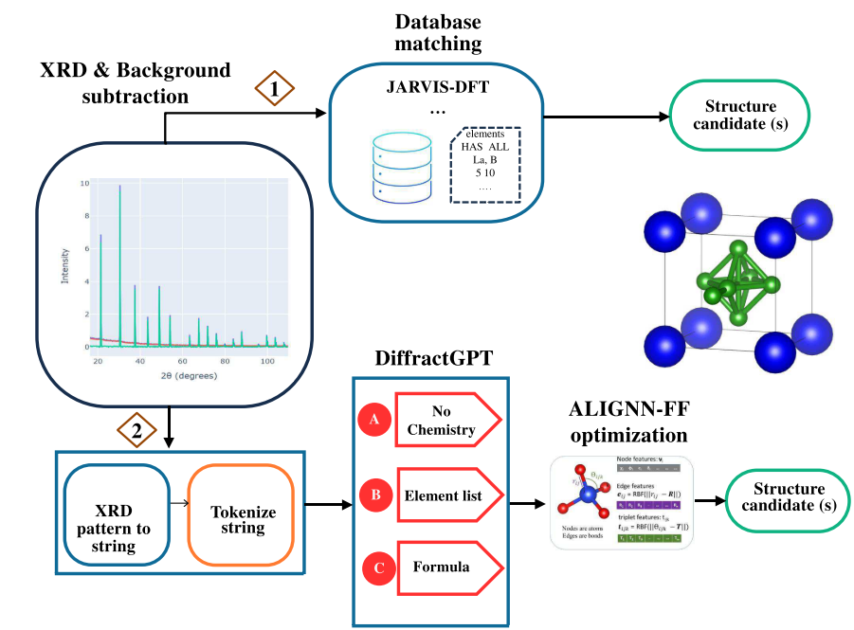
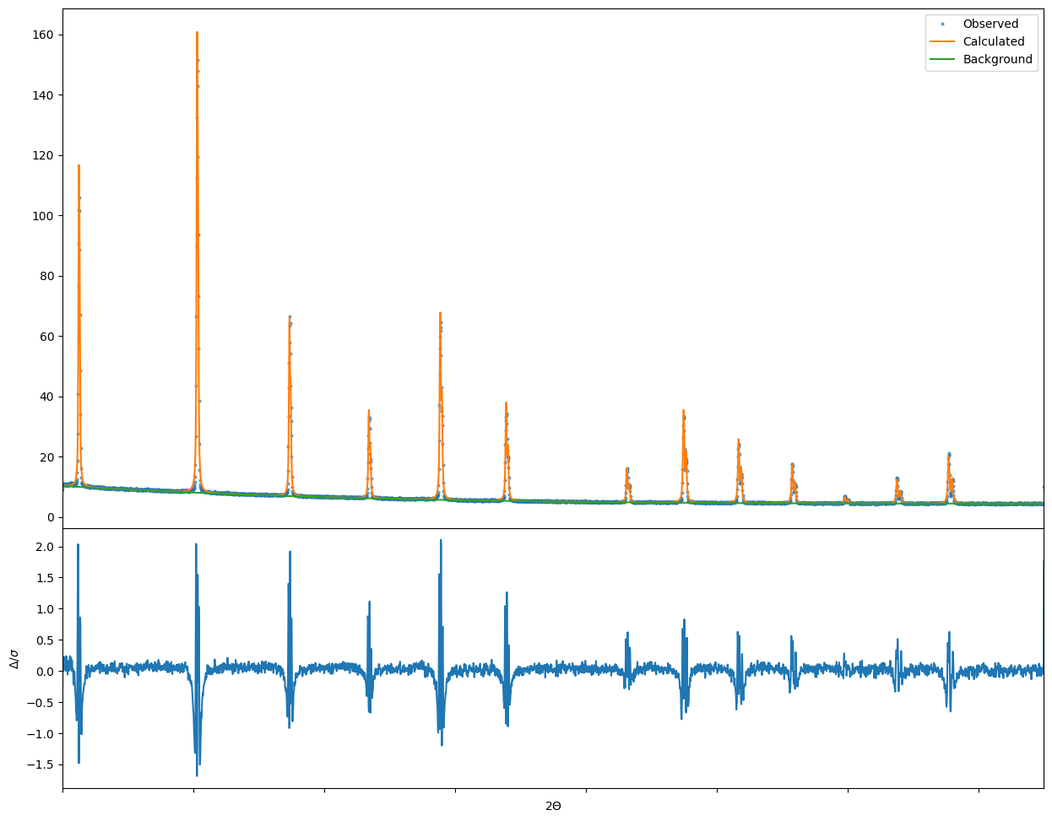

DiffractGPT/GSAS Pipeline
Not sure if it’s always necessary, but GSAS kept failing when refining the P1 CIF
Pymatgen
Symmetrized CIF
(Pm-3m)
Fails
GSAS-II
Predicted CIF
Without Symmetry (P1)
Starting point
Lattice parameters
Chi2

