Slide 1
Modeling Fourth-Down
Decision-Making in
College Football
822,703
plays collected from 2023–2025
FBS-only
A three-season analysis of FBS fourth-down behavior,
Notre Dame tendencies, and team aggressiveness
team rankings and benchmark comparisons
Luke Wrenn
2023–2025 FBS play-by-play • CollegeFootballData • Fourth-down decisions only
01
Notes:
Open by framing the project as a coaching decision study, not simply a charting exercise. Explain that the objective is to understand how college football teams make fourth-down decisions, where conservative behavior shows up most clearly, and how Notre Dame compares to the national FBS baseline. Emphasize the scale: more than 822,000 plays across three seasons. This helps establish credibility before getting into the specific findings.

Slide 2
RESEARCH QUESTION
When do college football teams choose aggression on fourth down?
Fourth down is one of the cleanest places to observe coaching risk tolerance.
• Fourth-down choices force coaches to choose between field position, points, and possession. • The same distance can produce different decisions depending on field position and team philosophy. • This Version 1 analysis focuses on observable behavior and simple context-adjusted comparisons.
INSIGHT
IMPLICATION
The project asks what teams actually do, not what a model says they should do.
This keeps Version 1 focused, explainable, and presentation-ready.
2023–2025 FBS play-by-play • CollegeFootballData • Fourth-down decisions only
02
Notes:
Explain that fourth-down decisions are valuable analytically because they are discrete, observable choices. Every play can be classified as a punt, field goal, or go-for-it decision. This gives us a clean way to compare coaching behavior. Point out that this version intentionally stays descriptive: the goal is to establish a reliable baseline before adding expected value or machine learning in later versions.

Slide 3
DATA FOUNDATION
Dataset and methodology
A consistent classification pipeline powers all Version 1 findings.
822,703
2023–2025
3 decisions
FBS-only
total plays collected
three FBS seasons
punt • field goal • go for it
team rankings
• Fourth downs were classified using play type; penalties and timeouts were removed. • Go-for-it success equals yards gained ≥ distance needed. • Aggressiveness Index compares actual go rate to expected go rate by distance bucket and field zone.
INSIGHT
IMPLICATION
The methodology is intentionally simple and transparent.
That makes the results easy to explain to coaches, students, or analytics staff.
2023–2025 FBS play-by-play • CollegeFootballData • Fourth-down decisions only
03
Notes:
Walk through the data construction briefly. Mention that the dataset begins with all plays, but the analysis narrows to fourth-down decisions. Non-decision events like penalties and timeouts are excluded to avoid polluting the denominator. Success is only calculated for go-for-it plays. The Aggressiveness Index is a first-pass, interpretable metric: it adjusts for the two most important situational factors in Version 1, distance and field position.

Slide 4
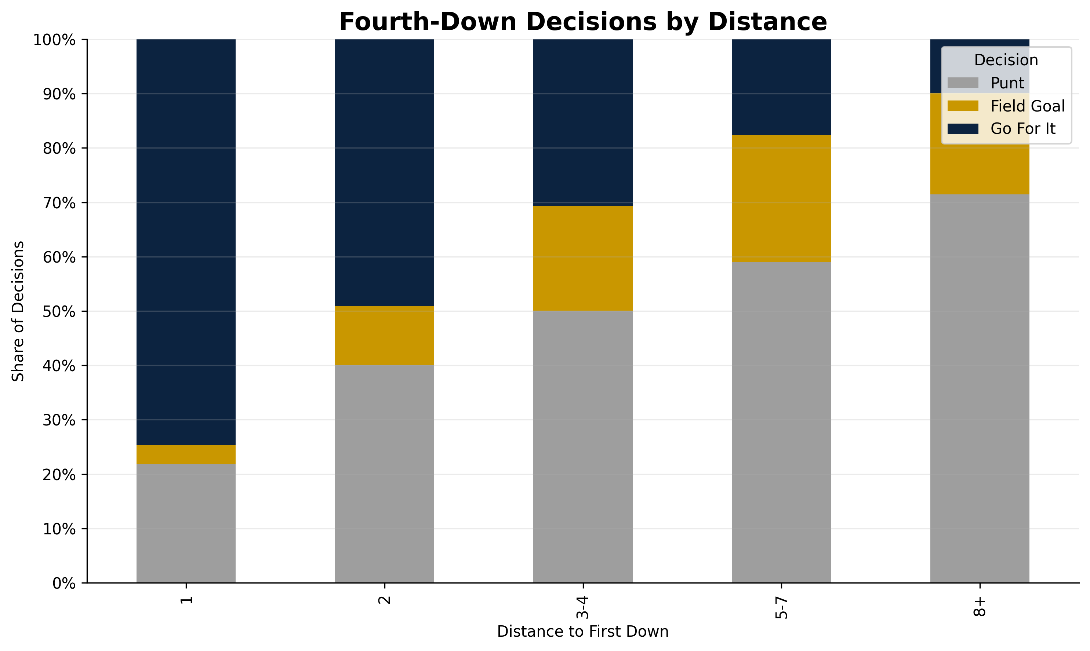
NATIONAL BEHAVIOR
Short yardage drives aggression; long yardage drives conservatism.
The decision threshold appears between two and three yards.
• 4th & 1: teams go 74.6% of the time. • 4th & 3–4: go rate falls to 30.7%. • 4th & 8+: punt rate rises to 71.4%.
INSIGHT
Coaches appear to treat fourth down categorically rather than continuously.
IMPLICATION
The sharp drop after two yards is a strong signal for where analytics can challenge convention.
Threshold shift: 2 → 3 yards
2023–2025 FBS play-by-play • CollegeFootballData • Fourth-down decisions only
04
Notes:
This slide introduces the first major national pattern. Point to the high go-for-it share on fourth-and-one. Then emphasize how quickly aggression falls once the distance moves beyond two yards. The core message is not that coaches are irrational; it is that behavior changes sharply at a threshold. This provides a simple, memorable opening insight: short yardage invites aggression, but moderate yardage quickly brings back conservatism.

Slide 5
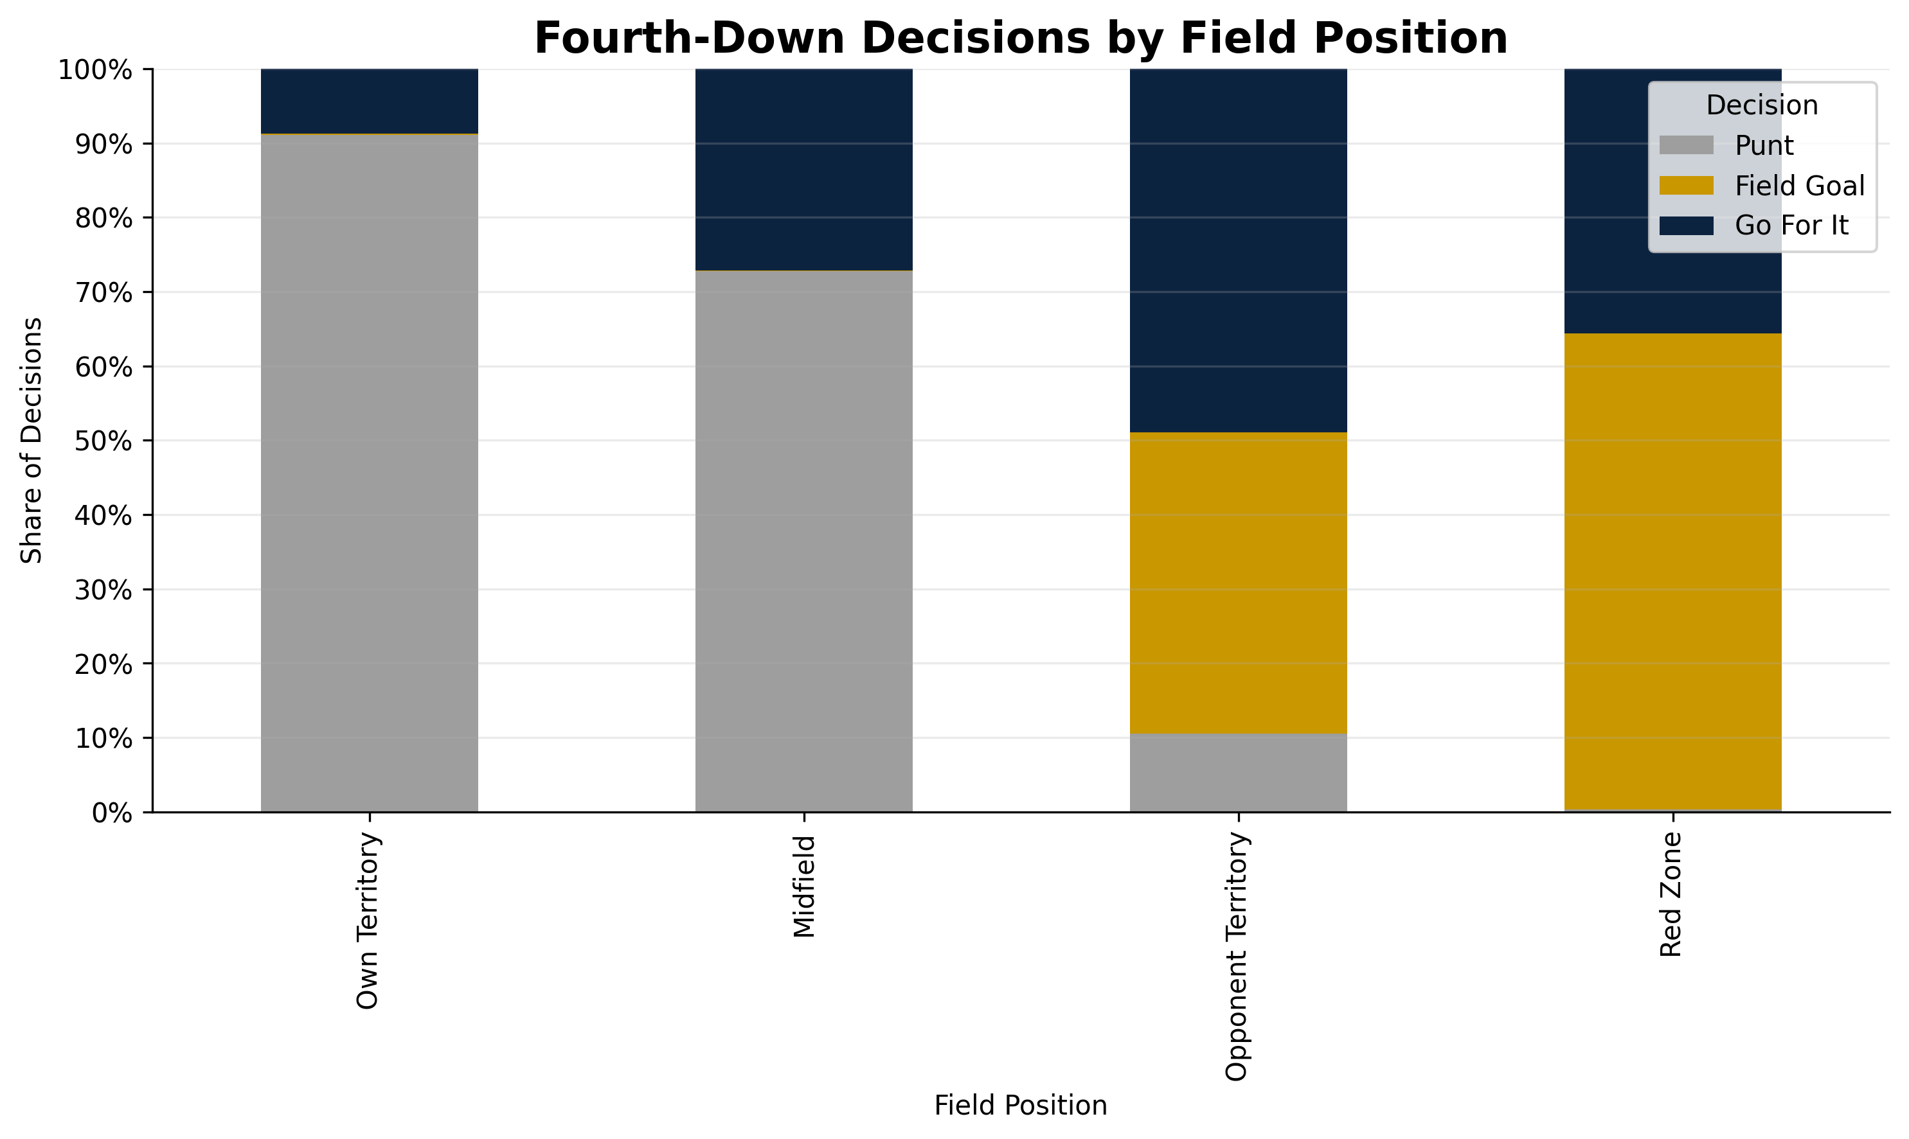
NATIONAL BEHAVIOR
Midfield remains the largest conservative zone.
Teams punt 72.7% of the time in midfield.
• Own territory is predictably punt-heavy. • Opponent territory is much more balanced. • Red zone decisions heavily favor field goals.
INSIGHT
Midfield is the clearest conservative decision zone.
IMPLICATION
Predictable midfield punting may leave strategic value on the table.
72.7% punts in midfield
2023–2025 FBS play-by-play • CollegeFootballData • Fourth-down decisions only
05
Notes:
This is one of the anchor slides. Explain that extreme field positions behave as expected: own territory leads to punts, red zone often leads to field goals. The important middle ground is midfield, where the offense has enough field position to consider aggression but teams still punt nearly three quarters of the time. Use this slide to establish the core inefficiency theme for the deck.

Slide 6
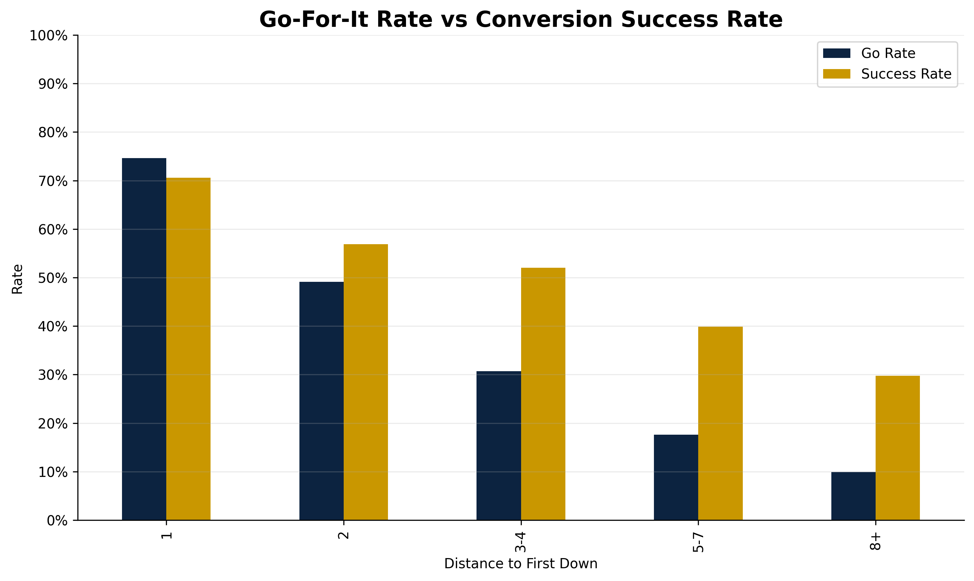
CONVERSION OUTCOMES
Teams often convert more often than they attempt.
Moderate yardage shows the clearest gap between behavior and outcomes.
• 4th & 2: 49.1% go rate vs 56.9% success. • 4th & 3–4: 30.7% go rate vs 52.0% success. • 4th & 5–7: 17.6% go rate vs 39.9% success.
INSIGHT
Success rates remain meaningful beyond one yard.
IMPLICATION
This does not mean teams should always go; it suggests under-aggression in select situations.
3–4 yards: 52% success vs 31% go
2023–2025 FBS play-by-play • CollegeFootballData • Fourth-down decisions only
06
Notes:
This slide compares what teams do with what happens when they go. Be careful with the wording: do not say teams should always go for it because this chart does not account for all context. Instead, say the observed success rates suggest some situations may be underutilized, especially fourth-and-three to four. This gives the project a prescriptive edge without overstating the result.

Slide 7
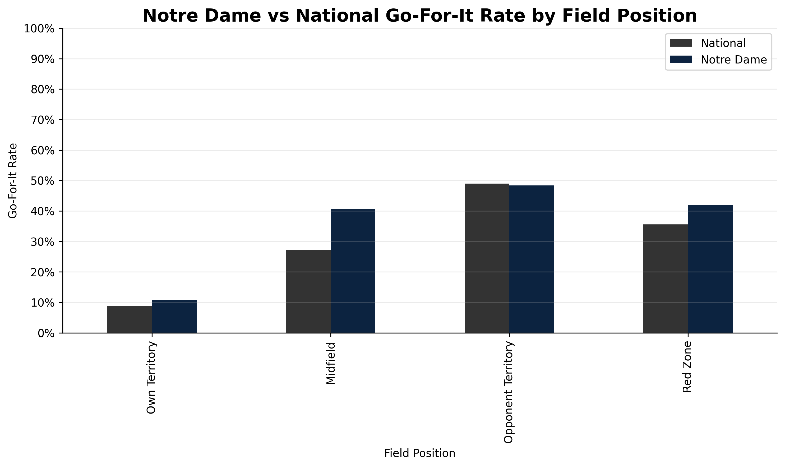
NOTRE DAME CASE STUDY
Notre Dame is more aggressive than average in midfield.
Notre Dame goes for it 40.7% in midfield versus 27.1% nationally.
• Midfield: Notre Dame 40.7% vs national 27.1%. • Own territory: Notre Dame 10.7% vs national 8.7%. • Red zone: Notre Dame 42.1% vs national 35.6%.
INSIGHT
Notre Dame shows a more aggressive profile in the key zone.
IMPLICATION
That makes ND a useful case study rather than just another team comparison.
ND midfield: +13.6 pts vs national
2023–2025 FBS play-by-play • CollegeFootballData • Fourth-down decisions only
07
Notes:
Transition from national behavior to the Notre Dame case study. The key number is midfield go rate: Notre Dame is meaningfully above the national average. This is important because midfield was the main conservative zone nationally. The takeaway is that Notre Dame is not merely more aggressive overall; it is more aggressive in a strategically important region of the field.

Slide 8
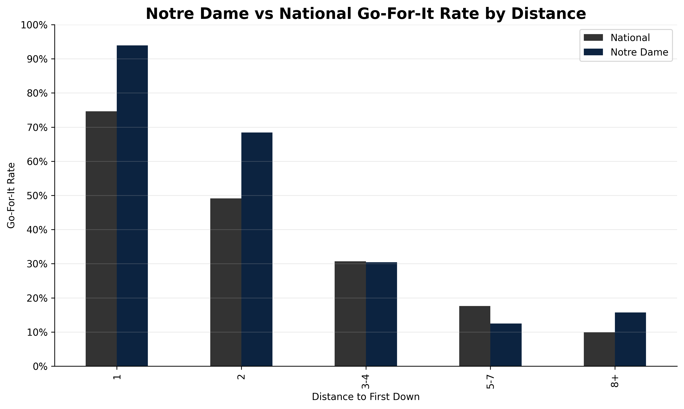
NOTRE DAME CASE STUDY
Notre Dame is especially aggressive in short yardage.
Notre Dame is situationally aggressive, not universally aggressive.
• 4th & 1: Notre Dame 93.9% vs national 74.6%. • 4th & 2: Notre Dame 68.4% vs national 49.1%. • At longer distances, Notre Dame is closer to or below national behavior.
INSIGHT
Notre Dame’s aggression is concentrated in favorable situations.
IMPLICATION
That distinction keeps the analysis balanced and avoids overstating the case.
Short-yardage edge is the ND signature
2023–2025 FBS play-by-play • CollegeFootballData • Fourth-down decisions only
08
Notes:
This slide adds nuance. Notre Dame is very aggressive on fourth-and-one and fourth-and-two, but the profile is not simply “go for everything.” At longer distances Notre Dame becomes more conservative. This matters because it supports a more mature interpretation: ND appears to be selectively aggressive in situations where the odds are more favorable.

Slide 9
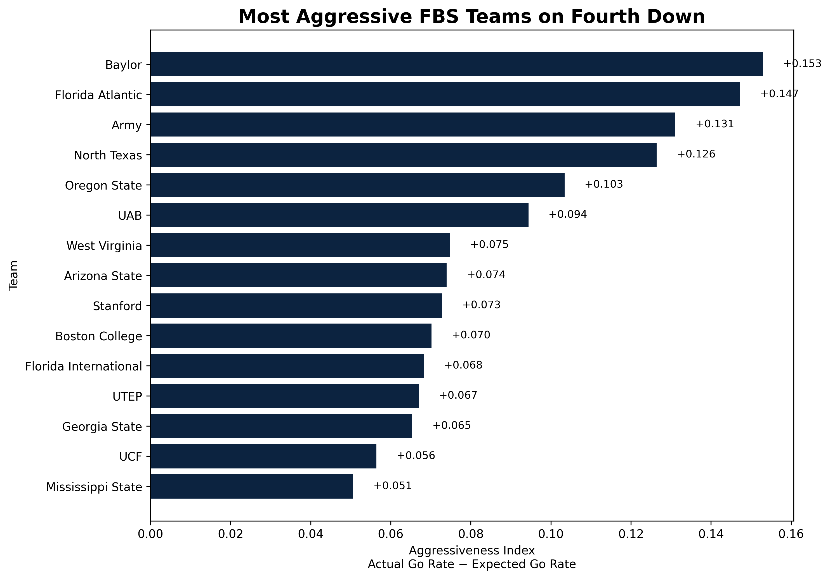
TEAM PROFILES
Aggression can be measured relative to situation.
The Version 1 index adjusts for distance bucket and field zone.
• Baylor ranks #1 in the Version 1 Aggressiveness Index. • FAU, Army, North Texas, and Oregon State are major outliers. • The index compares actual go rate to expected go rate in similar situations.
INSIGHT
Some programs consistently choose aggression even after contextual adjustment.
IMPLICATION
This turns fourth-down behavior into a comparable team profile.
2023–2025 FBS play-by-play • CollegeFootballData • Fourth-down decisions only
09
Notes:
Introduce the Aggressiveness Index. Explain that raw go rate alone can be misleading because some teams face different mixes of distances and field positions. The index adjusts for distance bucket and field zone, then asks whether the team goes more often than expected. Mention Baylor as the top-ranked team, but emphasize that the metric is Version 1 and intentionally simple.

Slide 10
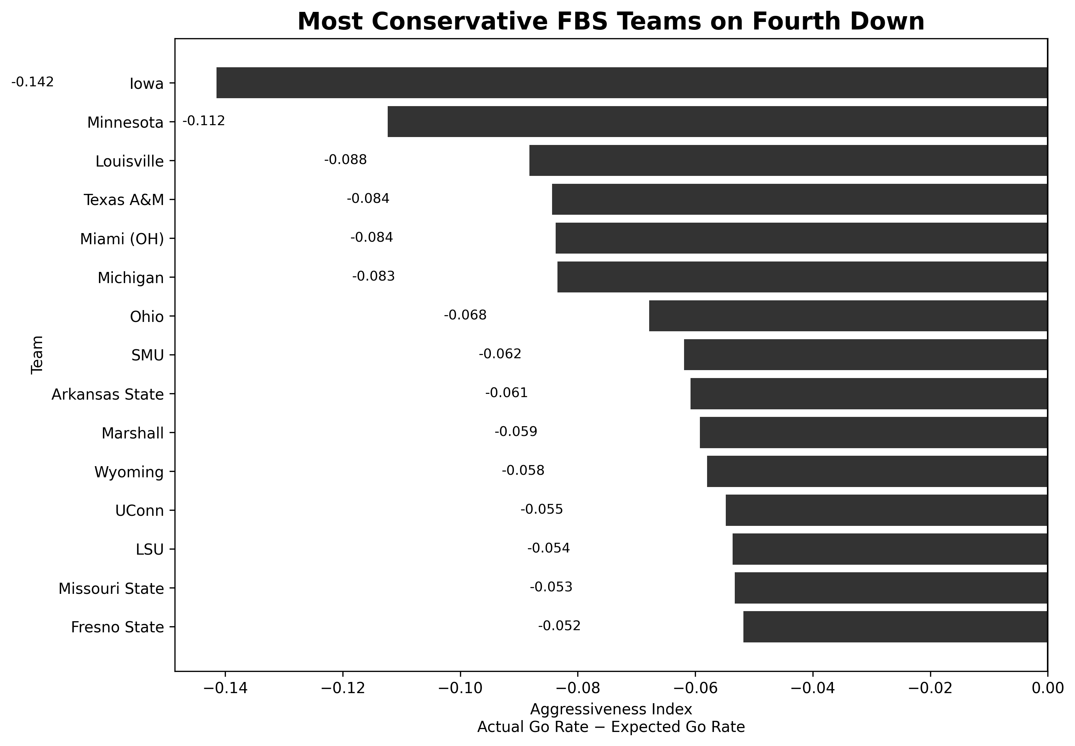
TEAM PROFILES
Some programs consistently choose lower-risk options.
Conservative does not necessarily mean wrong; it reflects relative behavior.
• Iowa ranks as the most conservative FBS team in this dataset. • Minnesota, Louisville, Texas A&M, and Michigan are also conservative outliers. • The index measures behavior, not whether the decision was correct.
INSIGHT
The conservative tail is just as informative as the aggressive tail.
IMPLICATION
Program identity and coaching philosophy show up in fourth-down behavior.
2023–2025 FBS play-by-play • CollegeFootballData • Fourth-down decisions only
10
Notes:
Use this slide carefully. Conservative teams are not necessarily “bad” or wrong. The point is that their observed choices are below what the national baseline would predict in similar distance and field-position situations. This helps frame the index as a behavioral profile rather than a value judgment.

Slide 11
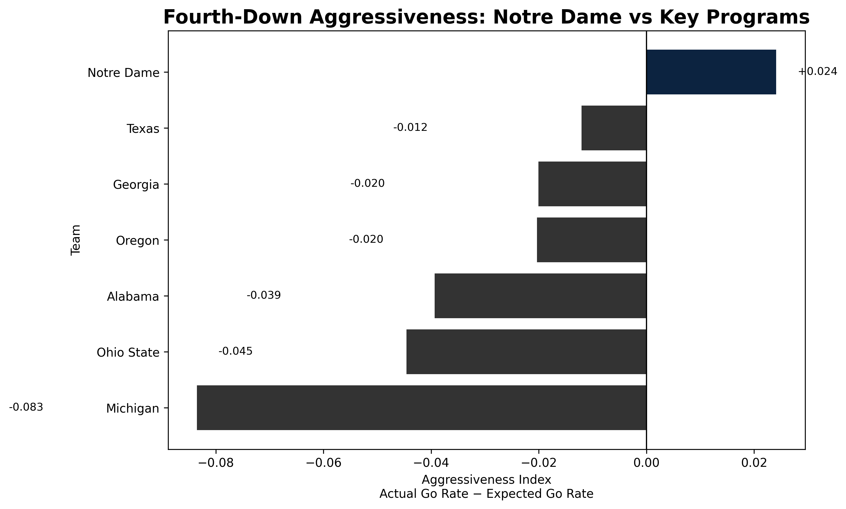
TEAM PROFILES
Notre Dame is slightly aggressive, but not an extreme outlier.
Notre Dame ranks 36th nationally with an index of +0.024.
• Notre Dame ranks 36th nationally. • Notre Dame Aggressiveness Index: +0.024. • Texas, Georgia, Oregon, Alabama, Ohio State, and Michigan rate below expectation.
INSIGHT
Notre Dame is aggressive situationally, not universally.
IMPLICATION
This reconciles the ND case study with the broader team ranking.
ND: aggressive, but not extreme
2023–2025 FBS play-by-play • CollegeFootballData • Fourth-down decisions only
11
Notes:
This slide resolves a potential tension. Earlier slides showed Notre Dame being aggressive in midfield and short yardage. Here, the broader context-adjusted ranking shows Notre Dame is only modestly above expectation overall. That is not a contradiction; it means Notre Dame’s aggression is targeted rather than extreme.

Slide 12
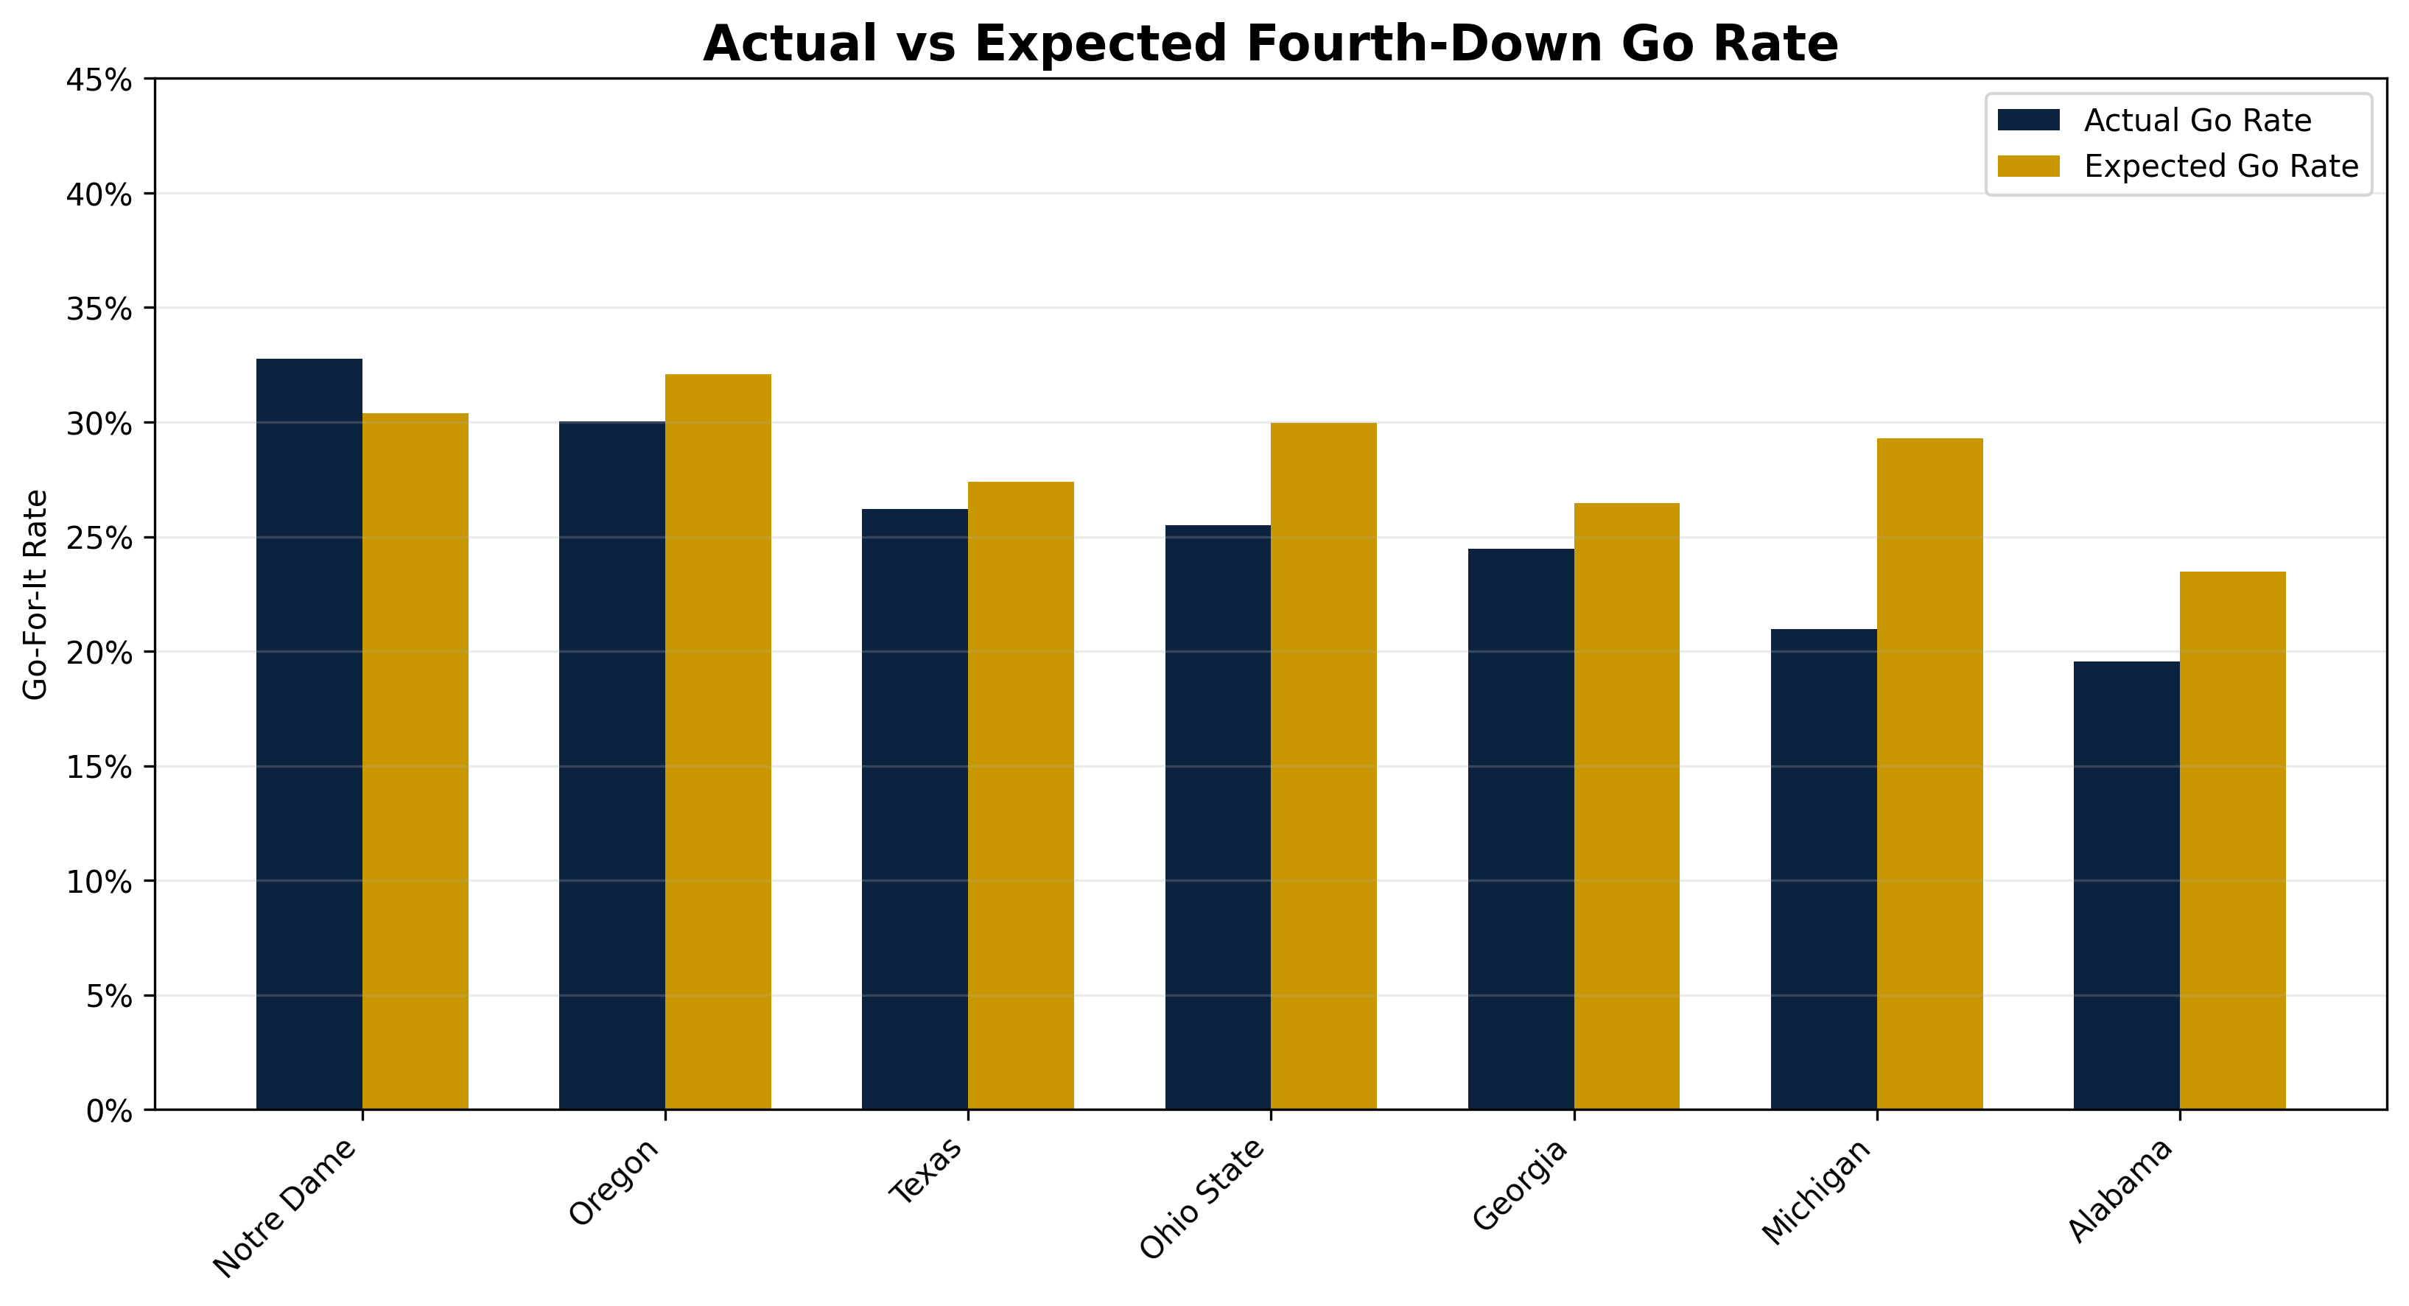
TEAM PROFILES
The index separates raw behavior from contextual expectation.
Actual go rate alone can mislead without situation mix.
• Notre Dame actual go rate: 32.8%. • Notre Dame expected go rate: 30.4%. • Michigan actual go rate: 21.0% vs expected 29.3%.
INSIGHT
Context-adjusted rates explain why the index differs from raw go rate.
IMPLICATION
This makes team comparisons more defensible.
2023–2025 FBS play-by-play • CollegeFootballData • Fourth-down decisions only
12
Notes:
Explain why actual and expected rates matter. A team can have a high raw go rate because it faces more short-yardage or favorable field-position situations. The expected rate controls for that situation mix. Notre Dame’s actual rate is only slightly above expected, while Michigan’s is well below expected, which explains the ranking difference.

Slide 13
CONCLUSION
Key takeaways
Version 1 establishes a clean foundation for future modeling.
• Distance is the strongest visible driver of fourth-down decisions. • Field position sharply changes coaching behavior, especially in midfield. • Notre Dame is more aggressive than average in short-yardage and midfield situations. • The Aggressiveness Index shows Notre Dame as modestly above expectation, not an extreme outlier. • Version 1 can extend naturally into expected value, machine learning, or a decision-support dashboard.
INSIGHT
IMPLICATION
The story is not “always go for it.” It is “identify where behavior diverges from opportunity.”
A finished Version 1 creates a credible base for deeper analytics later.
2023–2025 FBS play-by-play • CollegeFootballData • Fourth-down decisions only
13
Notes:
Close by summarizing the major themes. The model of the presentation is: national behavior, Notre Dame comparison, then team-level ranking. Emphasize that Version 1 is intentionally interpretable. It gives a clean descriptive foundation and a simple benchmark for team behavior. If there is time, mention the next logical step: expected value modeling or a coach-facing decision-support tool.

