Slide 1
Module 8: Introduction to Desired State Configuration (DSC)
Module Overview
Notes:
This module includes the following sections:
Module 8: DSC
Section 1: Introduction
Lesson 1: Overview
Lesson 2: Built-in Resources
Lesson 3: Custom Resources
Section 2: DSC Examples
Example 1: Push Mode - Web Site Installation and Configuration
Example 2: Pull Mode - Web Site Installation and Configuration
Section 3: Quick Reference

Slide 2
Module 8: Intro to Desired State Configuration (DSC)
Section 1: Introduction
Lesson 1: Overview
Lesson 2: The Configuration
Lesson 3: Resources
Lesson 4: MOF Files
Lesson 5: Local Configuration Manager (LCM)
Lesson 6: Applying Configurations – Push
Lesson 7: Applying Configurations – Pull
Section 2: Real-World Example
Lesson 1: Web Site Installation and Configuration (Push)

Slide 3
Module 8: Introduction to Desired State Configuration (DSC)
Section 1: Introduction
Lesson 1: Overview
Notes:
After this lesson, you will:
Be able to describe DSC
Know the DSC architecture and the requirements for using DSC
Know when to use DSC
Know when to use DSC rather than a Workflow or Function

Slide 4
What is Desired State Configuration (DSC)?
New management platform in Windows PowerShell
Enables deployment and management of a remote machine’s software and host OS
PowerShell language extensions, cmdlets, and resources to declaratively specify state
Enforce the desired state and prevent configuration drift
No procedural scripting required
Basically the Microsoft version of ‘Puppet’, built into PowerShell.
Notes:
Powershell language extension in v4.0

Slide 5
What is Desired State Configuration (DSC)?
Method of specifying the configuration to be present on a computer
PowerShell language extension in v4.0, v5.x
Enables deployment and management of software configuration
Allows continuous configuration testing and re-application to prevent configuration drift
Resources specify how software is to be configured
Requires PowerShell Remoting to be enabled
STRONGLY recommend PowerShell v5.1 for all systems.
Fully supported in Azure Automation (the preferred deployment method)

Slide 6
Imperative vs. Declarative Language
Imperative
Declarative
Add-WindowsFeature Windows-Server-Backup
Configuration BaseBuild {
WindowsFeature Backup {
Ensure = "Present"
Name = "Windows-Server-Backup"
}
}

Slide 7
When to use DSC?
Automate configuration of a set of computers (target nodes)
Option to create custom resources to configure the state of any application or system setting
Scripts
Environment Variables
Registry
Repair
Desired
State
Report
Desired
State
Deploy
Software
Roles and
Features
Files and
Directories
Processes and Services
Users and
Groups
Notes:
LONG DESCRIPTION
DSC is a management platform in Windows PowerShell.
It enables the deployment and management of configuration data
for software services and the environment on which these services run.
DSC provides a set of Windows PowerShell language extensions,
new cmdlets, and resources that you can use to declaratively specify
how you want the state of your software environment to be configured.
DSC is introduced in Windows PowerShell 4.0.
For detailed information about DSC, see
"Windows PowerShell Desired State Configuration" in the TechNet Library at
http://go.microsoft.com/fwlink/?LinkId=311940.
USING DSC
To use DSC to configure your environment, first define a Windows
PowerShell script block using the Configuration keyword, followed by an
identifier, which is in turn followed by the pair of curly braces delimiting
the block. Inside the configuration block you can define node blocks that
specify the desired configuration state for each node (computer) in the
environment. A node block starts with the Node keyword, followed by the name
of the target computer, which can be a variable. After the computer name, come
the curly braces that delimit the node block. Inside the node block, you can
define resource blocks to configure specific resources. A resource block starts
with the type name of the resource, followed by the identifier you want to
specify for that block, followed by the curly braces that delimit the block,
as shown in the following example.
Configuration MyWebConfig
{
# Parameters are optional
param ($MachineName, $WebsiteFilePath)
# A Configuration block can have one or more Node blocks
Node $MachineName
{
# Next, specify one or more resource blocks
# WindowsFeature is one of the resources you can use in a Node block
# This example ensures the Web Server (IIS) role is installed
WindowsFeature IIS
{
# To ensure that the role is not installed, set Ensure to "Absent"
Ensure = "Present"
Name = "Web-Server" # Use the Name property from Get-WindowsFeature
}
# You can use the File resource to create files and folders
# "WebDirectory" is the name you want to use to refer to this instance
File WebDirectory
{
Ensure = "Present" # You can also set Ensure to "Absent"
Type = "Directory" # Default is "File"
Recurse = $true
SourcePath = $WebsiteFilePath
DestinationPath = "C:\inetpub\wwwroot"
# Ensure that the IIS block is successfully run first before
# configuring this resource
Requires = "[WindowsFeature]IIS" # Use Requires for dependencies
}
}
}
To create a configuration, invoke the Configuration block the same way you would
invoke a Windows PowerShell function, passing in any expected parameters you may
have defined (two in the example above). For example, in this case:
MyWebConfig -MachineName "TestMachine" -WebsiteFilePath "\\filesrv\WebFiles" `
-OutputPath "C:\Windows\system32\temp" # OutputPath is optional
This generates a MOF file per node at the path you specify. These MOF files specify
the desired configuration for each node. Next, use the following cmdlet to parse the
configuration MOF files, send each node its corresponding configuration, and enact
those configurations.
Start-DscConfiguration -Verbose -Wait -Path "C:\Windows\system32\temp"
USING DSC TO MAINTAIN CONFIGURATION STATE
With DSC, configuration is idempotent. This means that if you use DSC to enact the
same configuration more than once, the resulting configuration state will always
be the same. Because of this, if you suspect that any nodes in your environment
may have drifted from the desired state of configuration, you can enact the same
DSC configuration again to bring them back to the desired state. You do not need
to modify the configuration script to address only those resources whose state has
drifted from the desired state.
The following example shows how you can verify whether the actual state of
configuration on a given node has drifted from the last DSC configuration enacted
on the node. In this example we are checking the configuration of the local computer.
$session = New-CimSession -ComputerName "localhost"
Test-DscConfiguration -CimSession $session
BUILT-IN DSC RESOURCES
DSC provides the following set of built-in resources that you can use in a
configuration script: Registry, Script, Archive, File, WindowsFeature, Package,
Environment, Group, User, Log, Service, and WindowsProcess. The example above
demonstrates how to use the File and WindowsFeature resources. To see all the
properties that you can use with a given resource, place the cursor on the resource
keyword (for example, File) within your configuration script in the Windows PowerShell
ISE, hold down CTRL, and press the SPACEBAR.
SEE ALSO
"Windows PowerShell Desired State Configuration"
(http://go.microsoft.com/fwlink/?LinkId=311940)

Slide 8
When to use DSC?
Automate configuration of a set of computers (target nodes)
Option to create custom resources to configure the state of any application or system setting
Enabling or disabling server roles and features
Managing registry settings
Managing files and directories
Starting, stopping, and managing processes and services
Managing groups and user accounts
Deploying new software
Managing environment variables
Running Windows PowerShell scripts
Fixing a configuration that has drifted away from the desired state
Discovering actual configuration state on a given node
Notes:
LONG DESCRIPTION
DSC is a management platform in Windows PowerShell.
It enables the deployment and management of configuration data
for software services and the environment on which these services run.
DSC provides a set of Windows PowerShell language extensions,
new cmdlets, and resources that you can use to declaratively specify
how you want the state of your software environment to be configured.
DSC is introduced in Windows PowerShell 4.0.
For detailed information about DSC, see
"Windows PowerShell Desired State Configuration" in the TechNet Library at
http://go.microsoft.com/fwlink/?LinkId=311940.
USING DSC
To use DSC to configure your environment, first define a Windows
PowerShell script block using the Configuration keyword, followed by an
identifier, which is in turn followed by the pair of curly braces delimiting
the block. Inside the configuration block you can define node blocks that
specify the desired configuration state for each node (computer) in the
environment. A node block starts with the Node keyword, followed by the name
of the target computer, which can be a variable. After the computer name, come
the curly braces that delimit the node block. Inside the node block, you can
define resource blocks to configure specific resources. A resource block starts
with the type name of the resource, followed by the identifier you want to
specify for that block, followed by the curly braces that delimit the block,
as shown in the following example.
Configuration MyWebConfig
{
# Parameters are optional
param ($MachineName, $WebsiteFilePath)
# A Configuration block can have one or more Node blocks
Node $MachineName
{
# Next, specify one or more resource blocks
# WindowsFeature is one of the resources you can use in a Node block
# This example ensures the Web Server (IIS) role is installed
WindowsFeature IIS
{
# To ensure that the role is not installed, set Ensure to "Absent"
Ensure = "Present"
Name = "Web-Server" # Use the Name property from Get-WindowsFeature
}
# You can use the File resource to create files and folders
# "WebDirectory" is the name you want to use to refer to this instance
File WebDirectory
{
Ensure = "Present" # You can also set Ensure to "Absent"
Type = "Directory" # Default is "File"
Recurse = $true
SourcePath = $WebsiteFilePath
DestinationPath = "C:\inetpub\wwwroot"
# Ensure that the IIS block is successfully run first before
# configuring this resource
Requires = "[WindowsFeature]IIS" # Use Requires for dependencies
}
}
}
To create a configuration, invoke the Configuration block the same way you would
invoke a Windows PowerShell function, passing in any expected parameters you may
have defined (two in the example above). For example, in this case:
MyWebConfig -MachineName "TestMachine" -WebsiteFilePath "\\filesrv\WebFiles" `
-OutputPath "C:\Windows\system32\temp" # OutputPath is optional
This generates a MOF file per node at the path you specify. These MOF files specify
the desired configuration for each node. Next, use the following cmdlet to parse the
configuration MOF files, send each node its corresponding configuration, and enact
those configurations.
Start-DscConfiguration -Verbose -Wait -Path "C:\Windows\system32\temp"
USING DSC TO MAINTAIN CONFIGURATION STATE
With DSC, configuration is idempotent. This means that if you use DSC to enact the
same configuration more than once, the resulting configuration state will always
be the same. Because of this, if you suspect that any nodes in your environment
may have drifted from the desired state of configuration, you can enact the same
DSC configuration again to bring them back to the desired state. You do not need
to modify the configuration script to address only those resources whose state has
drifted from the desired state.
The following example shows how you can verify whether the actual state of
configuration on a given node has drifted from the last DSC configuration enacted
on the node. In this example we are checking the configuration of the local computer.
$session = New-CimSession -ComputerName "localhost"
Test-DscConfiguration -CimSession $session
BUILT-IN DSC RESOURCES
DSC provides the following set of built-in resources that you can use in a
configuration script: Registry, Script, Archive, File, WindowsFeature, Package,
Environment, Group, User, Log, Service, and WindowsProcess. The example above
demonstrates how to use the File and WindowsFeature resources. To see all the
properties that you can use with a given resource, place the cursor on the resource
keyword (for example, File) within your configuration script in the Windows PowerShell
ISE, hold down CTRL, and press the SPACEBAR.
SEE ALSO
"Windows PowerShell Desired State Configuration"
(http://go.microsoft.com/fwlink/?LinkId=311940)

Slide 9
What about Group Policy?
DSC
No domain needed
Works with no network at all
MOF based (open platform)
Not as simple to deploy
Authentication flexibility
Requires PS v4.0
GPO
Only works in domain scenario
Connectivity generally needed
Born from registry control
Fairly easy to setup and deploy
Well-known and established
Requires remoting is enabled
Works everywhere
Resources drive scalability
New unknown factor

Slide 10
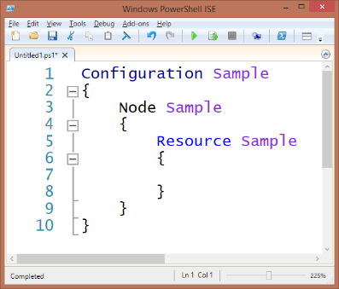
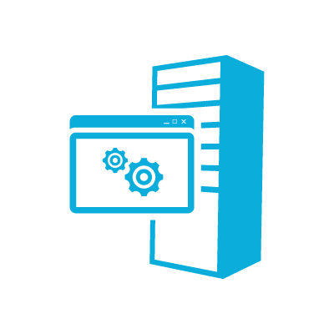

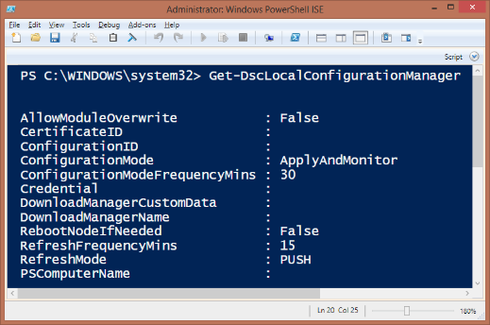

DSC Components
DSC
Configuration
MOF Files
Local Configuration Manager
Optional Pull Server
Resources
Notes:
Do not go into detail on this slide, this is just to highlight some of terms and names of parts. Each will be touched later in this module

Slide 11



DSC Distribution Modes (Push vs. Pull)
Authoring
Staging
Nodes
Config Pushed
Config Pulled
Server1
Configs Deployed
IIS or fileshare
Server1.mof
Config Pulled
Server1.mof
Server1
Server1.mof
Configs Deployed
Azure Automation
Server1.mof
Server1
Notes:
Authoring
DSC consumes MOF files.
MOF files can be created using any text editor. PowerShell v4 makes it easier to create a MOF file because it has declarative syntax extensions and IntelliSense.
Staging
Pull → DSC Data and custom resources are stored on a central IIS web server with a well defined OData interface that functions as the "Pull Server". Target Nodes connect using a URI and a unique identifier to retrieve its configuration.
Push → DSC Data is pushed to the target nodes. Custom resources must exist on the target nodes.
Nodes
DSC data is pulled or pushed to the "Local Configuration Store" which contains the current, previous and the DSC. The configuration then gets parsed and the relevant WMI provider implements the change.

Slide 12
Module 8: Introduction to Desired State Configuration (DSC)
Section 1: Introduction
Lesson 2: The Configuration

Slide 13
Configuration Script
Defines the desired configuration and separates the configuration logic ("What") from the node data ("Where")
Simplifies configuration data reuse
Definitions consist of nested hash tables
Configuration block (outer wrapper for a complete state)
Node blocks (inner wrapper for node(s))
Resource blocks
Configuration data

Slide 14
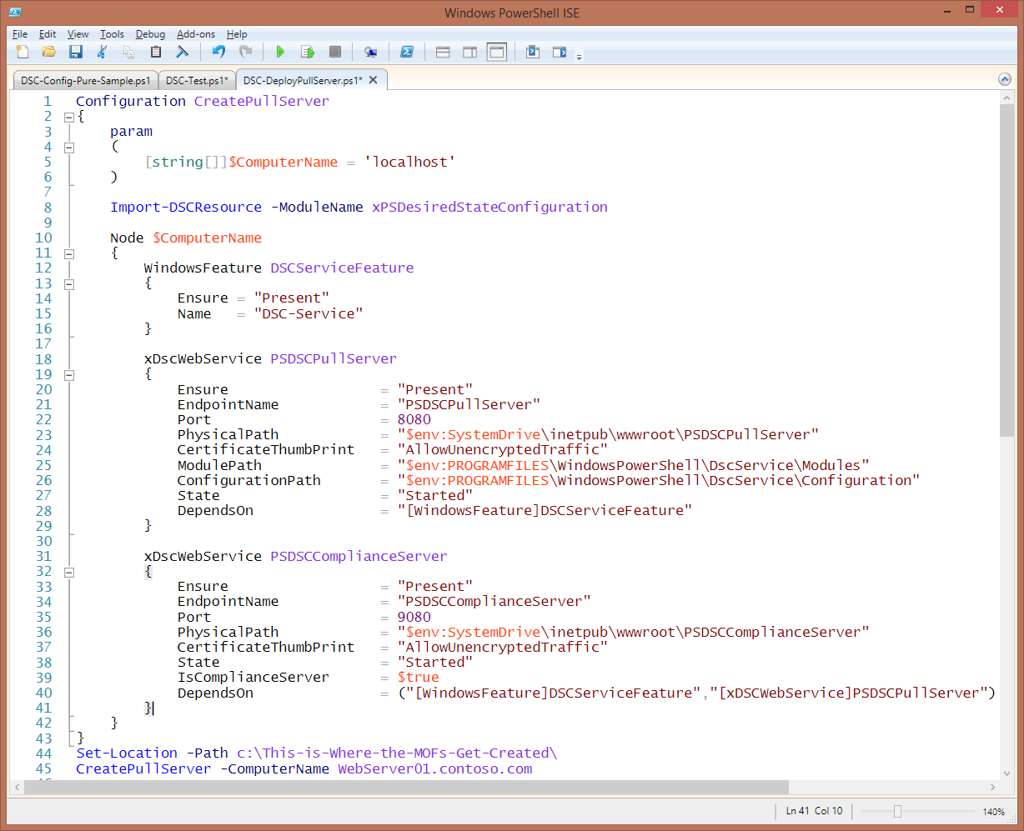
The Configuration
Declarative end state
Simpler than a script
More like an old .ini

Slide 15
Configuration Block The outside bounds
Configuration CreatePullServer
{
param
(
[string[]]$ComputerName = 'localhost'
)
Import-DSCResource -ModuleName xPSDesiredStateConfiguration
Node $ComputerName
{
WindowsFeature DSCServiceFeature
{
Ensure = "Present"
Name = "DSC-Service"
}
xDscWebService PSDSCPullServer
{
Ensure = "Present"
EndpointName = "PSDSCPullServer"
Port = 8080
PhysicalPath = "$env:SystemDrive\inetpub\wwwroot\PSDSCPullServer"
CertificateThumbPrint = "AllowUnencryptedTraffic"
ModulePath = "$env:PROGRAMFILES\WindowsPowerShell\DscService\Modules"
ConfigurationPath = "$env:PROGRAMFILES\WindowsPowerShell\DscService\Configuration"
State = "Started"
DependsOn = "[WindowsFeature]DSCServiceFeature"
}
xDscWebService PSDSCComplianceServer
{
Ensure = "Present"
EndpointName = "PSDSCComplianceServer"
Port = 9080
PhysicalPath = "$env:SystemDrive\inetpub\wwwroot\PSDSCComplianceServer"
CertificateThumbPrint = "AllowUnencryptedTraffic"
State = "Started"
IsComplianceServer = $true
DependsOn = ("[WindowsFeature]DSCServiceFeature","[xDSCWebService]PSDSCPullServer")
}
}
}
Set-Location -Path c:\This-is-Where-the-MOFs-Get-Created\
CreatePullServer -ComputerName WebServer01.contoso.com
Node Block Machine Centric
Resource Block The workers

Slide 16
Configuration CreatePullServer
{
param
(
[string[]]$ComputerName = 'localhost'
)
Import-DSCResource -ModuleName xPSDesiredStateConfiguration
Node $ComputerName
{
WindowsFeature DSCServiceFeature
{
Ensure = "Present"
Name = "DSC-Service"
}
xDscWebService PSDSCPullServer
{
Ensure = "Present"
EndpointName = "PSDSCPullServer"
Port = 8080
PhysicalPath = "$env:SystemDrive\inetpub\wwwroot\PSDSCPullServer"
CertificateThumbPrint = "AllowUnencryptedTraffic"
ModulePath = "$env:PROGRAMFILES\WindowsPowerShell\DscService\Modules"
ConfigurationPath = "$env:PROGRAMFILES\WindowsPowerShell\DscService\Configuration"
State = "Started"
DependsOn = "[WindowsFeature]DSCServiceFeature"
}
xDscWebService PSDSCComplianceServer
{
Ensure = "Present"
EndpointName = "PSDSCComplianceServer"
Port = 9080
PhysicalPath = "$env:SystemDrive\inetpub\wwwroot\PSDSCComplianceServer"
CertificateThumbPrint = "AllowUnencryptedTraffic"
State = "Started"
IsComplianceServer = $true
DependsOn = ("[WindowsFeature]DSCServiceFeature","[xDSCWebService]PSDSCPullServer")
}
}
}
Set-Location -Path c:\This-is-Where-the-MOFs-Get-Created\
CreatePullServer -ComputerName WebServer01.contoso.com
Optional Param Block
Valid Resource Name
Cosmetic Name
Resource Properties

Slide 17
Configuration CreatePullServer
{
param
(
[string[]]$ComputerName = 'localhost'
)
Import-DSCResource -ModuleName xPSDesiredStateConfiguration
Node $ComputerName
{
WindowsFeature DSCServiceFeature
{
Ensure = "Present"
Name = "DSC-Service"
}
xDscWebService PSDSCPullServer
{
Ensure = "Present"
EndpointName = "PSDSCPullServer"
Port = 8080
PhysicalPath = "$env:SystemDrive\inetpub\wwwroot\PSDSCPullServer"
CertificateThumbPrint = "AllowUnencryptedTraffic"
ModulePath = "$env:PROGRAMFILES\WindowsPowerShell\DscService\Modules"
ConfigurationPath = "$env:PROGRAMFILES\WindowsPowerShell\DscService\Configuration"
State = "Started"
DependsOn = "[WindowsFeature]DSCServiceFeature"
}
xDscWebService PSDSCComplianceServer
{
Ensure = "Present"
EndpointName = "PSDSCComplianceServer"
Port = 9080
PhysicalPath = "$env:SystemDrive\inetpub\wwwroot\PSDSCComplianceServer"
CertificateThumbPrint = "AllowUnencryptedTraffic"
State = "Started"
IsComplianceServer = $true
DependsOn = ("[WindowsFeature]DSCServiceFeature","[xDSCWebService]PSDSCPullServer")
}
}
}
CreatePullServer -ComputerName WebServer01.contoso.com -OutputPath c:\dsc\
Execute Configuration MOF file(s) created
Target Node Name MOF file(s) created
Location of MOFs In folder named for Config

Slide 18
Module 8: Introduction to Desired State Configuration (DSC)
Section 1: Introduction
Lesson 3: Resources
Notes:
After this lesson, you will:
Know what resources are available for use with DSC out-of-the-box

Slide 19
DSC Resources
Resources implement the configuration
Contain the PowerShell code to get to the desired state
Configurations generally combine resource settings and dependencies
Contained within modules

Slide 20
Where to get resources
Windows PowerShell DSC ships with 12 built-in resources
Download additional resources from https://github.com/PowerShell/DscResources
Create custom resources yourself

Slide 21
Built-in DSC Resources
Provider | Description
Archive | Unpacks archive (.zip) files at specific paths
Environment | Manages system environment variables
File | Manages files and directories
Group | Manages local groups
Log | Logs configuration messages
Package | Installs and manages Windows Installer and setup.exe packages
Process | Configures Windows processes
Registry | Manages registry keys and values
Role | Adds or removes Windows features and roles
Script | Runs PowerShell script blocks
Service | Manages services
User | Manages local user accounts

Slide 22
Additional Resources
Microsoft has released ‘validated’ DSC resource modules to Github
Many community resources available!
Use PowerShellGet to find/install resources

Slide 23
Create Custom Resources
Use xDSCResourceDesigner Module (much easier)
Create an empty parent module
Create resource sub-modules (1 per resource)
Standard functions required for each
Get-TargetResource
Set-TargetResource
Test-TargetResource

Slide 24
*-TargetResource Functions
Functions contain PowerShell code necessary to implement the state
Code will differ based on target technology
Specific output requirements of each function
Get-TargetResource function returns the current state.
Set-TargetResource function sets the system state.
Test-TargetResource function compares the current state to the desired state.

Slide 25
File Structure Overview
$env: psmodulepath (folder)
|- <ModuleName> (folder)
|- <ModuleName>.psd1 (file)
|- DSCResources (folder)
|- <ResourceName1> (folder)
|- <ResourceName1>.psm1 (file, required)
|- <ResourceName1>.schema.mof (file, required)
|- <ResourceName2>(folder)
|- <ResourceName2>.psm1 (file, required)
|- <ResourceName2>.schema.mof (file, required)

Slide 26
Module 8: Introduction to Desired State Configuration (DSC)
Section 1: Introduction
Lesson 4: MOF Files

Slide 27
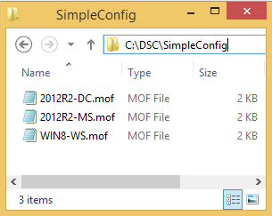
1. Author Configuration
Configuration SimpleConfig
{
$Nodes = '2012R2-MS','2012R2-DC','WIN8-WS'
Node $Nodes
{
File CreateFolder
{
DestinationPath = 'c:\temp\'
Ensure = 'Present'
Type = 'Directory'
}
}
}
3. MOF Files Automatically Created
Directory: C:\dsc\SimpleConfig
Mode Length Name
----- ------ ----
-a--- 1266 2012R2-MS.mof
-a--- 1266 2012R2-DC.mof
-a--- 1262 WIN8-WS.mof
2. Execute Configuration
SimpleConfig -OutputPath c:\dsc\SimpleConfig

Slide 28
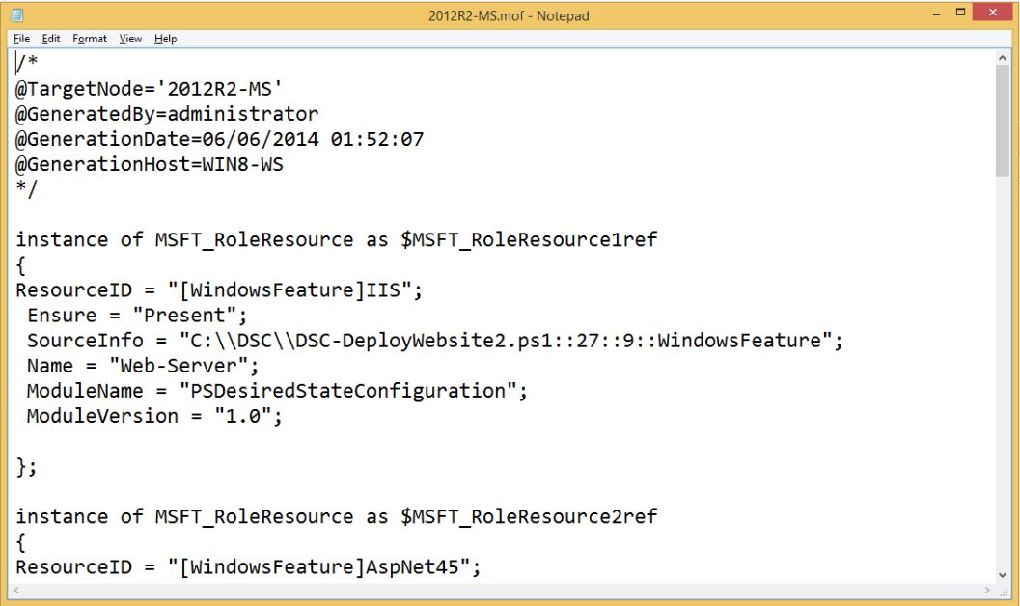
Managed Object Format
DSC Middle-Man
Per Node In Pull Mode, node names are abstracted with a GUID
Cross Platform

Slide 29
Module 8: Introduction to Desired State Configuration (DSC)
Section 1: Introduction
Lesson 5: Local Configuration Manager (LCM)

Slide 30
Local Configuration Manager (LCM)
Local Configuration Manager is the engine that applies the configuration
Two ways to apply a configuration to nodes
Manual Push
Automatic Pull
One configuration per node (v4)
See also ‘Composite’ and ‘Partial’ configurations (V5.x)

Slide 31
LCM Options
LCM is configured through a DSC configuration (normally pushed once)
LocalConfigurationManager
{
ConfigurationID = "646e48cb-3082-4a12-9fd9-f71b9a562d4e"
ConfigurationModeFrequencyMins = 90
ConfigurationMode = "ApplyAndAutocorrect"
RefreshFrequencyMins = 45
DownloadManagerName = "WebDownloadManager"
RefreshMode = "Pull"
DownloadManagerCustomData =
(@{ServerUrl="https://$PullServer/psdscpullserver.svc"})
CertificateID = "71AA68562316FE3F73536F1096B85D66289ED60E"
Credential = $cred
RebootNodeIfNeeded = $true
AllowModuleOverwrite = $false
}
Configuration to pull
ApplyAndAutoCorrect
ApplyAndMonitor
ApplyOnly
Push vs. Pull
Pull Server Location
Notes:
http://blogs.msdn.com/b/powershell/archive/2013/12/09/understanding-meta-configuration-in-windows-powershell-desired-state-configuration.aspx

Slide 32
LCM lifecycle
LCM will start the (minimum) 15 minute cycle based on: • A new metaconfig is applied using Set-DscLocalConfigurationManager • A machine restart • For any condition where the timer process experiences a crash, that will be detected within 30 seconds and the cycle will be restarted
The start time is absolute. This means if an operation begins at T0 and some other activity is in progress at time T1 and takes 5 minutes, the next timer will kick in after T1+15 (with 15 minute frequency). If an operation is already in progress and the duration exceeds the configured cycle frequency, the next timer will not start.
Example, the metaconfig is configured at a 15 minute pull frequency and a pull occurs at T1. The node does not finish work (such as setting a configuration) for 16 minutes. At T1+15, the timer is ignored and next pull will happen at T1+15+15.

Slide 33
Module 8: Introduction to Desired State Configuration (DSC)
Section 1: Introduction
Lesson 6: Applying Configurations - Push
Notes:
After this lesson, you will:
Know what resources are available for use with DSC out-of-the-box

Slide 34
Push a Configuration
Create Configuration
Run Configuration to Create MOF File(s)
Push Configuration to Target(s)

Slide 35
Single MOF
PS> Start-DSCConfiguration –Path c:\MOFs\
Configuration Pushed
Server1.mof
Server1

Slide 36
Many MOFs
PS> Start-DSCConfiguration –Path c:\MOFs\
Configuration Pushed
Server1.mof
Server1
Configuration Pushed
Server2.mof
Server2
Configuration Pushed
Server3.mof
Server3

Slide 37
Module 8: Introduction to Desired State Configuration (DSC)
Section 1: Introduction
Lesson 7: Apply Configurations - Pull

Slide 38



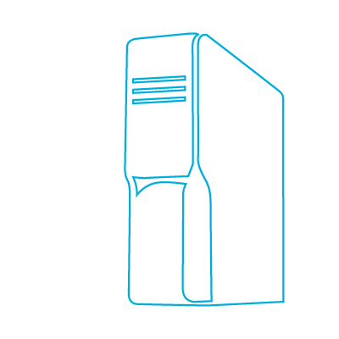
Pull Servers
Possible Server Modes
HTTPS Web Server
HTTP Web Server
SMB File Share
Azure Automation
Local configuration manager
on target node pulls the
configuration
File Share

Slide 39
Overview - Setting up for Pull
Authoring
and Staging
Create Pull Server
Run Config , which creates MOF File(s)
Rename MOFs with GUIDs
Create Config
Place MOFs and Modules on Pull Server
Checksum MOFs and Resource Modules
Configure LCM on targets
Targets Pull Config and Apply
Per Node

Slide 40
Resources and Clients
Push Configuration
Resource manually deployed
Pull Configuration
Pull server stores needed modules
Pull client downloads modules based on configuration
Azure Automation
Pull server is ‘built-in’
Automation holds needed configs and modules (uploaded as .Zip files)
AzureVM is registered and DSC resources pushed-compiled-pulled to VM

Slide 41
Module 8: Introduction to Desired State Configuration (DSC)
Section 2: Real-World Example
Lesson 1: Web Site Installation and Configuration (Push)
Notes:
After this lesson, you will:
Know how to create customized resources for use with DSC

Slide 42
Example 1: Push Mode – Web Site Installation and Configuration
Step 2: Define Configuration
Step 1: Create Custom Resources (if required)
Step 3: Create consumable MOF File
Step 4: Push Configuration to target node(s)
Preparation: Define Goals
Notes:
Ensure that PSRemoting is enabled on the target node and the machine where the configuration is being distributed from.

Slide 43
Preparation: Define Goals (List Settings and Desired Values)
Setting | Value
Ensure IIS is installed | Yes
Define Web Server Name | Web-Server
Define DestinationPath (Desired location to ensure state for a file or directory) | c:\inetpub\wwwroot
Ensure subdirectories exist | Yes
Define SourcePath (Path to copy from) | Specify with parameter (to make code more dynamic)
Notes:
Note: SourcePath should be local to target node or a UNC path.

Slide 44
Step 1: Create Custom Resources (if required)
Not required for this example – Built-in resources will be used

Slide 45
Step 2: Define Configuration
Configuration MyWebConfig { param ($MachineName, $WebsiteFilePath) Node $MachineName { WindowsFeature IIS { Ensure = "Present" Name = "Web-Server" } File WebDirectory { Ensure = "Present" Type = "Directory" Recurse = $true SourcePath = $WebsiteFilePath DestinationPath = "C:\inetpub\wwwroot" DependsOn = "[WindowsFeature]IIS" } } }
Node Block
Windows Feature Resource Block
File Resource Block
Notes:
Rules for nesting node and configuration blocks
The following nesting rules apply.
There can be zero or more node blocks inside a configuration block.
A target node can have more than one node block inside a given configuration block. In other words, the same node block identifier can appear more than once inside a given configuration block. This is functionally equivalent to grouping the contents of all the blocks for a given node inside one node block.
A given type of resource can have zero or more blocks inside the same node block. However, it is not possible to have duplicate resource identifiers. Inside a given node block, each resource block must have a unique identifier.

Slide 46
Step 3: Create Consumable MOF File
Run Configuration in previous step Create a Consumable MOF File
PS C:\> MyWebConfig ` -MachineName om12ms ` -WebsiteFilePath "c:\scripts\inetpub\wwwroot" Directory: C:\MyWebConfig Mode LastWriteTime Length Name ---- ------------- ------ ---- -a--- 10/02/2014 3:45 PM 1878 om12ms.mof
‘MyWebConfig’ directory and ‘om12ms.mof’ file is created

Slide 47
Step 4: Push Configuration
Apply MOF File using Push Mode
PS C:\> Start-DscConfiguration –Path .\MyWebConfig –Wait –Verbose VERBOSE: Perform operation 'Invoke CimMethod' with following parameters, ''methodName' = SendConfigurationApply,'className' = MSFT_DSCLocalConfigurationManager,'namespaceName' = root/Microsoft/Windows/DesiredStateConfiguration'. VERBOSE: An LCM method call arrived from computer OM12 with user sid S-1-5-21-3390618620-1605188856-1237132424-500. ... VERBOSE: Operation 'Invoke CimMethod' complete. VERBOSE: Time taken for configuration job to complete is 181.518 sec…
Note: The configuration is applied immediately to the target node
Notes:
Now test changes by accessing IIS http://Localhost on the target node.

Slide 48
DependsOn
Configuration DependsOnExample {
Import-DscResource -ModuleName PSDesiredStateConfiguration
Node localhost {
File DSCTempFolder {
DestinationPath = 'C:\DSCTemp\'
Ensure = 'Present'
Type = 'Directory'
}
Archive ExtractZIP {
Ensure = 'Present'
Path = 'C:\InstallSource\LogParser.zip'
Destination = 'C:\DSCTemp\logparser\'
Force = $true
DependsOn = '[File]DSCTempFolder'
}
Package InstallLogParser {
Ensure = 'Absent'
Name = 'Log Parser 2.2'
Path = 'C:\DSCTemp\logparser\logparser.msi'
ProductId = '4AC23178-EEBC-4BAF-8CC0-AB15C8897AC9'
DependsOn = '[Archive]ExtractZIP'
}
}
}
The order of execution of resources is not guaranteed.
Use the common property DependsOn to establish order in the format [Resource]Name .

Slide 49
Credential Example: Configuration
Configuration CredentialEncryptionExample
{
Param(
[Parameter(Mandatory=$true)]
[PsCredential]$Credential
)
Node $AllNodes.NodeName
{
Group TestGroup
{
GroupName = 'LocalServiceGroup'
Members = 'contoso\ericlang'
Ensure = 'Present'
Credential = $Credential
}
LocalConfigurationManager
{
CertificateId = $node.Thumbprint
}
}
}
Credential Parameter
Resource Credential
LCM Certificate Thumbprint
Notes:
http://blogs.msdn.com/b/powershell/archive/2014/01/31/want-to-secure-credentials-in-windows-powershell-desired-state-configuration.aspx

Slide 50
Detecting Configuration Drift
Compare current and actual configuration
PS C:\> $Session = New-CimSession –ComputerName "om12ms" PS C:\> Test-DscConfiguration –CimSession $session
Returns "True" if the configuration matches and "False" if it does not match

Slide 51
Query the Desired State
Test-DscConfiguration – true/false desired state
Get-DscConfiguration – current state of configured resources
Get-DscConfigurationStatus – Date & time, success or failure
Get-DscConfigurationStatus -All – History of DSC events and status
Use CIM sessions to target multiple nodes.
See also https://microsoft.github.io/DSCEA/

Slide 52
Common Pitfalls
Verify connectivity to nodes using Test-WSMan. Consider firewall and Kerberos authentication.
Build/compile your configuration on the same DSC version as the target node.
Patch servers to ensure the latest version of the LCM is available.
Unblock DSC resource zip files before extracting them.
Remember to publish resources to the pull server or copy them to the node for push.
Remember to use New-DSCCheckSum with -Force when publishing configurations or resources.
Ensure that you only have a single copy of a resource module in your $ENV:PSModulePath.
Ensure that you chain configuration dependencies with the DependsOn property.
In configurations use unique resource names with no spaces or special characters.
You can only live debug DSC resources ImplementedAs PowerShell, not Binary.

Slide 53
Test-DscConfiguration -ReferenceConfiguration
Choose a configuration MOF as a baseline.
Existing: C:\Windows\System32\Configuration\current.mof
Generate a fresh MOF for comparison.
Create a CIM session to the node(s) for comparison.
Test-DscConfiguration –ReferenceConfiguration
Note: An existing DSC configuration is not required on the target node(s).
Test-DscConfiguration -CimSession $cim -ReferenceConfiguration .\localhost.mof

Slide 54
Azure DSC Extension
Credential handling in the Azure DSC Extension is automatic.
Configurations are automatically transmitted over HTTPS.
Credentials are encrypted using the server’s Azure certificate.
The Node name must be localhost.
The ConfigurationData block is not required.
Notes:
Secure credentials in the Azure PowerShell Desired State Configuration (DSC) extension
http://blogs.msdn.com/b/powershell/archive/2014/09/10/secure-credentials-in-the-azure-powershell-desired-state-configuration-dsc-extension.aspx

Slide 55
Linux and DSC
OMI stuff lives in /opt/omi/lib /opt/omi/bin
For troubleshooting you look at the logs which are here: cat /var/opt/omi/log/omiserver.log # the OMI CIM server cat /var/opt/omi/log/dsc.log # the LCM and DSC logging. Start your troubleshooting here!
the MOFs are in /etc/opt/omi/conf/dsc/configuration backup.mof Current.mof Failed.mof MetaConfig.mof DSCEngineCache.mof
modules live in ls /opt/microsoft/dsc/modules the zips get downloaded to ls /opt/microsoft/dsc/module_packages
getDscConfiguration is a Python script, run from /opt/microsoft/dsc/Scripts
sudo /opt/microsoft/dsc/Scripts/GetDscConfiguration.py
see also: sudo ./GetDscConfiguration.py sudo ./TestDscConfiguration.py sudo ./SetDscLocalConfigurationManager.py sudo ./RestoreConfiguration.py sudo ./PerformRequiredConfigurationChecks.py sudo ./InstallModule.py
You cannot (today) compile MOFs using Linux PowerShell 6.x – this will probably change when the new DSC engine ( written in ‘C’ ) is released circa late 2018

Slide 56
Linux DSC resource ‘nx’
Configuration NxApacheconfig
{
PARAM([ValidateSet('Ubuntu','RedHat')][string]$Distro='RedHat')
Import-DscResource -ModuleName NX
if ($Distro -eq 'Ubuntu') {
#DEBIAN
$ApachePackages = @('apache2','php5','libapache2-mod-php5')
$ServiceName = 'apache2'
$VHostDir = "/etc/apache2/sites-enabled"
$PackageManager = "apt"
$ServiceCtl = "Init"
}
else {
#RHEL
$ApachePackages = @('httpd','mod_ssl','php','php-mysql')
$ServiceName = 'httpd'
$VHostDir = '/etc/httpd/conf.d'
$PackageManager = 'yum'
$ServiceCtl = "SystemD"
}
$rwxrr = 744
Node localhost
{
ForEach ($Package in $ApachePackages) {
nxPackage $Package
{
Ensure = 'Present'
Name = $Package
PackageManager = $PackageManager
}
}
nxFile vHostDirectory {
DestinationPath = $VhostDir
Type = 'Directory'
Ensure = 'Present'
Owner = 'root'
Mode = $rwxrr
}
#Ensure default content does not exist
nxFile DefVHost {
DestinationPath = "${VhostDir}/000-default.conf"
Ensure = 'Absent'
}
#Ensure website is defined
nxFile DefaultSiteDir {
DestinationPath = '/var/www/html/defaultsite'
Type = 'Directory'
Owner = 'root'
Mode = $rwxrr
Ensure = 'Present'
}
#Configure Apache Service
nxService ApacheService {
Name = $ServiceName
Enabled = $true
State = 'running'
Controller = $ServiceCtl
DependsOn = '[nxFile]DefaultSite.conf'
}
}
}

Slide 57
DSC and ARM
https://blogs.technet.microsoft.com/lukeb/2017/12/14/azure-dsc-automation-windows-vs-linux/
https://blogs.technet.microsoft.com/markrenoden/2016/11/24/revisit-deploying-a-dc-to-azure-iaas-with-arm-and-dsc/

Slide 58
Module 8: Introduction to Desired State Configuration (DSC)
Links
https://docs.microsoft.com/en-us/powershell/dsc/overview
https://github.com/PowerShell/DscResources
https://microsoft.github.io/DSCEA/
PFE has a 3-day DSC workshop
PFE has a 3-day Azure Automation workshop
Notes:
This module includes the following sections:
Module 8: DSC
Section 1: Introduction
Lesson 1: Overview
Lesson 2: Built-in Resources
Lesson 3: Custom Resources
Section 2: DSC Examples
Example 1: Push Mode - Web Site Installation and Configuration
Example 2: Pull Mode - Web Site Installation and Configuration
Section 3: Quick Reference

