Slide 1

The Business Problem
Improving Overall Sales Performance at Turtle Games
4 ways to improve sales performance:
Gain new customers.
Avoid losing customers (i.e., churn).
Increase the frequency of transactions per customer.
Increase the size of customer transactions (e.g., upselling).

Slide 2
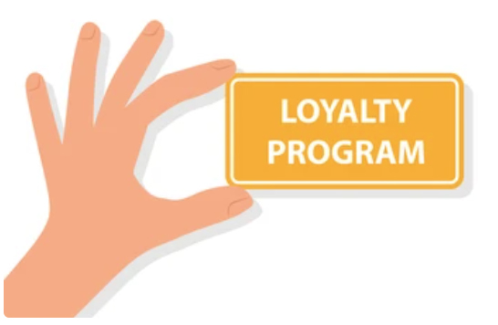
The Loyalty Program
The Purpose
The typical purpose of the loyalty program is to reward repeat customers (discounts, multi-buy, bundles, pre-ordering) in return for valuable personal data.
Questions
What relationships can we find between this data and spending habits?
Which customers do Turtle Games need to keep satisfied? Which customers offer the most potential for growth in sales?
Accumulate Loyalty Points = Spending More In Store

Slide 3
Group Classification Model
5 Unique Groups Identified: Ranked by Importance
Group Classification (Rank) | Avg. Age | Characteristics
high spending_score, high remuneration (Group 1) | 36 | Frequent and large buyers of the more expensive products. Possible promoters, bringing new customers with positive reviews/comments. 2nd largest group. Average accumulated loyalty points are 3,988.
low spending_score, high remuneration (Group 2) | 41 | Perhaps new customers, uninterested in the products, or casual buyers. Requires investigation. This group has potential to improve sales significantly.
medium spending_score, medium remuneration (Group 3) | 42 | The largest group, ‘bread-and-butter’ customers. 2nd highest average age.
high spending_score, low remuneration (Group 4) | 32 | Lowest average age, spending high relative to income, impulsive. Opportunities to engage with promotions, multi-buy offers, flash sale of popular products.
low spending_score, low remuneration (Group 5) | 44 | Low risk, spend relative to income. Highest average age. Unlikely to buy impulsively.
18.14%
9.46%
8.68%

Slide 4
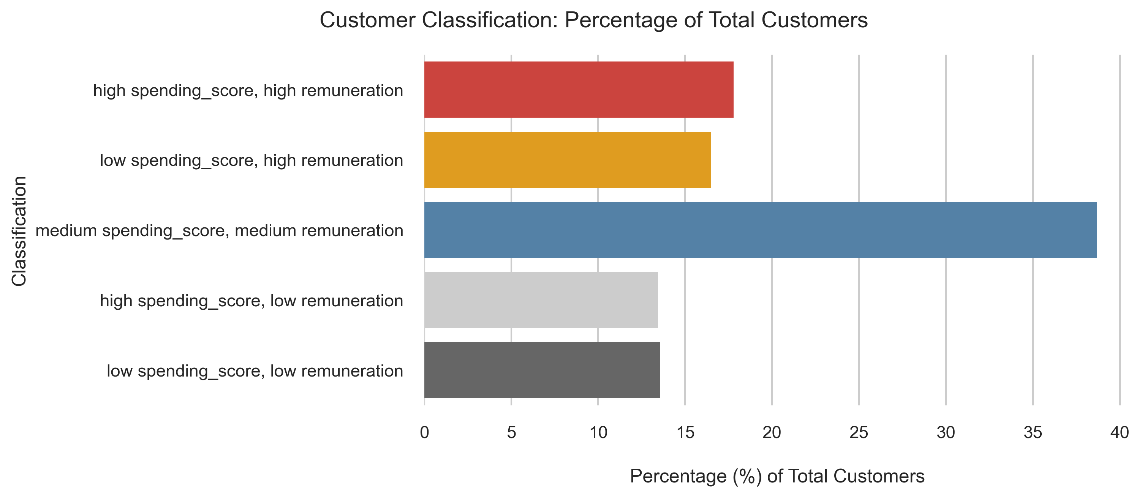
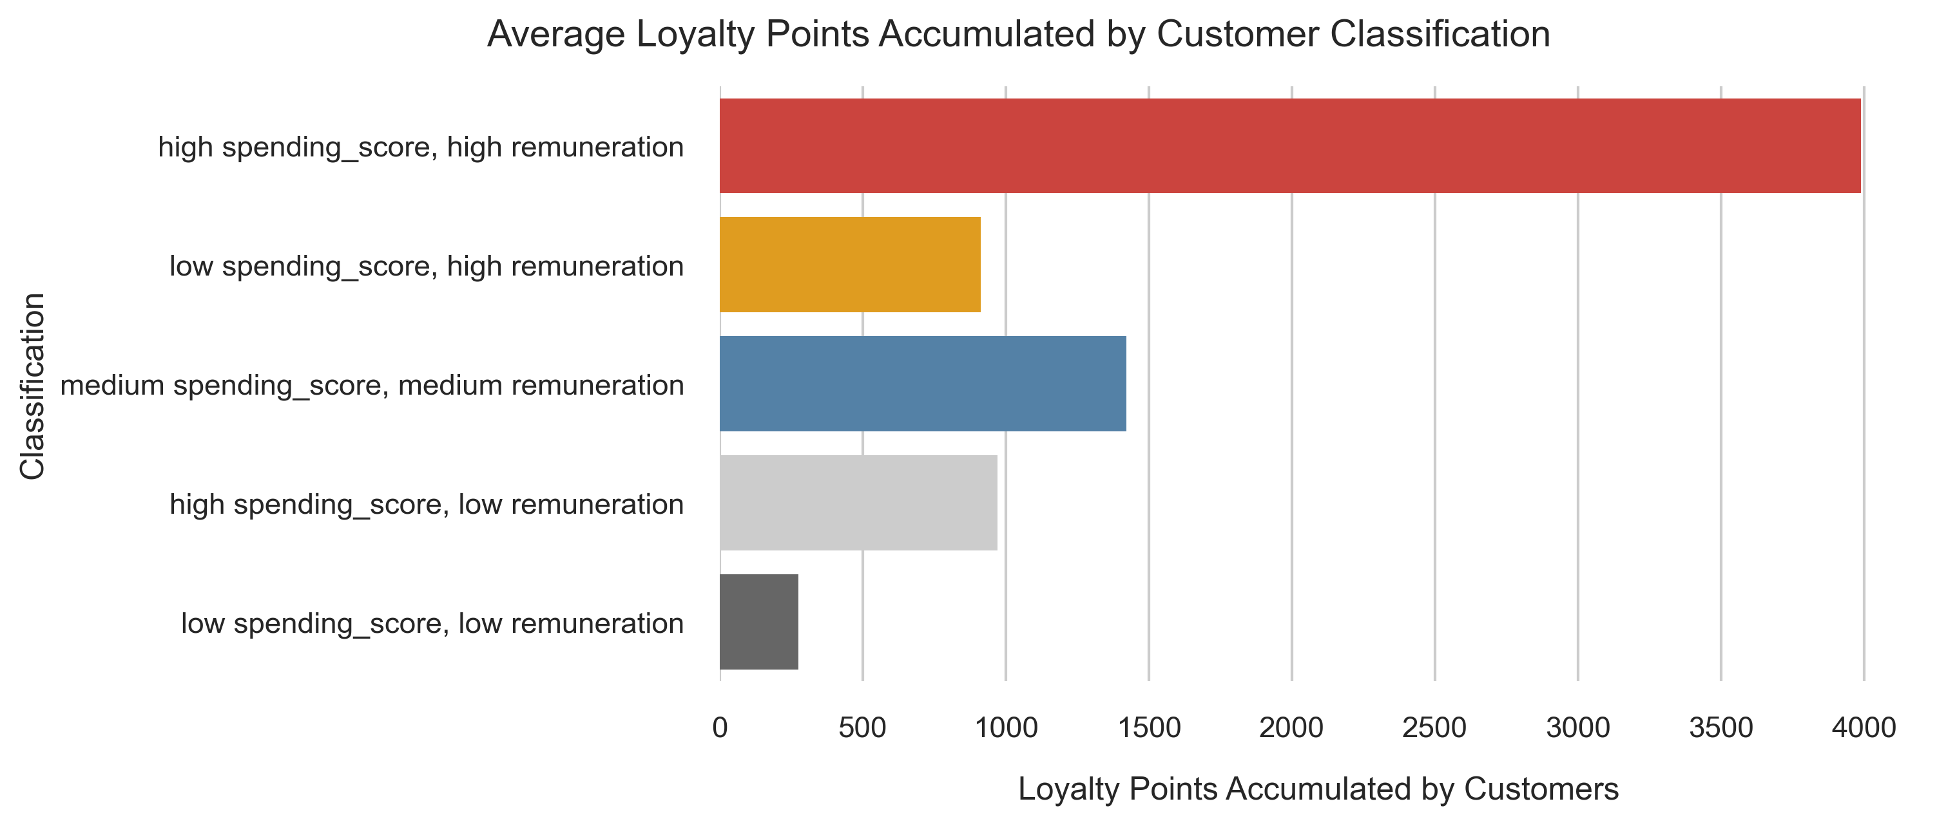
Group Classification Model: Understand the Groups
Group Importance
18.50%
The marketing department should target the largest groups and the groups that accumulate the most loyalty points, since this is linked to customer spending.
What other relationships can be found in the customer data?
16.50%
38.60%
3988
916
1400

Slide 5
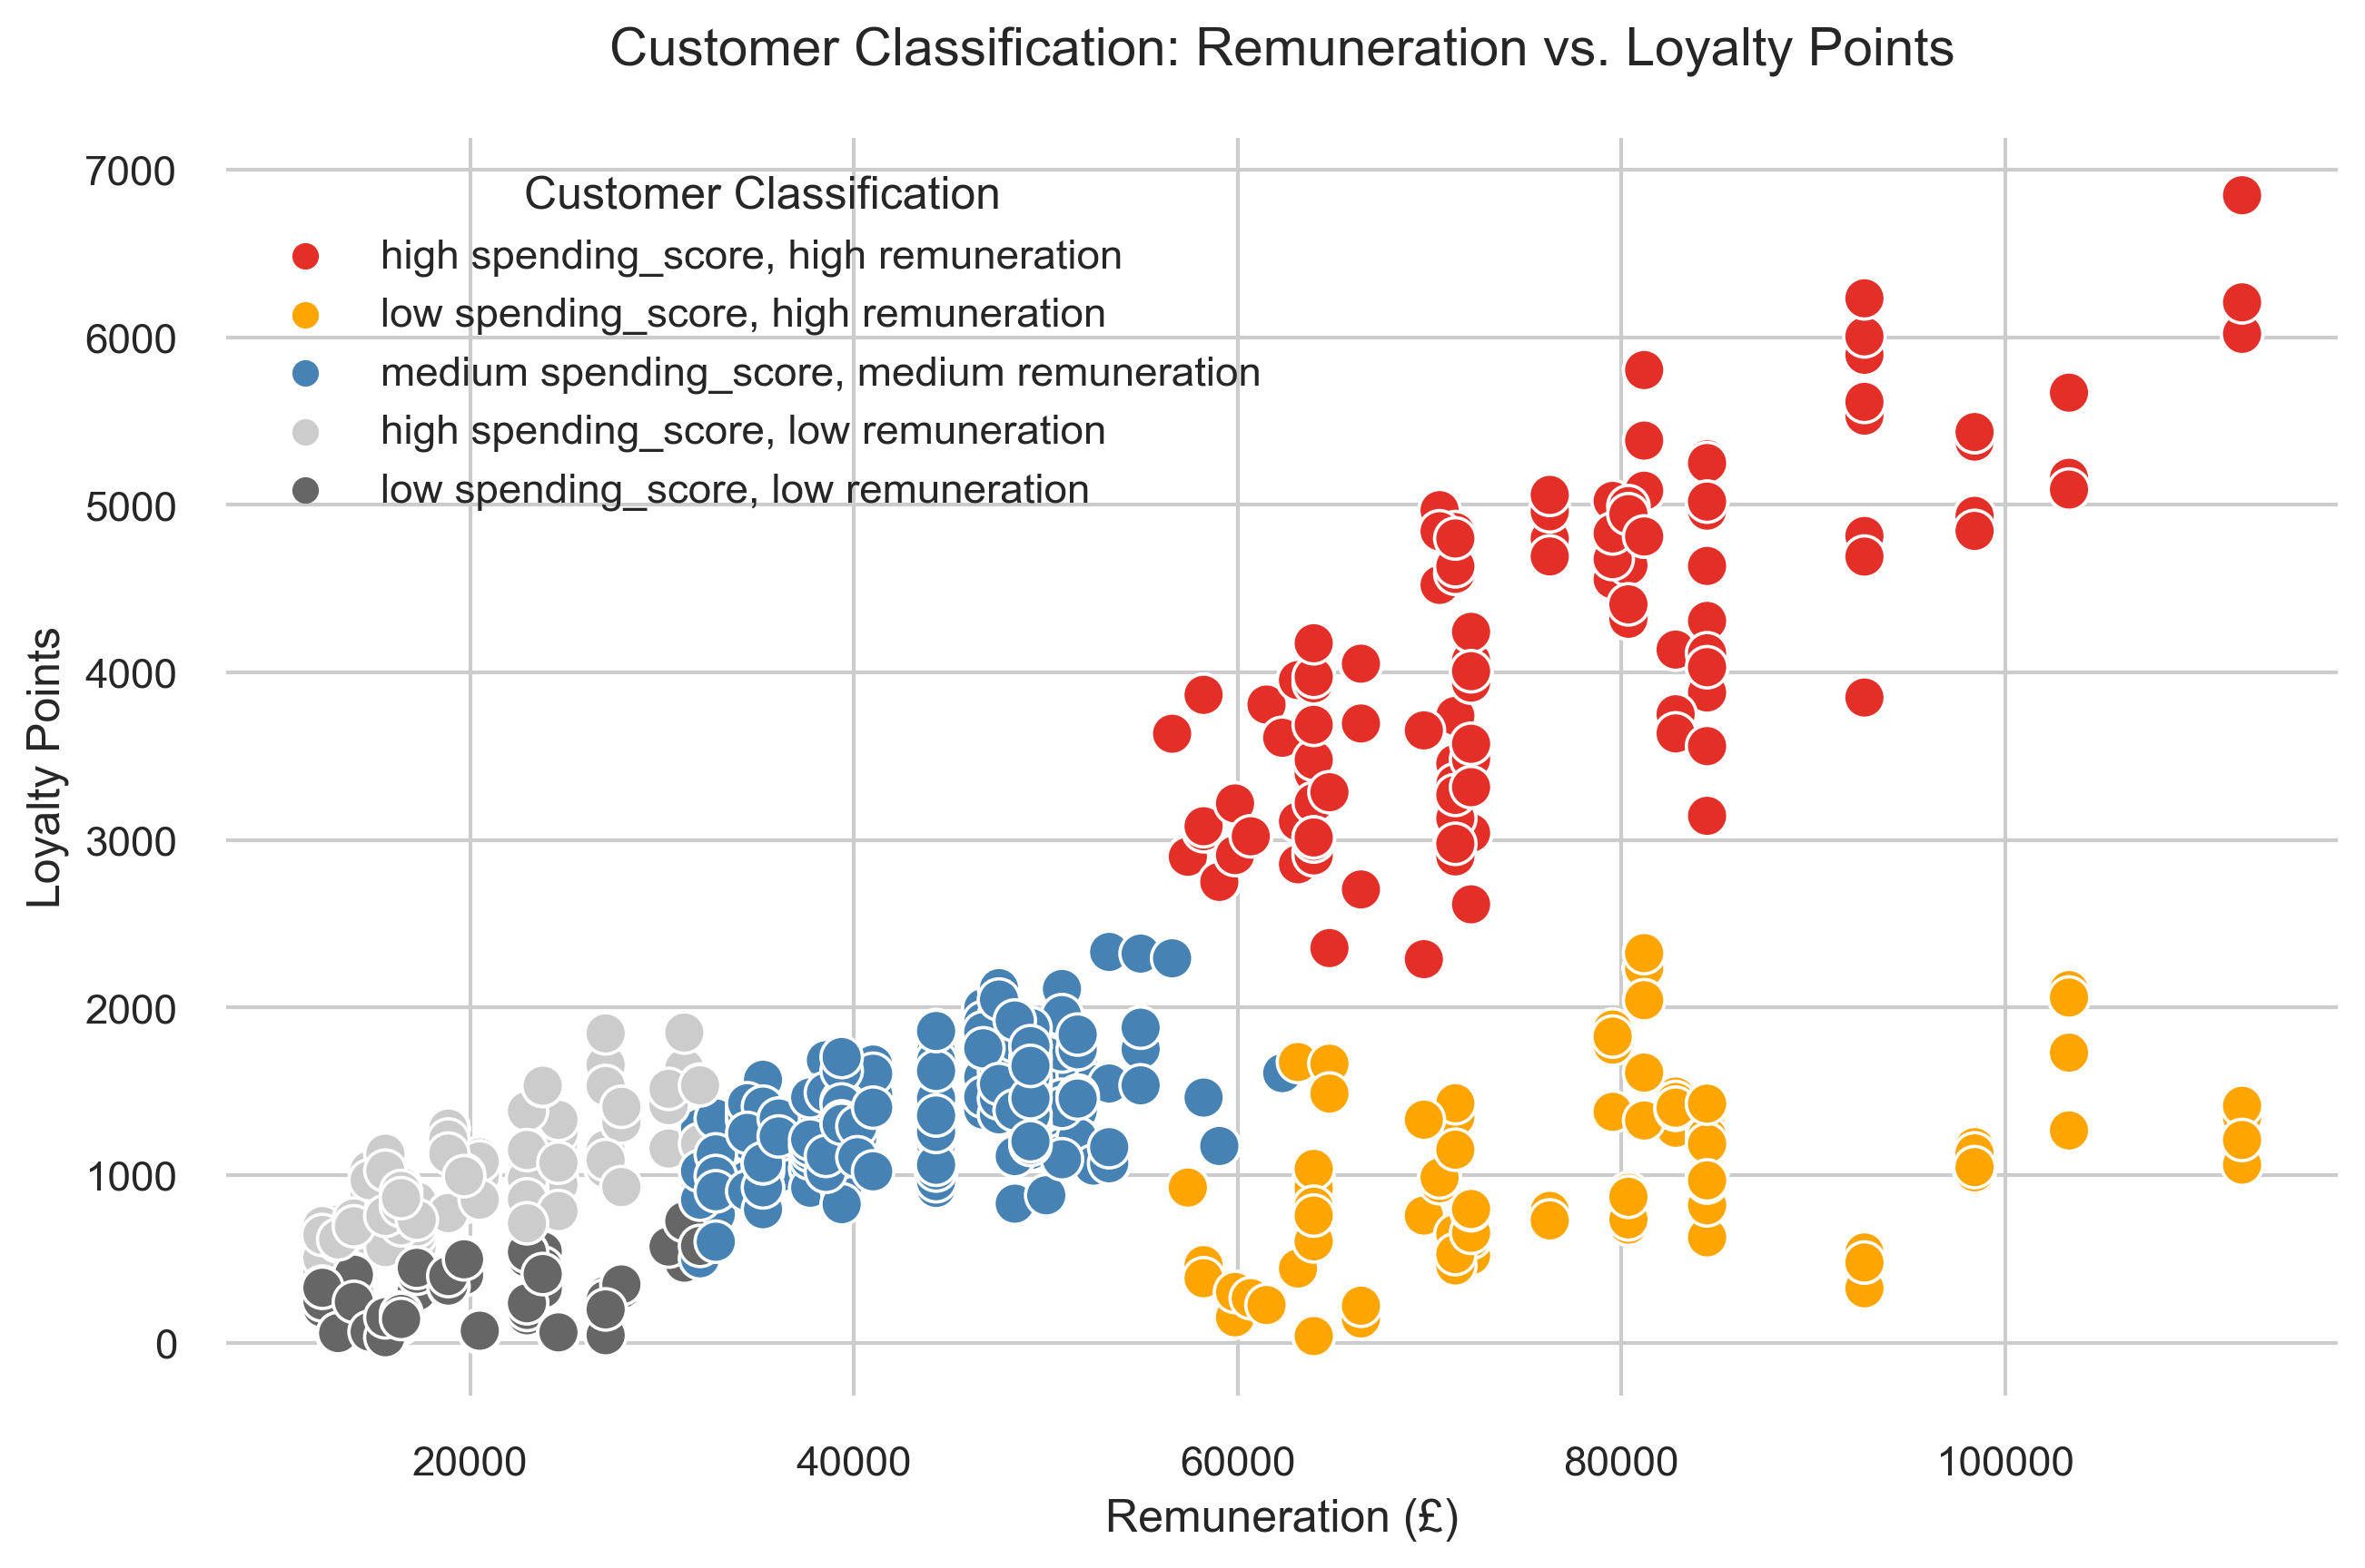
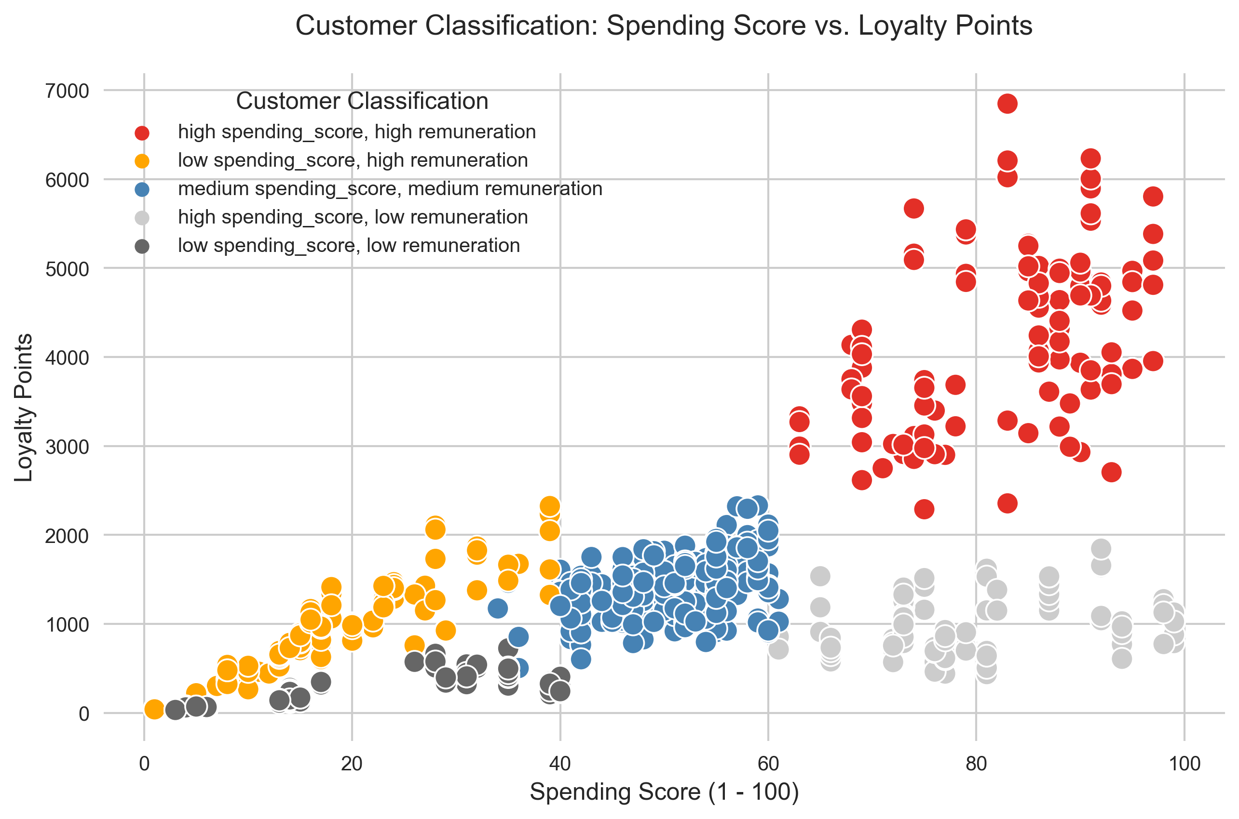
Group Classification Model: Loyalty Points
Remuneration vs. Loyalty Points
Strong positive relationship.
Increase in remuneration = increase in loyalty points.
Group 2 (low spending_score, high remuneration) group clearly contradicts the narrative.
Spending Score vs. Loyalty Points
Strong positive relationship.
Increase in spending score = increase in loyalty points.
Group 4 (high spending_score, low remuneration) clearly contradicts the narrative.
Wide variance of loyalty points in the red group.

Slide 6
Predicting Loyalty Points: Explaining The Model
Customer Demographics & Behaviour
The model predicted the value of loyalty points based on customer age, remuneration and spending score.
For every increase of 1 in the age, there will be an increase of 11 in loyalty points.
For every increase of £1000 in the remuneration, there will be an increase of 35 in loyalty points.
For every increase of 1 in the spending score, there will be an increase of 35 in loyalty points.
In plain terms, as the customers get older and earn a higher yearly income, spending power increases.
What does the model look like visually?

Slide 7
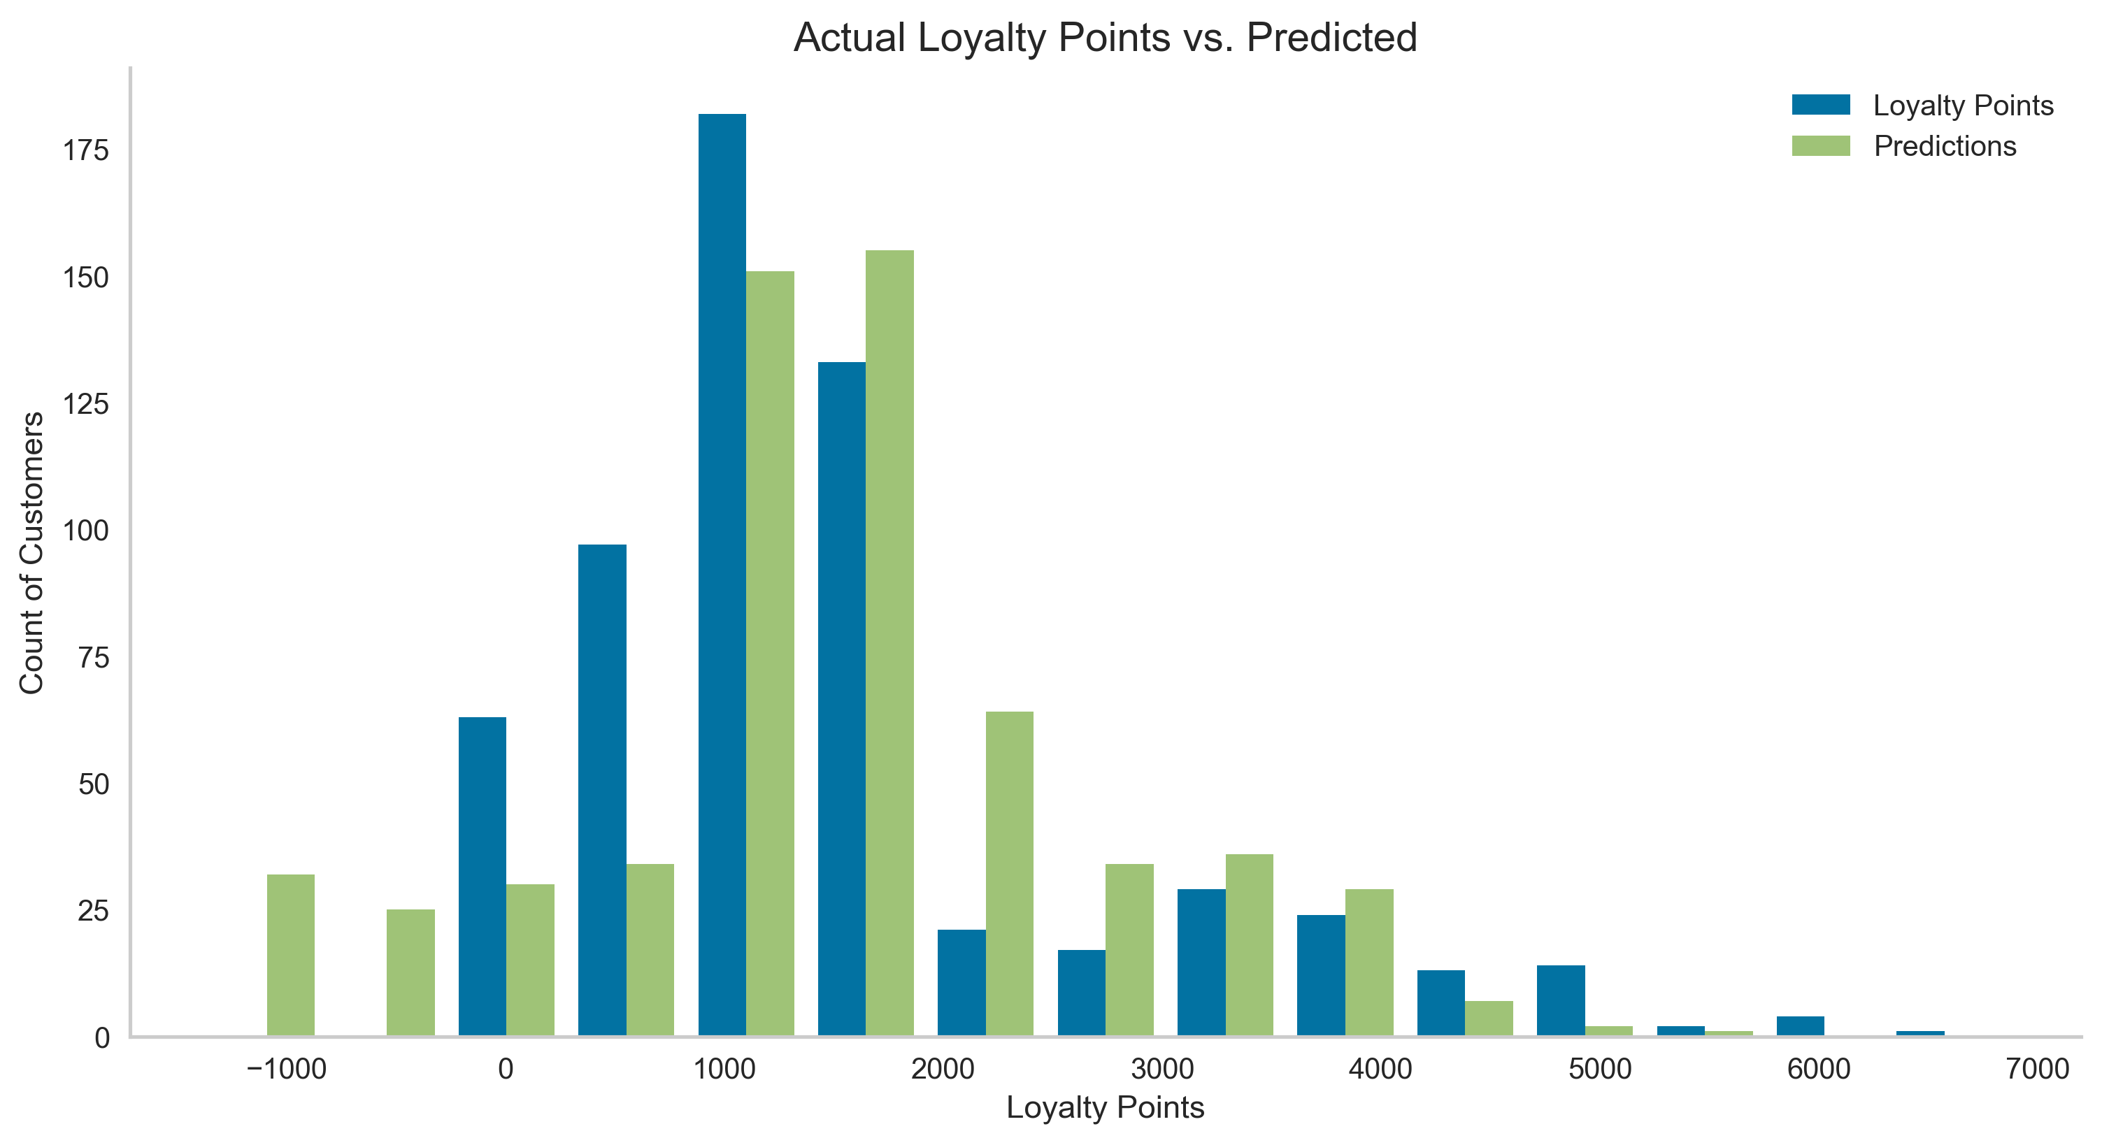
Predicting Loyalty Points: Model Performance
The model was most accurate where the predicted value of loyalty points is between 1000 and 4500.
The accuracy of the model could be improved by testing different customer data which can be obtained via the loyalty program. For example, number of children, post code, house valuation.

Slide 8
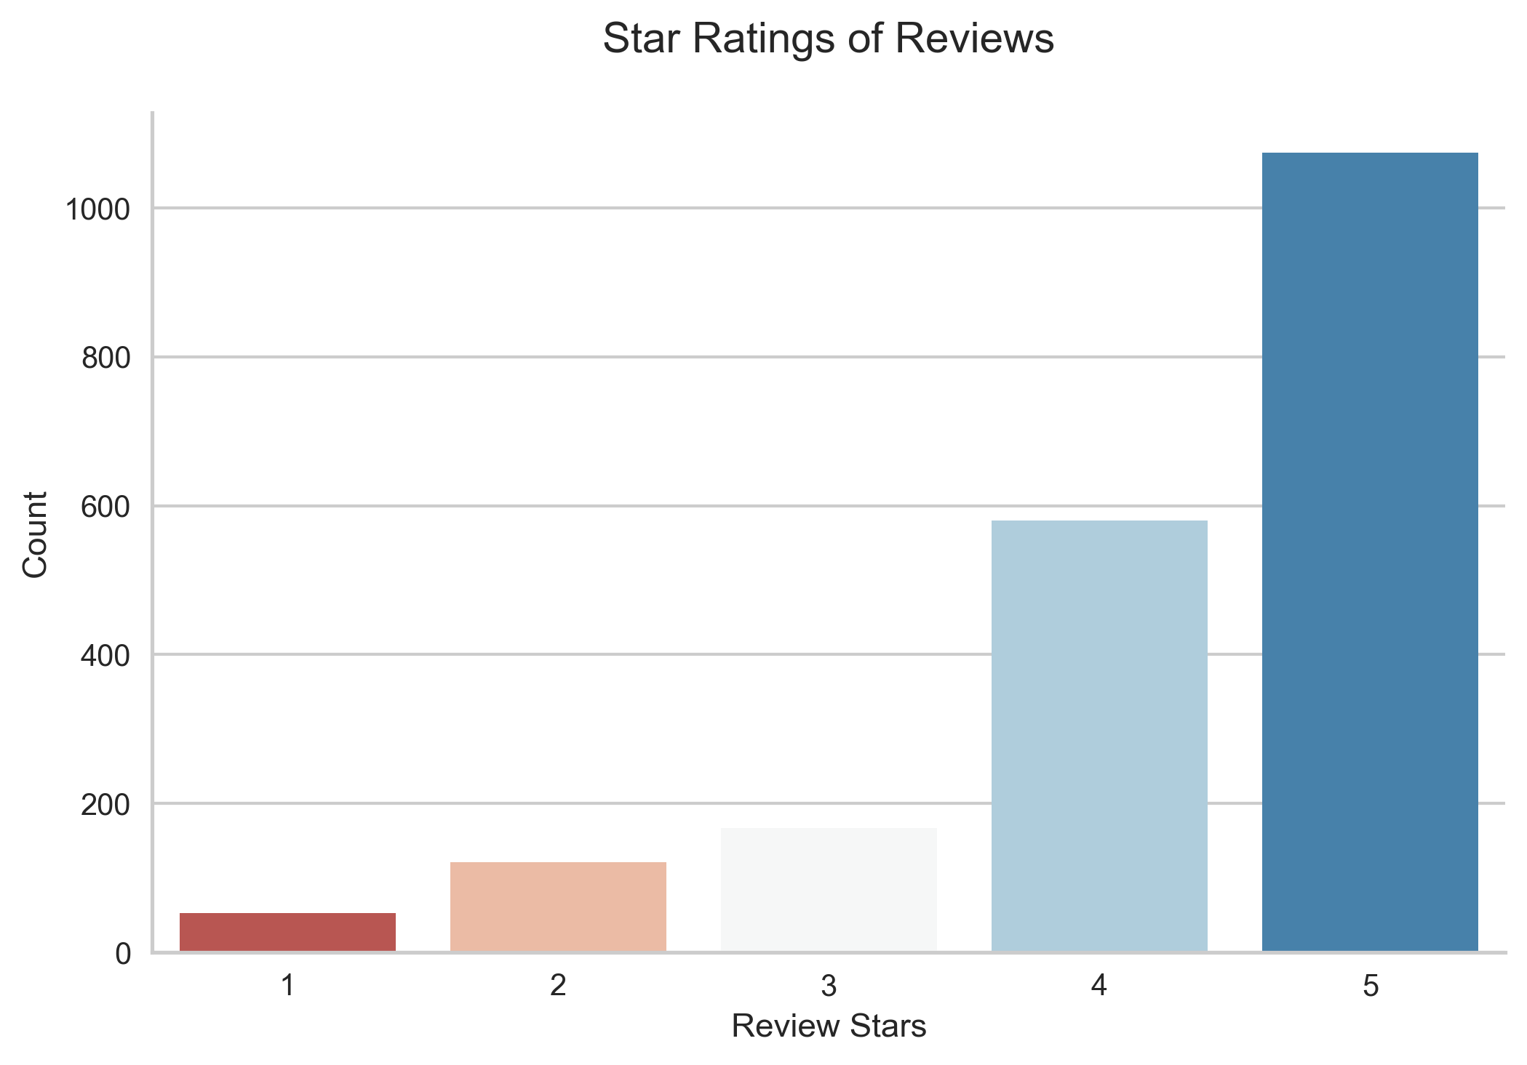
Sentiment Analysis of Reviews: Star Rating Model
Model Explanation
Star Rating (1 to 5):
1= Negative Sentiment
5 = Positive Sentiment
Pros: Accurate, no pre-processing text, easy to interpret, actionable.
Cons: Limited to processing 512 words maximum.
Analysis Results
83% of reviews were rated with positive sentiment.
How can sentiment analysis improve sales performance?
54%
29%

Slide 9
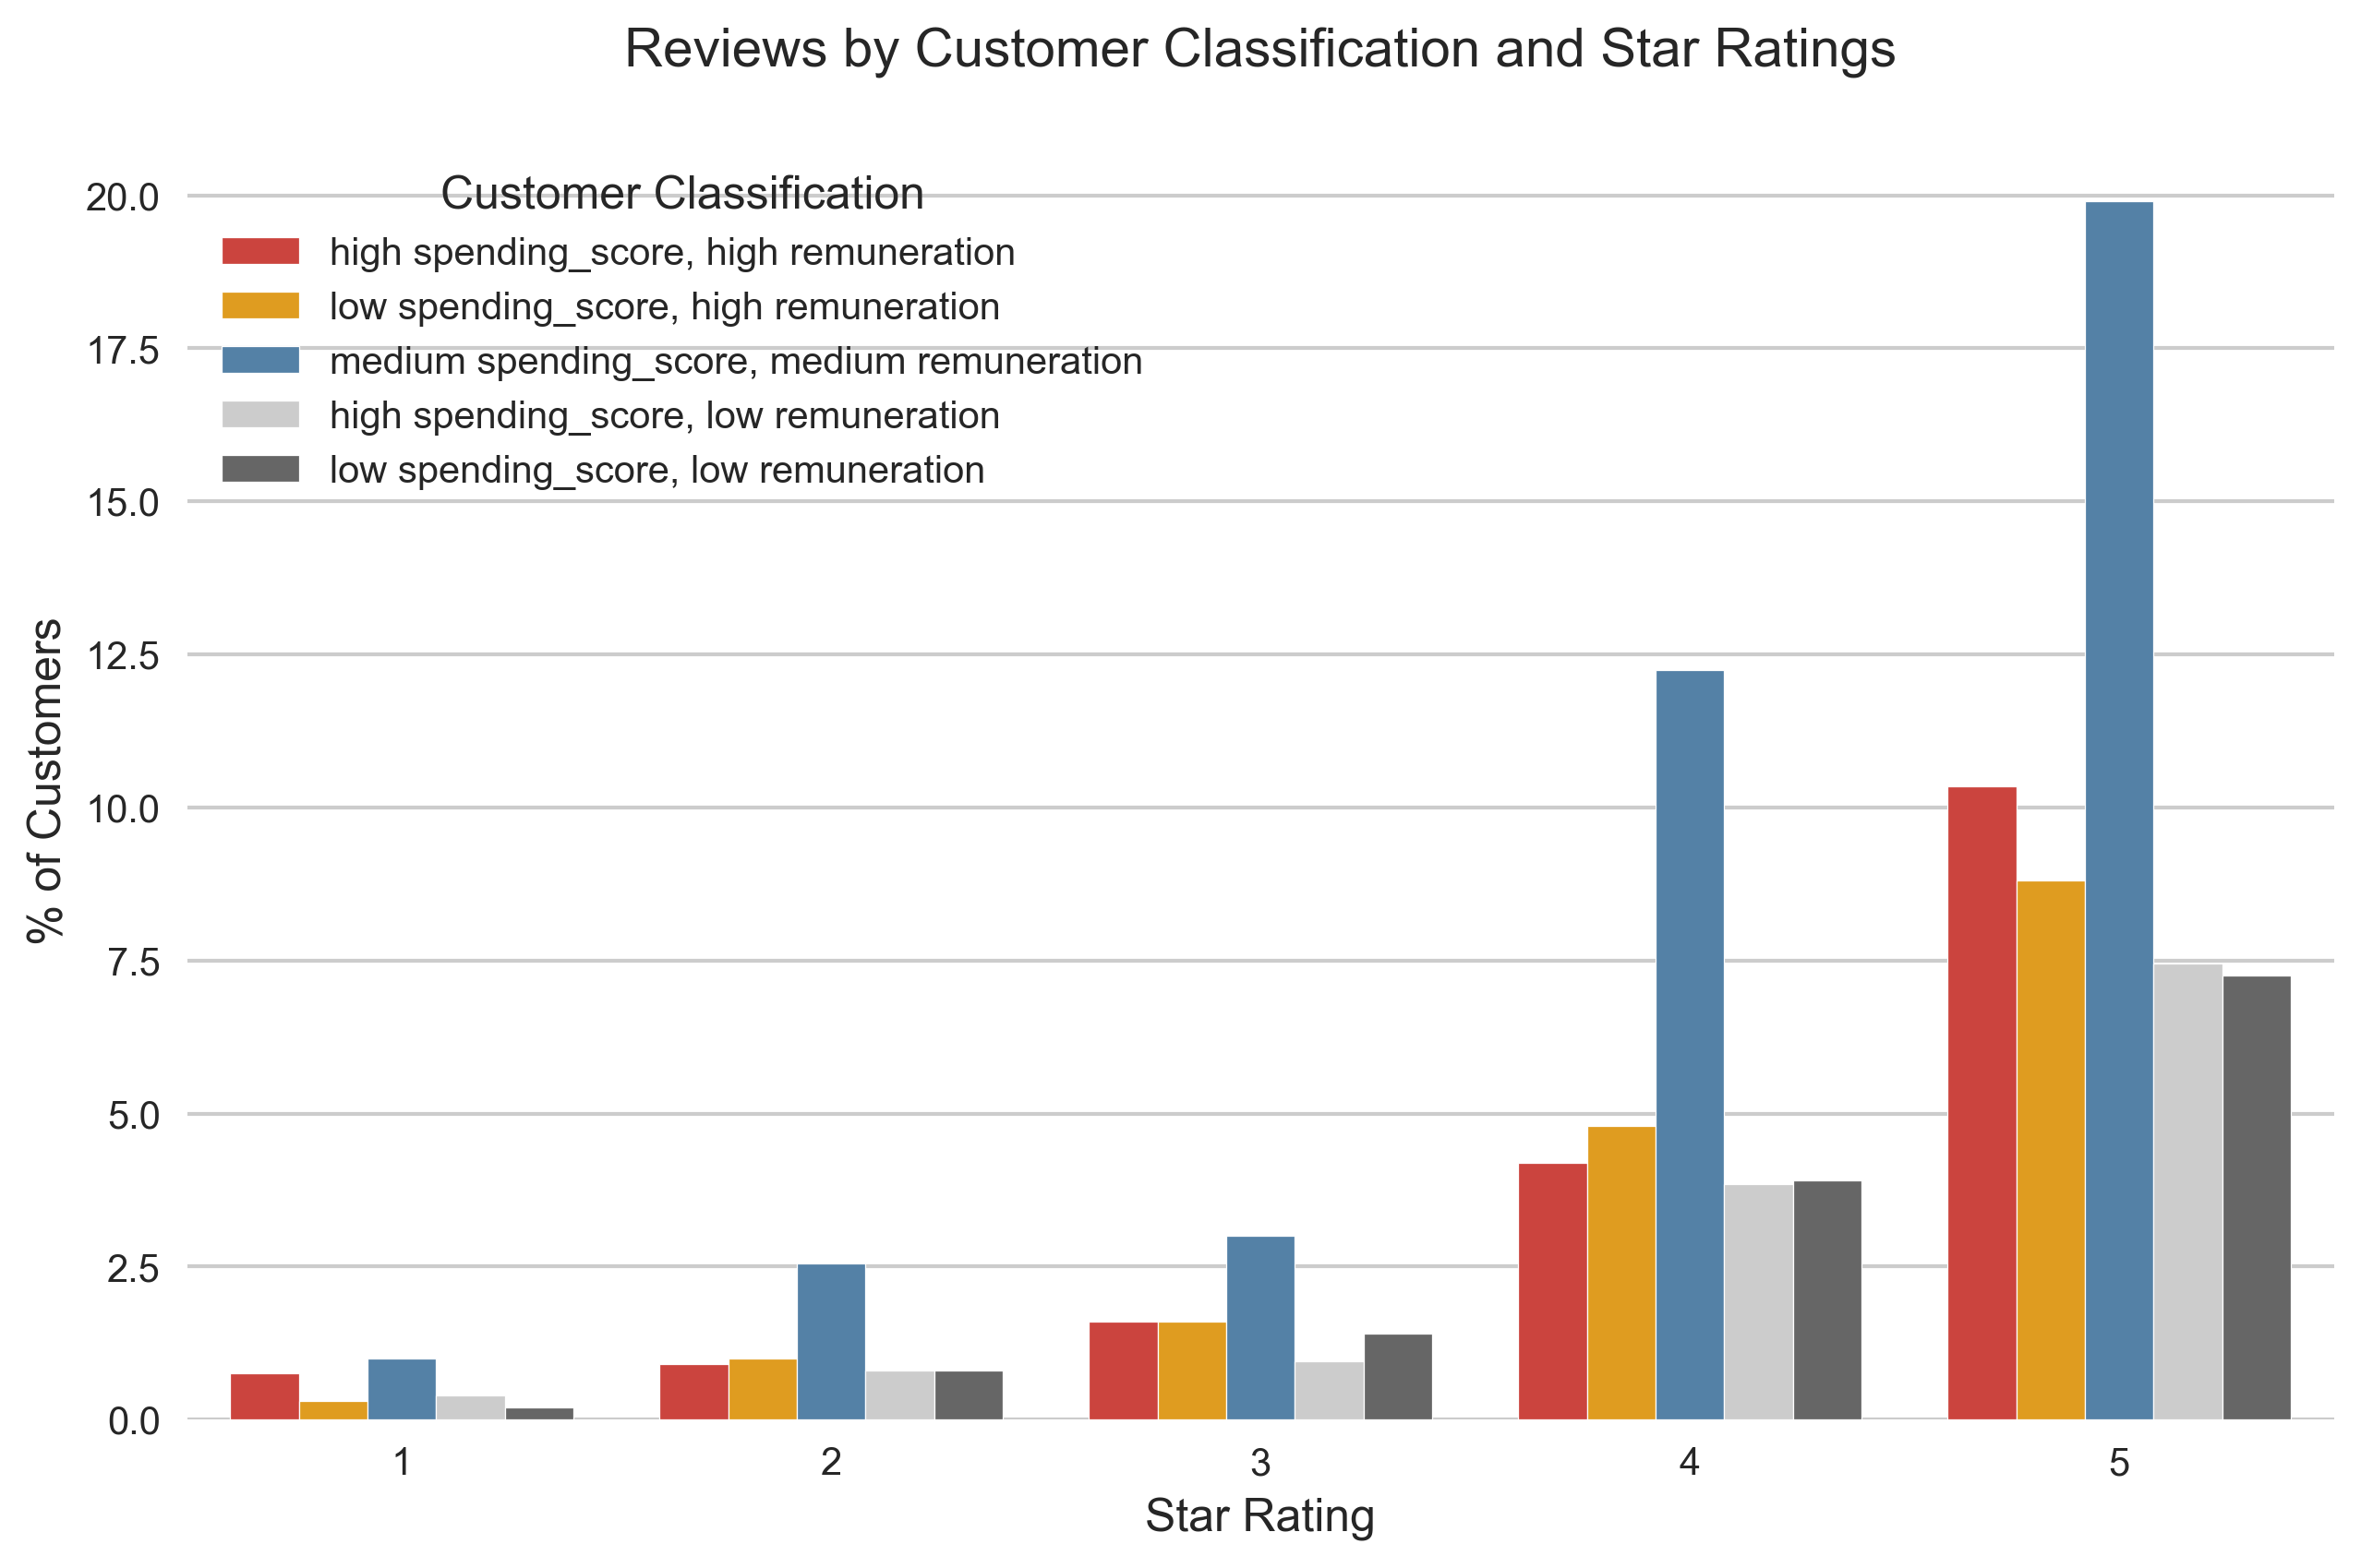
Sentiment Analysis: Identifying Target Customers
How to Implement the Model
Reward customers for writing reviews.
1 and 2 star reviews can be flagged to customer services.
Products consistently reviewed poorly can be monitored and removed from sale if necessary.
Top-rated products by review can be promoted to new customers.
These actions can be related to the target groups identified by the group classification model. For example, a negative product review by a customer in one of the target groups should be responded to immediately.

Slide 10
Summary & Limitations
Group Classification
5 unique groups identified for the marketing department. The marketing department can develop strategies for each one.
Predicting Loyalty Points
Spending score is a very important predictor, as similar to loyalty points, it will change depending on customer spending behaviour.
Remuneration and age are both important customer demographic metrics.
Sentiment Analysis
The accuracy of the model is essential.
Implementation will help improve efficiency and targeting of resources by the marketing department and customer services.
Limitations
The products in the data were not correctly labelled, meaning that the popularity of products by customer sentiment could not be properly explored.
The model predictions could be improved if the customer data was not so limited.

Slide 11
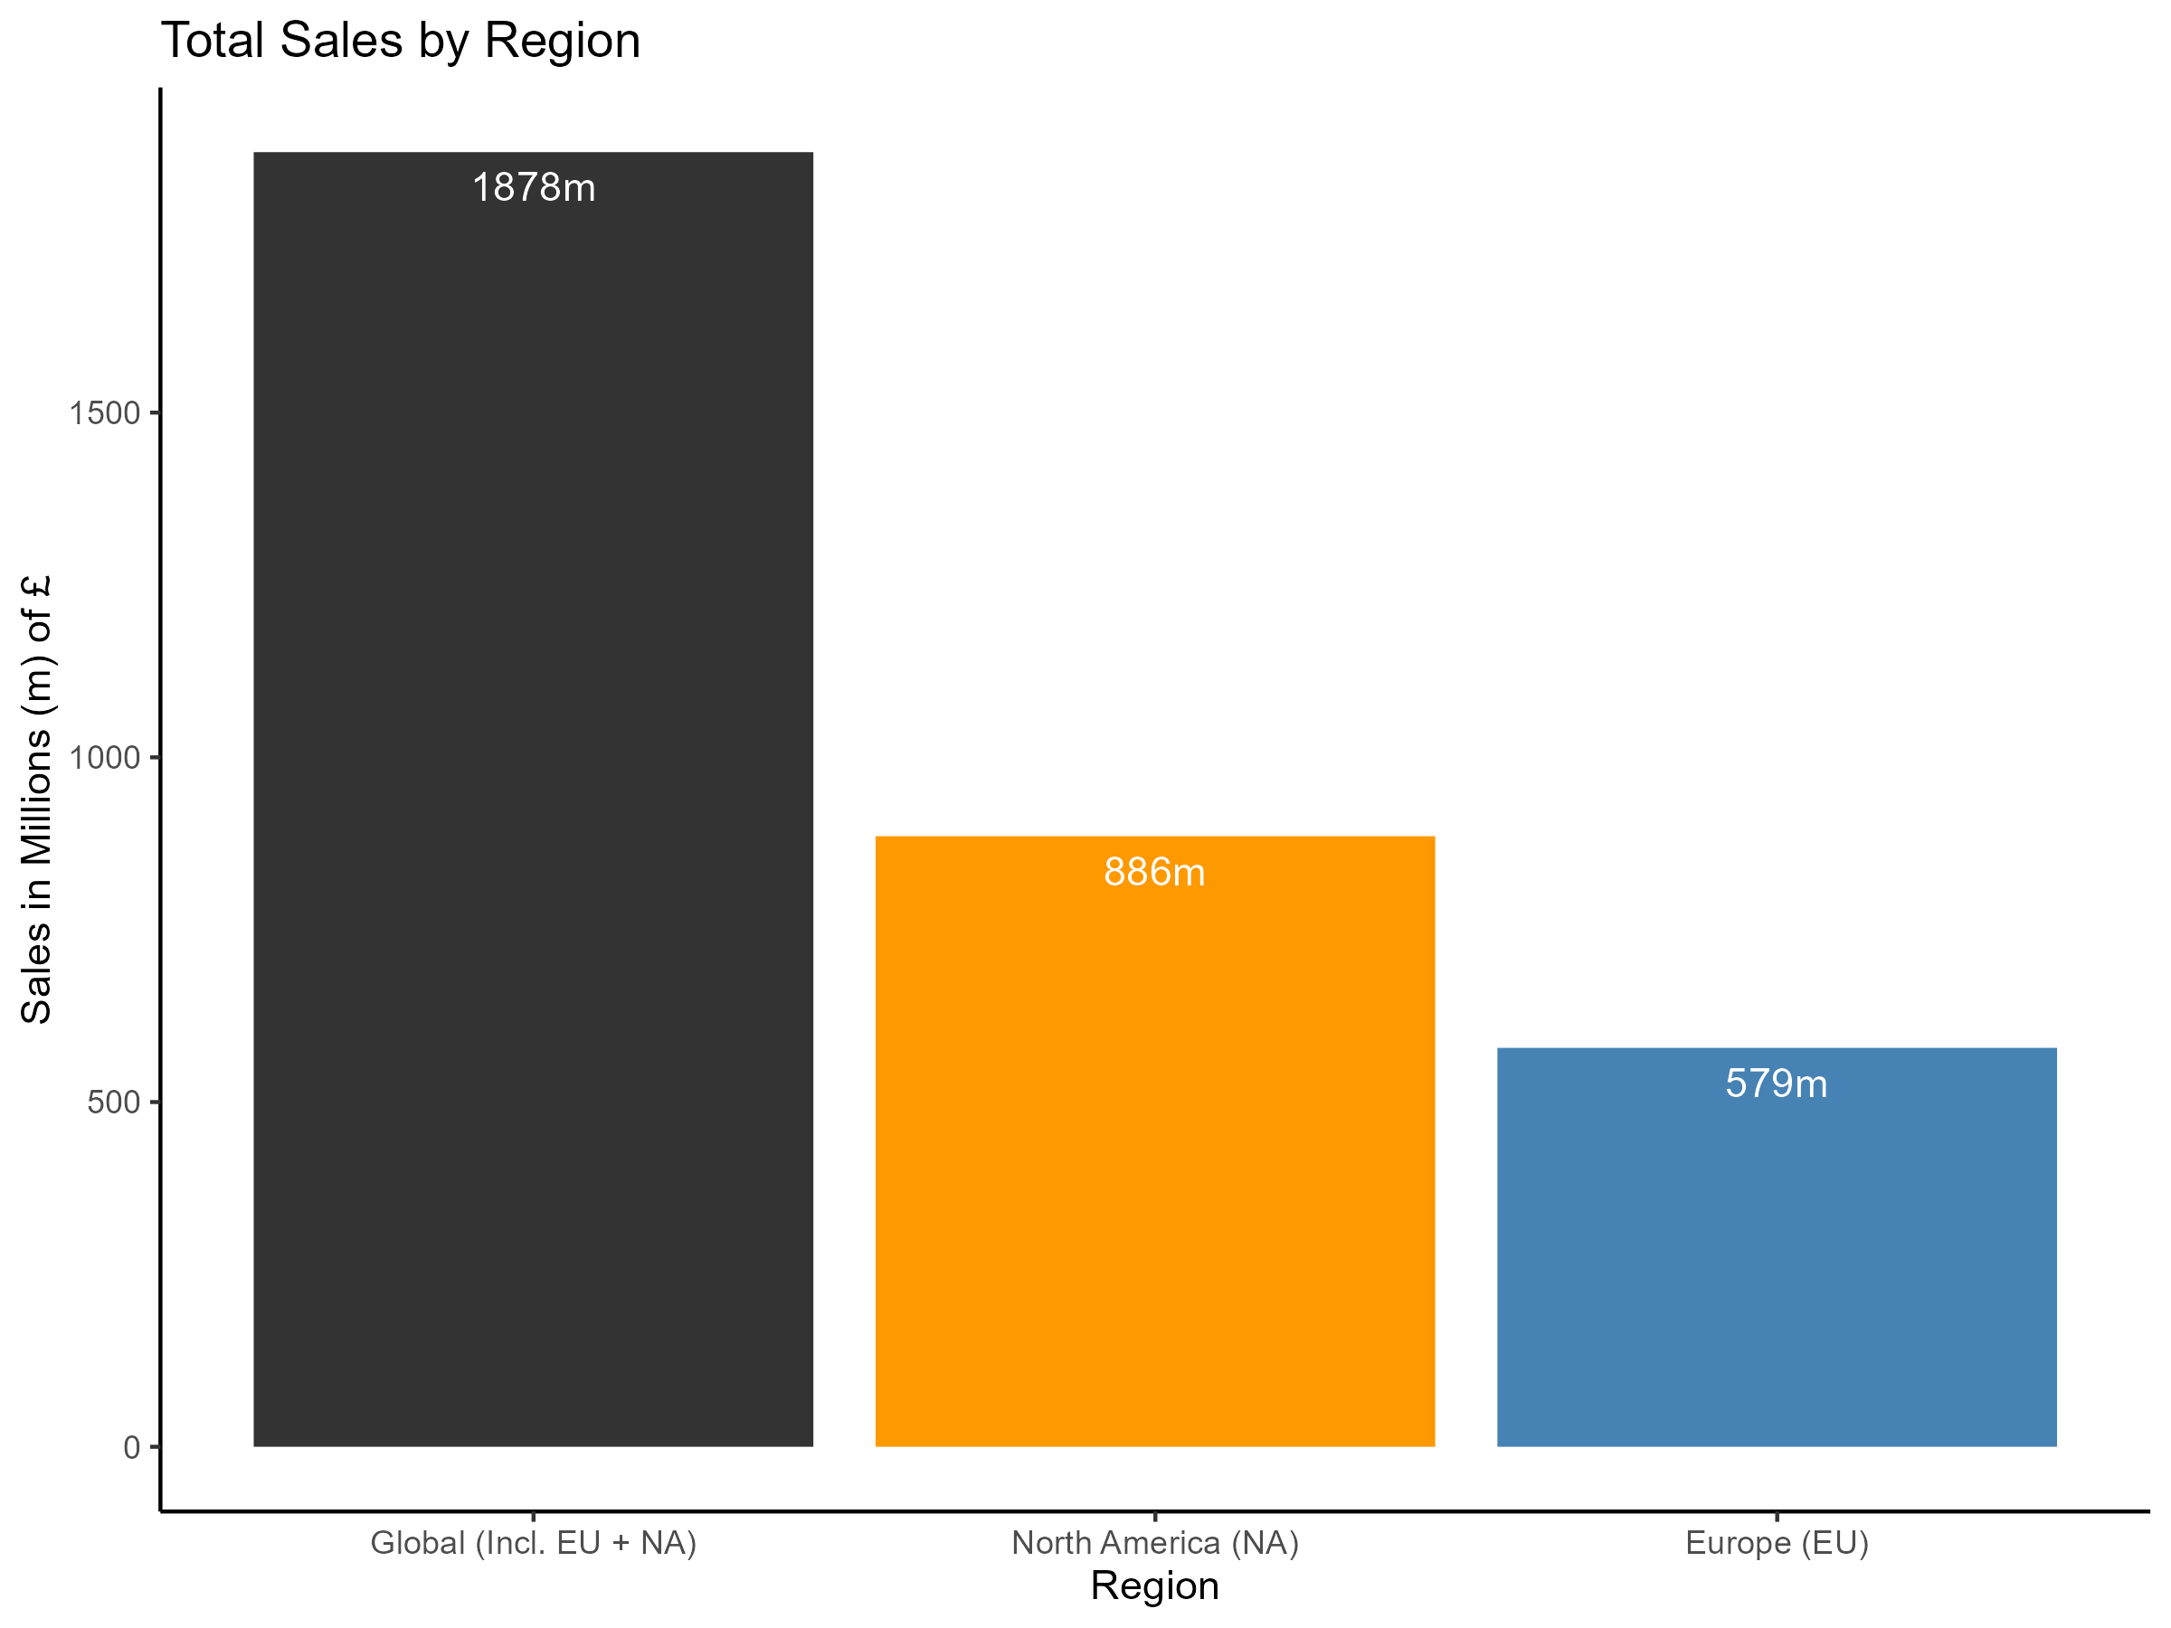
Video Games Sales by Region
Sales by Region
47% of all sales are in North America, a total of £886m, which is 53% more than sales in Europe.
The sales data is missing some regions (e.g. Asia) which would be useful.

Slide 12
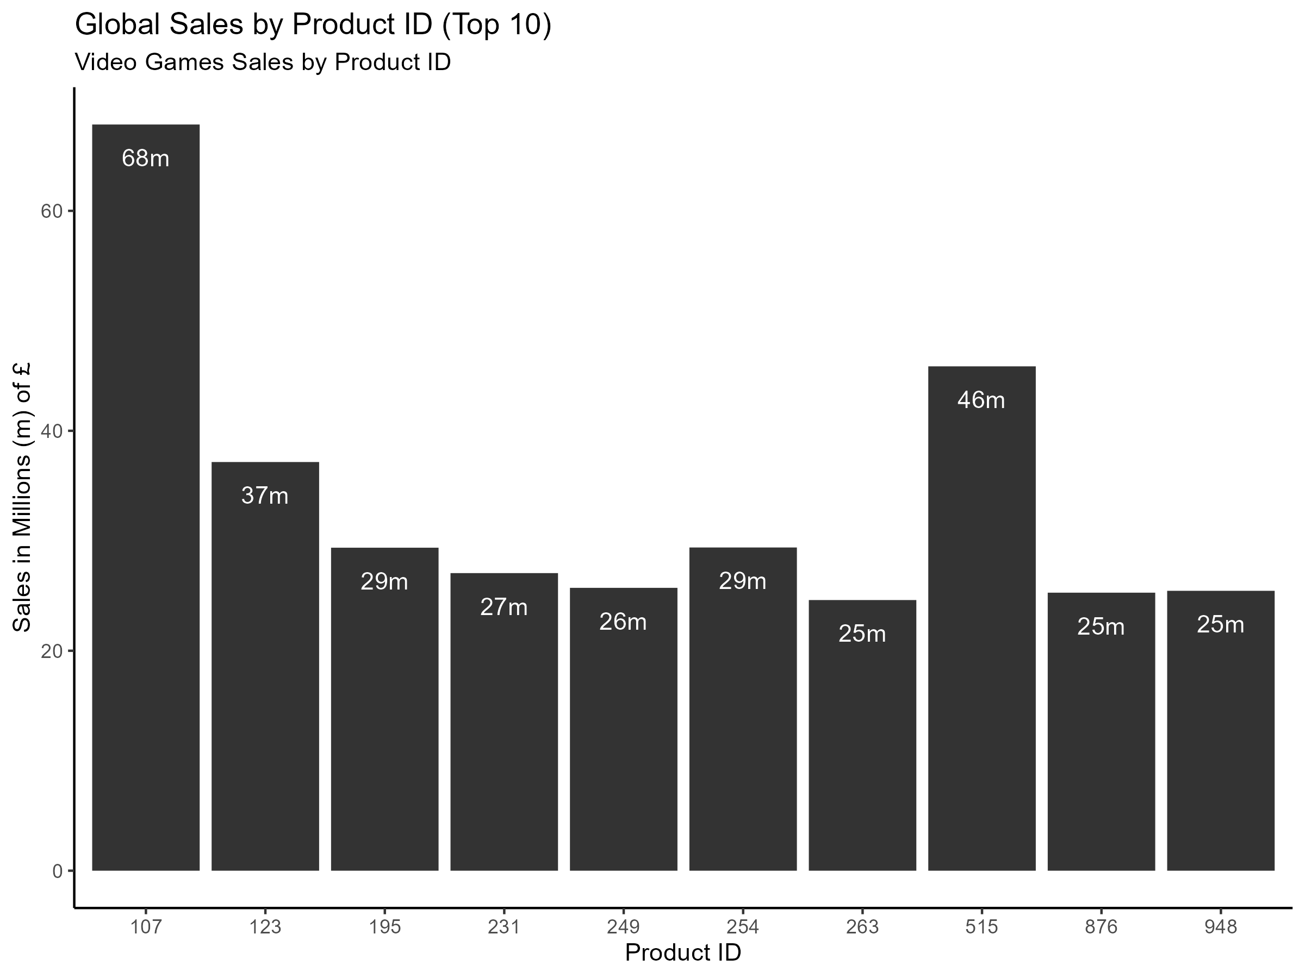
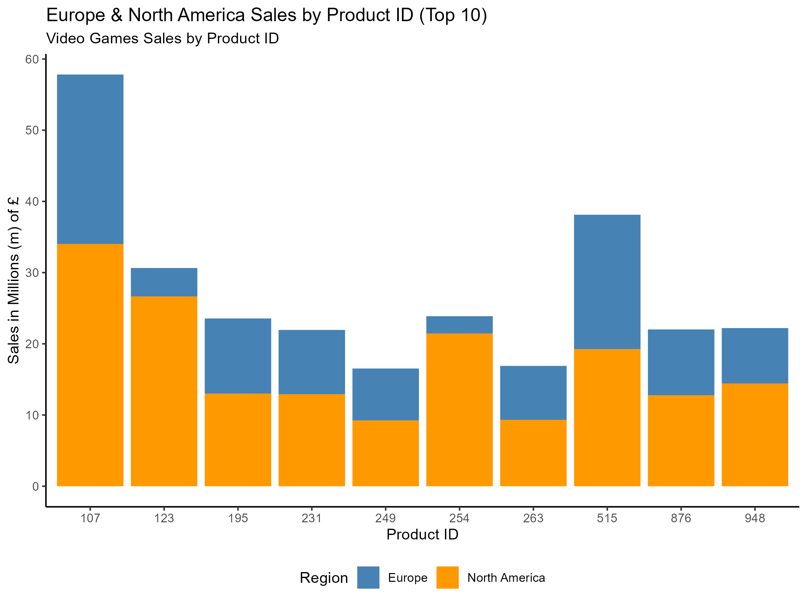
Video Games Sales by Product ID (Top 10 out of 175)
Average = £10.73m
Sales by Product
The top selling video game sold a total of £68m worth. This is 3.62% of all sales.
Some video games (ID 123, 254) sold many more in North America in comparison to Europe. This indicates regional differences in video game preferences.

Slide 13
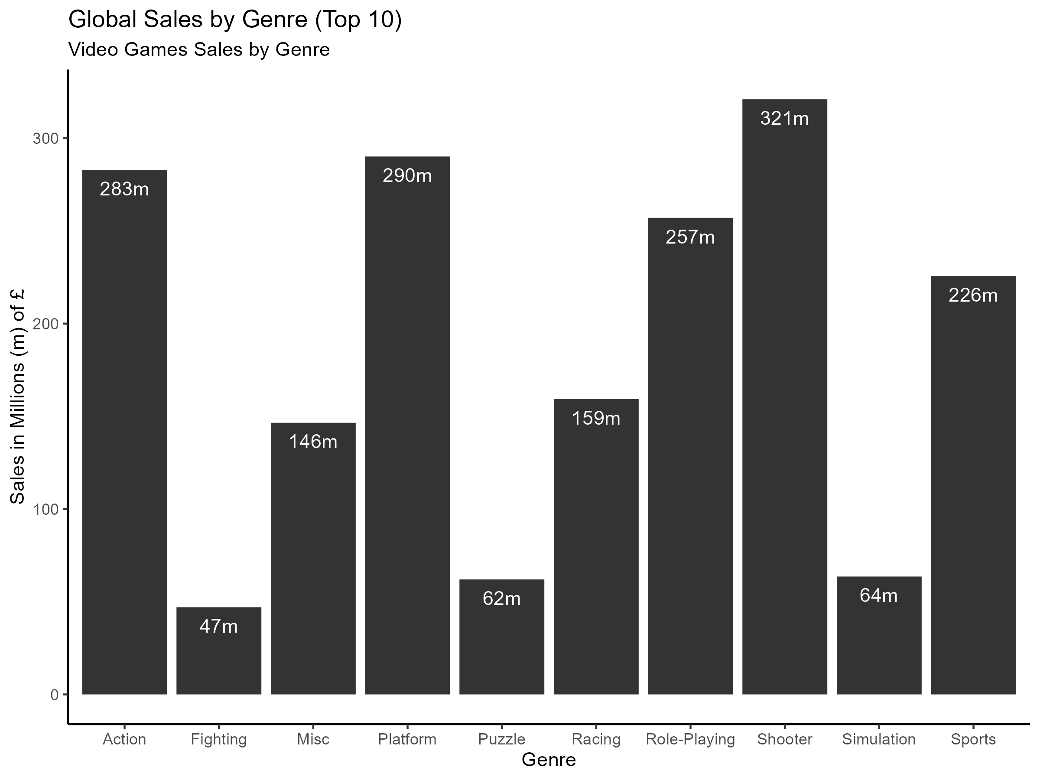
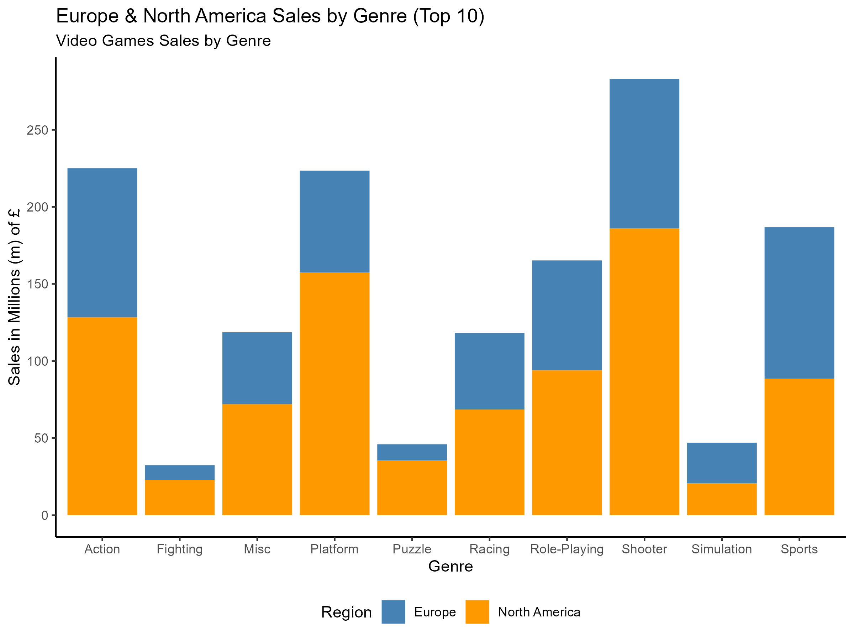
Video Games Sales by Genre (Top 10)
Sales by Genre
Shooter video games sold £321m worth, accounting for 17% of total sales.
Other popular genres include; Platform, Action, Role-Playing and Sports.
Noticeable regional differences in sales by genre.
Many sales for the Role-Playing genre are outside North America and Europe.

Slide 14
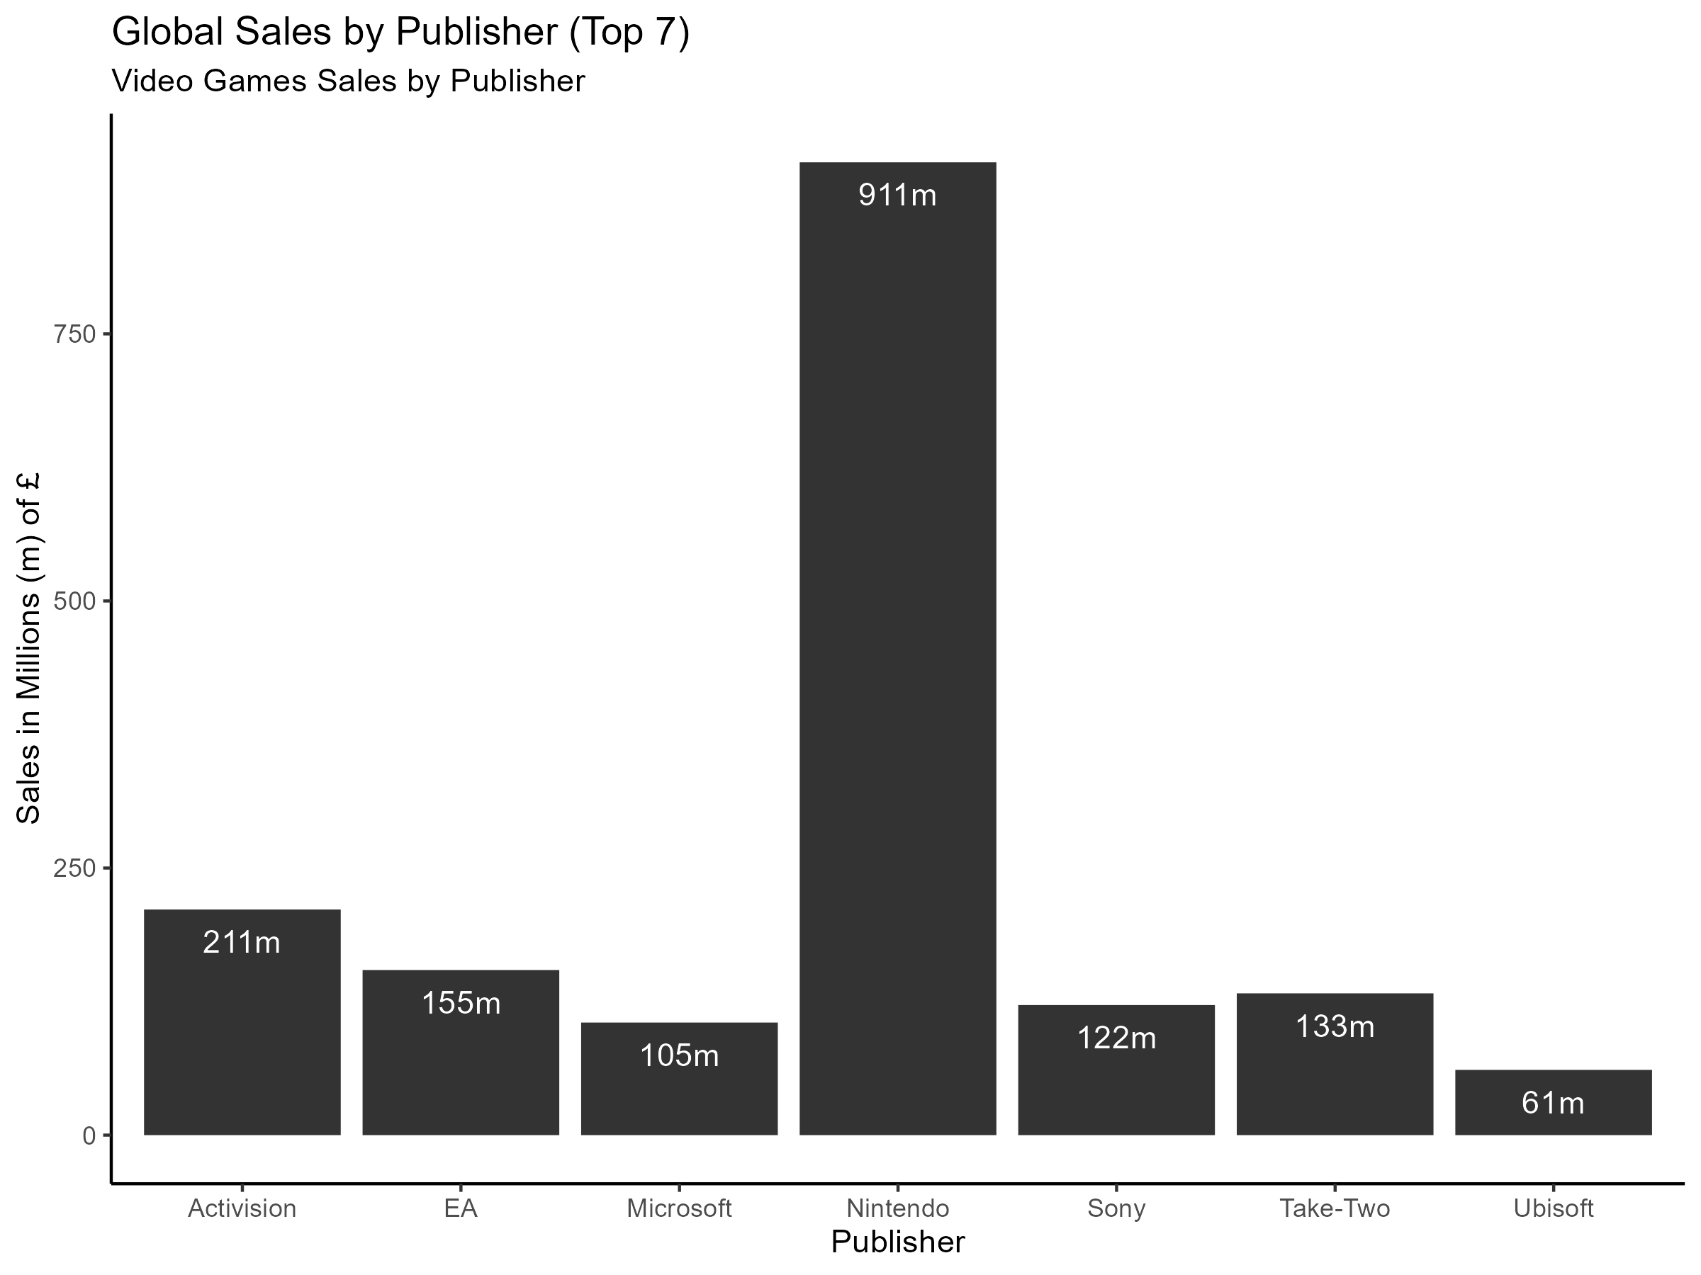
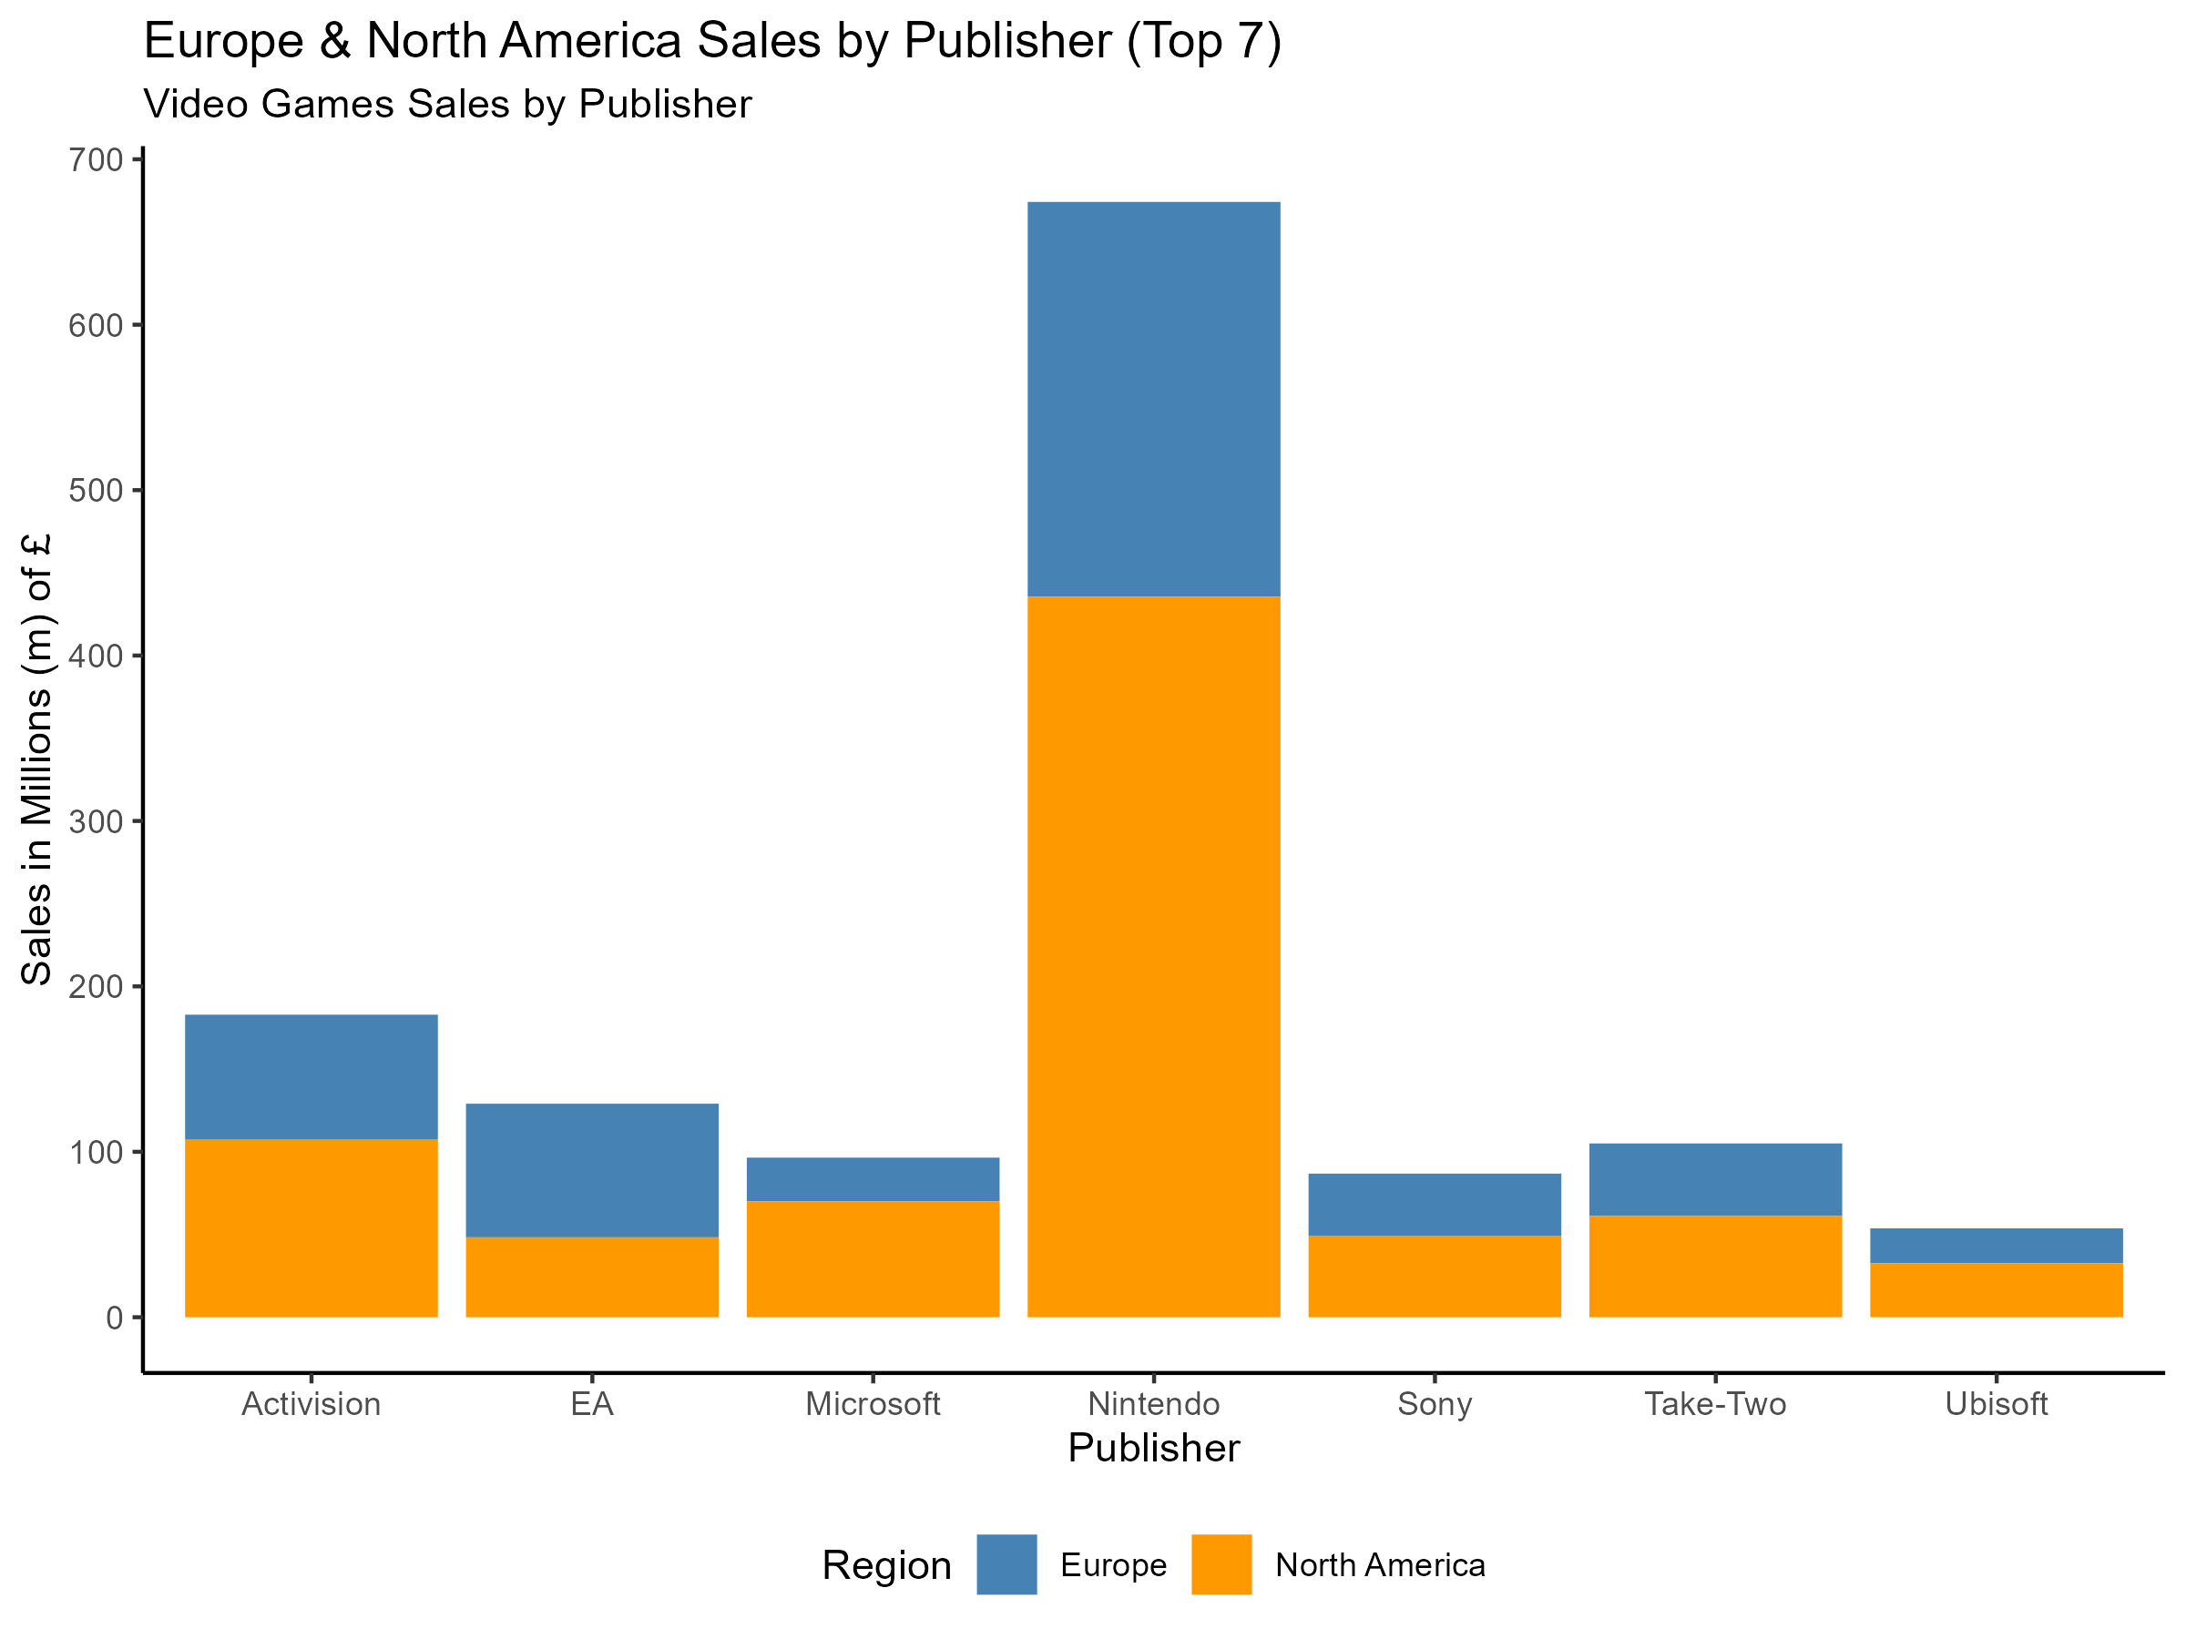
Video Games Sales by Publisher (Top 7 out of 24)
Sales by Publisher
There are 24 video game publishers.
Nintendo is the largest publisher, because they produce all the games for their consoles.
Many other publishers will be creating games unique to their speciality, e.g. EA = Sports genre.

Slide 15
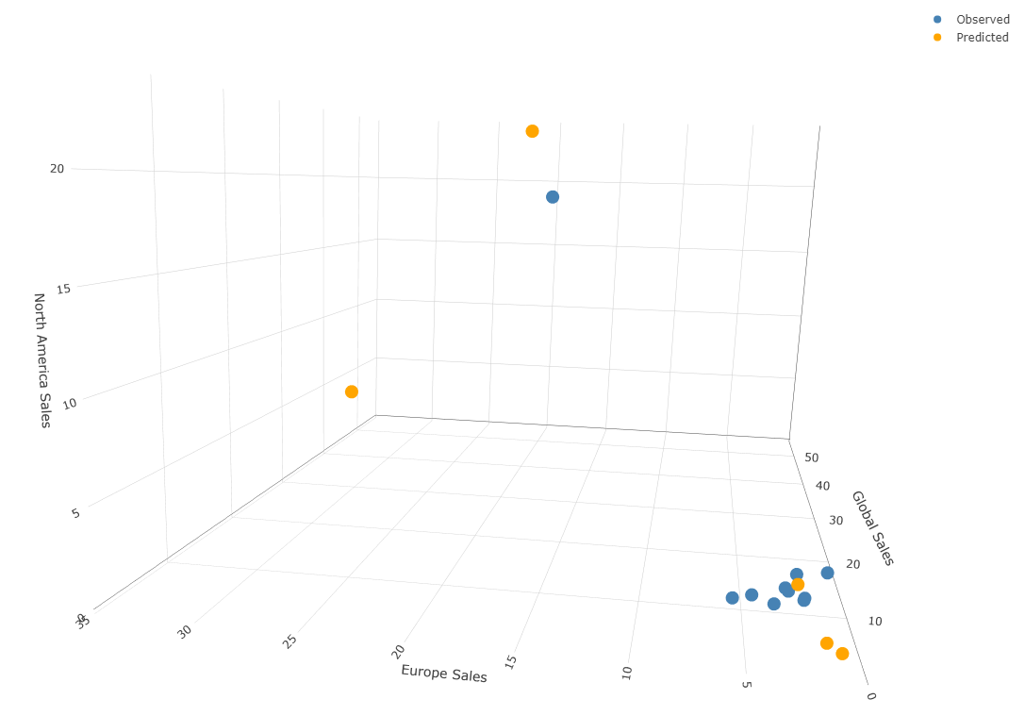
Predicting Global Sales: The Model
Explanation
The model predicted Global sales based on the sales in North America and
Europe.
Limitations
The dataset was too small to generate meaningful results.
Ideally, any scenario involving predicting or forecasting sales would require time-based analysis. In this case, the data was limited to a snapshot in time, if the data was monthly then a time-series model could be built to show trends and/or seasonality, and forecast future sales.

Slide 16
Recommendations
How can Turtle Games improve overall sales performance?
The Marketing Department must act on the target groups identified, for example:
Send an Net-Promoter Score survey to customers in Group 1 (high spending score + high remuneration). These customers should be kept satisfied through special marketing promotions.
Use a survey to understand more about Group 2 (low spending score + high remuneration).
Use the loyalty program to collect more customer data which can improve the predictive model. The primary goal is to find key metrics that explain the accumulation of loyalty points e.g. house ownership, number of children, postcode.
Implement sentiment analysis on any customer contact such as product reviews, chat and emails. Focus on (i) keeping customers satisfied (e.g., fast-track complaints), (ii) products trending negative or positive, (iii) and identifying and rewarding happy customers who actively promote the brand.

