Slide 1
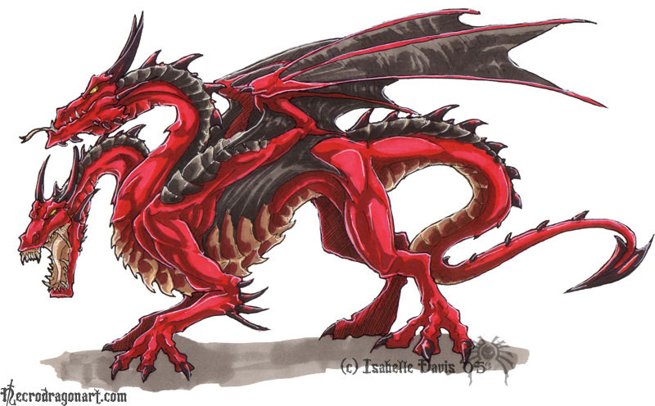
“If you know the enemy and know yourself, you need not fear the result of a hundred battles. If you know yourself but not the enemy, for every victory gained you will also suffer a defeat. If you know neither the enemy nor yourself, you will succumb in every battle.”
― Sun Tzu, The Art of War

Slide 2
Today: two views on where the enemy lays when building [distributed] systems
[1]: Starting from a single system mindset
  Peter Deutsch’s “8 fallacies”
[2]: Managing complexity: is the key difficulty in (computer) system building

Slide 3
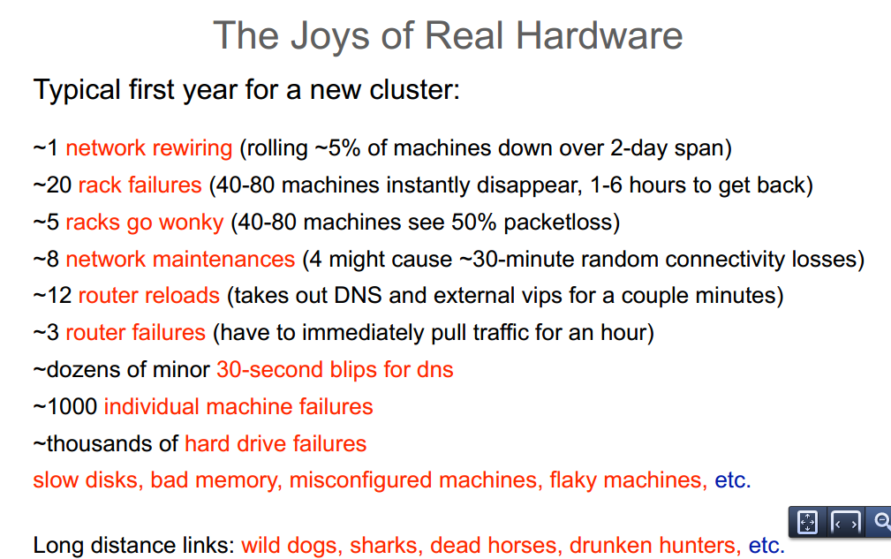
Developing distributed systems: Pitfalls
[aka Peter Deutsch’s “8 fallacies”, cca’95] [1, 2]
The network is reliable [refs: survey, 3, 4]
Latency is zero [verizon monitoring data]
Bandwidth is infinite
Transport cost is zero
The network is secure
The topology does not change
There is one administrator
The network is homogeneous
Note that almost all above are network related!
Your network link: 10Gbps, 100ms RTT, 1KB MSS
Transport protocol: TCP
How long it will take to send an 100KB message?
(a 2x approx. factor is fine)
0.1ms
1.0ms
10.0ms 100.0ms
1,000.ms
Notes:
Queen: Estimating Packet Loss Rate between Arbitrary Internet Hosts
Y. Angela Wang
Cheng Huang
Jin Li
Keith W. Ross
PAM '09 Proceedings of the 10th International Conference on Passive and Active Network Measurement

Slide 4
Today: two views on where the enemy lays when building [distributed] systems
[1]: Starting from a single system mindset
  Peter Deutsch’s “8 fallacies”
[2]: Managing complexity: is the key difficulty …
  What are the external indicators of a complex system?
  What issues may come up?
    Emergent properties.
    Propagations of effects.
    [incommensurate] Scaling
    Tradeoffs
  What drives complexity?
    Large number of interacting features / requirements
    Requirement for high performance / high utilization
  What are your tools?

Slide 5
Unlike constraints for engineering “real” systems:
  Unconstrained design space
  … no weight, physics laws, etc.
Key Challenge: managing complexity to efficiently produce bug-free, maintainable, reliable, scalable, secure [add your attribute here] software systems.
Slides dapted from: Principles of Computer System Design: An Introduction, J. Saltzer, F Kaashoek, Morgan Kaufman 2009.

Slide 6
Complexity
Hard to define; symptoms:
  Large # of components
  Large # of connections
  Irregular
  No short description
  Many people required to design/maintain
Technology rarely the limit!
  Indeed tech opportunity can be a problem
  The limit is usually designers’ understanding

Slide 7
Problem Types in Complex Systems
Emergent properties
  Surprises
Propagation of effects
  Small change -> BIG effect
[ Incommensurate ] scaling
  Design for small model may not scale
Tradeoffs
Note: These problems will show up in non-computer systems as well

Slide 8
Emergent Property Example: Ethernet
All computers share single cable
Goal is reliable delivery
Listen before send to avoid collisions

Slide 9
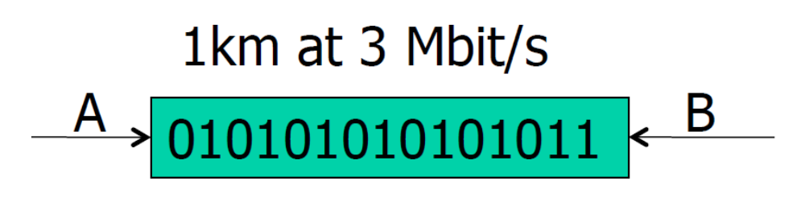
Will listen-while-send detect collisions?
1 km at 60% speed of light = 5 microseconds
  A can send 15 bits before bit 1 arrives at B
A must keep sending for 2 * 5 microseconds
  To detect collision if B sends when first bit arrives
Minimum packet size is 5* 2 * 3 = 30 bits

Slide 10
3 Mbit/s -> 10 Mbit/s
Experimental Ethernet design: 3Mbit/s, 1km max segment
  Default header is: 5 bytes = 40 bits
  No problem with detecting collisions
First Ethernet standard: 10 Mbit/s, 2.5km
  Must send for 2*20 μseconds = 400 bits = 50 bytes
  But Ethernet header is 14 bytes!
Need to pad packets to at least 50 bytes
  Minimum packet size!

Slide 11
Propagation of Effects Example
(L. Cole 1969)
Attempt to control malaria in North Borneo …
  Sprayed villages with DDT
  Wiped out mosquitoes, but ….
  Roaches collected DDT in tissue
  Lizards ate roaches and became slower
  Easy target for cats
  Cats didn’t deal with DDT well and died
  Forest rats moved into villages
  Rats carried the bacillus for the plague
… Leads to replacing malaria with the plague

Slide 12
Incommensurate scaling example (1)
Mouse -> Elephant (Haldane 1928)
Mouse has a particular skeleton design
  Can one scale it to something big? An elephant?
Scaling mouse to size of an elephant
  Weight ~ Volume ~ O(n³)
  Bone strength ~ cross section ~ O(n²)
Mouse design will collapse
  Elephant needs different design!

Slide 13
Incommensurate scaling example (2)
Scaling Ethernet’s bit-rate
  10 Mbit/s: min packet 64 bytes, max cable 2.5 km
  100 Mbit/s: 64 bytes, (new) 0.25 km
  1,000 Mbit/s: (new) 512 bytes, 0.25 km
  10,000 Mbit/s → design has collapsed!
    New design: no shared cable

Slide 14
Sources of Complexity
Many goals/requirements
  Interaction of features
Requirements for Performance/High utilization

Slide 15
Example: More goals → more complexity
1975 Unix kernel:
10,500 lines of code
2008 Linux 2.6.24 line counts:
85,000 processes
430,000 sound drivers
490,000 network protocols
710,000 file systems
1,000,000 different CPU architectures
4,000,000 drivers
7,800,000 Total
Growth in size of Linux Kernel between 1991 and 2003

Slide 16
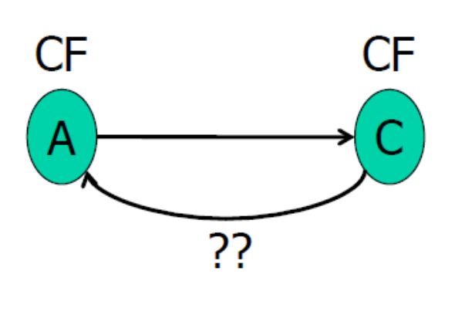
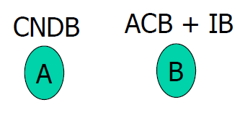
Example: Interacting features → more complexity
Some simple features ..
Call Forwarding
Call Number Delivery Blocking
Automatic Call Back
Itemized Billing
…assemble to complex system-level behavior
A calls B, B is busy
• Once B is done, B calls A
• A’s number on appears on B’s bill

Slide 17
Interacting Features
The point is not that these interactions can’t be fixed …
  … but that the [many] interactions that have to be considered [and possibly treated as special cases] are a huge source of complexity.
  Possibly n^2 interactions or more,
Cost of thinking about / fixing interaction gradually grows to dominate s/w costs.
Complexity is super-linear (with # features)

Slide 18
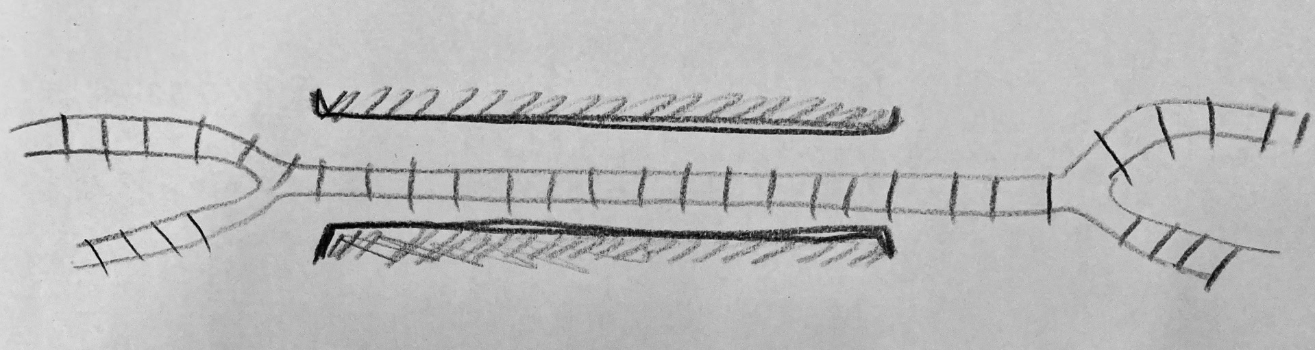
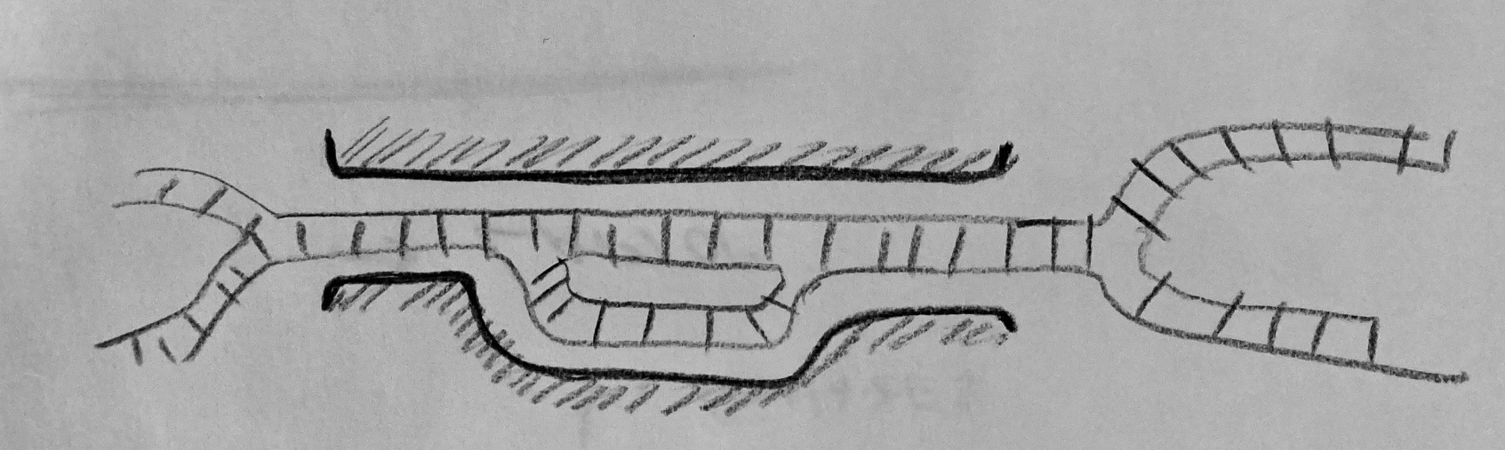
Example: More performance -> more complexity
One rail track in a narrow canyon
Base design: alternate trains
  Low “performance”: low throughput, high delay, low utilization
  Worse than two-track, but cheaper than blasting
Improved design?(increase utilization at low capital cost)
Increase utilization w/ a siding and two trains
  Is a new signaling design needed?
  Precise schedule
  Siding limits train length! (a global effect!)
Cost of increased ‘performance’ is often supra-linear

Slide 19
Summary of examples
Expect surprises!
There is NO small change.
  “Just one more feature!”
10x increase ⇒ perhaps re-design
Performance cost is super-linear

Slide 20
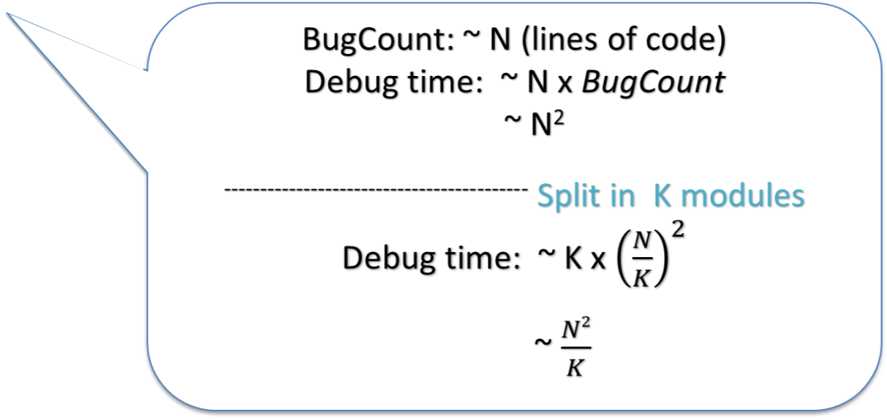
Coping with Complexity
[a lens to view most CPEN courses]
Simplifying insights / experience / principles / successful designs
  E.g., “Avoid excessive generality”
Modularity
  Split up system, consider small pieces separately
Abstraction
  Hide implementation internals / hide usage details. Helps avoiding propagation of changes
Hierarchy
  Reduce connections / regular layouts
Layering
  Gradually build up capabilities
  Reduce connections

Slide 21
Coping with Complexity
[a lens to view all CPEN courses: e.g., CPEN221]
Simplifying insights / experience / principles
  E.g., “Avoid excessive generality”, immutability, design patterns, idioms
Modularity
  Split up system, consider small pieces separately
  Data Types
Abstraction
  Helps avoiding propagation of effects
  Specifications: hide internals of implementation / hide usage details
  Abstract Data Types
Hierarchy
  Reduce connections / regular layouts
  Subtyping, Divide-and-conquer,
Layering
  Gradually build up capabilities
  Reduce connections

Slide 22
Coping with Complexity
[This course: CPEN431]
Simplifying insights / experience / principles
  Theoretical constructs: reasoning about time and event ordering, commit protocols, CAP theorem
  Analyze [successful/failed] designs and building blocks (e.g., end-to-end principle, soft-state, DHTs, epidemic protocols,
  Lots of hands-on experience, define tradeoff space; feeling for what matters
Modularity and abstraction
  Split up system, consider parts separately
  Hide implementation internals / hide usage details
  Technology for remote modules/abstraction: RPC, Protocol Buffers.
  Effects of decomposition with unreliable components/networks
Hierarchy - Reduce connections / regular layouts
Layering
  Reduce connections. Most designs in this space. Cross-layer optimizations.

Slide 23
A1: Server is up. Assignment is due Monday Jan 16th
A2: Server is up. Assignment is due Friday Jan 20th
  Take a look at FAQs (at the bottom of A1/A2 descriptions)
A4: description is up (there is no A3).
  May be useful to start and have an early prototype.

Slide 24
A1: assignment is up. Due Monday Jan 16th
A2: assignment is up. Due Friday Jan 20th
  Same story as in A1 but:
    Protocol Buffers rather than ad-hoc serialization protocol
    Checksums
    Opportunity to rethink you design to separate request/reply layer from application level layer
  Server is up
  Take a look at FAQs (at the bottom of A2 description)
A3 and A4: descriptions are up.
  May be useful to start on A3 and have an early prototype.

