Slide 1
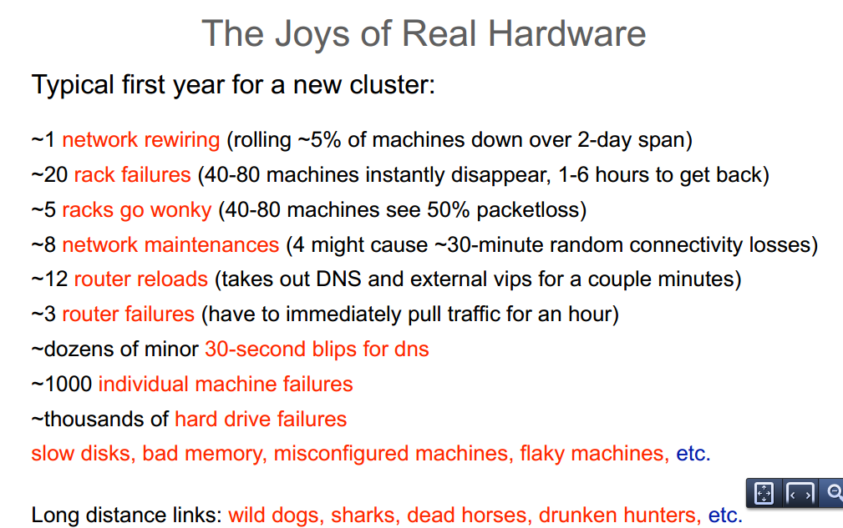
Developing distributed systems: Pitfalls
[aka Peter Deutsch’s “8 fallacies”, cca’95] [1, 2]
The network is reliable [refs: survey, 3, 4]
Latency is zero [verizon monitoring data]
Bandwidth is infinite
Transport cost is zero
The network is secure
The topology does not change
There is one administrator
The network is homogeneous
Note that almost all above are network related!
Your network link: 10Gbps, 100ms RTT, 1KB MSS
Transport protocol: TCP
How long it will take to send an 100KB message?
(a 2x approx. factor is fine)
0.1ms
1.0ms
10.0ms 100.0ms
1,000.ms
Notes:
Queen: Estimating Packet Loss Rate between Arbitrary Internet Hosts
Y. Angela Wang
Cheng Huang
Jin Li
Keith W. Ross
PAM '09 Proceedings of the 10th International Conference on Passive and Active Network Measurement

