Slide 1
What is a Distributed System?
You know you have one …
… when the failure of a computer you’ve never heard of stops you from getting any work done
(L. Lamport, ‘84)

Slide 2
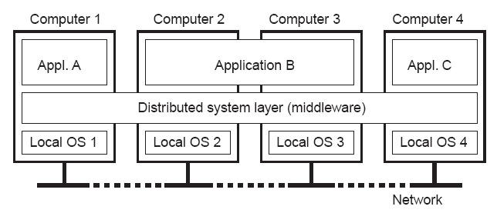
What is a Distributed System?
A collection of independent computers that appears to its users as a single coherent system
1.1
Independent hardware installations
Uniform software layer (middleware)
CPEN431: Design of Distributed Software Applications

Slide 3
Collection of independent components that appears
to its users as a single coherent system
Requirement: Components need to communicate
  Shared memory
  Message exchange (our focus for this course)

Slide 4
[Detour] Message Passing
vs. Shared Memory
Message passing
Why good? All sharing is explicit – less chance for error
Why bad? Overhead
Data copying, across protection domains (context switches)
Shared memory
Why good? Performance
  Data access w/o crossing protection domains
Why bad?
  error prone - things change “behind your back”
  more expensive
Enforced modularity!
CPEN 431: Design of Distributed Software Applications

Slide 5
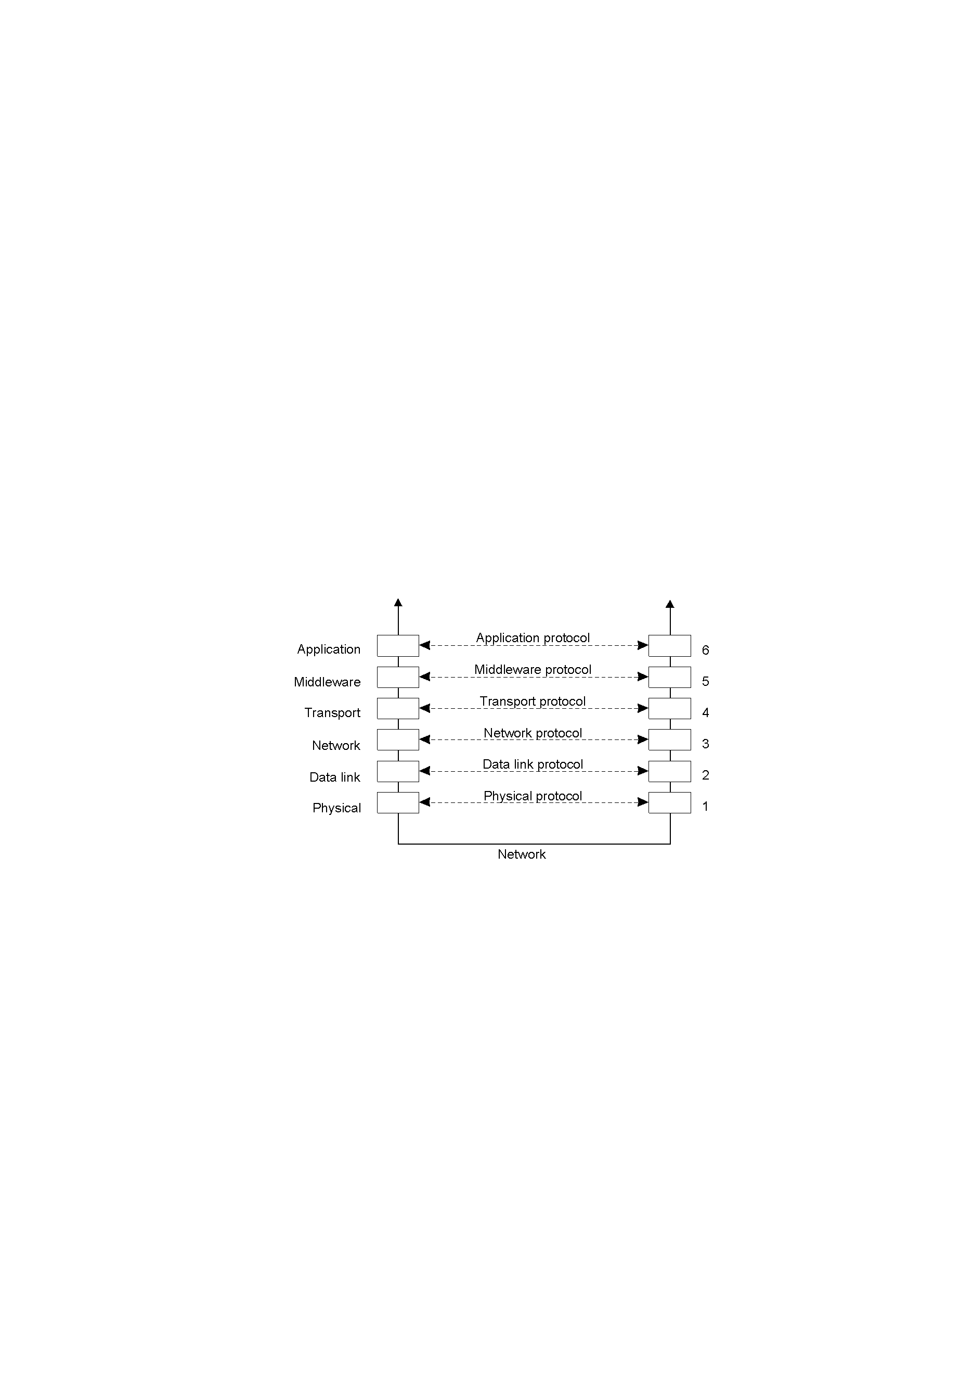
Collection of independent components that appears
to its users as a single coherent system
Requirement: Components need to communicate
  Shared memory
  Message exchange (our focus for this course)
need to agree on many things: Protocols
  how to send/receive data (i.e. what transport to use),
  data formats,
  fault handling,
  naming, …

Slide 6
How does the layered design connect with A1-A4
KVStore Layer
KVStore Protocol
A3, A4
Request/Reply Protocol
Request/Reply
Layer
A1 .. A4
UDP
Lower Network Layers
Wire protocol: A1 ad-hoc serialization, A2→A4 Protocol buffers
Dealing with faults:
  A1, A2 – client side of request reply protocol.
  A3, A4 – server side of request reply protocol
Layer design:
  What does each layer put on the wire?
  Modularity / Abstraction
    (vs. Cross-layer optimizations)
Notes:
Objectives:
Design of a request/reply protocol
At most once semantics
Dealing with failures
Implementation
Play with a layered design
Cross layer
Reasoning / designing with faults
Two generals problem / impossibility of agreement in an asynchronous system

Slide 7
Request-reply Protocol
Client
Server
doOperation
Request
message
getRequest
select object
(wait)
execute
Reply
method
message
sendReply
(continuation)
To design a request/reply protocol need to decide:
  transport protocol: TCP/UDP
  data format for serialization,
  exception handling,
  naming, …
Notes:
Why request reply? Manage complexity – an instantiation of layered design
What’s easy: choice of transport, choice of serialization, implement a first prototype
What’s hard: design for faults, test, get high performance in the presence of faults

Slide 8
Request-reply Protocol
Client
Server
doOperation
Request
message
getRequest
select object
(wait)
execute
Reply
method
message
sendReply
(continuation)
Decide on:
  transport protocol: TCP/UDP?
  data format for serialization: Why? What are the alternatives? …
  fault handling,
  naming, …

Slide 9
Serialization: Protocol Buffers
message SearchRequest {
string query = 1;
int32 page_number = 2;
int32 result_per_page = 3;
}
Properties:
Efficient, binary serialization
Support protocol evolution
  Can add new parameters
  Order in which parameters are specified is not important
  Can skip non-essential parameters
Supports types, which give you compile-time errors!
Supports somewhat complex structures (embedded definitions)
Use:
Pattern: for each new “service” define a message type for its input (the request) and one for its output (the reply) in a .proto file
Used for other things, e.g., serializing data to non-relational databases –backward-compatible features make for nice long-term storage formats
Google uses them *everywhere* (10,000s of proto buf definitions)
CPEN 431: Design of Distributed Software Applications

Slide 10
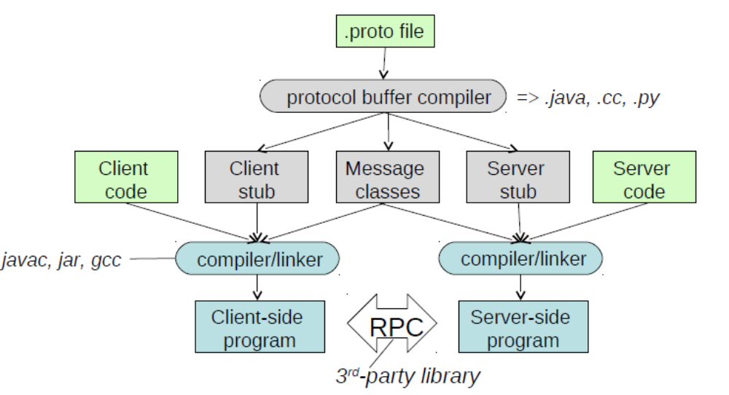
Protocol Buffer Workflow
Request – Reply Comm Library
(3rd party)
Note: Serialization/deserialization only!
Supports service definitions and stub generation …
… but does not come with transport (your own code or libraries for this).
CPEN 431: Design of Distributed Software Applications

Slide 11
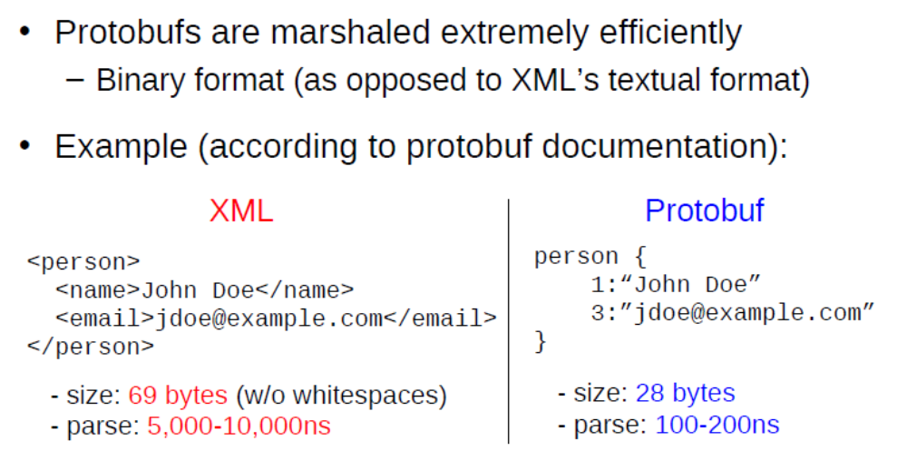
Protobuf vs. Alternatives
Runtime overheads
  parsing speed,
  space
Ease of use
  code maintainability
  debugging cost
Q: What is the trade-off space?
Any drawbacks?
CPEN 431: Design of Distributed Software Applications

Slide 12
Request-reply protocol
Client
Server
doOperation
Request
message
getRequest
select object
(wait)
execute
Reply
method
message
sendReply
(continuation)
Design of a request/reply protocol: many decisions:
  transport protocol: TCP/UDP?
  data format for serialization: Why? Alternatives …
  fault handling,
  naming, …

Slide 13
Key Issue: Dealing with faults
Faults: crash, omission, timing, arbitrary
– some hidden by underlying network layers (e.g., TCP)

Slide 14
Design process in a layered system:
Application layer
(0) Define your goals
Request reply protocol
Request/reply layer
Transport protocol
(1) Decide model for lower layer
Transport layer
  (0) Define your goals: Decide the properties your layer needs to offer
  (1) Decide abstract model for environment (e.g., where does lower layer fail?)
    E.g., communication is lossy, message propagation time is bounded or not, end-point failure mode (e.g., fail-crash, fail-silent)
  (2) Design & implement your layer under the assumed model for underlying layer
  (3) Deploy and test
    possibly iterate to (1): if it turns out assumptions about lower layer were incorrect
    you may need to redefine your goals and iterate back to (0) if it turns out implementation too complex or impossible with the assumptions made
Next slides will take you through this process …

Slide 15
Application layer
(0) Define your goals
Request reply protocol
Request/reply layer
Transport protocol
(1) Decide model for lower layer
Transport layer
Goal: Deliver “reliable” request-reply functionality
  on top of some transport layer that passes messages
  application agnostic (i.e., multiple applications can use it, no assumptions about the application)
For each fault scenario
(0): Further refine the goal: what exactly does “reliable” mean?
(1): Possibly rethink assumptions about the transport layer/environment

Slide 16
Application layer
(0) Define your goals
Request reply protocol
Request/reply layer
Transport protocol
(1) Decide model for lower layer
Transport layer
Goal: Deliver “reliable” request-reply functionality
  on top of some transport layer
  application agnostic
Issue I – messages may be corrupted (Variant A)
(0) Def. “reliable” = when received at destination, message is unaltered
(1) Lower layer model: No message loss. Bounded propagation time. No end-point failure. Random bit flips (with some low probability)
Q: Design a protocol that provides the above definition of ‘reliable’ request/reply communication
Notes:
S

Slide 17
Application layer
(0) Define your goals
Request reply protocol
Request/reply layer
Transport protocol
(1) Decide model for lower layer
Transport layer
Goal: Deliver “reliable” request-reply functionality
  on top of some transport layer
  application agnostic
Issue I – messages may be corrupted (Variant B)
(0) Def. “reliable” = when received at destination, message is unaltered
(1) Lower layer model: No message loss. Bounded propagation time. No end-point failure. Adversary can rewrite packets.
Q: Design a protocol that provides the above definition of ‘reliable’ request/reply communication

Slide 18
Application layer
(0) Define your goals
Request reply protocol
Request/reply layer
Transport protocol
(1) Decide model for lower layer
Transport layer
Goal: Deliver “reliable” request-reply functionality
  on top of some transport layer
  application agnostic
Issue II: Message loss
(0) “reliable” = the request is always delivered to the destination and a reply is always received by sender. Bounded termination time.
(1) Lower layer model: Transport layer has message loss. Message propagation time is bounded. No end-point failures.
Q: Design a protocol that provides the above definition of ‘reliable’ request/reply communication

Slide 19
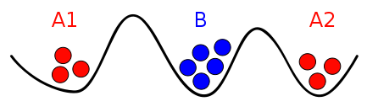
Two Generals Problem
Context
Red generals need to attack at the same time (coordinate) to win the battle.
Coordination is possible only by sending a messenger through the territory controlled by the Blue general (who might capture the messenger)
Task: Design a strategy that guarantees that the Red generals can always coordinate their attack
Takeaway:
No solution that guarantees correctness AND termination

Slide 20
Application layer
(0) Define your goals
Request reply protocol
Request/reply layer
Transport protocol
(1) Decide model for lower layer
Transport layer
Goal: Deliver “reliable” request-reply functionality
  on top of some transport layer
  application agnostic
Issue II: message loss, propagation time,
(0) “reliable” = the request is always delivered to the destination and a reply is always received by sender. Bounded termination time.
(1a) Lower layer model: Transport layer has loss. Message propagation time is bounded. No end-point failures.
(1b) Lower layer model: no message loss, but UNBOUNDED message propagation time and end-point-failures.
IMPOSSIBLE

Slide 21


Application layer
(0) Define your goals
Request reply protocol
Request/reply layer
Transport protocol
(1) Decide model for lower layer
Transport layer
Goal: Deliver “reliable” request-reply functionality
  “reliable” = the request is always delivered to the destination and a reply is always received by sender. Bounded termination time.
Redefine meaning of “reliable” / new semantics
  at-least-once: if protocol completes, the message has been delivered to the destination (at least once). [no bound for termination]
    possible variant: exactly-once
  at-most-once: when the protocol completes (i.e., fixed # of retries), the message has been delivered to the destination at most once.
    If ‘success’: the message has been delivered to the destination (once).
    If ‘failure’: the message may have been delivered to the destination (once)
IMPOSSIBLE

Slide 22
Let’s recap where we are …
Goal: “Reliable” request-reply functionality.
[deals ‘correctly’ with message corruption, duplication, loss, server crashes]
BUT … one can not build a protocol that guarantees both termination AND “reliable” message delivery on top of an unreliable substrate.
As a consequence
  Redefined expectations: ‘reliable’ → at-most-once
Next:
Impact of at-most-once semantics
Implementation
CPEN 431: Design of Distributed Software Applications

Slide 23
W2-Q0:
Request/reply semantics
Can my [correctly implemented] request-reply functionality
at-most-once semantics still lead to surprises for application developers?
Assume I have implemented a key/value store on top of it.
  PUT (key, 100)
  PUT (key, 1)
  val = GET (key)
First two PUT operations succeed.
What value is associated with key (no value associated initially)
Choose: nothing, 0, 1, 100, 99, something else?

Slide 24
W2-Q1:
Request/reply semantics”
Can my [correctly implemented] request-reply functionality
at-most-once semantics still lead to surprises for application developers?
Assume I have implemented a key/value store on top of it.
  PUT (key, 100)
  PUT (key, 1)
  val = GET (key)
First two PUT operations fail.
What value is associated to key (no value associated initially)
Choose: nothing, 0, 1, 100, 99, something else?
Notes:
What if first operation succeeds?

Slide 25
W2-Q2: A counter on top of at-most-once
Assume a counter serving increment and decrement requests correctly implemented over a request-reply protocol with
at-most-once semantics
The protocol used to send 10 requests to increment a counter (initially at 0). All return FAIL.
Select all possible values of the counter at the end of this sequence.
Select from: 0 / 1 / 10 / 20

Slide 26
W2-Q3: A counter on top of at-least-once
Assume a counter serving increment and decrement requests correctly implemented over a request-reply protocol with
at-least-once semantics
The protocol used to send 10 requests to increment a counter (initially at 0). All return SUCCESS.
Select all possible values of the counter at the end of this sequence.
Select from: 0 / 1 / 10 / 20

Slide 27
W2-Q4: Testing
The TA wants to test correctness of your key/value sever developed on top of a request/reply protocol with at-most-once semantics.
The client API (put, get) returns four possible application-level error codes
    0 – success, 1 – timeout , 2 – key is not there, 3 – server error
You are graded based on the following test:
      errCode1 = put (K, V)
      (errCode2, VReturned) = get (K)
      if (errCode1 == SUCCESS and
      errCode2 == SUCCESS and V == VReturned)
      then TEST_PASSED → add points
      else TEST_FAIL → deduct points
Q: Is this correct? Should you complain?

Slide 28
What should be the decision after previous test?
PUT returns GET returns | SUCCESS | TIMEOUT | NO-KEY | FAIL CODE (explicit info that the server has rejected the request)
SUCCESS | PASS (if V == Vreturned)
TIMEOUT
NO-KEY | FAIL
FAIL | FAIL
PASS
(if V == Vreturned)
FAIL
UNDECIDED
UNDECIDED
UNDECIDED
FAIL

Slide 29
Let’s recap where we are …
Goal: “Reliable” request-reply functionality.
[deals ‘correctly’ with message corruption, duplication, loss, server crashes]
BUT … one can not build a protocol that guarantees termination AND reliable message delivery on top of an unreliable substrate.
As a consequence
  Redefined expectations: ‘reliable’ → at-most-once
Next:
Impact of at-most-once semantics
Implementation issues
CPEN 431: Design of Distributed Software Applications

Slide 30
Goal: Deliver at-most-once request-reply functionality
  on top of some transport layer, application agnostic
Implementation issues:
[client side] Fairly simple: retry policy, pairing requests and replies, identify message corruption
[server side] Tricky. Main issue: Caching / filtering
  [Why do you need caching/filtering?]
  Issue 1: What to cache? [i.e., What ‘state’ to maintain to enable filtering?]
  Issue 2: How does one garbage collect the cache? (Eviction Policy)
    Client and server need to agree on retry policy (#retries / timeout)
    Additional assumptions about the underlying transport layer: maximum message propagation time in the network

Slide 31
W3-Q1: Cache sizing
A key-value server is migrated on a faster node. Tests with a wide set of benchmarks show that code runs at least 2x faster
On the original node the server was configured with a 500MB cap on the space to maintain state to deal with duplicate requests (the “cache”). Everything was working fine.
On the new node the same configuration is maintained.
Q: Will the k/v store throughput on the new node double?
Yes, of course – why not?
Nah, this is too optimistic – things never work the way one hopes
Maybe, it depends on …?
CPEN 431: Design of Distributed Software Applications

Slide 32
Goal: Deliver at-most-once request-reply functionality
  on top of some transport layer, application agnostic
Implementation issues:
[client side] Fairly simple: retry policy, pairing requests and replies, identify message corruption
[server side] Tricky. Main issue: Caching / filtering
  [Why do you need caching/filtering?]
  Issue 1: What to cache? [i.e., What ‘state’ to maintain to enable filtering?]
  Issue 2: How does one garbage collect the cache? (Eviction Policy)
    Client and server need to agree on retry policy (#retries / timeout)
    Additional assumptions about the underlying transport layer: maximum message propagation time in the network
  Issue 3: Cache sizing
    Impact on throughput!
Emergent property

Slide 33
Recap main ideas (I)
Design process for layered systems:
  (0) Decide the properties top layer needs to offer
  (1) Decide abstract model for environment (lower layer)
    E.g., communication is lossy, message propagation time is unbounded, end-point failure mode (fail-crash, fail-silent)
  (2) Design solution under the assumed model
  (3) Deploy and test
    possibly iterate to (1) or even redefine your goals and iterate back to (0)
Application layer
(0) Define your goals
Request/reply layer
(1) Decide model for lower layer
Transport layer

Slide 34
Recap main ideas (II)
Observation: One can not build a protocol that guarantees both termination AND “reliable” message delivery on top of an unreliable substrate.
Solution in the context of request-reply functionality:
(re)define semantics or “reliable”: at-most-once
Key ingredients for implementation:
  unique messageIDs, checksums,
  Server side mechanism to deal with client retries (“caching”): (i) messageID to filter out duplicates; (ii) cache reply value to reply to identified duplicate requests that have already been served.
  client and server must coordinate: #retries / retry timeout
  assumption about maximum message propagation time,
Notes:
Implementation alternative:
Coupling client / server → additional messaging …meh
Coordinating clocks

Slide 35
Recap main ideas (III)
Design guidelines:
  (1) where possible design systems based on timeouts rather than explicit message exchange
    CAN NOT guarantee both termination and reliable message delivery anyways
  (2) simpler designs are possible if one can make assumptions about the application (layer above)

Slide 36
A few additional design issues
The design can be simplified if the lower layer can make assumptions about the usage patterns
Breaking the abstraction: Layering vs. cross-layer optimizations
Preserving at-most-once semantics across server crashes
CPEN 431: Design of Distributed Software Applications

Slide 37
A few additional design issues
The design can be simplified if the lower layer can make assumptions about the usage patterns
Layering vs. cross-layer optimizations
Preserving at-most-once semantics across server crashes
CPEN 431: Design of Distributed Software Applications

Slide 38
There are situations where the design may be simpler
Goal so far: Deliver “at-most-once” request-reply functionality
  on top of some transport layer
  application agnostic
Can the design be simplified …
… if server-side is stateless?
  i.e., no state kept at the server across requests
    E.g., here is an integer; give me the next prime number.
  implication: does not care about duplicate requests, server crashes

Slide 39
Warning: Needs careful analysis!
Goal so far: Deliver “at-most-once” request-reply functionality
  on top of some transport layer
  application agnostic
Can the design be simplified …
… if requests are idempotent?
  Idempotent: the result of a successfully performed request is independent of the number of times it is executed. (i.e., same result returned and the same end state).
      Sequence: PUT (key, 1); val2=GET(key); val1=GET(key);

Slide 40
W3-Q2: Idempotent requests
Based on the fact that a key-value store PUT/GET always return the same result (no mater how many retries) you try a simpler implementation for a request/reply layer.
up to 3 retries
at the server: no attempt to identify retries (just re-execution).
Assume a key/value store on top of this request/reply layer
(initially nothing is associated with the 'key' and the following trace)
    PUT (key, 100)
    PUT (key, 1)
    val = GET (key)
Q: All operations succeed. What are the possible values in val?
1 (one) 100 something else nothing
CPEN 431: Design of Distributed Software Applications

Slide 41
Poll: Idempotent requests
You are asked to implement a request-reply protocol specialized for applications that will only have idempotent requests.
Q: Which one of the following is true?
[] You can safely get rid of the component that identifies duplicate requests. There will be no surprises at the application level.
[] Still need to filter out duplicates. (explain why)
CPEN 431: Design of Distributed Software Applications

Slide 42
A few additional design issues
Generally the design can be simplified if the lower layer can make assumptions about the usage patterns
Layering vs. cross-layer optimizations
Preserving at-most-once semantics across server crashes
CPEN 431: Design of Distributed Software Applications

Slide 43
A3 .. A12
KVStore Layer
KVStore Protocol
Request/Reply Protocol
Request/Reply
Layer
Lower Network Layers
Q: Can you come up with a cross-layer optimization that provides some tangible benefit (e.g., performance, efficiency) for your KVS server but still maintain at-most-once semantics?
CPEN 431: Design of Distributed Software Applications

Slide 44
Poll
Your key value store may receive up to 4 GET (re)tries with the same messageID (and, implicitly the same key) within the cache timeout period.
Which implementation would you go for?
(Select one of the following)
Cache the value at the time of the first GET (re)try, and return that same value for all other retries.
Always return the latest value in the KV store at the time of the retry.
CPEN 431: Design of Distributed Software Applications

Slide 45
A few additional design issues
The design can be simplified if the lower layer can make assumptions about the usage patterns
Layering vs. cross-layer optimizations
Preserving at-most-once semantics across server crashes
CPEN 431: Design of Distributed Software Applications

Slide 46
One more server side issue: How to handle server crashes?
Why is this a problem?
Solution 1: Persist all cache transactions. But sloooow!
Solution 2: Once server restarts, delay server does not reply to requests for a period of time T.
  What’s the minimal T that guarantees correctness?
  W3-Q3
Solution 3: Can you design an even better solution?
  Goal: Based on Solution 2, preserve at-most-once semantics and improve server availability (lower wait time to restart), minimal overhead

Slide 47
W2-Q7: At-most-twice semantics ☺
Consider the following trace. All requests calls are synchronous. There is nothing associated with K in the beginning.
PUT (K, 10)
PUT (K, 20)
val = GET (K)
The underlying request/reply protocol over which the key value store was implemented offers a novel "at-most-twice" semantics (claimed to be easier to implement):
Let's be more formal and define at-most-twice semantics as follows: 0, 1 or 2 deliveries may all correct depending on the message loss scenario.
* The request-reply layer guarantees that in all scenarios at most two copies of the request are delivered to the server.
* The client returns TIMEOUT if it can not guarantee that at least one copy of the request has been received (similar to at-most once).
* The client returns SUCCESS if it can guarantee at least one copy of the request has been received.
In the code snippet above all commands return SUCCESS.
What are the possible values in val? (Select all that apply)
□ empty □ 10 □ 20 □ 99
Now-think about “at-least-once” implications
Or exactly-once: How big is the cache then?

Slide 48
Backup slides:
Dealing with failures – for request/reply
Failures: crash, omission, timing, arbitrary
– some hidden by underlying network layers (e.g., TCP)
What can go wrong:
Client cannot locate server
Client request is lost
Server crashes
Server response is lost
Client crashes

Slide 49
Backup slides:
Dealing with failures (1/5)
What can go wrong with RPC:
Client cannot locate server
Client request is lost
Server crashes
Server response is lost
Client crashes
[1:] Client cannot locate server. Relatively simple → just report back to client application

Slide 50
Backup slides:
Dealing with failures: message loss (2/5)
[2, 4:] Client request lost or server reply is lost
Two cases:
Idempotent requests (i.e., server state does not change)
  Just resend. But: how many times?
  Can this lead to reordering visible by the client?
Non-idempotent requests,
  Add request identifiers so that you can repeat invocation
  Leads to more complex mechanism:
    What should the server log? When?
    Now one has to deal with state at the server (the log).
      New issue: how to maintain this state? Log can not grow infinitely
Midterm-like question: sketch a mechanism to deal with lost messages

Slide 51
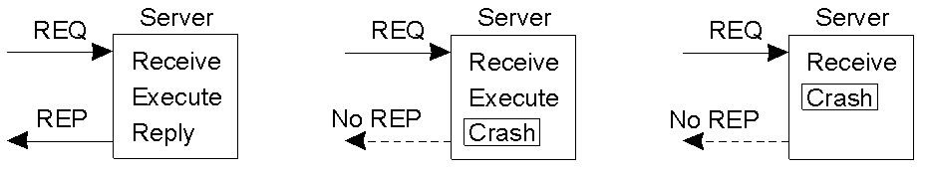
Backup slides:
Dealing with failures: machine crashes
[3] Server crashes
  Same issues as for message loss: client does not know what the server has already done:
  Additional issue: state loss
No-failure
execution
Client can not distinguish between these two
Midterm-like question: sketch a mechanism to deal with server crashes

Slide 52
Backup slides:
Dealing with failures: node failures
[5:] Client crashes → Issue: The server is doing work and holding resources for nothing (orphan computation).
Possible solutions:
[expiration] Require computations to complete in a T time units. Old ones are simply removed.
[orphan extermination] Orphan is killed by client when it reboots

