Slide 1
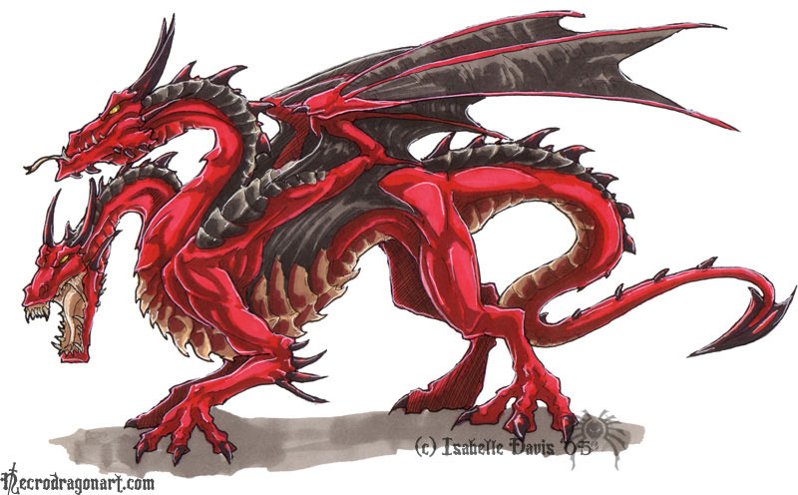
Managing complexity: the key difficulty in (computer) system building
Tools to cope with complexity
Simplifying insights / experience / successful designs
Modularity
  Split up system, consider small pieces separately
Abstraction
  Hide implementation internals / hide usage details.
Hierarchy -- Reduce connections / regular layouts
Layering -- Gradually build up capabilities. Reduce connections
Notes:
Modularity: Breaks the "big problem" into smaller, more manageable pieces, which are easier to change without affecting other modules.
Abstraction: Aims to give these pieces nice "inter-piece" boundaries, meaning that the pieces function with few to no assumptions about the functionality of other modules.
These two techniques go hand-in-hand; if the interface between modules does not function well (modularity without abstraction), the effect of having modularity at all becomes less convenient to the programmer than the lack of modularity.

Slide 2
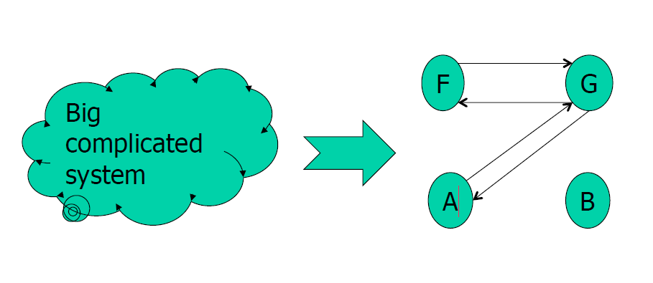
A modularity tool: the procedure call

Slide 3
Procedures as modules
What is private and what is shared between procedures?
  Local variables are private
  Stack, heap, global variables are shared
Module 1
Module 2
Code
Code
Private
state
Shared
state
Private
state

Slide 4
Procedures as modules
How is control transferred between procedures?
  Caller adds arguments and RA to stack, jumps into callee code
  Callee sets up local variables, runs code, jumps to RA
Module 1
Module 2
Code
Code
Private
state
Shared
state
Private
state

Slide 5
Procedures as modules
Is modularity between procedures enforced?
  No, either module can corrupt the other
  No guarantee that callee will return to caller either
    callee may crash (and crash the application – aka “fate sharing” or hang)
Module 1
Module 2
Code
Code
Private
state
Shared
state
Private
state
Soft modularity!

Slide 6
Can we do better?
  enforce modularity by (among various options)
  deploying on different machines, and
  making communication explicit through messages
Module 1
Module 2
Code
Code
Private
state
Private
state
  Do we still have the same problems?
  Can either module corrupt the other?
  Can guarantee that caller will eventually continue?
    (regardless of what calle does (e.g., hang, crash)
Notes:
Think of other ways to enforce modularity

Slide 7
[Another way to think about RPCs]
The process of building a distributed application
Design from scratch
Communication-oriented design
  Start with communication protocol;
    Design message format and syntax
  Design components (clients, servers) by specifying how they react to incoming messages
Where it gets hard
  Protocol design problems
  Complexity: specify components as finite state machines
  Focus on communication instead of on the application
Design based on existing single-box application
Application-oriented design
  Start with application
    Design, build, test conventional (single-box) application
  Partition your application using middleware support [e.g.RPC]
Where it gets hard
  Preserving semantics when partitioning program (using remote resources)
  Masking failures
  Concurrency
  Remote Procedure Calls (RPC) and Java Remote Method Invocation (RMI) are meant to offer support with this approach
Notes:
Logical view vs. design view
(or start with a class diagram or a state diagram)

Slide 8
So far:
Procedure Calls: an [imperfect] tool for modularity
  “soft modularity” – contract not enforced
Enforced/hard modularity: enforce the contract
  E.g., separate caller and callee on different machines
    One could build using request/reply only … but impractical (compared to procedure)
Next: Remote Procedure Calls:
Make calling a procedure hosted remotely similar to calling a local procedure
Enforced modularity + transparency
Notes:
Contract not enforced:
One module corrupt the other?
Does not guarantee that caller will eventually continue? (regardless of what calle does (e.g., hang, crash)
fate sharing

Slide 9
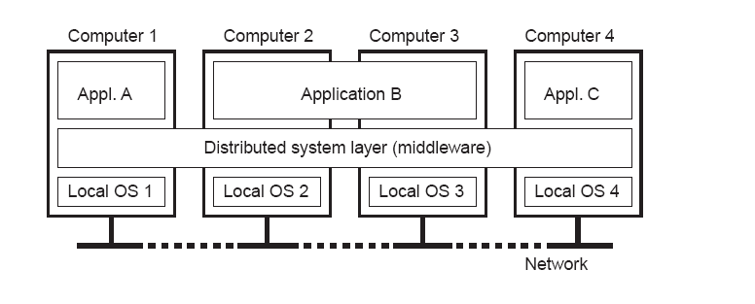
Distributed System: A collection of independent computers that appears to its users as a single coherent system
Independent hardware installations
Uniform software layer (middleware)
1.1
Key goals
Connect users and resources
Distribution transparency
Openness
Scalability

Slide 10
Goal II: Transparency
Dimension | Description
Access | Hide differences in data representation and resource access
Location | Hide where a resource is located
Migration | Hide that a resource may move to another location
Relocation | Hide that a resource may migrate while in use
Replication | Hide that a resource may have multiple copies
Concurrency | Hide that a resource may be shared by several competing users
Failure | Hide the failure and recovery of a resource
Note: transparency may be set as a goal, but achieving it is a different story.

Slide 11
Today
Transparency …
  implementation mechanisms, limitations
… in a specific context Remote Procedure Calls

Slide 12
Remote Procedure Calls (RPC)
Goal: Make calling a procedure hosted remotely similar to calling a local procedure
  Info is passed as messages in procedure arguments and results
Key issue: Provide transparency
  (access transparency) mask differences in data representation
  (location, failure transparency) handle failures
  (location transparency) handle different address spaces
  (provide migration transparency, replication transparency)
  Security!
The context is important! The implementation details are specific to the programming language
Notes:
Network I/O is awkward
It isn't the usual abstraction we use for inter-module interfaces
We use function call instead
Well supported by languages
Can we extend this idea to cross-network inter-module interfaces?

Slide 13
Outline
Mechanics.
  How does it actually work …
  … and limitations
RPC in practice.
  Case study: The Network File System

Slide 14
RPC makes request/response ‘look’ local
  Provides the illusion of a function call
RPC isn’t a really a function call
  In a normal call, the PC jumps to the function
  Function then jumps back to caller
This is similar to request/response though
  Stream of control goes from client to server
  And then returns back to the client

Slide 15
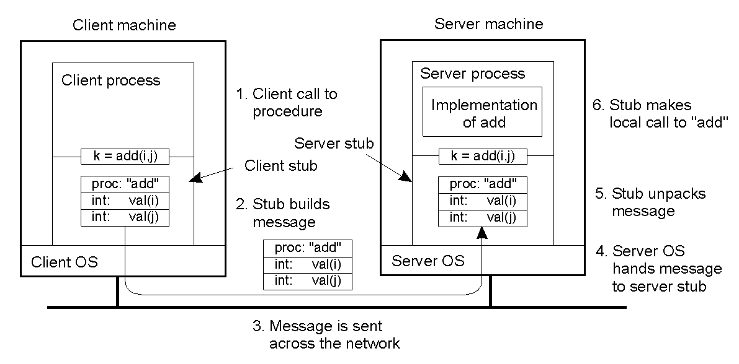
Note: parameters/result are passed by value
2-8

Slide 16
RPC architecture
Client
Server
User (unmodified) code
Client code
Server
code
Interface
Interface
Generated code to map user defined functions to generic runtime
Client
stub
Server
stub
RPC
runtime
RPC
runtime
Thread control
Request/reply protocol
Serialization (e.g., ProtocolBuffers)
Network

Slide 17
How is everything we’ve looks at so far relevant?
Request/reply protocol
  Two generals: discussion about impossibility to guarantee agreement
    All the discussion about call semantics (e.g., at-most-once semantics)
    Design discussion around handling network faults and server crashes
      Retries
Common wire protocol
CPEN 431: Design of Distributed Software Applications

Slide 18
RPC architecture
Client
Server
Client code
Server
code
Import
Export
Interface
Interface
Export
Client
stub
Server
stub
Import
Network
RPC
runtime
RPC
runtime
Who imports and who exports the interface?

Slide 19
RPC architecture
Client
Server
Client code
Server
code
Import
Export
Interface
Interface
Export
Client
stub
Server
stub
Import
Network
RPC
runtime
RPC
runtime
Who defines the interface?
The programmer

Slide 20
RPC architecture
Client
Server
Client code
Server
code
Import
Export
Interface
Interface
Export
Client
stub
Server
stub
Import
Network
RPC
runtime
RPC
runtime
Who writes the client and server code?
The programmer

Slide 21
RPC architecture
Client
Server
Client code
Server
code
Import
Export
Interface
Interface
Export
Client
stub
Server
stub
Import
Network
RPC
runtime
RPC
runtime
Who writes the stub code?
An automated stub generator (rmic in Java)

Slide 22
RPC architecture
Client
Server
Client code
Server
code
Import
Export
Interface
Interface
Export
Client
stub
Server
stub
Import
Network
RPC
runtime
RPC
runtime
Why can stub code be generated automatically?
Interface precisely defines
what data comes in, what is returned

Slide 23
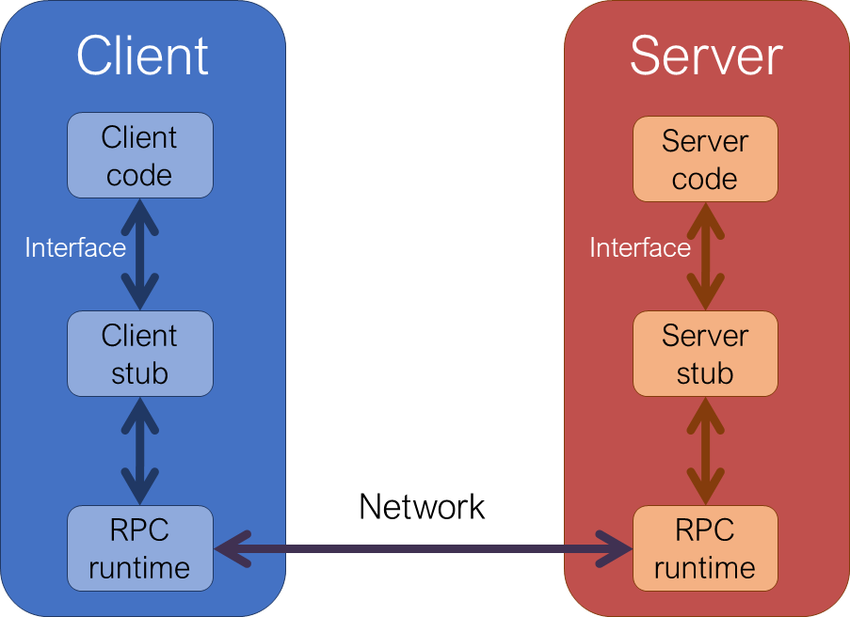
RPC stub functions
Client stub
  1) Builds request message with server function name and parameters
  2) Sends request message to server stub
    Transfer control to server stub: clients-side code is paused
  8) Receives response message from server stub
  9) Returns response value to client
Server stub
  3) Receives request message
  4) Calls the right server function with the specified parameters
  5) Waits for the server function to return
  6) Builds a response message with the return value
  7) Sends response message to client stub

Slide 24
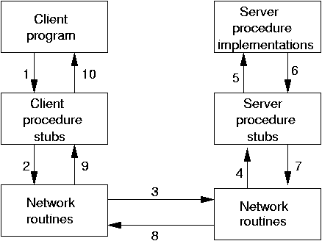
Steps of a Remote Procedure Call.
Client procedure calls client stub in normal way
Client stub builds message calls local OS
Client's OS sends message to remote OS
Remote OS gives message to server stub
Server stub unpacks parameters, calls server
Server does work, returns result to the stub
Server stub packs it in message, calls local OS
Server's OS sends message to client's OS
Client's OS gives message to client stub
Stub unpacks result, returns to client

Slide 25
RPC mechanics
Objective: developer concentrates
only the client- and server-specific code;
  the RPC ‘system’ (i.e., code generators and libraries) does the rest.
Components of an RPC system
Standards for wire format of RPC msgs and data types. (e.g. Sun’s XDR)
Library of routines to marshal / unmarshal data.
Stub generator (aka “RPC compiler”) to produce "stubs".
  For client: marshal arguments, call, wait, unmarshal reply.
  For server: unmarshal arguments, call real fn, marshal reply.
Server framework: Dispatch each call message to correct server stub, thread management, etc
Client framework: Give each reply to the correct waiting thread.
Binding mechanisms: how does the client find the right server?
Q: Poll: Where would Google’s Protocol Buffers fit above?

Slide 26
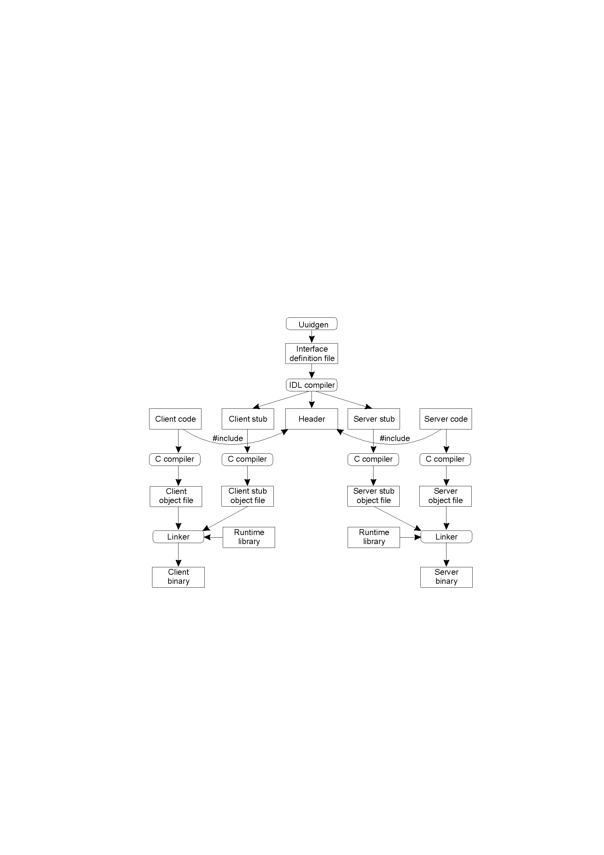
RPC in practice: Writing a Client and a Server
2-14
The steps in writing a client and a server in DCE RPC.

Slide 27
Outline
Mechanics. How does it actually work …
  … and limitations
Discussion: do we achieve transparency?
  Generic RPC framework
  Case study: The Network File System

Slide 28
Issue (I):
Does RPC achieve transparency?
Yes:
Hides wire format and marshal / unmarshal leg-work.
Hides details of send / receive APIs
Hides details of transport protocol (TCP vs. UDP)
Hides who the client is.
No:
Latency, performance impact may be visible
[Depending on the language one aims to support …] Limits on what data can be passed using RPCs. (example in next slide)
  Typing info needed.
  Breaks if context is wider than arguments (e.g., lobal variables, pointers)
Concurrency
Failures

Slide 29
You are to implement the RPC support for C.
C language has a construct called union where the same memory location can hold one of several alternative data types.
Example: The following piece of code declares a new union type union_def. Variables of this type can hold either one of an integer, a float or a character. Then in the variable is assigned a float then an integer.
    union union_def { int a; float b; char c;} ; // define the type
    union union_def union_var; // define the variable
    union_var.b=99.99; or // initialize the variable
    union_var.a=34;
Can your RPC implementation transparently support ‘union’ type? Explain your answer.
Notes:
Key issue: static analysis can not guarantee how a union passed as an argument will be used inside a procedure.

Slide 30
Issues (II):
Should the IDL* break transparency?
Original take (Sun RPC): attempt to provide total transparency
Today (JavaRMI): same interface but force programmer to handle exceptions for remote calls
  … the programmer has to acknowledge (s)he is making a remote call
  Separate network errors from errors in the server code.
*IDL = interface definition language

Slide 31
Outline
Mechanics. How does it actually work …
  … and limitations
War stories: Does one achieve transparency?
  Case study: The Network File System

Slide 32
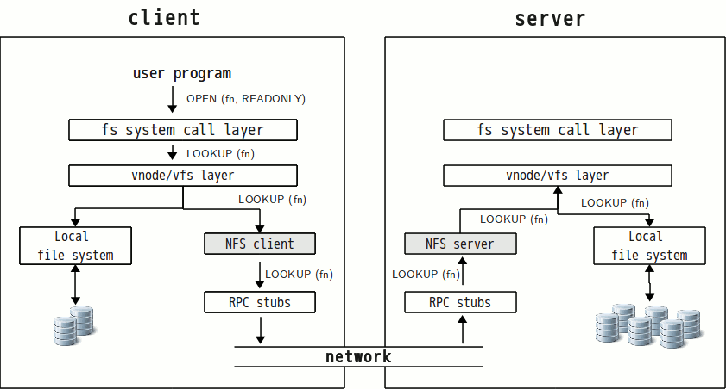
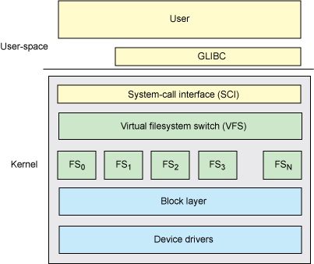
Case study: Network File System (NFS)
What does the RPC split up in this case?
  app calls, syscalls, kernel file system, local disk?
Is transparency preserved?
Syntactic level: yes
Semantic level: not really
Not enough to preserve just the API. System calls must mean the same thing.
    Otherwise existing programs may compile and run but not be correct.
Notes:
RemoteCall: In kernel, just below syscall interface. "vnode" layer.

Slide 33
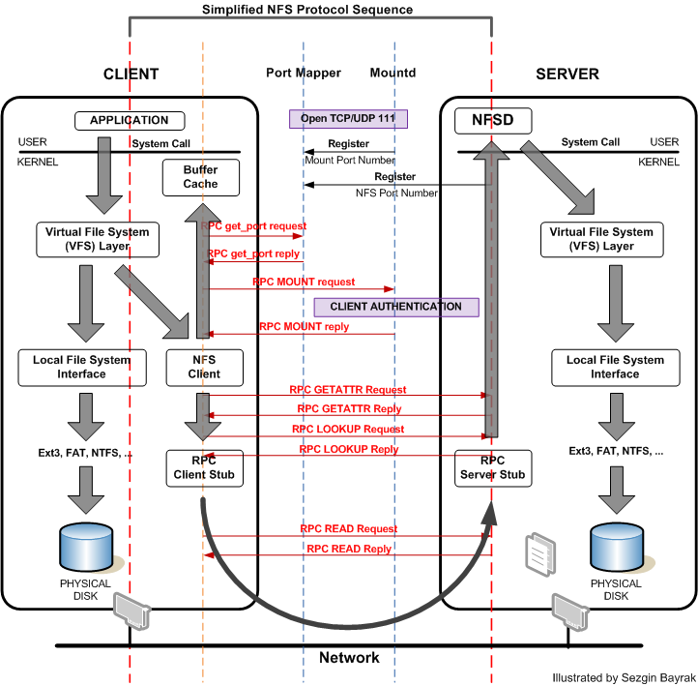

CPEN 431: Design of Distributed Software Applications

Slide 34
Does NFS preserve the semantics of file system operations?
New semantics: Open() system call:
  Originally (i.e., no RPC), open() only failed if file didn't exist
  Now open (and all others) can fail for other reasons (e.g., if server has died, network is down).
    Obs: Apps have to know to retry or fail gracefully.
    Obs: Think of process coordination through FS
  This is fundamental, not an NFS quirk.

Slide 35
NSF: New Semantics (II)
New semantics: close() system call
Originally client only waits for disk in write()
  close() never returned an error for local file system.
Now: close() might fail if server disk out of space.
  So apps have to check close() for ‘out-of-space’ errors
    as well as write().
  Why? Caused by additional optimizations: NFS trying to hide latency by batching.
    Side effect of async write RPCs in client, for efficiency.
    They could have made write() synchronous (and much slower!).

Slide 36
NSF: New Semantics … (III)
New semantics: deletion of open files
Scenario: I open a file for reading. Some other process deletes it while I have it open.
Old behavior:
  my reads still work!
New behavior: my reads fail.
  Side-effect of NFS's statelessness.
    NFS server does not remembers all operations it has performed for each specific client.
How would one attempt to fix this?

Slide 37
NSF: New Semantics examples … (IV)
Scenario:
  rename("a", "b")
  Suppose server performs rename, crashes before sending reply.
NFS client re-sends rename(). But now "a" doesn't exist
  (NFSv2: retries not identified) produces an error. This never used to happen.
  v3 and after – mechanisms to identify retries

Slide 38
NFS: security
Security is totally different
On local system: UNIX enforces read/write protections: Can't read my files w/o my password
On [older versions of] NFS: Server believes whatever UID appears in NFS request
  Anyone on the with network access can put whatever they like in the request
Why aren't NFS servers ridiculously vulnerable?
  Hard to guess correct file handles.
  This is fixable (SFS, AFS, even some NFS variants do it)
    Require clients to authenticate themselves cryptographically.
      Hard to reconcile with statelessness.

Slide 39
RPC / NFS case-study summary
Areas of RPC non-transparency
1. Partial failure, network failure
2. Latency
3. Efficiency/semantics tradeoff
4. Security. You can rarely deal with it transparently.
5. Pointers. Write-sharing.
6. Concurrency (if multiple clients)
However, it turns out none of these issues prevented NFS from being useful.
  People fix their programs to handle new semantics.
  … install firewalls for security.
  And get most advantages of ‘transparent’ client/server.

Slide 40
Design stories
Environment: Unreliable communication, nodes may crash
Context1 – (generic) RPC / network file system stories
  Takeaway: not 100% ‘transparent’. Pay attention to semantics
Context2 – (specialization) Distributed garbage collection
  Keep track of number of active [remote] references to an object (reference counting style)
  Take away: Light-weight solutions are possible in certain cases.
Context3: one-to-many communication
Environment: Unreliable communication, nodes may crash
CPEN 431: Design of Distributed Software Applications

Slide 41
Goal: Keep track of number of active ‘users’ of a [remote] entity
We’ve seen [somewhat similar] versions of this problem already
  [NFS] How many remote clients have this file open?
  [Request/Reply Protocol] Is the client done with ‘this’ request?
  [new context: garbage collection for a distributed object oriented language] How many remote clients have a reference to this object?
Questions to consider:
How will creating the remote object and a reference to it work?
How will passing a remote reference work?
  P¹ attempts to pass to P² a remote reference to O
What happens if a client crashes (while holding a remote reference)
Solution 0: Mark and Sweep? (Non-Distributed GC)
Solution 1: Increment/Decrement on top of a request/reply protocol

Slide 42
Solution 1: Increment/Decrement on top of a request/reply protocol
Overview
  Reference Counting
Questions to consider:
How will creating the remote object and a reference to it work?
  Create object on remote server. Creation method returns reference.
How will passing a remote reference work?
  P¹ attempts to pass to P² a remote reference to O
What happens if the client crashes (while holding a remote reference)
  Handling network / client / server failures?

Slide 43
W4-Q2: GC on top of increment/decrement RPC
Assume you implement a reference counting garbage collection mechanism on top of an increment/decrement RPC.
Further assume the following fault scenarios: the network can lose packets, and nodes on which client code is deployed may fail. However, the nodes on which the remote objects are deployed will never fail (e.g., they use some form of hardware redundancy). [assuming, of course, a correct implementation]
Q1: Are there scenarios that lead to a resource leak (i.e., objects are never used anymore but they are never collected)?
□ Q1: YES - resource leak is possible
□ Q1: NO - no resource leak possible
Q2: Are there scenarios where the system will behave incorrectly: the garbage collection mechanism will inadvertently collect an object to which there are still active clients holding references
□ Q2: YES - the system may inadvertently garbage collect live objects
□ Q2: NO - the system will never collect objects that are live

Slide 44
Goal: Keep track of number of active ‘users’ of a [remote] entity
[context: garbage collection for a distributed object oriented language]
  How many remote clients have a reference to this object?
Questions to consider:
How will creating the remote object and a reference to it work?
How will passing a remote reference work?
  P¹ attempts to pass to P² a remote reference to O
What happens if the client crashes (while holding a remote reference)
Solution 0: Mark and Sweep? (Non-Distributed GC)
Solution 1: Increment/Decrement on top of a request/reply protocol
Solution 2: Reference Listing

Slide 45
Solution 2:
Reference Listing (Java RMI’s solution)
Overview
  Object ‘stub’ maintains a list of remote clients
  Each remote client regularly sends a reminder ‘I’m alive!’
  ‘stub’ deletes entry from list if it’s not refreshed for a certain time
Questions to consider:
How will creating the remote object and a reference to it work?
  Create object on remote server. Creation method returns reference.
How will passing a remote reference work?
  P¹ attempts to pass to P² a remote reference to O
What happens if the client crashes (while holding a remote reference)
  Handling network / client / server failures?

Slide 46
W4-Q3: GC on top of reference listing
Assume you implement a reference counting garbage collection mechanism on top of reference listing
Assume the following failure scenarios: (i) the network can lose packets, and (ii) nodes on which client code is deployed may fail.
Q1: Are there scenarios that lead to a resource leak (i.e., objects are never used anymore but they are never collected)?
□ Q1: YES - resource leak is possible
□ Q1: NO - no resource leak possible
Q2: Are there scenarios where the system will behave incorrectly: i.e., the garbage collection mechanism will inadvertently collect an object to which there are still active clients holding references
□ Q2: YES - the system may inadvertently garbage collect live objects
□ Q2: NO - the system will never collect objects that are live

Slide 47
Reference Listing (Java RMI’s solution)
Advantages:
  Simple protocol
  Client failures handled gracefully. No explicit client failure detection
Drawbacks
  overheads/scalability – the list of client proxies can grow large
  unannounced client failures may lead to temporary resource leak
  possible early garbage collection if network partitions
No need to detect duplicates. Why does this work?
  List entry ‘refresh’ operations only.
  ‘Refresh’ operations are idempotent (i.e., duplicate operations have no effect)
    … and (in this case) relative ordering is not important.

Slide 48
A larger category:
‘Soft-state’ mechanisms or Leases
Mechanism: (soft-state / leases)
  Client holding a “lease” regularly sends lease renewal message to server
  Server keep list of lease holders and associated timeouts. Deletes if no update.
The Alternative: explicit state management
Advantages:
(1) Decouples state producer and consumer
No explicit state removal messages
No explicit failure detection (of consumer)
Simpler server fail-over
Consequence: ‘Eventual’ state
(2) Lightweight. Fairly easy to tune
ContinueToUseRemoteRef
Client
Remote Object
RPC: Increment
RPC: Decrement
Client
Remote Object
There are a number of hybrid possibilities that combine the two
A full analysis: A Comparison of Hard­state and Soft­state Signaling Protocols, Ping Ji et al., SIGCOMM 2003
Notes:
Generally in soft-state mechanisms a state producer sends its state to one or more receivers over a (lossy) communication channel. Receivers maintain copies of this state together with associated timeouts. State is deleted if not refreshed within a timeout interval. This mechanism is used in a number of Internet (RSVP Resource Reservation Protocol, RIP Routing Information Protocol) and Grid protocols (MDS-2) and works well in practice.
Soft-state mechanisms have two main advantages:
Decouples state producer from consumers -- no explicit failure detection and state removal messages. As information introduced by failed nodes is eventually eliminated through timeouts, there is no need for explicit failure detection and state removal. Similarly, new nodes do not set-up an explicit state-gathering protocol when joining;
‘Eventual’ state. state simply flows through the network and a long-lived node eventually collects all available state. (One could argue that making full state available only in time creates an incentive for nodes to participate longer in the system).
Adaptiveness. Traditionally, soft state systems have used fixed, empirically determined timeouts. However, state producers can also obey more complex policies that save network bandwidth (e.g. “generate an update each hour and each time the set of files stored locally has changed by 10%, but make sure not to employ more than 1% of the available network bandwidth”). In this case, receivers have to estimate timeouts dynamically [32]. In order to further reduce generated network traffic the soft-state mechanism could combine full state announcements with incremental updates.

Slide 49
Design stories
Context1 – generic: RPC / network file system (NFS) stories
  Takeaway: not 100% ‘transparent’. Pay attention to deviations in semantics
Context2 – specialization: distributed garbage collection
  Keep track of number of active [remote] references to an object (reference counting style)
  Take away: Light-weight solutions are possible in certain cases.
Context3: one-to-many communication
Environment: Unreliable communication, nodes may crash
CPEN 431: Design of Distributed Software Applications

