Slide 1
Amazon S3 incident July 20th, 2008
S3 service: Provides a simple web services interface to store and retrieve any amount of data.
Intent: highly scalable, reliable, fast, inexpensive storage infrastructure…
Scale:
  Large number of customers. Amazon itself uses S3.
  Lots of objects stored
    4billion Q4’06 → 40B Q4’08 → 100B Q2’10 → 2 trillion Q2’13
SLA guarantees 99.9% monthly uptime
  Less than 43 minutes of downtime per month

Slide 2
Amazon S3 incident on Sunday, July 20th, 2008
8:40am PDT: error rates began to quickly climb
10 min: error rates significantly elevated and very few requests complete successfully
15 min: Multiple engineers investigating the issue. Alarms pointed at problems within the systems and across multiple data centers.
  Trying to restore system health by reducing system load in several stages. No impact.

Slide 3
Amazon S3 incident on Sunday, July 20th, 2008
1h01min: engineers detect that servers within Amazon S3 service have problems communicating with each other
  Amazon S3 uses an epidemic protocol to spread servers’ state info in order to quickly route around failed or unreachable servers
  Engineers determine that a large number of servers were spending almost all of their time in the epidemic protocol
1h52min: unable to determine and solve the problem, they decide to shut down ALL components, clear the system's state, and then reactivate the request processing components.
Restart the system!

Slide 4
Amazon S3 incident on Sunday, July 20th, 2008
2h29min: the system's state cleared
5h49min: internal communication restored and began reactivating request processing components in the US and EU.
7h37min: EU was up correctly, and US location began to process requests successfully.
8h33min: Request rates and error rates had returned to normal in US.

Slide 5
Post-event investigation
Message corruption was the cause of the server-to-server communication problems
A few messages on Sunday morning had a single bit corrupted
MD5 checksums were generally used in the system, but Amazon did not apply them to detect errors in this particular internal state
The corruption spread wrong state throughout the system, and led to increased system load

Slide 6
Amazon’s the report for the incident http://status.aws.amazon.com/s3-20080720.html
Current status for Amazon services http://status.aws.amazon.com/

Slide 7
Lessons: Preventing a similar incident
Verify message and state correctness – all kind of corruption errors may occur
  Add checksums to detect corruption of system state and messages where possible
  Verify invariants before processing state
Engineer protocols to control the amount of traffic they generate.
  Add rate limiters.
  Put additional monitoring and alarming for gossip rates
An emergency procedure to restore clear state in your system may be the solution of last resort. Make it work quickly.
You get a big hammer … use it wisely!

Slide 9
Design stories
Context1 – generic: RPC / network file system (NFS) stories
  Takeaway: not 100% ‘transparent’. Pay attention to deviations in semantics
Context2 – specialization: distributed garbage collection
  Keep track of active [remote] references to an object
  (reference lising style)
  Take away: Light-weight solutions are possible in certain cases.
Context3: one-to-many communication
Environment: Unreliable communication, nodes may crash
ACK: some of these slides contain material developed by Indranil Gupta (UIUC).

Slide 10
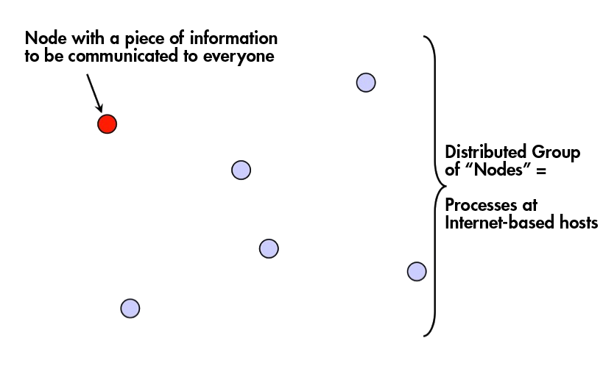

Slide 11
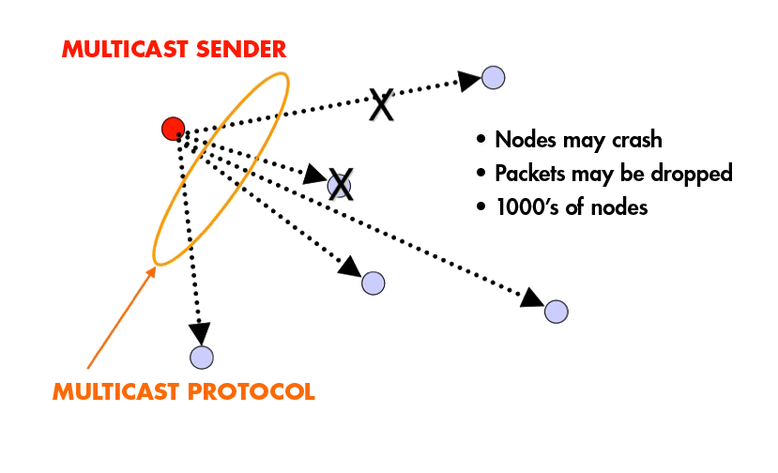
What’s success?
Reliability (100% delivery ideally)
Latency
Overheads
…

Slide 12
Multicast: IP-based vs. overlay
Overlay
IP Multicast
MIT1
MIT1
Chicago
Chicago
MIT2
MIT2
UBC
UBC
end systems
overlay tunnels
end systems routers
IP multicast flow
Calgary
Calgary
Two categories of solutions:
  Based on support from the network: IP-multicast
    Issues: limited WAN-level deployment, scaling, dealing with message loss,
  Without IP-layer support: application-layer
    Issues: Overheads, dealing with dynamicity (nodes leaving / joining)
    Depending on structure: Tree-based, Epidemic

Slide 13
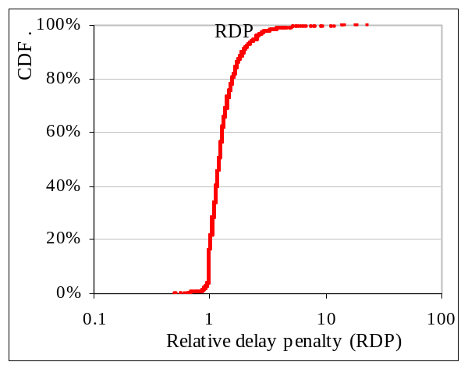
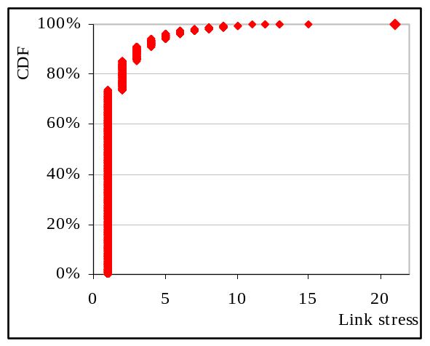
Application-level multicast success metrics:
Relative Delay Penalty and Link Stress
  Relative Delay Penalty (RDP): Overlay-delay vs. IP-delay
  Link Stress: number of duplicate packets on each physical link
Chicago
MIT1
Chicago
MIT1
UBC
MIT2
UBC
MIT2
Calg1
Calg1
IP Multicast
Overlay
Calg2
Calg2
Relative delay penalty distribution
Link stress distribution
90%-tile RDP
Maximum link stress
Notes:
So, how do I evaluate success of these overlays:
One first set of metrics evaluates the overheads compared to an ‘ideal’ solution which is IP-layer multicast.
It is important to note here that since these metrics compare with the an idealized performance linked to the physical topology

Slide 14
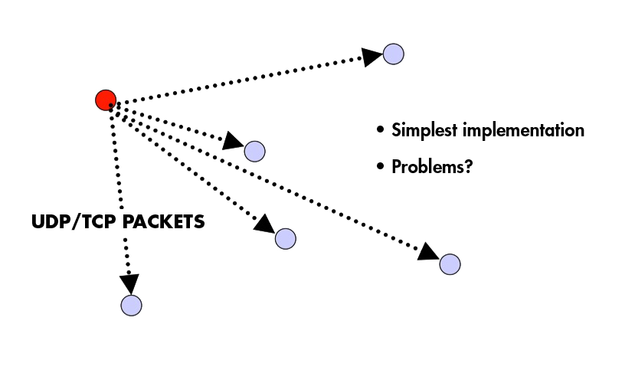
Possible solution: Centralized

Slide 15
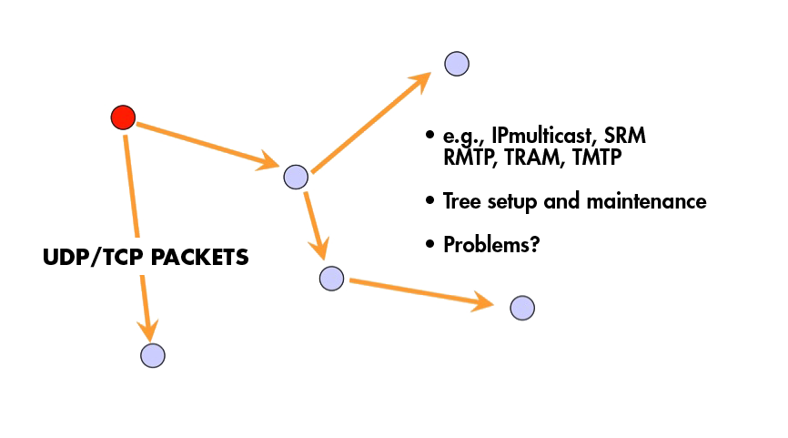
Possible solutions:
Tree-Based
Build a spanning tree among processes in the multicast group
  Use it to disseminate packets
Use ACKs to repair multicasts not received
  or negative ACKs (NAKs)
SRM (Scalable Reliable Multicast)
  Uses NAKs, but adds random delays, and uses exponential backoff to avoid NAK storms
RMTP (Reliable Multicast Transport Protocol)
  Uses ACKs, sent to designated receivers, which then re-transmit missing multicasts
These protocols may still cause an O(N) ACK/NAK overhead [Birman99]

Slide 16
Possible solutions:
Epidemic
Goal:
  Propagate data from one initial data source (node) to all participants
  [Assumption: if multiple sources, there are no write–write conflicts]
Context: makes sense to use this solution if
  (relatively) frequent node failures and/or message loss
    thus no coordinator is feasible, fixed tree structure costly
  message propagation can be ‘lazy’,
    i.e., solution does not require ‘immediate’ propagation

Slide 17
Language used: borrowed from epidemiology
An epidemic protocol
Node that has new state to spread:
infected / contaminated
Node that has not yet received the new state: susceptible
/not contaminated

Slide 28
Advantages of epidemic techniques
Asynchronous communication pattern.
  Operate in a 'fire-and -forget' mode, where, even if the initial sender fails, surviving nodes will receive the update.
Robust with respect to message loss & node failures.
  Once a message has been received by a few other nodes it is almost impossible to prevent the spread of the information through the system.
Autonomous actions.
  Nodes take actions based on the data received without the need for additional communication to reach agreement with partners; nodes can take decisions autonomously.
Probabilistic model yet rigorous mathematical underpinnings.
  Good framework for reasoning about the spread of information through a system over time.
No central coordinator!

Slide 29

Cautionary tale

Slide 30
Summary so far
Supporting: 1-to-N communication
  Limited deployment for IP-level support
  Can be implemented adequately at the application level
Tree-based multicast protocols
When concerned about scale and fault-tolerance, epidemic-style protocols are an attractive solution
  Fast, reliable, fault-tolerant, scalable

Slide 32
Key issues:
Who participates (initiates) in each round? (contaminated nodes / non-contaminated / both?)
When to stop?
Anti-entropy epidemic protocols:
  Algorithm works in ‘phases’
    Each node regularly chooses another node (or small subset) at random
      state gets updated (passed single direction or both directions)
  Termination: #phases
[Variation] Gossiping:
  No ‘phases’. A node which has just been updated (has been contaminated), tells a number of other nodes about its update (contaminating them as well)
  Termination: each node decides independently

Slide 33

Anti-entropy Protocols
Directionality: Push / Pull / Hybrid
“Push” protocol: ‘contaminated’ nodes initiate exchange
  IF ‘contaminated’ (e.g., have a new message) THEN start passing ‘infection’
“Pull” protocol: ‘susceptible’ nodes initate
  IF NOT ‘contaminated’ THEN
    contact other node at random
    IF contacted node is ‘infected’ THEN epidemic is transmitted
Hybrid variant: Push-Pull: everyone
Push
Pull
Infection
Infection
Susceptible (clean) node
Contaminated node

Slide 34
Performance and reliability analysis
Claim: the simple PUSH protocol
Is lightweight in large groups
Is fast: spreads a multicast quickly
Is highly fault-tolerant

Slide 35
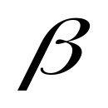
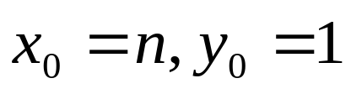
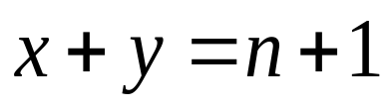
Analysis
Population of (n+1) individuals mixing homogeneously
Contact rate between any individual pair:
At any time, each individual is either uninfected (numbering x) or infected (numbering y)
Then,
  and at all times
Dynamic:
Infected–uninfected contact turns the latter infected (and they stay infected).
Other contacts have no consequence.
old mathematical branch of Epidemiology [Bailey 75]

Slide 36
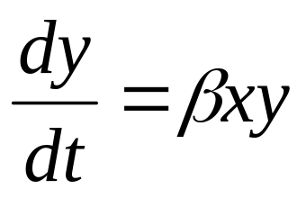
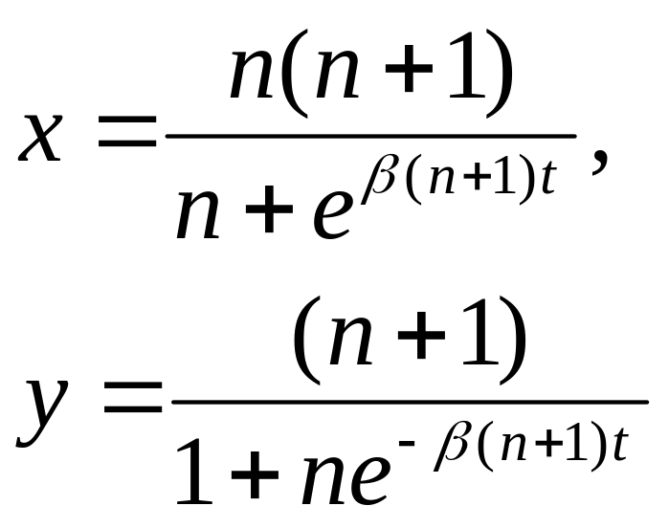
Analysis (contd.)
Continuous time process
(why?)
with solution:
Not infected
Infected
(can you derive it?)

Slide 37
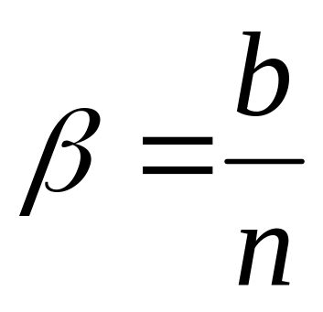
Epidemic Multicast
Protocol operates in rounds
INFECTED
b ^{random}
^{targets / round}
SUSCEPTIBLE
(NOT INFECTED)
(reasonable approximation.)

Slide 38
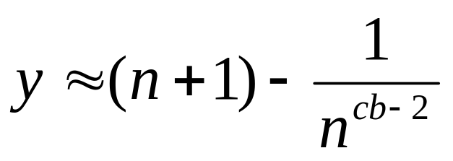
Epidemic Multicast Analysis
Substituting,
at time t = c * log(n) the number of infected nodes is
(infected )

Slide 39

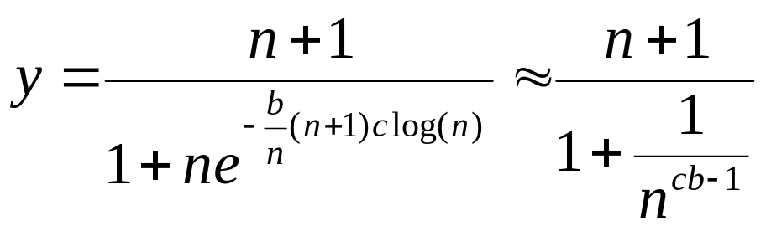
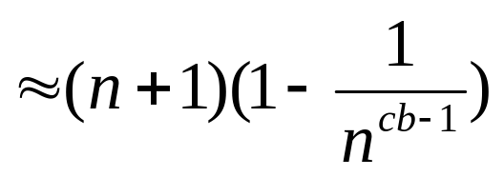
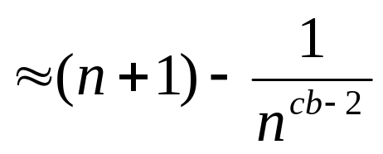
Answer – Push Analysis (contd.)
Using:
Substituting, at time t=clog(n)

Slide 40
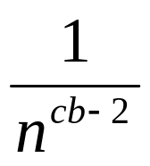
Analysis of push protocol (contd.)
Set c, b to be small numbers independent of n
Within c * log(n) rounds, [low latency]
  all but number of nodes receive the multicast
  [reliability]
  each node has transmitted no more than b * c * log(n) messages [lightweight]

Slide 41
Why is number of rounds [log(N)] low?
log(N) is not constant
  but pragmatically, it is a very slowly growing number
Base 2
  log(1000) ~ 10
  log(1M) ~ 20
  log (1B) ~ 30
  log(all IPv4 address) = 32
Within c * log(n) rounds [low latency]
  all but 1/n^{cb-2} number of nodes receive the multicast [reliability]
  each node has transmitted no more than b * c * log(n) messages [lightweight]

Slide 42
Fault-tolerance
Packet loss
  50% packet loss: analyze with b replaced with b/2
  To achieve same reliability as 0% packet loss, takes twice as many rounds
Node failure
  50% of nodes fail: analyze with n replaced with n/2 and b replaced with b/2
  Same as above
Within c * log(n) rounds [low latency]
  all but 1/n^{cb-2} number of nodes receive the multicast [reliability]
  each node has transmitted no more than b * c * log(n) messages [lightweight]

Slide 43
Fault-tolerance: With failures, is it possible that the epidemic might die out quickly?
Possible, but improbable:
  Once a few nodes are infected, with high probability, the epidemic will not die out
  … the analysis we saw in the previous slides is actually behavior with high probability [Galey and Dani 98]
Intuition: Most rumors do spread fast. Infectious diseases do cascade quickly into epidemics. A computer virus or worm does spread rapidly.

Slide 44
PULL Protocol Analysis
In all forms of push protocol, it takes O(log(N)) rounds before about N/2 processes get “infected”
  This is an upper bound. Why? Because that’s the fastest you can spread a message: a spanning tree with constant fanout (degree) has O(log(N)) nodes
Thereafter, pull is faster than push
Let p_{i} be the fraction of non-infected processes after the i ^{th} round
Let each round have k pulls.
  Then, for each process, the probability to stay non-infected in next round is p_{i} ^{k} .
  This makes p_{i} decrease faster than exponential
Second half of pull gossip finishes in time O(log(log(N))

Slide 45
Is this all theory and a bunch of equations?
  … or are there implementations and real use
Two big categories:
  Updating state
  Computing aggregates

Slide 46
Example applications (Updating state)
Updating replicas – distributing updates:
  E.g., disconnected replicated address book maintenance – Demers et al., Epidemic algorithms for replicated database maintenance. SOSP’87
  NNTP protocol
Membership protocols:
  Multiple-key value stores
    e.g., Amazon Dynamo service: Dynamo: Amazon’s Highly Available Key-value Store, SOSP’07
    Cassandra,
    Amazon S3, Uber
  Various p2p networks (e.g., Tribler)

Slide 47
Example applications: aggregation functions
Sensor networks
  The problem: compute the max value for a large set of sensors
  The Solution
  Let every node i maintain a variable x_{i}. When two nodes engage in the protocol, they each reset their variable to
  x_{i}, x_{k} ← max (x_{i}, x_{k})
  Repeat for log(N) rounds
  Result: in the end each node will have the max

Slide 48
Data aggregation: avg;
  The problem: compute the average value for a large set of sensors

Slide 49
How would one use an epidemic style protocol to calculate the number of sensors in a sensor network.
Notes:
See textbook

Slide 50
Recap of the idea
  Update operations are initially performed at one node
  Node passes its updated state to a limited number of ‘peers’ (often chosen randomly) …
  … which, in-turn, pass the update to other peers
  Eventually, each update will reach every node
In what contexts is this kind of design is useful?
  Frequent node failures
  Update propagation can be lazy, i.e., not immediate
  There are no write–write conflicts
Questions: What if I drop each of these assumptions: why an epidemic solution may not be adequate?

Slide 51
Backup

Slide 52
Termination alternative
Anti-entropy protocols work in rounds:
A round: each node takes the initiative to start one (or fixed number of) exchange(s)
Termination: for push-pull it takes O(log(N)) rounds to disseminate updates to all N nodes
But: Need to have some approximation of N
[Alternative] Gossiping (aka rumor mongering protocols)
Individual node decisions

Slide 53
Gossiping
Basic model: A ‘contaminated’ node starts propagating the infection (contacts other randomly chosen nodes)
  All newly contaminated nodes proceed similarly
Key question: When does everyone stop?
  Intuition: the state of a randomly chosen node contains (probabilistic) information about the spread of the infection
Termination decision (individual):
    while (true) {
    if the contacted node is already infected
      then stop with probability ¹/_{k}
    }
    // (k allows tradeoffs between effort and likelihood to cover all nodes)

Slide 54
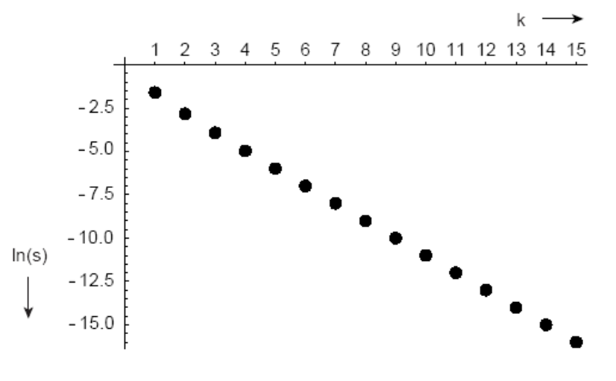
Gossiping: Termination decision
Termination decision:
While (true):
if the contacted node already is already
then stop with probability ¹/_{k}.
P the share of nodes that have not been reached
P = e ^{-(k+1)(1-p)}
K | P
1 | 20.0%
2 | 6.0%
4 | 0.7%
  ln(P)

Slide 55
Topology-Aware Epidemic Protocol
Network topology is hierarchical
Random push/pull target selection
Fix:
  In subnet i, which contains n_{i} nodes, pick target in your subnet with probability (1-1/n_{i})
  Router load=O(1)
  Dissemination time=O(log(N))
N/2 nodes in a subnet
Router
N/2 nodes in a subnet

Slide 56
Quiz-like questions
Discuss the tradeoffs between a multicast overlay and an epidemic protocol.
  Give motivated examples where one or the other solution may be more appropriate
Notes:
See textbook

Slide 57
Quiz-like questions
A distributed application operates on a large cluster. The application has one component running on each node.
Cluster nodes might be shut down for maintenance, they might simply fail, or (new) nodes might come (back) online.
To function correctly each application component needs an accurate list of all other nodes/components that are active.
TO DO: Design a (distributed) mechanism that provides this list
Describe the mechanism in natural language
Provide the pseudocode.
Evaluate overheads
Notes:
Sketch of a solution:
A.) Brief natural language description.
Each node establishes P pairs - where the two nodes in a pair monitor each other through heartbeats.
Epidemic protocol: Every N secs – each node distributes a list of pairs that are alive (this list is versioned). This list is further redistributed through an epidemic push-pull protocol (F fanout; log N rounds).
At the end of the log N rounds of the protocol each node can construct a good estimate of all nodes participating in the service.
B.) Pseudocode …
C.) Overheads: log(N) * F messages at each node to participate in each round of the epidemic protocol.

Slide 58
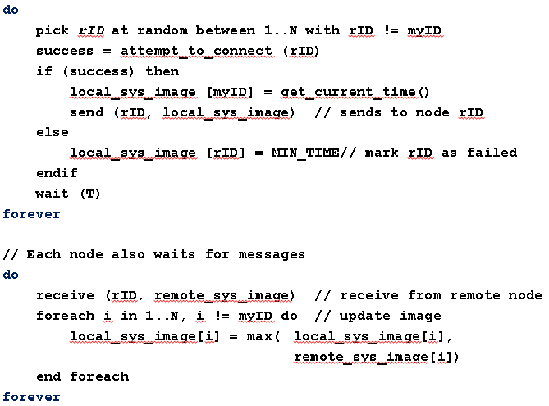
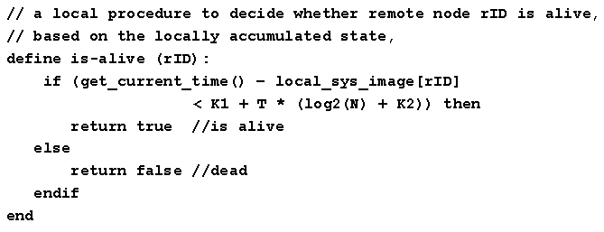
Is this buggy? (Piazza: W4-Q1-2020)

Slide 59
do
pick rID at random between 1..N with rID != myID
success = attempt_to_connect (rID)
if (success) then
local_sys_image [myID] = get_current_time()
send (rID, local_sys_image) // sends to node rID
else
local_sys_image [rID] = MIN_TIME// mark rID as failed
endif
wait (T)
forever
// Each node also waits for messages
do
receive (rID, remote_sys_image) // receive from remote node
foreach i in 1..N, i != myID do // update image
local_sys_image[i] = max( local_sys_image[i],
remote_sys_image[i])
end foreach
forever

Slide 60
// a local procedure to decide whether remote node rID is alive,
// based on the locally accumulated state,
define is-alive (rID):
if (get_current_time() – local_sys_image[rID]
< K1 + T * (log2(N) + K2)) then
return true //is alive
else
return false //dead
endif
end

Slide 61
Send
Output: Local State
When: Every Round
Goal: Infect
Receive
Input: Remote State
Output: Local State
When: Any Time
Goal: Merge States
State
N₁ -> ?
N₂ -> ?
…
…
N_{N} -> ?
Cell Writer?
Single Writer
Multiple Writers
  Conflicts?
Cell Value?
Binary Flag
Timestamp
Logical/Vector Clock
Failure?
Packet Loss
Permanent Node Failures
Temporary Node Failures
Reaper
When: F(Log(N))

