Slide 1
A distributed system is:
a collection of independent computers that appears to its users as a single coherent system
Components need to:
Communicate
  one-to-one (Request/Reply, RPC)
  one-to-many communication (epidemic)
Cooperate => support needed
  Naming – enables some resource sharing
  Synchronization

Slide 2
Problem solved by a name service
Given a [unstructured] name (i.e., the ‘key’)
… locate/return the associated value
(or the node responsible for the value)
Similar to a [huge] hash-table:
  API: put (key, value),
  get (key) → value

Slide 3
The Lookup Problem
At the heart of many services
N₂
N₁
N₃
PUT (Key=“title”
Value=file data…)
Internet
?
Client
Publisher
GET(key=“title”)
N₄
N₆
N₅
Notes:
1000s of nodes.
Set of nodes may change…

Slide 4
Strawman1: Centralized Lookup (Napster)
N₁
N₂
SetLoc(“title”, N4)
N₃
Client
Publisher@
N₄
DB
Lookup(“title”)
Key=“title”
Value=file data…
N₈
N₉
N₇
N₆
Simple, but:
O(N) state, and
a single point of failure
Notes:
O(N) state means its hard to keep the state up to date.

Slide 5
Strawman2: Flooded Queries (Gnutella)
N₁
N₂
Lookup(“title”)
N₃
Client
Publisher@
N₄
Key=“title”
Value=file data…
N₆
N₇
N₈
N₉
Robust, but not scalable:
worst case O(N) messages per lookup

Slide 6
A way to think about the solution: decide on a rendez-vous point between publisher (PUT) and client (GET) based on key
N₁
N₂
N₃
Client
Publisher
N₄
GET (key) → value
PUT (key, value)
N₆
N₇
N₈
N₉
Note: problem is simpler if routing info directly encoded in key
Notes:
Challenge: can we make it robust? Small state? Actually find stuff in a changing system?
Consistent rendezvous point, between publisher and client.

Slide 7
Desirable Properties
Scalable: multiple axes - network traffic overhead, state at nodes, routing cost, repair cost,
  Incremental scalability
Efficient: find items quickly (latency)
Dynamic: deals with node failure, join
General-purpose: unstructured keys
Decentralized / symmetric design
  i.e., nodes have similar roles

Slide 8
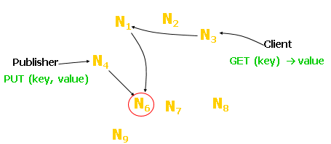
Design Issues
Issue 1: How to map keys to nodes?
Issue 2: How to route requests?
Issue 3: How to deal with node joins?
Issue 4: How to deal with node failures?
Issue 5: How to deal with node heterogeneity

Slide 9
Mapping keys to nodes
(Strawman Solutions)
Assumption: All nodes know ALL other nodes (Local State: O(N))
Membership
N₀ | N₁ | N₂ | N₃
Simplification: Keys are English Words
Solution 1:
Key ID = First Character
Uniform Key ID /Node Map
A-F | G-L | M-R | S-Z
Desired features
  Balanced: No bucket has disproportionate number of objects
  Smoothness: Addition/removal of bucket does not cause movement among existing buckets (only immediate buckets)
Issues?

Slide 10
Mapping keys to nodes
(Strawman Solutions)
Assumption: All nodes know ALL other nodes (Local State: O(N))
Membership
N₀ | N₁ | N₂ | N₃
Simplification: Keys are English Words
Solution 1:
Key ID = First Character
Uniform Key ID /Node Map
A-F | G-L | M-R | S-Z
Issues?
Solution 2:
Key ID = Hash(Key)
Uniform Key ID /Node Map
Node = Key ID % Nodes.Length
[0, H/4) | [H/4, H/2) | [H/2, 3*H/4) | [3*H/4, H]
Issues?

Slide 11
Mapping keys to nodes
The output range of a hash function is treated as a fixed circular space or “ring”.
Node ID
K5
Key ID .
N10
0
K11
128
N100
K30
Circular
ID Space
K99
N32
K33
N80
K52
N60

Slide 12
Mapping keys to nodes
Key ID Node ID
N10
K5, K10
K99
N100
Circular
ID Space
N32
K11, K30
K65, K70
N80
N60
K33, K40, K52
Notes:
Smoothness → addition of bucket does not cause much movement between existing buckets
Spread & Load → small set of buckets that lie near object
Balance → no bucket is responsible for large number of objects

Slide 13
Mapping keys to nodes
Did I get?
  Load balancing
  Smoothness
Key ID Node ID
N10
K5, K10
K99
N100
Circular
ID Space
N32
K11, K30
K65, K70
N80
N60
K33, K40, K52
Notes:
Smoothness → addition of bucket does not cause much movement between existing buckets
Spread & Load → small set of buckets that lie near object
Balance → no bucket is responsible for large number of objects

Slide 14
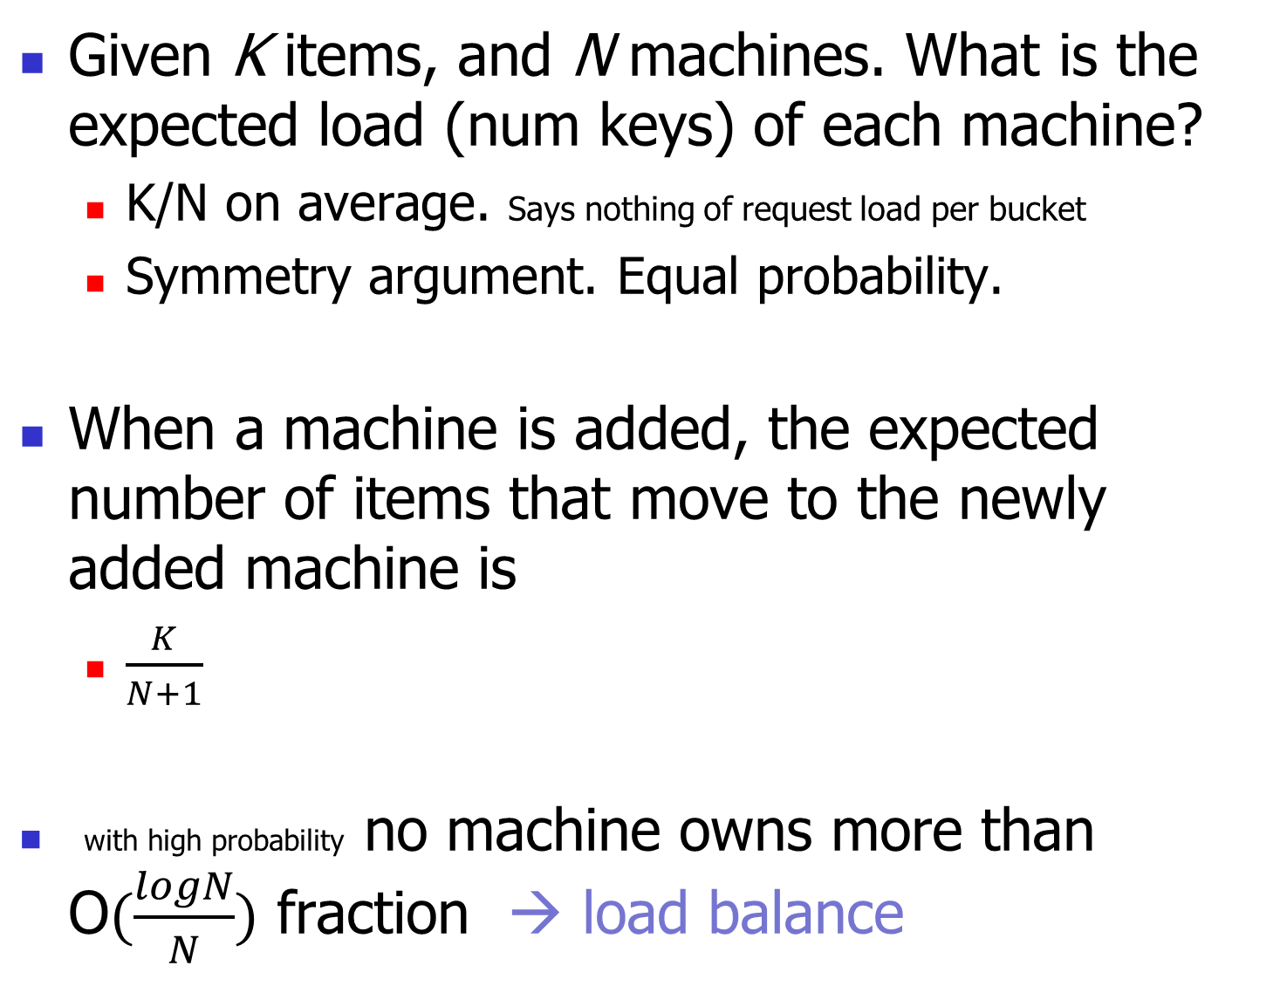
Notes:
Karger, D.; Lehman, E.; Leighton, T.; Panigrahy, R.; Levine, M.; Lewin, D. (1997). Consistent Hashing and Random Trees: Distributed Caching Protocols for Relieving Hot Spots on the World Wide Web. STOC’97

Slide 15
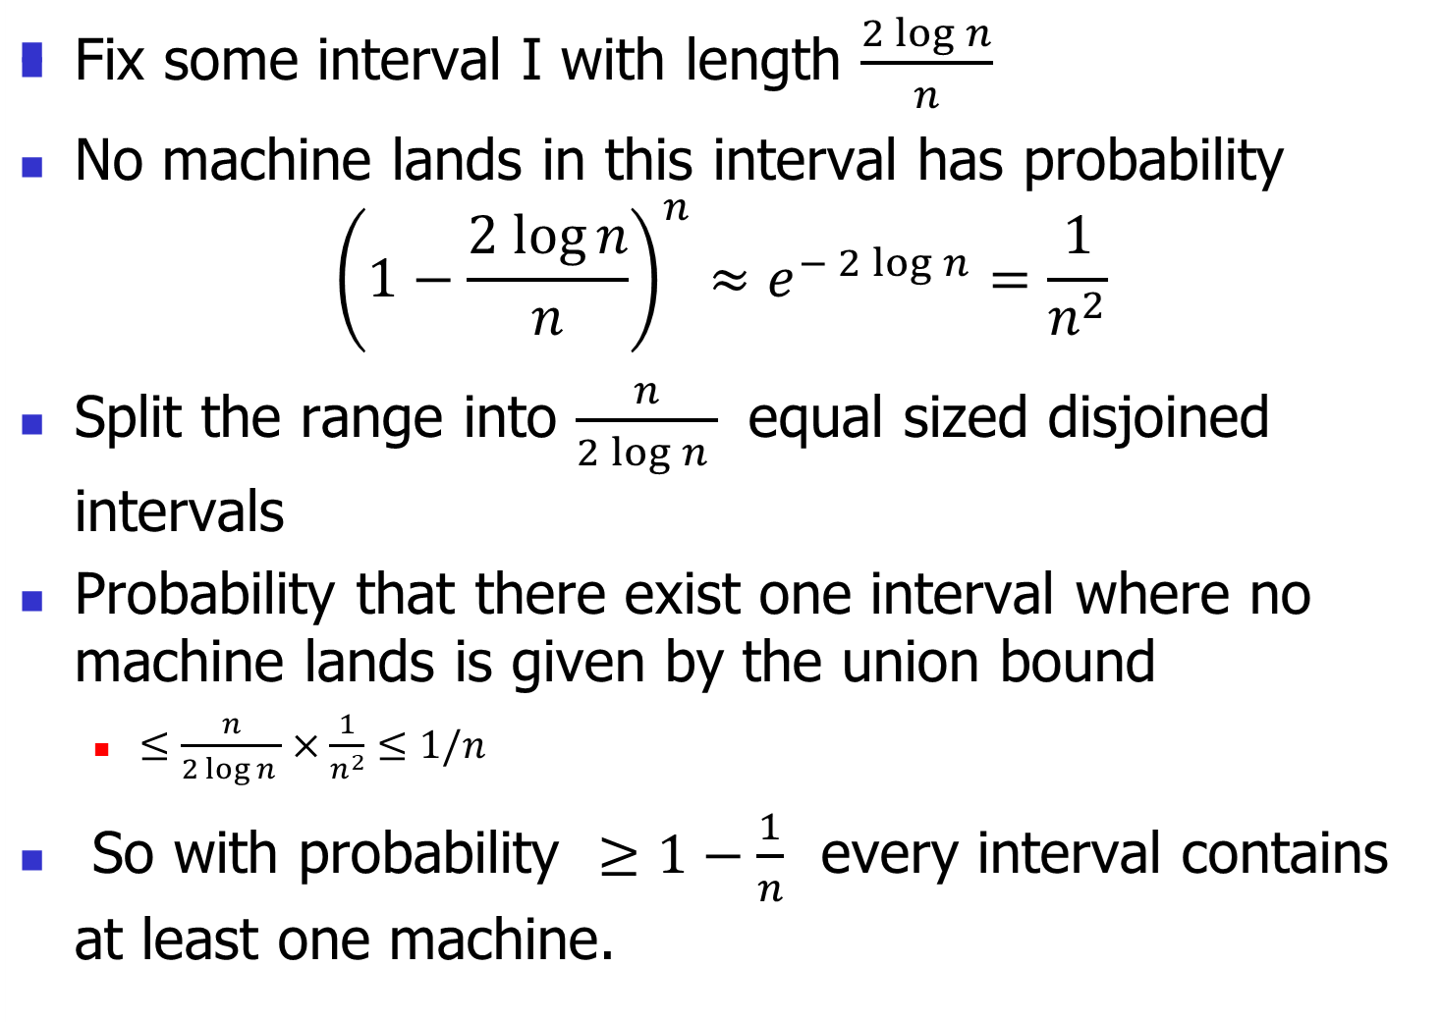
Proof

Slide 16
Did I get?
  Load balancing
  Smoothness
N8
K5
Key ID Node ID
N10
K10
K99
N100
N32
K11, K30
K65, K70
N80
N60
K33, K40, K52

Slide 17
Join: Transfer Keys
Only keys in the range are transferred
N5
N20
N99
N36
K30
Copy keys 21..36
from N40 to N36
N40
K38
K30
K38
N80
N60

Slide 18
Consistent hashing and failures
0
Consider network of n nodes
  If each node has 1 bucket
    Owns 1/n^{th} of keyspace in expectation
If a node fails:
  Its successor takes over bucket
  Achieves smoothness goal: Only localized shift, not O(n)
  But now successor owns 2 buckets: keyspace of size 2/n
Instead, each node maintains v random nodeIDs, not 1
  “Virtual” nodes spread over ID space, each of size 1 / vn
  Upon failure, v successors take over, each now stores (v+1) / vn
14
12
Bucket
4
8

Slide 19
Design Issues
Issue 1: How to map keys to nodes?
Issue 2: How to route requests?
Issue 3: How to deal with node joins?
Issue 4: How to deal with node failures?
Issue 5: How to deal with node heterogeneity

Slide 20


Slide 21

Scheme I: Consistent hashing
Lookup cost: O(1)
State at each node: ???
Direct routing.
Key ID Node ID
N10
K5, K10
K99
N100
“Key 5 is
At N10”
N32
K11, K30
K65, K70
N80
What node stores K5?
N60
K33, K40, K52

Slide 22
Potential Issue: Large state at each node
O(N); N number of nodes.
Can one rely on less state at each node)?
Key ID Node ID
N10
K5, K10
K99
N100
“Key 5 is
At N10”
N32
K11, K30
K65, K70
N80
N60
K33, K40, K52

Slide 23
N5
N10
N110
K19
N20
N99
N32
Lookup(K19)
N80
[Strawman]
Lookup: O(N)
State at each node: O(1)
N60
OR?
Notes:
Without a finger table, lookups are slow
Usually each node maintains a list of K successors (not just 1).

Slide 24
“Finger Table” Accelerates Lookups
N5
N10
¼
½
N110
K19
N20
N99
1/8
N32
1/16
1/32
1/64
Lookup(K19)
N80
N60
Notes:
Log(N) means we don’t have to track all nodes. Easy to maintain finger info.

Slide 25
Scheme II : Distributed Hash Table
N5
N10
N110
K19
N20
N99
N32
Lookup(K19)
N80
Lookup: O(log N)
State at each node: O(log N)
N60
Notes:
Maybe note that fingers point to the first relevant node.

Slide 26
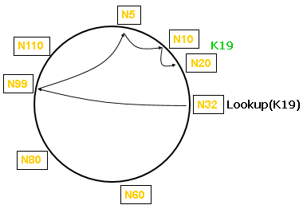
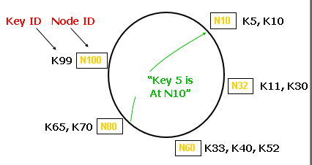
Distributed
Hash Table
Consistent
Hashing
O(log N)
O(log N)
Lookup hops: O(1)
Routing state per node: O(N)

Slide 27
Design Issues
Issue 1: How to map keys to nodes?
Issue 2: How to route requests?
Issue 3: How to deal with node joins?
  [maintain routing structure, data placement]
Issue 4: How to deal with node failures?
Issue 5: How to deal with node heterogeneity

Slide 28
Distributed
Hash Table
  What’s the cost of a node join?
How many nodes do I need to update (to correct routing tables)
How many messages do I need to send (to correct routing tables)?
Consistent
Hashing
Lookup: O(1)
Routing state per node: O(N)
Node joins ??
O(log N)
O(log N)

Slide 29
Consistent hashing
Key ID Node ID
N10
K5, K10
K99
N100
N32
K11, K30
K65, K70
N80
WILL JOIN AS
N8
N60
K33, K40, K52

Slide 30
Distributed
Hash Table
Consistent
Hashing
Lookup: O(1)
Routing state per node: O(N)
Node joins O(N)
O(log N)
O(log N)
???

Slide 31
DHT: What info to maintain to route correctly?
(at a minimum) Lookups correct if each node can maintain its successor. [invariant to maintain]
Finger table: acceleration only, can be approximates
N5
N10
N110
“Where is key 50?”
N20
N99
“Key 50 is
At N60”
N32
N40
N80
N60

Slide 32
Joining the Ring: DHT
Steps of the process [does order matter?]
  Identify predecessor and successor nodes
  [copy keys from successor to new node]
  Announce yourself to predecessor and successor
  Initialize ‘fingers’/shortcuts of new node [can be done lazily]
  Update fingers of existing nodes [can be done lazily]
  [delete extra k/v pairs] [can be done lazily]
Invariants to maintain to ensure correctness
  Each node’s maintains its successor
  successor(k) is responsible for monitoring k

Slide 33
Join: Transfer Keys
Only keys in the range are transferred
N5
N20
N99
N36
K30
Copy keys 21..36
from N40 to N36
N40
K38
K30
K38
N80
N60

Slide 34
How to initialize new node’s finger table?
N5
N20
N36
N99
1. Lookup(37,38,40,…,100)
N40
N80
N60

Slide 35
Join: Update Fingers of Existing Nodes
New node calls update function on existing nodes
Existing nodes recursively update fingers of other nodes
Note: updates can be lazy.
N5
N20
N99
N36
N40
N80
N60

Slide 36
Design Issues
Issue 1: How to map keys to nodes?
Issue 2: How to route requests?
Issue 3: How to deal with node joins?
Issue 4: How to deal with node failures?
  [(i) maintain routing structure, (ii) maintain data]
Issue 5: How to deal with node heterogeneity
Issue 6: Iterative vs. recursive routing
Issue 7: Performance optimizations

Slide 37
Distributed
Hash Table
Consistent
Hashing
Lookup: O(1)
Routing state per node: O(N)
Node joins O(N)
Node failure ???
O(log N)
O(log N)
O(log N)

Slide 38
Distributed
Hash Table
Consistent
Hashing
Lookup: O(1)
Routing state per node: O(N)
Node joins O(N)
Node failure O(N)
O(log N)
O(log N)
O(log N)
????

Slide 39
DHT Fault-tolerance:
Successor Lists Ensure Robust Lookup
N5 knows about N10, N20, N32
N5
20, 32, 40
5, 10, 20
N10
N110
32, 40, 60
N20
110, 5, 10
N99
40, 60, 80
N32
N40
60, 80, 99
99, 110, 5
N80
N60
80, 99, 110
Each node remembers R successors
Lookup can skip over dead nodes
Notes:
All r successors have to fail before we have a problem.
List ensures we find actual current successor.

Slide 40
Quiz like question
How does one dimension the successor list?
What is the chance that the system works correctly after N nodes fail?
system fails if at least one has lost all its successors (the ring can not be repaired)
F – the fraction of the nodes that fail
R – length of successor list ;
N – nodes in the system
P(all successors of a specific node have failed) = F^{R}
P(no system failure) =
= P(all nodes are ok) =
= (1-F^{R})^{N}
Notes:
Scenario: catastrophic failure: F=50%=1/2
Dimension R = log2(N)
P = (1-1/2^log2N)^N = (1 – 1/N)^N

Slide 41
Design Issues
Issue 1: How to map keys to nodes?
Issue 2: How to route requests?
Issue 3: How to deal with node joins?
Issue 4: How to deal with node failures?
  [(i) maintain routing structure, (ii) maintain data]
Issue 5: How to deal with node heterogeneity

Slide 42
How to maintain data?
The same solutions work for consistent hashing and DHT
Nodes failure: replicate data
  Pick an uniform choice of nodes to do replication
    E.g., replicate to R successors
Node joins: migrate data
  (Lazily) delete unnecessary replicas

Slide 43
Replicates [k,v] pairs at R Successors
N5
N110
N10
N20
N99
K17
N40
N80
N50
N68
N60
  Replicas are easy to find if successor fails
  Hashed node IDs ensure independent failure
Notes:
Nodes with replicas are not likely to be near each other in underlying network.

Slide 44
Design Issues
Issue 1: How to map keys to nodes?
Issue 2: How to route requests?
Issue 3: How to deal with node joins?
Issue 4: How to deal with node failures?
Issue 5: How to deal with node heterogeneity
Issue 6: Iterative vs. recursive routing
Issue 7: Performance optimizations

Slide 45
Problem: How to load balance when nodes are heterogeneous?
Solution idea: Each node owns an ID space proportional to its ‘power’
Virtual Nodes:
Each physical node is responsible for multiple (similar) virtual nodes.
Virtual nodes are treated the same
Advantages: load balancing, incremental scalability,
Dealing with heterogeneity: The number of virtual nodes that a node is responsible for can decided based on its capacity, accounting for heterogeneity in the physical infrastructure.
When a node joins (if it supports many VN) it accepts a roughly equivalent amount of load from each of the other existing nodes.
If a node becomes unavailable the load handled by this node is
evenly dispersed across the remaining available nodes.

Slide 46
Design Issues
Issue 1: How to map keys to nodes?
Issue 2: How to route requests?
Issue 3: How to deal with node joins?
Issue 4: How to deal with node failures?
Issue 5: How to deal with node heterogeneity
Issue 6: Iterative vs. recursive routing
Issue 7: Performance optimizations [link]

Slide 47
Design Choices:
  Routing (Recursive vs. Iterative).
  At-most-once cache? (Front-End vs. Back-End)

Slide 48
Recap: Properties
Decentralized / symmetric design: nodes have similar roles
Scalable: multiple axes
  network traffic overhead, state at nodes, routing cost, …
Incremental scalability
Efficient: find items quickly (latency)
Dynamic: deals with node failure, join
General-purpose: flat naming, heterogeneous platform

Slide 49
BACKUP

Slide 50
Idea: Key = Hash(Value)
Why a ‘secure’ hash function?
  One way
  Uniform distribution for hash(x)
Some games played:
  Client uses: key = hash(value)
  PUT (hash(value), value)
  Advantages
  Free error detection
  Attacker can not change value (as long as client remembers the key)

Slide 51
Some experimental results and performance optimizations

Slide 52
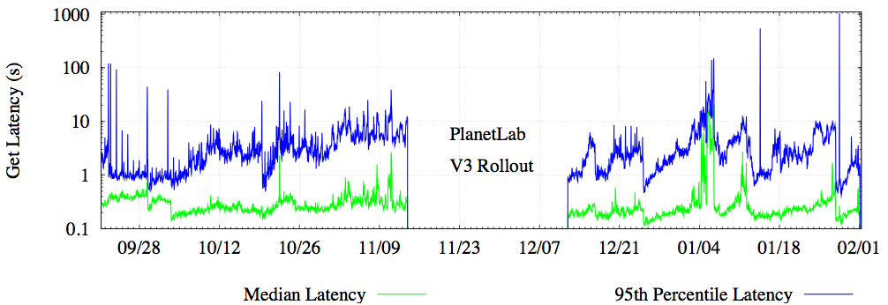
Fixing the Embarrassing Slowness of OpenDHT on PlanetLab (2005)
  Median RTT between hosts ~ 140 ms
Median get performance: 200 ms
95th percentile get latency is high!
  Generally measured in seconds
  And even median spikes up from time to time

Slide 53
Delay-Aware Routing
Mode | Latency (ms) |  | Cost
 | 50th | 99th | Msgs | Bytes
Greedy | 150 | 4400 | 5.5 | 1800
Delay-Aware | 100 | 1800 | 6.0 | 2000
Latency drops by 30-60%
Cost goes up by only ~10%
Fixing the Embarrassing Slowness of OpenDHT on PlanetLab, Sean C. Rhea

