Slide 1
Synchronization Physical clocks Logical clocks

Slide 2
Summary so far …
A distributed system is:
a collection of independent computers that appears to its users as a single coherent system
Components need to:
Communicate
Point to point: request-reply, RPC/RMI
Point to multipoint: multicast, epidemic
Cooperate
Naming to enable some resource sharing
Naming systems for unstructured (flat) namespaces:
consistent hashing, DHTs
Naming systems for structured namespaces
Event ordering
Synchronization

Slide 3

An example
Multiplayer game …
Distributed implementations generally use replicated state: each player has its own view of the world.
Object A (the target) and the “world” are replicated as S₁ and S₂
… players shoot the same target at about the same time
Players shot at local times t₁ and t₂ on two replicas S₁ and S₂
Who gets the points?
Need to aggregate events into one consistent view.
Issues: Correctness. Overheads. Fairness.
Room for application-specific solutions
Notes:
3

Slide 4
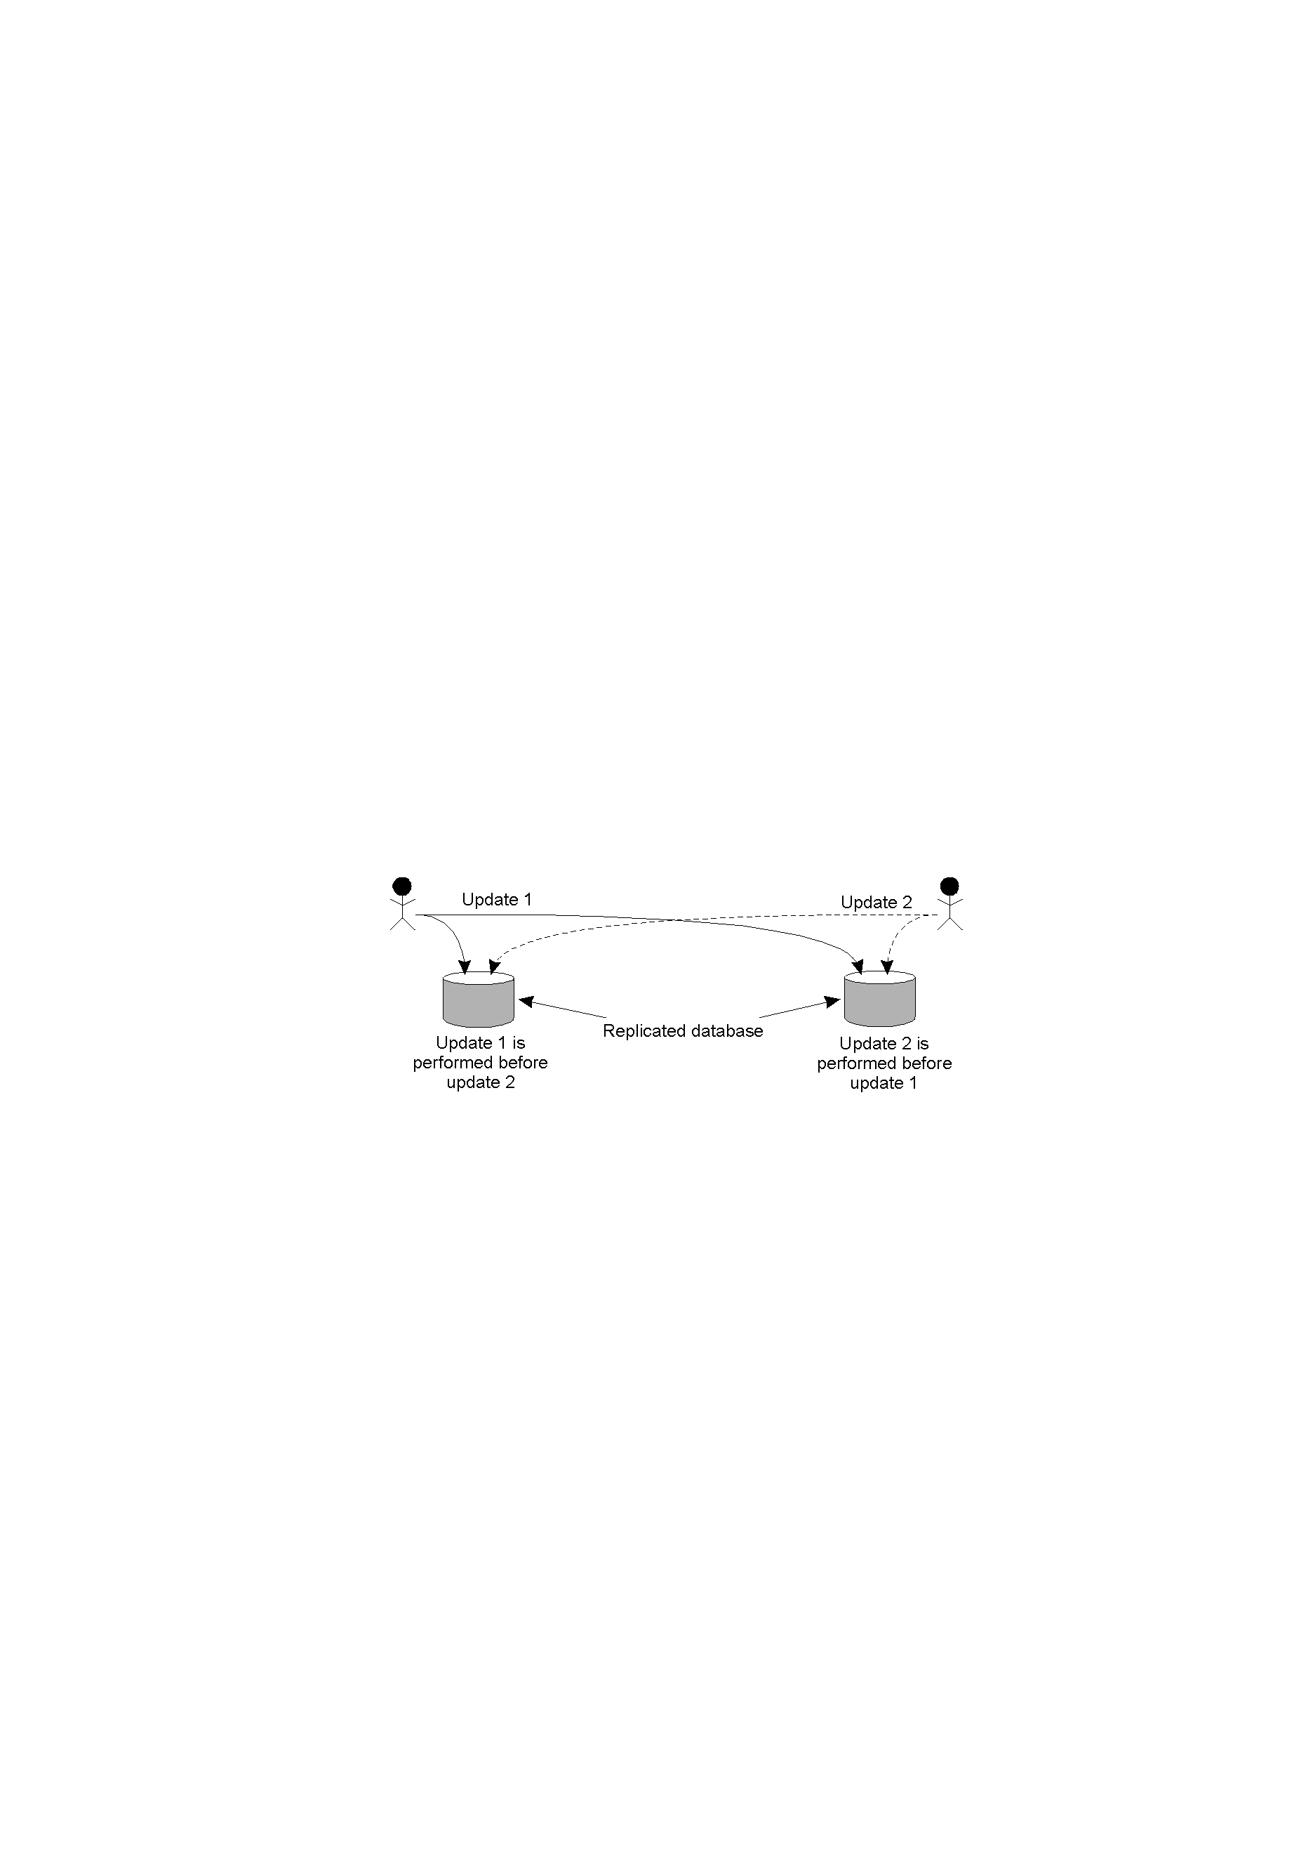
Example: Replicated State Machine
Add 1% interest
Account X
Add $1,000, Account X
Middleware: one-to-many communication layer
Q: Do the updates need to be executed in the same order on the two replicas?
Issues:
What kind of ordering: partial or total?
Does ‘real’ (physical time) ordering matter for correctness?

Slide 5
Why event ordering is more complex than in a single-box system?
No single physical clock
Likely multiple physical clocks,
Likely out of sync and drifting
Need to aggregate a ‘global’ view
Failures

Slide 6
What are your tools?
Physical clocks
Provide [an estimate of] actual (real) time.
‘Logical clocks’
Where only ordering of events matters
Lamport clocks
Vector clocks (ability to trace event dependence)

Slide 7
Keeping track of time easily gets complex …
"Fifty-six standards of time are now employed by the various railroads of the country in preparing their schedules of running times"
-- New York Times, April 1883 [source]
Other Examples?
The October with only 20 days (in 1582)
Leap Second
Notes:
(1): Point: once you mut multiple systems together (link by rail) you’ll start having coordination problems.
(2): Point: Reconciling clocks is messy – as always when “software” touches the limits of real world.
From: https://en.wikipedia.org/wiki/Leap_second
A leap second is a one-second adjustment that is occasionally applied to Coordinated Universal Time (UTC), to accommodate the difference between precise time (International Atomic Time (TAI), as measured by atomic clocks) and imprecise observed solar time (UT1), which varies due to irregularities and long-term slowdown in the Earth's rotation. The UTC time standard, widely used for international timekeeping and as the reference for civil time in most countries, uses TAI and consequently would run ahead of observed solar time unless it is reset to UT1 as needed. The leap second facility exists to provide this adjustment.
Because the Earth's rotation speed varies in response to climatic and geological events,^{[1]} UTC leap seconds are irregularly spaced and unpredictable. Insertion of each UTC leap second is usually decided about six months in advance by the International Earth Rotation and Reference Systems Service (IERS), to ensure that the difference between the UTC and UT1 readings will never exceed 0.9 seconds.^{[2][3]}
This practice has proven disruptive, particularly in the twenty-first century and especially in services that depend on precise timestamping or time-critical process control. The relevant international standards body^{[who?]} has been debating whether or not to continue the practice.
…
Issues created by insertion (or removal) of leap seconds[edit]
Calculation of time differences and sequence of events[edit]
To compute the elapsed time in seconds between two given UTC dates requires the consultation of a table of leap seconds, which needs to be updated whenever a new leap second is announced. Since leap seconds are known only 6 months in advance, time intervals for UTC dates further in the future cannot be computed.
Missing leap seconds announcement[edit]
Although BIPM announces a leap second 6 months in advance, most time distribution systems (SNTP, IRIG-B, PTP) announce leap seconds at most 12 hours in advance,^{[citation needed][55]} sometimes only in the last minute and some even not at all (DNP 03).^{[citation needed]} Clocks that are not regularly synchronized can miss a leap second, but still can claim to be perfectly synchronized.^{[clarification needed]}
Implementation differences[edit]
Not all clocks implement leap seconds in the same manner. Leap seconds in Unix time are commonly implemented by repeating 23:59:59 or adding the time-stamp 23:59:60. Network Time Protocol (SNTP) freezes time during the leap second,^{[56]} some time servers declare "alarm condition".^{[citation needed]} Other schemes smear time in the vicinity of a leap second, spreading out the second of change over a longer period. This aims to avoid any negative effects of a substantial (by modern standards) step in time.^{[57][58]} This approach has led to differences between systems, as leap smear is not standardized and several different schemes are used in practice.^{[59]}
Textual representation of the leap second[edit]
The textual representation of a leap second is defined by BIPM as "23:59:60". There are programs that are not familiar with this format and may report an error when dealing with such input.
Binary representation of the leap second[edit]
Most computer operating systems and most time distribution systems represent time with a binary counter indicating the number of seconds elapsed since an arbitrary epoch; for instance, since 1970-01-01 00:00:00 in POSIX machines or since 1900-01-01 00:00:00 in NTP. This counter does not count positive leap seconds, and has no indicator that a leap second has been inserted, therefore two seconds in sequence will have the same counter value. Some computer operating systems, in particular Linux, assign to the leap second the counter value of the preceding, 23:59:59 second (59–59–0 sequence), while other computers (and the IRIG-B time distribution) assign to the leap second the counter value of the next, 00:00:00 second (59–0–0 sequence).^{[citation needed]} Since there is no standard governing this sequence, the timestamp of values sampled at exactly the same time can vary by one second. This may explain flaws in time-critical systems that rely on timestamped values.^{[60]}
Other reported software problems associated with the leap second[edit]
Several models of global navigation satellite receivers have software flaws associated with leap seconds:
Some older versions of Motorola Oncore VP, UT, GT, and M12 GPS receivers had a software bug that would cause a single timestamp to be off by a day if no leap second was scheduled for 256 weeks. On November 28, 2003, this happened. At midnight, the receivers with this firmware reported November 29, 2003, for one second and then reverted to November 28, 2003.^{[61][62]}
Older Trimble GPS receivers had a software flaw that would insert a leap second immediately after the GPS constellation started broadcasting the next leap second insertion time (some months in advance of the actual leap second), rather than waiting for the next leap second to happen. This left the receiver's time off by a second in the interim.^{[63][64]}
Older Datum Tymeserve 2100 GPS receivers and Symmetricom Tymeserve 2100 receivers apply a leap second as soon as the a leap second notification is received, instead of waiting for the correct date. The manufacturers no longer supports these models and no corrected software is available. A workaround has been described and tested, but if the GPS system rebroadcasts the announcement, or the unit is powered off, the problem will occur again.^{[65]}
Four different brands of navigational receivers that use data from BeiDou satellites were found to implement leap seconds one day early.^{[66]} This was traced to a bug related to how the BeiDou protocol numbers the days of the week.
Several software vendors have distributed software that has not properly functioned with the concept of leap seconds:
NTP specifies a flag to inform the receiver that a leap second is imminent. However, some NTP server implementations have failed to set their leap second flag correctly.^{[67][68][69][70]} Some NTP servers have responded with the wrong time for up to a day after a leap second insertion.^{[71]}
A number of organizations reported problems caused by flawed software following the June 30, 2012, leap second. Among the sites which reported problems were Reddit (Apache Cassandra), Mozilla (Hadoop),^{[72]} Qantas,^{[73]} and various sites running Linux.^{[74]}
Despite the publicity given to the 2015 leap second, a small number of network failures occurred due to leap second-related software errors of some routers.^{[75]} Several older versions of the Cisco Systems NEXUS 5000 Series Operating System NX-OS (versions 5.0, 5.1, 5.2) are affected by leap second bugs.^{[76]}
Some businesses and service providers have been impacted by leap-second related software bugs:
In 2015, interruptions occurred with Twitter, Instagram, Pinterest, Netflix, Amazon, and Apple's music streaming series Beats 1.^{[77]}
Leap second software bugs in Linux reportedly affected the Altea airlines reservation system, used by Qantas and Virgin Australia, in 2015.^{[78]}
Cloudflare was affected by a leap second software bug. Its DNS resolver implementation incorrectly calculated a negative number when subtracting two timestamps obtained from the Go programming language's time.Now()function, which then used only a real-time clock source.^{[79]} This could have been avoided by using a monotonic clock source, which has since been added to Go 1.9.^{[80]}
The Intercontinental Exchange, parent body to 7 clearing houses and 11 stock exchanges including the New York Stock Exchange, chose to cease operations for 61 minutes at the time of the June 30, 2015, leap second.^{[81]}
There were misplaced concerns that farming equipment using GPS navigation during harvests occurring on December 31, 2016, would be affected by the 2016 leap second.^{[82]} GPS navigation makes use of GPS time, which is not impacted by the leap second.^{[83]}
Due to a software error, the UTC time broadcast by the NavStar GPS system was incorrect by about 13 microseconds on January 25–26, 2016.^{[84][85]}

Slide 8
Physical clocks (I)
Problem: Achieve coordination on real time in a distributed system
The standard: Coordinated Universal Time (UTC):
Atomic clocks: Based on the number of transitions per second of the cesium 133 atom
accurate but expensive
Leap second from time to time to compensate for days getting longer.
UTC is broadcast through short wave radio and satellite.
Accuracy ± 1ms (but if weather conditions considered ±10ms)
Needs a receiver

Slide 9
Problem:
Suppose we have a distributed system with a UTC-receiver somewhere in it.
How do we:
distribute time to each machine, and
maintain a bound on how much local time differs from actual tim?

Slide 10
Internal mechanism (the “clock”) at each node
Each machine has a timer
Timer causes an interrupt H times a second
Interrupt handler adds 1 (a ‘tick’) to a software clock
Software clock keeps track of the number of ticks since some agreed-upon time in the past.

Slide 11
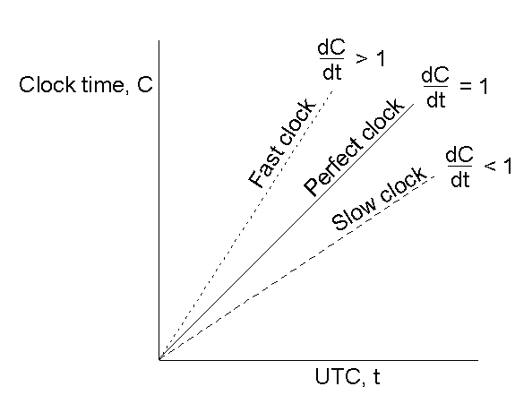

Clock drift and drift rate
Time is correct
Drift = 0
Clock does not deviate Drift rate = 0
Notation: Value of clock on machine p at real time t is C_{p}(t)
Clock drift : |C_{p}(t) - t |
Ideally: C_{p}(t) == t
Goal: Guarantee on maximum drift
i.e., never let clocks on two nodes differ by more than x time units
How?
Manufacturer guarantees max drift rate ρ
1 - ρ ≤ (dC/dt) ≤ 1 + ρ
Nodes synchronizes at least every x/(2ρ) seconds.
Drift rate: $\frac{\text{dC}\text{p}\text{(}\text{t}\text{)}}{\text{dt}} −1$
dC_{p}(t) = dt

Slide 12
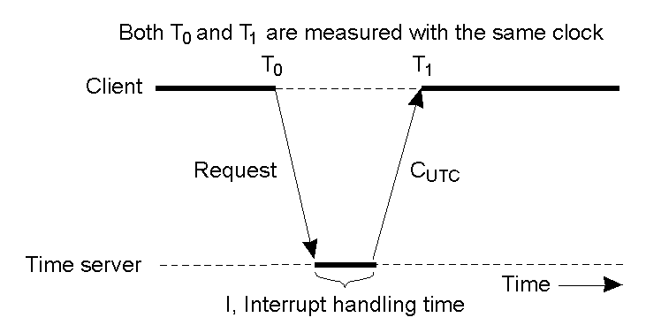
Building a complete system …
Every machine asks a time server for the accurate time at least once every x/(2ρ) seconds
Client updates time to?
T_{new}=C_{UTC}+(T₁-T₀)/2
Fundamental: setting the time back is never allowed ➔ smooth adjustments.
Q: Problems?
Notes:
Option: (isolated system) Let the time server scan all machines periodically, calculate an average, and inform each machine how it should adjust its time relative to its present time.
Note: you don’t even need to propagate UTC time.

Slide 13
Real world: Network Time Protocol (NTP)
Stratum 1 NTP servers – receive time from external sources (cesium clocks, GPS, radio broadcasts)
Stratum N+1 servers synchronize with stratum N servers and between themselves
Self-configuring network
Survey (fairly old: 2006)
> 1M NTP servers
0.2% of the NTP servers >128ms
offset from synchronization peer
Excluding these: - median: 0.7ms
- mean: 7ms

Slide 14
[Summary so far] Physical clocks
Clock drift: time difference between two clocks
Sources of errors (drift)
Variability in time to propagate radio signals. (±10ms)
Clocks are not perfect: Drift rates
Network latencies are not symmetric
Differences in speed to process messages
System design to limit drift
One node holds the ‘true’ time
Other nodes contact this node periodically and adjust their clocks
How often?
How exactly the adjustment is done?

Slide 15
We’ve established that clocks can not be perfectly synchronized (and atomic clocks are costly).
What can one do in these conditions?
Get a better estimate of time by using different technology
e.g., use GPS to obtain time in your system
Expose uncertainty and design the system to take drift into account
Example 1: Google’s Spanner
Example 2: Server design to provide at-most-once semantics
Give up physical clocks!
Consider only event order - Logical clocks

Slide 16

GPS – Global Positioning Systems Intro
Basic idea: To estimate distance to a landmark (e.g., s satellite)
Estimate signal propagation time between you and the landmark
Multiply by signal speed
Strawman: Assume that the clocks of the satellites and receiver are accurate and perfectly synchronized:
But, in real world:
3D not 2D
The receiver’s clock is definitely
out of sync with the satellite

Slide 17
GPS – Global Positioning Systems (2)
Unknowns: x_{r}, y_{r}, z_{r} coordinates of the receiver.
Known:
x_{i}, y_{i}, z_{i} coordinates of satellite i
T_{i} is the send timestamp on a message from satellite i
∆I_{i} = (T_{now} – T_{i}) measured delay for message sent by satellite i
Distance to satellite i can be estimated:
(1) Propagation time: d_{i} = c x ∆I_{i}
(2) Geometric distance:
3 satellites→ 3 equations in 3 unknowns. I’M DONE!
… BUT: I assumed receiver clock is synchronized!
*the satellite has an atomic clock anyways so Ti is correct

Slide 18
GPS – Global Positioning Systems (2)
Unknowns: x_{r}, y_{r}, z_{r} coordinates of the receiver.
Known: X_{i}, Y_{i}, Z_{i} - coordinates of satellite i
T_{i} - the send timestamp on a message from satellite i
∆I_{i} = (T_{now} – T_{i}) propagation delay of message sent by satellite i
Distance to satellite i can be estimated:
Propagation time: d_{i} = c x ∆I_{i}
Geometric distance:
So far I assumed receiver clock is synchronized*!
What if it needs to be adjusted? T_{real}=T_{now}+ ∆r
∆I_{i} = (T_{now} + ∆r ) – T_{i}
Collect one more measurement from one more satellite!
*the satellite has a atomic clock anyways so Ti is correct

Slide 19
Two takeaways
(1) Triangulation technique
Can be used in other contexts: e.g., computing geographical position in wired networks
(2) Enough information to correct the clock drift at the receiver

Slide 20
Similar triangulation techniques work in other contexts: Computing geographical position in wired networks
Observation: a node P needs at least k + 1 landmarks to compute its own position in a k-dimensional space.
Consider two-dimensional case:
Solution: P needs to solve three
equations in two unknowns (x_{P},y_{P})

Slide 21
We’ve established that clocks can not be perfectly synchronized (and atomic clocks are costly).
What can one do in these conditions?
Get a better estimate of time by using new technology
e.g., use GPS to obtain time in your system
Expose uncertainty / design the system to account for drift
Example 1: Google’s Spanner – Extended time API
Example 2: Server design to provide at-most-once semantics
Give up physical clocks!
Consider only event order - Logical clocks

Slide 22
Google’s Spanner
“Global wall-clock time” with bounded uncertainty
Time estimate: TT.now() → [earliest, latest]
Guaranteed interval
TT.now()
time
earliest
latest
2*ε
Notes:
Spanner provides externally consistent [16] reads and writes, and globally-consistent reads across the database at a timestamp ….
… [enabled by] Spanner assigns globally-meaningful commit timestamps to transactions, even though transactions may be distributed. In addition, the serialization order satisfies external consistency (or equivalently, linearizability [20]): if a transaction T1 commits before another transaction T2 starts, then T1’s commit timestamp is smaller than T2’s. Spanner is the first system to provide such guarantees at global scale.

Slide 23
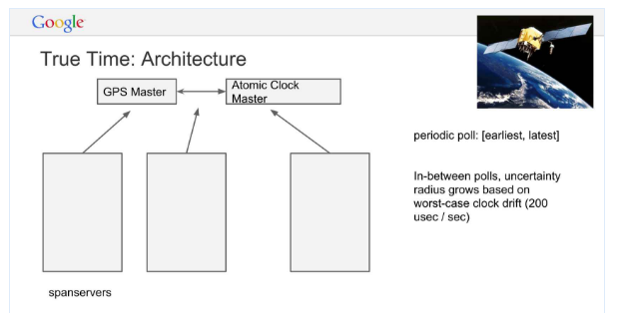
TrueTime implementation
ε = reference ε +
worst-case local-clock drift
ε
+6ms
Max drift rate:
200 μs/sec →
Max drift: 6ms
(for a 30s sync interval)
reference
uncertainty
time
0sec
30sec
60sec
90sec
Notes:
Section 3:
“TrueTime uses two forms of time reference because they have different failure modes. GPS reference-source vulnerabilities include antenna and receiver failures, local radio interference, correlated failures (e.g., design faults such as incorrect leapsecond handling and spoofing), and GPS system outages. Atomic clocks can fail in ways uncorrelated to GPS and each other, and over long periods of time can drift significantly due to frequency error.
“TrueTime is implemented by a set of time master machines per datacenter and a timeslave daemon per machine. The majority of masters have GPS receivers with dedicated antennas; these masters are separated physically to reduce the effects of antenna failures, radio interference, and spoofing. The remaining masters (which we refer to as Armageddon masters) are equipped with atomic clocks. An atomic clock is not that expensive: the cost of an Armageddon master is of the same order as that of a GPS master. All masters’ time references are regularly compared against each other. Each master also cross-checks the rate at which its reference advances time against its own local clock, and evicts itself if there is substantial divergence. Between synchronizations, Armageddon masters advertise a slowly increasing time uncertainty that is derived from conservatively applied worst-case clock drift. GPS masters advertise uncertainty that is typically close to zero
Every daemon polls a variety of masters [29] to reduce vulnerability to errors from any one master. Some are GPS masters chosen from nearby datacenters; the rest are GPS masters from farther datacenters, as well as some Armageddon masters. Daemons apply a variant of Marzullo’s algorithm [27] to detect and reject liars, and synchronize the local machine clocks to the nonliars. To protect against broken local clocks, machines that exhibit frequency excursions larger than the worstcase bound derived from component specifications and operating environment are evicted.
Between synchronizations, a daemon advertises a slowly increasing time uncertainty. is derived from conservatively applied worst-case local clock drift. also depends on time-master uncertainty and communication delay to the time masters. In our production environment, is typically a sawtooth function of time, varying from about 1 to 7 ms over each poll interval. is therefore 4 ms most of the time. The daemon’s poll interval is currently 30 seconds, and the current applied drift rate is set at 200 microseconds/second, which together account for the sawtooth bounds from 0 to 6 ms. The remaining 1 ms comes from the communication delay to the time masters. Excursions from this sawtooth are possible in the presence of failures. For example, occasional time-master unavailability can cause datacenter-wide increases in . Similarly, overloaded machines and network links can result in occasional localized spikes.

Slide 24
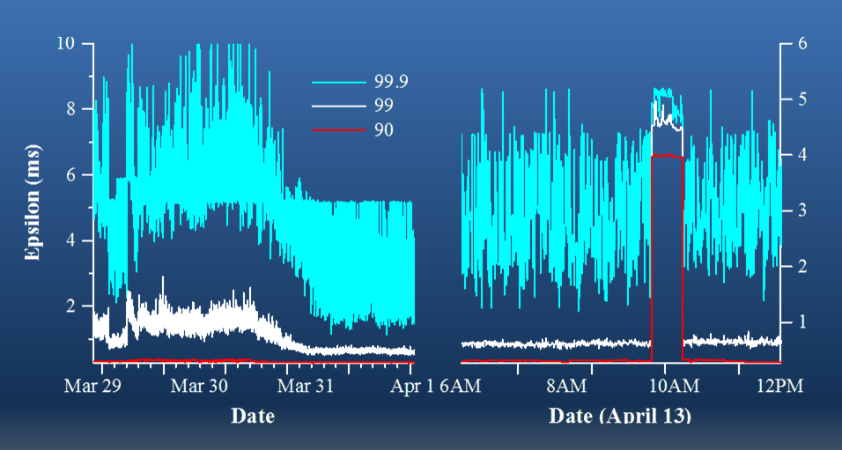
Practical Experience @Google
(1) Is ε truly a bound on clock uncertainty?
Violations of guarantees [drift rate] unlikely: Bad CPUs 6 times more likely than bad clocks (based on 1y of data)
“As a result, we believe that TrueTime’s implementation is as trustworthy as any other piece of software upon which Spanner depends”
(2) How bad does ε get?
Network-induced
uncertainty
ε sampled at timeslave daemons immediately after polling the time masters
Notes:
Figure 6 presents TrueTime data taken at several thousand spanserver machines across datacenters up to 2200. km apart. It plots the 90th, 99th, and 99.9th percentiles of , sampled at timeslave daemons immediately after polling the time masters. This sampling elides the sawtooth in due to local-clock uncertainty, and therefore measures time-master uncertainty (which is generally 0) plus communication delay to the time masters.
The data shows that these two factors in determining the base value of are generally not a problem. However, there can be significant tail-latency issues that cause higher values of . The reduction in tail latencies beginning on March 30 were due to networking improvements that reduced transient network-link congestion. The increase in on April 13, approximately one hour in duration, resulted from the shutdown of 2 time masters at a datacenter for routine maintenance. We continue to investigate and remove causes of TrueTime spikes.

Slide 25
Recap: expose uncertainty of time estimates
“Global wall-clock time” with bounded uncertainty
Time estimate
Guaranteed interval
TT.now()
time
earliest
latest
2*ε

Slide 26
How would Spanner/TrueTime help here ….
Add 1% interest
Account X
Add $1,000, Account X
Middleware: one-to-many communication layer
Goal (for next few slides):
aggregate data from transaction initiators to construct a correct ordering of events
[NB: This is a over-simplified view of spanner]
Q: Do the updates need to be executed in the same order on the two replicas?
Issues:
What kind of ordering: partial or total?
Does ‘real’ (physical time) ordering matter for correctness?
Notes:
NB: This is a over-simplified view of spanner

Slide 27
Ok – so how does this help with event ordering?
T₁
T₂
T₄
Machine 1
time
T₃
T₅
Machine 2
time
Events get timestamped (with uncertainty intervals)
Use the timestamps to recreate a global view for the order in which events occurred.
Order unambiguous as long as the uncertainty intervals do not overlap
Notes:
https://cloud.google.com/spanner/docs/true-time-external-consistency
https://sookocheff.com/post/time/truetime/
So how does a transaction look like:
Take some locks
Copy workspace
Execute all work
If execution fails
Use backup to restore all data
Release locks
Imagine two transactions initiated on two nodes:
-- if they operate on the same data, I want them executed in the same order when re-executing the trace
-- if they do not – I do not care
Time of a transaction: commit-time().
If I want to be sure of ordering: commit-times() spaced by at least 2*E

Slide 28
Ordering transactions
T₁
T₂
T₄
Machine 1
time
T₃
T₅
Machine 2
time
Assume that T_{x} are transaction timestamps.
Timestamps taken at commit time
Goal is to recreate the global transaction order
If two transactions are not conflicting: order does not matter
Else: need to get the order right
Notes:
https://cloud.google.com/spanner/docs/true-time-external-consistency
https://sookocheff.com/post/time/truetime/
So how does a transaction look like:
Take some locks
Copy workspace
Execute all work
If execution fails
Use backup to restore all data
Release locks
Imagine two transactions initiated on two nodes:
-- if they operate on the same data, I want them executed in the same order when re-executing the trace
-- if they do not – I do not care
Time of a transaction: commit-time().
If I want to be sure of ordering: commit-times() spaced by at least 2*E

Slide 29
Ordering transactions
T₁
T₂
T₄
Machine 1
time
T₃
T₅
Machine 2
time
Assume that T_{x} are transaction commit timestamps.
Goal is to recreate the global transaction order
If two transactions are not conflicting: order does not matter
Else: need to get the order right
Notes:
https://cloud.google.com/spanner/docs/true-time-external-consistency
https://sookocheff.com/post/time/truetime/
So how does a transaction look like:
Take some locks
Copy workspace
Execute all work
If execution fails
Use backup to restore all data
Release locks
Imagine two transactions initiated on two nodes:
-- if they operate on the same data, I want them executed in the same order when re-executing the trace
-- if they do not – I do not care
Time of a transaction: commit-time().
If I want to be sure of ordering: commit-times() spaced by at least 2*E

Slide 30
Spanner solution
T₄
Machine 1
time
T₅
Machine 2
time
Move timestamp within the transaction
So that full uncertainty interval is within the transaction
If needed (i.e., transaction is too short) extend the transaction
i.e., delay releasing the resources
This way conflicting transactions have timestamps that can be ordered without uncertainty
Notes:
https://cloud.google.com/spanner/docs/true-time-external-consistency
https://sookocheff.com/post/time/truetime/
So how does a transaction look like:
Take some locks
Copy workspace
Execute all work
If execution fails
Use backup to restore all data
Release locks
Imagine two transactions initiated on two nodes:
-- if they operate on the same data, I want them executed in the same order when re-executing the trace
-- if they do not – I do not care
Time of a transaction: commit-time().
If I want to be sure of ordering: commit-times() spaced by at least 2*E

Slide 31
We’ve established that clocks can not be perfectly synchronized (and atomic clocks are costly).
What can one do in these conditions?
Get a better estimate of time
e.g., use GPS to extract time in your system /
Expose uncertainty and design the system to take drift into account
Example 1: Google’s Spanner – Extended time API
Example 2: Server design to provide at-most-once semantics
Give up physical clocks!
Consider only event order - Logical clocks

Slide 32
Efficient at-most-once message delivery
Goal : Server has to identify previously served requests to implement at-most-once semantics
[New] Assumptions:
No bound on message propagation time
There is a bound on clock drift
any two clocks in the system differ by at most MaxClockDrift
Client may resend messages for up to MaxLifeTime
after that reports error to application
Issues
1: For how long to maintain ‘transaction’ data?
2: How to deal with server failures?
(minimize the state that is persistently stored, when to restart)
[Old] Assumptions:
Message propagation time bounded
Physical clocks not used
(so no need to make assumptions about drift rates)
Client may resend messages for up to MaxLifeTime

Slide 33
Issue1: For how long to maintain transaction data at server?
Server’s goals:
1. Identify message duplicates – at-most-once delivery
2. While trying to avoid storing too much state
Context:
No bound on message propagation time
Any two clocks in the system differ by at most MaxClockDrift
Client may resend messages for up to MaxLifeTime
Mechanism idea: Server discards messages that have been generated too far in the past.
Client protocol: client sends transactionID and physical timestamp
Server computes: G = T_{now} - MaxLifeTime – MaxClockDrift
… and maintains transaction data only for the interval [G..T_{now}]
Discards messages with msg_{timestamp} older than G
Ignores (or delays) messages that arrive in future: msg_{timestamp} >T_{current}

Slide 34
Efficient at-most-once message delivery
Design goal : Server has to identify previously served requests to implement at-most-once semantics
[New] Assumptions:
No bound on message propagation time
There is a bound on clock drift
any two clocks in the system differ by at most MaxClockDrift
Client may resend messages for up to MaxLifeTime
after that reports error (timeout) to the application
Issues
1: For how long to maintain ‘transaction’ data?
2: How to deal with server failures? What to persist across server failures? When to restart?
(minimize the state that is persistently stored, minimize downtime)

Slide 35
Efficient at-most-once message delivery (II)
Issue 2: What to persistently store across server failures?
Strawman #1: Store nothing persistently.
Incorrect if server reboots quickly
Strawman #2: Persistently store ALL transactions.
Costly
Strawman #3: Store nothing persistently, and wait MaxLifeTime after reboot before starting to process messages
Correct but lowers availability.

Slide 36
Efficient at-most-once message delivery (II)
Issue 2: What to persistently store across server failures?
Towards a solution: need to approximate failure time
Write current time (CT) to disk every ΔT
At recovery read it
Failure time is approximated as G_{failure} from last saved CT
After recovery – when a new message arrives
(let’s ignore clock drift for now and assume perfect clocks)
Discard messages with timestamp older than G_{failure} + ΔT
Reason: the server might have seen these in the past (but lost the cache)
Process messages with timestamp newer than G_{failure} + ΔT
Reason: surely not seen before failure
[Quiz-like question: Change the formulas to consider clock drift]
Notes:
Quiz-like questions:
the two bullets above ignore clock drift. How fo you Change the formulas to consider the clock drift
Should consider MaxLifeTime in the message processing decision in the second blue bullet above? What’s the impact if flitered out – correctness? Speed? Something else?

Slide 37
Quiz-like question
Previous solution
no assumption on maximum message propagation time
uses physical clocks (with a bound on max clock drift)
You can now assume an upper bound B on message propagation time
Design a solution that does not use physical clocks?

Slide 38
We’ve established that clocks can not be perfectly synchronized (and atomic clocks are costly).
What can I do in these conditions?
Get a better estimate of time by using new technology
GPS systems
Expose uncertainty / Design the system to take drift into account
Example: Server design to provide at-most-once semantics
Give up physical clocks!
Consider only event order - Logical clocks

Slide 39
Logical clocks -- Time Revisited
What’s important?
The precise time two events occurred?
OR
The order in which the two events occured?

Slide 40
(1) Alice intends to quit her employer
She removes her boss as a friend
Posts “I’ll quit tomorrow! Here is the story: … “
(visible to friends only)
(2) Bob, a friend of Alice,
Reads Alice’s post
Messages Charlie, a common friend:
“Wow! Alice just posted that she’ll quit! Read her story!” *
(3) Charlie, a friend of both
Reads Bob’s message
Goes to Alice’s timeline to read the story
Alice expects her boss will not be able to see her post
Charlie expects to see Alice’s post
Common expectation: process events in the order they occurred
* We are in 2003, post sharing has not been invented

Slide 41
Logical clocks: ROADMAP
Define partial order for events
“happens before” relationship “→”
Logical clocks
Assign timestamps to events
such that:
if a → b then ts(a) < t(b)
What are the constraints?
What does ‘ordering’ mean?
Come up with a system to ‘label’ events that respects these constraints
Build systems
E.g., totally ordered group communication
How is this used?

Slide 42
What are the constraints? What does ‘order’ mean?
Need to introduce a notion of ordering (before we can order anything).
The happened-before relation (notation: “→”) on a set of events in a distributed system
if a, b are events in the same process, and a occurs before b, (in physical time) then a → b
if a is the event of sending a message by a process, and b
receiving same message by another process then a → b
Property: Transitive: if a→b and b→c then a→ c
Two events are concurrent if nothing can be said about the order in which they happened (i.e. happens-before is a partial order)

Slide 43
Logical clocks: ROADMAP
Define partial order for events
“happens before” relationship
Notation: →
Logical clocks
Assign timestamp to events such that if a → b then ts(a) < t(b)
Come up with a system to ‘label’ events that respects these constraints
What are the constraints?
What does ‘ordering’ mean?
Build systems
E.g., totally ordered group communication
How may this be used?

Slide 44
Logical clocks
Objective: Build a view on the system’s behavior that is consistent with the ‘happened-before’ relation
Attach a timestamp ts(e) to each event e, such that:
P1: If a and b are events in the same process, and a happened before in physical time b, then we demand that ts(a) < ts(b).
P2: If a corresponds to sending a message, and b to the receipt of that message, then also ts(a) < ts(b).
Problem: How to attach timestamps to all events in the system (consistent with the rules above) when there’s no global clock
maintain a consistent set of logical clocks, one per process.
Notes:
Quiz question: Would using physical time to do the same thing work? When?

Slide 45
Problem: Need to attach timestamps to all events in the system
maintain a consistent set of logical clocks, one per process.
there’s no global clock
Solution (Lamport): Each process P_{i} maintains a local counter C_{i} and adjusts it as follows:
For any two successive events that take place within P_{i} the counter c_{i} is incremented by 1.
Each time a message m is sent by process P_{i} the message is timestamped ts(m) = c_{i}
Whenever a message m is received by a process P_{j}, P_{j} adjusts its local counter c_{j} to max{C_{j}, ts(m)}; then executes step 1 before passing m to the application.
Property P1 is satisfied by (1); Property P2 by (2) and (3).

Slide 46
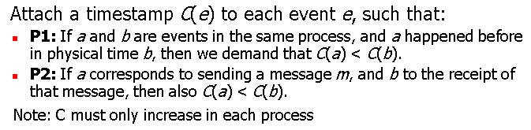
Updating Lamport’s logical timestamps
Physical Time
p 1
0
1
2
8
7
1
8
p 2
3
0
2
2
3
6
p 3
4
10
0
3
5
9
4
7
p 4
7
0
5
6
n
Clock Value
Message
timestamp
Notes:
46

Slide 47
Quiz-like question
Notation: timestamp(a) is the Lamport logical clock associated with event a
By construction if a → b => timestamp(a) < timestamp(b)
(if a happens before b, then timestamp(a) < timestamp(b))
Q: is the converse true?
That is: if timestamp(a) < timestamp(b) => a → b
No. If timestamp(a) < timestamp(b), it does NOT imply that a happens before b
Q: Do I know anything timestamp(a) < timestamp(b)?
A: Only that b→ a is FALSE (i.e.. b surely did NOT happen before a, more concrete:
a and b concurrent OR a happened before b )
?

Slide 48
Example
Physical Time
p 1
0
1
2
8
7
1
8
p 2
3
0
2
2
3
6
p 3
4
10
0
3
5
9
4
7
p 4
7
0
5
6
n
Clock Value
concurrent events can not be detected based on Lamport clock info
timestamp
Message
Note: Lamport Timestamps: 3 < 7, but event with timestamp 3 is concurrent to event with timestamp 7, (events are not in ‘happen-before’ relation).
Notes:
48

Slide 49
Last Time: Logical time
What is that?
• Discrete assignment of sequence numbers to events, which preserves “happens-before” order
How do Lamport clocks work?
• Processes increment their clocks upon receiving/sending new messages and based on other processes' clocks (carried with messages)

Slide 50
Example
Physical Time
p 1
0
1
2
8
7
1
8
p 2
3
0
2
2
3
6
p 3
4
10
0
3
5
9
4
7
p 4
7
0
5
6
n
Clock Value
concurrent events can not be detected based on Lamport clock info
timestamp
Message
Note: Lamport Timestamps: 3 < 7, but event with timestamp 3 is concurrent to event with timestamp 7, (events are not in ‘happen-before’ relation).
Notes:
50

Slide 51
Define partial order for events
“happens before” relationship
Logical clocks
Assign timestamp to events such that if a → b then ts(a) < t(b)
Build systems
E.g., totally ordered group communication

Slide 52
One example use
\big_detour{start}
Mutual exclusion
[see separate slide set]

Slide 53
\big_detour{end}

Slide 54
Example II – replicated state machine
Two accounts:
Initial state: $100 account balance
Update 1: add $100
Update 2: add 1% monthly interest
Updates need to be performed in the same order at the two replicas!
Middleware layer that provides total ordering

Slide 55
Architectural view
Middleware layer in charge of:
Local management of logical clocks
i.e., stamping messages with (logical) clock times, updating timestamps at message receival,
Message ordering: e.g. by delaying delivery/buffering (if needed)

Slide 56
Totally ordered group communication (cont)
Setup (for simplicity)
All members are both
senders and receivers
A one-to-many communication substrate
FIFO / Reliable Channels
No Side Channels
Sketch of a solution:
Middleware at each member maintains an ordered queue of received messages that have not yet been delivered to the application.
Main issue: when to deliver to application such that, at all endpoints, messages are delivered in the same order.
Each message is timestamped with local logical time then multicasted
When multicasted, also message logically sent to the sender itself
When receiving a message, the middleware layer
Adds message to local queue (ordered by sending timestamp)
Acknowledges (using multicast) the message
Delivers from top of queue to application only when all acks for message on top have been received (or optimization: see next slide)

Slide 57
Totally Ordered Multicast – Algorithm
Process P_{i} sends timestamped message msg_{i} to all others. The message itself is put in the local queue_{i} as well
Any incoming message msg_{i} received at P_{k} is queued in queue_{k} according to its sent timestamp, and acknowledged to every other process.
P_{k} delivers a message msg_{i} to its application if:
msg_{i} is at the head of queue_{k} and
for each process P_{x}, there is an ack or a message in queue_{k} with a larger sending timestamp.
Guarantee: all messages are delivered in the same order at all destinations
Note: We assume that communication is reliable and FIFO ordered.
Sending / Receiving
Deliver to application
Notes:
What happens if we drop channel reliability assumption?
- Fails (hangs): If a message is lost the protocol as described hangs.
What happens if we drop channel FIFO assumption?
- Fails (incorrect results): The whole reasoning about correctness in the protocol is based on the fact that no messages with an earlier timstamp can arrive

Slide 58
Quiz-Like Questions
What’s the complexity of the protocol in terms of number of messages
What happens if we drop channel reliability assumption?
Does the protocol still work? If it fails, explain how.
What happens if we drop channel FIFO assumption?
Does the protocol still work?
How would you change the previous protocol to still work correctly without this assumption?
Assume you have a bound on message propagation time in the network. Design a protocol that provides total ordering (and generates less traffic)
Notes:
Q1: What’s the complexity of the protocol in terms of number of messages
- A: N^2
Q2, Q3: see previous page
Q4:

Slide 59
Define (partial) order for events
“happens before” relation
Logical clocks
Assign timestamp to events such that:
if a → b then ts(a) < ts(b)
ISSUE
By design (with Lamport timestamps)
a → b => timestamp(a)<timestamp(b)
But
If timestamp(a)<timestamp(b) one can not reason about relative ordering of a and b
[the only thing you know is that b→a is FALSE]
Build systems
E.g., totally ordered group communication

Slide 60
Example
Physical Time
p 1
0
1
2
8
7
1
8
p 2
3
0
2
2
3
6
p 3
4
10
0
3
5
9
4
7
p 4
7
0
5
6
n
Clock Value
concurrent events can not be detected
timestamp
Message
Issue: Lamport Timestamps 3 < 7, but event with timestamp 3 is concurrent to event with timestamp 7, i.e., events are not in ‘happen-before’ relation.
Notes:
60

Slide 61
Causality
Isue: Lamport timestamps don’t properly capture causality
Introduce more ordering than necessary
Applications often need to reason about (i.e., order similarly) only causally related messages.
Example: news postings have multiple independent threads of messages.
What are the constraints on ordering?
To model causality – vector timestamps
Intuition: each item in vector logical clock for one causality thread.

Slide 62
Define partial order for events
“happens before” relationship
Vector clocks
Assign timestamps to keep track of event causality
Build systems
E.g., causally ordered group communication

Slide 63
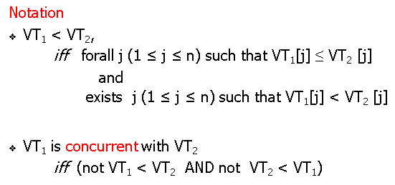
Example: Vector Timestamsps
logically concurrent events can be detected
Physical Time
p 1
1,0,0,0
2,0,0,0
3,0,2,2
4,0,2,2
0,0,0,0
(1,0,0,0)
p 2
1,2,0,0
(4,0,2,2)
0,0,0,0
1,1,0,0
(2,0,0,0)
(1,2,0,0)
(2,0,2,2)
p 3
0,0,0,0
2,0,2,0
4,2,5,3
2,0,1,0
2,2,3,0
4,2,4,2
(2,0,2,0)
(2,0,2,3)
p 4
0,0,0,0
2,0,2,2
2,0,2,1
2,0,2,3
n,m,p,q
Vector logical clock
(vector timestamp)
Message
Notes:
63

Slide 64
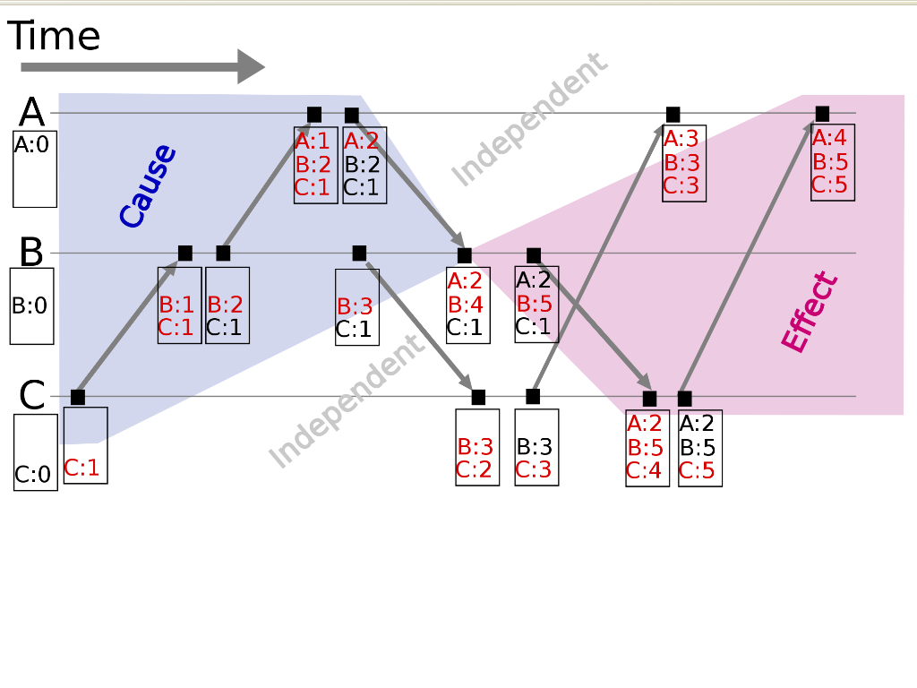
Vector clocks/timestamps enable reasoning about causality
Events in the blue region are the causes leading to event B4, whereas those in the red region are the effects of event B4

Slide 65
Vector clocks: the formal definition
Each process P_{i} has an array VC_{i} [1..n] of clocks (all initially at 0)
VC_{i} [j] denotes the number of events that process P_{i} knows have taken place at process P_{j}.
P_{i} increments VC_{i} [i]: when an event occurs
local event, message sending, message receiving
timestamp of the event is vector value
When sending
Messages sent by VC_{i} includes a vector timestamp vt(m).
Result: upon arrival, recipient knows P_{i}’s timestamp.
When P_{j} receives a msg from P_{i} with vector timestamp ts(m):
for k ≠ j: update each VC_{j} [k] to max{VC_{j} [k], ts(m)[k]}
Note: vector timestamps require a static notion of system membership
Notes:
Question: What does VC_{i}[j] = k mean in terms of messages sent and received?
A: Current state at process i is based on state at process j after this has processed k messages

Slide 66
Comparing vector timestamps
Notation
VT₁ < VT₂,
iff forall j (1 ≤ j ≤ n) such that VT₁[j] ≤ VT₂ [j]
and
exists j (1 ≤ j ≤ n) such that VT₁[j] < VT₂ [j]
VT₁ is concurrent with VT₂
iff (not VT₁ < VT₂ AND not VT₂ < VT₁)
Notes:
66

Slide 67
Quiz like problem
Show that:
a → b if and only if vectorTS(a) < vectorTS(b)
Notes:
Solution at: http://www.ece.ubc.ca/~matei/EECE411/proof-timestamps.pdf

Slide 68
Extending group communication
ASSUMPTIONS
messages are multicast to (named) process groups
reliable and FIFO channels
processes don’t crash
processes behave as specified (i.e., we are not considering Byzantine behaviour)
Architectural view
Application: chooses delivery order of message service e.g. total order, FIFO order, causal order
(last time we looked at ‘total order’)
Application
process
Middleware: may reorder/delay message delivery to application by buffering messages to implement reordering policy
Messaging middleware
OS comms. interface
Basic network layer: provides reliable FIFO from each source (done at lower levels)

Slide 69
FIFO multicast
FIFO (or sender ordered) multicast: Messages sent by any single sender are received in the same order
Nothing guaranteed for relative ordering of messages sent by two different senders
a
e
P1
P2
P3
P4

Slide 70
FIFO multicast
FIFO (or sender ordered) multicast: Messages sent by any single sender are received in the same order
Nothing guaranteed for relative ordering of messages sent by two different senders
a
e
P1
P2
P3
P4
b
c
d
delivery of c to P1 is delayed until after b is delivered
d and e are received in different order at P2 and P3

Slide 71
Implementing FIFO multicast
Basic reliable (i.e., no message loss) multicast has this property
Without failures all we need is to run it on FIFO channels (like TCP)
[Later: dealing with node failures]

Slide 72
Causal multicast
Causal (or happens-before ordering)
If send(a) → send(b) (i.e., there was some causal relationship)
then deliver(a) occurs before deliver(b) at common destinations
a
P1
P2
P3
P4
b

Slide 73
Ordering properties: Causal
Causal (or happens-before ordering)
If send(a) → send(b) (i.e., there was some causal relationship)
then deliver(a) occurs before deliver(b) at common destinations
a
P1
P2
P3
P4
b
c
delivery of c to P1 is delayed until after b is delivered

Slide 74
Ordering properties: Causal
Causal (or happens-before ordering)
If send(a) → send(b) (i.e., there was some causal relationship)
then deliver(a) occurs before deliver(b) at common destinations
a
e
P1
P2
P3
P4
b
c
d
e is sent (causally) after b and c
e is sent concurrently with d

Slide 75
Ordering properties: Causal
Causal (or happens-before ordering)
If send(a) → send(b)
(i.e., if there was some causal relationship) between a and b)
then deliver(a) occurs before deliver(b) at common destinations
a
e
P1
P2
P3
P4
b
c
d
delivery of c to P1 is delayed until after b is delivered
delivery of e to P3 is delayed until after b&c are delivered
delivery of e and d to P2 and P3 in any relative order (concurrent)

Slide 76
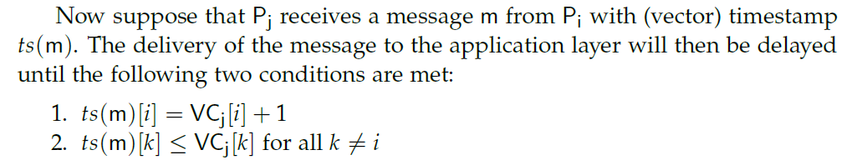
Implementing causally ordered multicast
[note slightly different update rule for vector clocks to enable counting the number of messages sent by each machine]

Slide 77
Implementing causally ordered multicast
P₀
(0,0,0)
P₁
(0,0,0)
P₂
(0,0,0)
Vector clocks on each process all initialized at (0,0,0)
At process P_{i} position i will count how many messages P_{i} has sent
position k≠ i will count how many messages P_{i} has received from P_{k}

Slide 78
[note slightly different update rule for vector clocks to enable counting the number of messages sent by each machine]
M₀ = (1,0,0)
P₀
(1,0,0)
P₁
(0,0,0)
P₂
(0,0,0)
Message Mo is initiated at Po and can be delivered to application locally.
Vector clock at Po is updated.
Mo is sent with its vector clock

Slide 79
M₀
P₀
(1,0,0)
(1,0,0)
P₁
(0,0,0)
P₂
(0,0,0)
Message Mo is initiated at Po and can be delivered to the application locally.
Vector clock at Po is updated.
Mo is sent with its vector clock to the other processes

Slide 80
M₀
P₀
(1,0,0)
(1,0,0)
P₁
(0,0,0)
P₂
(0,0,0)
Message Mo arrives at P1
Message Mo can be delivered to the application at P1: the check - all messages that have potentially been received at Po before generating Mo have been seen by P1 as well

Slide 81
M₀
P₀
(1,0,0)
(1,0,0)
P₁
(1,0,0)
P₂
(0,0,0)
Message Mo is delivered at P1
P1 updates its vector clock

Slide 82
M₀
P₀
(1,0,0)
(1,0,0)
P₁
(1,1,0)
M₁
(1,1,0)
P₂
(0,0,0)
Message M1 is created by P1. The message can be delivered to local application at P1. P1 updates its vector clock. This timestamp (1,1,0) is carried by M1.
Message M1 arrives at P2. Can not be delivered to P2 since, M1’s vector clock at position 0 implies that, when M1 was created it has one message from Po and P2 has not yet seen that message.

Slide 83
M₀
P₀
(1,0,0)
(1,0,0)
P₁
(1,1,0)
M₁
(1,1,0)
(1,0,0)
P₂
(0,0,0)
Message Mo arrives at P2. Can be delivered to P2 (same argument)

Slide 84
M₀
P₀
(1,0,0)
(1,0,0)
P₁
(1,1,0)
M₁
(1,1,0)
(1,0,0)
P₂
(1,0,0)
Message Mo is delivered to P2. P2’s vector clock is updated.
Now P2 can look at the other messages it has in its queue

Slide 85
M₀
P₀
(1,0,0)
(1,0,0)
P₁
(1,1,0)
M₁
(1,1,0)
(1,0,0)
P₂
(1,1,0)
Now Mo can be delivered to application at P2. P2’s vector clock is updated.

Slide 86
M₀
P₀
(1,1,0)
(1,0,0)
P₁
(1,1,0)
M₁
(1,1,0)
(1,0,0)
P₂
(1,1,0)
M1 arrives at Po and can be delivered to application. Po updates its vector clock

Slide 87
Implementing causal order multicast
Start with FIFO multicast
Strengthen this into a causal multicast by adding vector time
Advantages (compared with totally ordered multicast)
No additional messages needed!
Lower overhead
causal multicast (as well as FIFO multicast) are asynchronous:
Sender doesn’t get blocked and can deliver a copy to itself without “stopping” to learn a safe delivery order

Slide 88
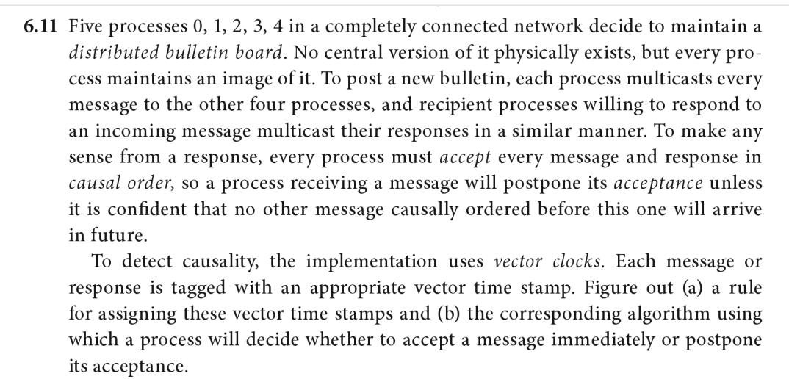
Sample quiz question

Slide 89
So far …
Physical clocks
Two applications
Provide at-most-once semantics
Global Positioning Systems
‘Logical clocks’
Where only ordering of events matters
Next:
Replication
One application that puts everything together

