Slide 1
Mutual exclusion

Slide 2
Example use I – mutual exclusion [access granted in order]
Goal: a solution for granting a resource to a process which satisfies the following three conditions:
[mutual exclusion] A process which has been granted the resource must release it before the resource can be granted to another process.
[termination/progress] If every process which is granted the resource eventually releases it, then every request is eventually granted.
[ordering] Requests must be granted in the order in which they are made.

Slide 3
Distributed Mutual Exclusion Is Different
Regular mutual exclusion solved using shared state
– E.g., atomic test-and-set of shared variable
Only tool for distributed mutual exclusion:
message passing

Slide 4
Assumptions
Communication channels
reliable: messages do arrive at destination
in-order: messages are delivered in the order in which they are sent
asynchronous (messages may take long time)
Participants do not fail.
Q: Potential Designs?

Slide 5
Distributed Mutual Exclusion Protocols
• Key ideas:
– Before entering critical section, processor must get
permission (from other processors, or from arbitrator)
– When exiting critical section, processor must let the
others know that he’s finished
– For fairness, processors allow other processors who
have asked for permission earlier than them to proceed
Compare liveness, message overhead, synchronization delay

Slide 6
Solution 1: Centralized Lock Server
• To enter critical section:
– send REQUEST to central server
– wait for permission from server
• To leave critical section:
– send RELEASE to central server
• Server:
– Has an internal queue of all REQUESTs it’s received
but to which it hasn’t yet sent OK
– Delays sending OK back to process until process is at head of queue
– Removes process from the queue after it get RELEASE

Slide 7
Server
Queue:
User
Enter()
P₁
P₄
P₂
P₃

Slide 8
Server
Queue:
User
3
Enter()
P₁
P₄
P₂
P₃

Slide 9
Server
Queue:
User
3
P₁
P₄
P₂
P₃

Slide 10
Server
Queue:
User
3
enter()
P₁
P₄
P₂
P₃

Slide 11
Server
Queue:
4
User
3
enter()
P₁
P₄
P₃

Slide 12
Server
Queue:
4
User
3
enter()
enter()
P₁
P₄
P₂
P₃

Slide 13
Server
Queue:
4, 2
User
3
enter()
enter()
P₁
P₄
P₂
P₃

Slide 14
Server
Queue:
4, 2
User
3
enter()
enter()
exit()
P₁
P₄
P₂
P₃

Slide 15
Server
Queue:
4, 2
User
enter()
enter()
P₁
P₄
P₂
P₃

Slide 16
Server
Queue:
2
User
4
enter()
P₁
P₄
P₂
P₃

Slide 17
Lamport’s algorithm -
Each process (locally) maintains Qi a local copy of a shared priority queue
To enter critical section, P
must have replies from all other processes AND
be at the front of Qi
Rationale: When P has all replies:
#1: All other processes are aware of P’s request
#2: P is aware of any earlier requests for the mutex (if any)

Slide 18
Advantages:
– Simple (we like simple!)
– Only 3 messages required per sync session (enter&exit)
Disadvantages:
– Single point of failure
– Single performance bottleneck
– With an asynchronous network, doesn’t achieve in-order fairness (even for logical time order)
– Must select (or elect) a central server

Slide 19
Solution 2: A ring-based algorithm
Pass a token around a ring
– Participant enters critical section only if it holds the token
Problems:
– Not in-order
– Long synchronization delay
Need to wait for up to N-1 messages, for N processors
– Very unreliable
Any process failure breaks the ring
Does not guarantee ordering (but this can be fixed). How?

Slide 20
To request the resource: process P^{i} sends
the message request_resource (T^{m}:P^{i}) to every process, and
puts that message on its own request queue
[T^{m} is the timestamp of resource request: i.e. logical clock when req. is sent]
When P^{j} receives request_resource (T^{m}:P^{i}),
it places it on its request queue
sends a (timestamped) acknowledgment message to P^{i}
To release the resource, P^{i}
removes any request_resource(T^{m}:P^{i}) message from its request queue
sends a (timestamped) release_resource (P^{i}) to every other process.
When process P^{j} receives a P^{i} releases resource message,
it removes any request_resource (T^{m}:P^{i}) message from its queue.
Process P^{i} is granted the resource when
there is a requests resource (T^{m}:P^{i}) message at the top of its own request queue (ordered by logical timestamp in T^{m}) AND
P^{i} has received a message from every other process timestamped later than T^{m}

Slide 21
Lamport Algorithm
Rule 1
To request a resource, process i
sends a request message T_{m}:i to every other process,
T_{m} is the timestamp of the message.
then stores a copy of the message in its request queue.

Slide 22
Lamport Example
Total ordering: C ≺ D ≺ E
C
RQ_{C} = { }
D
RQ_{D} = { }
E
RQ_{E} = { }

Slide 23
Lamport Example
D requests the resource by sending request messages to C and E
C
RQ_{C} = { }
req(1:D)
1
D
RQ_{D} = { }
req(1:D)
E
RQ_{E} = { }

Slide 24
Lamport Example
D then stores its own request
C
RQ_{C} = { }
req(1:D)
1
D
RQ_{D} = { 1:D }
req(1:D)
E
RQ_{E} = { }

Slide 25
Lamport Example
C requests the resource by sending request messages to D and E
1
C
RQ_{C} = { }
req(1:C)
req(1:D)
1
D
RQ_{D} = { 1:D }
req(1:D)
E
RQ_{E} = { }

Slide 26
Lamport Example
C then stores its own request
1
C
RQ_{C} = { 1:C }
req(1:C)
req(1:D)
1
D
RQ_{D} = { 1:D }
req(1:D)
E
RQ_{E} = { }

Slide 27
Lamport Algorithm
Rule 2
When process j receives a request message T_{m}:i,
it places it in its request queue, and
sends a timestamped acknowledgment back to process i.

Slide 28
Lamport Example
1
C
RQ_{C} = { 1:C }
req(1:C)
req(1:D)
1
D
RQ_{D} = { 1:D }
req(1:D)
E
RQ_{E} = { }

Slide 29
Lamport Example
E places D’s request in its queue and sends an acknowledgment back
1
C
RQ_{C} = { 1:C }
req(1:C)
req(1:D)
1
D
RQ_{D} = { 1:D }
req(1:D)
ack(3:E)
E
2
RQ_{E} = { 1:D }
3

Slide 30
Lamport Example
D places C’s request in its queue and sends an acknowledgment back
1
C
RQ_{C} = { 1:C }
req(1:C)
req(1:D)
ack(3:D)
1
D
2
req(1:D)
3
RQ_{D} = { 1:C, 1:D }
ack(3:E)
E
2
RQ_{E} = { 1:D }
3

Slide 31
Lamport Example
C places D’s request in its queue and sends an acknowledgment back
1
2
3
C
req(1:C)
ack(3:C)
RQ_{C} = { 1:C, 1:D }
req(1:D)
ack(3:D)
1
D
2
req(1:D)
3
RQ_{D} = { 1:C, 1:D }
ack(3:E)
E
2
RQ_{E} = { 1:D }
3

Slide 32
Lamport Algorithm
Rule 5
Process i is granted the resource when the following conditions are satisfied:
There is a request T_{m}:i in its request queue that is ordered before any other request (by the total order)
Process i has received a message from every other process with a timestamp later than T_{m}

Slide 33
Lamport Example
1
2
3
C
req(1:C)
ack(3:C)
RQ_{C} = { 1:C, 1:D }
req(1:D)
ack(3:D)
1
D
2
req(1:D)
3
RQ_{D} = { 1:C, 1:D }
ack(3:E)
E
2
RQ_{E} = { 1:D }
3

Slide 34
Lamport Example
D isn’t granted the resource since 1:C ⇒ 1:D
1
2
3
C
req(1:C)
ack(3:C)
RQ_{C} = { 1:C, 1:D }
req(1:D)
ack(3:D)
1
4
D
2
req(1:D)
3
RQ_{D} = { 1:C, 1:D }
ack(3:E)
E
2
RQ_{E} = { 1:D }
3

Slide 35
Lamport Example
C isn’t granted the resource since it has not received a message from E
1
2
3
4
C
req(1:C)
ack(3:C)
RQ_{C} = { 1:C, 1:D }
req(1:D)
ack(3:D)
1
4
D
2
req(1:D)
3
RQ_{D} = { 1:C, 1:D }
ack(3:E)
E
2
RQ_{E} = { 1:D }
3

Slide 36
Lamport Example
E places C’s request in its queue and sends an acknowledgment back
1
2
3
4
C
req(1:C)
ack(3:C)
RQ_{C} = { 1:C, 1:D }
req(1:D)
ack(3:D)
1
4
D
2
req(1:D)
3
RQ_{D} = { 1:C, 1:D }
ack(3:E)
ack(5:E)
E
2
3
4
RQ_{E} = { 1:C, 1:D }
5

Slide 37
Lamport Example
D isn’t granted the resource since 1:C ⇒ 1:D
1
2
3
4
C
req(1:C)
ack(3:C)
RQ_{C} = { 1:C, 1:D }
req(1:D)
ack(3:D)
1
4
D
2
req(1:D)
3
5
RQ_{D} = { 1:C, 1:D }
ack(3:E)
ack(5:E)
E
2
3
4
RQ_{E} = { 1:C, 1:D }
5

Slide 38
Lamport Example
C is granted the resource since 1:C ⇒ 1:D and it has received later (i.e., timestamp > 1) messages from D and E
1
2
3
4
6
C
req(1:C)
ack(3:C)
RQ_{C} = { 1:C, 1:D }
req(1:D)
ack(3:D)
1
4
D
2
req(1:D)
3
5
RQ_{D} = { 1:C, 1:D }
ack(3:E)
ack(5:E)
E
2
3
4
RQ_{E} = { 1:C, 1:D }
5

Slide 39
Lamport Algorithm
Rule 3
To release a resource,
process i removes any T_{m}:i requests from its queue, and
sends a timestamped release message to every other process.

Slide 40
Lamport Example
C is finished with resource
1
2
7
3
4
6
C
req(1:C)
ack(3:C)
RQ_{C} = { 1:C, 1:D }
req(1:D)
ack(3:D)
1
4
D
2
req(1:D)
3
5
RQ_{D} = { 1:C, 1:D }
ack(3:E)
ack(5:E)
E
2
3
4
RQ_{E} = { 1:C, 1:D }
5

Slide 41
Lamport Example
C removes its request from its own queue
1
2
7
3
4
6
C
RQ_{C} = { 1:D }
req(1:C)
ack(3:C)
req(1:D)
ack(3:D)
1
4
D
2
req(1:D)
3
5
RQ_{D} = { 1:C, 1:D }
ack(3:E)
ack(5:E)
E
2
3
4
RQ_{E} = { 1:C, 1:D }
5

Slide 42
Lamport Example
C releases the resource by sending release messages to D and E
1
2
7
3
4
6
C
RQ_{C} = { 1:D }
req(1:C)
ack(3:C)
rel(7:C)
req(1:D)
ack(3:D)
1
4
D
2
req(1:D)
3
5
RQ_{D} = { 1:C, 1:D }
ack(3:E)
ack(5:E)
E
2
3
4
RQ_{E} = { 1:C, 1:D }
5

Slide 43
Lamport Algorithm
Rule 4
When process j receives a release message from process i,
it removes any T_{m}:i requests from its request queue.

Slide 44
Lamport Example
1
2
7
3
4
6
C
RQ_{C} = { 1:D }
req(1:C)
ack(3:C)
rel(7:C)
req(1:D)
ack(3:D)
1
4
D
2
req(1:D)
3
5
RQ_{D} = { 1:C, 1:D }
ack(3:E)
ack(5:E)
E
2
3
4
RQ_{E} = { 1:C, 1:D }
5

Slide 45
Lamport Example
E removes C’s request
1
2
7
3
4
6
C
RQ_{C} = { 1:D }
req(1:C)
ack(3:C)
rel(7:C)
req(1:D)
ack(3:D)
1
4
D
2
req(1:D)
3
5
RQ_{D} = { 1:C, 1:D }
ack(3:E)
ack(5:E)
8
E
2
3
4
RQ_{E} = { 1:D }
5

Slide 46
Lamport Example
D removes C’s request
1
2
7
3
4
6
C
RQ_{C} = { 1:D }
req(1:C)
ack(3:C)
rel(7:C)
req(1:D)
ack(3:D)
1
4
8
D
2
req(1:D)
3
5
RQ_{D} = { 1:D }
ack(3:E)
ack(5:E)
8
E
2
3
4
RQ_{E} = { 1:D }
5

Slide 47
Lamport Example
D is granted the resource since it has received more later messages (timestamp > 1) from C and E
1
2
7
3
4
6
C
RQ_{C} = { 1:D }
req(1:C)
ack(3:C)
rel(7:C)
req(1:D)
ack(3:D)
1
4
8
D
2
req(1:D)
3
5
RQ_{D} = { 1:D }
ack(3:E)
ack(5:E)
8
E
2
3
4
RQ_{E} = { 1:D }
5

Slide 48
Why is this cool?
Fair, short synchronization delay
Condition to enter critical section tested locally
Each process independently follows these rules,
there is no one coordinating process or central storage.
Disadvantages:
Unreliable: any process failure halts progress

Slide 49
Other algorithms
Ricart & Agrawal: optimizes Lamport to reduce the number of messages
Same drawbacks
Voting based: more reliable – deals with failures / slow servers
But unfair (no ordering)

Slide 50
A voting-based protocol
Goal: Higher availability - deal with (temporary/ & full-stop) server failures, slow servers
Principle: Voting. The server protecting the resource is replicated n times, we’ll call each server replica a coordinator
Client access requires a majority vote from m > n/2 coordinators.
A coordinator always responds immediately to a request.
(without contacting other coordinators)
Client behavior if not enough votes: sends back votes and retries.
Failure model: If a coordinator crashes, it will (eventually) recover, but will have forgotten about the past (permissions it had granted).
Availability? Much better (load level dependednt?)
Correctness? Probabilistic! Issue: How robust is this system? What is the probability to make an incorrect ‘grant acces’ decision?

Slide 51
A voting-based protocol (cont)
Operating mode: Assume n coordinators (servers)
A coordinator always responds immediately to a request.
Access requires a majority vote from m > n/2 coordinators.
If a coordinator fails, it restarts immediately but looses state
Issue: How robust is this system?
When may the system malfunction?
How many servers have to ‘flip’
What’s the chance?

Slide 52
Malfunctioning?
Initial state: decision made for A: M votes for A, N-M votes for B
A
A
A
A
A
B
B
B
Some F nodes fail
A
A
A
A
A
B
B
B
And reset their state
A
A
A
B
B
B
Requests for B arrived later are effectively similar with a vote switch
A
B
A
B
A
B
B
B
Violation if (N-M) + F > M

Slide 53
A voting-based protocol (cont)
Operating mode: Assume n coordinators (servers)
A coordinator always responds immediately to a request.
Access requires a majority vote from m > n/2 coordinators.
If a coordinator fails, it restarts immediately but looses state
Issue: How robust is this system?

Slide 54
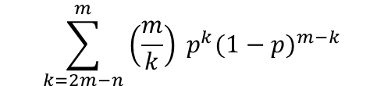
What’s the probability of malfunctioning
(violate mutual exclusion requirement and allow two clients in the critical region)?
p the probability that a coordinator resets in the next Δt
(crashes and recovers immediately)
p = Δt /T, where T is the an average server lifetime
The probability that k out m coordinators reset during Δt P[k]=C(k,m)p^{k}(1-p)^{m-k}:
Violation when at least 2m-n coordinators reset
[conservative bound]
Notes:
The setup.
* N coordinators in total. M votes needed to enter critical section (M > N/2).
* Let’s assume clients A and B want to enter the critical region, and launch their requests at the same time. A gets M votes and enters the critical region. B gets N-M votes only because his requests to the other coordinators are delayed.
The question.
How many servers need to fail (and reset immediately, and finally receive the request from B) such that the system makes an incorrect decision and also grants access to B in the critical region.
The solution
For this to happen you’d need to have the servers that have voted for A to fail (and grant access to B after they receive the delayed request).
How many of them? B already has N-M votes and needs X votes more to reach M. As an equation: N-M + X >= M leads to X >= 2M-N.
So, if at least 2M-N servers (out of the M) servers that voted for A fail (and the servers that voted for B continue to operate) the system makes an incorrect decision.
What’s the probability? You know that The probability that k out m coordinators reset during Δt is P[k]=C(k,m)p^{k}(1-p)^{m-k}.
Thus, the probability that at least 2M-N servers (out of the M) fail is:
sum (from k=2M-N to M) P[k]=C(k,M)p^{k}(1-p)^{M-k}.
Thus, the probability that at least 2M-N servers (out of the M) fail AND the servers that voted for B continue to operate is:
sum (from k=2M-N to M) P[k]=C(k,M)p^{k}(1-p)^{M-k}.(1-p) ^{N-M}

Slide 55
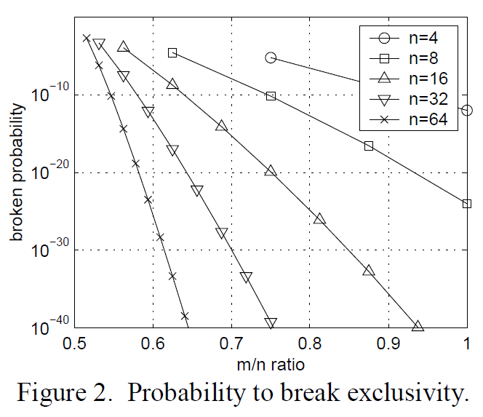

Slide 56
Issues
Any possible issues with the design?
Deadlock?

Slide 57
Recap: Assume n coordinators
Access requires a majority vote from m > n/2 coordinators.
A coordinator always responds immediately to a request.
A client that does not gain a voting `round` sends back its votes.
How are we doing on various success criteria? fairness, avoid starvation, robustness (ability to deal with failures), low overhead, timeliness?

Slide 58
Performance issue – starvation
Goodput with naïve solution

Slide 59
Performance issue – starvation
The fix:
Exponential backoff +
Informed by estimated place in the race

Slide 60
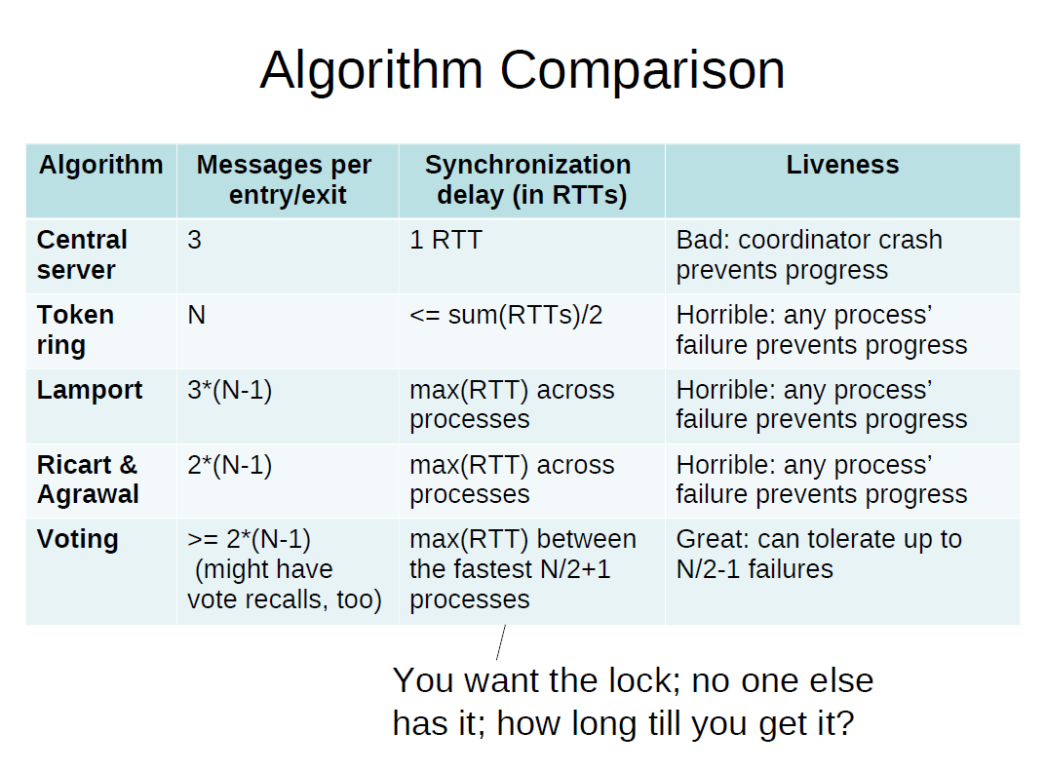

Slide 61
So, Who Wins?
Well, none of the algorithms we’ve looked at thus far
But the closest one to industrial standards is…
The centralized model (e.g., Google’s Chubby, Yahoo’s ZooKeeper)
But replicate it for fault-tolerance across a few machines
Replicas coordinate via mechanisms similar to the ones we’ve shown for the distributed algorithms (e.g., voting) – we’ll talk later about generalized voting alg.
For manageable load, app writers must avoid using the centralized lock service as much as humanly possible!

Slide 62
Take-Aways
Lamport algorithm
demonstrates how distributed processes can maintain consistent replicas of a data structure (the priority queue)
demonstrate utility of logical clocks
Cost of a distributed system may be high.

Slide 63
\big_detour{end}

