Slide 1
Replication & Consistency

Slide 2
  Replication: Creating and using multiple copies of data (or services)
  Why replicate?
  Improve system reliability
    Prevent data loss : i.e. increase data durability
    Increase data/service availability
      Note: availability ≠ durability
    Increase confidence: e.g. deal with byzantine failures
  Improve performance
    Scaling throughput
    Reduce access times

Slide 3
Context
Rather trivial
Stateless service replication
e.g., Web server dealing with page layout (constructed somewhere else), services in application tier in a 3-tier architecture
Data replication
E.g., File system, web site mirrors, browser caches, DNS
Control replication
Model: replicated state machine;
Stateful services (data and control), e.g., critical infrastructure service
Our focus for now

Slide 4
What are the issues?
Issue 1. Dealing with data changes
Consistency models
  What is the semantic the system implements?
    [not all applications require ‘strict’ consistency
Consistency protocols
  How to implement the semantic agreed upon?
  [Tools: (a) Operation ordering (delay some operations);
  (b) Operation assignment to replicas]
Issue 2. Replica management
How many replicas? Where to place them? When to get rid of them?
Issue 3. Request redirection/routing
Which replica should clients use?

Slide 5
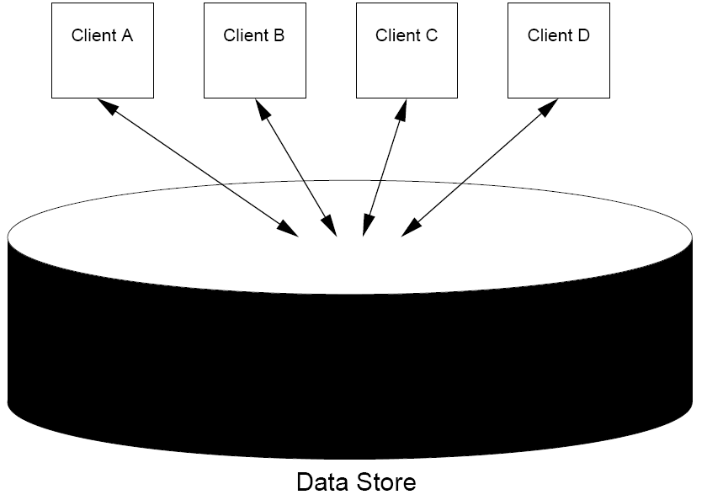
Client‘s view of the data-store
Ideally ‘black box’ – i.e., complete ‘transparency’ over how data is stored and managed

Slide 6
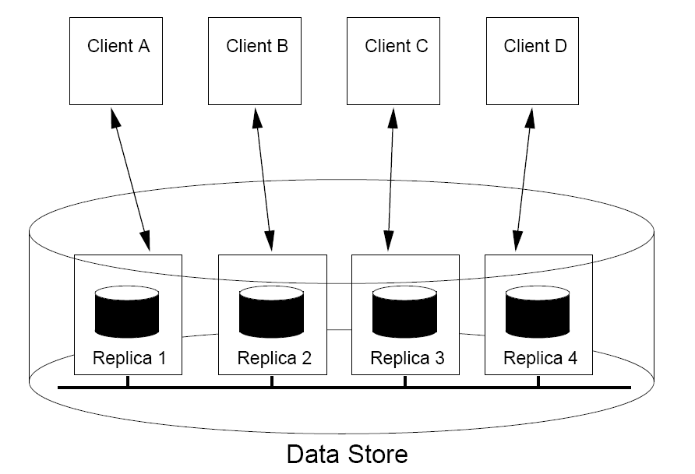
Replica management system view on data store: controls the allocated resources and aims to provide transparency

Slide 7
Consistency model:
Contract between: (i) the data store, and
(ii) the clients:
specifies the acceptable result of reads and writes in the presence of concurrent operations, failures, etc.

Slide 8
Why do I need one?

Slide 9
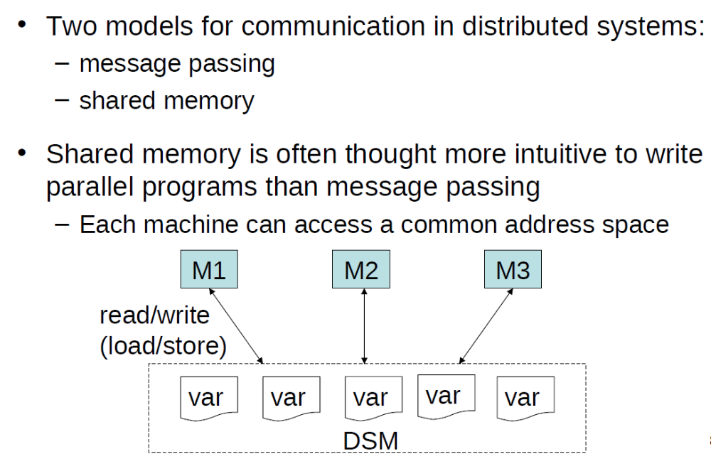
An example scenario: Distributed Shared Memory

Slide 10

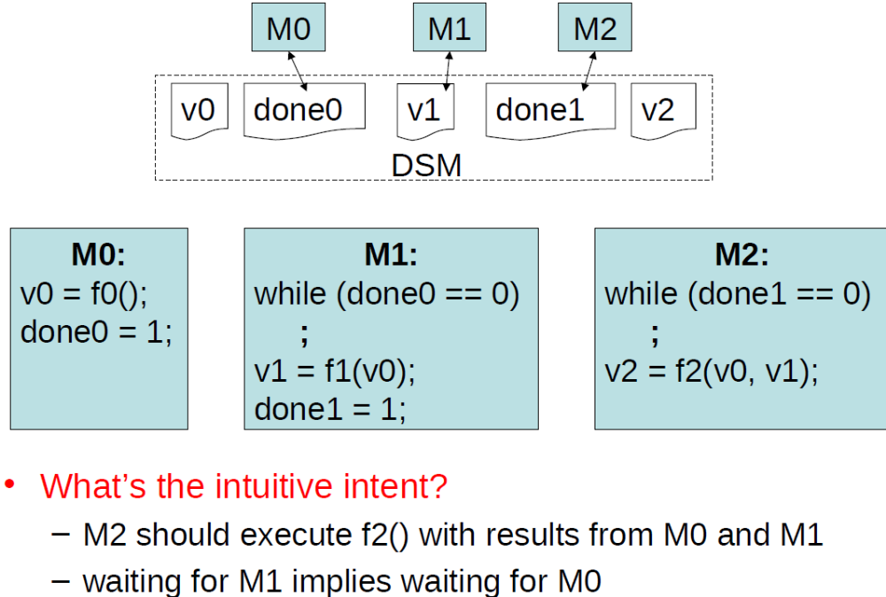
An example scenario: Distributed Shared Memory

Slide 11
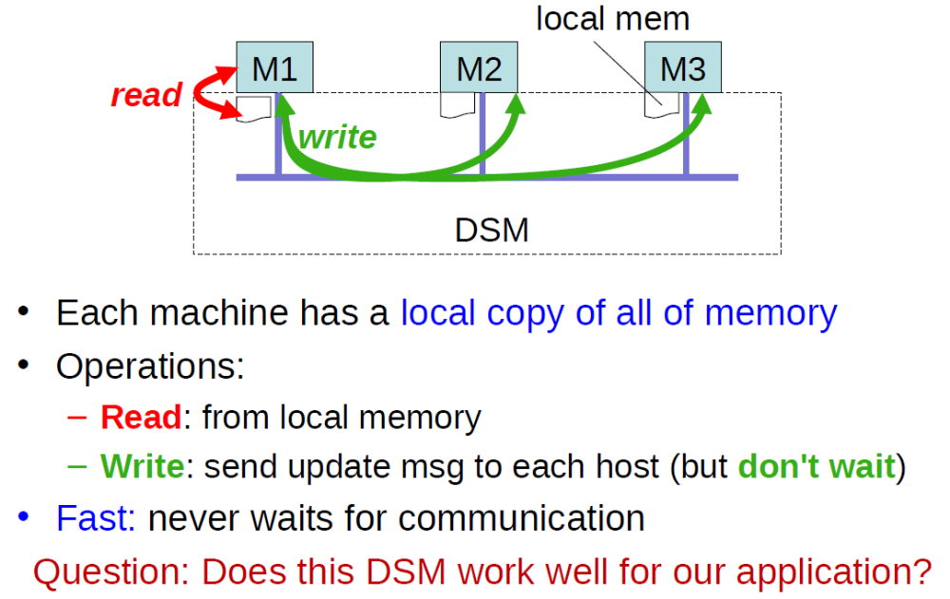
A naïve DSM implementation:

Slide 12
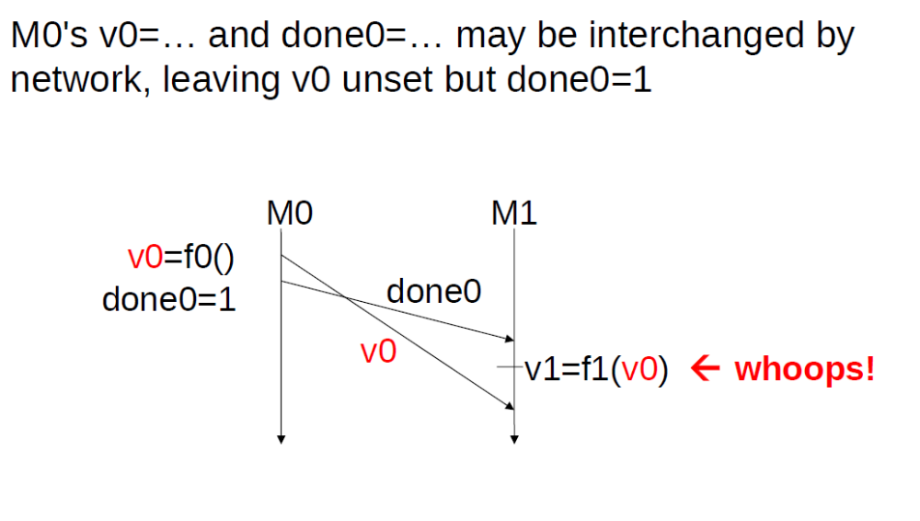
Problem 1 with the naïve implementation

Slide 13
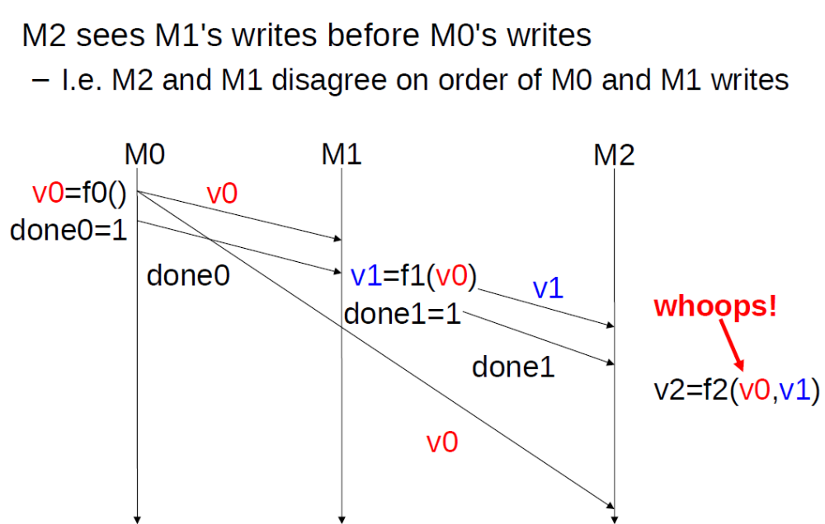
Problem 2 with the naïve implementation

Slide 14
Naïve DSM is fast but has unexpected behaviour
Maybe DSM is not “correct”
… or maybe I should have never expected the application to work in the first place
the consistency model
  The “contract” the DSM will obey and the application will rely on

Slide 15
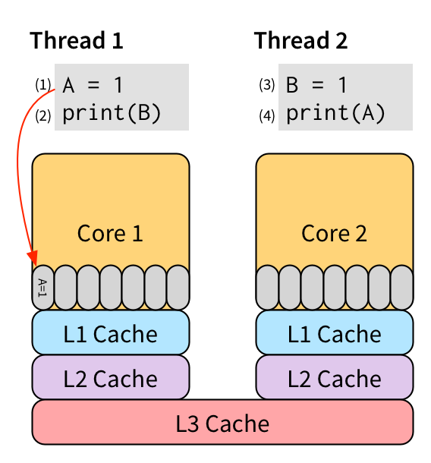
Do modern multi-processor architectures provide sequential consistency?
Notes:
What do current multiprocessor architectures do? Do they provide sequential consistency?
https://homes.cs.washington.edu/~bornholt/post/memory-models.html
No. At best TSO – Total Store Ordering

Slide 16
Roadmap
(1) Consistency models:
  contracts between the data store and the clients that specify the [acceptable] result of read/write operation stream in the presence of conflicting operations.
(2) Consistency protocols
  How does one implement a consistency model?
  Tools
    Operation ordering, delay some
    Operation assignment to replicas
(3) Replica management: creation, placement, deletion
(4) One system that integrates may of the techniques we have discussed so far
Notes:
(1) note that the acceptable result may be nondeterministic!

Slide 17
Performance and Scalability
[high level] one way to provide consistency: ensure that conflicting operations are done in the same order everywhere
  Conflicting operations: (from the world of transactions):
  Read–write conflict: a read operation and a write operation act concurrently
  Write–write conflict: two concurrent write operations
Problem: Guaranteeing global ordering on conflicting operations may be costly, reducing scalability
Solution: Weaken the consistency model (adjust consistency requirements) so that hopefully global synchronization can be avoided
Scalability
Performance
Programmer friendliness
(often implies management overheads)
←TENSION→
Notes:
Ok – perhaps you are convinced that one needs ‘a’ consistency model. But why many?

Slide 18
Consistency model: Contract between the data store and the clients: specifies the [acceptable] results of read and write operations in the presence of concurrent operations.
Choices that determine the design space:
Contract covers all items or subsets (or even each item individually)?
Contract covers all users or individual users?
Contract covers sets of operations (e.g., transactions, for databases; or multiple ops on the same object, for files)

Slide 19
Recap
Why are replication (and caching) needed?
  For performance, scalability, fault tolerance (availability, durability), ability to operate while disconnected
When do consistency concerns arise?
  With replication and caching (our focus)
  Concurrent (sets of) operations on shared data
    e.g., databases, filesystems

Slide 20
The space to cover is huge – so the ‘consistency’ as contract terminology appears in lots of contexts.
E.g., what type of consistency do distributed filesystems provide?
session consistency (AFS)
  aka. – open-to-close consistency
‘close-to-open’ consistency (NFS > v2.4.10)?
GFS: see discussion here
Notes:
Session consistency (e.g., in ASF v2) (aka open-to-close consistency)
A file write is not visible to processes on other machines until the file is closed
When a file is closed, changes are visible to new opens, but are not visible to “old” opens • Last closer wins!
Close-open consistency (NFS)
“The only consistency guarantee made by NFS is called close-to-open consistency, which means that any changes made by you are flushed to the server on closing the file, and a cache revalidation occurs when you re-open it.
“One can hardly fail to notice that there is a lot of handwaving in this sort of cache management. This model is adequate for environments where there is no concurrent read/write access by different clients on the same file, such as when exporting users’ home directory, or a set of readonly data.”

Slide 21
ACID properties
Atomic: All or nothing
  State shows either all the effects of a transaction, or none of them:
Consistent (think of it as Correct): Guarantees basic properties
  A transaction moves the database from a state where integrity holds, to another where integrity holds (eg: constraints)
Isolated: Each transaction runs as if alone
  Effect of concurrent transactions is the same as transactions running one after another (ie looks like batch mode)
Durable: Cannot be undone
  Once a transaction has committed, it can not be undone in spite of failures.

Slide 22
Recap
Why are replication (and caching) needed?
  For performance, scalability, fault tolerance (availability, durability), ability to operate while disconnected
When do consistency concerns arise?
  With replication and caching (our focus)
    Cover one operation at a time (rather than sets
  Concurrent (sets of) operations on shared data
    e.g., databases, filesystems

Slide 23
Consistency models (for replicated data)
Data centric: Assume a global, data-store view (i.e., across all clients)
  Models based on ordering of operations
    Constraints on operation ordering at the data-store level
  Eventual consistency
  Continuous consistency
    Limit the deviation between replicas
Client centric
  Assume client-independent
  views of the datastore
  Constraints on operation
  ordering for each client
  independently

Slide 24
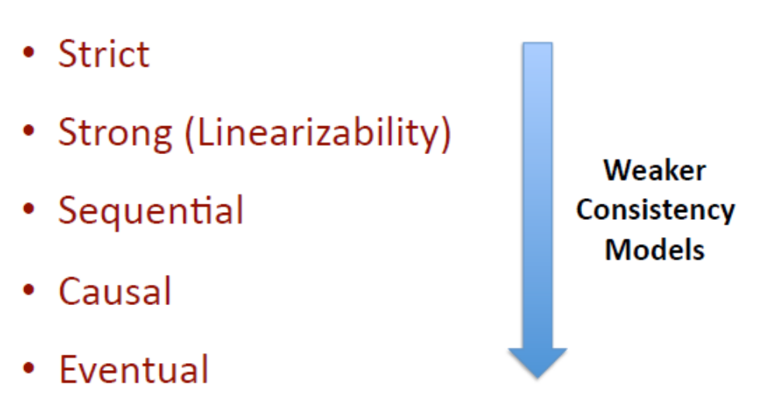
Consistency models
Data centric: Assume a global, data-store view (i.e., across all clients)
  Models based on ordering of operations
    Constraints on operation ordering at the data-store level
  Eventual consistency
  Continuous consistency

Slide 25
Eventual Consistency
Original idea: If single point to insert updates (no write-write conflicts), and no updates take place for a long enough period time, make sure all replicas will gradually (i.e., eventually) become consistent.
Where does this work well?
Mostly read-only workloads, and
No concurrent updates
  e.g., updates have only one source, or all updates performed through a master replica
Clients can operate with out-of-date data
Two-word summary: best-effort

Slide 26
Eventual Consistency (II)
No constraint on operation ordering
Allow stale reads, but ensure that reads will eventually reflect previously written values
  Even if this takes very long …
Don’t order concurrent writes as they are executed
  which might create conflicts later: which write was first?
  Used by Amazon’s Dynamo …
    with a mechanism for read reconciliation based on vector clocks

Slide 27
Why / Why NOT Eventual consistency
[+] Support disconnected operations or network partitions
  [for some apps] Better to read a stale value than nothing
  [for some apps] Better to save writes somewhere than nothing
[+] Support for increased parallelism
  Though that’s not what people have typically used this for
[-] Potentially anomalous application behavior – Stale reads and conflicting writes…

Slide 28
Consistency models
Data centric: Assume a global, data-store view (i.e., across all clients)
  Models based on ordering of operations
    Constraints on operation ordering at the data-store level
  Continuous consistency
    Limit the deviation between replicas
  Eventual consistency
Client centric
  Assume client-independent
  views of the datastore
  Constraints on operation
  ordering for each client
  independently

Slide 29
Roadmap
(1) Consistency models:
  contracts between the data store and the clients that specify the [acceptable] result of read/write operation stream in the presence of conflicting operations.
(2) Consistency protocols
  How does one implement a consistency model?
  Tools
    Operation ordering, delay some
    Operation assignment to replicas
(3) Replica management: creation, placement, deletion
(4) One system that integrates may of the techniques we have discussed so far
Notes:
(1) note that the acceptable result may be nondeterministic!

Slide 30
Recap
Why are replication (and caching) needed?
  For performance, scalability, fault tolerance (availability, durability), ability to operate while disconnected
When do consistency concerns arise?
  With replication and caching (our focus)
    Cover one operation at a time (rather than sets
  Concurrent (sets of) operations on shared data
    e.g., databases, filesystems

Slide 31
Consistency models
Data centric: Assume a global, data-store view (i.e., across all clients)
  Models based on ordering of operations
    Constraints on operation ordering at the data-store level
  Eventual consistency
  Continuous consistency

Slide 32
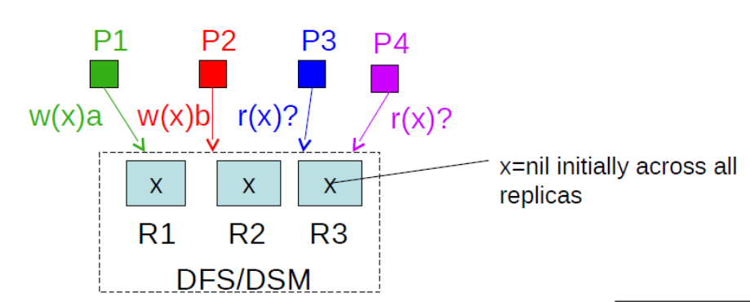
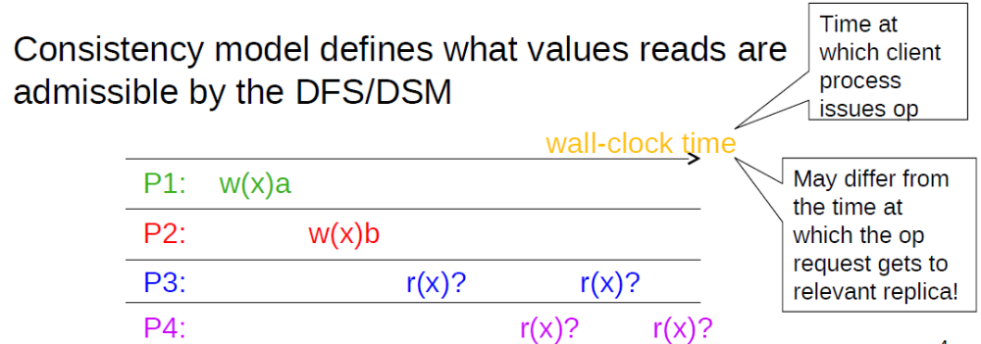
Notations
Notations:
Read: R_{i}(x) a -- client i reads a from location x
Write: W_{i}(x) b -- client i writes b at location x

Slide 33
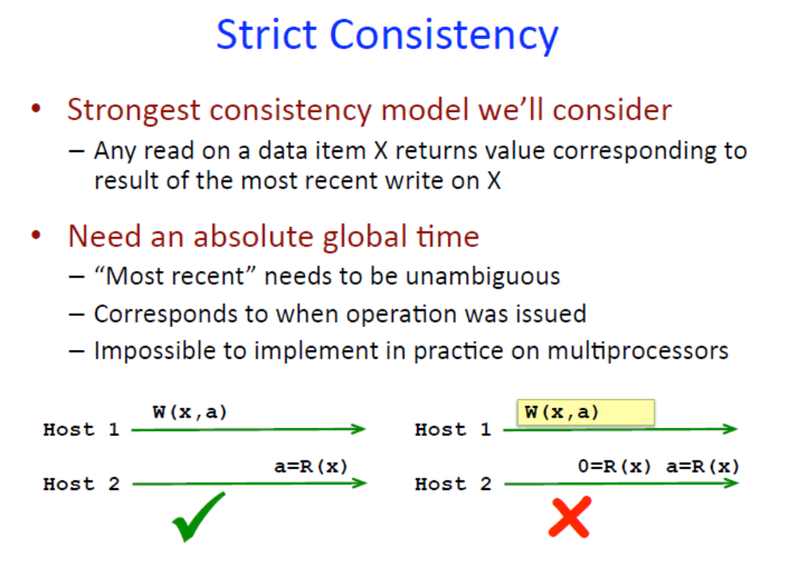
Notes:
Strict consistency: The most obvious consistency model is strict consistency.
Def: Any read to a memory location x returns the value stored by the most recent write operation to x.
This definition implicitly assumes the existence of a global clock, so that the determination of “most recent” is unambiguous.
Strict consistency is supported by uniprocessors (single thread), but it is generally impossible to implement in distributed shared memory (DSM) systems or other with higher latency.
In a DSM system, a read from a nonlocal memory location, or a write to a nonlocal memory location, requires sending a message. This message requires a finite time to travel to and from the node where the memory is located. During that time, some other processor might change the value in the memory location. Regardless of how efficient a message system is, it cannot cause messages to travel faster than the speed of light. If the difference in the two access times is, say, one ns., and the nodes are 3m. apart, the signal would have to travel at 10 times the speed of light to return the most recent value.
Fortunately, strict consistency is rarely necessary. To summarize, with strict consistency,
all writes are instantaneously visible to all processes;
all subsequent reads see the new value of the write, no matter how soon after the write the read is done, and no matter where the process executing the read is located.
Source: http://people.engr.ncsu.edu/efg/506/s01/lectures/notes/lec13.pdf

Slide 34
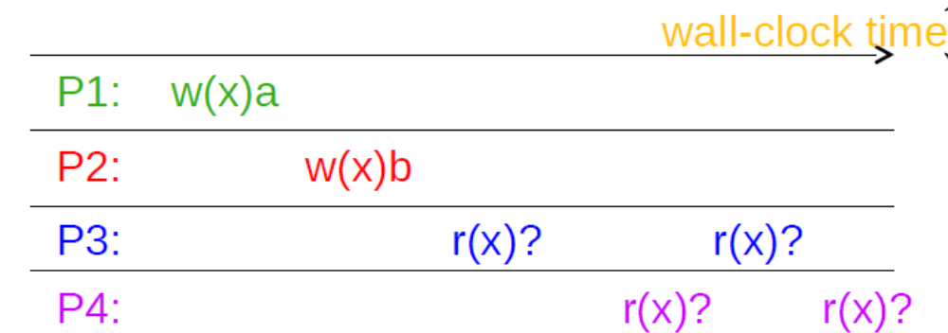
What do reads return with ‘strict consistency’

Slide 35
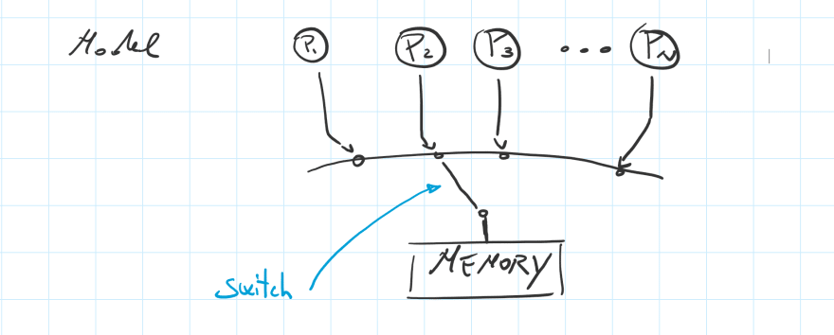

Sequential Consistency
[the technical definition]The result of any execution is the same as if :
operations were executed in some global order (on the entire data store)
the operations of each individual process appear in the order in which they are issued.
[an intuitive definition]: a system is sequentially consistent if a system with no replication and synchronous operations could have produced any of its traces.
One replica
Are there other outputs a sequential system could produce?
Can you list all of them?
Give an example of a trace that is sequentially consistent but not strictly

Slide 36
strict vs. sequential consistency
In sequential consistency, the [physical time] ordering of events does NOT matter.
  (except for events in the same process)
All that is required for sequential:
  All processors see the same ordering of operations
    (regardless of whether this is the order that the operations actually occurred)
      except operations in the same process which must preserve their actual ordering.

Slide 37
Sequential Consistency (example)
3 processes (P1, P2, P3) and 3 (replicated ) variables X, Y, Z initialized to 0
Process1: Process 2 Process 3
X ← 1 Y ← 1 Z ← 1 Read (Y, Z) Read (X, Z) Read (X, Y) Collect output: print_{P1} (Y^{P1}, Z^{P1}); print_{P2} (X^{P2}, Z^{P2}); print_{P3} (X^{P3}, Y^{P3}) Is output: 11 11 11 possible if you assume sequential consistency?
Parallel
Sequential
What about: 00 00 00?
What about: 00 10 10?
Notes:
Example to apply definition of previous slide to see if an output could be produced by a sequentially consistent system:
Read (X,Y) goes to some local variables that are not replicated.
Def: the system is sequentially consistent, if a system with no replication and synchronous operations could have produced the observed trace.

Slide 38
Sequential vs. Eventual Consistency
One view:
Sequential: pessimistic concurrency handling
  Decide on update order as they are executed
Eventual: optimistic concurrency handling
  Let updates happen, worry about deciding their order later
  May raise conflicts
    Think about when you code offline for a while – you may need to resolve conflicts with other team members when you commit
    Resolving conflicts is not that difficult with code, but it’s really hard in general (e.g., think about resolving conflicts when you’ve updated an image)

Slide 39
Linearizability (linerarizable consistency)
(aka. external consistency)
(aka. strong consistency)
The result of any execution is the same as if
(1) operations by all processes were executed in some sequential order, and
(2) this order reflects
  (2’) [sequential consistency] the order in each individual process
  (2”) [linearizability] the order in which the operations execute in real time*
strict ⸦ linearizable ⸦ sequential
* assume operations are synchronous (then non-overlapping operations can be ordered), or assume some loosely synch clocks to get order
** operation effects are visible to subsequent, non-overlapping operations in other processes
Notes:
e.g., assuming some loosely synchronized clocks, or (vanSteen, pg. 367) order determined by non-overlapping synchronous execution
Similar def to [external consistency] used by Google’s spanner: “the order in which the operations appear to execute to an external observer (e.g., an application)” – whether that application is armed with loosely synchronized clocks or can infer through messages and happens-before relationships.
Notes – if system is linearizable
* Once write completes, all later reads (by wall-clock start time) should return value of that write or value of later write.
* Once read returns particular value, all later reads should return that value or a value of later write.

Slide 40
More examples
Give an example of a trace that is generated by a system that is:
  (a) NOT sequential
  (b) sequential but NOT linearizable
  (c) linearizabe but NOT strictly consistent
If the DSM is sequentially consistent does the code in the example before (slide 10) ‘work’?
  Yes.

Slide 41
Harder Problem
Give an example of a trace of a system that demonstrates that sequential consistency is not composable
  i.e., when having data items (or data stores) that are each (independently) kept sequentially consistent, their composition as a set need not be so
Notes:
Solution: Note 7.3 (page 367 in vanSteen – typo in v3.02)
Fix: Linerizable (or strong) consistency is composable

Slide 42
P1: W(x)a R(x)a
P2: W(x)b
P1: W(y)a
P2: W(y)b R(y)b
P1: W(x)a W(y)a R(x)a
P2: W(y)b W(x)b R(y)b
Traces observed on datastores X and Y independently do not violate sequential consistency
Datastore X
Let’s assume that no matter how far further on gets in time the result is still R(x)a (same assumption below for R(y)b)
Datastore Y
Combined datastore X and Y
Combined trace on X and Y violates sequential consistency for the combined store (see next slide) for argument
Notes:
Solution: Note 7.3 (page 367 in vanSteen – typo in v3.02)
Fix: Linerizable (or strong) consistency IS composable

Slide 43
The original trace |  |  |  |  |  | Writes Have Propagated
P1: | W(x)a | W(y)a |  |  |  |  | R(x)a
P2: | W(y)b | W(x)b |  |  |  |  | R(y)b
The possible ways of sequencing the operations
 | W(x)a | W(y)a | W(y)b | W(x)b |  |  |  | x=b | y=b
 | W(x)a | W(y)a | W(x)b | W(y)b | not possible - would violate ordering in P2
 | W(x)a | W(y)b | W(y)a | W(x)b |  |  |  | x=b | y=a
 | W(x)a | W(y)b | W(x)b | W(y)a |  |  |  | x=b | y=a
 | W(x)a | W(x)b | … | … | not possible - would violate ordering in P2
 | W(y)a | … | … | … | not possible - would violate ordering in P1
 | W(y)b | W(x)a | W(y)a | W(x)b |  |  |  | x=b | y=a
 | W(y)b | W(x)a | W(x)b | W(y)a |  |  |  | x=b | y=a
 | W(y)b | W(y)a | … | … | not possible
 | W(y)b | W(x)b | W(x)a | W(y)a |  |  |  | x=a | y=a
 | W(y)b | W(x)b | W(y)a | W(x)a | not possible
 | W(x)b | … | … | … | not possible

Slide 44
So far …
Consistency models:
  contract between the data store and the clients that specify the [acceptable/possible] results of read/write operations in a stream in the presence of conflicting operations.
Linearizability
(strong)
Causal
Eventual
Sequential

Slide 45
So far …
Consistency models:
  contract between the data store and the clients that specify the [acceptable/possible] results of read/write operations in a stream in the presence of conflicting operations.
Consistency protocols
  How does one implement a consistency model?
  Tools to exploit
    Operation ordering, delay some
    Operation assignment to replicas

Slide 46
Consistency protocols
Question: How does one design a protocol to implement the desired consistency model?
[focus] Sequential consistency
  Primary / backup
  Chain replication
  Quorum protocols

Slide 47


A protocol for primary-backup
Overview (note that many variants are possible!):
  All write operations are forwarded to the primary replica
    Write operations are synchronous (i.e., blocking)
  Read operations to any replica
Approach for write ops
Client connects to some replica R_{C}
If the client issues write operation to R_{C}:
  R_{C} forwards the request to the primary replica R_{P}
  R_{P} updates its local value
  R_{P} forwards the update to other replicas R_{i}
  Other replicas R_{i} update, and send an ACK back to R_{P}
After R_{P} receives all ACKs, it informs R_{C} that the write operation is completed
R_{C} acknowledges the client, which in return completes the write operation
x+=5
Client 1
Primary server
R₁
R₂
R₃
x₁=5
x₁=0
x₂=0
x₃=5
x₂=5
x₃=0
Data-store
Notes:
Primary-backup protocols provide a straightforward implementation of sequential consistency, as the primary can order all incoming writes in a globally unique time order. Evidently, all processes see all write operations in the same order, no matter which backup server they use to perform read operations.
Also, with blocking protocols, processes will always see the effects of their most recent write operation (note that this cannot be guaranteed with a nonblocking protocol without taking special measures).

Slide 48
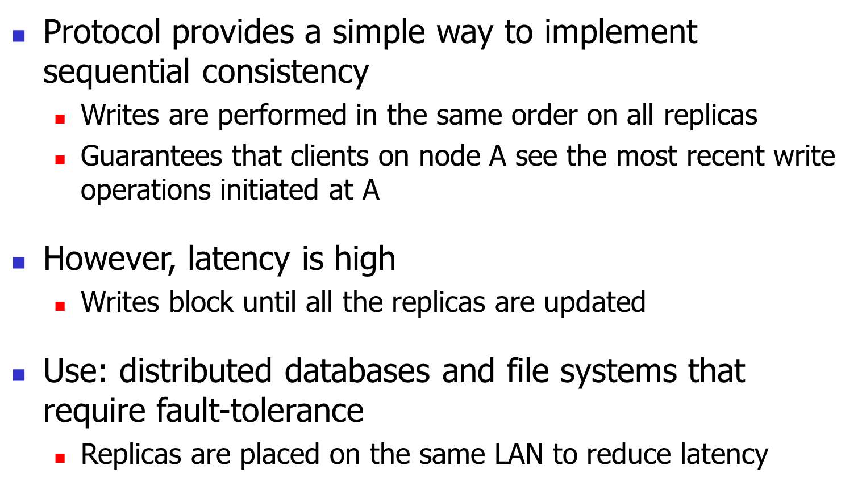
Discussion (I)

Slide 49
Discussion (II)
Q: Could a non-blocking strategy be applied?
  (And maintain the same consistency properties?)
  Writes return immediately after touching a replica? Writes return after touching primary? What assumptions would you make? What properties result?
Q: How to deal with failures?
Of backup replicas
Of the primary?
Primary server
R₁
R₂
R₃
Data-store

Slide 50
Consistency protocols
Question: How does one design a protocols to implement the desired consistency model?
Sequential consistency
  Primary / backup
  Chain replication
  Quorum protocols

Slide 51
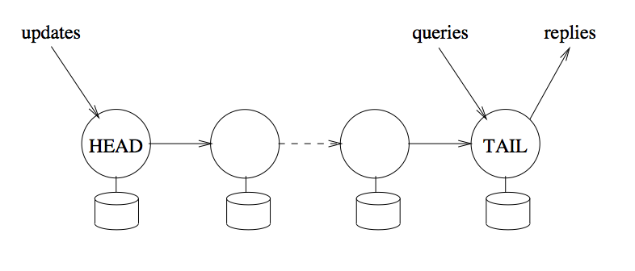
Chain replication

Slide 52
Consistency protocols
Question: How does one design a protocols to implement the desired consistency model?
Sequential consistency
  Primary / backup
  Chain replication
  Quorum protocols

Slide 53
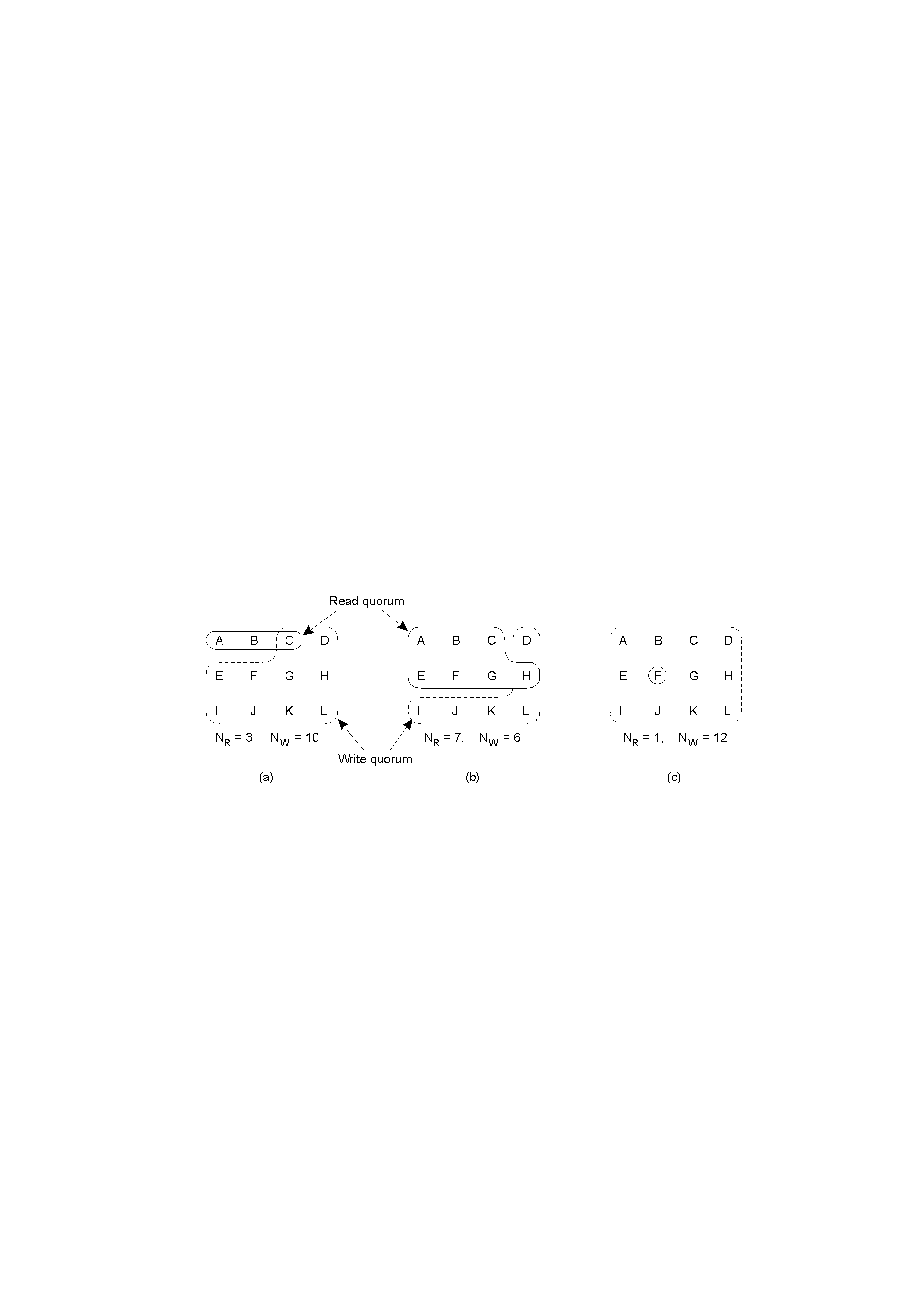
Replicated writes: Quorums
Problem (with primary-backup scheme): some replicas may not be available all the time / may be slow
leads to low availability (for writes) / high response time
Solution: quorum-based protocols: Ensure that each operation is carried on enough replicas (not all )
  a majority ‘vote’ is established before each operation
  distinguish a read quorum and a write quorum:

Slide 54
What’s a valid quorum configuration?
Two basic rules for correctness
A read quorum should “intersect” any prior write quorum at >= 1 processes
  Q_{r} + Q_{w} > N
A write quorum should intersect any other write quorum
  Q_{w} + Q_{w} > N results in Q_{w} > N/2

Slide 55
Quorums:
Mechanics for read operations
Setup: Replicas have “versions”
  Versions are numbered (timestamped)
  Timestamps must increase monotonically (process id to break ties)
Read operations:
Client send RPCs until Q_{r} processes reply
Then use the replica with the largest timestamp (the most recently updated replica)
Notes:
Two options for who implements the replication protocol: (i) a client library (as described here); or (ii) one of the replicas (as in Amazon Dynamo examples).

Slide 56
Quorums:
Mechanics write operations
Setup: Replicas have “versions”,
  Versions are numbered (e.g., logically timestamped)
  Timestamps must increase monotonically
Writes:
Need to determine next version number.
Need a protocol to protect from concurrent writes
  Need to make sure all replicas are updated atomically
Notes:
Writes: note that the ‘sloppy’ protocol in Dynamo is different for two reasons:
write quorum size constraint may be violated; (2) versions are identified by a vector.
Two possible reasons to end up with divergent replica versions (in Dynamo)
Write quorum size constraint is violated (i.e., write quorums for writes did not intersect)
Concurrent writes handled by different replicas (Dynamo does not protect against concurrent writes)

Slide 57
Quorum based protocols: Write algorithm
(similar to two-phase commit)
Client: Contacts all replica hosts and propose the write.
  “I would like to execute write W_{j} on data-item I”
Replica:
  Locks the replica against other writes (may fail).
  Puts the request in a queue of pending writes
  Sends back: ACK, proposed version-number (e.g., logical clock) , pID
Client:
  If < Q_{w} replies: send ABORT to all participants
  If ≥ Q_{w} replies:
    new_replica_number = max [versions] + 1
    Send (COMMIT, new_replica_number)
Replica:
  Commit, unlock
Notes:
Similar to two-phase-commit protocol. We’ll discuss there how to deal with lost messages / failed participants. (in a few weeks)

Slide 58
Wrapping up:
a note on trade-offs
Linearizability
(strong)
Causal
Eventual
Sequential

Slide 59
: Replicas
: Clients
C+PT (-A)
Option 1: accept reads accept reads
reject writes reject writes
Option 2: accept reads reject reads
accept writes reject writes
A+PT (-C)
accept reads + writes accept reads + writes
‘inconsistent’ results ‘inconsistent’ results

Slide 60
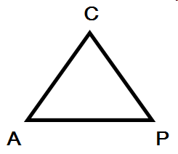
CAP
Theorem
Consistent
Pick two!
Availabile
Partition tolerant
CAP Twelve Years After – How the “Rules” Have Changed, IEEE Spectrum 2012 [link]
Brewer's conjecture and the feasibility of consistent, available, partition-tolerant web services, SIGACT News 33(2): 51-59 (2002)

Slide 61

CAP Theorem: Proof
Not
consistent
Gilbert, Seth, and Nancy Lynch. "Brewer's conjecture and the feasibility of consistent, available, partition-tolerant web services." ACM SIGACT News 33.2 (2002): 51-59.

Slide 62
CAP Theorem: Proof
Not
available
Gilbert, Seth, and Nancy Lynch. "Brewer's conjecture and the feasibility of consistent, available, partition-tolerant web services." ACM SIGACT News 33.2 (2002): 51-59.

Slide 63
CAP Theorem: Proof
Not
partition
tolerant
Gilbert, Seth, and Nancy Lynch. "Brewer's conjecture and the feasibility of consistent, available, partition-tolerant web services." ACM SIGACT News 33.2 (2002): 51-59.

Slide 64
CAP Theorem: AP or CP
Not
partition
tolerant
Criticism: It’s not 2-out-of-3
Can’t “choose” no partitions
So: AP or CP

Slide 65
More tradeoffs: Latency vs. Consistency
Low-latency: Speak to fewer than quorum of nodes?
  Primary-backup: write N, read 1
  General: |W| + |R| > N
L and C are fundamentally at odds
  “C” = linearizability, sequential

Slide 66
PAC / ELC
If there is a partition (P):
  How does system tradeoff A and C?
Else (no partition)
  How does system tradeoff L and C?
Is there a useful system that switches?
  Dynamo: PA/EL
  “ACID” dbs: PC/EC
http://dbmsmusings.blogspot.com/2010/04/problems-with-cap-and-yahoos-little.html

Slide 67
A brief review / discussion

Slide 68



write(A,1)
success
1
read(A)
Phone call: happens-before relationship, through “out-of-band” communication
Which consistency model would guarantee the expected r(A)1 outcome?
Notes:
Note: for some systems out-of-band communication may introduce happens-befores relationships that are not visible by just observing the system / the messages exchanged

Slide 69
write(A,1)
success
1
read(A)
One cool trick: Delay responding to writes/ops until properly performed on all replicas
Notes:
One tool to make sure all replicas have been updated when a reply is generated to the client: delay the reply as much as needed.

Slide 70

write(A,1)
success
done
1
read(A)
Isn’t sufficient to return value of third node: It doesn’t know precisely when op is “globally” committed
Instead: Need to actually order read operation
Notes:
To implement a concurrency model (that is stronger than eventual consistency) it is not enough to contact some replica and return the value existing there. Need to somehow reason about ordering of operations and/or actually order them through the consistency protocol.

Slide 71

write(A,1)
success
1
read(A)
Potential solutions to order all operations via: (1) leader/primary, (2) consensus, or (3) physical time (a la Spanner)
[we have discussed (1) and briefly (3) when we talked about Spanner]
Notes:
Ways to order

Slide 72
Strong consistency = linearizability
Linearizability (Herlihy and Wang 1991)
  All servers execute all ops in some identical sequential order
  Global ordering preserves each client’s own local ordering
  Global ordering preserves real-time guarantee
    All ops receive global time-stamp using a sync’d clock
    If ts_{op1}(x) < ts_{op2}(y), OP1(x) precedes OP2(y) in sequence
Once write completes, all later reads (by wall-clock start time) should return value of that write or value of later write.
Once read returns particular value, all later reads should return that value or value of later write.
Notes:
If ts(a) < ts (b), are either linearizable? Does ts(a) have to be before ts(b)? If concurrent, both just need to agree (tie break via some other thing (processor ID)?)

Slide 73

Intuition: Real-time ordering
write(A,1)
success
1
committed
read(A)
Once write completes, all later reads (by wall-clock start time) should return value of that write or value of later write.
Once read returns particular value, all later reads should return that value or value of later write.

Slide 74
Weaker: Sequential consistency
Sequential = Linearizability – real-time ordering
  All servers execute all ops in some identical sequential order
  Global ordering preserves each client’s own local ordering
With concurrent ops, “reordering” of ops (w.r.t. real-time ordering) acceptable, but all servers must see same order
  e.g., linearizability cares about time sequential consistency cares about program order
Notes:
If ts(a) < ts (b), are either linearizable? Does ts(a) have to be before ts(b)? If concurrent, both just need to agree (tie break via some other thing (processor ID)?)

Slide 75
Sequential Consistency
write(A,1)
success
0
read(A)
In this example, system orders read(A) before write(A,1) [a sequential concurrency contract would allow this]

Slide 76
Valid Sequential Consistency?
x
✓
Why? Because P3 and P4 don’t agree on order of ops. Doesn’t matter when events took place on diff machine, as long as proc’s AGREE on order.
What if P1 did both W(x)a and W(x)b?
  Neither valid, as (a) doesn’t preserve local ordering

Slide 77
We stopped here

Slide 78
Causal consistency
Remember causality notion from Lamport (logical) clocks?
  That’s what causal consistency enforces
Causal consistency: Any execution is the same as if all causally-related read/write ops were executed in an order that reflects their causality
  All concurrent ops may be seen in different orders
Therefore:
  Reads are fresh only w.r.t. the writes they are causally dependent on
  causally-related writes are ordered by all replicas in the same way, BUT
  concurrent writes may be committed in different orders by different replicas, and hence read in different orders by different applications

Slide 79
Causal Consistency (1)
“Causally related” relationship (notation ‘→’):
A read is causally related to the write that provided the data for the read.
A write is causally related to a read that happened before this write in the same process.
Relationship is transitive: If write1 → read, and read → write2, then write1 → write2.
Def: concurrent ops == NOT causally related

Slide 80

Causal Consistency (Example)
Note: W₁(x)a → W₂(x)b, but not W₂(x)b → W₁(x)c
Is this sequence is allowed with a causally-consistent store?
Is this sequence allowed with sequentially consistent store?

Slide 81
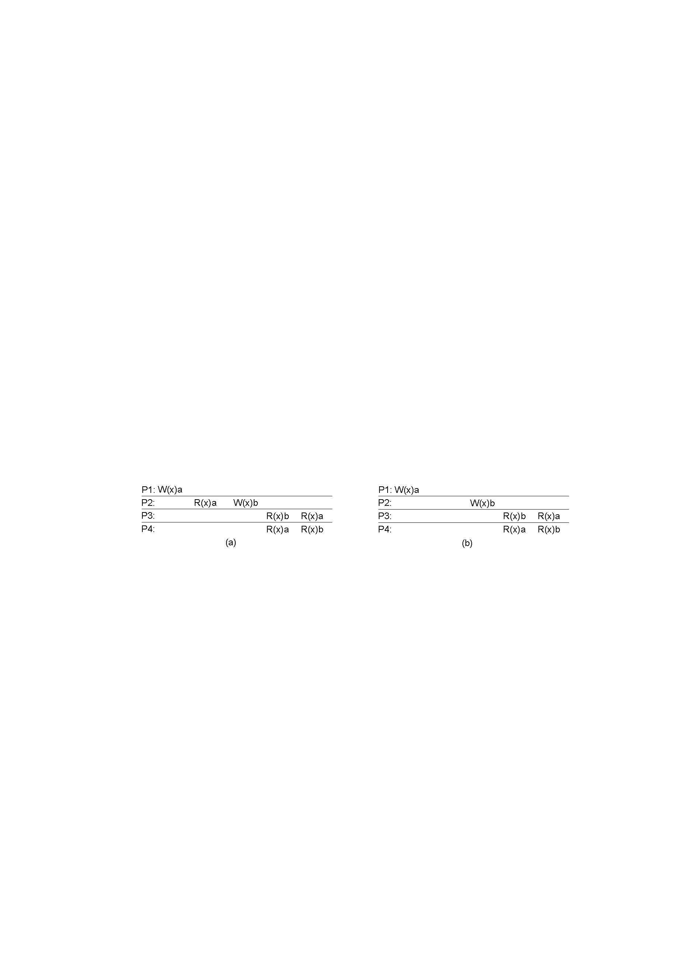
Causal Consistency: (More Examples)
SecC: no
CauC: no
SecC: no
CauC: yes
Which sequence is allowed with a causally-consistent store?
Which sequence allowed with sequentially consistent store?

Slide 82
Why Causal Consistency?
Causal consistency is strictly weaker than sequential consistency (and can give weird results (as you’ve seen)
  strict ⸦ linearizabile ⸦ sequential ⸦ causal
BUT causal also offers more possibilities for concurrency:
  Concurrent operations (which are not causally-dependent) can be executed in different orders by different replicas
  In contrast, with sequential consistency, you need to enforce a global ordering of all operations
Hence, one can get better performance than with sequential
From what I know, not very popular in industry So, we’re not gonna focus on it any more

Slide 83
Consistency protocols
Question: How does one design a protocols to implement the desired consistency model?
Sequential consistency
  Group with total ordering
  Primary / backup
  Chain replication
  Quorum protocols
Causal consistency
  Group with causal ordering

Slide 84
Many Other Consistency Models Exist …
Data centric: Assume a global, data-store view (i.e., across all clients)
  Models based on ordering of operations
    Constraints on operation ordering at the data-store level
  Continuous consistency
    Limit the deviation between replicas
Client centric
  Assume client-independent
  views of the datastore
  Constraints on operation
  ordering for each client
  independently

Slide 85
Many Other Consistency Models Exist
Other standard consistency models
  … take a look at next slides here
  read Tanenbaum 7.3

Slide 87
Consistency models
Data centric: Assume a global, data-store view (i.e., across all clients)
  Models based on ordering of operations
    Constraints on operation ordering at the data-store level
  Eventual consistency
  Continuous consistency

Slide 88
Consistency models
Data centric: Assume a global, data-store view (i.e., across all clients)
  Models based on ordering of operations
    Constraints on operation ordering at the data-store level
  Continuous consistency
    Limit the deviation between replicas
  Eventual consistency
Client centric
  Assume client-independent
  views of the datastore
  Constraints on operation
  ordering for each client
  independently

Slide 89
Client-centric Consistency Models
Goal: Avoid system-wide consistency, by concentrating on what each client independently wants
(instead of maintaining a global view)

Slide 90
Example: Consistency for Mobile Users
Example: Distributed database to which a user has access through her notebook.
  Notebook acts as a front end to the database.
At location A user accesses the database with reads/updates
At location B user continues work, but unless it accesses the same server as the one at location A, she may detect inconsistencies:
  updates at A may not have yet been propagated to B
  user may be reading newer entries than the ones available at A:
  user updates at B may eventually conflict with those at A
Note: The only thing the user really needs is that the entries updated and/or read at A, are available at B the way she left them in A.
Idea: the database will appear to be consistent to the user

Slide 91
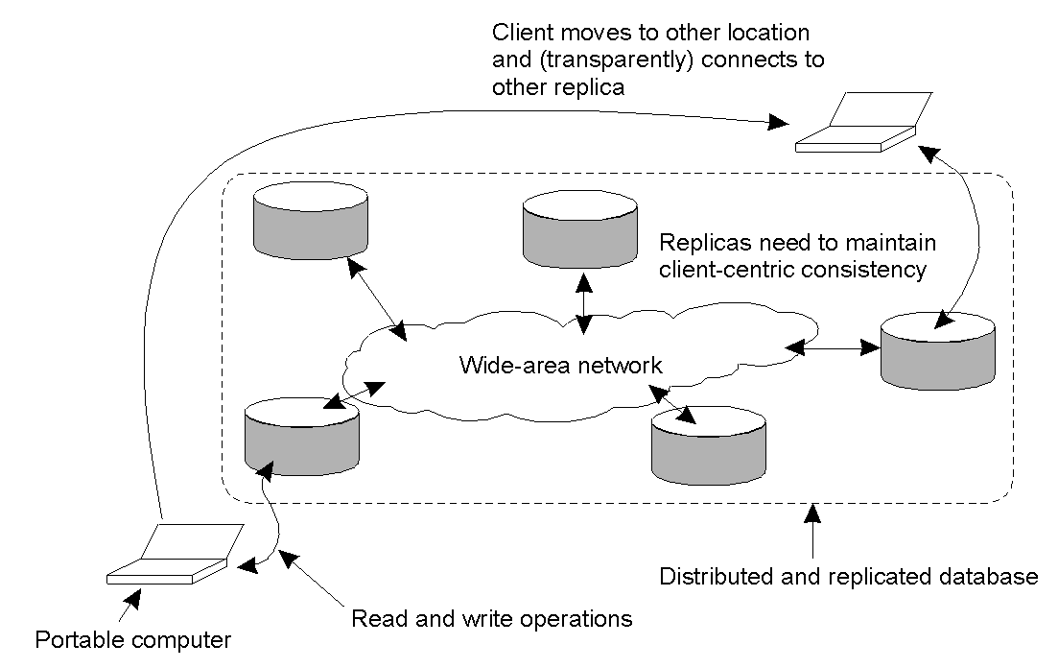
Example - Consistency for Mobile Users

Slide 92
Client-centric Consistency
Idea: Guarantee a degree of data access consistency for a single client/process point of view.
Notations:
x_{i}[t] → Value of data item x at time t at local replica L_{i}
WS(x_{i} [t]) → working set (all write operations) at L_{i} up to time t on data item x
WS(x_{i} [t]; x_{j} [t]) → indicates that it is known that
WS(x_{i} [t]) is included in WS(x_{j} [t])
Shorthand: we do not use [t] (it’s implied)

Slide 93

Monotonic-Read Consistency
Intuition: Client “sees” the same or newer version of data.
Definition: If a process reads the value of a data item x, any successive read operation on x by that process will always return that same or a more recent value.

Slide 94
Monotonic reads – Examples
A personalized news webpage
Reading (not modifying) incoming e-mail while you are on the move.
  Each time you connect to a different e-mail server, that server fetches (at least) all the updates from the server you previously visited.
Reading personal calendar updates from different servers.
  Monotonic Reads guarantees that the user sees always more recent updates, no matter from which server the reading takes place.
(All the above assume read-only)

Slide 95

Monotonic-Write Consistency
Intuition: A write happens on a replica only if it’s brought up to date with preceding write operations on same data (but possibly at different replicas)
Definition: A write operation by a process on a data item x is completed (on all replicas) before any successive write operation on x by the same process.
WS
Notes:
WS

Slide 96
Monotonic writes – Examples
Updating a program at server S2, and ensuring that all components on which compilation and linking depend, are also placed at S2.
Maintaining versions of replicated files in the correct order everywhere (propagate the previous version to the server where the newest version is installed).

Slide 97

Read-Your-Writes Consistency
Intuition: All previous writes are always completed before any successive read
Definition: The effect of a write operation by a process on data item x, will always be seen by a successive read operation on x by the same process.

Slide 98
Read-Your-Writes - Examples
Updating your Web page and guaranteeing that your Web browser shows the newest version instead of its cached copy.
Password database

Slide 99

Writes-Follow-Reads Consistency
Intuition: Any successive write operation on x will be performed on a copy of x that is same or more recent than the last read.
Definition: A write operation by a process on a data item x following a previous read operation on x by the same process, is guaranteed to take place on the same or a more recent value of x that was read.
Examples: news groups

Slide 100
Writes-Follow-Reads - Examples
See reactions to posted articles only if you have the original posting
  a read “pulls in” the corresponding write operation.

Slide 101
Quiz like questions
What is the crucial difference between data-centric and client-centric consistency models?
Where does the ‘eventual consistency’ model fit in this taxonomy: is it data-centric or client-centric?
Consider a system that combines read-your-writes consistency with writes-follow-reads consistency (that is, it provides both). Is this system also sequentially consistent?

Slide 102
Question: How does one design the protocols to implement the desired consistency model?
Data centric
  Constraints on operation ordering at the data-store level
    Sequential consistency.
  Continuous consistency: limit the deviation between replicas
Client centric
  Constraints on operation ordering
  for each client independently

Slide 103
Reminder: Monotonic-Read Consistency
Definition: If a process reads the value of a data item x, any successive read operation on x by that process will always return that same or a more recent value.
Intuition: Client “sees” the same or a newer version of the data.
How would you implement this?
Notes:
Quiz-like questions: See section 7.5.5. in the textbook.

Slide 104
Implementation of monotonic-read consistency
Key intuition: client carries state to identify the last operation(s)
Protocol sketch:
Globally unique ID for each write operation
The client keeps track of:
  ReadSet: the write IDs relevant to the read operations performed so far on various objects
When a client launches a new read
  Client sends the ReadSet to the replica server
  The server checks that all updates in the ReadSet have been performed.
    [If necessary] Fetches unperformed updates
  Executes the read operation.

Slide 105
More quiz-like questions
Sketch a protocol design for the following consistency model
Monotonic-writes
Read-your-writes
Writes-follow-reads
Write the pseudo-code
Notes:
Quiz-like questions: See section 7.5.5. in the textbook

Slide 106
Consistency models
Data centric: Assume a global, data-store view (i.e., across all clients)
  Models based on ordering of operations
    Constraints on operation ordering at the data-store level
  Eventual consistency
  Continuous consistency
    Limit the deviation between replicas
Client centric
  Assume client-independent
  views of the datastore
  Constraints on operation
  ordering for each client
  independently

Slide 107
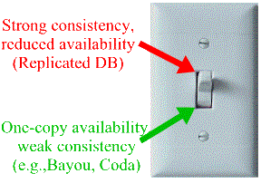
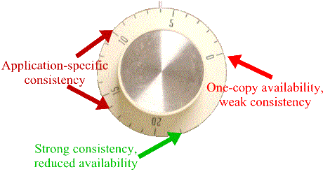
Continuous Consistency
Obs1: We can talk a about a degree of consistency
    Goal: Limit the deviation between replicas
Metaphor: Knob vs. switch

Slide 108
Continuous Consistency
Obs1: We can talk a about a degree of consistency
    Goal: Limit the deviation between replicas
Obs2: Multiple metrics to measure deviation are possible
replicas may differ in their numerical value
replicas may differ in their relative staleness
replicas may differ with respect to (number and order) of performed update operations
conit: consitency unit → specifies the data unit over which consistency is to be enforced.

Slide 109
Limitations of Consistency Mechanisms Based on Request Ordering
: Replicas
: Clients
Option 1: accept reads accept reads
reject writes reject writes
Option 2: accept reads reject reads
accept writes reject writes

Slide 110
Effects of Continuous Consistency
Policy: each replica can buffer up to 5 writes
Option 1: accept reads accept reads
reject writes reject writes
New Option 1: accept reads accept reads
accept first 10 writes accept first 5 writes

Slide 111
Effects of Continuous Consistency
Policy: each replica can buffer up to 5 writes
Option 2: accept reads reject reads
accept writes reject writes
New Option 2: accept reads accept first few reads
accept writes accept first 5 writes

Slide 112
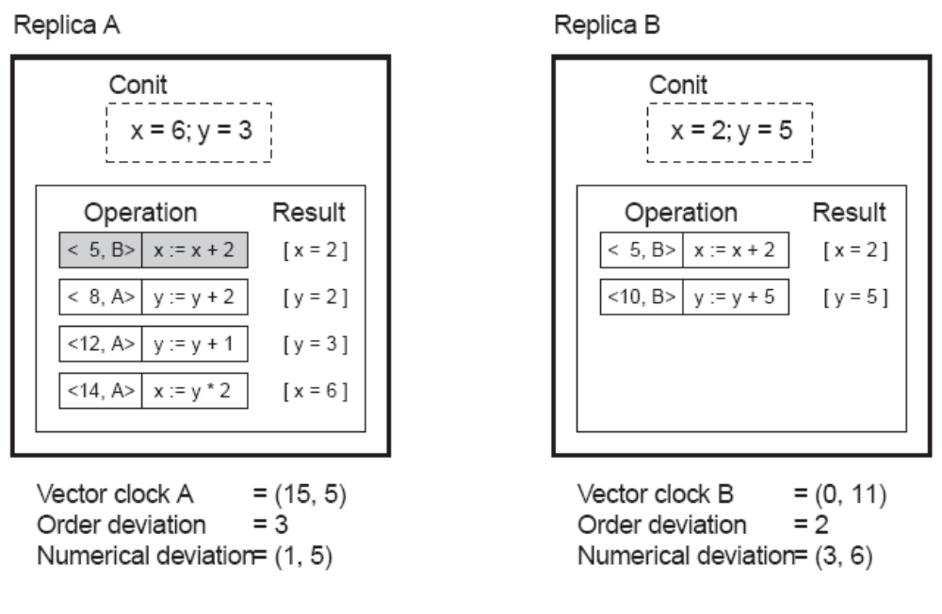
Example
Conit: contains the variables x and y:
Each replica maintains a vector clock
B sends A operation [<5,B>: x := x + 2]; A has made this operation permanent (cannot be rolled back)
A has three pending operations ➔ order deviation = 3

Slide 113
Consistency protocols
Question: How does one design the protocols to implement the desired consistency model?
Data centric
  Constraints on operation ordering at the data-store level
    Sequential consistency.
  Continuous consistency: limit the deviation between replicas

Slide 114
Continuous Consistency
Obs1: We can talk a about a degree of consistency
    Goal: Limit the deviation between replicas
Obs2: Multiple metrics to measure deviation
replicas may differ in their numerical value
replicas may differ in their relative staleness
replicas may differ with respect to (number and order) of performed update operations

Slide 115
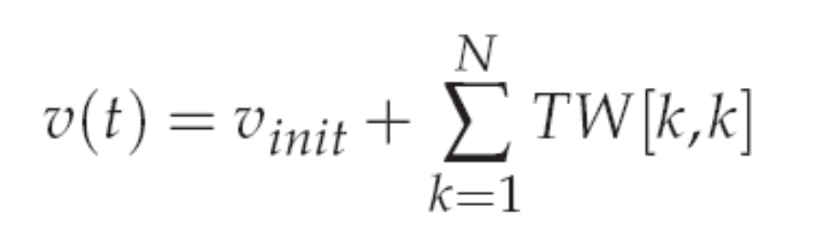
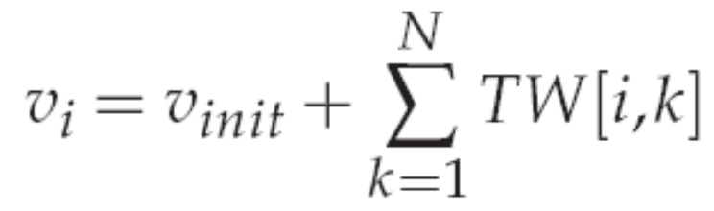
Continuous Consistency:
Bounding Numerical Errors (I)
Setup: consider a conit (data item) x and let weight(W(x)) denote the numerical change in its value after a write W.
  [for simplicity] Assume that for all W(x), weight(W) > 0
W is initially forwarded to one of the N replicas: the origin(W).
TW[i, j] are the writes executed by server S_{i} that originated from S_{j}
TW[i, j]=Σ {weight(W)| origin(W)=S_{j} & W in log(S_{i})}
Note: Actual value of x: v_{i} : value of x at replica i

Slide 116
Continuous Consistency: Bounding Numerical Errors (II)
Reminder: TW[i, j] writes executed by server S_{i} originated at S_{j}
Actual value of x: v_{i} : value of x at replica i
Goal: need to ensure that v (t) − v_{i} < d for every S_{i}.

Slide 117
Continuous Consistency: Bounding Numerical Errors (II)
Reminder: TW[i, j] writes executed by server S_{i} originated at S_{j}
Actual value of x: v_{i} : value of x at replica i
Goal: need to ensure that v (t) − v_{i} < d for every S_{i}.
Approach: Let every server S_{k} maintain a view TW_{k}[i, j] for what S_{k} believes is the value of TW[i, j].
  This information can be piggybacked when an update is propagated.
Note: 0 ≤ TW_{k}[i, j] ≤ TW[i, j] ≤ TW[j, j]

Slide 118
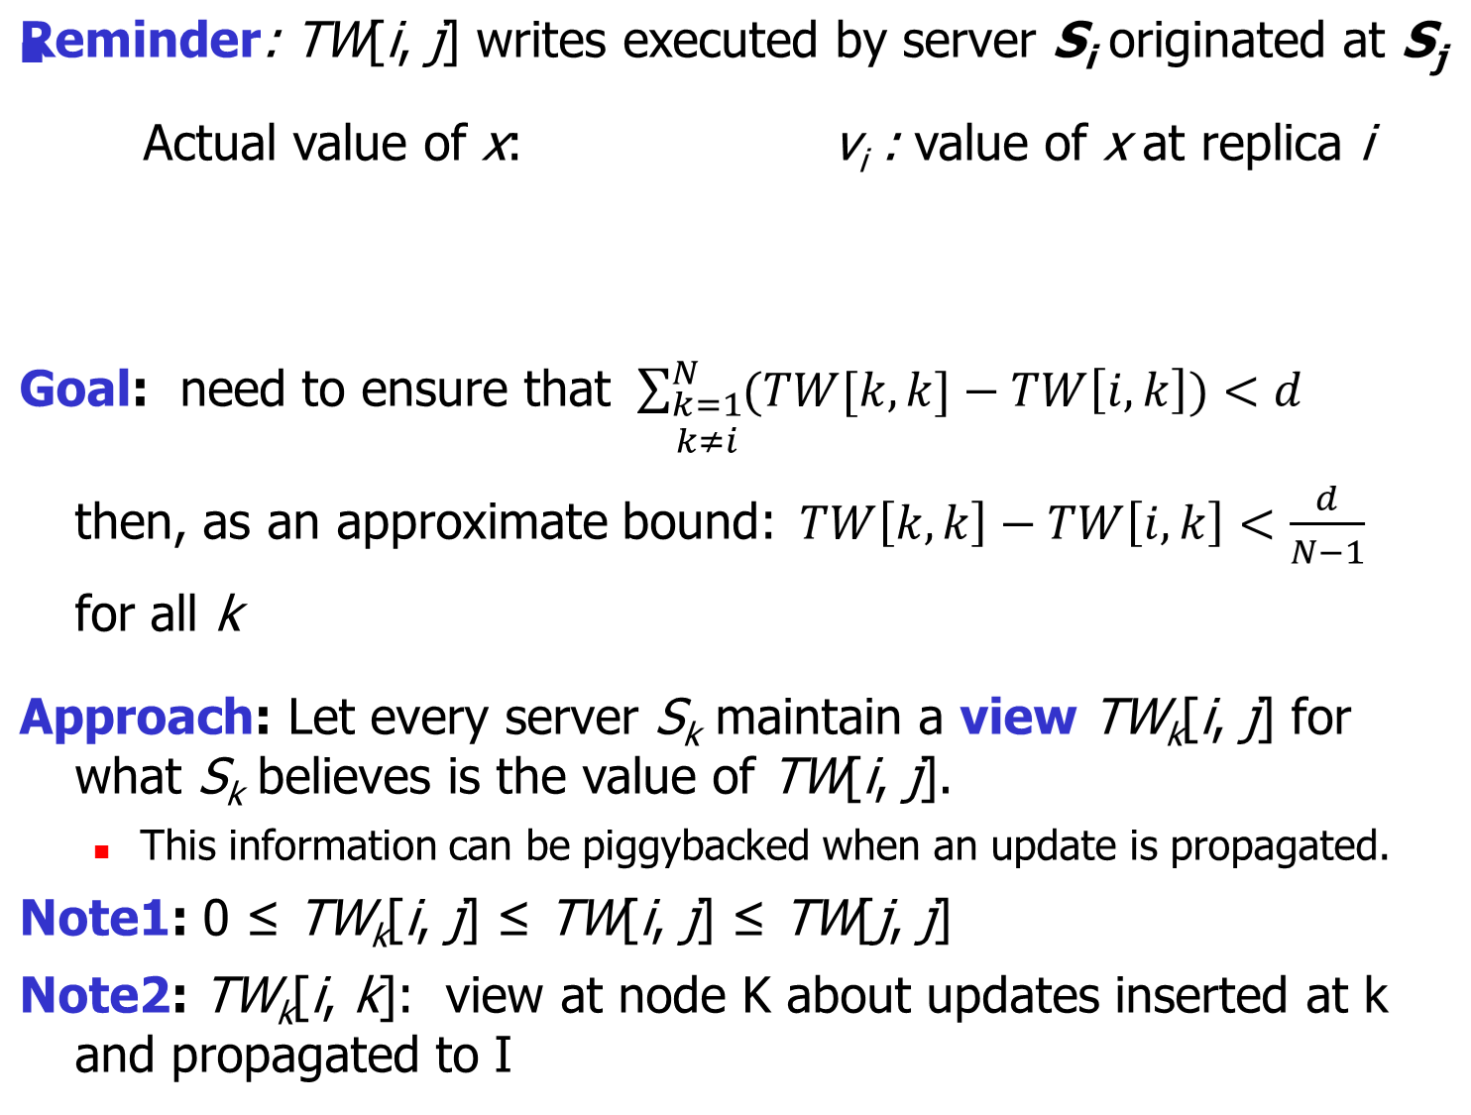

Slide 119
Reminder: TW[i, j] writes executed by server S_{i} originated at S_{j}
Actual value of x: v_{i} : value of x at replica i
Goal: need to ensure that v (t) − v_{i} < d for every S_{i}.
Approach: Let every server S_{k} maintain a view TW_{k}[i, j] for what S_{k} believes is the value of TW[i, j].
  This information can be piggybacked when an update is propagated.
Solution: S_{k} sends operations from its log to S_{i} when it sees that TW_{k}[i, k] is getting too far from TW[k, k],
  in particular, when TW[k, k] − TW_{k}[i, k] > d_{i}/(N − 1).
Note: Staleness can be done analogously, by essentially keeping track of what has been seen last from S_{k}

Slide 120
Consistency models: contracts between the data store and the clients
Data centric: solutions at the data store level
  Continuous consistency
    limit the deviation between replicas, or
  Eventual consistency
  Models based on ordering of operations
    Constraints on operation ordering at the data-store level
Client centric
  Assume client-independent views of the datastore
  Constraints on operation ordering
  for each client independently

Slide 122
Rodamap
Issue 1. Dealing with data changes
Consistency models
  What is the semantic the system implements
  (luckily) applications do not always require strict consistency
Consistency protocols
  How to implement the semantic agreed upon?
Issue 2. Replica management
How many replicas?
Where to place them?
When to get rid of them?
Issue 3. Redirection/Routing
Which replica should clients use?

Slide 123
Replica server placement
Problem: Figure out what the best K places are out of N possible locations.
Select best location out of N – j, j:0..K-1 for which the average distance to clients is minimal. Then choose the next best server.
  (Note: The first chosen location minimizes the average distance to all clients.)
  Computationally expensive.
Select the k largest autonomous system and place a server at the best-connected host.
  Computationally expensive.
Position nodes in a d-dimensional geometric space, where distance reflects latency. Identify the K regions with highest density and place a server in every one.
  Computationally cheap.

Slide 124
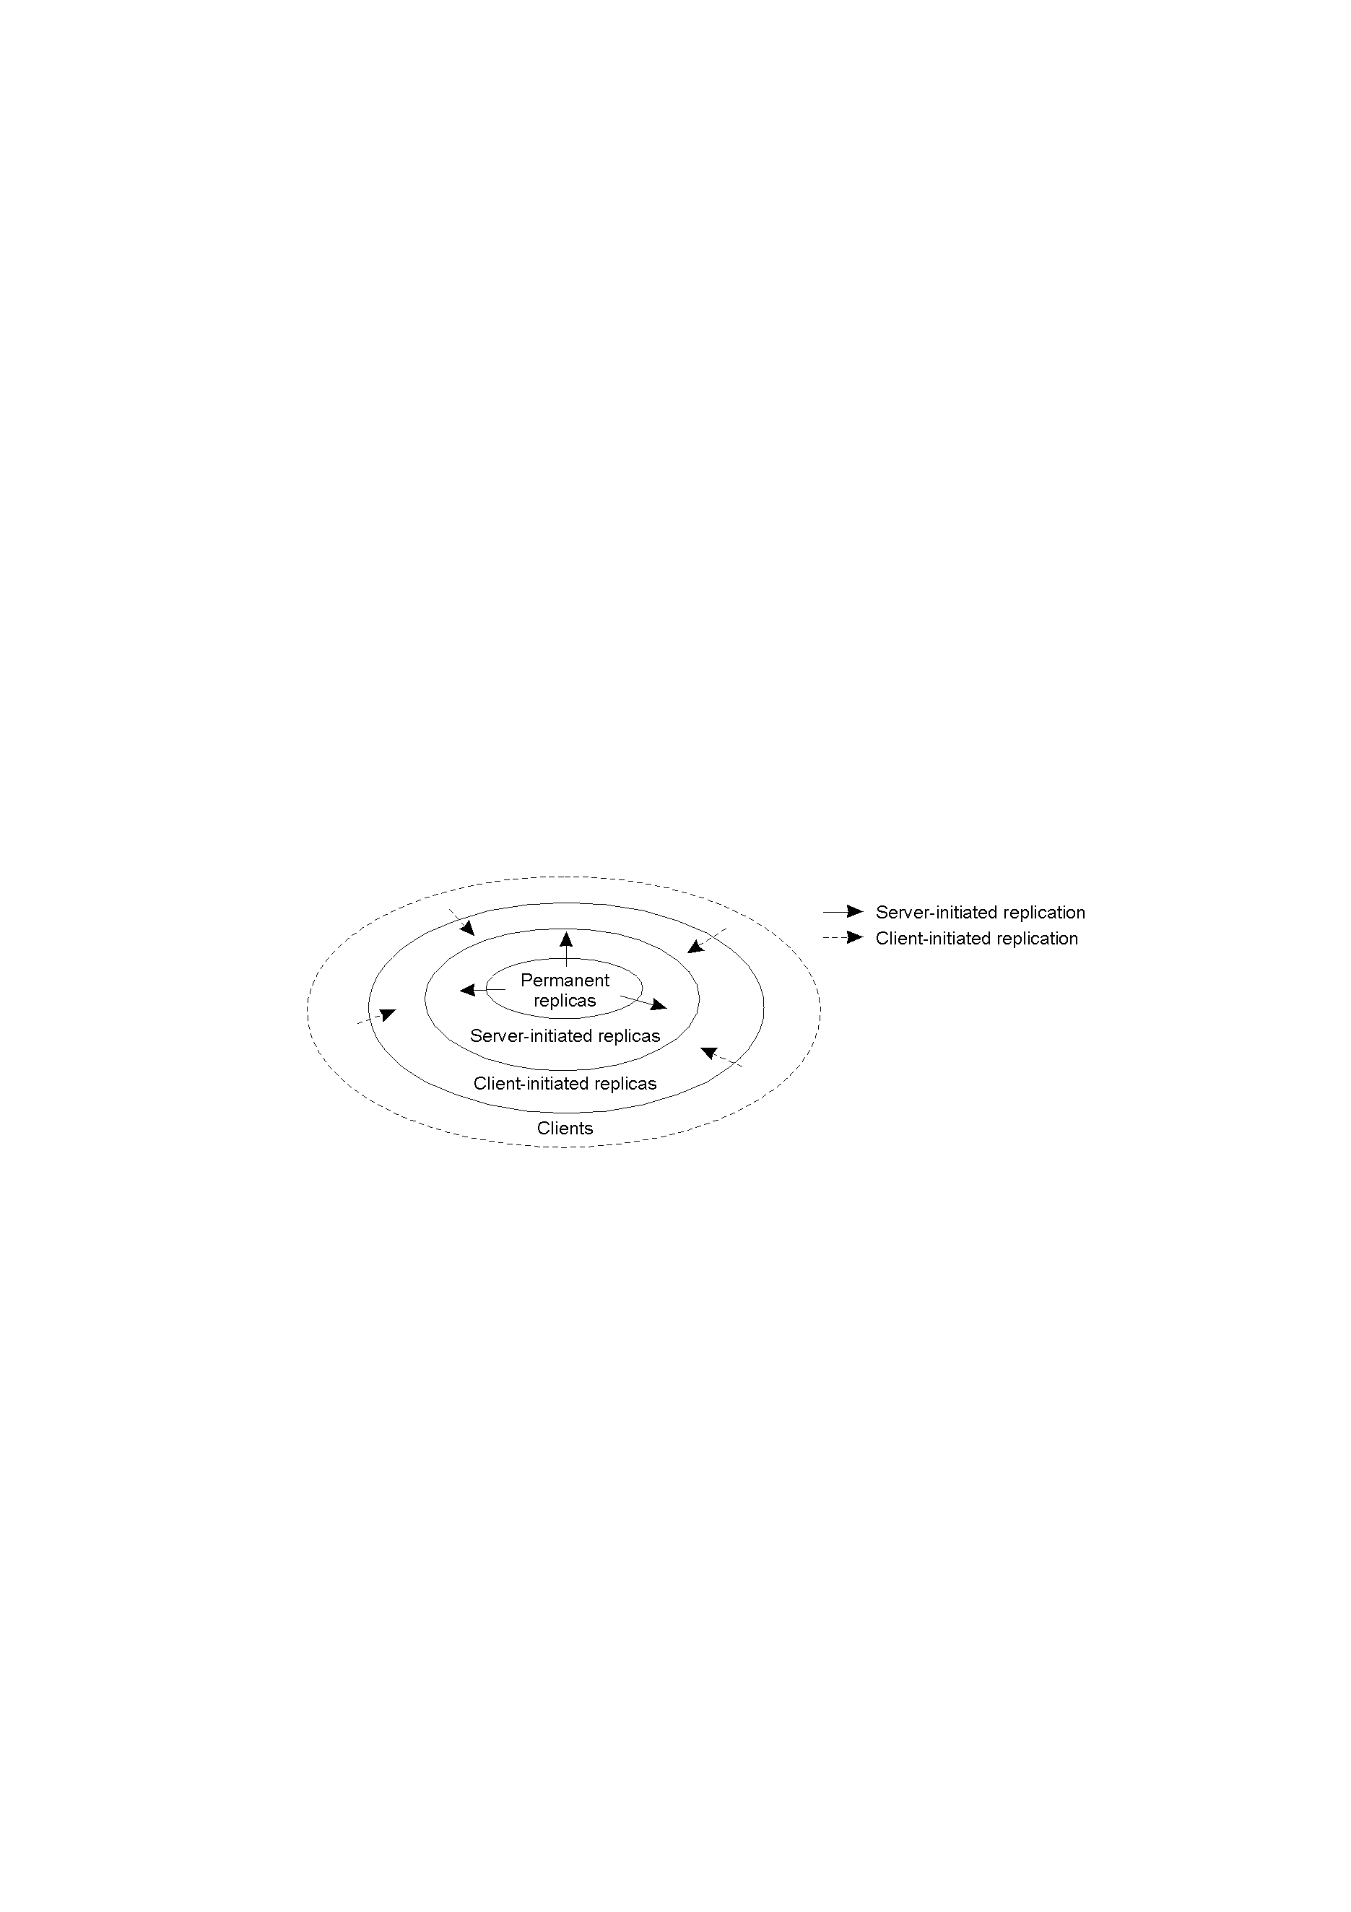
Content replication and placement
Model: We consider objects
(don't worry whether they contain data or code, or both)
Distinguish different processes: A process is capable of hosting a replica of an object :
Permanent replicas: Process/machine always having a replica (the discussion so far!)
Server-initiated replica: Process that can dynamically host a replica on request of another server in the data store
Client-initiated replica: Process that can dynamically host a replica on request of a client (client caches)

Slide 125
Client initiated replicas (caches)
Issue: What do I propagate when content is dynamic?
State vs. operations
Propagate only notification/invalidation of update (often used for web caches)
Transfer data from one copy to another (often for caching in distributed databases)
Propagate the update operation to other copies (similar to active replication)
Note: No single approach is the best, but depends highly on (1) available bandwidth and read-to-write ratio at replicas; (2) consistency model

Slide 126
Propagating updates (1/2)
Pushing updates: server-initiated approach, in which the update is propagated regardless of whether the target asked for it.
Pulling updates: client-initiated approach, in which client requests to be updated.
Issue | Push-based | Pull-based
State of server | List of client replicas and caches | None
Messages sent | Update message (and possibly fetch update later) | Poll and update
Response time at client | Immediate (or fetch-update time) | Fetch-update time

Slide 127
Propagating updates: Leases (2/2)
Observation: We can dynamically switch between pull and push using leases:
  Lease: A contract in which the server promises to push updates to the client until the lease expires.
Additional Technique: Make lease expiration time dependent on system's behavior (adaptive leases):
Age-based leases: An object that hasn't changed for a long time, will not change in the near future, so provide a long-lasting lease
Renewal-frequency based leases: The more often a client requests a specific object, the longer the expiration time for that client (for that object) will be
State-based leases: The more loaded a server is, the shorter the expiration times become

Slide 128
Summary
Issue 1. Dealing with data changes
Consistency models
  What is the semantic the system implements
  (luckily) applications do not always require strict consistency
Consistency protocols
  How to implement the semantic agreed upon?
Issue 2. Replica management
How many replicas?
Where to place them?
When to get rid of them?
Issue 3. Client Side Caching
How to deal with client initiated replication

Slide 129
[Intuition for]
Google’s spanner (much simplified)
Goal: provide linearizability (external consistency)
Context: slightly different
  distributed transactions (rather than replication)
Key issue: how to execute transactions and assign timestamps such that
  “order reflects the order in which the transactions appear to execute to an external observer (e.g., an application).”
Key innovation:
  Atomic clocks and reasoning about time uncertainty.

Slide 130
[Google’s spanner] Timestamps, Global Clock
Strict two-phase locking for write transactions
Assign timestamp while locks are held
Acquired locks
Release locks
T
Pick s = now()
OSDI 2012

Slide 131
Timestamp Invariants
Timestamp order == commit order
T₁
T₂
Timestamp order respects global wall-time order
T₃
T₄
OSDI 2012

Slide 132
TrueTime: “Global wall-clock time” with bounded uncertainty
TT.now()
time
earliest
latest
2*ε
OSDI 2012

Slide 133
Timestamps and TrueTime
Acquired locks
Release locks
T
Pick s = TT.now().latest
s
Wait until TT.now().earliest > s
Commit wait
average ε
average ε
OSDI 2012

Slide 134
