Slide 1
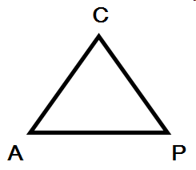
CAP
Theorem
Consistent
HBase,
MongoDB
MemcacheDB
(distributed locking,
majority protocols)
Traditional
Databases (mySQL)
Pick two!
Dynamo
Cassandra
Availabile
Partition tolerant
CAP Twelve Years After – How the “Rules” Have Changed, IEEE Spectrum 2012 [link]
Brewer's conjecture and the feasibility of consistent, available, partition-tolerant web services, SIGACT News 33(2): 51-59 (2002)

Slide 2
: Replicas
: Clients
C+PT (-A)
Option 1: accept reads accept reads
reject writes reject writes
(-L)
Option 2: accept reads reject reads
accept writes reject writes
A+PT (-C)
accept reads + writes accept reads + writes
‘inconsistent’ results ‘inconsistent’ results
(+L)
Amazon’s Dynamo:
if partitioning → favor Availability (over Consistency)
normal operation → favor low latency (over Consistency)

Slide 3
PAC / ELC
If there is a partition (P):
  How does system tradeoff A and C?
Else (no partition)
  How does system tradeoff L and C?
Amazon’s Dynamo: PA/EL
http://dbmsmusings.blogspot.com/2010/04/problems-with-cap-and-yahoos-little.html

Slide 4
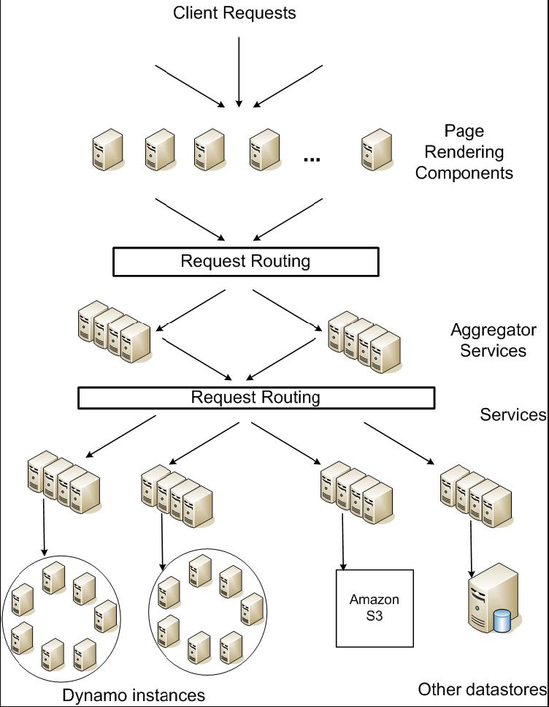
Dynamo: Amazon’s Highly Available Key-value Store
(SOSP’07)
Giuseppe DeCandia, Deniz Hastorun,
Madan Jampani, Gunavardhan Kakulapati,
Avinash Lakshman, Alex Pilchin, Swaminathan Sivasubramanian, Peter Vosshall
and Werner Vogels

Slide 5
Amazon eCommerce platform
Throughput
80M checkout operations per day (peak season) [2017]
Massive scale
At this scale component-level outages are continuous!
Slightest outage has significant financial consequences
  $1M/minute (2021)
  ….and impacts customer trust
Notes:
“One of the lessons our organization has learned from operating Amazon’s platform is that the reliability and scalability of a system is dependent on how its application state is managed. Amazon uses a highly decentralized, loosely coupled, service oriented architecture consisting of hundreds of services.
“In this environment there is a particular need for storage technologies that are always available. For example, customers should be able to view and add items to their shopping cart even if disks are failing, network routes are flapping, or data centers are being destroyed by tornados. Therefore, the service responsible for managing shopping carts requires that it can always write to and read from its data store, and that its data needs to be available across multiple data centers.

Slide 6
Why favor availability over consistency?
Application Requirements
(1) High data availability; (2) always writeable data store
.
Favor availability
(vs. consistency)
Favor writes
(vs. reads)
Favor low latency
(vs. consistency)
“even the slightest outage has significant financial consequences and impacts customer trust”
… consistency violations may as well have financial consequences and impact customer trust
  But not in (a majority of) Amazon’s services
  NB: Billing is a separate story
Why favour writes vs. reads?

Slide 7
Architectural requirements
Incremental scalability
Symmetry (no ‘special’ node)
Ability to run on a heterogeneous platform
Notes:
“A select set of applications requires a storage technology that is flexible enough to let application designers configure their data store appropriately based on these tradeoffs to achieve high availability and guaranteed performance in the most cost effective manner.
“There are many services on Amazon’s platform that only need primary-key access to a data store. For many services, such as those that provide best seller lists, shopping carts, customer preferences, session management, sales rank, and product catalog, the common pattern of using a relational database would lead to inefficiencies and limit scale and availability. Dynamo provides a simple primary-key only interface to meet the requirements of these applications.
---
“SLA: A common approach in the industry for forming a performance oriented SLA is to describe it using average, median and expected variance. At Amazon we have found that these metrics are not good enough if the goal is to build a system where all customers have a good experience, rather than just the majority. For example if extensive personalization techniques are used then customers with longer histories require more processing which impacts performance at the high-end of the distribution. An SLA stated in terms of mean or median response times will not address the performance of this important customer segment. To address this issue, at Amazon, SLAs are expressed and measured at the 99.9th percentile of the distribution. The choice for 99.9% over an even higher percentile has been made based on a cost-benefit analysis which demonstrated a significant increase in cost to improve performance that much.

Slide 8
Data Access Model
Data stored as (key, object) pairs:
  Interface put(key, object), get(key)
    ‘identifier’ (key) generated as a hash for object
  Objects: Opaque
Application scenarios: shopping carts, customer preferences, session management, sales rank, product catalog, S3
Notes:
Traditionally production systems store their state in relational databases. For many of the more common usage patterns of state persistence, however, a relational database is a solution that is far from ideal. Most of these services only store and retrieve data by primary key and do not require the complex querying and management functionality offered by an RDBMS. This excess functionality requires expensive hardware and highly skilled personnel for its operation, making it a very inefficient solution. In addition, the available replication technologies are limited and typically choose consistency over availability. Although many advances have been made in the recent years, it is still not easy to scale-out databases or use smart partitioning schemes for load balancing.
===

Slide 9
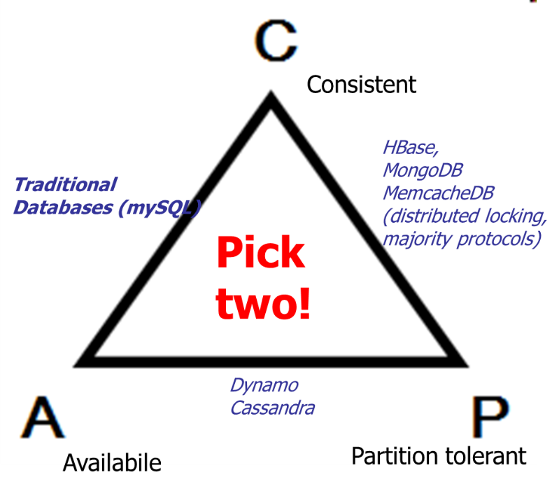
Further assumptions:
Relatively small objects (<1MB)
Query by objectID only
Operations do not span multiple objects
Friendly (cooperative) environment
One Dynamo instance per service → 100s to 1,000s hosts/service
Why not a database?
Notes:
Further issue : One of the main design considerations for Dynamo is to give services control over their system properties, such as durability and consistency, and to let services make their own tradeoffs between functionality, performance and costeffectiveness.

Slide 10
Requirements: High availability / always writeable store / low (write) latency
Key ideas
(1) Multiple replicas …
… but avoid synchronous replica coordination …
  [used by solutions that provide strong/sequential consistency]
... ‘weak consistency’ makes it possible to provide availability
  However need subsequent decisions:
    WHEN to resolve possible consistency conflicts,
      Dynamo: at read time (allows providing an “always writeable” data store)
    WHO should solve them
      Dynamo: the data store [if it can], OR [if that fails] the application (configurable, app specific)
(2) Vector clocks [to keep track of causality]
(3) Quorum protocols [to reduce latency / manage tradeoffs]
Notes:
One of the main design considerations for Dynamo is to give services control over their system properties, such as durability and consistency, and to let services make their own tradeoffs between functionality, performance and costeffectiveness.
----
2.3 Design Considerations Data replication algorithms used in commercial systems traditionally perform synchronous replica coordination in order to provide a strongly consistent data access interface. To achieve this level of consistency, these algorithms are forced to tradeoff the availability of the data under certain failure scenarios. For instance, rather than dealing with the uncertainty of the correctness of an answer, the data is made unavailable until it is absolutely certain that it is correct. From the very early replicated database works, it is well known that when dealing with the possibility of network failures, strong consistency and high data availability cannot be achieved simultaneously [2, 11]. As such systems and applications need to be aware which properties can be achieved under which conditions.
For systems prone to server and network failures, availability can be increased by using optimistic replication techniques, where changes are allowed to propagate to replicas in the background, and concurrent, disconnected work is tolerated. The challenge with this approach is that it can lead to conflicting changes which must be detected and resolved. This process of conflict resolution introduces two problems: when to resolve them and who resolves them. Dynamo is designed to be an eventually consistent data store; that is all updates reach all replicas eventually.
An important design consideration is to decide when to perform the process of resolving update conflicts, i.e., whether conflicts should be resolved during reads or writes. Many traditional data stores execute conflict resolution during writes and keep the read complexity simple [7]. In such systems, writes may be rejected if the data store cannot reach all (or a majority of) the replicas at a given time. On the other hand, Dynamo targets the design space of an “always writeable” data store (i.e., a data store that is highly available for writes). For a number of Amazon services, rejecting customer updates could result in a poor customer experience. For instance, the shopping cart service must allow customers to add and remove items from their shopping cart even amidst network and server failures. This requirement forces us to push the complexity of conflict resolution to the reads in order to ensure that writes are never rejected.
The next design choice is who performs the process of conflict resolution. This can be done by the data store or the application. If conflict resolution is done by the data store, its choices are rather limited. In such cases, the data store can only use simple policies, such as “last write wins” [22], to resolve conflicting updates. On the other hand, since the application is aware of the data schema it can decide on the conflict resolution method that is best suited for its client’s experience. For instance, the application that maintains customer shopping carts can choose to “merge” the conflicting versions and return a single unified shopping cart. Despite this flexibility, some application developers may not want to write their own conflict resolution mechanisms and choose to push it down to the data store, which in turn chooses a simple policy such as “last write wins”.
Other key principles embraced in the design are:
Incremental scalability: Dynamo should be able to scale out one storage host (henceforth, referred to as “node”) at a time, with minimal impact on both operators of the system and the system itself.
Symmetry: Every node in Dynamo should have the same set of responsibilities as its peers; there should be no distinguished node or nodes that take special roles or extra set of responsibilities. In our experience, symmetry simplifies the process of system provisioning and maintenance.
Decentralization: An extension of symmetry, the design should favor decentralized peer-to-peer techniques over centralized control. In the past, centralized control has resulted in outages and the goal is to avoid it as much as possible. This leads to a simpler, more scalable, and more available system.
Heterogeneity: The system needs to be able to exploit heterogeneity in the infrastructure it runs on. e.g. the work distribution must be proportional to the capabilities of the individual servers. This is essential in adding new nodes with higher capacity without having to upgrade all hosts at once.

Slide 11
Key issues
Partitioning the key/data space. Request routing
High availability for writes
Handling temporary node failures
Recovering from permanent failures
Membership and failure detection

Slide 12
Things to remember from last time …
Vector clocks
  Can be used to model causality dependence.
  So far two usage examples
    [Causally ordered] Group communication
    [Replica management] Determine replica divergence and the causally related stream of updates
Voting-based / Quorum-based protocols
  More examples later

Slide 13
Problem | Technique | Advantage
Partitioning / Request routing | Consistent hashing | Incremental scalability, load balancing, etc.
High availability for writes | Eventual consistency Reconciliation during reads (uses vector clocks) Quorum protocol | Low latency writes
Handling temporary failures | ‘Sloppy’ quorum protocol and hinted handoff | Provides availability and durability when some of the replicas are temporarily not available.
Recovering from permanent failures | Anti-entropy using Merkle trees | Synchronizes divergent nodes in the background.
Membership and failure detection | epidemic-based membership protocol | Preserves symmetry and avoids having a centralized registry for storing membership and node liveness information.

Slide 14
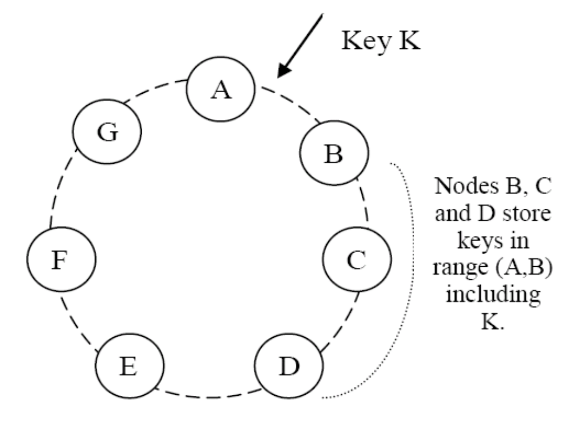
Partition Algorithm: Consistent hashing
Each data item is replicated at N hosts (successors)

Slide 15
Problem | Technique | Advantage
Partitioning / Request routing | Consistent hashing | Incremental scalability, load balancing, etc.
High availability for writes | Eventual consistency Reconciliation during reads (uses vector clocks) Quorum protocol | Availability
Handling temporary failures | ‘Sloppy’ quorum protocol and hinted handoff | Provides high availability and durability guarantee when some of the replicas are not available.
Recovering from permanent failures | Anti-entropy using Merkle trees | Synchronizes divergent nodes in the background.
Membership and failure detection | epidemic-based membership protocol | Preserves symmetry and avoids having a centralized registry for storing membership and node liveness information.

Slide 16
Traditional quorum system:
R/W: the minimum number of nodes that must participate in a successful read/write operation.
  Latency of a read/write operation: the slowest of the R (or W) replicas
  To improve latency R and W are usually configured to be less than N.
R + W > N and W > N/2 yields a quorum-like system.
Dynamo’s “Sloppy” quorum:
A put() may return before W replicas updated!
  [A first factor leading to inconsistencies]
Notes:
Note multidimensional space:
Availability
Consistency
+ Durability
Sloppy quorum: “a put() may return to its caller before the update has been applied at all the replicas, which can result in scenarios where a subsequent get() operation may return an object that does not have the latest updates..

Slide 17
A second factor for inconsistencies: Dealing with temporary failures through “Hinted handoff”
Assume replication factor R = 3.
Replicas on next R nodes.
When A is temporarily down
  (or unreachable) during a write,
  send the write to D.
D is ‘hinted’ that the replica belongs to A and will deliver it to A when A recovers.
Objective: “always writeable”

Slide 18
Data versioning
Multiple replicas …
  … but with focus on availability they may diverge
The issues this introduces:
  when to resolve possible conflicts?
    Dynamo’s solution: at read time (allows providing an “always writeable” data store)
      A put() may return before the update has been applied at all the replicas
      A get() call may return different versions of the same object.
  who should solve them?
    the data store → use vector clocks to capture causality between different versions of the same object. OR
    the application → uses application specific logic.

Slide 19
How does the data-store solve conflicts: Vector Clocks?
Each version of each object has one associated vector clock.
  list of (node, counter) pairs.
Data store: Which version to keep V’ or V’’?
If V’ is a direct ancestor of V’’ then keep V’’
  direct ancestor: each counter on the V’ vector clock is each less-or-equal than corresponding counter in V’’
Otherwise: application-level reconciliation

Slide 20
D1 ([Sx, 1])
write handled
by Sx
D2 ([Sx, 2])
write handled
by Sx
write handled
by Sy
D3 ([Sx, 2][Sy,1])
D4 ([Sx, 2] [Sz,1])
write handled
by Sz
D5 ([Sx, 3][Sy,1][Sz,1])
Able to determine that neither D3 or D4 are an ancestor of the other one (“conflicting”)
Reconciled at the application level and written by Sx
Notes:
In Dynamo, when a client wishes to update an object, it must specify which version it is updating. This is done by passing the context it obtained from an earlier read operation, which contains the vector clock information. Upon processing a read request, if Dynamo has access to multiple branches that cannot be syntactically reconciled, it will return all the objects at the leaves, with the corresponding version information in the context. An update using this context is considered to have reconciled the divergent versions and the branches are collapsed into a single new version.
Figure: A client writes a new object. The node (say Sx) that handles the write for this key increases its sequence number and uses it to create the data's vector clock. The system now has the object D1 and its associated clock [(Sx, 1)]. The client updates the object. Assume the same node handles this request as well. The system now also has object D2 and its associated clock [(Sx, 2)]. D2 descends from D1 and therefore over-writes D1, however there may be replicas of D1 lingering at nodes that have not yet seen D2. Let us assume that the same client updates the object again and a different server (say Sy) handles the request. The system now has data D3 and its associated clock [(Sx, 2), (Sy, 1)].

Slide 21
Divergent versions rarely created in practice
1 version → 99.94%
2 versions → 0.0057%
3 versions → 0.00047%
4 versions → 0.00007%
Live production environment; % versions reconciled using application logic
Source: Clients with high volume of concurrent writes (not failures)
… these may be robots
Notes:
Divergent versions of a data item arise in two scenarios. The first is when the system is facing failure scenarios such as node failures, data center failures, and network partitions. The second is when the system is handling a large number of concurrent writers to a single data item and multiple nodes end up coordinating the updates concurrently. From both a usability and efficiency perspective, it is preferred to keep the number of divergent versions at any given time as low as possible. If the versions cannot be syntactically reconciled based on vector clocks alone, they have to be passed to the business logic for semantic reconciliation. Semantic reconciliation introduces additional load on services, so it is desirable to minimize the need for it.

Slide 22
Problem | Technique | Advantage
Partitioning | Consistent hashing | Incremental scalability, load balancing, etc.
High availability for writes | Eventual consistency Vector clocks with reconciliation during reads Quorum protocol | Availability
Handling temporary failures | ‘Sloppy’ quorum protocol and hinted handoff | Provides high availability and durability guarantee when some of the replicas are not available.
Recovering from permanent failures | Anti-entropy using Merkle trees | Synchronizes divergent replicas in the background.
Membership and failure detection | epidemic-based membership protocol | Preserves symmetry and avoids having a centralized registry for storing membership and node liveness information.

Slide 23
Problem | Technique | Advantage
Partitioning | Consistent hashing | Incremental scalability, load balancing, etc.
High availability for writes | Eventual consistency Vector clocks with reconciliation during reads Quorum protocol | Availability
Handling temporary failures | ‘Sloppy’ quorum protocol and hinted handoff | Provides high availability and durability guarantee when some of the replicas are not available.
Recovering from permanent failures | Anti-entropy using Merkle trees | Synchronizes divergent replicas in the background.
Membership and failure detection | epidemic-based membership protocol | Preserves symmetry and avoids having a centralized registry for storing membership and node liveness information.

Slide 24
Reconciliation
Dynamo will replicate each data item on N successors
  A pair (k,v) is stored by the node closest to k and replicated on N successors of that node
Why is this may be hard?
  As nodes may be slow, fail temporarily …sloppy quorum, hinted handoff
  Need to reconciliate keysets
k

Slide 25
Replication Meets Epidemics
Goal: synchronize sets of key/value pairs on two nodes
Candidate Algorithm
  For each (k,v) stored locally, compute SHA(k.v)
  Every period, pick a random leaf-set neighbor
  Ask neighbor for all its hashes
  For each unrecognized hash, ask for key and value
    (if needed use vector timestamps to reason about version freshness)
This is an epidemic algorithm All N members will have all (k,v) in log(N) periods
  But (above) the cost is O(C), where C is the size of the set of items stored at the original node

Slide 26
Merkle Trees
An efficient summarization technique
  Interior nodes are the secure hashes of their children
  E.g., I = SHA(A.B), N = SHA(K.L), etc.
R
M
N=SHA(K.L)
I=SHA(A.B)
J
K
L
A
B
C
D
E
F
G
H

Slide 27
Merkle Trees
Merkle trees are an efficient summary technique
  If the top node is signed and distributed, this signature can later be used to verify any individual block, using only O(log n) nodes, where n = # of leaves
  E.g., to verify block C, need only R, N, I, C, & D
R
M
N
I
J
K
L
A
B
C
D
E
F
G
H
One use: enables client to verify integrity of data stored in a cloud

Slide 28
Using Merkle Trees as Summaries
Use Merkle tree to accelerate set comparison (and identify differences)
  B gets tree root from A, if same as local root, done
  Otherwise, recurse down tree to find difference
  [assumption: sets diverge little]
A’s values:
B’s values:

Slide 29
Using Merkle Trees as Summaries
Use Merkle tree to accelerate set comparison (and identify differences)
  B gets tree root from A, if same as local root, done
  Otherwise, recurse down tree to find difference
New cost is O(d log C)
  d = number of differences, C = size of disk
A’s values:
B’s values:

Slide 30
Using Merkle Trees as Summaries
Still too costly:
  If A is down for an hour, then comes back, changes will be randomly scattered throughout tree
A’s values:
B’s values:

Slide 31
Using Merkle Trees as Summaries
Still too costly:
  If A is down for an hour, then comes back, changes will be randomly scattered throughout tree
Solution: order values by time instead of hash
  Localizes values to one side of tree
A’s values:
B’s values:

Slide 32
Problem | Technique | Advantage
Partitioning | Consistent hashing | Incremental scalability, load balancing, etc.
High availability for writes | Eventual consistency Vector clocks with reconciliation during reads Quorum protocol | Availability
Handling temporary failures | ‘Sloppy’ quorum protocol and hinted handoff | Provides high availability and durability guarantee when some of the replicas are not available.
Recovering from permanent failures | Anti-entropy using Merkle trees | Synchronizes divergent replicas in the background.
Membership and failure detection | epidemic-based membership protocol | Preserves symmetry and avoids having a centralized registry for storing membership and node liveness information.

Slide 33
Dynamo Implementation
Java
  non-blocking IO
Local persistence component allows for different storage engines to be plugged in:
  Berkeley Database (BDB) Transactional Data Store: object of tens of kilobytes
  MySQL: larger objects
Quorum choices (N,W,R) → influence object availability, durability, consistency

Slide 34
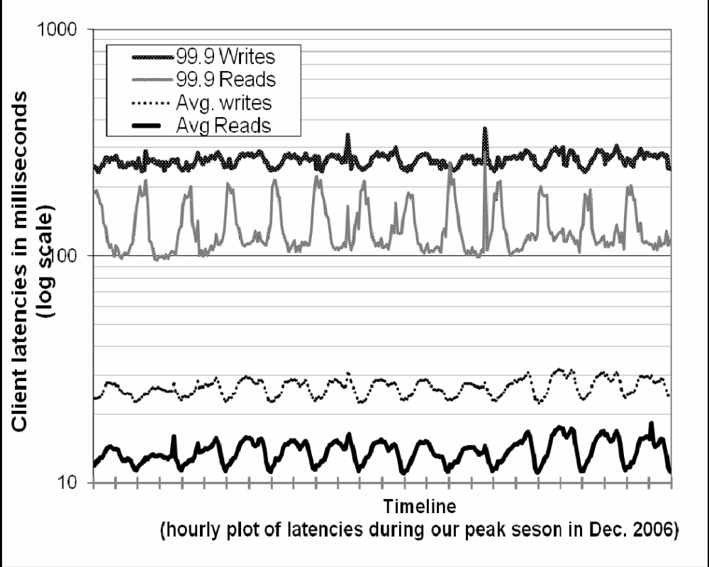
Performance evaluation
Writes
Notes:
Moreover, the write latencies are higher than read latencies obviously because write operations always results in disk access. Also, the 99.9th percentile latencies are around 200 ms and are an order of magnitude higher than the averages. This is because the 99.9th percentile latencies are affected by several factors such as variability in request load, object sizes, and locality patterns.

Slide 35
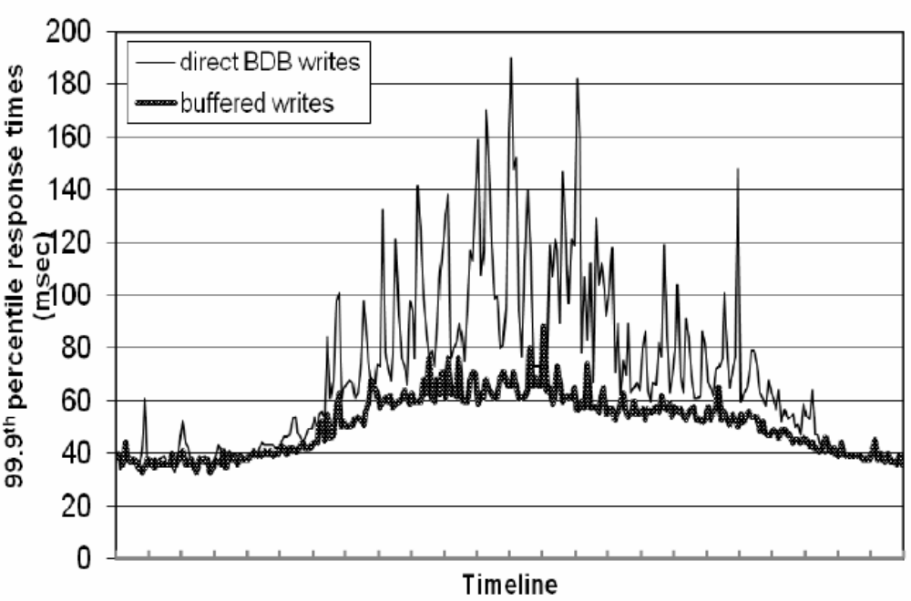
Trading between latency & durability
Comparison of performance of 99.9th %-tile latencies for buffered vs. non-buffered writes over 24 hours. The intervals between consecutive ticks in the x-axis correspond to one hour.
Notes:
“A few customer-facing services required higher levels of performance. For these services, Dynamo provides the ability to trade-off durability guarantees for performance. In the optimization each storage node maintains an object buffer in its main memory. Each write operation is stored in the buffer and gets periodically written to storage by a writer thread. In this scheme, read operations first check if the requested key is present in the buffer. If so, the object is read from the buffer instead of the storage engine.
“This optimization has resulted in lowering the 99.9th percentile latency by a factor of 5 during peak traffic even for a very small buffer of a thousand objects (see Figure 5). Also, as seen in the figure, write buffering smoothes out higher percentile latencies. Obviously, this scheme trades durability for performance. In this scheme, a server crash can result in missing writes that were queued up in the buffer. To reduce the durability risk, the write operation is refined to have the coordinator choose one out of the N replicas to perform a “durable write”. Since the coordinator waits only for W responses, the performance of the write operation is not affected by the performance of the durable write operation performed by a single replica.

Slide 36
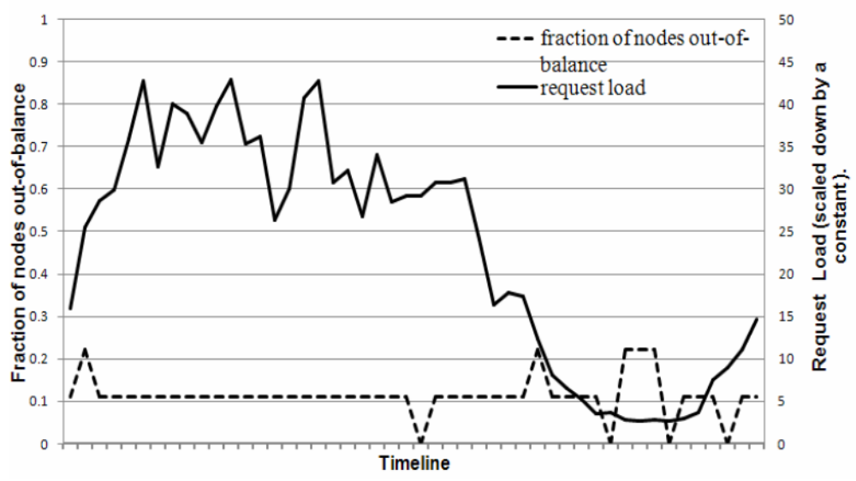
Load balance
out-of-balance: nodes with request load above 15% from the average system load

Slide 37
Divergent versions rarely created in practice
1 version → 99.94%
2 versions → 0.0057%
3 versions → 0.00047%
4 versions → 0.00007
Source: High volume of concurrent writes … robots?

Slide 38
Problem | Technique | Advantage
Partitioning | Consistent Hashing | Incremental Scalability
High Availability for writes | Eventual consistency Vector clocks with reconciliation during reads | Version size is decoupled from update rates.
Handling temporary failures | ‘Sloppy’ quorum and hinted handoff | Provides high availability and durability guarantee when some of the replicas are not available.
Recovering from permanent failures | Anti-entropy using Merkle trees | Synchronizes divergent replicas in the background.
Membership and failure detection | epidemic-based membership protocol and failure detection. | Preserves symmetry and avoids having a centralized registry for storing membership and node liveness information.

Slide 39
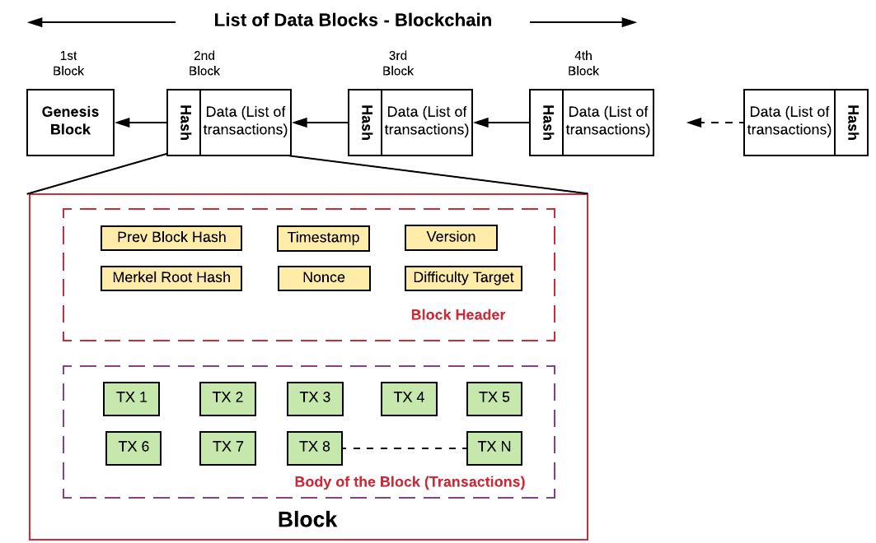
Large set S: say 1M elements, each element 1KB-1MB
P1: Need to test for differences between two sets
  isDifferent (S1, S2) → list of differences
P2: You also know that if there is a difference between S1 and S2, it’s small
Bonus: Verifiable proof of membership

Slide 40
Gilbert/Lynch theorems
Theorem 1: It is impossible in the asynchronous network model to implement a read/write object store that guarantees
  Availability AND
  Atomic consistency
in all executions (including those in which messages are lost)
asynchronous networks: no clocks, message delays unbounded

Slide 41
Gilbert/Lynch theorems
Theorem 2: It is impossible in the partially synchronous network model to implement a read/write object store that guarantees
  Availability AND
  Atomic consistency
in all executions (including those in which messages are lost)
partially synchronous network model. Bounds on:
a) time it takes to deliver messages that are NOT lost, and
b) message processing time
exist and are known, but process clocks are not synchronized

