Slide 1
Distributed Agreement
(with a side discussion on distributed transactions)

Slide 2
Distributed Agreement
Two Phase Commit
Three Phase Commit
Paxos
Some slides from Roxana Geambasu / Columbia U.
https://roxanageambasu.github.io/ds-class//assets/lectures/lecture17.pdf

Slide 3
Problem: A set of nodes need to agree on a decision, value of a variable, or order of events.
Pervasive in distributed systems
(We’ve seen instances of the problem already)
  Bank transfer example: both parties to agree that their end of the transaction was successful
  A primary/backup protocol: nodes having to agree on the primary
  A chain replication protocol: nodes having to agree on the structure of the chain
  A quorum protocol: nodes having to agree on the next version ID

Slide 4
DISTRIBUTED AGREEMENT PROBLEM
You want to go out with 4 friends at 6pm on Tuesday
  Goal: go out only if ALL friends can make it
What do you do?
  Call each of them and ask if can do 6pm on Tuesday (voting phase)
  If all can do Tuesday, call each friend back to ACK (commit)
  If one can’t do Tuesday, call other three to cancel (abort)
Critical details:
  While you are calling everyone to ask, people who’ve promised they can do 6pm Tuesday must block that slot
  You need to remember the decision (commit/abort) and tell everyone what the decision was.
Notes:
Strawman: Why not a “one-phase-commit”?
WHEN vs. WHERE (next slide)

Slide 5
Two ‘flavors’ for the distributed agreement problem:
Participants need to agree on a value / action …
  [consensus problem] … and they are willing and capable to accept any value.
  [atomic commitment problem] … … and they have specific constraints on whether they can accept any particular value.
We’ll focus on this first
Notes:
NB: terminology is somewhat ad-hoc but it is useful to differentiate.
Each of these problems have intuitive correspondents in real life:
• A group’s decision on when to meet is probably an atomic commitment problem, because each participant has his/her own calendar constraints.
• A group’s decision on where to meet (say, which specific room on campus of those that are of suitable size) can probably be cast as a consensus problem: most likely no one cares where they meet, but they all need to agree on the same value. (There may be preferences on specific locations, but probably no hard constraints specific to each participant.)

Slide 6
ACID properties
Atomic: All or nothing
  State shows either all the effects of a transaction, or none of them:
Consistent (think of it as Correct): Guarantees basic properties
  A transaction moves the database from a state where integrity holds, to another where integrity holds (given constraint, triggers, etc)
Isolated: Each transaction runs as if alone
  Effect of concurrent transactions is the same as transactions running one after another (ie looks like batch mode)
Durable: Cannot be undone
  Once a transaction has committed, it can not be undone in spite of failures.

Slide 7
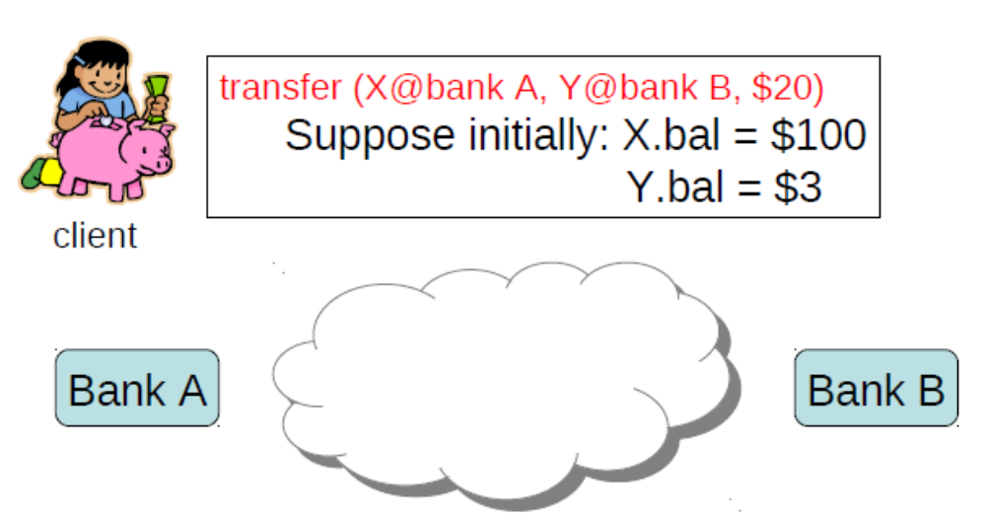
Where would you need distributed agreement?
Example: bank transfer between two banks
If not isolated and atomic:
might overdraw the src account
might “create” or “destroy” money
Clients desire:
1. Atomicity: transfer either happens or not at all
2. Concurrency control: maintain serializability
(the “I” – Isolated in ACID)
3. Durable: once transaction has committed,
it can not be undone in spite of failures.

Slide 8
A set of processes
  Transaction Coordinator (TC): initiates an action:
  Transaction Participants (TP): may vote for/against the action
Goal: all-or-nothing outcome
  All will perform the action only, if all vote in favor;
    if any votes against (or does not vote), all will “abort” (none will take the action)
  With: isolation and durability
  (all in the presence of faults)

Slide 9
Desired properties of a solution:
Safety (correctness)
  All nodes agree on the same value (action)
  The agreed value has been proposed by some node
  (the one proposed by the coordinator)
  [when failures] Never forget the decision taken
Liveness (availability)
  [if less than some fraction of nodes crash] the correctly operating nodes should reach agreement and the system should operate normally

Slide 10

Strawman solution
Transfer $20
  From scr@X
  To dest@Y
Transaction
coordinator
client
Node A
Node B

Slide 11
Typical protocol: two-phase commit (2PC)
Coordinator asks all processes if they can take the action
Processes decide if they can, and send back “commit” or “abort”
Coordinator collects all the answers (or times out)
Coordinator computes outcome and sends decision back

Slide 12
2-Phase Commit Protocol Illustrated
TC
TP¹
TP²
TP³
Transaction.commit()
Vote-request

Slide 13
2-Phase Commit Protocol Illustrated
TC
TP¹
TP²
TP³
Transaction.commit()
Process checks if transaction can be commited
(locks local data, prepares transaction, and writes on disk)
Vote-request

Slide 14
2-Phase Commit Protocol Illustrated
TC
TP¹
TP²
TP³
Process checks if transaction can be commited
(and locks local data …)
Transaction.commit()
Vote-request
Vote-commit

Slide 15
2-Phase Commit Protocol Illustrated
TC
TP¹
TP²
TP³
Process checks if transaction can be commited
(and locks local data …)
Transaction.commit()
Coordinator tallies votes
doCommit/ [doAbort]

Slide 16
2-Phase Commit Protocol Illustrated
Process checks if transaction can be commited
(and locks)
TC
TP¹
TP²
TP³
Transaction.commit()
Coordinator tallies votes
doCommit/ [doAbort]
Process: (1) commits
(2) unlocks
(3) ACKs

Slide 17
We have skipped the “client”
Client
Transaction.commit()
Process checks if transaction can be commited
(and locks)
TC
TP¹
TP²
TP³
Coordinator tallies votes
doCommit/ [doAbort]
Process: (1) commits
(2) unlocks
(3) ACKs
Ok/Nok

Slide 18
Atomic: All or nothing
  State shows either all the effects of a transaction, or none of them:
Consistent (think of it as Correct): Guarantees basic properties
  A transaction moves the database from a state where integrity holds, to another where integrity holds (given constraint, triggers, etc)
Isolated: Each transaction runs as if alone
  Effect of concurrent transactions is the same as transactions running one after another (ie looks like batch mode)
Durable: Cannot be undone
  Once a transaction has committed, it can not be undone in spite of failures.

Slide 19
Atomic: All or nothing
  State shows either all the effects of a transaction, or none of them:
Consistent (think of it as Correct): Guarantees basic properties
  A transaction moves the database from a state where integrity holds, to another where integrity holds (given constraint, triggers, etc)
Isolated: Each transaction runs as if alone
  Effect of concurrent transactions is the same as transactions running one after another (ie looks like batch mode)
Durable: Cannot be undone
  Once a transaction has committed, it can not be undone in spite of failures.

Slide 20
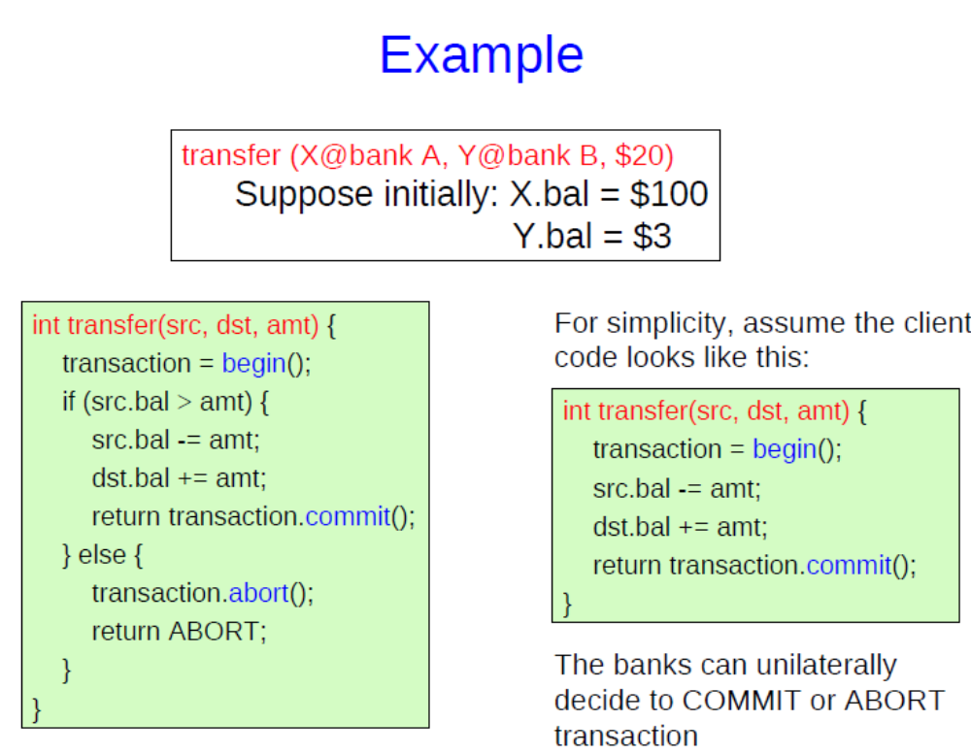

If not isolated and atomic:
might overdraw the src account
might “create” or “destroy” money

Slide 21
Problems to avoid
Lost updates
  Another transaction overwrites your change based on a previous value of some data
Inconsistent retrievals
  You read data that can never occur in a consistent state
    E.g., partial writes by other transactions, writes by a transaction that later aborts
Notes:
All local operations

Slide 22
One bad solution
A global lock
Let only one transaction run at a time
  make changes permanent on commit or undo changes on abort, if necessary

Slide 23
Better …
Lock objects independently
  E.g., one lock for the src account, one lock for the dest account
  Other transactions can execute concurrently, as long as they don’t read or write the src or dest accounts
  Fairly easy to implement with the tools we have

Slide 24
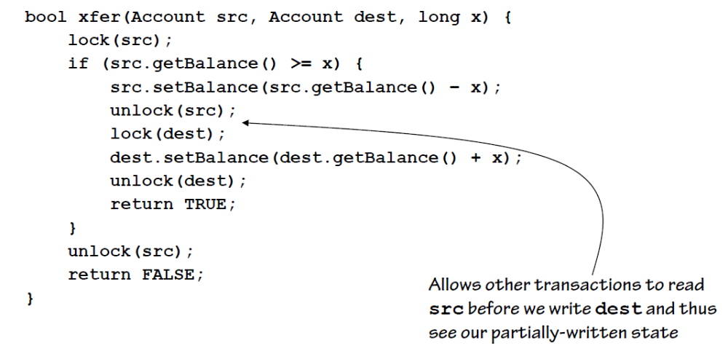
Locks alone are insufficient
[… you need to use them correctly ☺]

Slide 25
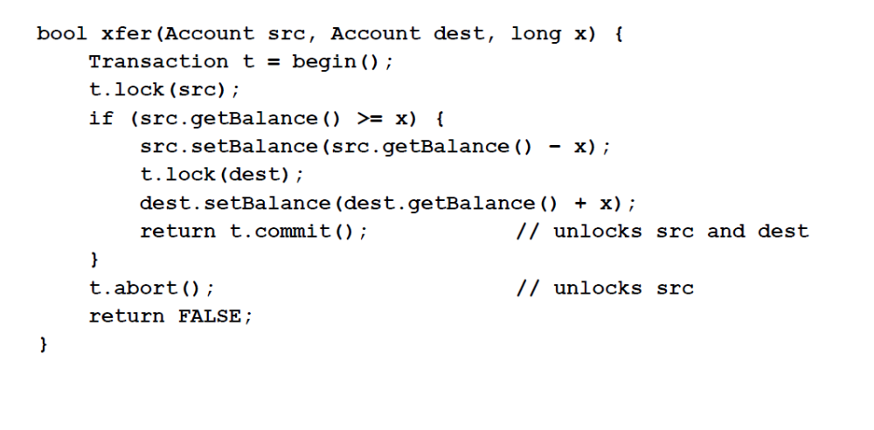
2PL – Two Phase Locking
Phase 1: acquire locks
Phase 2: release locks
  You may not get any more locks after you release any locks
  Typically implemented by not allowing explicit unlock calls
    (Instead) Locks automatically released on commit/abort

Slide 26
What’s the next problem?
…deadlocks!
Preventing deadlocks
  Each transaction gets all locks at once
  Each transaction gets all locks in a predefined order
  Impractical: transactions often do not know in advance what locks they will need

Slide 27
So?
Detecting deadlock
  Build a ‘wait-for’ graph
    Each vertex is a transaction.
    T1 → T2 if T1 waits for a lock held by T2
  If cycles then you have deadlock
    Abort one of the transactions in the cycle
“Ignoring” deadlocks
  Automatically abort a long transaction
  Not a bad strategy if you expect transactions to be short
    (A long-running “short” transaction is likely a deadlock)

Slide 28
Atomic: All or nothing
  State shows either all the effects of a transaction, or none of them:
Consistent (think of it as Correct): Guarantees basic properties
  A transaction moves the database from a state where integrity holds, to another where integrity holds (given constraint, triggers, etc)
Isolated: Each transaction runs as if alone
  Effect of concurrent transactions is the same as transactions running one after another (ie looks like batch mode)
Durable: Cannot be undone
  Once a transaction has committed, it can not be undone in spite of failures.

Slide 29
  Let’s have an eye on durable part:
  key issue: maintain transaction decision (commit / abort) in spite of failures (e.g., timeouts / rebots)
Worth thinking about: how would a world where transactions / agreement is NOT durable
  Blockchain wold: transactions are not durable – their ‘finality’ is probabilistic
Notes:
https://hal-cea.archives-ouvertes.fr/cea-03080029v3/document

Slide 30
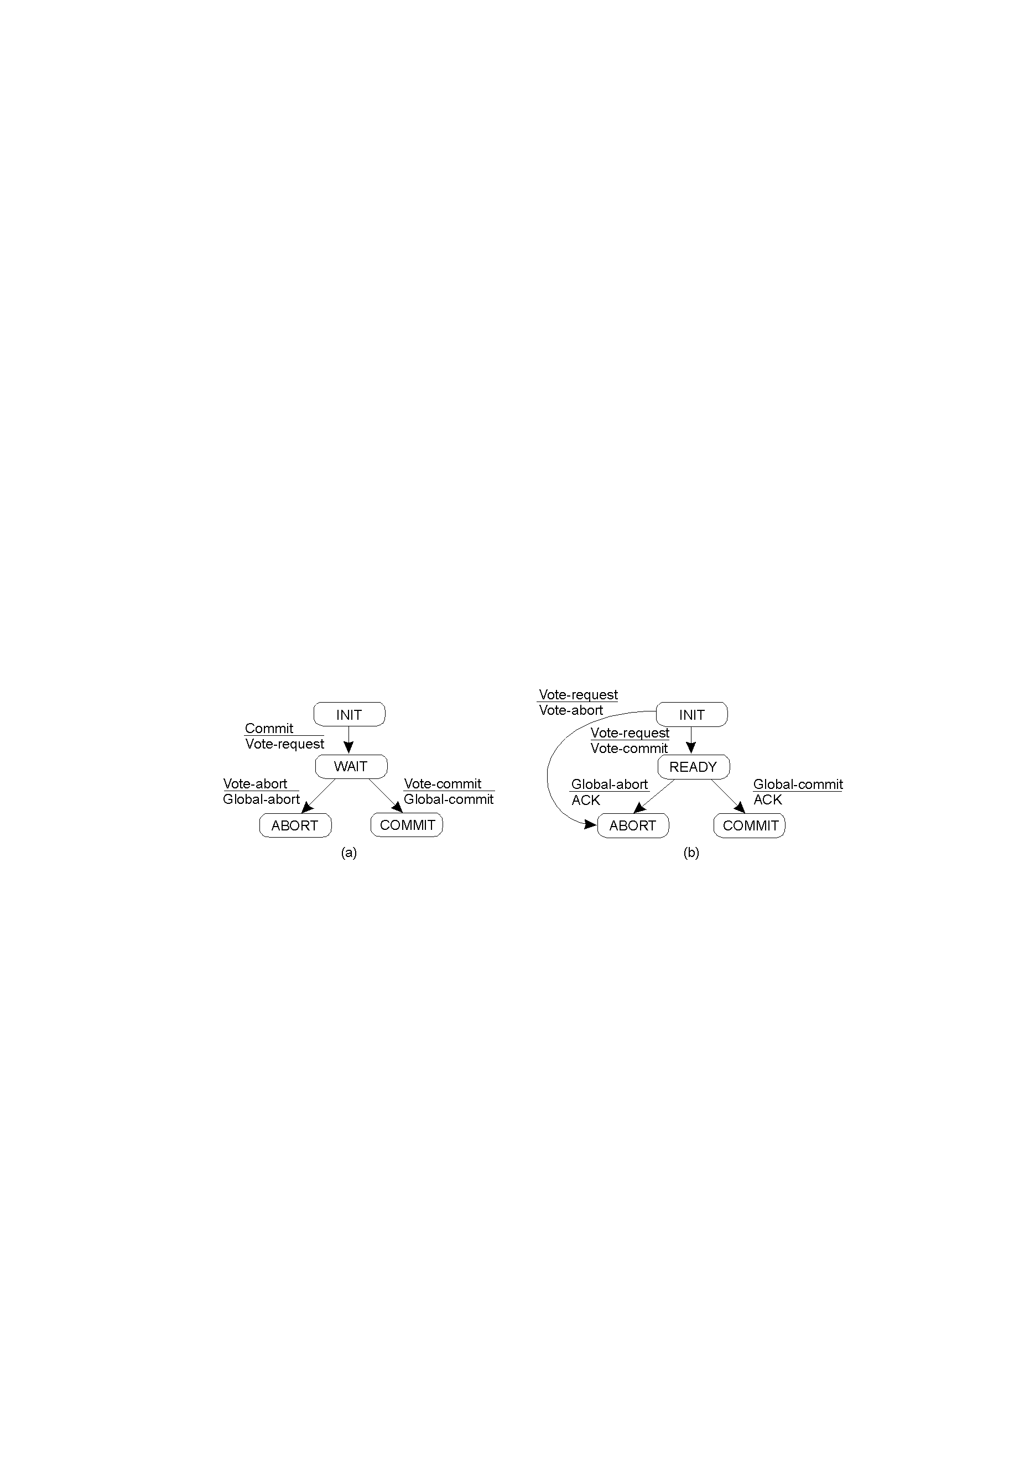
Finite State Machine: Coordinator
Finite State Machine: Notations
State
Message received
Message sent

Slide 31
Finite State Machine: Participant?

Slide 32
Two-Phase Commit – Finite State Machines
Coordinator (TC)
Participant (TP)

Slide 33
Coordinator (TC)
Participant (TP)
Observation: Blocking protocol
in WAIT and READY states: progress is made by collaborating with others.
Potentially slow / What if failures …?
Goal: continue to operate after network and node failures

Slide 34
Impact of network failure …
TC
TP¹
TP²
TP³
ok to commit?
… times out
abort!
Temporary partition
ok with us
Vote-abort
Process aborts
(and unlocks)

Slide 35
Goal: all-or-nothing outcome
  All will perform the action only, if all vote in favor;
    if any votes against (or does not vote), all will “abort” (none will take the action)
  with: isolation and durability
  (all in the presence of faults)
What’s the fault model?

Slide 36
Fault model
Different safety/liveness properties are possible under different failure models!
(1) Time bounds on communication / progress rate
  synchronous systems: machines and networks can only be delayed by a bounded time
    i.e., using a sufficiently large timeout, you can tell with certainty whether the machine crashed or the network is just slow
  *asynchronous systems: machines and networks can be arbitrarily delayed
    no way to tell whether a machine has crashed or is just slow
(2) What happens after a crash? *Fail-recover vs. fail-stop
  Fail-recover: Machines can crash … but will reboot (and will be ok/fixed)
    Assumption 1: disks cannot fail
    Assumption 2: failures are not ‘hard’ - i.e., reboot fixes them. Examples: software bug, power loss cause reboot
(3) Trust: Are there ‘byzantine’ faults? we’ll assume *no byzantine
* ← our failure model in what’s next
Makes sense in the context of a “atomic commit”
(fail-stop for “consensus”?)

Slide 37
We’ll assume:
asynchrounous
fail-recover
no byzantine

Slide 38
Desired properties of a solution:
Safety (correctness)
  All nodes agree on the same value (action)
  The agreed value has been proposed by some node
  (the one proposed by the coordinator)
  [when failures] Never forget the decision taken
Liveness (availability)
  [If less than some fraction of nodes crash] the correctly operating nodes should reach agreement and the system should operate normally
Implementation mechanisms at two levels:
Local system: we assume write-ahead logging.
  A node persists: transaction workspace + state machine change
Distributed system: Coordination between nodes (our focus)

Slide 39
Failure Recovery in 2PC
Two cases:
  Recovery after crashes/reboots
  Recovery after timeouts
    Network (or nodes!) can be very slow
      TC times-out waiting for participants’ votes
      TP times-out waiting for decision by TC

Slide 40
Prelims: Crash and Reboot
Q
All nodes must log protocol progress
What and when does TC log to disk?
What and when does TP log to disk?
Nodes cannot back out if commit was decided
Examples
  TC crashes just after deciding “commit”
    Cannot forget about its decision after reboot
  TP crashes after sending “vote-commit”
    Cannot forget about its response after reboot and send ‘vote-abort’
Log the state-changes (new state)
  Coordinator: INIT, WAIT, COMIT/ABORT
  Participants: INIT, READY, COMIT/ABORT
Make sure messages are idempotent!
  In recovery, resend whatever message was next
Coordinator
Participant

Slide 41
Recovery Upon Reboot
TC: If TC finds “COMMIT”, then resend ‘global-commit’,
else abort
TP: If TP finds ‘INIT’ on disk, then abort
If TP finds ‘READY’, then run termination protocol
Coordinator
Participant

Slide 42
Handling Timeouts
Two blocking states that may lead to timeouts:
  TC in WAIT: times out waiting for a TP response
  TP in READY: times out waiting for TC’s decision
Note: timeouts aren’t necessarily due to network problems
  They could be due to slow, overloaded hosts

Slide 43
Handling Timeouts @ Coordinator?
What can TC do if timeout?
  (the only waiting TC state is ‘WAIT’)
ABORT!
Coordinator
Participant

Slide 44
Handling Timeouts @ Participants
      What if additional info is available?
      TP² has received global-commit/abort
      TP² responded with ABORT
      TP² has not responded yet
      TP² responded with COMMIT
TP¹ times out in READY state waiting for TC “Global-commit / Global-abort” response
  Can TP¹ unilaterally decide to commit?
  Can TP¹ unilaterally decide to abort?
Coordinator
Participant

Slide 45
Example of a hard scenario
TC
TP¹
TP²
TP³
ok to commit?
Votes something
Sends vote
ok
Gathers votes, Confirms to P3, Crashes
ok
ok
Times out!
      Termination protocol: Contacts another participant and tries to figure out what the decision was
      TP^{N} has received GLOBAL_COMMIT/ABORT
      TP^{N} has responded with ABORT
      TP^{N} has not responded yet
      TP^{N} has responded with COMMIT [no progress can be made! Let’s contact others]

Slide 46
Example of a hard scenario
TC
TP¹
TP²
TP³
ok to commit?
Votes something
Sends vote
Crashes after receiving decision
ok
Gathers votes, Confirms to P3, Crashes
ok
ok
Times out!
      Termination protocol: Contacts another participant and tries to figure out what the decision was
      TP² has received global-commit/abort
      TP² has responded with ABORT
      TP² has not responded yet .. contact others
        TP³ has crashed [no progress can be made!]

Slide 47
Possible termination protocol
Execute termination protocol if TP¹ times out on TC and has voted “yes” (and timed-out or recovered after failure)
  TP¹ sends “status” message to TP²
  If TP² has received “commit”/”abort” from TC …
  If TP² has responded to TC with “no”, …
  If TP² has not responded to TC, …
  If TP² has responded with “yes”, …
Resolves most failure cases except sometimes when TC + one TP fail
  If TC is also participant, as it typically is, then this protocol is vulnerable [it blocks] to a single-node failure (the TC’s failure)!

Slide 48
Summary so far.
Desired properties of a solution:
Safety (correctness)
  All nodes agree on the same value
  The agreed value X has been proposed by some node
Liveness (availability)
  [If less than some fraction of nodes fail] the correctly operating nodes reach agreement and the system operates normally
2PC: can block even when one (or a few) machines fail (i.e., the whole system can not make progress during the failure).
  Safety (correctness) – YES;
  Liveness (availability) – NO, in some failure cases
3PC: liveness but at the cost of safety (issues only with network partitions)
Paxos: fixes the problem in most cases in you’ll see in practice

Slide 49
Summary so far

Slide 50
Two ‘flavors’ for the distributed agreement problem:
Participants need to agree on a value / action …
  [consensus problem] … and they are willing and capable to accept any value.
  [atomic commitment problem] … … and they have specific constraints on whether they can accept any particular value.
We’ have focused on this so far
Notes:
NB: terminology is somewhat ad-hoc but it is useful to differentiate.
Each of these problems have intuitive correspondents in real life: • A group’s decision on when to meet is probably an atomic commitment problem, because each participant has his/her own calendar constraints. • A group’s decision on where to meet (say, which specific room on campus of those that are of suitable size) can probably be cast as a consensus problem: most likely no one cares where they meet, but they all need to agree on the same value. (There may be preferences on specific locations, but probably no hard constraints specific to each participant.)

Slide 51
Fault model
(1) Time bounds on communication / progress rate
  synchronous systems: machines and networks can only be delayed by a bounded time
    Consequence: using a sufficiently large timeout, you can tell with certainty whether the machine crashed or the network is just slow
  *asynchronous systems: machines and networks can be arbitrarily delayed
    no way to tell whether a machine has crashed or is just slow
(2) What happens after a crash? *Fail-recover vs. fail-stop
  Fail-recover: Machines can crash … but will reboot (and will be ok/fixed)
    Assumption 1: disks cannot fail
    Assumption 2: failures are not ‘hard’ - i.e., reboot fixes them. Examples: software bug, power loss cause reboot
(3) Trust: Are there ‘byzantine’ faults? we’ll assume *no byzantine
* our failure model in what’s next .
Makes sense in the context of a “atomic commit”
(fail-stop for “consensus”?)

Slide 52
We assumed:
asynchrounous
fail-recover
no byzantine

Slide 53
Desired properties of a solution:
Safety (correctness)
  All nodes agree on the same value (action)
  The agreed value has been proposed by some node
  (the one proposed by the coordinator)
  [when failures] Never forget the decision taken
Liveness (availability)
  [If less than some fraction of nodes crash] the correctly operating nodes should reach agreement and the system should continue to operate normally
Different safety/liveness properties are possible under different failure models!

Slide 54
Typical protocol: two-phase commit (2PC)
Implementation mechanisms at two levels:
Local system: write-ahead logging.
  A node persists: transaction workspace + state machine transition
Distributed system: coordination between nodes

Slide 55
2-Phase Commit Protocol Illustrated
TC
TP¹
TP²
TP³
Transaction.commit()
Vote-request

Slide 56
2-Phase Commit Protocol Illustrated
TC
TP¹
TP²
TP³
Transaction.commit()
Process checks if transaction can be commited
(locks local data, prepares transaction, and writes on disk)
Vote-request

Slide 57
2-Phase Commit Protocol Illustrated
TC
TP¹
TP²
TP³
Process checks if transaction can be commited
(and locks local data …)
Transaction.commit()
Vote-request
Vote-commit

Slide 58
2-Phase Commit Protocol Illustrated
TC
TP¹
TP²
TP³
Process checks if transaction can be commited
(and locks)
Transaction.commit()
Coordinator tallies votes
doCommit/ [doAbort]

Slide 59
2-Phase Commit Protocol Illustrated
Process checks if transaction can be commited
(and locks)
TC
TP¹
TP²
TP³
Transaction.commit()
Coordinator tallies votes
doCommit/ [doAbort]
Process: (1) commits
(2) unlocks
(3) ACKs

Slide 60
We have skipped the “client”
Client
Transaction.commit()
Process checks if transaction can be commited
(and locks)
TC
TP¹
TP²
TP³
Coordinator tallies votes
doCommit/ [doAbort]
Process: (1) commits
(2) unlocks
(3) ACKs
Ok/Nok

Slide 61
Example of a hard scenario
TC
TP¹
TP²
TP³
ok to commit?
Votes something
Sends vote
Crashes after receiving decision
ok
Gathers votes, Confirms to P3, Crashes
ok
ok
Times out!
      Termination protocol: Contacts another participant and tries to figure out what the decision was
      TP² has received global-commit/abort
      TP² has responded with ABORT
      TP² has not responded yet .. contact others
        TP ^{N} has crashed [no progress can be made!]

Slide 62
So what we’ve got ….
Desired properties of a solution:
Safety (correctness)
  All nodes agree on the same value
  The agreed value X has been proposed by some node
Liveness (availability)
  [If less than some fraction of nodes fail] the correctly operating nodes reach agreement and the system operates normally
2PC: may block even when one (or a few) machines fail
(i.e., the whole system can not make progress during the failure).
  Safety (correctness) – YES;
  Liveness (availability) – NO (in some failure cases)

Slide 63
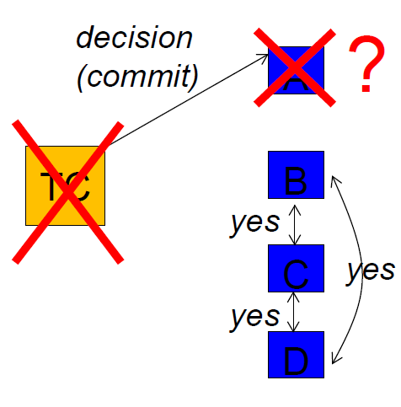
2PC: Safe but at the cost of liveness
Does the fault model matter?
  Async vs. sync
  Fail-recover vs. fail-stop
Assuming fail-stop AND sync then the protocol has no liveness issues!

Slide 64
Next
2PC: can block even when one (or a few) machines fail
(i.e., the whole system blocked -- can not make progress -- during the failure)
  Safety (correctness) – YES;
  Liveness (availability) – NO – in some failure cases
3PC: one attempt to fix liveness (but at the cost of safety)
(issues only with network partitions)
(we keep the initial fault model:
asynchrounous
fail-recover
no byzantine
)
Notes:
NB: in what follows we build a strawman – different design decisions can be made for 3PC, but the protocol will either be not save or blocking (i.e., not live) (for some failure scenarios)

Slide 65
One attempt to fix: 3PC
Goal: Turn 2PC into a live (non-blocking) protocol
  ‘force’ progress after timeout!
  our 3PC should never block on node failure as 2PC did
Insight: 2PC suffers from allowing nodes to irreversibly commit an outcome before ensuring that the others know the outcome, too
Idea: split the “commit/abort” phase into two phases
  First communicate the outcome to everyone
  Commit only after everyone knows the outcome

Slide 66
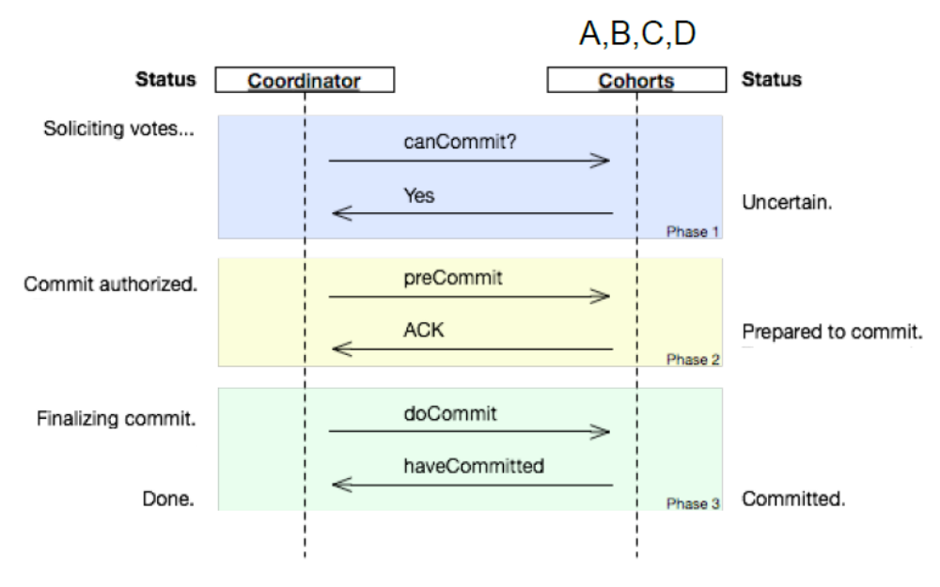

Slide 67
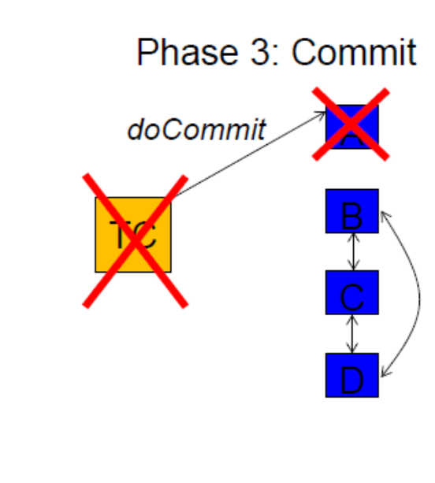
Does 3PC solve the blocking issue?
Assuming same scenario as before (TC, A crash)
Can B/C/D reach a safe decision when they time out?
1. If one of them has received preCommit, …
2. If none of them has received preCommit, …

Slide 68
Does 3PC solve the blocking issue?
Assuming same scenario as before (TC, A crash)
Can B/C/D reach a safe decision when they time out?
1. If one of them has received preCommit, … can commit
2. If none of them has received preCommit, … abort
Blocking solved! ☺

Slide 69
But is 3PC always safe (correct)?
Liveness (availability): Yep
  Doesn’t block, it always makes progress by/after timing out
Safety (correctness): ???
  Can you think of scenarios in which 3PC would result in inconsistent decisions?
Cases / network partition that may lead to unsafety:
  A hasn’t crashed, it’s just offline [network partition]
  TC hasn’t crashed, it’s just offline [network partition]

Slide 70
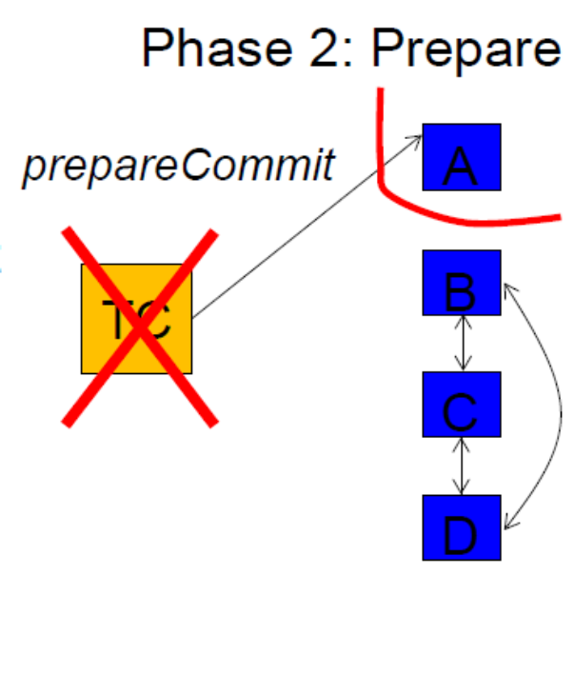
One example
One example scenario:
A receives prepareCommit from TC
Then,
  A gets partitioned from B/C/D and
  TC crashes
On timeout:
  None of B/C/D have not received prepareCommit, hence they all Abort
  A is prepared to commit, hence, according to protocol, it unilaterally decides to commit
Similar scenario with partitioned, not crashed, TC
Note: this scenario is impossible in a snchroneous system

Slide 71
2PC: can block even when one (or a few) machines fail (i.e., the whole system can not make progress during the failure).
  Safety (correctness) – YES;
  Liveness (availability) – MOSTLY – except in some failure cases
3PC: liveness but at the cost of safety
  Safety (correctness) – MOSTLY except sometimes when partitions
  Liveness (availability) – YES
Can one design a protocol that’s both safe and live?
It turns out that it’s impossible in the most general case!

Slide 72
Fischer-Lynch-Paterson [FLP’85] Impossibility Result
It is impossible for a set of processors in an asynchronous system to agree on a binary value, [even if only a single process is subject to an unannounced failure]
The core of the problem is asynchrony
  makes it impossible to tell whether or not a machine has crashed (and therefore it will launch recovery and coordinate with you safely) or it is just unreachable now (and therefore it’s running separately from you, potentially doing stuff in disagreement with you)
[For synchronous systems, 3PC can be made to guarantee both safety and liveness!
  When you know the upper bound of message delays, you can infer when something has crashed with certainty
]

Slide 73
FLP – Translation
  What FLP says: [in the general case] you can’t guarantee both safety and progress when there is even a single fault at an inopportune moment
  What FLP doesn’t say: in practice, how close can you get to the ideal (safe and live)?
Next: Paxos algorithm, which in practice gets close

Slide 74
Two ‘flavors’ for the distributed agreement problem:
Participants need to agree on a value / action …
  [consensus problem] … and they are willing and capable to accept any value.
  [atomic commitment problem] … … and they have specific constraints on whether they can accept any particular value.
Notes:
NB: terminology is somewhat ad-hoc but it is useful to differentiate.
Each of these problems have intuitive correspondents in real life: • A group’s decision on when to meet is probably an atomic commitment problem, because each participant has his/her own calendar constraints. • A group’s decision on where to meet (say, which specific room on campus of those that are of suitable size) can probably be cast as a consensus problem: most likely no one cares where they meet, but they all need to agree on the same value. (There may be preferences on specific locations, but probably no hard constraints specific to each participant.)

Slide 75
Paxos
  One of the few safe and largely-live agreement protocols
  All nodes agree on the same value despite node failures, network failures, and delays
    Only blocks in exceptional circumstances that are rare in practice
Usage:
  Locks, coordinator election, next operation, next version, RSM
  Examples:
    Google: Chubby (Paxos-based distributed lock service)
      Most Google services use Chubby directly or indirectly
    Yahoo: Zookeeper (Paxos-based distributed lock service)
    MSR: Frangipani (Paxos-based distributed lock service)
vs. RAFT vs. B-PAXOS
Notes:
https://people.cs.rutgers.edu/~pxk/417/notes/paxos.html

Slide 76
10,000 feet view
Two Core Differentiating Mechanisms
1. Majority voting
  2PC needs all nodes to vote ‘Yes’ before committing
    As a result, 2PC may block when a single node fails
  Paxos requires only a majority of the acceptors (half+1) to accept a proposal
    As a result, in Paxos up to half the nodes can fail to reply and the protocol continues to work correctly
    Moreover, since no two majorities can exist simultaneously, network partitions do not cause problems (as they did for 3PC)
2. Proposal ordering
  Lets nodes decide which of several concurrent proposals to accept and which to reject

Slide 77
2PC: can block even when one (or a few) machines fail (i.e., the whole system can not make progress during the failure).
  Safety (correctness) – YES;
  Liveness (availability) – MOSTLY – except in some failure cases
3PC: liveness but at the cost of safety
  Safety (correctness) – MOSTLY except when partitions
  Liveness (availability) – YES
Paxos: fixes the problem for most cases you’ll see in practice
  Safety (correctness) – YES
  Liveness (availability) – ALMOST ALWAYS
    If less than half the nodes fail, the rest nodes reach agreement eventually

Slide 78
Paxos in more detail

Slide 79
Paxos
Safety
  Only a single value is chosen
  Only a proposed value can be chosen
  Only chosen values are learned by processes
Liveness ***
  Some proposed value eventually chosen if fewer than half of processes fail
  If value is chosen, a process eventually learns it

Slide 80
Paxos: Roles of a Process
Three conceptual roles
  Proposers propose values
  Acceptors accept values, where chosen if majority accept
  Learners learn the outcome (chosen value)
In reality, a process can play any/all roles

Slide 81
Strawman
3 proposers, 1 acceptor
  Acceptor accepts first value received
  No liveness on failure
3 proposers, 3 acceptors
  Accept first value received, acceptors choose common value known by majority
  But no such majority is guaranteed

Slide 82
Paxos
Each acceptor accepts multiple proposals
  Hopefully one of multiple accepted proposals will have a majority vote (and we determine that)
  If not, rinse and repeat (more on this)
How do we select among multiple proposals?
Ordering: proposal is tuple (proposal #, value) = (n, v)
  Proposal # strictly increasing, globally unique
  Globally unique? Trick: set low-order bits to proposer’s ID

Slide 83
Paxos Protocol Overview
Proposers:
  Choose a proposal number n
  Ask acceptors if any accepted proposals with n_{a} < n
  If existing proposal v_{a} returned, propose same value (n, v_{a})
  Otherwise, propose own value (n, v)
  Note altruism: goal is to reach consensus, not “win”
Accepters try to accept value with highest proposal n
Learners are passive and wait for the outcome

Slide 84
Paxos Phase 1
Proposer:
  Choose proposal number n, send <prepare, n> to acceptors
Acceptors:
  If n > n_{h}
    n_{h} = n ← promise not to accept any new proposals n’ < n
    If no prior proposal accepted
      Reply < promise, n, Ø >
    Else
      Reply < promise, n, (n_{a ,} v_{a}) >
  Else
    Reply < prepare-failed >

Slide 85
Paxos Phase 2
Proposer:
  If receive promise from majority of acceptors,
    Determine v_{a} returned with highest n_{a}, if exists
    Send <accept, (n, v_{a} || v)> to acceptors
Acceptors:
  Upon receiving (n, v), if n ≥ n_{h},
    Accept proposal and notify learner(s)
      n_{a} = n_{h} = n
      v_{a} = v

Slide 86
Paxos Phase 3
Learners need to know which value chosen
Approach #1
  Each acceptor notifies all learners
  More expensive
Approach #2
  Elect a “distinguished learner”
  Acceptors notify elected learner, which informs others
  Failure-prone

Slide 87
Paxos: Well-behaved Run
1
1
1
1
1
2
2
2
.
.
.
<accept,
(1,v₁)>
.
.
.
.
.
.
decide
v₁
<prepare, 1>
<promise, 1>
n
n
n
<accepted, (1 ,v₁)>

Slide 88
Paxos is safe
Intuition: if proposal with value v decided, then every higher-numbered proposal issued by any proposer has value v.
Majority of acceptors accept (n, v):
v is decided
Next prepare request with proposal n+1

Slide 89
Race condition leads to liveness problem
Process 0
Process 1
Completes phase 1 with proposal n0
Starts and completes phase 1 with proposal n1 > n0
Performs phase 2, acceptors reject
Restarts and completes phase 1 with proposal n2 > n1
Performs phase 2, acceptors reject
… can go on indefinitely …

Slide 90
Paxos with leader election
Simplify model with each process playing all three roles
If elected proposer can communicate with a majority, protocol guarantees liveness
Paxos can tolerate failures f < N / 2

Slide 91


Using Paxos in system
Leader election to decide transaction coordinator
1
2
3
L

Slide 92
Using Paxos in system
New leader election protocol
L _{new}
L
2
3
Still have split-brain scenario!

Slide 93
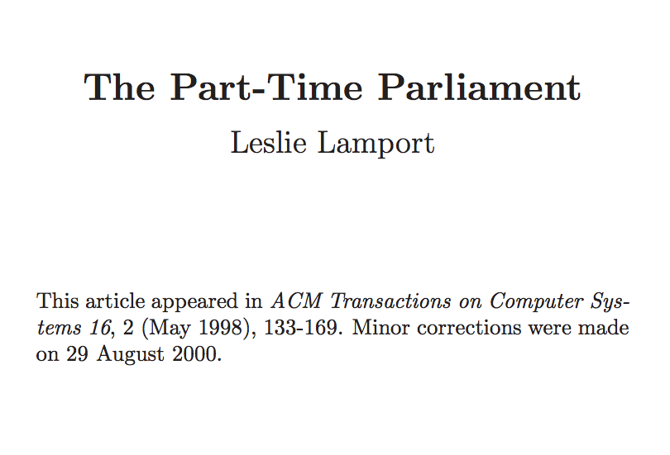
Tells mythical story of Greek island of Paxos with “legislators” and “current law” passed through parliamentary voting protocol
Misunderstood paper: submitted 1990, published 1998
Lamport won the Turing Award in 2013

Slide 94
The Paxos story…
As Paxos prospered, legislators became very busy.
Parliament could no longer handle all details of government, so a bureaucracy was established.
Instead of passing a decree to declare whether each lot of cheese was fit for sale, Parliament passed a decree appointing a cheese inspector to make those decisions.
Cheese inspector ≈ leader
using quorum-based voting protocol

Slide 95
The Paxos story…
Parliament passed a decree making ∆̆ικστρα the first cheese inspector. After some months, merchants complained that ∆̆ικστρα was too strict and was rejecting perfectly good cheese.
Parliament then replaced him by passing the decree
1375: Γωυδα is the new cheese inspector
But ∆̆ικστρα did not pay close attention to what Parliament did, so he did not learn of this decree right away.
There was a period of confusion in the cheese market when both ∆ῐκστρα and Γωυδα were inspecting cheese and making conflicting decisions.
Split-brain!

Slide 96
The Paxos story…
To prevent such confusion, the Paxons had to guarantee that a position could be held by at most one bureaucrat at any time.
To do this, a president included as part of each decree the time and date when it was proposed.
A decree making ∆ῐκστρα the cheese inspector might read
  2716: 8:30 15 Jan 72 – ∆ῐκστρα is cheese inspector for 3 months.
Leader gets a lease!

Slide 97
The Paxos story…
A bureaucrat needed to tell time to determine if he currently held a post. Mechanical clocks were unknown on Paxos, but Paxons could tell time accurately to within 15 minutes by the position of the sun or the stars.
If ∆̆ικστρα’s term began at 8:30, he would not start inspecting cheese until his celestial observations indicated that it was 8:45.
Handle clock skew:
Lease doesn’t end until expiry + max skew

Slide 98
Solving Split Brain
New leader election protocol
L _{new}
L
2
3
Solution
  If L isn’t part of majority electing L _{new}
    L _{new} waits until L’s lease expires before accepting new ops

Slide 99
Backup Slides

Slide 100
Three phase commit protocol illustrated
ok to commit?
ok ....
prepare to commit
prepared...
commit
Note: garbage collection protocol not shown here

Slide 101
Three-Phase Commit (1/2)
Phase 1a: Coordinator sends VOTE_REQUEST to participants
Phase 1b: When participant receives VOTE_REQUEST it returns either YES or NO to coordinator. If it sends NO, it aborts its local computation
Phase 2a: Coordinator collects all votes; if all are YES, it sends PREPARE to all participants, otherwise it sends ABORT, and halts
Phase 2b: Each participant waits for PREPARE, or waits for ABORT after which it halts
Phase 3a: (Prepare to commit) Coordinator waits until all participants have ACKed receipt of PREPARE message, and then sends COMMIT to all
Phase 3b: (Prepare to commit) Participant waits for COMMIT

Slide 102
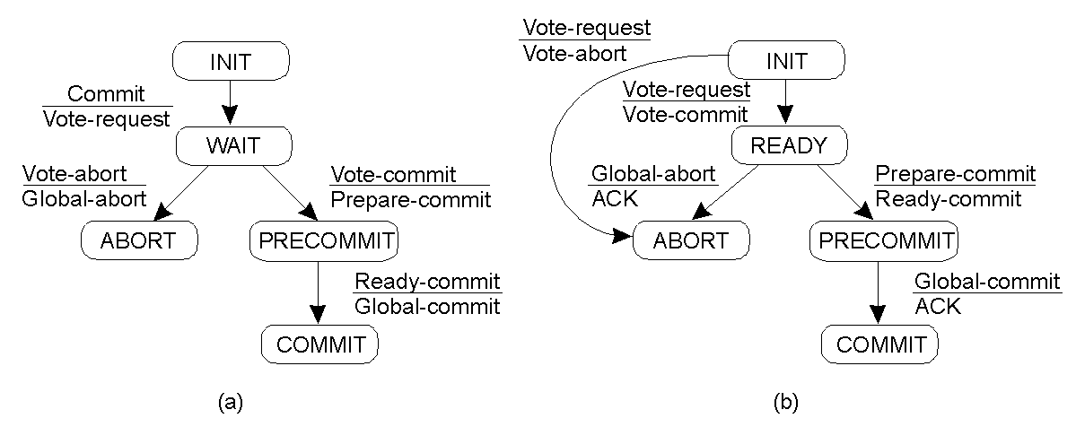
3PC → Finite state machines
Coordinator Participant
If any process is in “PRECOMMIT” all voted for commit
  Protocol commits only when all surviving processes have acknowledged prepare to commit
If coordinator fails, run the protocol forward to commit state (or back to abort state)

Slide 103
3PC → Recap. Failing Coordinator and Participant
Problem: Can P find out what it should it do after a crash in the ready or pre-commit state, even if other participants or the coordinator failed?
Solution idea: Coordinator and participants on their way to commit, never differ by more than one state transition
Consequences
  If a participant times out in ready state: it can find out at the coordinator or other participants whether it should abort, or enter pre-commit state.
  If a participant already made it to the pre-commit state, it can always safely commit (but is not allowed to do so for the sake of failing other processes)

