Slide 1
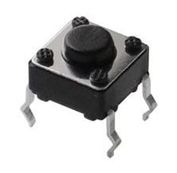
Not pushed
Pushed
Button State
MomentaryButton
PushEventButton
(capture push)
Value of “pushed()”
PushEventButton
(capture release)
PushEventButton
(capture both)
LatchingButton
Legend:
True
False

Slide 2
Not pushed
Pushed
NOTPRESSED
JUSTPRESSED
ISSHORTPRESSED
WASSHORTPRESSED
ISLONGPRESSED
Short Press
Sequence
WASLONGPRESSED
Not pushed
Pushed
Long Press
Sequence

