Slide 1
Ingegneria dei dati
Homework 1
A.A. 2024/2025
TOPIC: Speech Recognition
TEAM: Data Hunters
Members:
Luca Borrelli
Rainer Cabral Ilao

Slide 2
Homework Objectives
Learn to extract relevant data from scientific sources in Computer Science, focusing on data organization and cleanliness for effective use. Consolidate techniques for data extraction from HTML using XPath.
Phases
Download and Clean Papers: Acquire 498 HTML articles for data extraction.
Extract and Organize Data: Extract key information and format it into structured JSON for analysis.
Analysis: quality of phase 2

Slide 3
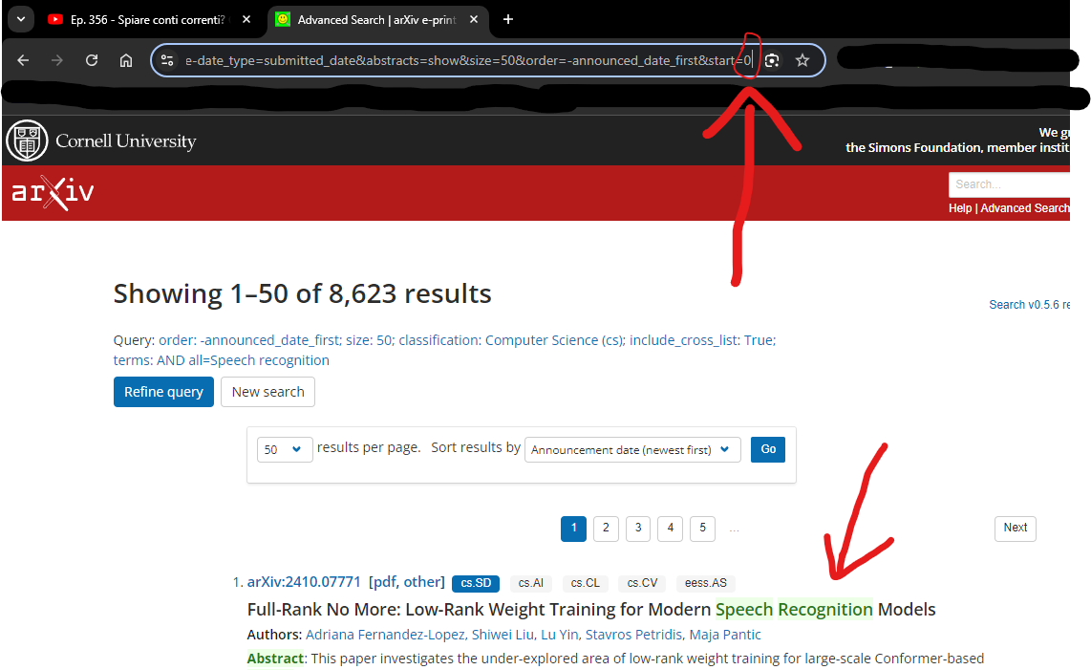
Phase 1.1: Download of Search Pages
We utilized the internal search engine of arXiv for targeted research on the topic.
This allowed us to obtain search pages containing links to relevant papers.

Slide 4
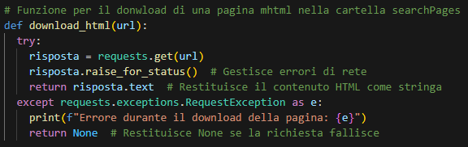
Phase 1.1: How to download a html page from Url?
To automatically download the search pages from the links, we simply used the requests library, one of the most well-known for this task.
We saved the HTML pages of the search results in the designated folder ‘searchPages.

Slide 5
Phase 1.2: How to extract right links of papers from Search Pages?
The next step involved the initial phase of data extraction from the 21 pages.
Using Python code, we retrieved the paper links from each search page with the following XPath query: //ol[@class='breathe-horizontal']//li//div//p//a[contains(@href, 'abs')].
This extracted a set of URLs in the format: https://arxiv.org/abs/2409.12156.
The Python code then modified each link by replacing the ‘x’ with a ‘5’ and saved the modified link to a text file, along with the corresponding code from the last portion of the link.
The library used for the XPath expression was BeautifulSoup.

Slide 6
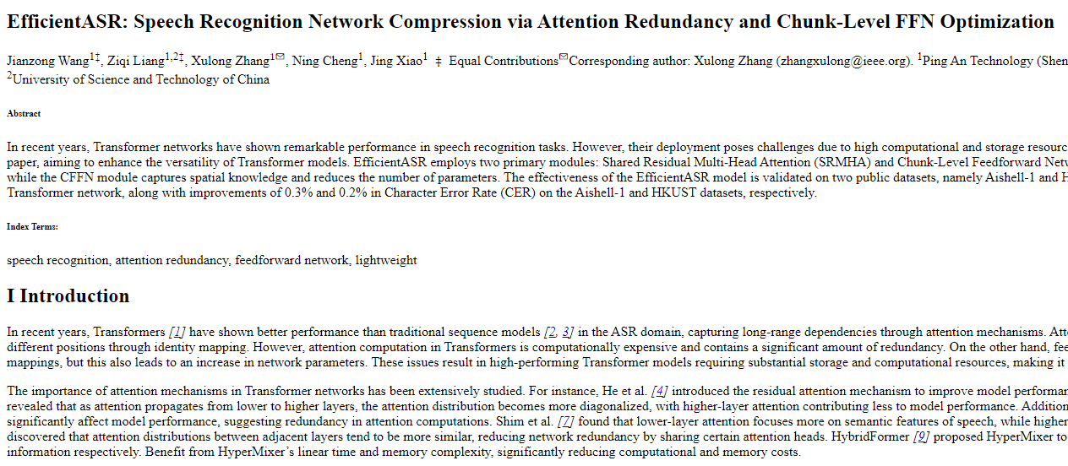
Phase 1.3: Download of Papers
From the text file, we downloaded all the papers for each URL into HTML files within the sources folder.
We simply reused the same code used for the SearchPages.
Example of html page

Slide 7
Phase 1.4: Problems of Phase 1.3
During the download, we faced three main issues:
The server at https://arxiv.org/ sometimes rejected our requests, leading to only 595 papers downloaded instead of 1,000.
Not all HTML pages were actual papers; some were previews instead.
Some pages were corrupted or empty, causing script execution problems.

Slide 8
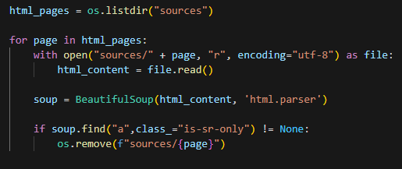
Phase 1.4: How to resolve Problem 2?
To remove HTML files that were previews of the papers, we checked each file for a specific tag thanks to xPath expression.
Using a Python script, we deleted those files, leaving only the actual papers.
After this process, the number of valid papers decreased from 595 to 498 papers.

Slide 9
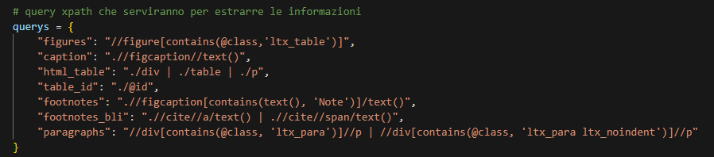
Phase 2: How to extract right data from sources?
To extract the required data from each paper, we utilized specific XPath queries with the lxml library.
The selection of these queries was based on analyzing the HTML structure of the papers, which were generally similar.
We also used the json library to manage and generate the JSON file for each paper.

Slide 10
Phase 2: How to extract right data from sources?
The function extract_info_from_html processes an HTML file of a paper to extract relevant information for each table. It does so by:
Table ID: Extracted using an XPath query to locate the identifier (e.g., "S4.T3") of the table within the HTML structure.
table_html: the html tag is extracted using figures present in the paper that has “ltx_table” class
Caption: Retrieved by parsing the text associated with each table's caption, also using an XPath query.
Footnotes:
Note into tables or figure-caption.
There was a second version:
Old Second option: Citation numbers within each table are identified through <cite> tags, and corresponding footnotes are extracted from other sections of the document by linking the citation number to its detailed text.
Duplicate footnotes are removed for clarity.
References: The function dynamically builds an XPath query to find paragraphs referencing the table, using the caption text to locate links pointing to the table. These references are cleaned to remove HTML tags, leaving only the textual content.

Slide 11
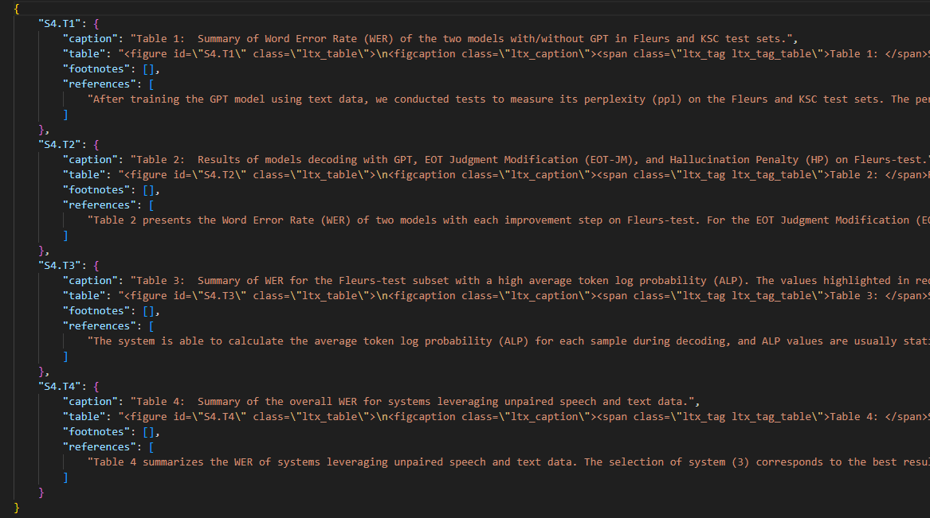
Phase 2: Result
Example of JSON file

Slide 12
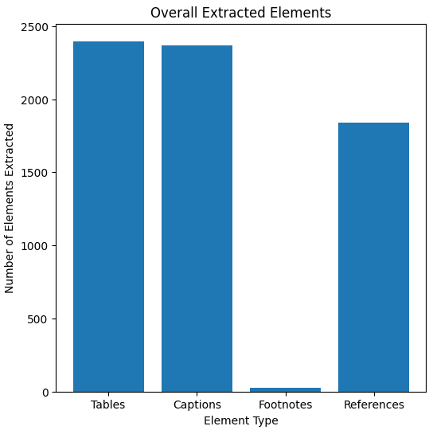
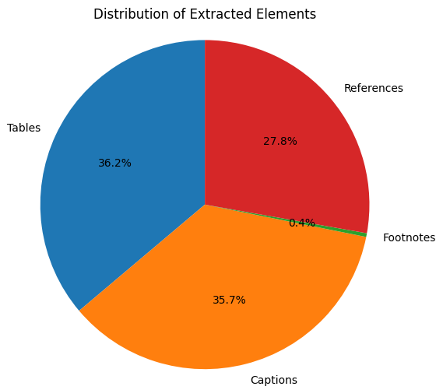
Phase 3: Analysis of Distribution of objects

Slide 13
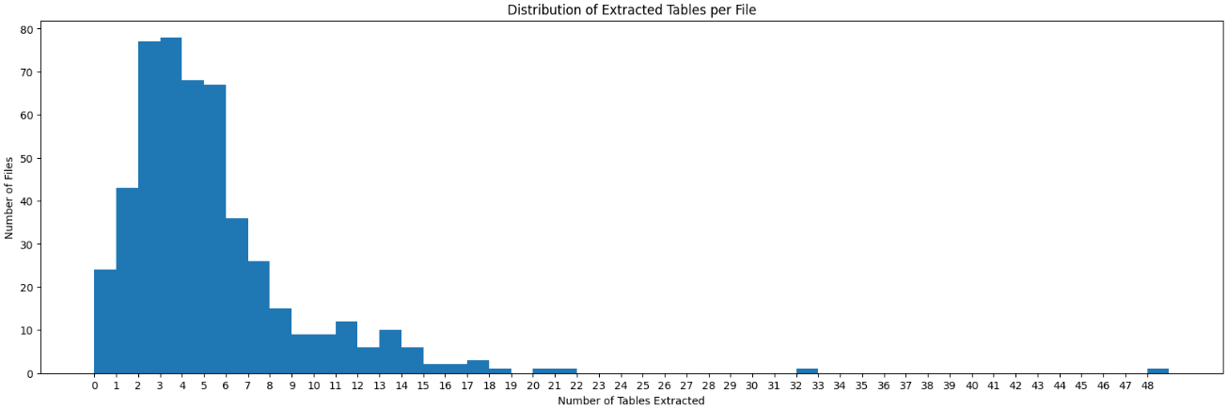
Phase 3: Distribution of number of tables
Avg of #table for each file: 4.87

Slide 14
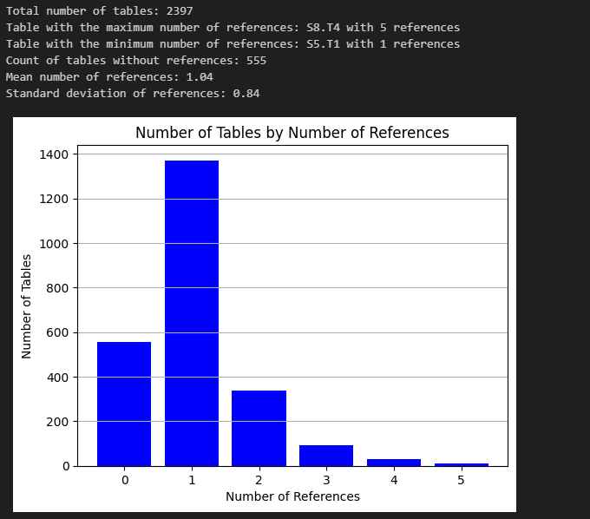
Phase 3: Analysis of Distribution of References

Slide 15
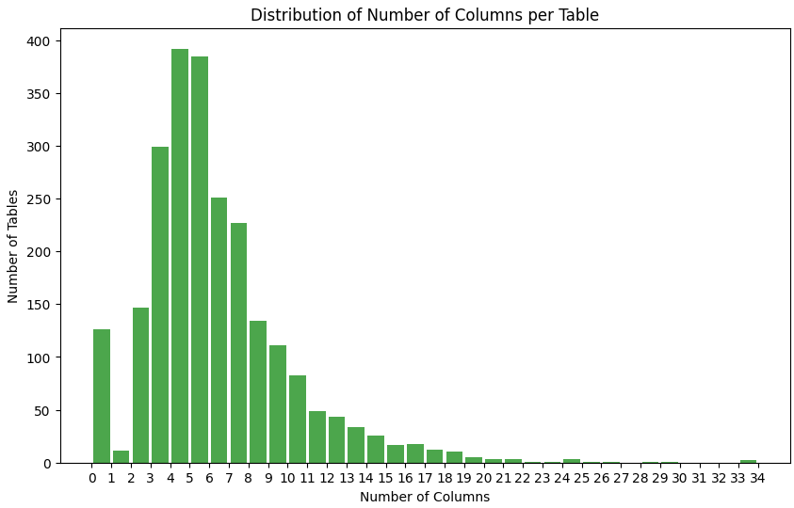
Phase 3: Analysis of distribution of Number of Columns per Table

Slide 16
Challenges
Table recognition
Search of footnotes
Heterogeneous document structure
Presence of images or graphics

Slide 17
What we have learned
Learn how to use XPath extensively as a tool for extracting data with precise patterns within HTML code.
Cleaning data for easy visualization

Slide 18
Thank you for your Attention
TOPIC: Speech Recognition
TEAM: Data Hunters
Members:
Luca Borrelli
Rainer Cabral Ilao

