Slide 1
MSE-Optimal K-factor of the Elo Rating System for
Round-Robin Tournament
Victor Chan
Western Washington University
CASSIS
Vancouver, September 2022

Slide 2
Introduction
Elo Rating System (ERS), both in its original and modified forms, are widely used in games and sports.
Numerous sports organizations use ERS to generate official ratings and establish rankings.
Researchers and sports enthusiasts also use ERS to make probabilistic predictions of game outcomes.

Slide 3
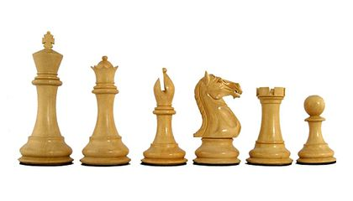
Introduction
The ERS algorithm updates the previous rating of a team/player after a match or a tournament or after some evaluation period
Updated rating change is based on the performance of the team or player (relative to their expected performance ) during the evaluation period
In this work, we focus on
-- updating after a round-robin
tournament
-- rating data from chess
 | Player 1 | Player 2 | Player 3 | Player 4 | Player 5
Player 1
Player 2
Player 3
Player 4
Player 5

Slide 4
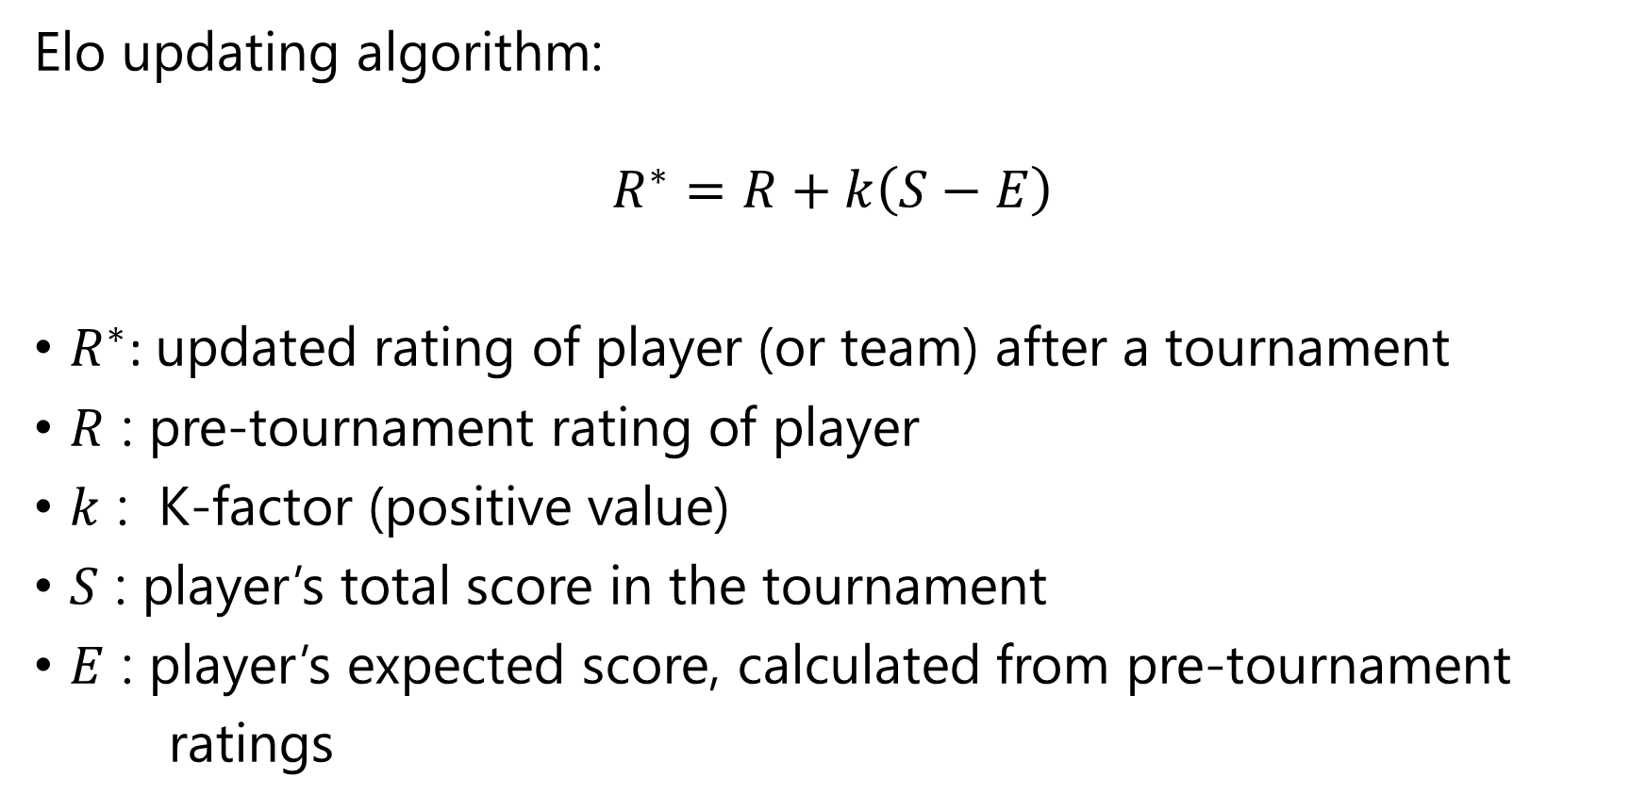
Introduction
Elo updating algorithm:
$$R^{∗}=R+k\left(S−E\right)$$
$R^{∗}$: updated rating of player (or team) after a tournament
$R$ : pre-tournament rating of player
$k$ : K-factor (positive value)
$S$ : player’s total score in the tournament
$E$ : player’s expected score, calculated from pre-tournament
ratings

Slide 5
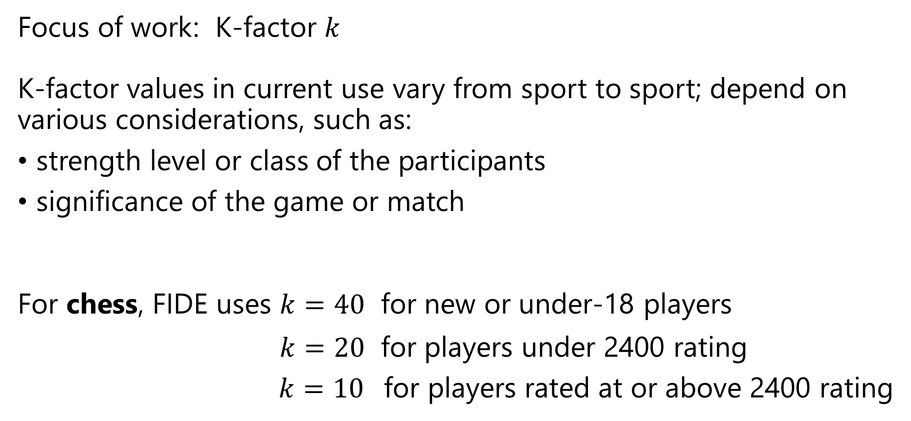
K-factor
Focus of work: K-factor $k$
K-factor values in current use vary from sport to sport; depend on various considerations, such as:
strength level or class of the participants
significance of the game or match
For chess, FIDE uses $k=40$ for new or under-18 players
$k=20$ for players under 2400 rating
$k=10$ for players rated at or above 2400 rating

Slide 6
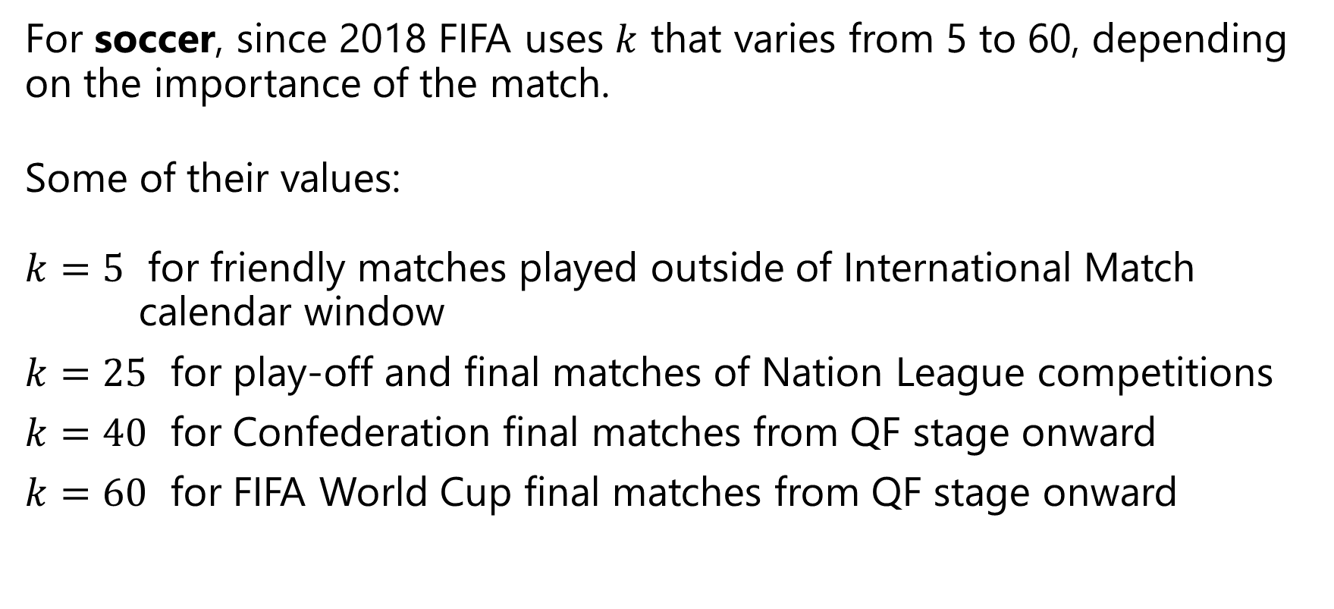
K-factor
For soccer, since 2018 FIFA uses $k$ that varies from 5 to 60, depending on the importance of the match.
Some of their values:
$k=5$ for friendly matches played outside of International Match calendar window
$k=25$ for play-off and final matches of Nation League competitions
$k=40$ for Confederation final matches from QF stage onward
$k=60$ for FIFA World Cup final matches from QF stage onward

Slide 7
Goals of Work
Question: What is the “best” value for the K-factor?
Goals:
Derive the MSE-optimal K-factor for updating the ratings after a round-robin tournament
Investigate possible influence of relevant variables, such as the number of players in the tournament, on the optimal K-factor

Slide 8
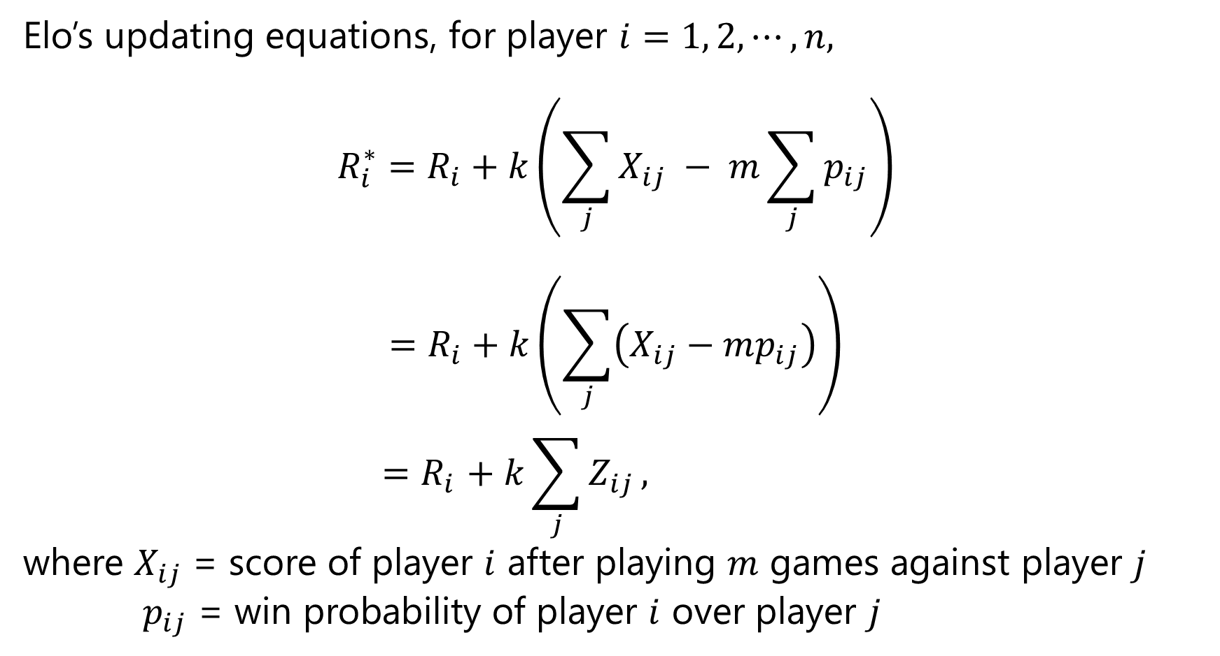
Derivation of Optimal K-factor
Elo’s updating equations, for player $i=1, 2,⋯,n,$
$$R_{i}^{∗}=R_{i}+k\left(\sum_{j}{X_{ij}} − m\sum_{j}{p_{ij}}\right)$$
$$=R_{i}+k\left(\sum_{j}{\left(X_{ij}−mp_{ij}\right)}\right)$$
$${=R}_{i}+ k\sum_{j}{Z_{ij}},$$
where $X_{ij}$ = score of player $i$ after playing $m$ games against player $j$
$p_{ij}$ = win probability of player $i$ over player $j$
S
E

Slide 9
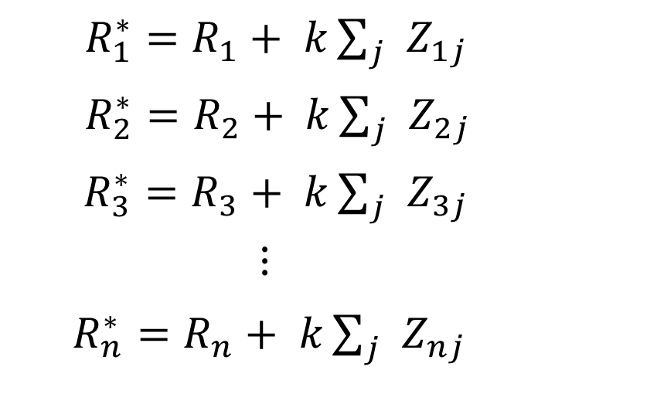

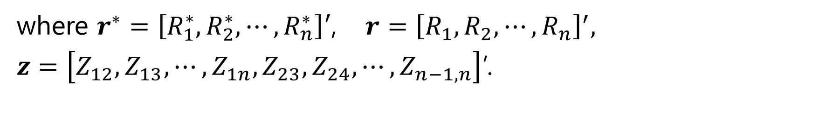
Derivation of Optimal K-factor
${R_{1}^{∗}=R}_{1}+ k\sum_{j}{Z_{1j}}$
${R_{2}^{∗}=R}_{2}+ k\sum_{j}{Z_{2j}}$
${R_{3}^{∗}=R}_{3}+ k\sum_{j}{Z_{3j}}$
$⋮$
${R_{n}^{∗}=R}_{n}+ k\sum_{j}{Z_{nj}}$
$⟹$ $r^{∗}=r + k U z$
where $r^{∗}=\left[R_{1}^{∗},R_{2}^{∗},⋯,R_{n}^{∗}\right]′$, $r={\left[R_{1},R_{2},⋯,R_{n}\right]}^{′},$
$z=\left[Z_{12},Z_{13},⋯,Z_{1n},Z_{23},Z_{24},⋯,Z_{n−1,n}\right]$’.

Slide 10
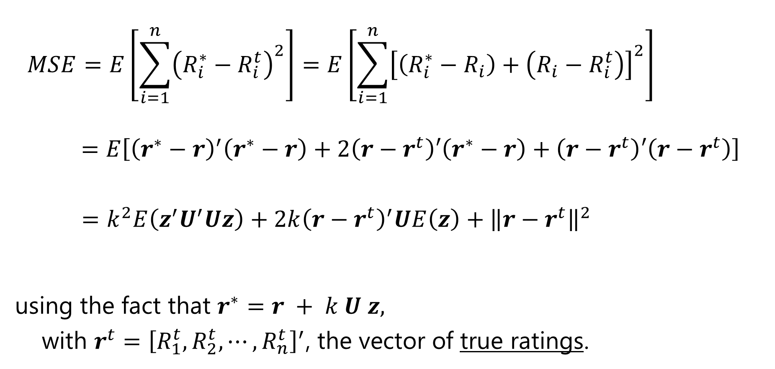
Derivation of Optimal K-factor
$$MSE=E\left[\sum_{i=1}^{n}{{\left(R_{i}^{∗}−R_{i}^{t}\right)}^{2}}\right]=E\left[\sum_{i=1}^{n}{{\left[\left(R_{i}^{∗}−R_{i}\right)+\left(R_{i}−R_{i}^{t}\right)\right]}^{2}}\right]$$
$$=E\left[{\left(r^{∗}−r\right)}^{′}\left(r^{∗}−r\right)+2\left(r−r^{t}\right)′\left(r^{∗}−r\right)+\left(r−r^{t}\right)′\left(r−r^{t}\right)\right]$$
$=k^{2}E\left(z^{′}U^{′}Uz\right)+2k{\left(r−r^{t}\right)}^{′}UE\left(z\right)+{\left\|r−r^{t}\right\|}^{2}$
using the fact that $r^{∗}=r + k U z,$
with $r^{t}={\left[R_{1}^{t},R_{2}^{t},⋯,R_{n}^{t}\right]}^{′}$, the vector of true ratings.

Slide 11
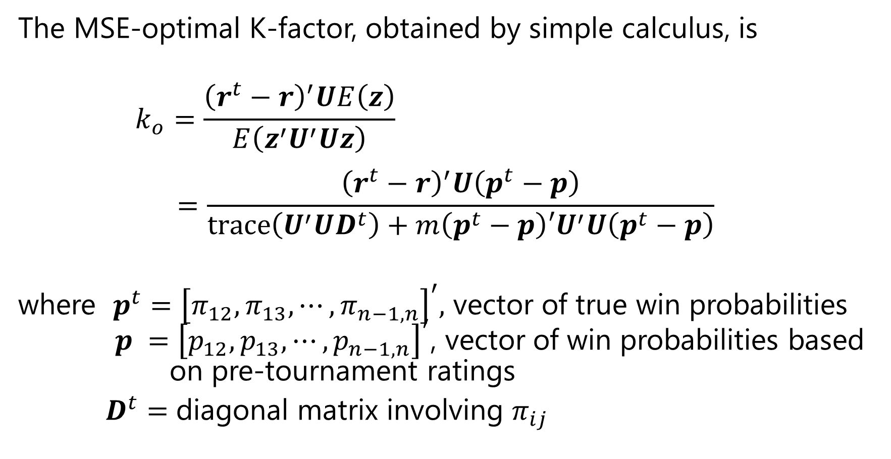
Derivation of Optimal K-factor
The MSE-optimal K-factor, obtained by simple calculus, is
$$k_{o}=\frac{{\left(r^{t}−r\right)}^{′}UE\left(z\right)}{E\left(z^{′}U^{′}Uz\right)}$$
$$=\frac{{\left(r^{t}−r\right)}^{′}U\left(p^{t}−p\right)}{trace\left(U^{′}UD^{t}\right)+m\left(p^{t}−p\right){′U}^{′}U\left(p^{t}−p\right)}$$
where $p^{t}={\left[π_{12},π_{13},⋯,π_{n−1,n}\right]}^{′},$ vector of true win probabilities $p ={\left[p_{12},p_{13},⋯,p_{n−1,n}\right]}^{′}$, vector of win probabilities based on pre-tournament ratings
$D^{t}$ $=$ diagonal matrix involving $π_{ij}$

Slide 12
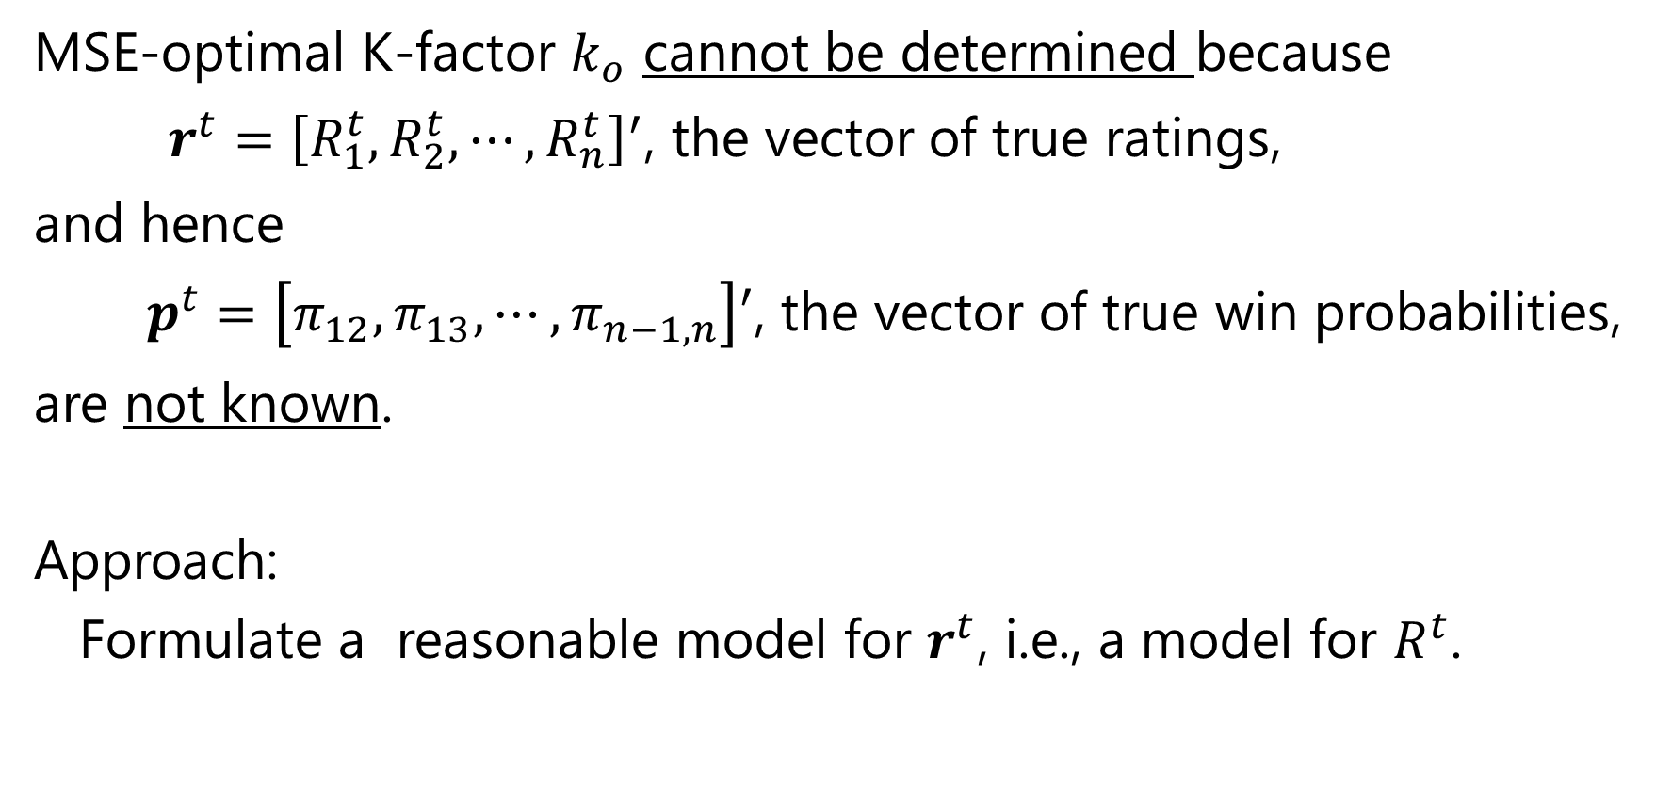
MSE-optimal K-factor $k_{o}$ cannot be determined because
$r^{t}={\left[R_{1}^{t},R_{2}^{t},⋯,R_{n}^{t}\right]}^{′}$, the vector of true ratings,
and hence
$p^{t}=\left[π_{12},π_{13},⋯,π_{n−1,n}\right]′$, the vector of true win probabilities,
are not known.
Approach:
Formulate a reasonable model for $r^{t}$, i.e., a model for $R^{t}$.

Slide 13
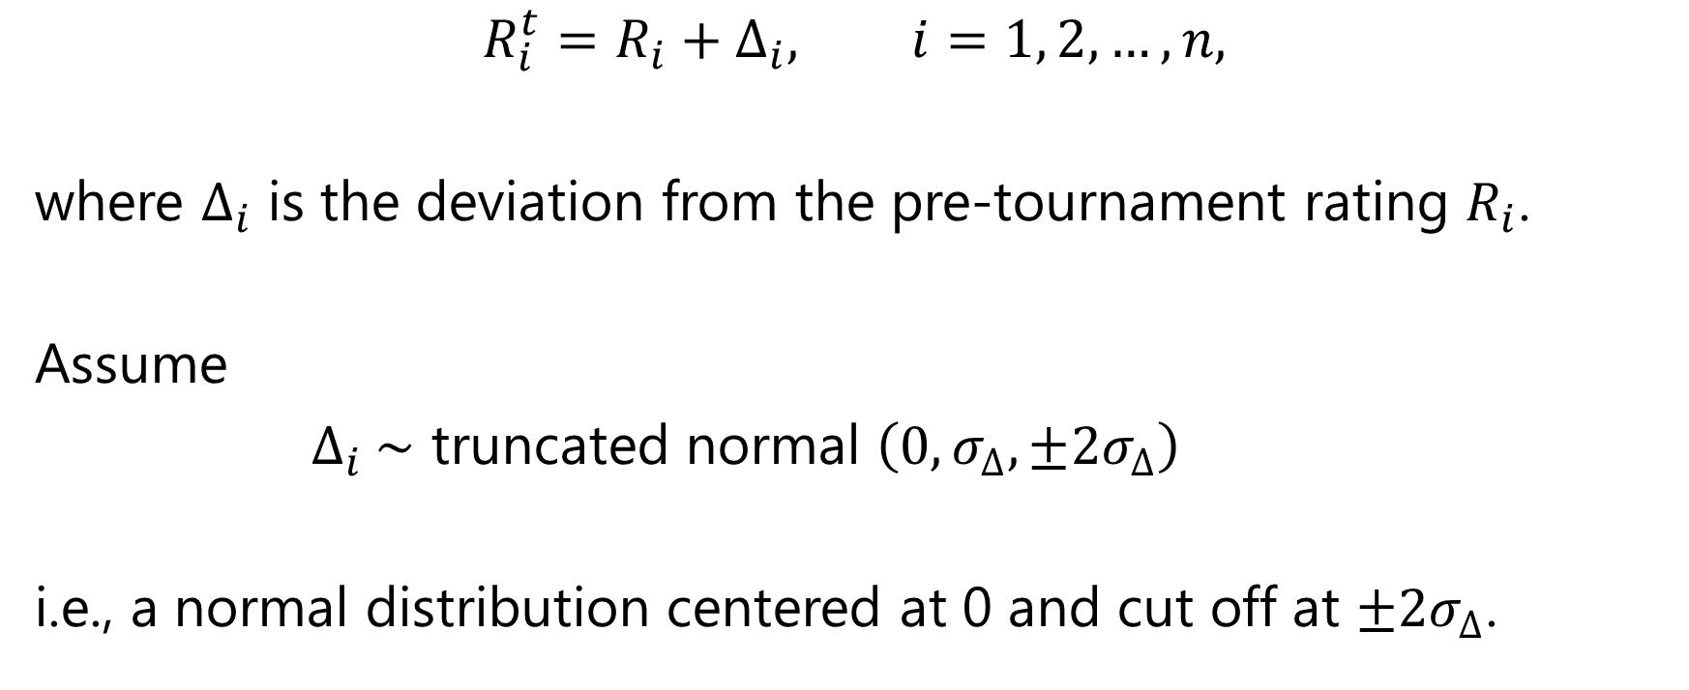
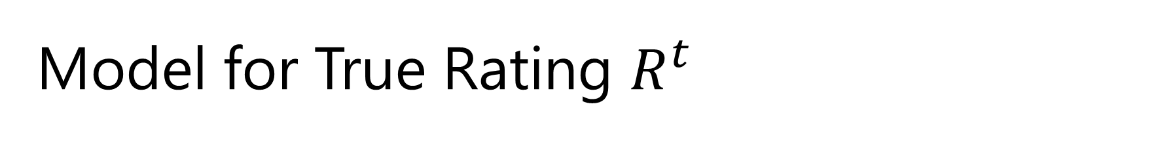
Model for True Rating $R^{t}$
$$R_{i}^{t}=R_{i}+∆_{i}, i=1, 2, …,n,$$
where $∆_{i}$ is the deviation from the pre-tournament rating $R_{i}$.
Assume
$∆_{i} \sim$ truncated normal $\left(0, σ_{∆},±{2σ}_{∆}\right)$
i.e., a normal distribution centered at 0 and cut off at $±{2σ}_{∆}$.

Slide 14
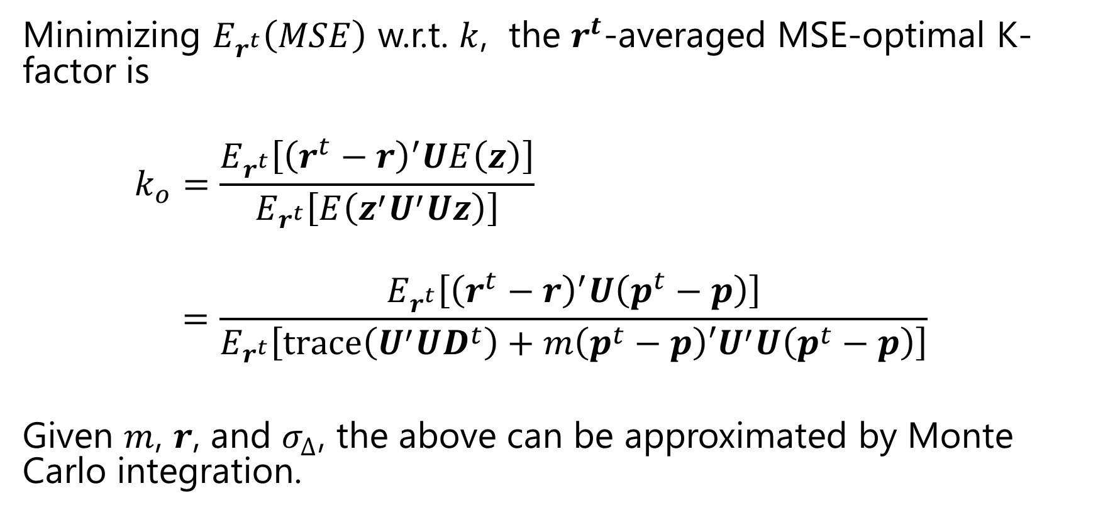
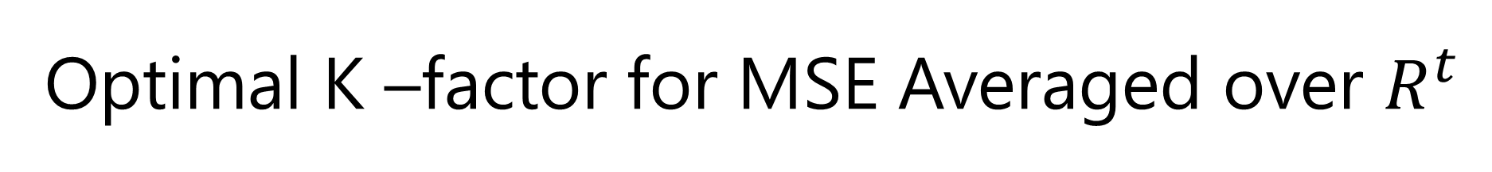
Optimal K –factor for MSE Averaged over $R^{t}$
Minimizing $E_{r^{t}}\left(MSE\right)$ w.r.t. $k$, the $r^{t}$-averaged MSE-optimal K-factor is
$$k_{o}=\frac{E_{r^{t}}\left[{\left(r^{t}−r\right)}^{′}UE\left(z\right)\right]}{E_{r^{t}}\left[E\left(z^{′}U^{′}Uz\right)\right]}$$
$$=\frac{E_{r^{t}}\left[{\left(r^{t}−r\right)}^{′}U\left(p^{t}−p\right)\right]}{E_{r^{t}}\left[trace\left(U^{′}UD^{t}\right)+m\left(p^{t}−p\right){′U}^{′}U\left(p^{t}−p\right)\right]}$$
Given $m$, $r$, and $σ_{∆}$, the above can be approximated by Monte Carlo integration.

Slide 15
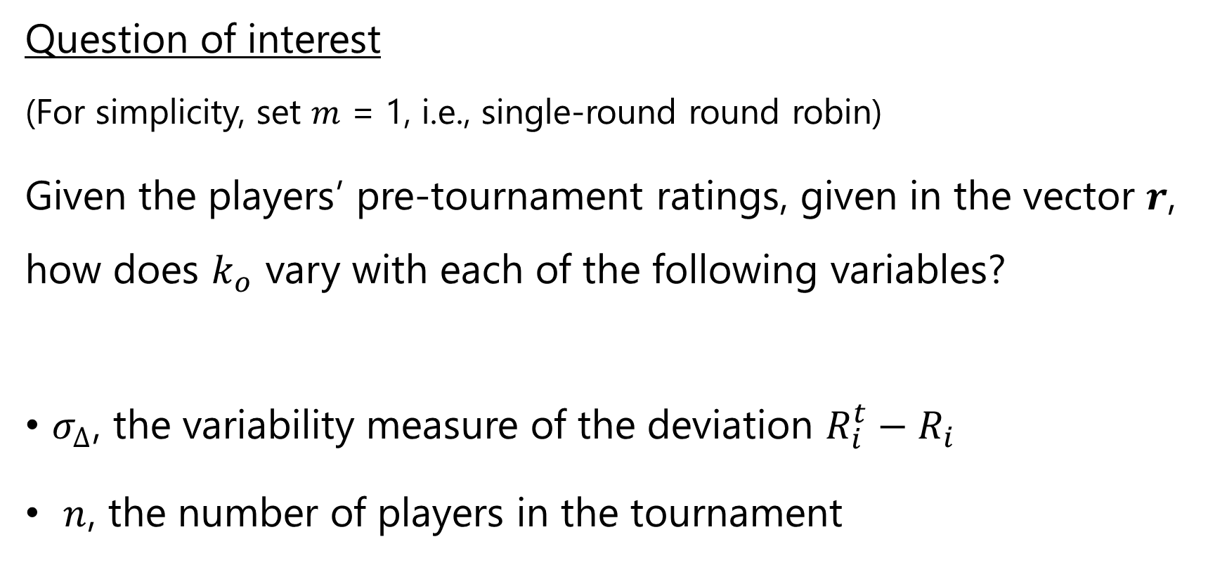
Sensitivity Analysis
Question of interest
(For simplicity, set $m$ = 1, i.e., single-round round robin)
Given the players’ pre-tournament ratings, given in the vector $r$, how does $k_{o}$ vary with each of the following variables?
$σ_{∆}$, the variability measure of the deviation $R_{i}^{t}−R_{i}$
$n$, the number of players in the tournament

Slide 16
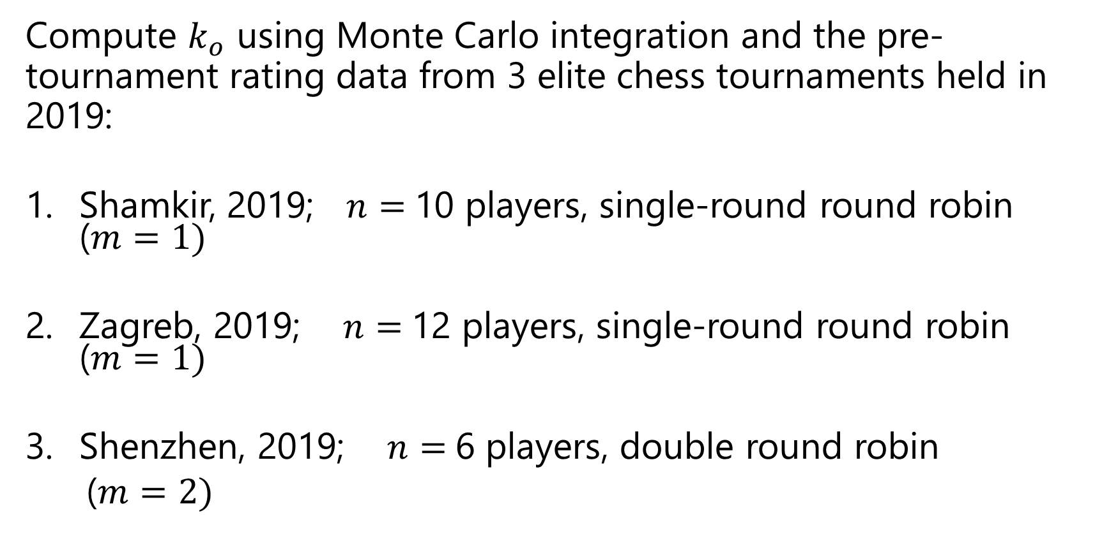
Sensitivity Analysis
Compute $k_{o}$ using Monte Carlo integration and the pre-tournament rating data from 3 elite chess tournaments held in 2019:
Shamkir, 2019; $n=$10 players, single-round round robin ($m=1)$
Zagreb, 2019; $n=$12 players, single-round round robin ($m=1)$
Shenzhen, 2019; $n=$6 players, double round robin
($m=2)$

Slide 17
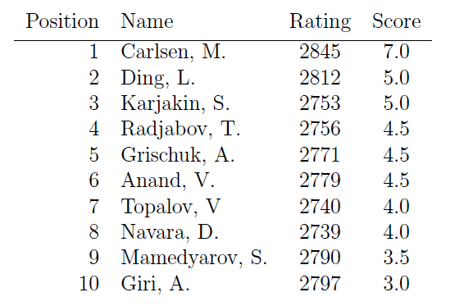
Shamkir 2019
Chess Tournament
Pre-tournament

Slide 18
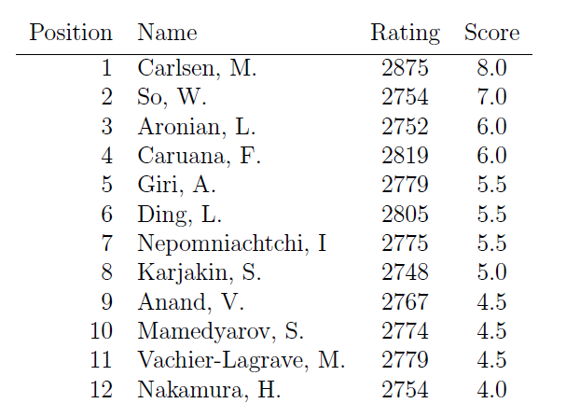
Zagreb 2019 Chess
Tournament
Pre-tournament

Slide 19
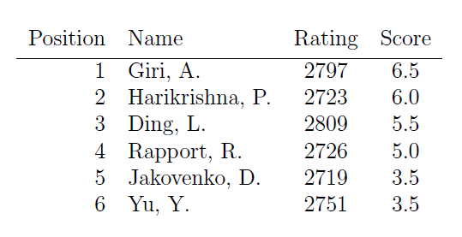
Shenzhen 2019
Chess Tournament
Pre-tournament
Note: Even though m = 2 for this tournament, m is set to 1 when calculating $k_{o}$for comparison purposes.

Slide 20
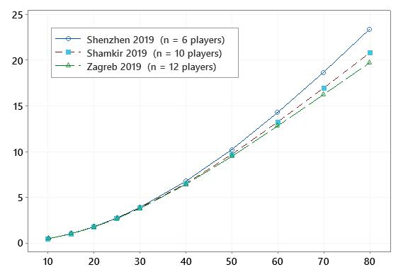
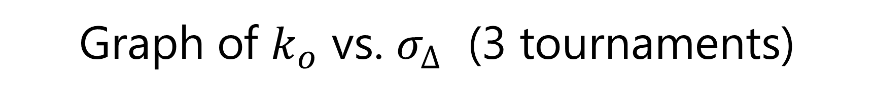


Graph of $k_{o}$ vs. $σ_{∆}$ (3 tournaments)
$$k_{o}$$
$$σ_{∆}$$

Slide 21

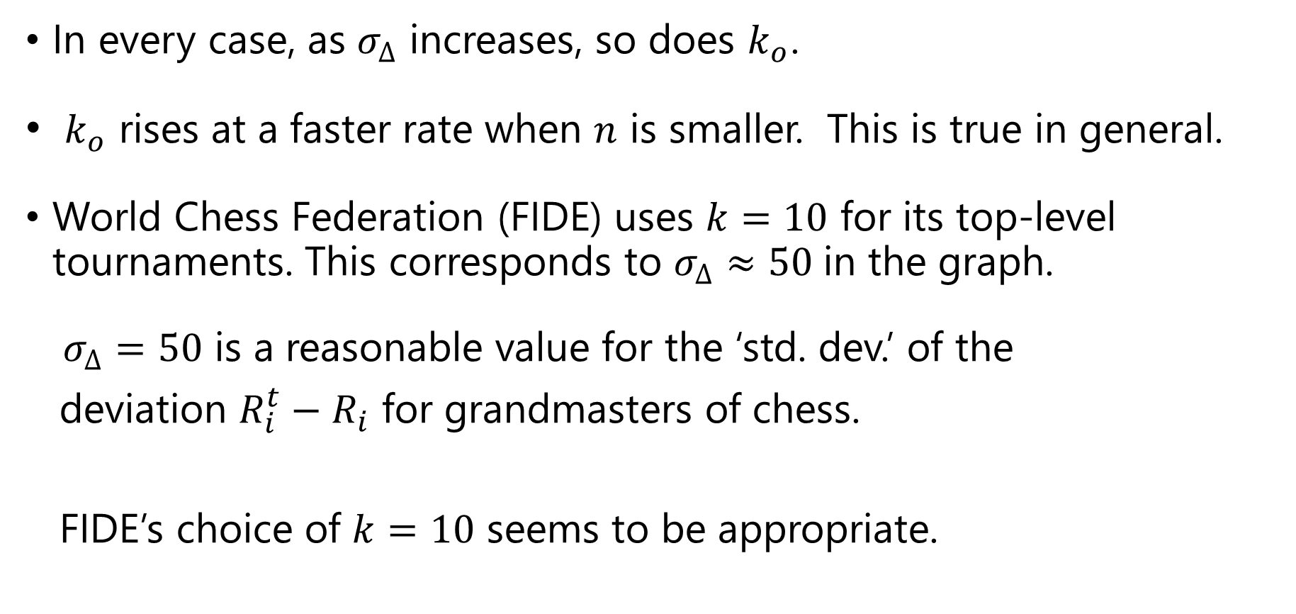
Observations from the graph
In every case, as $σ_{∆}$ increases, so does $k_{o}$.
$k_{o}$ rises at a faster rate when $n$ is smaller. This is true in general.
World Chess Federation (FIDE) uses $k=10$ for its top-level tournaments. This corresponds to $σ_{∆}≈50$in the graph.
$σ_{∆}=50$ is a reasonable value for the ‘std. dev.’ of the
deviation $R_{i}^{t}−R_{i}$ for grandmasters of chess.
FIDE’s choice of $k=10$ seems to be appropriate.
$$∴$$

Slide 22
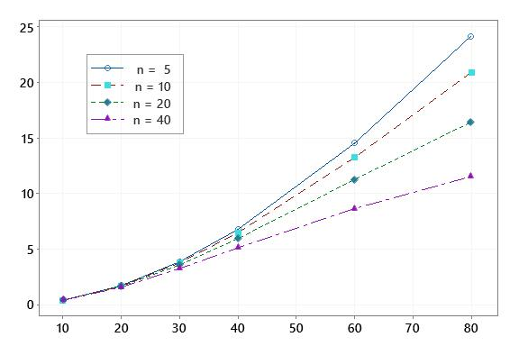
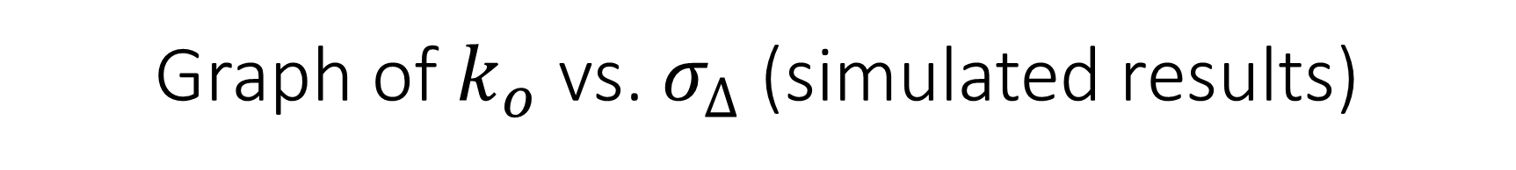


Graph of $k_{o}$ vs. $σ_{∆}$ (simulated results)
$$k_{o}$$
$$σ_{∆}$$

Slide 23
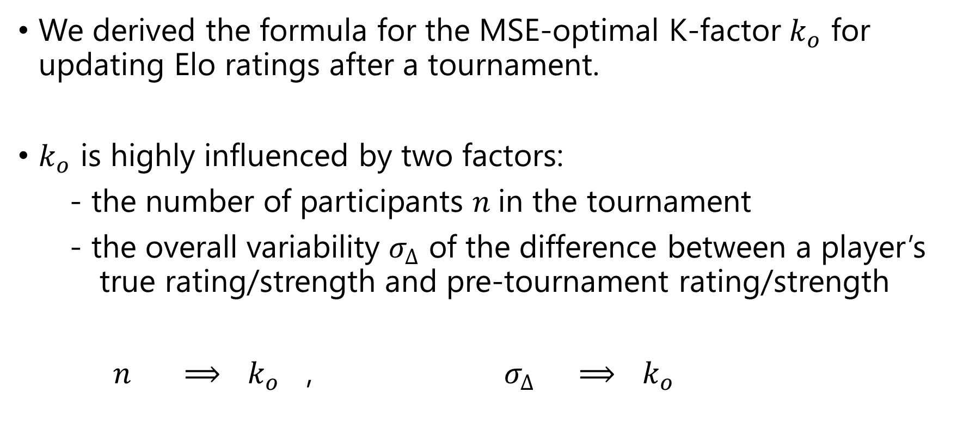
Takeaways
We derived the formula for the MSE-optimal K-factor $k_{o}$ for updating Elo ratings after a tournament.
$k_{o}$ is highly influenced by two factors:
- the number of participants $n$in the tournament
- the overall variability $σ_{∆}$ of the difference between a player’s true rating/strength and pre-tournament rating/strength
$n$ $⟹$ $k_{o}$ , $σ_{∆}$ $⟹$ $k_{o}$

Slide 24
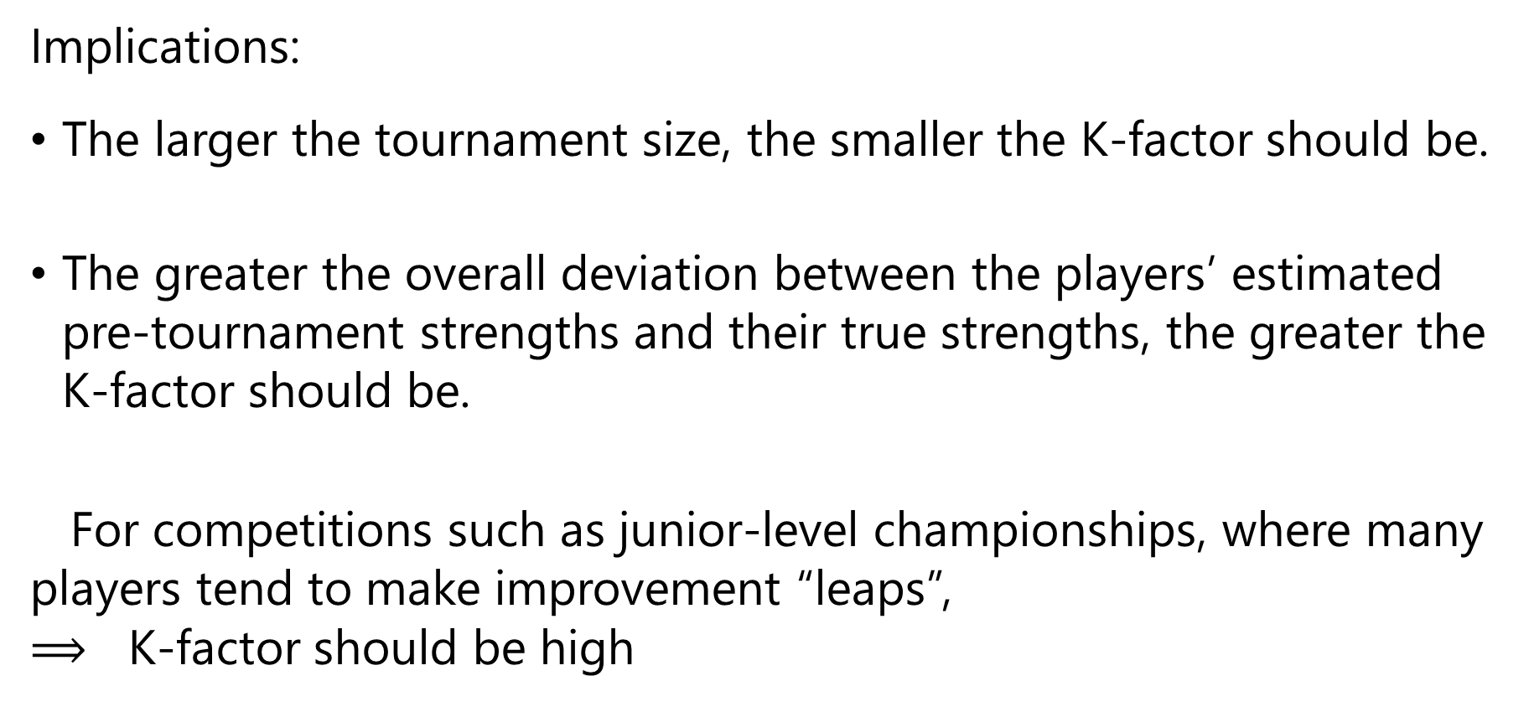
Takeaways
Implications:
The larger the tournament size, the smaller the K-factor should be.
The greater the overall deviation between the players’ estimated pre-tournament strengths and their true strengths, the greater the K-factor should be.
For competitions such as junior-level championships, where many players tend to make improvement “leaps”,
$⟹$ K-factor should be high

Slide 25
For more details, see
Chan, Victor. "MSE-optimal K-factor of the Elo rating system for round-robin tournament" Journal of Quantitative Analysis in Sports, vol. 18, no. 1, 2022, pp. 59-72.
Thank you!

