Slide 1
Programming Project

Slide 2
Outline
Internet of Things
Project Introduction
Project Requirement
Phase I
Phase II
Grading and Deadline
UNIX Socket Programming

Slide 3
Internet of Things
What is IoT?
Notes:
The Internet of things (IoT) describes the network of physical objects—“things”—that are embedded with sensors, software, and other technologies for the purpose of connecting and exchanging data with other devices and systems over the Internet.^{[1][2][3][4]}
Things have evolved due to the convergence of multiple technologies, real-time analytics, machine learning, commodity sensors, and embedded systems.^{[1]} Traditional fields of embedded systems, wireless sensor networks, control systems, automation (including home and building automation), and others all contribute to enabling the Internet of things. In the consumer market, IoT technology is most synonymous with products pertaining to the concept of the "smart home", including devices and appliances (such as lighting fixtures, thermostats, home security systems and cameras, and other home appliances) that support one or more common ecosystems, and can be controlled via devices associated with that ecosystem, such as smartphones and smart speakers. IoT can also be used in healthcare systems.^{[5]}

Slide 4


Slide 5
Internet of Things
How do we connect them together?
Limitations?
Characteristics?
Notes:
HTTP protocol? Heavy and not efficient. Considering sending messages which only 10% of the size is the actual data.
Limited bandwidth, resource, power
Large amount of small data fragments

Slide 6
Project Introduction
Publish Subscribe Protocol
Lightweight
Efficient
Roles
Publishers
Subscribers
Broker

Slide 7







Project Introduction
Publishers (Clients)
Subscribers (Clients)
Broker (Server)

Slide 8
Project Requirement (I)
Server
Handling multiple clients simultaneously
Doesn’t have to remember client information after disconnect
Client
Basic user interface
Can be both publisher and subscriber

Slide 9
Project Requirement (I)
Topic
WEATHER
NEWS
HEALTH
SECURITY
Message
CONNECT
DISCONNECT
PUBLISH
SUBSCRIBE

Slide 10
Project Requirement (II)
Hierarchical Topic Structures
Topic level separator (/)
test/alpha/sensor
test/beta/sensor
test/sensor
Multi-level wildcard (#)
#
test/#
test/#/sensor
Single level wildcard (+)
test/+
test/+/sensor
Notes:
You can only unsubscribe to a topic you subscribed before

Slide 11
Project Requirement
Retained message
Only one retained message for each topic will be stored
All new subscribers will immediately receive the retained message after subscription
Message
UNSUBSCRIBE
LIST
Notes:
You can only unsubscribe to a topic you subscribed before

Slide 12
Grading and Deadline
Phase I
Due: 04/07, 5 weeks
Phase II
Due: 05/05, 5 weeks
Grading
Message passing through sockets: 30%
Publish: 20%
Subscribe: 20%
Topics: 10%
Retain: 10%
Others: 10%
Readability
Documentation
Error handeling

Slide 13
UNIX Socket Programming
What are Sockets?
End-points of inter-process communication
Client-Server model
Server handles the requests from clients
Messages can be exchanged between server and clients

Slide 14
UNIX Socket Programming
What do we need to create a socket?
IP
Port
What makes a connection?
A pair of server socket and client socket

Slide 15
BSD Socket API
Introduced in 1981 BSD 4.1 UNIX
Connects two sockets on separate hosts
Sockets are owned by processes
Processes communicate through sockets

Slide 16
Sockets and Internet Protocols
API: BSD Sockets
Socket: source/destination IP addresses + port numbers
Transport: TCP/UDP
TCP: in-order, reliable data transfer
Connection-oriented
UDP: unreliable data transfer
No connection set-up
Network: IP
Connectionless, no guarantees

Slide 17
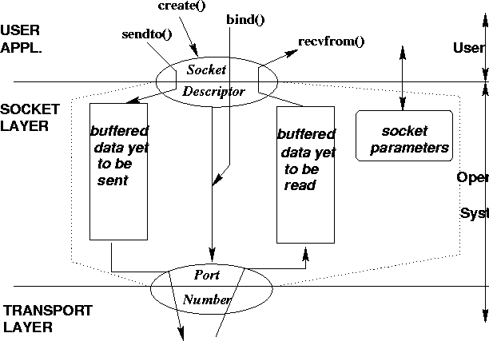
Sockets: Conceptual View
Notes:
You can think of the socket layer as another layer between application and transport layers. Or socket layer as the interface to transport layer services.

Slide 18
Connection-Oriented Application
Server gets ready to service clients
Creates a socket
Binds an address to the socket
Server’s address should be made known to clients
Client contacts the server
Creates a socket
Connects to the server
Server Accepts connection requests from clients
Further communication is specific to application

Slide 19
A Typical Working Scenario
For TCP Client
Get the IP address and port number of server
Create a TCP socket
Connect the socket to server
Send/Receive data through socket
Close the connection
For TCP Server
Create a TCP socket
Bind the socket to the IP address and port number
Listen and accept new connections
Send/Receive data through socket
Close the connect

Slide 20
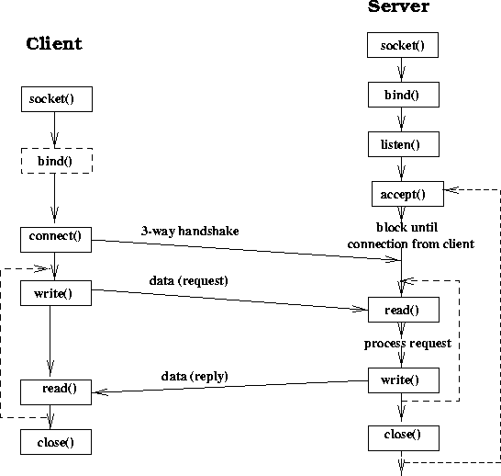

Slide 21




Concurrent Communications

Slide 22
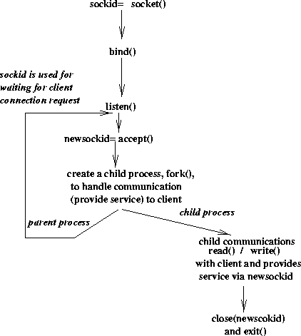
Typical Server Structure
Notes:
The behavior of accept() makes it easy to implement a concurrent server that serves more than one client simultaneously. The sockid returned by socket() is passed to accept() which returns newsockid. Then a process or a thread is spawned off to serve that specific client. This child process/thread communicates with that client using newsockid while the parent is ready to accept more connection using the original sockid.

Slide 23
Creating a Socket
int socket(int family, int service, int protocol)
family: symbolic name for protocol family
AF_INET, AF_UNIX
type: symbolic name for type of service
SOCK_STREAM, SOCK_DGRAM, SOCK_RAW
protocol: further info in case of raw sockets
typically set to 0
Returns socket descriptor
Notes:
The socket function call simply allocates a socket structure the contents of which get filled in by other calls such as bind(), connect(). This socket() call returns a socket descriptor which is used to refer to the socket for any subsequent operation on the socket.

Slide 24
Binding Socket with an Address
int bind(int sd, struct sockaddr *addr, int len)
sd: socket descriptor returned by socket()
addr: pointer to sockaddr structure containing address to be bound to socket
len: length of address structure
Returns 0 if success, -1 otherwise

Slide 25
Specifying Socket Address
struct sockaddr_in {
short sin_family; /* set to AF_INET */
u_short sin_port; /* 16 bit port number */
struct in_addr sin_addr; /* 32 bit host address */
char sin_zero[8]; /* not used */
};
struct in_addr {
u_long s_addr; /* 32 bit host address */
};

Slide 26
Bind Example
int sd; struct sockaddr_in ma;
sd = socket(AF_INET, SOCK_STREAM, 0);
ma.sin_family = AF_INET; ma.sin_port = htons(5100); ma.sin_addr.s_addr = htonl(INADDR_ANY); if (bind(sd, (struct sockaddr *) &ma, sizeof(ma)) != -1) …
Notes:
In this example, we are assuming that server is being bound to port 5100. The function htons() converts a short integer (port is a 16 bit number) from host format to network (standard) format. The special value for IP address INADDR_ANY says that the server is willing to accept requests addressed to any of its machine’s IP addresses. This option conveniently covers the case of the server machine having multiple interfaces each with an IP address. Similar to htons, the function htonl converts a long integer (IP address is a 32 bit number) from host format to network format.

Slide 27
Connecting to Server
int connect(int sd, struct sockaddr *addr, int len)
sd: socket descriptor returned by socket()
addr: pointer to sockaddr structure containing server’s address (IP address and port)
len: length of address structure
Returns 0 if success, -1 otherwise

Slide 28
Connection Acceptance by Server
int accept(int sd, struct sockaddr *from, int *len)
sd: socket descriptor returned by socket()
from: pointer to sockaddr structure which gets filled with client’s address information
len: length of address structure
Blocks until connection requested or error
returns a new socket descriptor on success
Notes:
For accept() you pass a structure and it gets filled with the details of the client when the accept() call returns. Note that for the third argument you have to pass a pointer to an integer so that the accept() call can store the length of the structure that got filled.
The accept() call blocks until there is a connection request from a client. It is important to remember that accept() call returns a new socket descriptor (unlike connect() call). This new socket descriptor can be used by the server to communicate with the specific client that requested the connection.

Slide 29
Byte Ordering
Integers:
Little Endian:
least significant byte first
E.g., DEC, Intel
Big Endian
most significant byte first
E.g., Sun, SGI, HP
Network Byte Order
Big Endian
Byte Order Conversion
m = ntohl(m) : network-to-host byte order, 32bit
m = htonl(m) : host-to-network byte order
ntohs, htons : short(16bit)

Slide 30
Big Endian vs. Little Endian

Slide 31
Connect Example
int sd; struct sockaddr_in sa;
sd = socket(AF_INET, SOCK_STREAM, 0);
sa.sin_family = AF_INET; sa.sin_port = htons(5100); //htons() converts host-byte-order into network-byte-order sa.sin_addr.s_addr = inet_addr(“128.101.34.78”); if (connect(sd, (struct sockaddr *) &sa, sizeof(sa)) != -1) …
Notes:
For connect(), we have to pass the whereabouts the server so that we can connect to the server. Here we are assuming that server is running on a machine with IP address 128.101.34.78 and bound to port 5100. The function inet_addr is used to convert IP address from dotted decimal string form to 32 bit integer.
Once the connect() is successful, the socket descriptor sd can be used just like a file descriptor to read from and write to the server.

Slide 32
Streams and Datagrams
Connection-oriented reliable byte stream
SOCK_STREAM based on TCP
No message boundaries
Multiple writes may be consumed by one read
TCP layer makes IP layer send multiple IP datagrams of TCP Maximum Segment Size (MSS).
Connectionless unreliable datagram
SOCK_DGRAM based on UDP
Message boundaries are preserved
Each sendto corresponds to one recvfrom
Each sendto generates an IP datagram.

Slide 33
Example: Echo Client/Server

Slide 34
Example: echo-server
#include <sys/types.h>
#include <sys/socket.h>
#include <netinet/in.h>
#include <arpa/inet.h>
#include <string.h>
#include <unistd.h>
#include <stdlib.h>
#include <stdio.h>
int main(int argc, char *argv[])
{ int s, t;
struct sockaddr_in sin;
char msg[80];
int sinlen;
if (argc < 2) { printf(“%s port\n”, argv[0]); return -1; }
if ((s = socket(PF_INET, SOCK_STREAM, 0)) < 0 ) {
perror(“socket”); return -1;
}

Slide 35
sin.sin_family = AF_INET;
sin.sin_port = htons(atoi(argv[1]));
sin.sin_addr.s_addr = INADDR_ANY;
if (bind(s, (struct sockaddr *)&sin, sizeof(sin)) < 0) {
perror(“bind”); return -1;
}
if (listen(s, 5) < 0) { perror(“listen”); return -1; }
sinlen = sizeof(sin);
if ((t = accept(s, (struct sockaddr *)&sin, &sinlen)) < 0) {
perror(“accept”); return -1;
}
printf(“From %s:%d. \n”, inet_ntoa(sin.sin_addr), ntohs(sin.sin_port));
if (read(t, msg, sizeof(msg)) < 0) {perror(“read”); return -1; }
if (write(t, msg, sizeof(msg)) < 0) {perror(“write”); return -1; }
if (close(t) < 0) { perror(“close”); return -1; }
if (close(s) < 0) { perror(“close”); return -1; }
return 0;
}

Slide 36
Example : echo-client
#include <sys/types.h>
#include <sys/socket.h>
#include <netinet/in.h>
#include <string.h>
#include <unistd.h>
#include <stdlib.h>
#include <stdio.h>
int main(int argc, char *argv[])
{ int s;
struct sockaddr_in sin;
char msg[80] = “Hello World !”;
int n;
if (argc < 3) { printf(“%s host port\n”, argv[0]); return -1; }

Slide 37
if ((s = socket(PF_INET, SOCK_STREAM, 0)) < 0) {
perror(“socket”); return -1;
}
sin.sin_family = AF_INET;
sin.sin_port = htons(atoi(argv[2]));
sin.sin_addr.s_addr = inet_addr(argv[1]);
if (connect(s, (struct sockaddr *)&sin, sizeof(sin)) < 0) {
perror(“connect”); return -1;
}
if (write(s, msg, strlen(msg)+1) < 0) {
perror(“write”); return -1;
}
if ((n = read(s, msg, sizeof(msg))) < 0) {
perror(“read”); return -1;
}
printf(“%d bytes: %s\n”, n, msg);
if (close(s) < 0) { perror(“close”); return -1; }
return 0;
}

