Slide 1
Antibody dynamics parameter inference

Slide 2
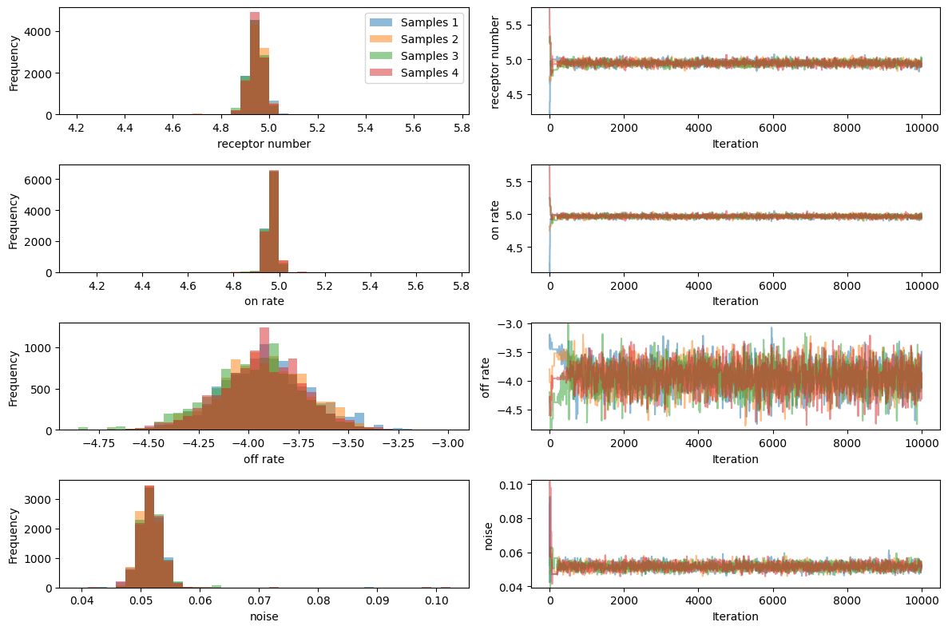
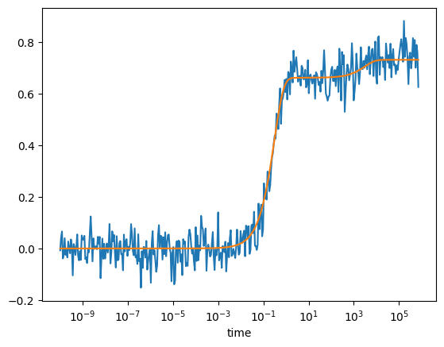
Measuring bound antibody
Rtot=10^5
Kon=10^5
Koff = 10^-4

Slide 3
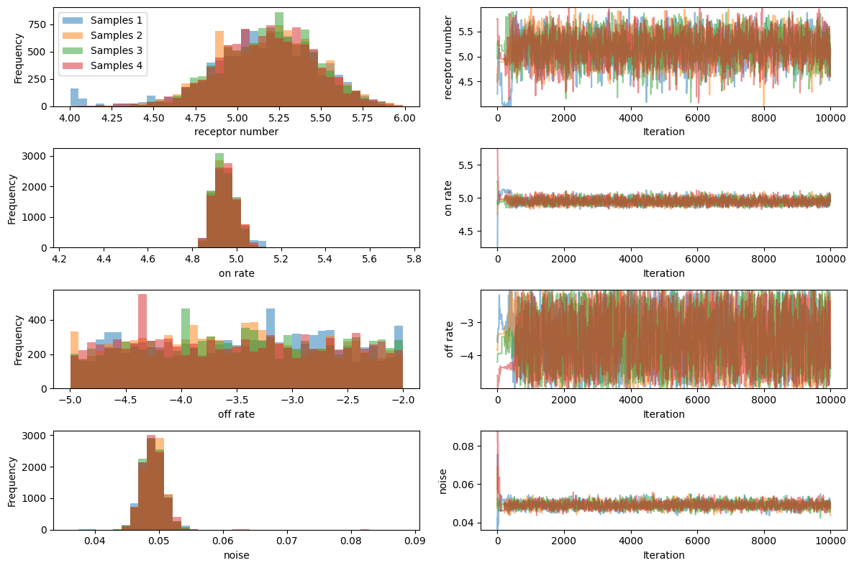
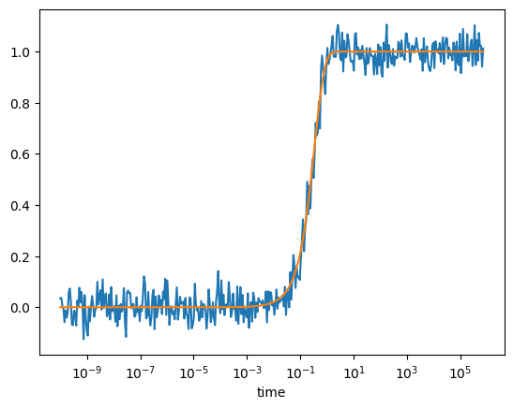
Measuring receptor occupancy

Slide 4
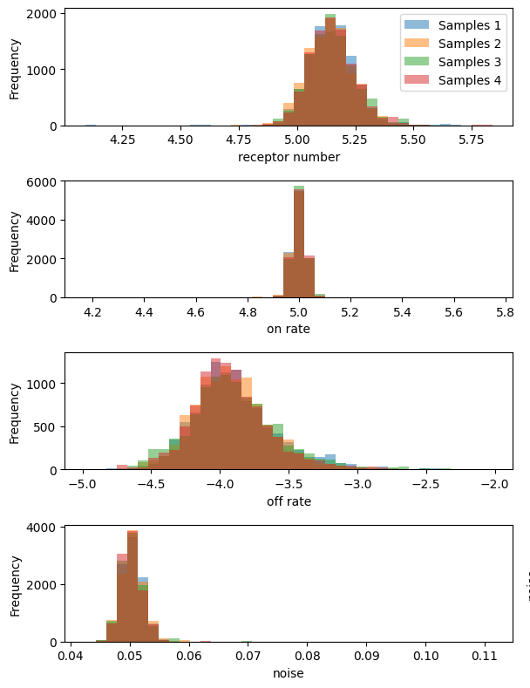
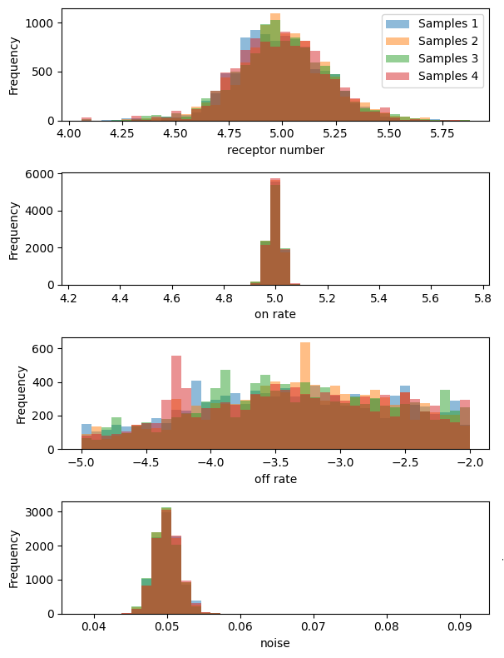
Effect of varying concentration
10^-5 M
10^-6 M
10^-7 M

