Slide 1
Bispecific Selectivity Work

Slide 2
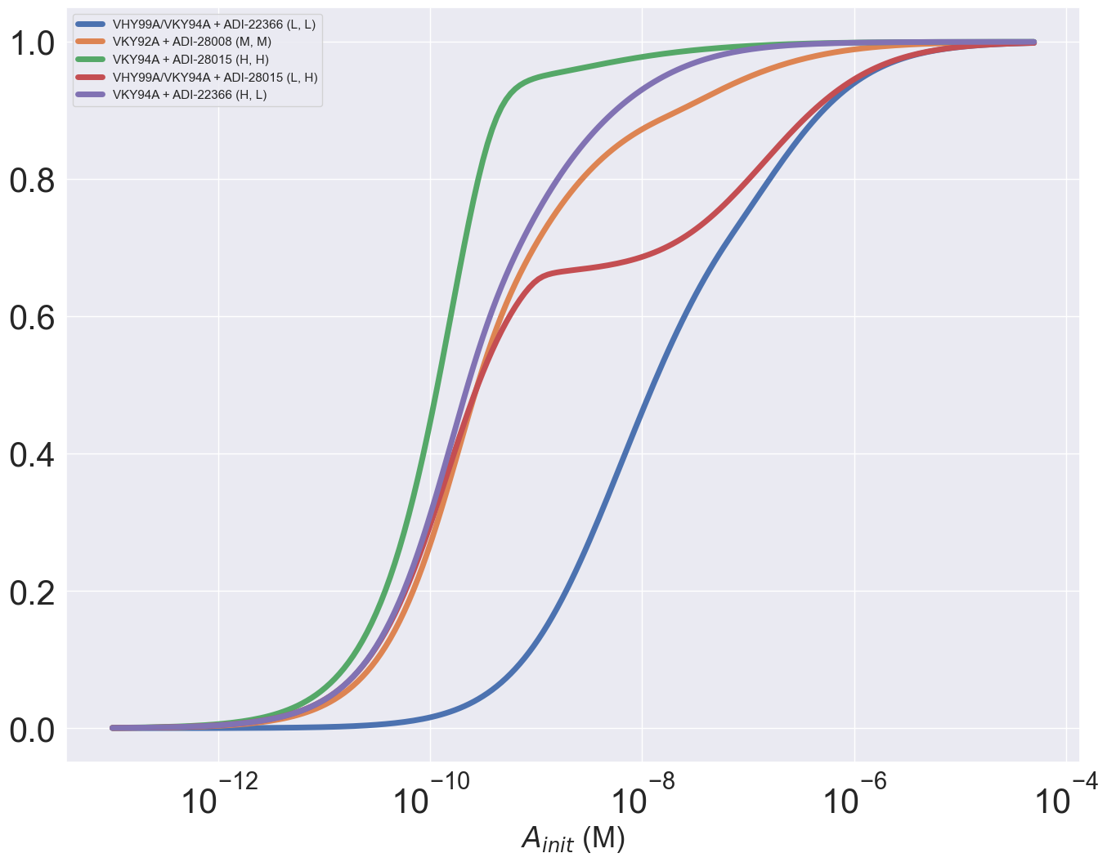
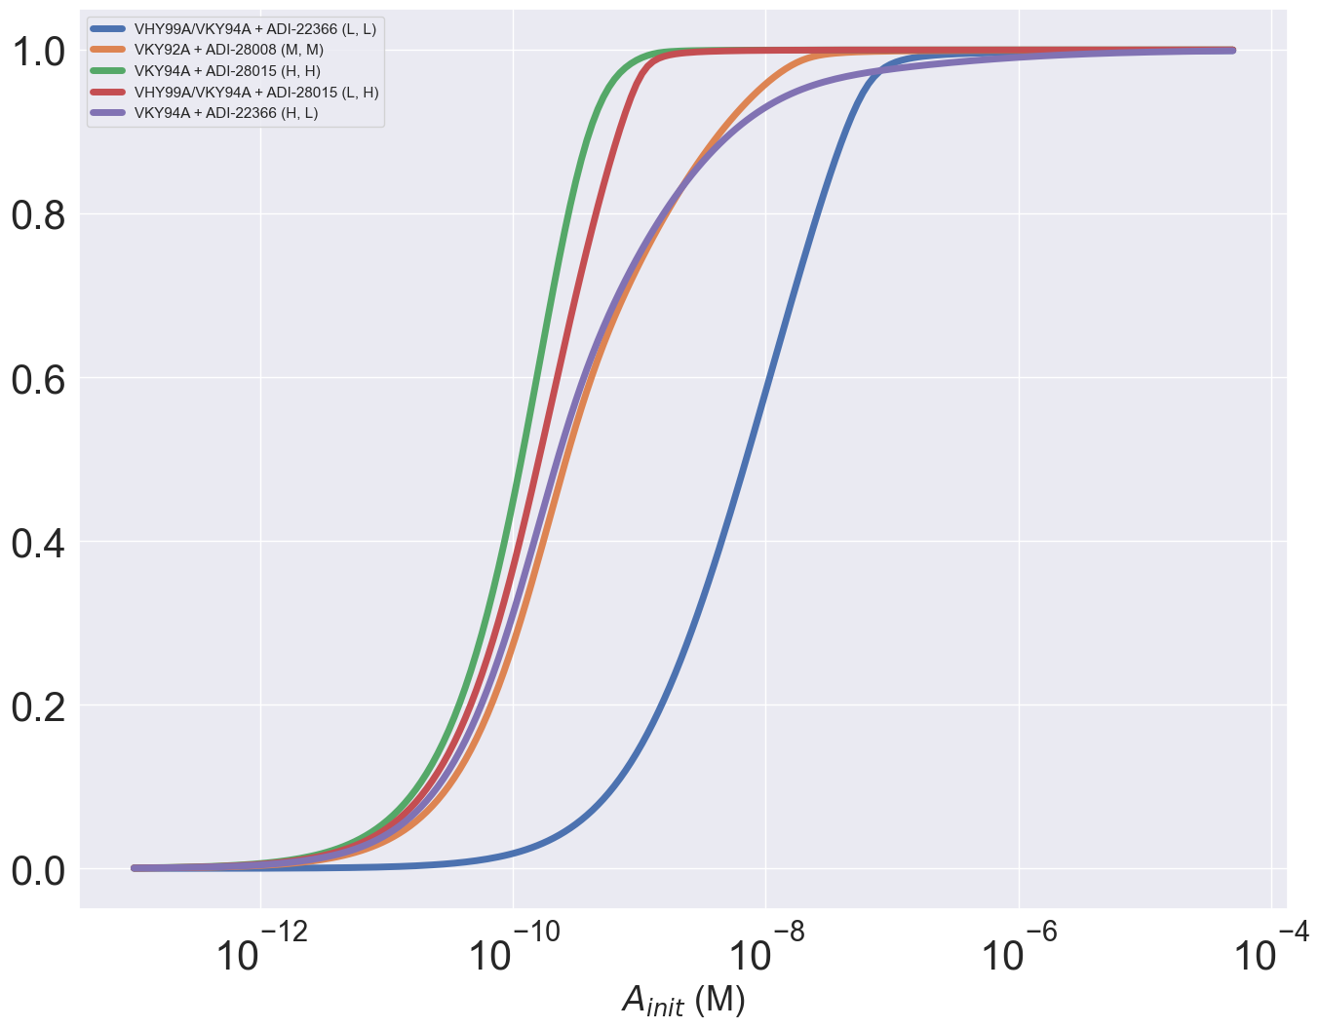
Single duel-expressing cell binding
CD4 Occupancy
PD1 Occupancy
1000 receptors for both CD4 and PD1

Slide 3
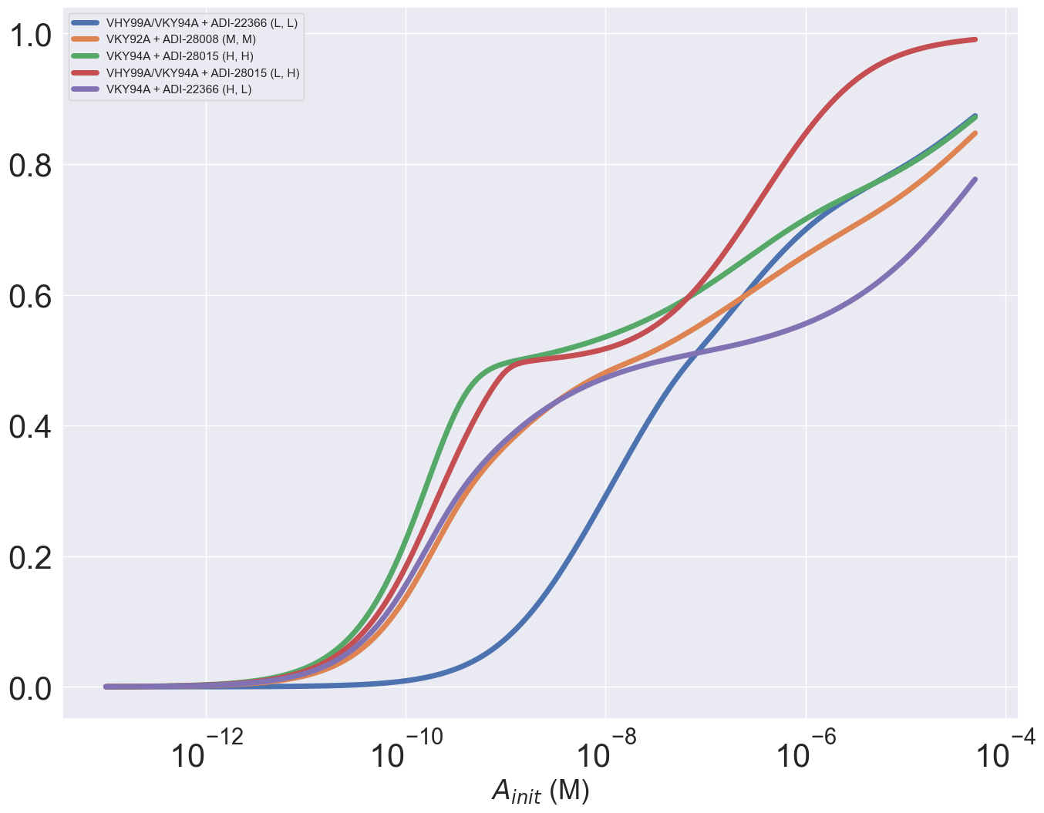
Bound Antibody Number

Slide 4
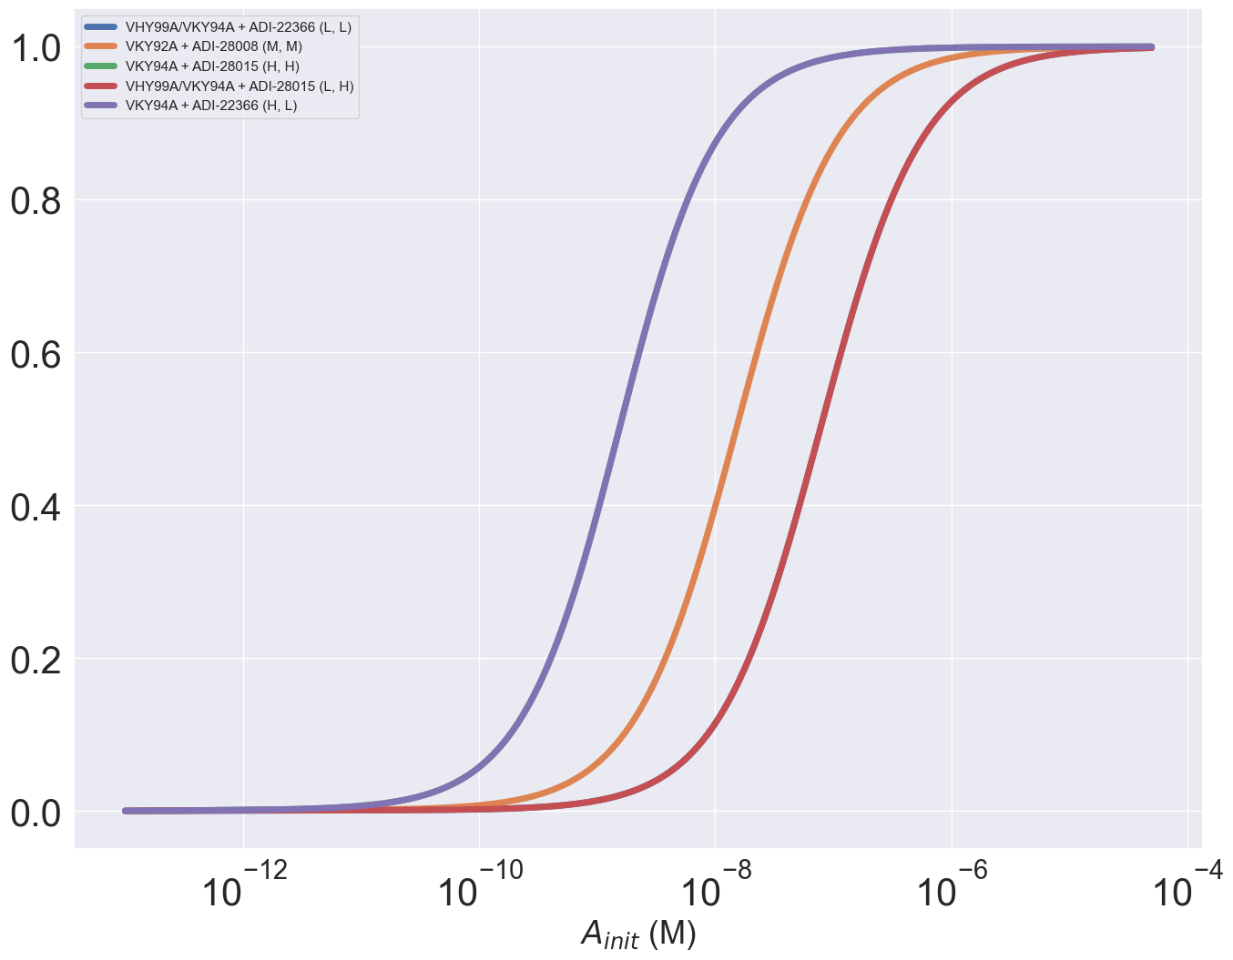
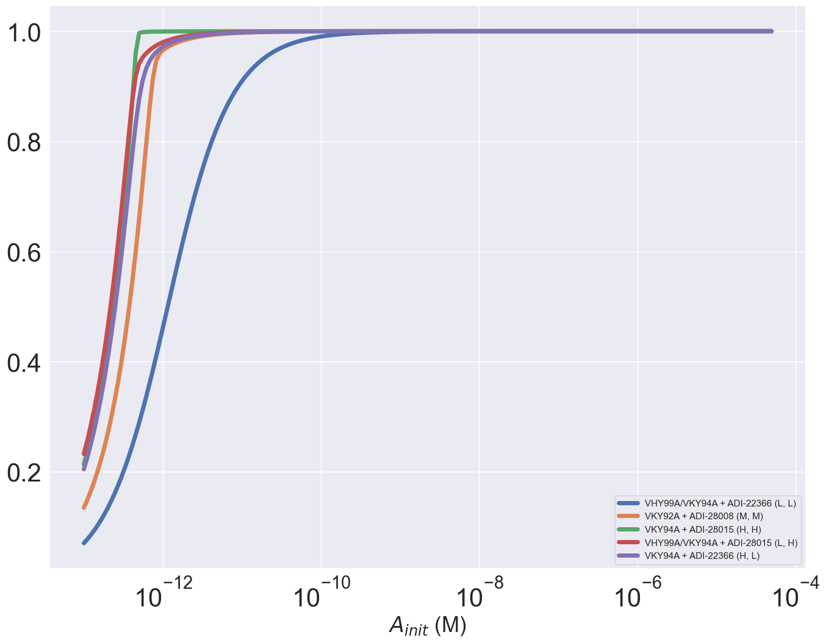
CD4 Occupancy
PD1 Occupancy
10^5 receptors per cell
100 receptors per cell

Slide 5

Bound Antibody Number

Slide 6
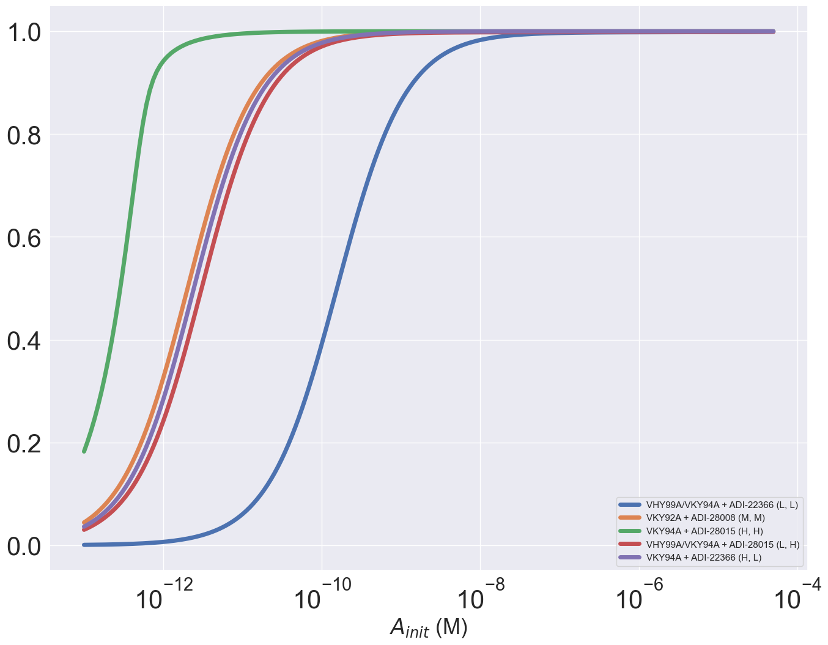
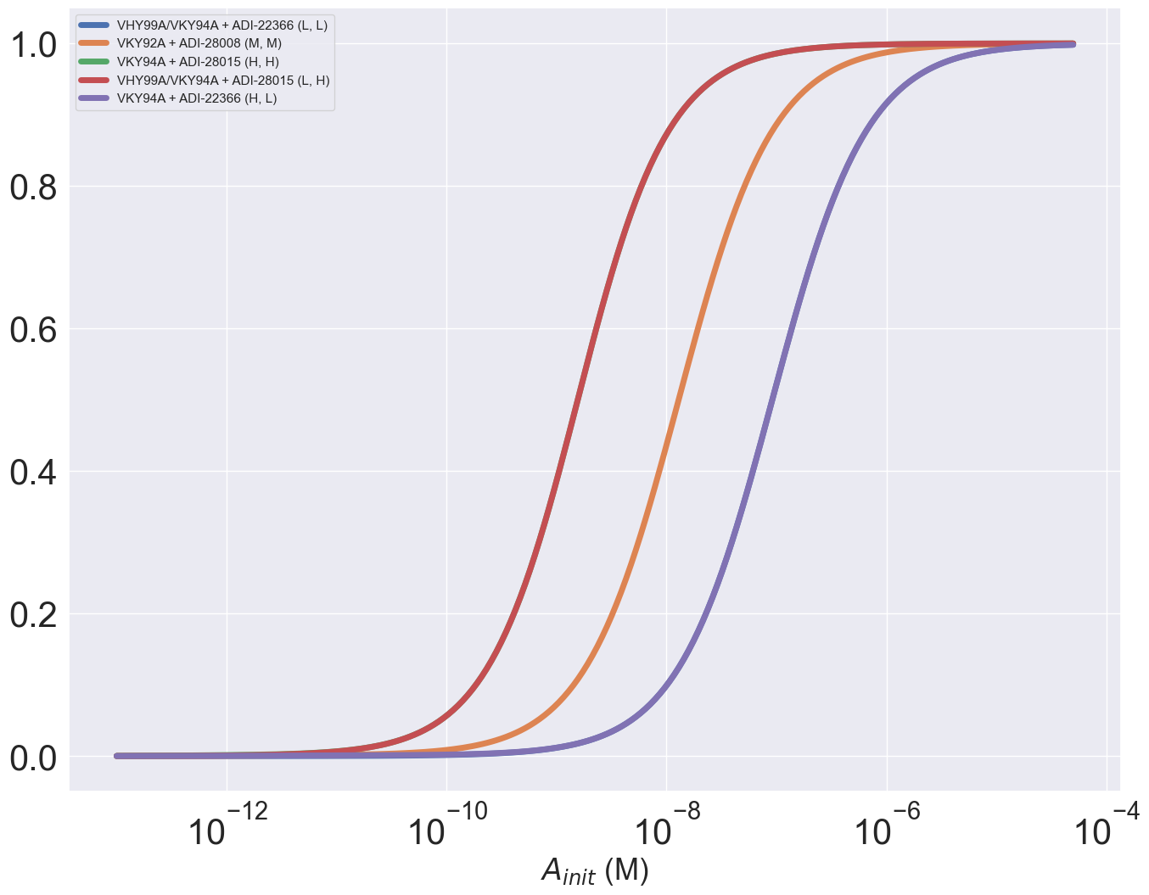
CD4 Occupancy
PD1 Occupancy
100 receptors per cell
1e5 receptors per cell

Slide 7

Bound Antibody Number

Slide 8
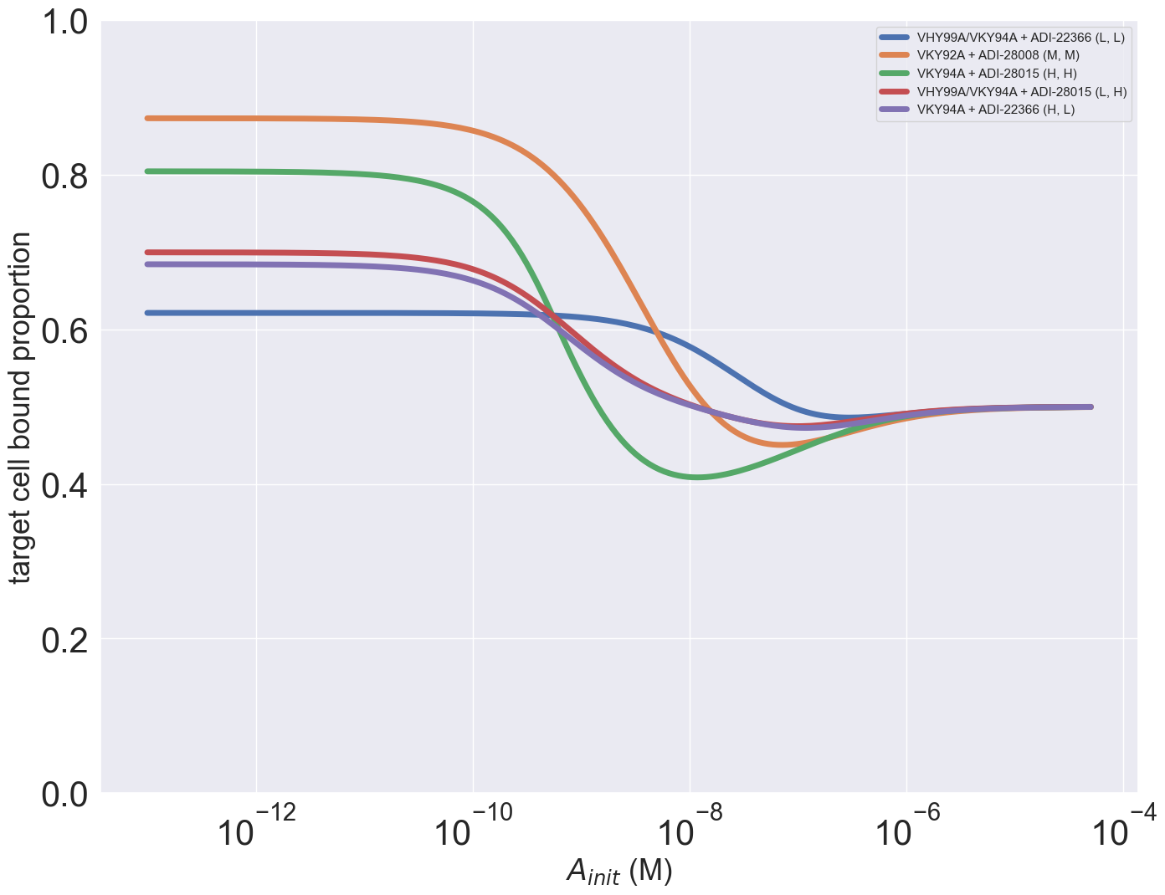
Multicell Selectivity
1000 receptors for each target on dual expressing cell
1000 receptors on both single expressing cells
Target cell number =10^5
Non-target cell number =10^5 for both types

Slide 9
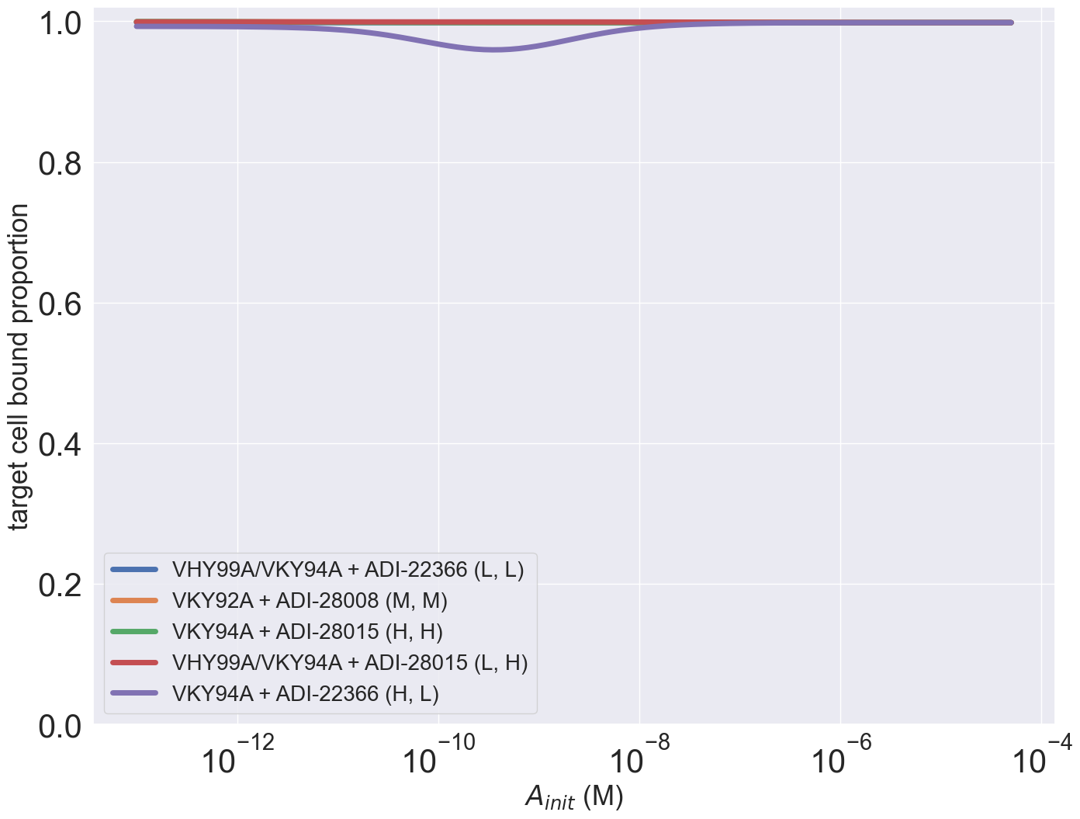

CD4=10^2, PD1=10^5 (dual expressing cells)
CD4=10^5, PD1=10^2 (dual expressing cells)
Both targets =10^2 on single expressing cells

Slide 10
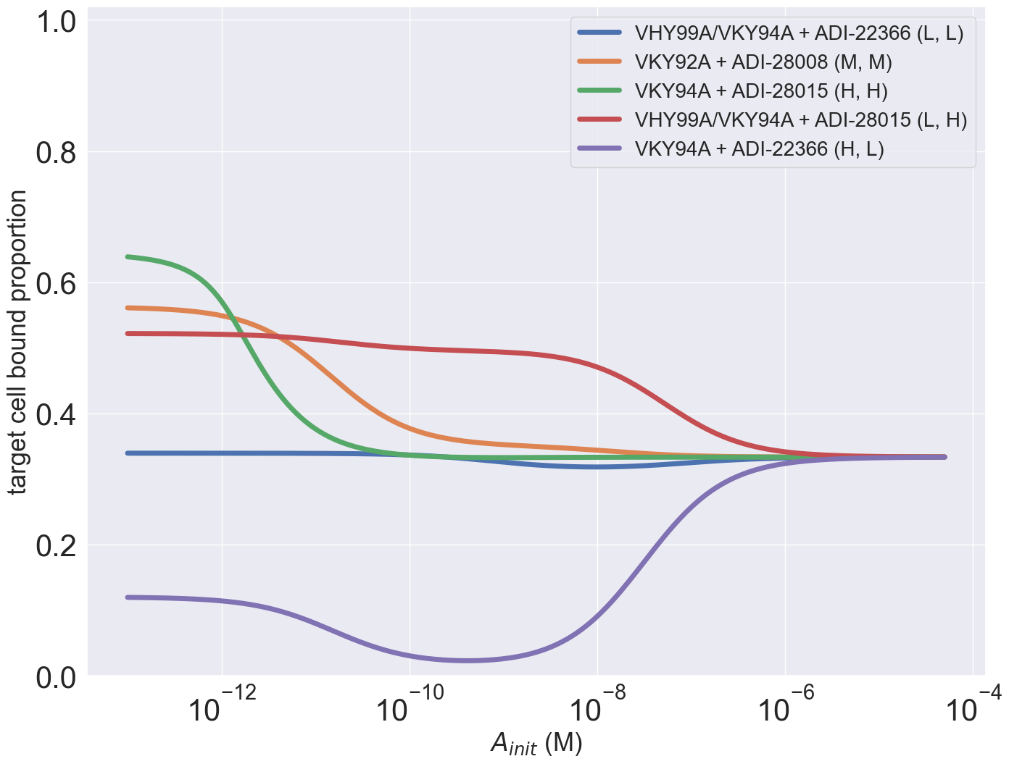
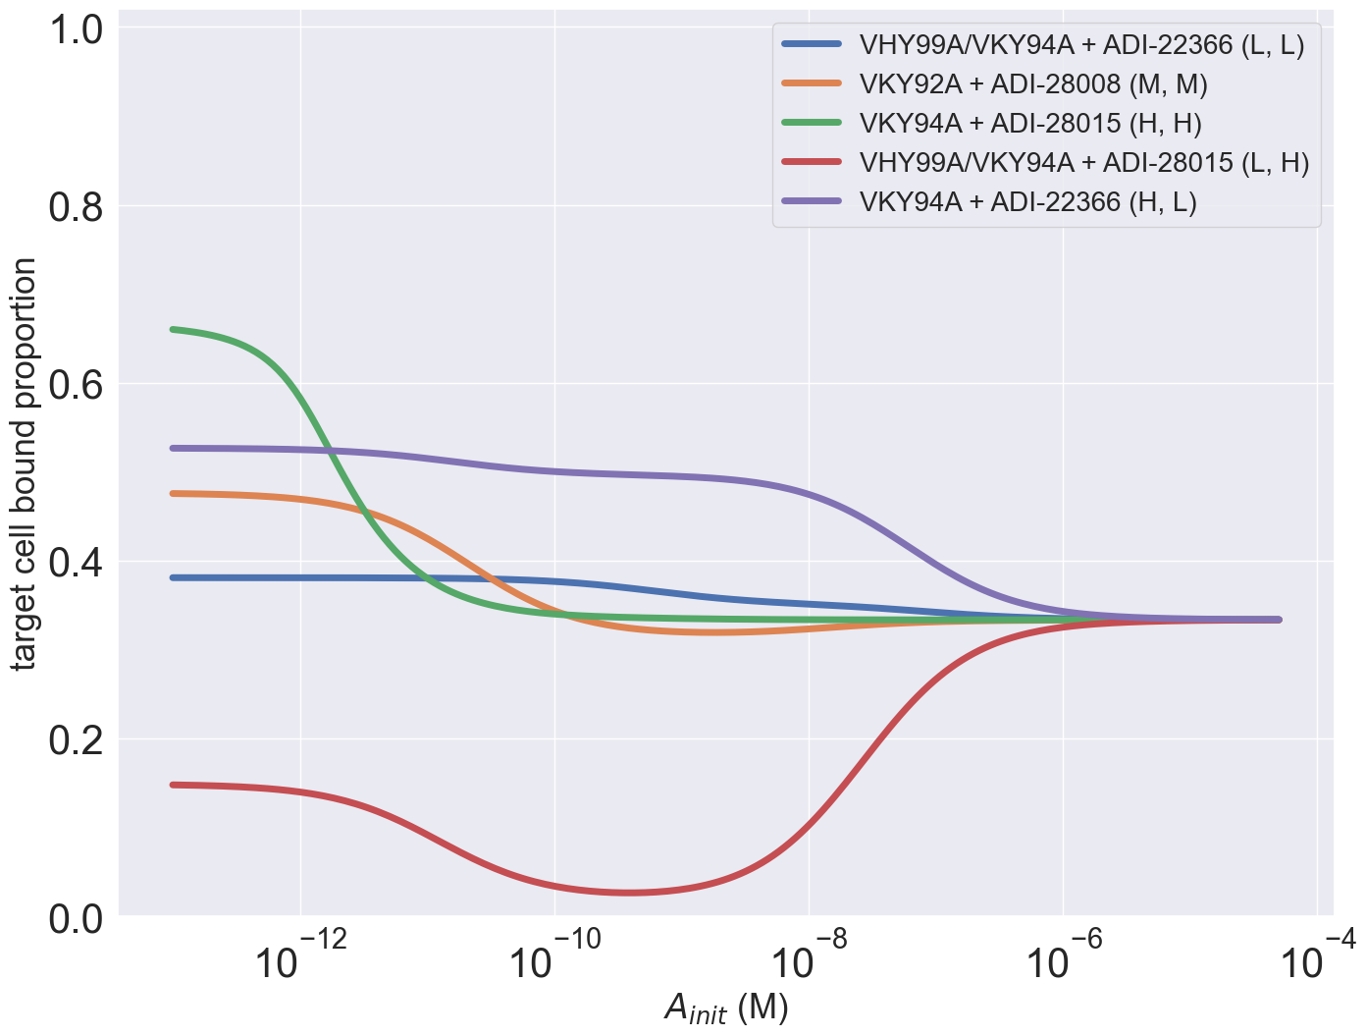
CD4=10^2, PD1=10^5 (dual expressing cells)
CD4=10^5, PD1=10^2 (dual expressing cells)
Both targets =10^5 on single expressing cells

Slide 11
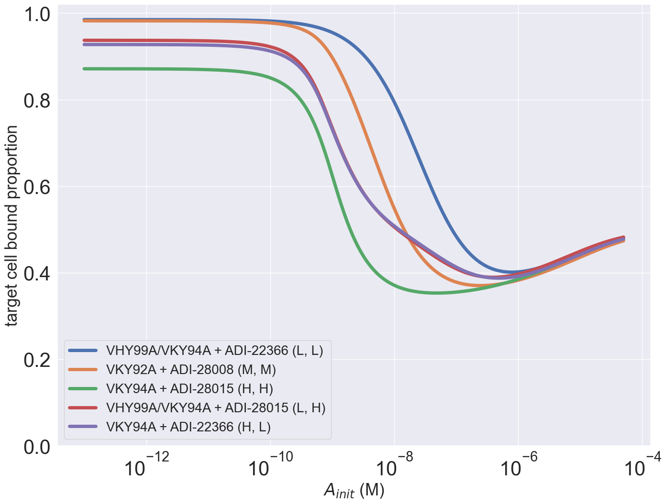
CD4=10^5, PD1=10^5 (dual expressing cells)
Both targets =10^5 on single expressing cells

Slide 12
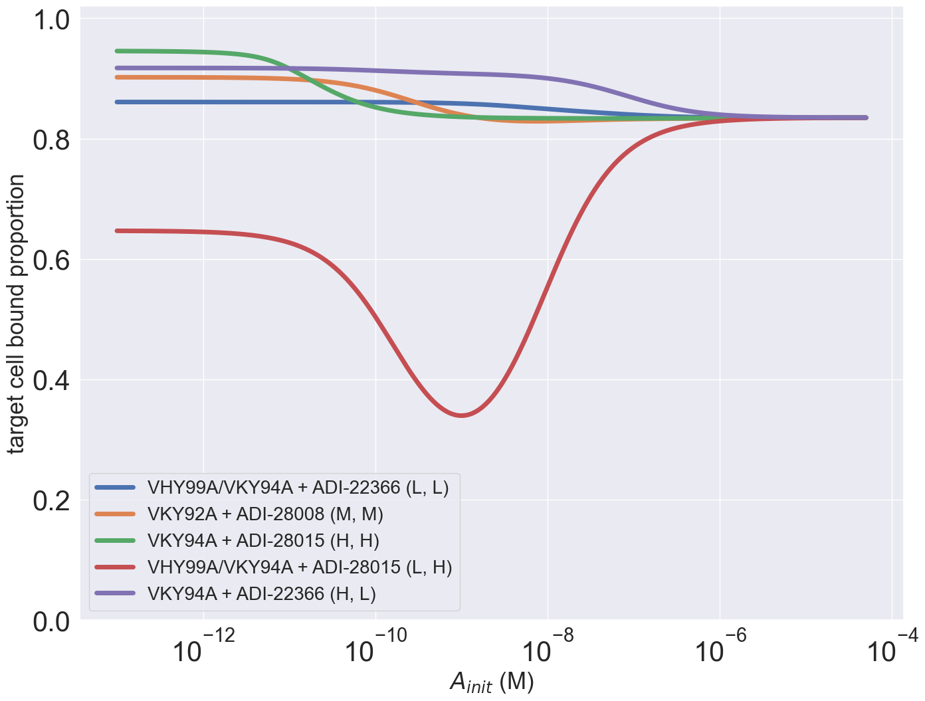
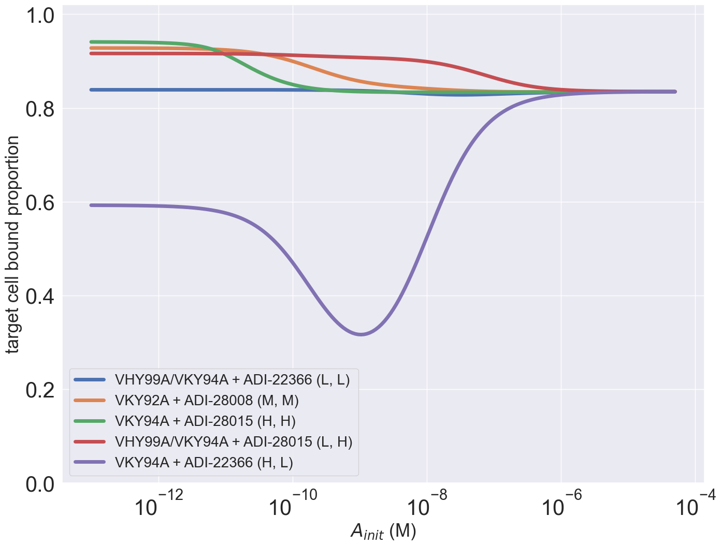
CD4=10^4, PD1=10^2 (dual expressing cells)
CD4=10^2, PD1=10^4 (dual expressing cells)
Both targets =10^3 on single expressing cells

Slide 13
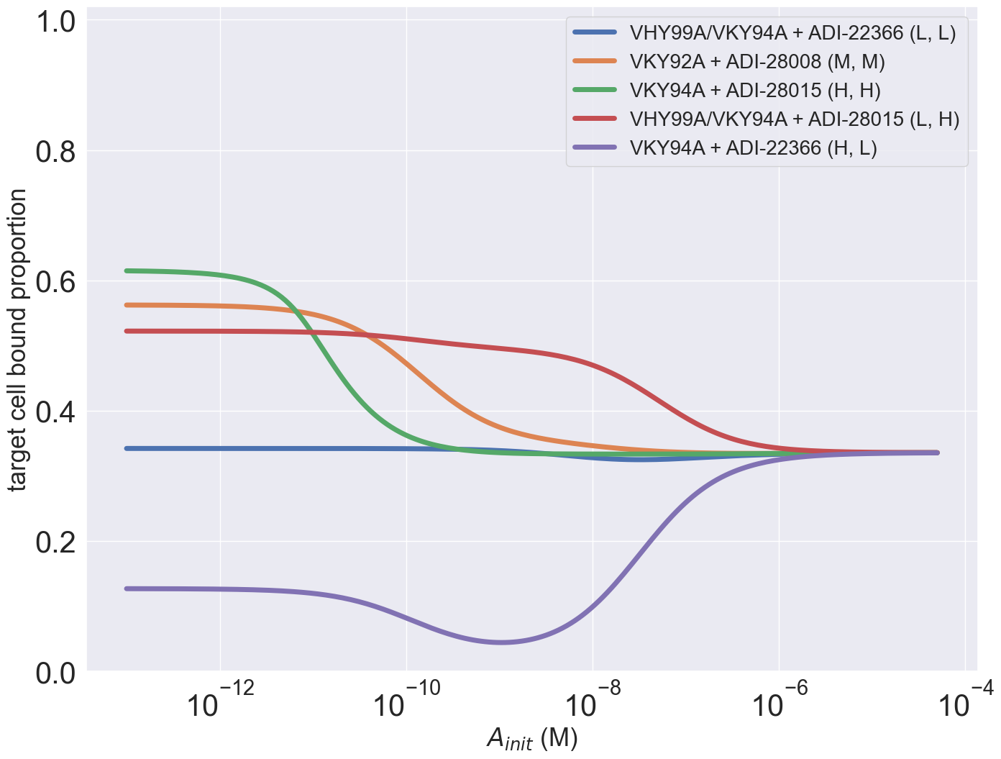
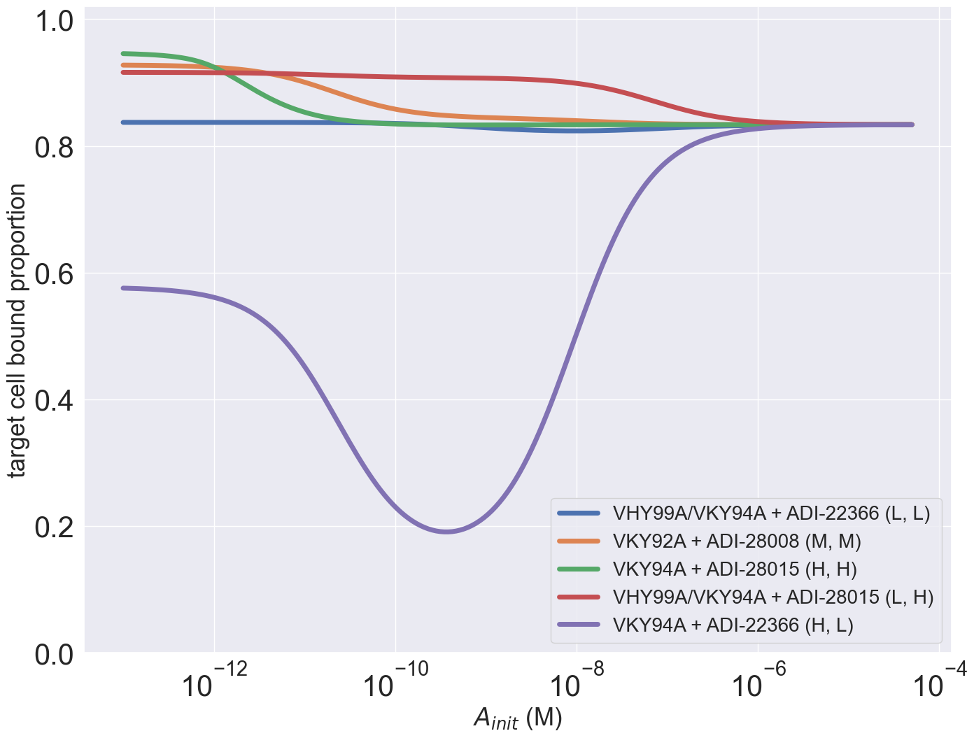
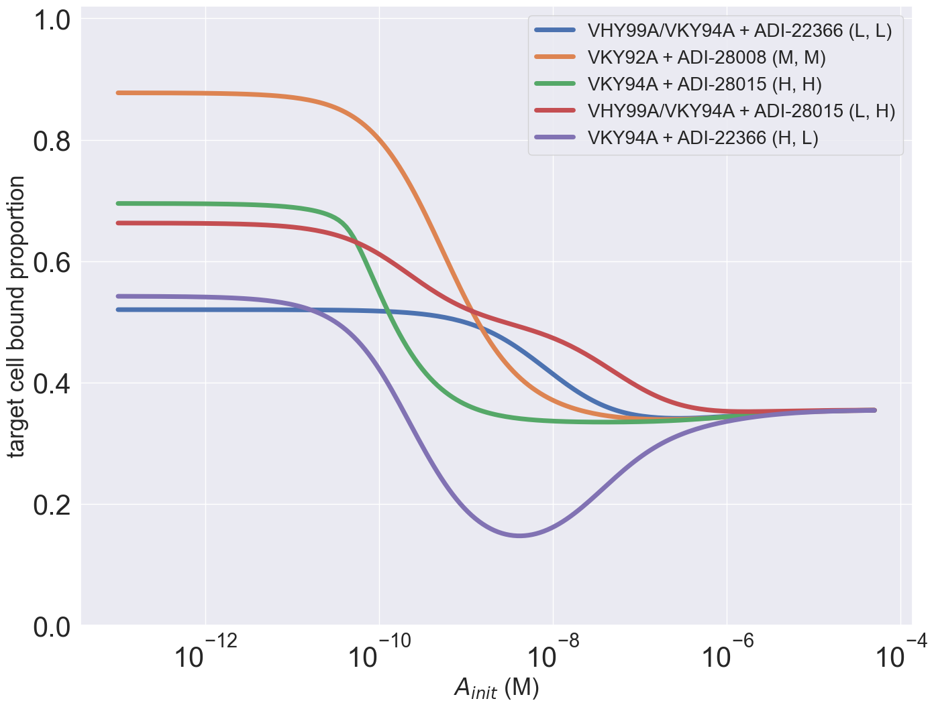
CD4=10^2, PD1=10^4 (dual expressing cells)
CD4=10^2, PD1=10^5 (dual expressing cells)
CD4=10^3, PD1=10^4 (dual expressing cells)
Both targets =10^3 on single expressing cells
Nontarget cell number = 10 x target cell number

