Slide 1
GSK monovalent vs bivalent follow up

Slide 2
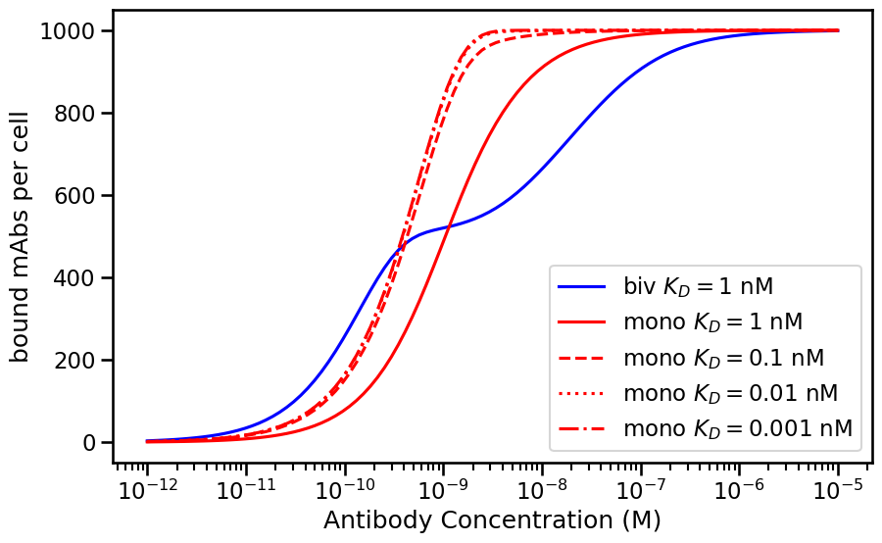
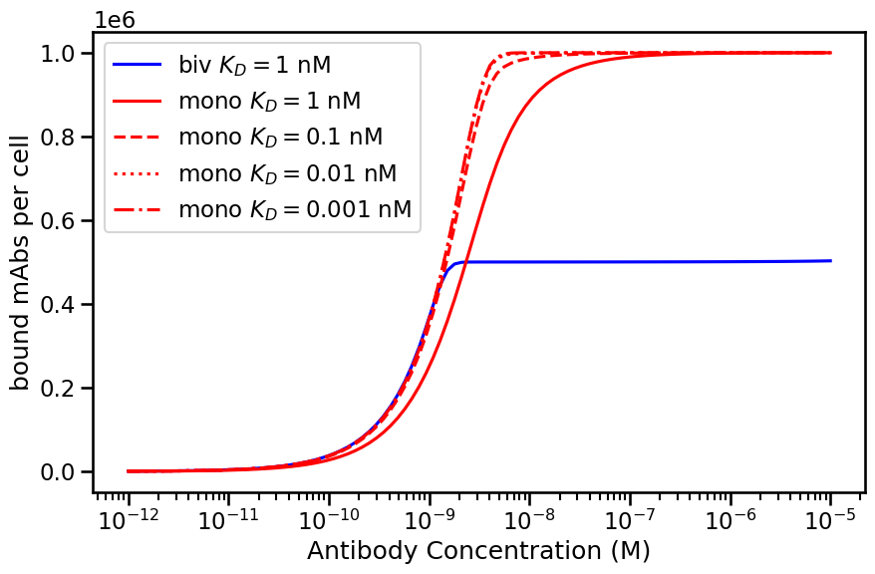
Bivalent same efficacy and slightly better EC50/potency as high affinity monovalent
Bivalent same potency but worse efficacy as high affinity monovalent
Rtot=10^3
D=10^-15
D=10^-13
Rtot=10^6

Slide 3
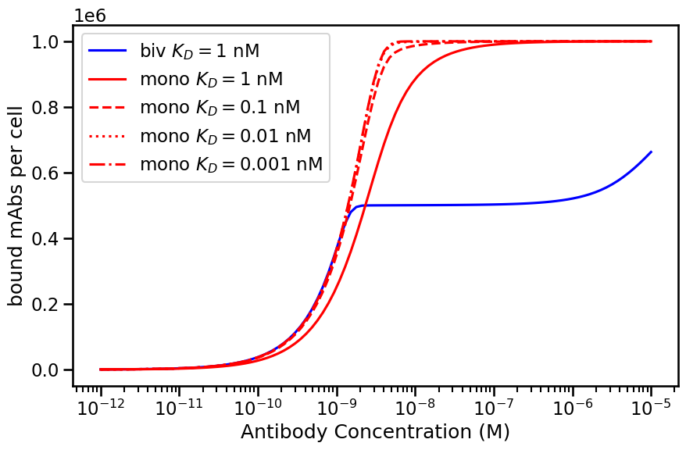

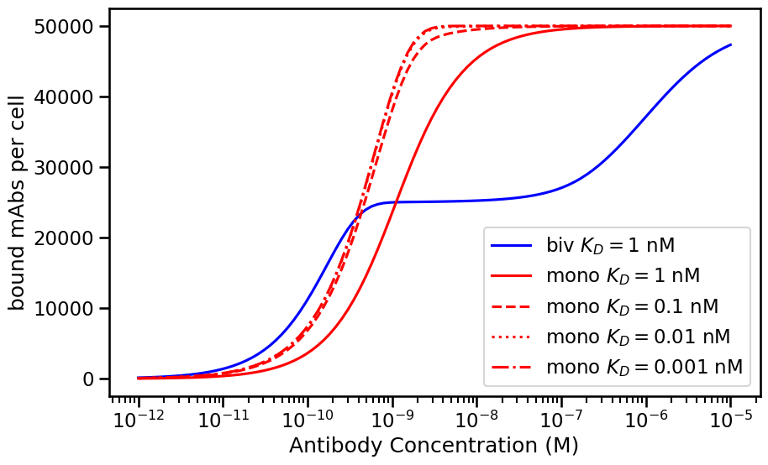
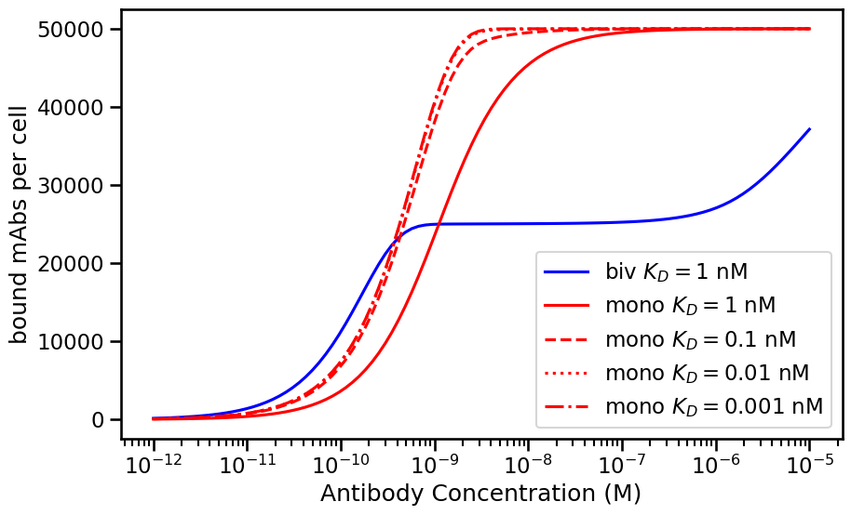
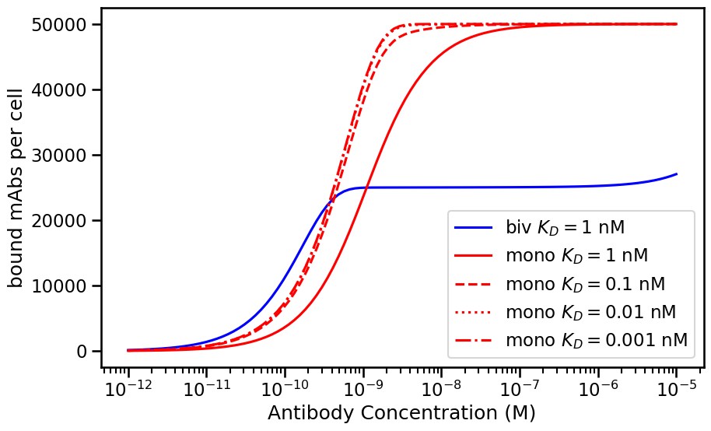
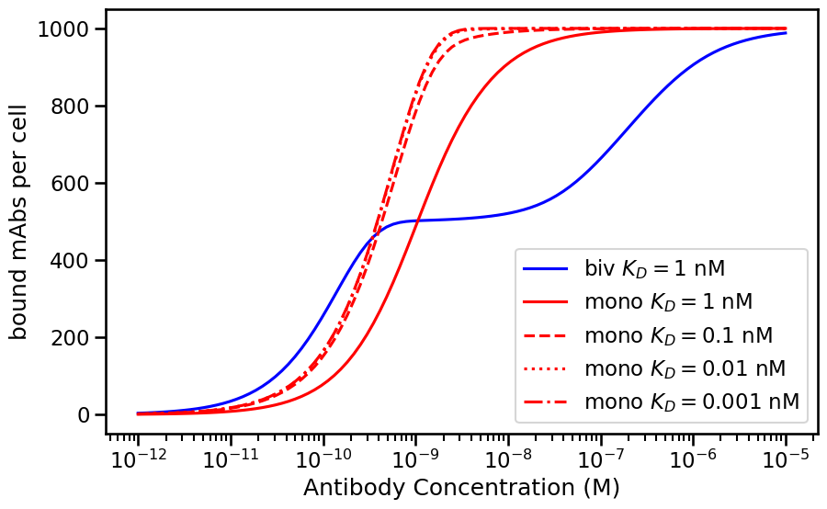
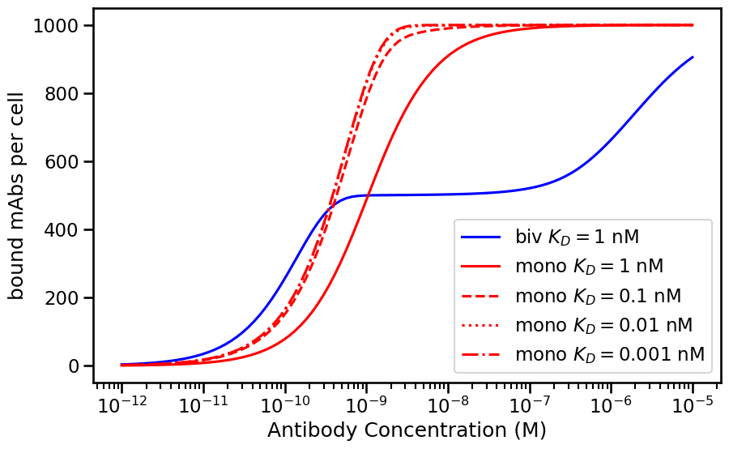
Rtot=10^6
Rtot=5 x10^4
Rtot=10^3
D=10^-15
D=10^-14
D=10^-13

Slide 4
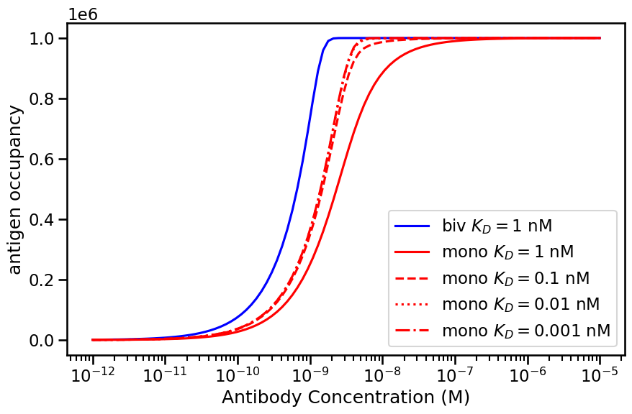


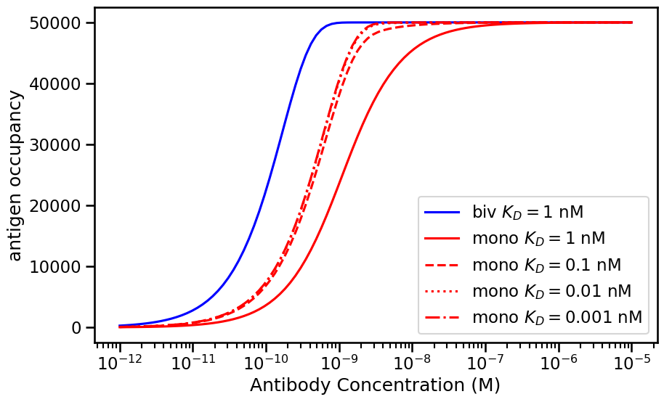


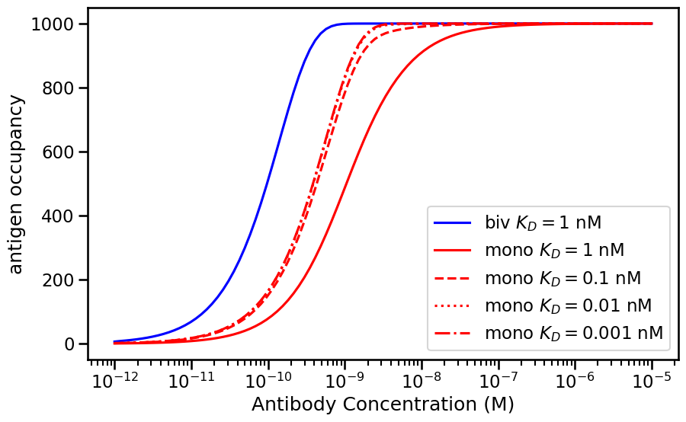


Rtot=10^6
Rtot=5 x10^4
Rtot=10^3
D=10^-15
D=10^-14
D=10^-13

Slide 5
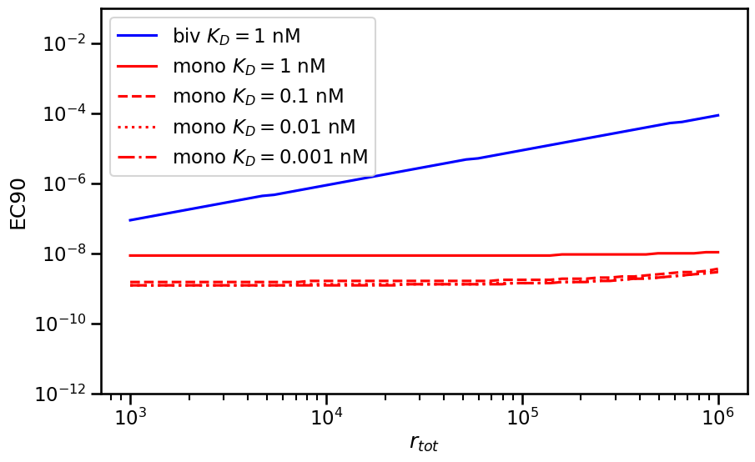
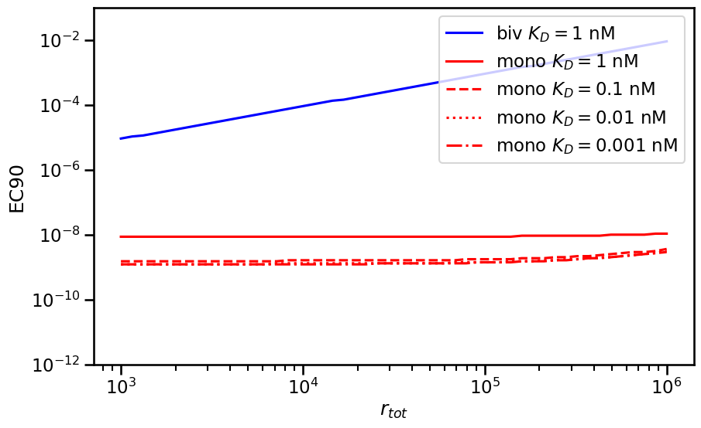
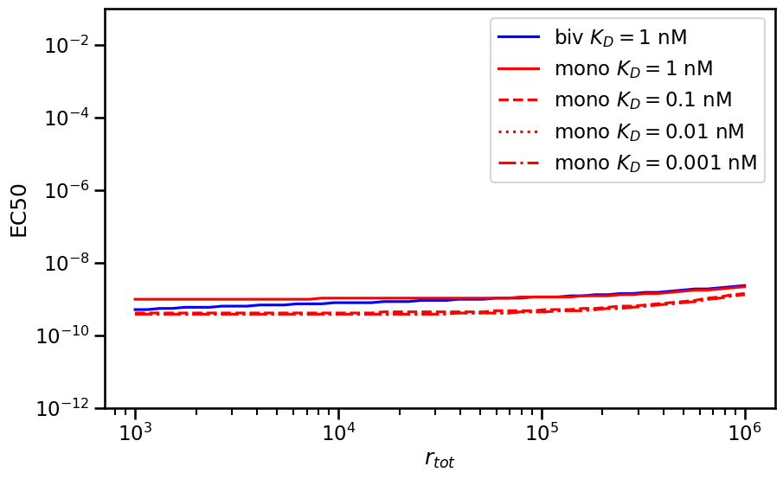
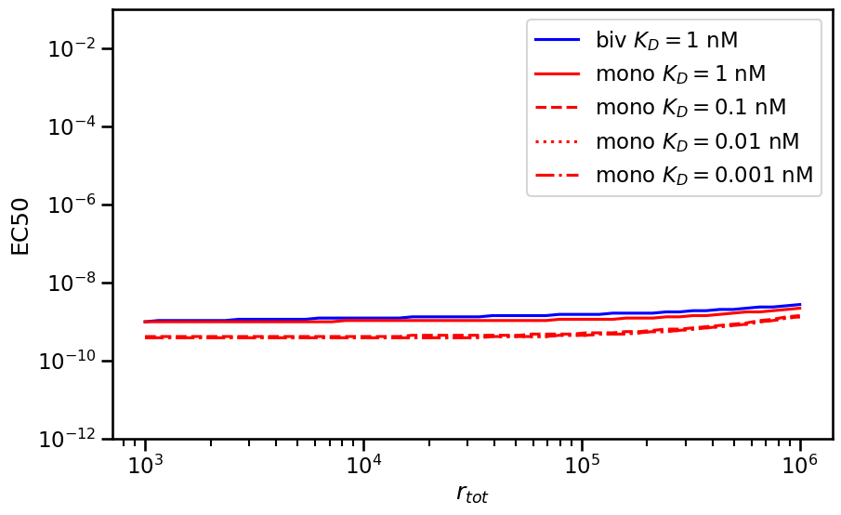
EC50 vs EC90
D=10^-15
D=10^-13

