Slide 1
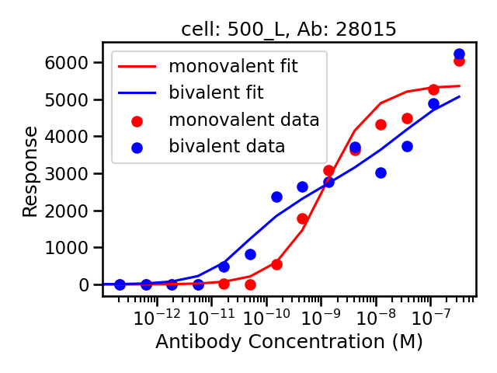
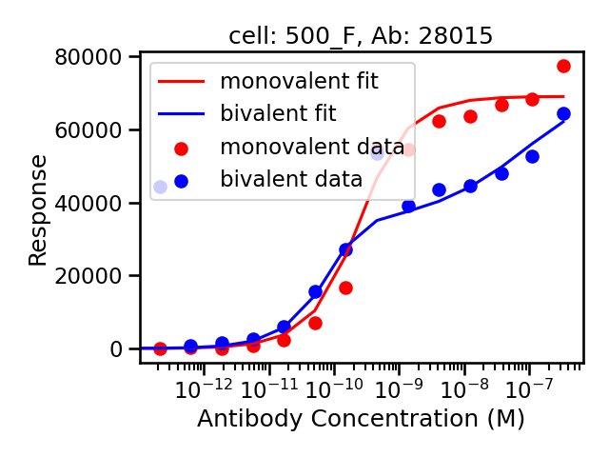
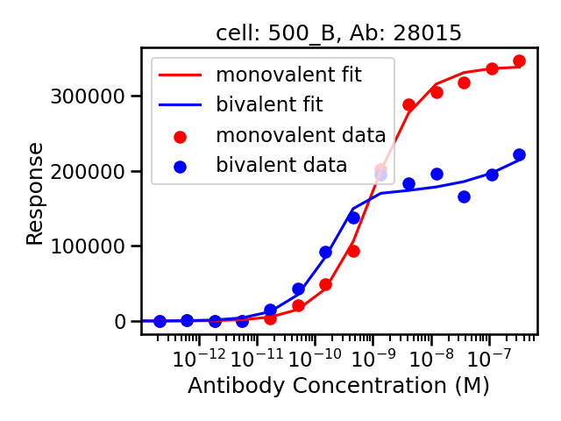
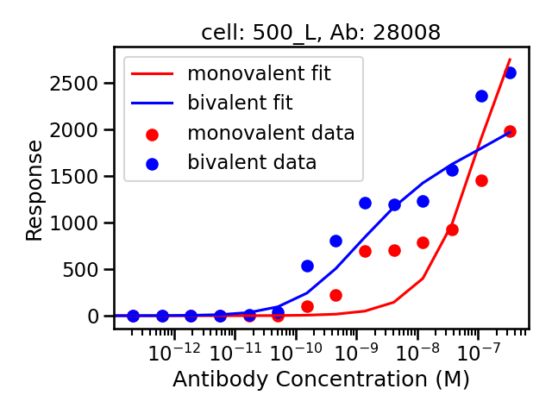
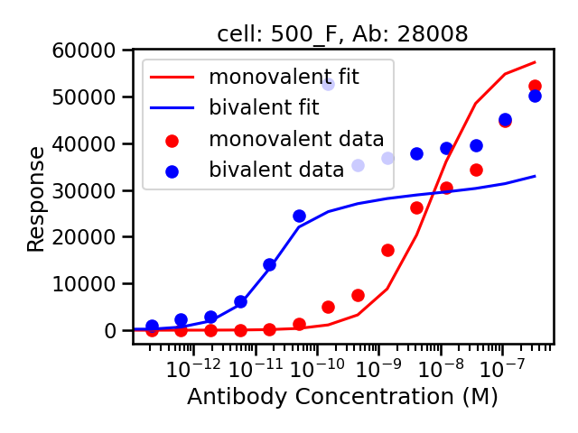
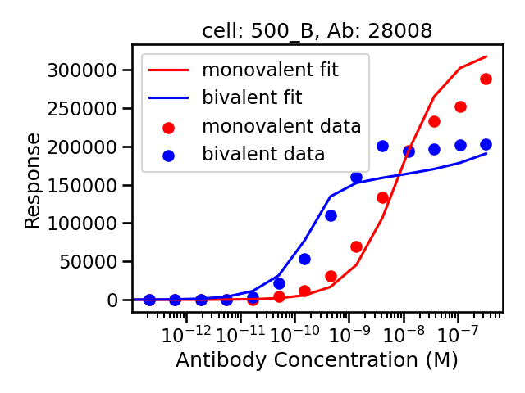
Noisy ->

Slide 2
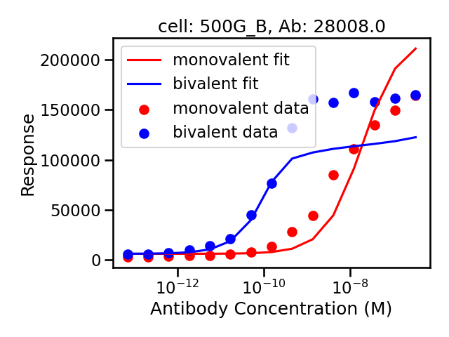
500_B fits before
New assay 500_B fits

Slide 3
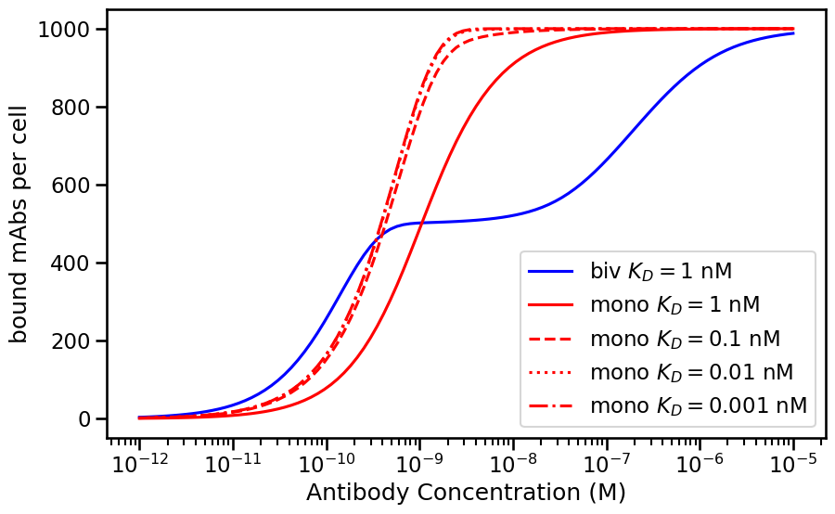
Calculating the Avidity Barrier
Avidity barrier = concentration at which bivalent
Reaches maximum – concentration at which
monovalent reaches maximum
Expectations:
Barrier large for high expression
Barrier increases with strength of avidity (k2)
What is the relationship with affinity?
Avidity Barrier

Slide 4
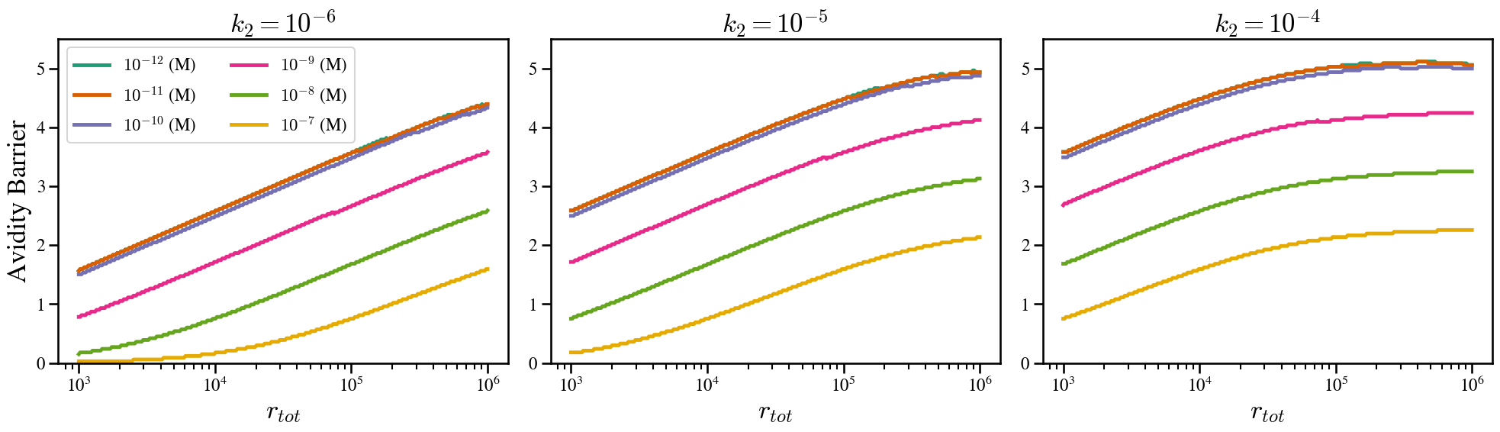
Size of Avidity Barrier Increases with Affinity

Slide 5
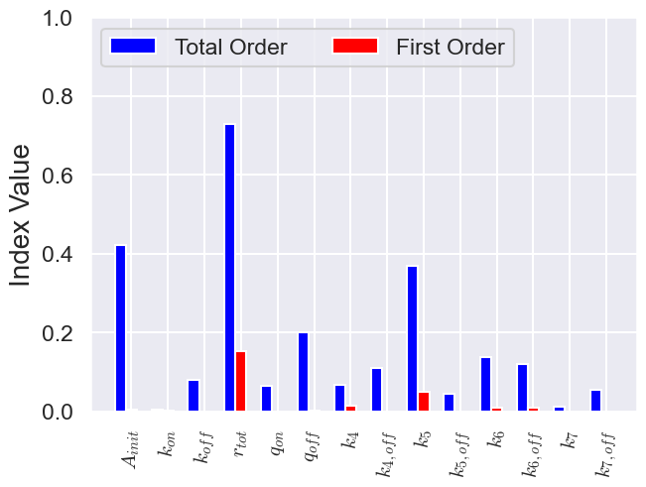

Slide 6
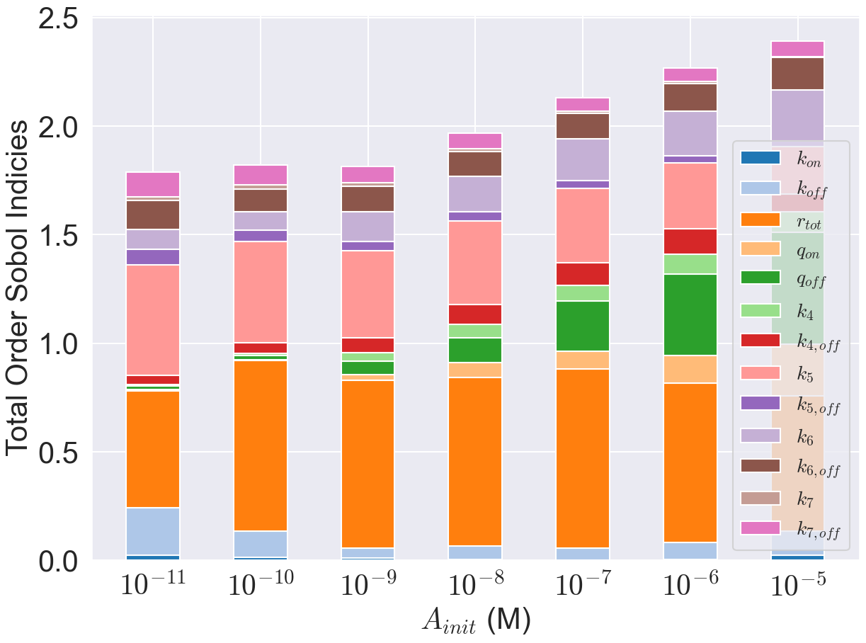

Slide 7
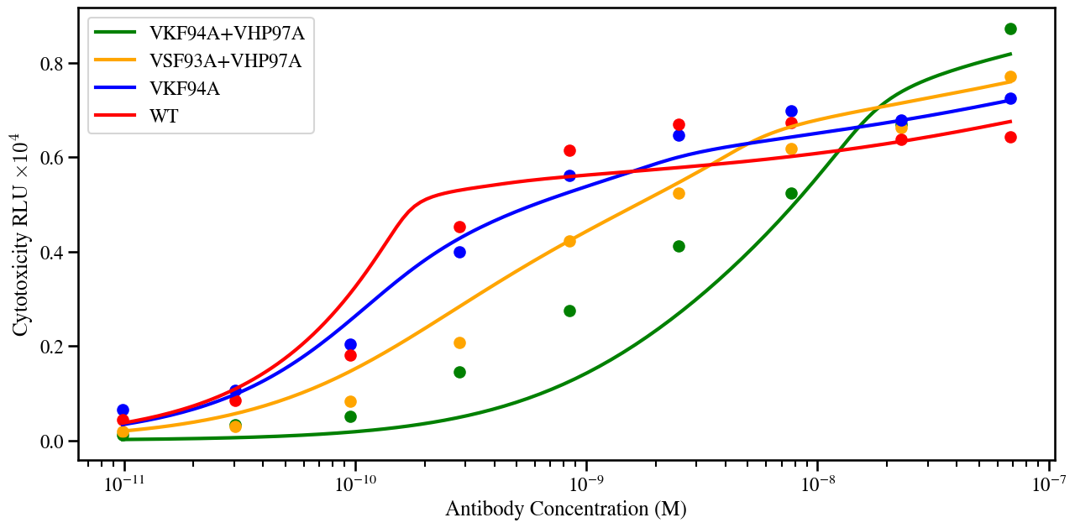
Synapse Model Fits to Mazor Data
k₄ = 10⁻⁵
k₅ = 10⁻⁷

Slide 8
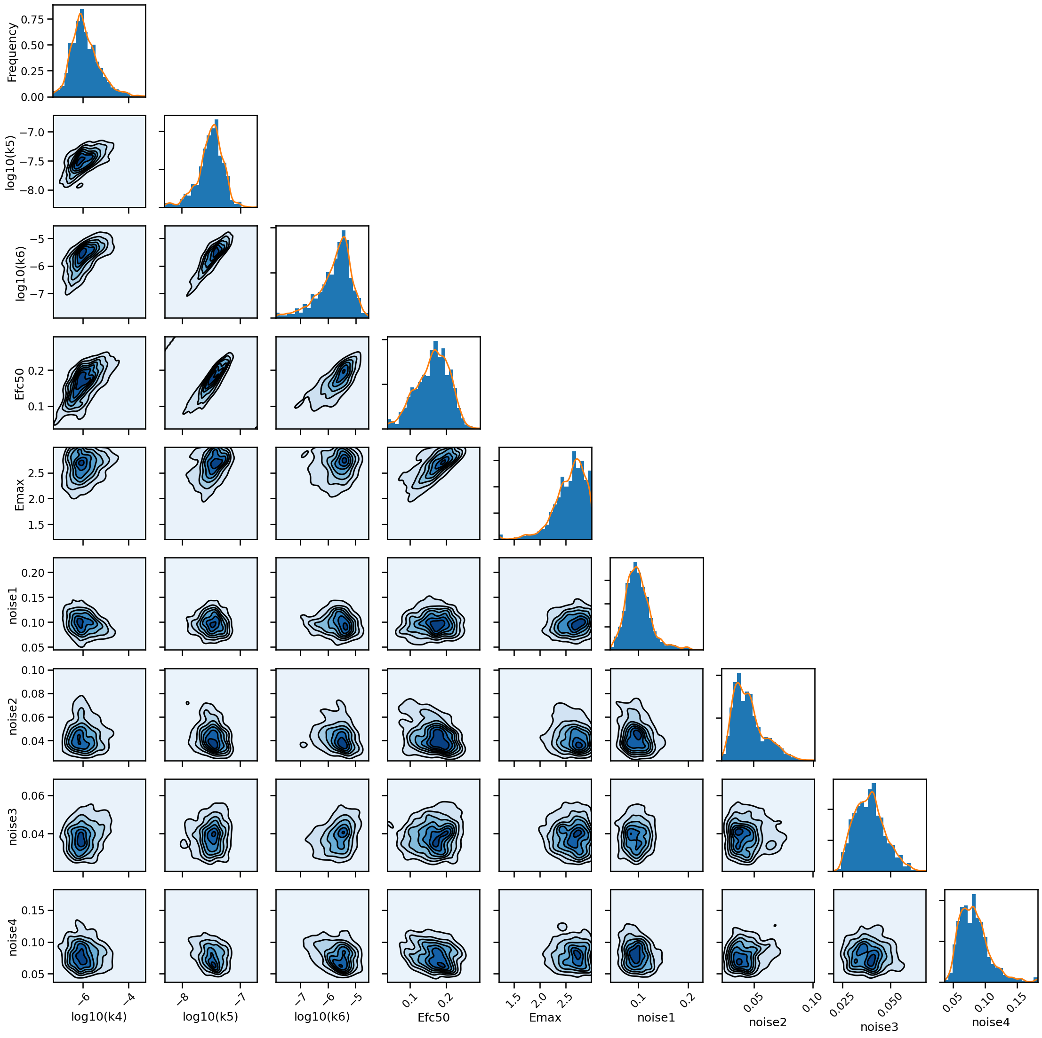
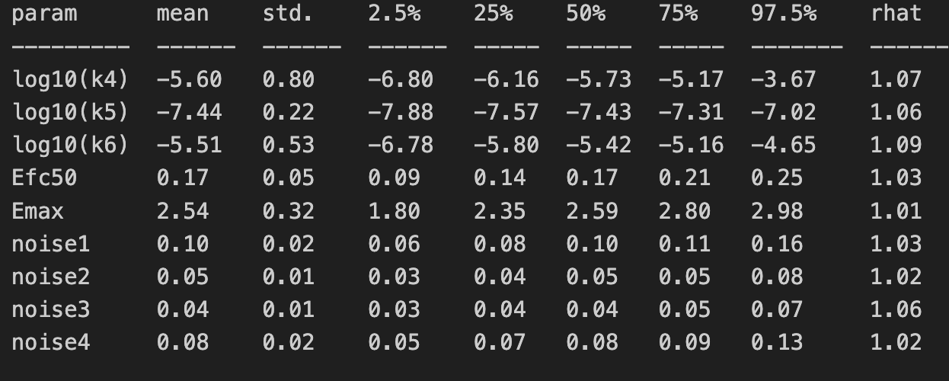

Slide 9
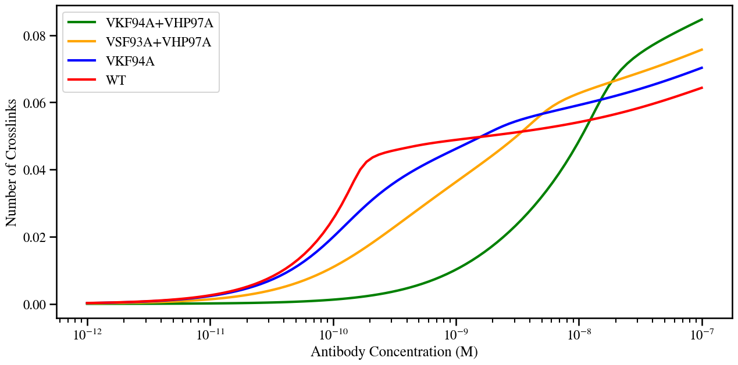

Slide 10
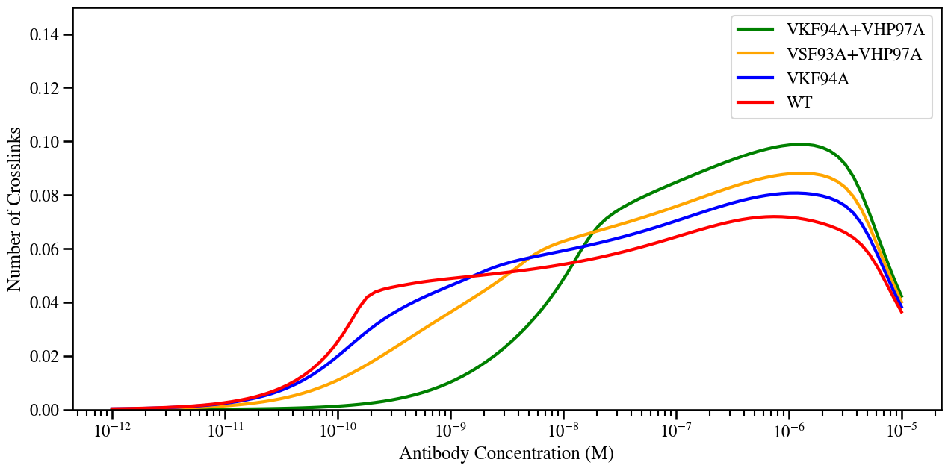
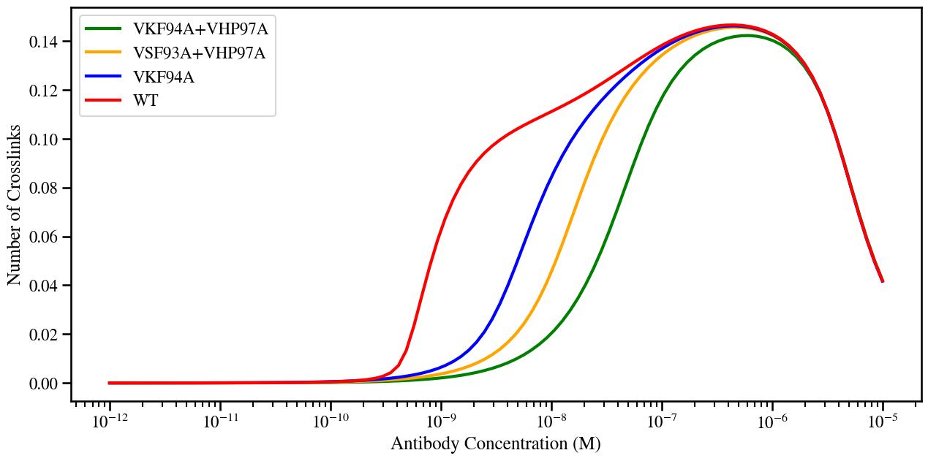
Bivalent
Monovalent

