Slide 1
Endogenous Antibody Competition

Slide 3
Nondimensional Model

Slide 4
Steady States

Slide 5
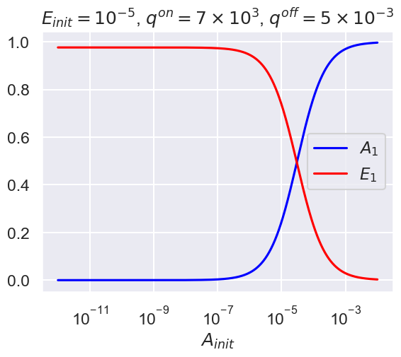
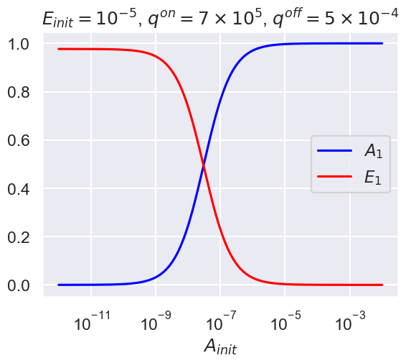
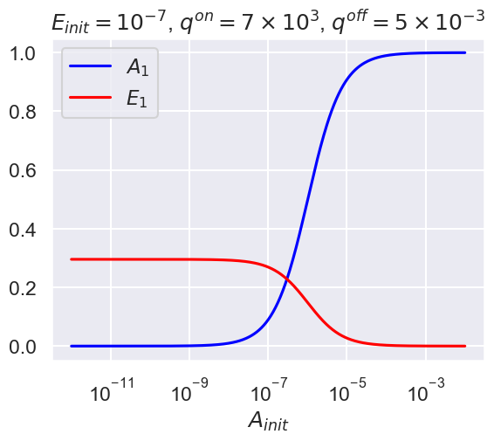
Decreasing Endogenous Antibody Concentration
Decreasing KD

Slide 6
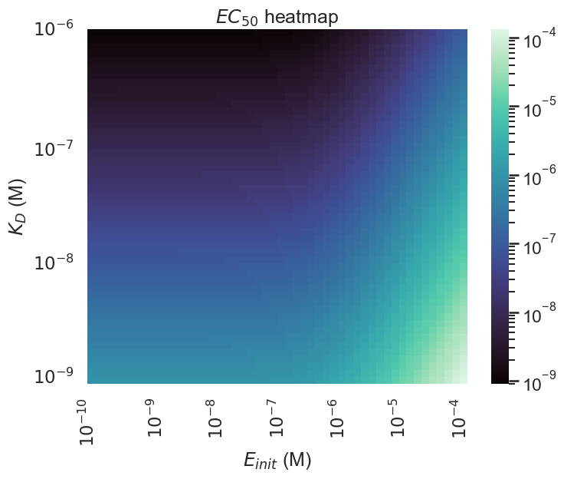
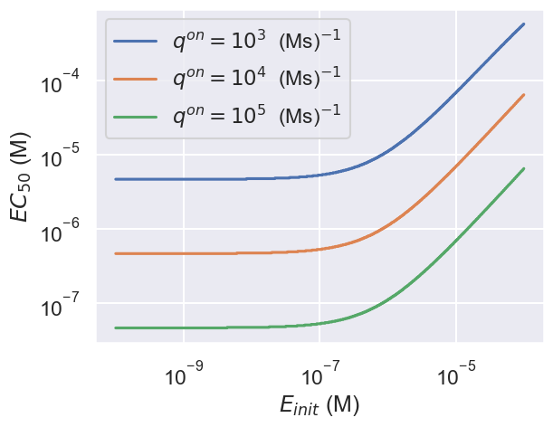
Effect on EC50

