Slide 1

Microscale Modelling of Antibody Dependent Cellular Cytotoxicity
Luke Heirene
Helen Byrne
Eamonn Gaffney
James Yates

Slide 2
General Project Goals
What are the key mechanisms that affect ADCC?
How much can we optimize antibody properties and dose for ADCC?
How do you model biologics on the microscale?
Given microscale parameters can we predict a macroscale outcome such as ADCC potency?

Slide 3
Talk Outline
Single cell antibody binding model Introduction
How to model second binding event?
Model Dynamics
Immune synapse model
Conclusions

Slide 4
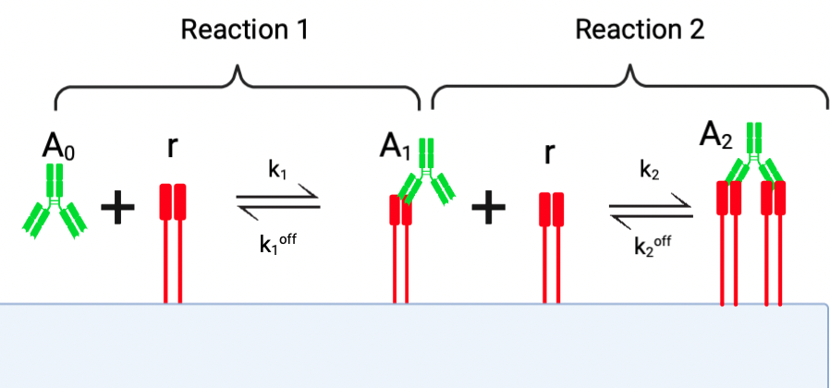
Mathematical Model Reaction Scheme

Slide 5
Model Assumptions
Model formulated in units of "receptor’” as opposed to concentration
Antibodies and receptors distributed uniformly
Receptor and antibody numbers are conserved
Neglect processes such as receptor internalization

Slide 6
How to model the second binding event?
The environment for the binding of the second arm is very different compared to the binding of the first arm
Best way to scale a volume reaction to a surface reaction?
Important things to consider?
Multiple methodologies in the literature

Slide 7


Method 1: Diffusion-limited Binding (Model S)
Sengers BG, McGinty S, Nouri FZ, Argungu M, Hawkins E, Hadji A, Weber A, Taylor A, Sepp A. Modelling bispecific monoclonal antibody interaction with two cell membrane targets indicates the importance of surface diffusion (2020)

Slide 8
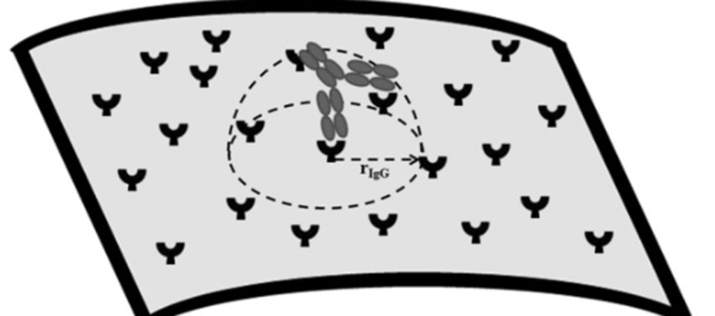
Method 2: Local Receptor Concentration (Model R)
Rhoden JJ, Dyas GL, Wroblewski VJ. A Modeling and Experimental Investigation of the Effects of Antigen Density, Binding Affinity, and Antigen Expression Ratio on Bispecific Antibody Binding to Cell Surface Targets. J Biol Chem. 2016 May 20

Slide 9
How do we compare the two methodologies?
Qualitatively similar equilibrium values?
Do the outputs of the models react similarly to changes in parameters? (sensitivity analysis)
Can both models identify parameters from data (identifiability analysis)

Slide 10
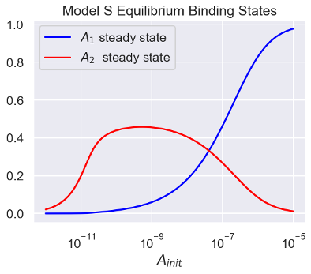
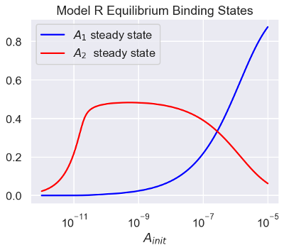
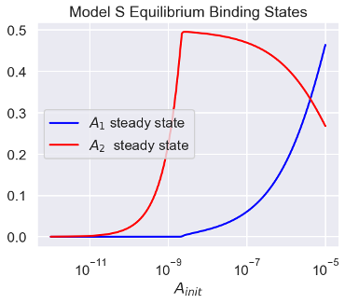
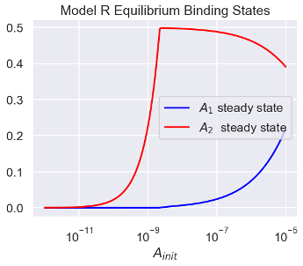
Antibodies are bivalently bound for low concentrations and monovalently bound for high concentrations.
Both models show qualitatively similar results.
Example equilibrium binding states

Slide 11
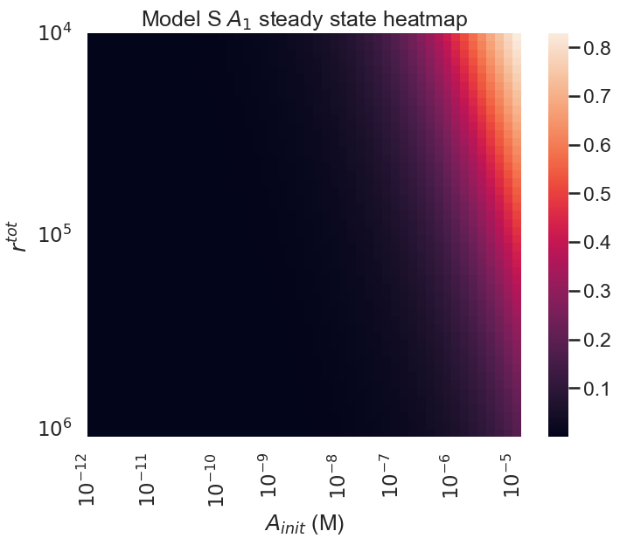

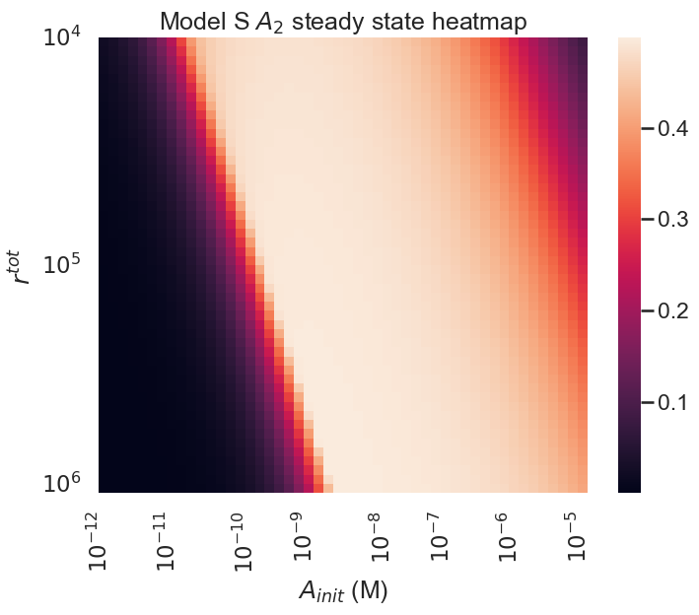
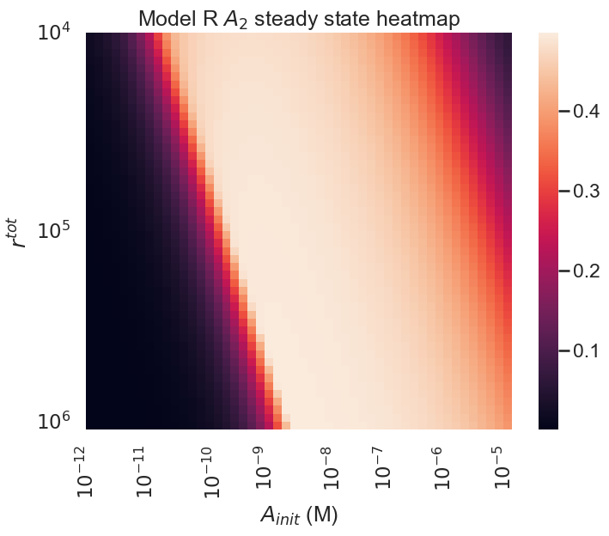
High antibody to receptor ratio favors A1
Antibody to receptor ratio dictates the equilibrium binding states.
Low antibody to receptor ratio favors A2

Slide 12
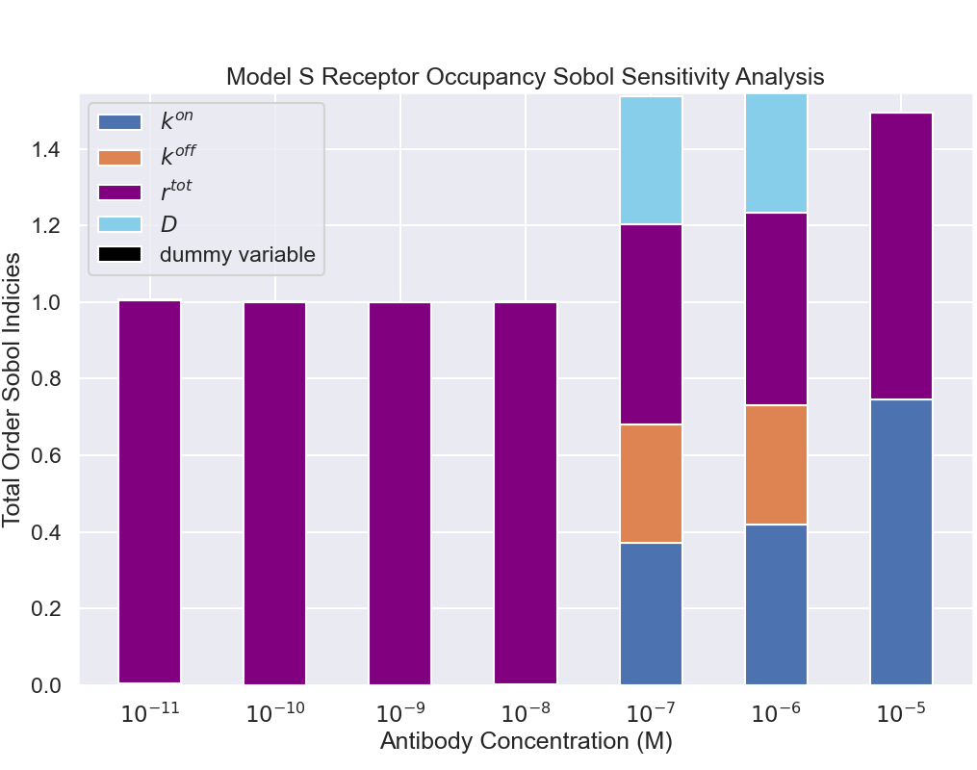
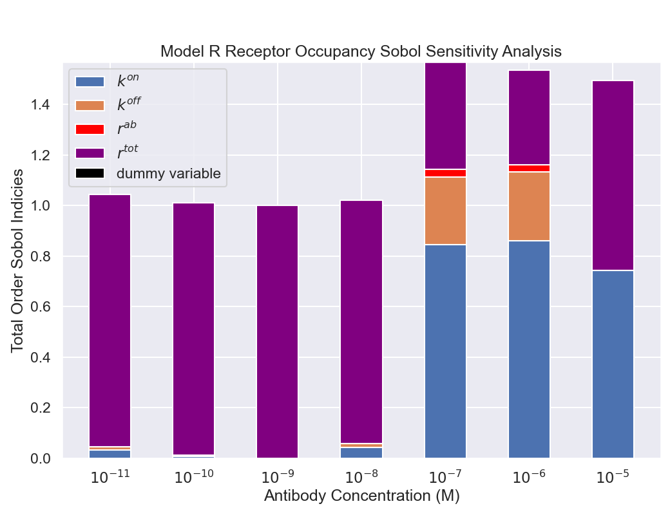
Receptor Occupancy Sensitivity Analysis
Both models display very similar sensitivities.
There are two regimes of sensitivity.
Low antibody concentrations: receptor number most important.
High antibody concentrations: binding parameters become important.
Relevant for therapeutics targeting receptor occupancy.

Slide 13
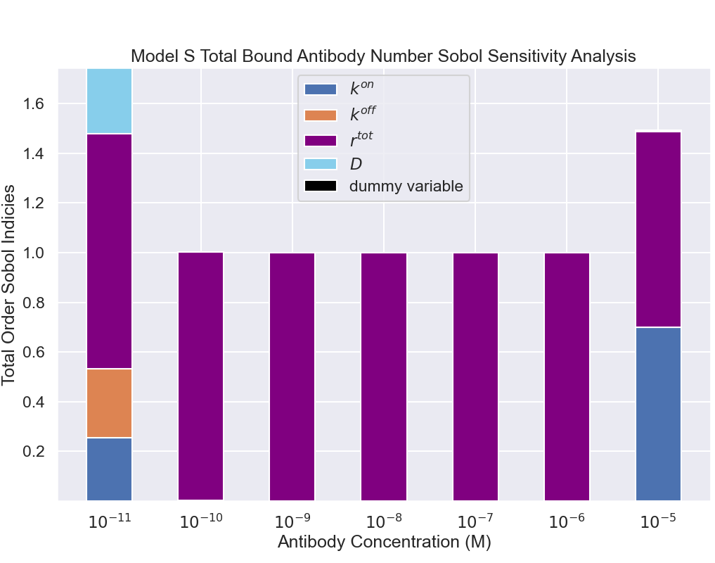
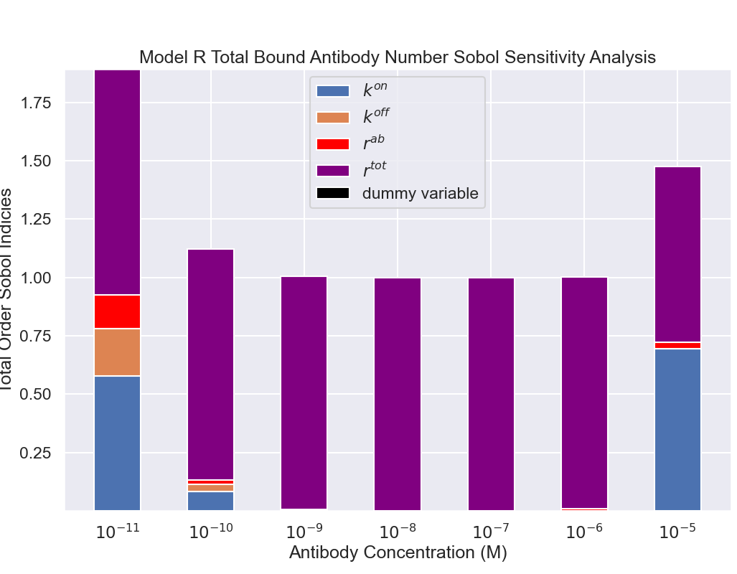
Bound Antibody Number Sensitivity Analysis
Receptor number most important for number of bound antibodies.
Relevant for ADCC employing antibodies where need to maximize number of bound activating effector cell receptors.

Slide 14
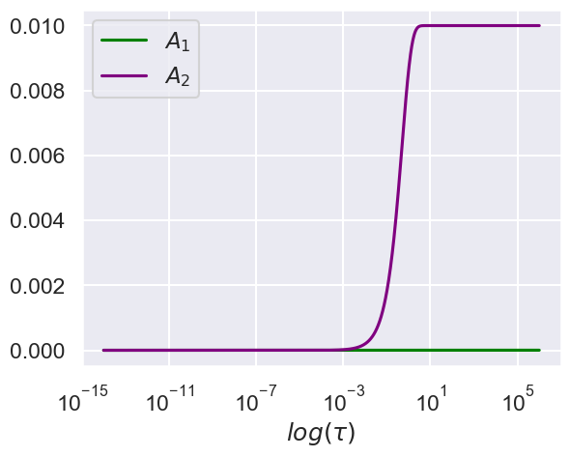
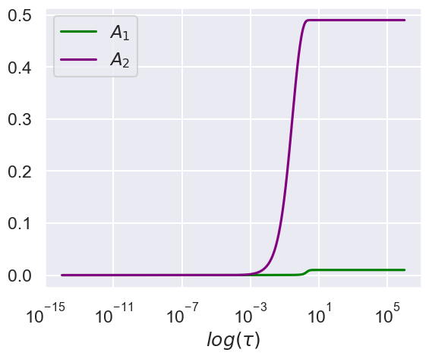
Model Dynamics
A2 dominates for small antibody to receptor due to availability of free receptor

Slide 15
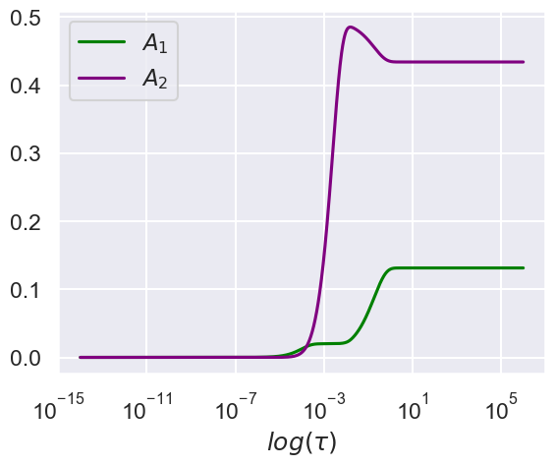
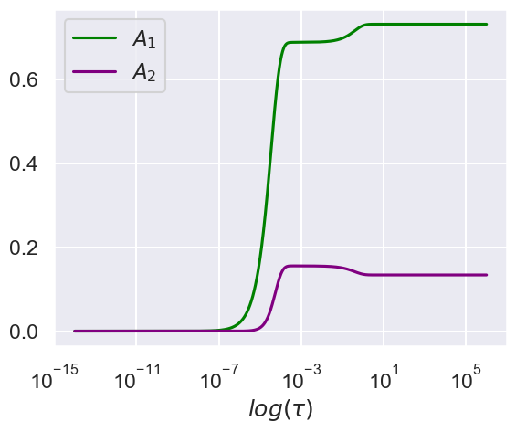
Higher antibody to receptor ratios show separation of timescales and interactions between A1 and A2 states

Slide 16

The Ratio of Antibody to Receptor Affects Binding States

Slide 17
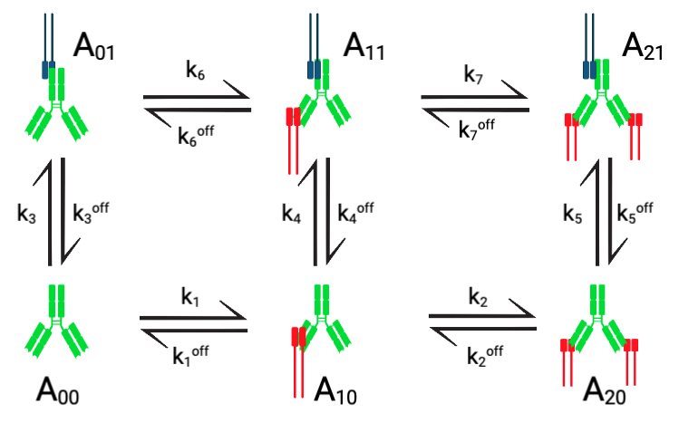
Synapse Model Schematic

Slide 18
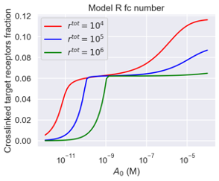
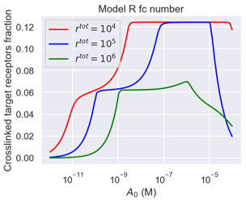
Synapse Model Shows Prozone Effect
No antibodies bound to effector cell
Antibodies bound to effector cell

Slide 19
Conclusions
Minimal difference between ways to model second binding event
Existence of two regimes that govern binding state
Low antibody vs receptor regime: model sensitive to receptor number
High antibody vs receptor regime: model sensitive to receptor number and binding parameters
Synapse model suggests that prozone effect is due to clogging of activating fc receptors on effector cell

Slide 20
Thank you for listening

