Slide 1
Project Update

Slide 2
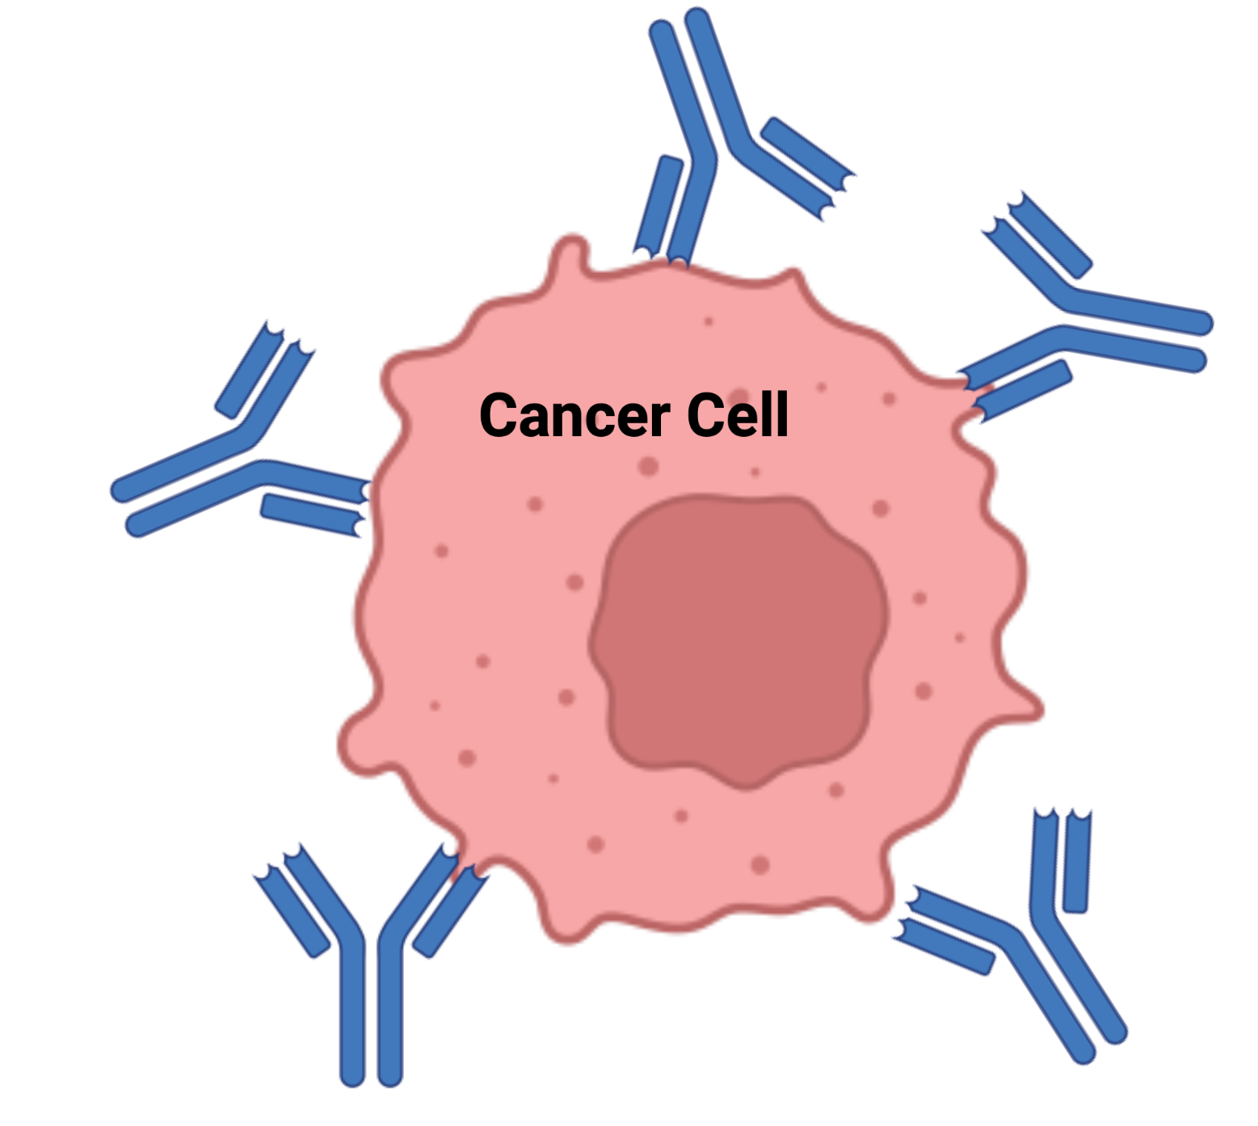
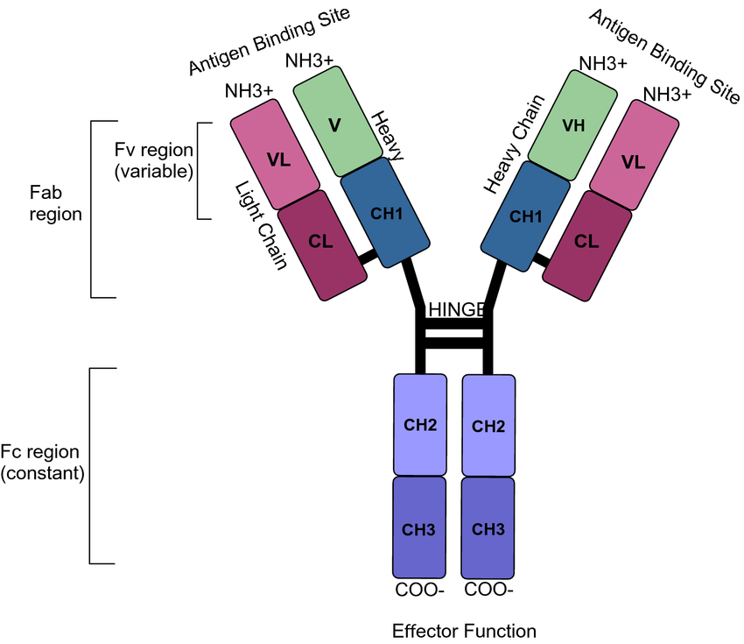
Why Monoclonal Antibodies (mAbs)?
Diseases
Cancer
Alzheimer’s disease
Autoimmune diseases
Varieties
Standard mab therapy
Radioimmunotherapy
ADCs
Checkpoint therapy

Slide 3
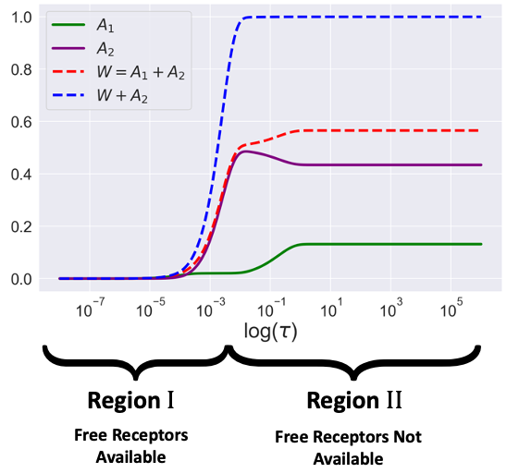
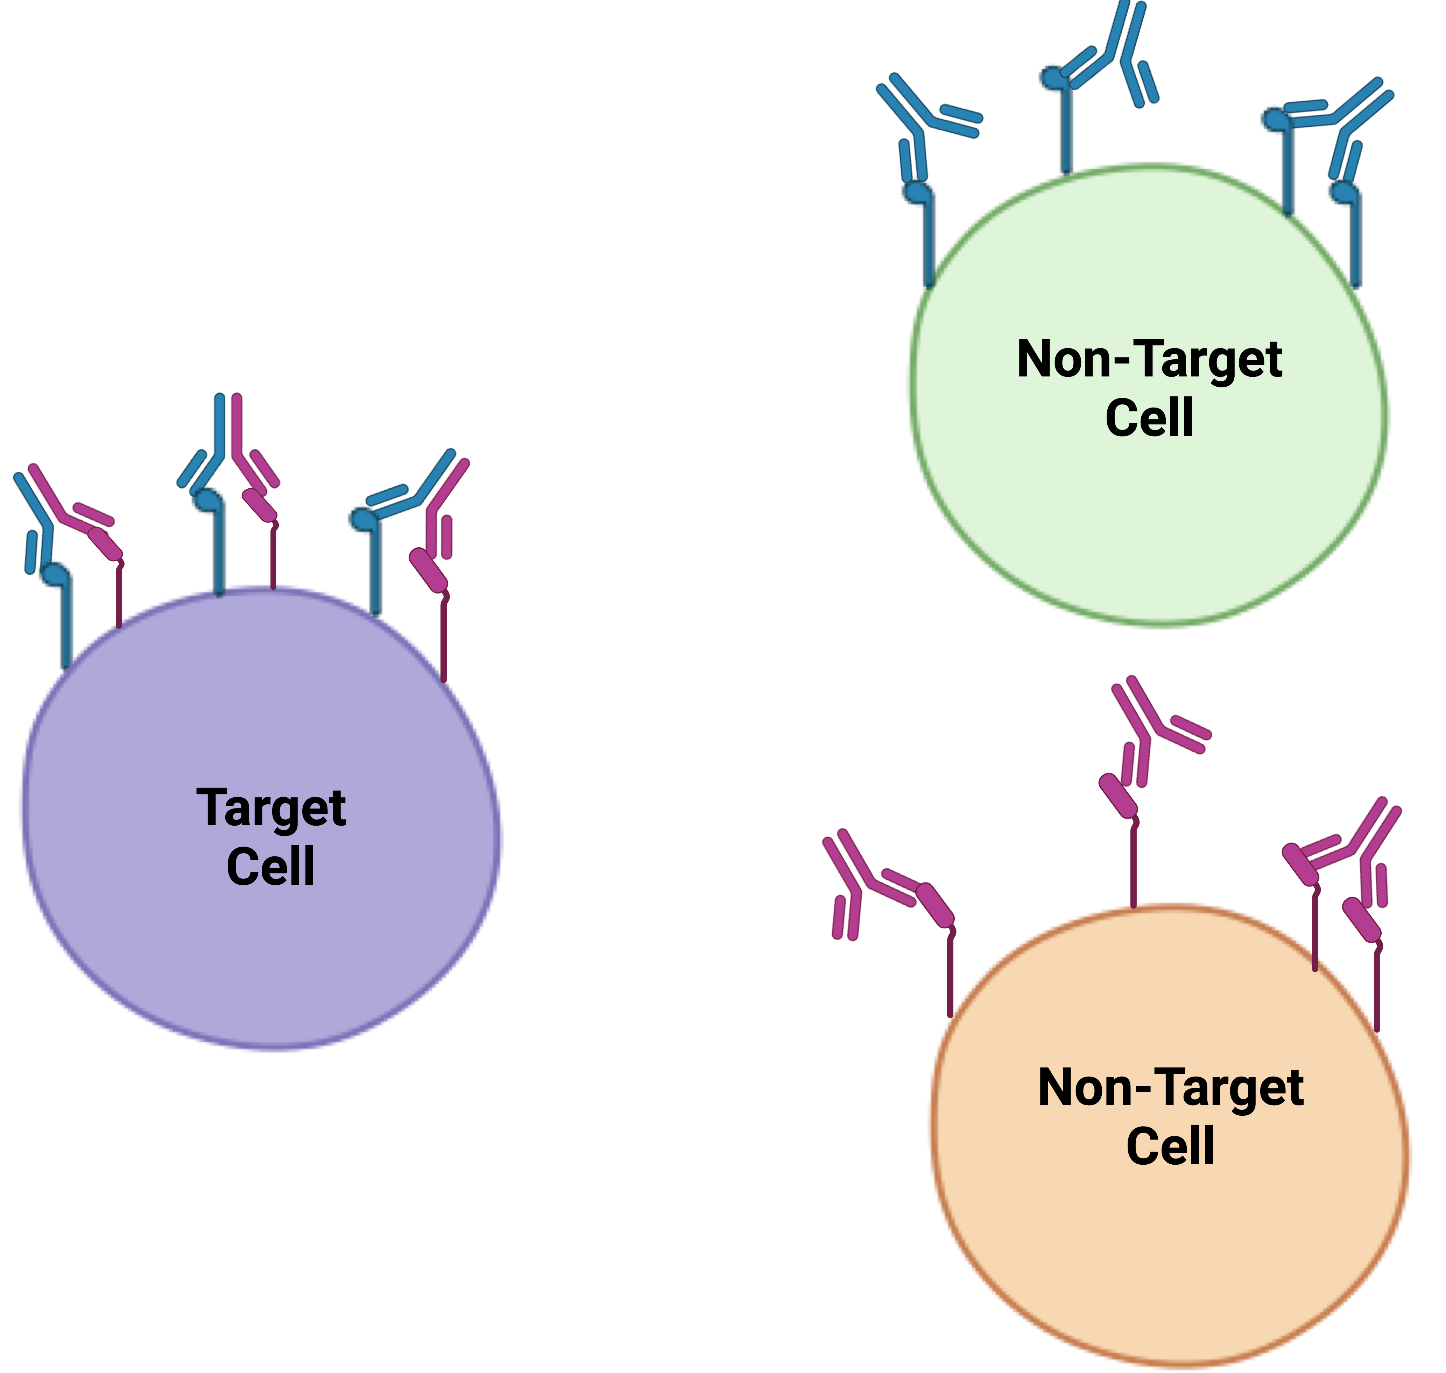
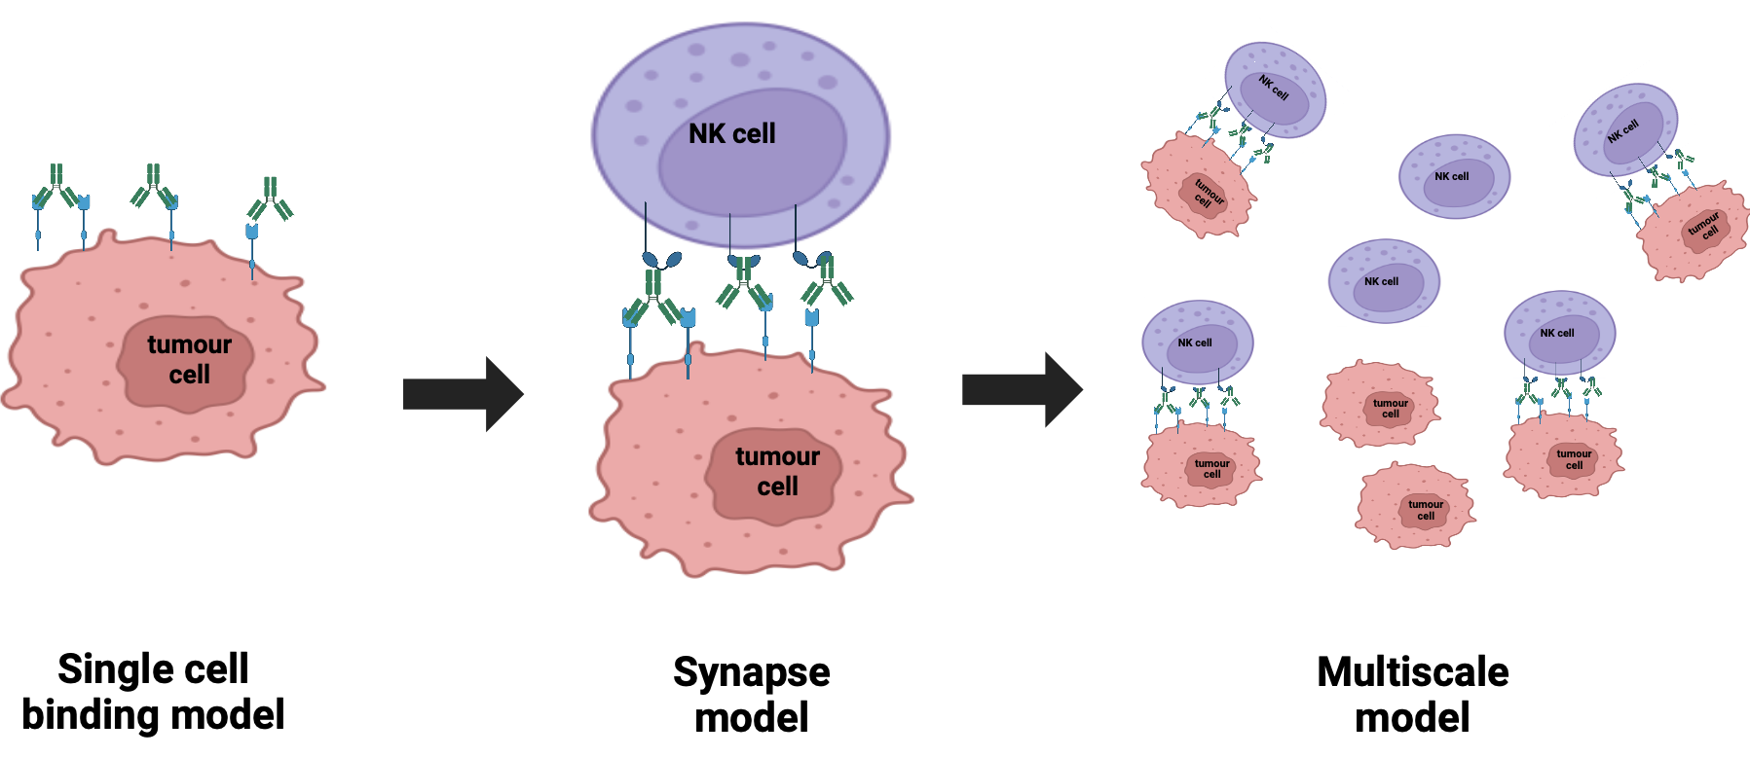

Slide 4
Bivalent Antibody Asymptotics
Monovalent case simple
Bivalent case common in biology with fast surface bound reaction
Antibody number ranges over many orders of magnitude
Can we use asymptotics to understand complex dynamics?
Asymptotics shows region 1 and region 2
Dissociation events driven by balancing of terms due to lack of free receptors

Slide 5
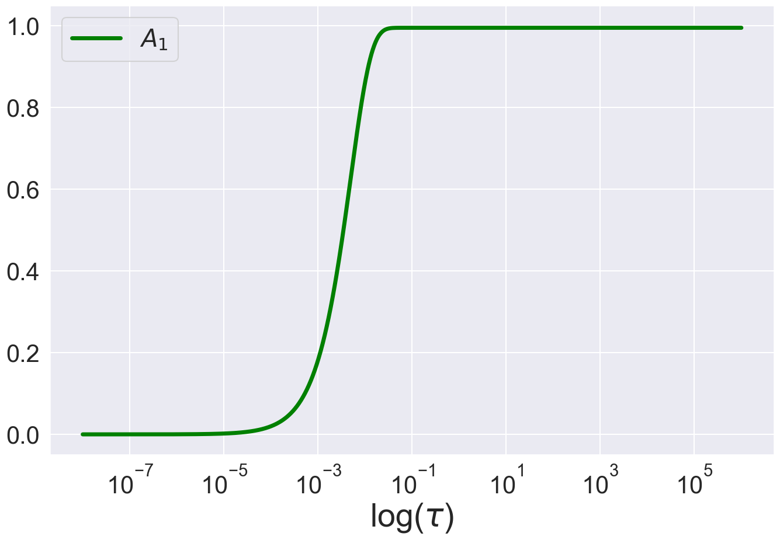

Slide 6
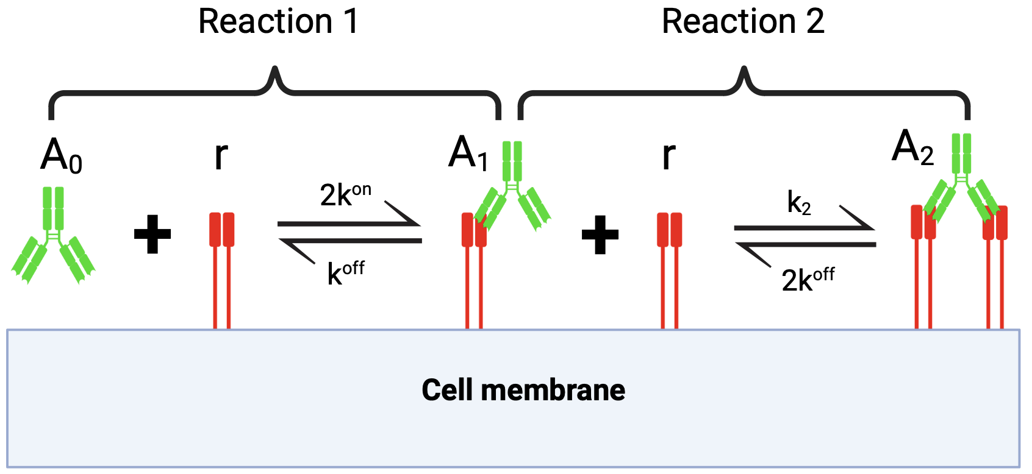

Slide 8
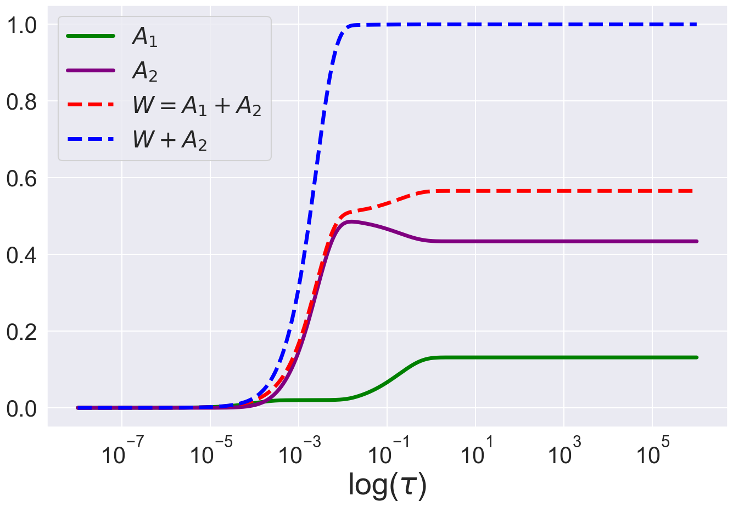

Slide 9
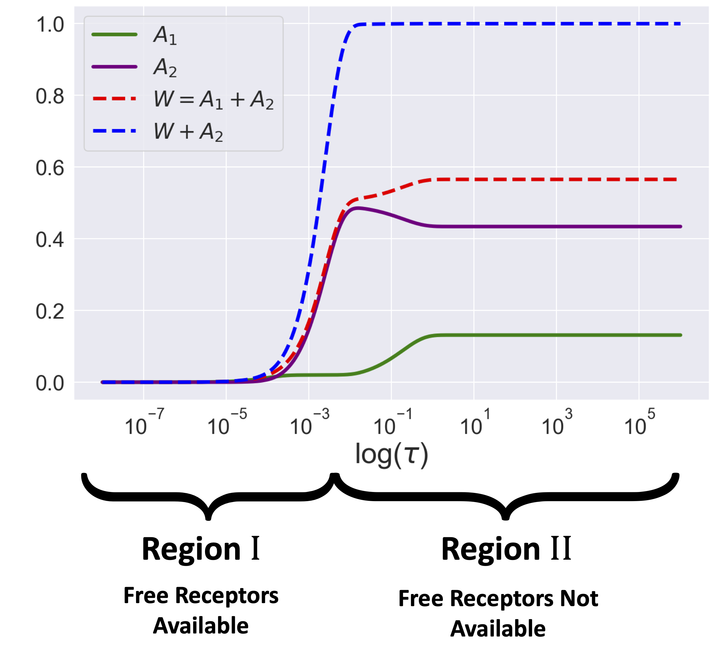

Slide 10
Modelling Bispecific Selectivity

Slide 11
General Synapse Model and Multiscale ADCC Model

