Slide 1
FLATS: Filling Logic and Testing Spatially for FPGA Tamper Detection and Authentication
Adam Duncan^{1,2}, Grant Skipper^{1,2}, Andrew Stern³, Adib Nahiyan³, Fahim Rahman³,
Andrew Lukefahr², Mark Tehranipoor³, Martin Swany²
NSWC Crane¹
Indiana University²
University of Florida³

Slide 2
Problem: Post-Synthesis Threats
Configuration Tamper Locations
IP
Synthesis
Place and Route
Generate Bitstream
Program FPGA
In Field
FPGA Lifecyle
Configuration Tampering: Modifying bitstream to change design functionality
Configuration Tampering Motivations: Malicious insertion (Hardware Trojan)
Profit (IP Piracy)

Slide 3
FPGA Configuration Tamper Security
Defenses:
Bitstream encryption – Key extraction
Xilinx FPGA | Introduced | Vulnerability
Virtex II | 2001 | [MBKP11]
Virtex 4 | 2005 | [MKP12]
Virtex 5 | 2006 | [MKP12]
6 series | 2009 | [MS16]
7 series | 2010 | [MS16]
UltraSCALE | 2014 | [LTKBS18]
Research community continues to publish FPGA encryption key extraction papers

Slide 4
FPGA Configuration Tamper Security
Defenses:
Bitstream encryption – Key extraction
Proprietary bitstream format - RE
Year | Author | Tool Name | Notable Feature
1999 | Guiccione |  | First known work
2002 | Raghavan | PARBITS
2002 | Horta | JPG
2006 | Ziener |  | Virtex II support
2008 | Note |  | Virtex 4/5 support
2010 | Lavin | Rapidsmith
2011 | Steiner | Torc
2012 | Benz | Bil
2013 | Ding
2017 | Pham | Bitman | API for 7-series+
2019 | Ender |  | RE + Trojan
Research community continues to publish bitstream reverse engineering papers

Slide 5
FPGA Configuration Tamper Security
Defenses:
Bitstream encryption – Key extraction
Proprietary bitstream format - RE
CRC – Disable
Runtime bitflip scrubbing – Disable
Detection:
JTAG verify – Spoofable
Runtime hashing – Bypass
We need additional FPGA configuration tamper detection techniques!

Slide 6
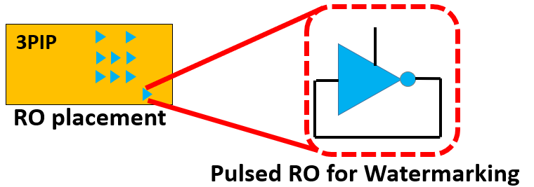
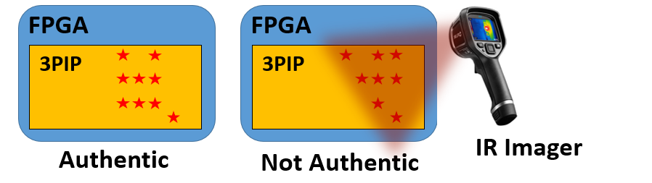
Our Idea: Out-of-Band Spatial Watermarking
IP
Integrate oscillators into a design to generate energy at design-specific spatial locations
Use infrared (IR) imaging to confirm spatial locations and detect bitstream tampering
IP
IP

Slide 7
FLATS: Filling Logic and Testing Spatially
Add Logic Controller
Compare with Expected
Authentic?
Y/N
Fill Unused Logic
Detect Spatially with IR
FLATS Insertion
FLATS Verification
Tamper Detected?
Y/N
Integrate Partial Oscillators in Design
Activate Partial Oscillators
Stimulate Logic Controller
Make Room for Partial Oscillators
IP
Synthesis
Place and Route
Generate Bitstream
Program FPGA
In Field
FLATS inserted to perform out-of-band authentication and tamper detection

Slide 8
FLATS Insertion Implementation
I1
O1
I1
O1
A
I2
O2
A
I2
O2
B
I3
B
I3
C
I4
C
I4
ECID
LUTA: O1 = open
O2 = I2 & I3 & I4
LUTA: O1 = 0
O2= I2 & I3 & I4
LFSR + Logic
Seed
User Input
I1
O1
I1
O1
Sequence
I2
O2
Z
I2
O2
Z
D
I3
D
I3
I4
‘1’
I4
ICAP
LUTB: O1 = open
O2 = I2 ^ I3
LUTB: O1 = 0
O2 = I2 ^ I3
Z = (A & B & C) ^ D
Original Post-Synthesis
Z = (A & B & C) ^ D
After FLATS

Slide 9
FLATS Insertion Implementation
I1
O1
I1
O1
A
I2
O2
A
I2
O2
0xA32F
B
I3
B
I3
C
I4
C
I4
ECID
LUTA: O1 = open
O2 = I2 & I3 & I4
LUTA: O1 = !I1 & I2 & I3 & I4
O2= I2 & I3 & I4
LFSR + Logic
Seed
User Input
I1
O1
I1
O1
Sequence
I2
O2
Z
I2
O2
Z
D
I3
0x92CD
D
I3
I4
‘1’
I4
ICAP
LUTB: O1 = open
O2 = I2 ^ I3
LUTB: O1 = 0
O2 = I2 ^ I3
Seq N = 0x104008
LUT = 0x1 (LUT A)
LUT Init = 0x0400
Freq Div = 0x8
Z = (A & B & C) ^ D
Original Post-Synthesis
Z = (A & B & C) ^ D
After FLATS

Slide 10
FLATS Insertion Implementation
I1
O1
I1
O1
A
I2
O2
A
I2
O2
0xA32F
B
I3
B
I3
C
I4
C
I4
ECID
LUTA: O1 = open
O2 = I2 & I3 & I4
LUTA: O1 = 0
O2= I2 & I3 & I4
LFSR + Logic
Seed
User Input
I1
O1
I1
O1
Sequence
I2
O2
Z
I2
O2
Z
D
I3
0x1D4F
D
I3
I4
‘1’
I4
ICAP
LUTB: O1 = open
O2 = I2 ^ I3
LUTB: O1 = !I1 & I2 & I3 & I4
O2 = I2 ^ I3
Seq N = 0x204008
LUT = 0x2 (LUT B)
LUT Init = 0x0400
Freq Div = 0x8
Z = (A & B & C) ^ D
Original Post-Synthesis
Z = (A & B & C) ^ D
After FLATS

Slide 11
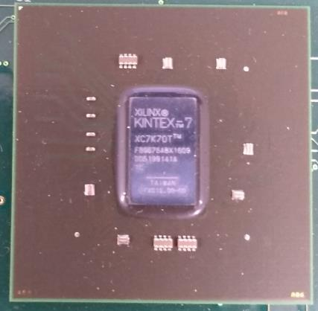
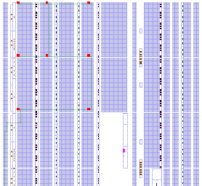
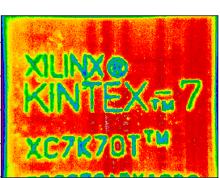
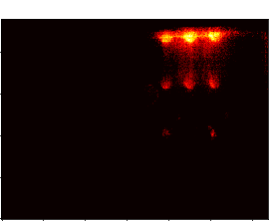
FLATS Verification Implementation
FPGA Die
P&R
4 Authenticators
IR Lock-In
Beacons and Authenticators
4 Beacons
FPGA Package
FPGA Design SW
IR Single Frame
IR after Lock-In
FLATS Insertion
FLATS Verification

Slide 12
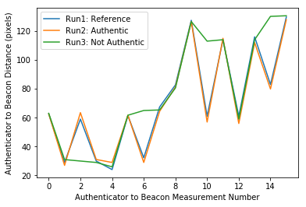
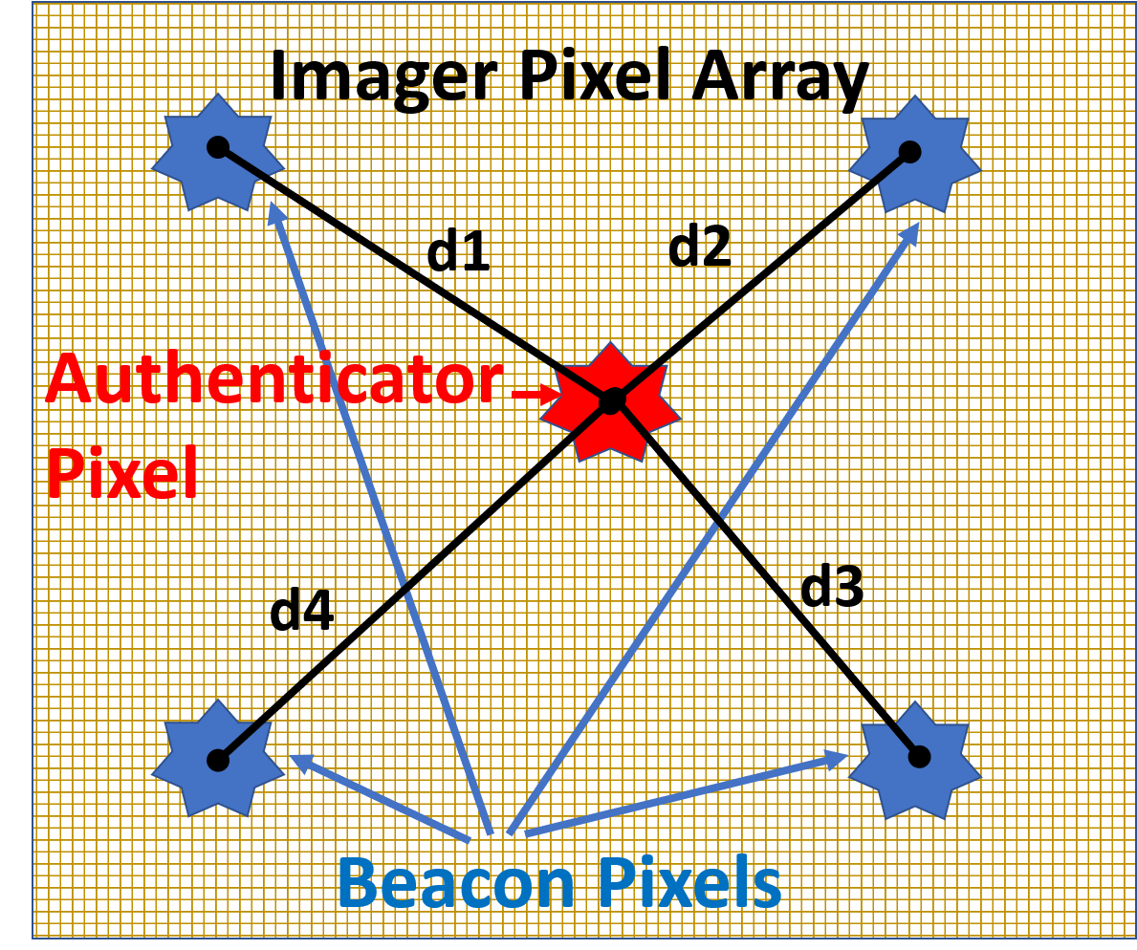
FLATS Authentication Example
Tampered
Authenticator
Beacons and Authenticators
ISCAS-85 c432 Experimental Results
ISCAS-85 Benchmark Circuits
< 12% area penalty
~ 15 µW per oscillator

Slide 13
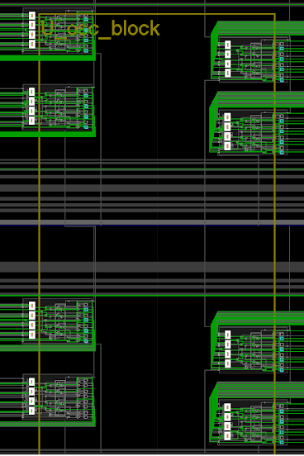
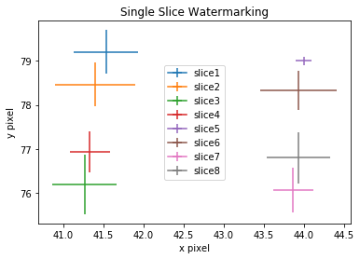
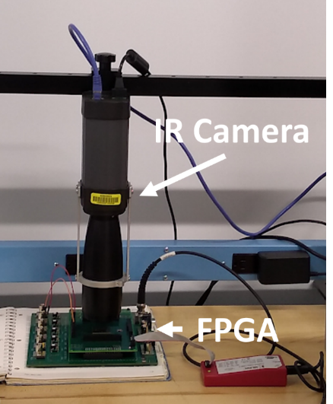
FLATS Resolution with COTS IR Imager
slice1
slice5
slice2
slice6
75 µm
FPGA
slice3
mirroring
slice7
IR Lock-In
Beacons and Authenticators
Prototype Setup
slice4
slice8
75 µm x 75 µm FPGA P&R
75 µm
IR Imaging
Single-LUT tamper detection possible using 25 µm x 25 µm COTS IR imager

Slide 14
FLATS Deployable Run-Time Extension
1Hz dT = 0.1C locations
FPGA Si Substrate
PCB

Slide 15

FLATS Deployable Run-Time Extension
Read Out IC
Substrate (Glass, Si, Flex material?)
1Hz, 0.1C
X,Y (SPI)
Response
FPGA Si Substrate
Ethernet MAC
PCB
Challenge

Slide 16
Conclusion
FPGA configuration tampering is an emerging threat to FPGA security
FLATS integrates oscillators into a user design for out-of-band spatial detection
FLATS detects configuration tampering and performs authentication

Slide 17
Backup

Slide 18
FPGA Reconfigurability vs. Security
FPGA: Field Programmable Gate Array
Benefits:
Reconfigurable
Short development times
Low NRE costs
Simplified design flows
Close to ASIC performance
Figure: IDA report, Examination of DoD’s Use of Microelectronics in Weapon Systems, 2013

