Slide 1
Composite Cores: Pushing Heterogeneity into a Core
Andrew Lukefahr, Shruti Padmanabha, Reetuparna Das, Faissal M. Sleiman, Ronald Dreslinski, Thomas F. Wenisch, and Scott Mahlke
University of Michigan
Micro 45
May 8th 2012

Slide 2
High Performance Cores
High energy yields high performance
Different phases can have very different performance on the same hardware
Performance
Energy
Low performance DOES NOT yield low energy
Time
High performance cores waste energy on low performance phases

Slide 3
Core Energy Comparison
Out-of-Order
In-Order
Dally, IEEE Computer’08
Brooks, ISCA’00
Do we always need the extra hardware?
Out-Of-Order contains performance enhancing hardware
Not necessary for correctness

Slide 4
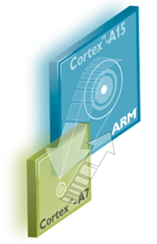
Previous Solution: Heterogeneous Multicore
2+ Cores
Same ISA, different implementations
High performance, but more energy
Energy efficient, but less performance
Share memory at high level
Share L2 cache ( Kumar ‘04)
Coherent L2 caches (ARM’s big.LITTLE)
Operating System (or programmer) maps application to smallest core that provides needed performance

Slide 5
Current System Limitations
Migration between cores incurs high overheads
20K cycles (ARM’s big.LITTLE)
Sample-based schedulers
Sample different cores performances and then decide whether to reassign the application
Assume stable performance with a phase
Phase must be long to be recognized and exploited
100M-500M instructions in length
Do finer grained phases exist?
Can we exploit them?

Slide 6
Performance Change in GCC
Huge performance changes within a quantum!
Average IPC over a 1M instruction window (Quantum)
Average IPC over 2K Quanta
Notes:
Define quantum

Slide 7
Finer Quantum
What if we could map these to a Little Core?
20K instruction window from GCC
Average IPC over 100 instruction quanta

Slide 8
Our Approach: Composite Cores
Hypothesis: Exploiting fine-grained phases allows more opportunities to run on a Little core
Problems
How to minimize switching overheads?
When to switch cores?
Questions
How fine-grained should we go?
How much energy can we save?

Slide 9
Problem I: State Transfer
10s of KB
iCache
Fetch
Fetch
iCache
State transfer costs can be very high:
~20K cycles (ARM’s big.LITTLE)
iTLB
iTLB
Branch Pred
<1 KB
Branch Pred
Decode
Decode
RAT
Rename
InO
Execute
Reg File
Reg File
O3
Execute
10s of KB
Limits switching to coarse granularity:
100M Instructions ( Kumar’04)
dTLB
dTLB
dCache
dCache

Slide 10
Creating a Composite Core
Only one uEngine active at a time
iCache
Fetch
Decode
O3 Execute
Big
uEngine
iTLB
RAT
Load/Store Queue
Branch Pred
Reg File
dTLB
iCache
Fetch
dCache
dTLB
iTLB
Controller
<1KB
dCache
Branch Pred
dCache
dTLB
iCache
Fetch
Little
uEngine
Decode
Reg File
Mem
iTLB
inO Execute
Branch Pred
Notes:
Define uEngine somewhere

Slide 11
Hardware Sharing Overheads
Big uEngine needs
High fetch width
Complex branch prediction
Multiple outstanding data cache misses
Little uEngine wants
Low fetch width
Simple branch prediction
Single outstanding data cache miss
Must build shared units for Big uEngine
over-provision for Little uEngine
Assume clock gating for inactive uEngine
Still has static leakage energy
Little pays ~8% energy overhead to use over provisioned fetch + caches

Slide 12
Problem II: When to Switch
Goal: Maximize time on the Little uEngine subject to maximum performance loss
User-Configurable
Traditional OS-based schedulers won’t work
Decisions to frequent
Needs to be made in hardware
Traditional sampling-based approaches won’t work
Performance not stable for long enough
Frequent switching just to sample wastes cycles

Slide 13

What uEngine to Pick
Run on Big
Run on Little
Run on Big
$${ΔCPI}_{Threshold}$$
Run on Little
Let user configure the target value
This value is hard to determine a priori, depends on application
Use a controller to learn appropriate value over time

Slide 14





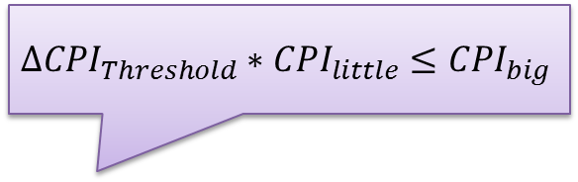




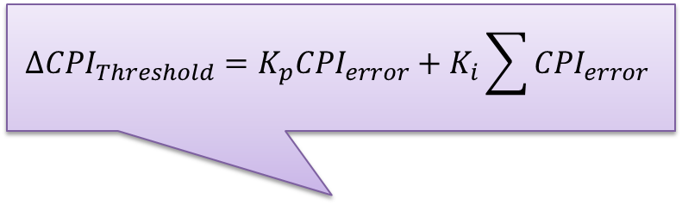


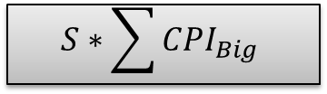
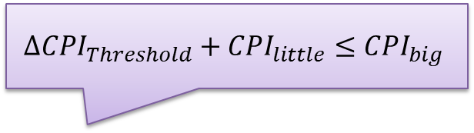
Reactive Online Controller
$${CPI}_{target}$$
$${CPI}_{big}$$
$$S∗\sum{{CPI}_{Big}}$$
$${CPI}_{big}$$
Big Model
$${CPI}_{little}$$
$${ΔCPI}_{Threshold}=K_{p}{CPI}_{error}+K_{i}\sum{{CPI}_{error}}$$
Little Model
User-Selected Performance
$${ΔCPI}_{Threshold}∗{CPI}_{little}≤{CPI}_{big}$$
$${CPI}_{little}$$
$${ΔCPI}_{Threshold}+{CPI}_{little}≤{CPI}_{big}$$
$${CPI}_{little}$$
$${CPI}_{error}$$
Threshold
Controller
$${CPI}_{big}$$
Switching Controller
True
Little uEngine
+
$${ΔCPI}_{Threshold}$$
Big uEngine
False
$${CPI}_{actual}$$
$$\sum{{CPI}_{Observed}}$$

Slide 15
uEngine Modeling
Little uEngine
IPC: 1.66
Collect Metrics of active uEngine
iL1, dL1 cache misses
L2 cache misses
Branch Mispredicts
ILP, MLP, CPI
while(flag){
foo();
flag = bar();
}
Use a linear model to estimate inactive uEngine’s performance
Big uEngine
IPC: ???
IPC: 2.15

Slide 16
Evaluation
Architectural Feature | Parameters
Big uEngine | 3 wide O3 @ 1.0GHz 12 stage pipeline 128 ROB Entries 128 entry register file
Little uEngine | 2 wide InOrder @ 1.0GHz 8 stage pipeline 32 entry register file
Memory System | 32 KB L1 i/d cache, 1 cycle access 1MB L2 cache, 15 cycle access 1GB Main Mem, 80 cycle access
Controller | 5% performance loss relative to all big core

Slide 17
Little Engine Utilization
Fine-Grained Quantum
Traditional OS-Based Quantum
3-Wide O3 (Big) vs. 2-Wide InOrder (Little)
5% performance loss relative to all Big
More time on little engine with same
performance loss

Slide 18
Engine Switches
~1 Switch / 306 Instructions
~1 Switch / 2800 Instructions
Need LOTS of switching to maximize utilization

Slide 19
Performance Loss
Composite Cores
( Quantum Length = 1000 )
Switching overheads negligible until ~1000 instructions

Slide 20
Fine-Grained vs. Coarse-Grained
Little uEngine’s average power 8% higher
Due to shared hardware structures
Fine-Grained can map 41% more instructions to the Little uEngine over Coarse-Grained.
Results in overall 27% decrease in average power over Coarse-Grained

Slide 21
Decision Techniques
Oracle
Knows both uEngine’s performance for all quantums
Perfect Past
Knows both uEngine’s past performance perfectly
Model
Knows only active uEngine’s past, models inactive uEngine using default weights
All models target 95% of the all Big uEngine’s performance

Slide 22
Little Engine Utilization
High utilization for memory bound application
Issue width dominates computation bound
Maps 25% of the dynamic instructions
onto the Little uEngine

Slide 23
Energy Savings
18% reduction in energy consumption
Includes the overhead of shared hardware structures

Slide 24
User-Configured Performance
20% performance loss yields 44% energy savings
1% performance loss yields 4% energy savings

Slide 25
More Details in the Paper
Estimated uEngine area overheads
uEngine model accuracy
Switching timing diagram
Hardware sharing overheads analysis

Slide 26
Conclusions
Questions?
Even high performance applications experience fine-grained phases of low throughput
Map those to a more efficient core
Composite Cores allows
Fine-grained migration between cores
Low overhead switching
18% energy savings by mapping 25% of the instructions to Little uEngine with a 5% performance loss

Slide 27
Composite Cores: Pushing Heterogeneity into a Core
Andrew Lukefahr, Shruti Padmanabha, Reetuparna Das, Faissal M. Sleiman, Ronald Dreslinski, Thomas F. Wenisch, and Scott Mahlke
University of Michigan
Micro 45
May 8th 2012

Slide 28
Back Up

Slide 29
The DVFS Question
Lower voltage is useful when:
L2 Miss (stalled on commit)
Little uArch is useful when:
Stalled on L2 Miss (stalled at issue)
Frequent branch mispredicts (shorter pipeline)
Dependent Computation
http://www.arm.com/files/downloads/big_LITTLE_Final_Final.pdf

Slide 30
Sharing Overheads

Slide 31
Performance
5% performance loss

Slide 32
Model Accuracy
Little -> Big
Big -> Little

Slide 33
Regression Coefficients

