Slide 1
Heterogeneous Microarchitectures Trump Voltage Scaling for Low-Power Cores
Andrew Lukefahr, Shruti Padmanabha, Reetuparna Das, Ronald Dreslinski Jr., Thomas F. Wenisch, and Scott Mahlke
University of Michigan
PACT’23
August 26th, 2014

Slide 2
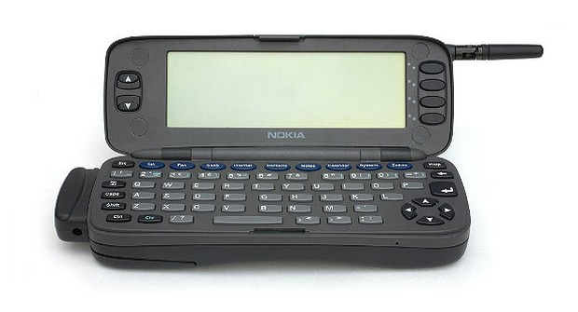

Low-Power Cores
1996
2013
Nokia 9000
Nexus 5
?
800 mAh battery
Intel 80386 @ 24MHz
2300 mAh battery
Krait 400 4x@2.3GHz
How do we get there?
HD video + Web surfing
All day battery?

Slide 3
The Big Picture
Study efficiency of heterogeneous architectures
Efficiency depends on the schedule
Factor out scheduling efficiency
Study architectural efficiency

Slide 4
Heterogeneity
Quanta
(Epochs)
Application
ILP
MLP
Floating
Point
Branch
Miss
Pointers
Core
ILP
Pointers
Decompose Core?

Slide 5
Heterogeneity
1000 MHz
250 MHz
OoO
Core
OoO
Core
Big Core
(OoO)
Ooo
Core
Ooo
Core
Pointers
Core
InO
Core
InO Core
Little Core
(InOrder)
Pointers
InO
Core
Pointers
InO Core
Single-ISA Heterogeneous Microarchitectures (HMs)
Migrate core microarchitecture (i.e. Big and Little) [Kumar’03]
Dynamic Voltage/Frequency Scaling (DVFS)
Change voltage/frequency points to improve efficiency [Horowitz’94]
More dimensions?

Slide 6
Quanta Size
Cache
Transfer
Off-Chip
Regulators
Big @ 1GHz
Big @ 750MHz
Little
Core
On-Chip
Regs
Shared
Caches
DVFS
HMs
Quantum
Coarse
Grained
20-70 uSec
[Mazouz’13]
15-25 uSec
[Greenhalgh’11]
10M Insts
Fine
Grained
10-20 nSec
[Kim’12]
10-30 nSec
[Padmanabha’13]
1K Insts

Slide 7
The Goal
DVFS
HMs
Coarse
Grained
?
Today’s
Cores
Future
Cores?
Yesterday’s
Cores
Fine
Grained
Future
Cores?
Future
Cores?
Future
Cores?
Which is most efficient?
DVFS vs. HMs
Coarse vs. Fine

Slide 8
Schedules
Quanta
(Epochs)
IPC
Performance
On Big Core
Performance
On Little Core
Time
Most efficient schedule?
Schedule:
Little
Big
Little
Big
Big
Little
Big

Slide 9
Pareto-Optimal Schedules
 | Quantum 1 |  | Quantum 2 |  | Quantum 3
 | Delay | Energy | Delay | Energy | Delay | Energy
Big Core | 10 ms | 50 mJ | 20 ms | 60 mJ | 30 ms | 60 mJ
Little Core | 20 ms | 20 mJ | 40 ms | 50 mJ | 35 ms | 40mJ
Schedule: Pick one core for each quantum
How efficient is this schedule?
Number | Schedule | Delay | Energy
1 | {B,B,B} | 60 ms | 170 mJ
2 | {B,B,L} | 65 ms | 150 mJ
3 | {B,L,B} | 80 ms | 160 mJ
4 | {B,L,L} | 85 ms | 140 mJ
5 | {L,B,B} | 70 ms | 140 mJ
6 | {L,B,L} | 75 ms | 120 mJ
7 | {L,L,B} | 90 ms | 130 mJ
8 | {L,L,L} | 95 ms | 110 mJ
{L,L,B} => ( 90 ms, 130 mJ )

Slide 10
Pareto-Optimal Schedules
Number | Schedule | Delay | Energy
1 | {B,B,B} | 60 ms | 170 mJ
2 | {B,B,L} | 65 ms | 150 mJ
3 | {B,L,B} | 80 ms | 160 mJ
4 | {B,L,L} | 85 ms | 140 mJ
5 | {L,B,B} | 70 ms | 140 mJ
6 | {L,B,L} | 75 ms | 120 mJ
7 | {L,L,B} | 90 ms | 130 mJ
8 | {L,L,L} | 95 ms | 110 mJ
1
3
2
Worse
5
4
7
Better
6
Number | Schedule | Delay | Energy
1 | {B,B,B} | 60 ms | 170 mJ
2 | {B,B,L} | 65 ms | 150 mJ
3 | {B,L,B} | 80 ms | 160 mJ
4 | {B,L,L} | 85 ms | 140 mJ
5 | {L,B,B} | 70 ms | 140 mJ
6 | {L,B,L} | 75 ms | 120 mJ
7 | {L,L,B} | 90 ms | 130 mJ
8 | {L,L,L} | 95 ms | 110 mJ
8
Pareto-optimal schedules determine best tradeoffs
Pareto-optimal schedules determine best tradeoffs for given architecture
Schedule efficiency effects
architectural efficiency
Some schedules just better
( #6 > #3 )

Slide 11
Schedule Efficiency
Lowest energy for given performance level
K Modes
x
N Quanta
Total Schedules: K^{N}
(12¹⁰⁰⁰⁰⁰⁰)
Find most efficient schedule
for given performance level

Slide 12
Regions
✗
Sum
Energy
Energy
Energy
Delay (0..m)
Delay (0..n)
Delay [m..n)
Merging regions requires
exponential complexity… ☹
Combine regions?
Can we break into regions?

Slide 13
Approximate Regions
Worst Energy & Delay
Sum
≤ΔE
Worst Case
Pareto Frontier
≤ΔD
Best Energy & Delay
Energy
Energy
Energy
Pareto-Optimal Region
Best Case
Pareto Frontier
Delay (0..m)
Delay [m..n)
Delay (0..n)
Limit region error to +/- 2.5%
Best energy/delay tradeoffs!
( with bounded error )

Slide 14
Evaluation - DVFS
DVFS
28nm node
Low-Power Fully Depleted Silicon-on-Oxide (FDSOI)
600MHz @ 0.6V
2000MHz @ 1.1V

Slide 15
Evaluation - HMs
HMs modeled off ARM’s big.LITTLE
Little (A7): 2-issue in-order core
Big (A15): 3-issue out-of-order core
Validation (Dhrystone):
System | Evaluation | Δ Performance | Δ Energy
Industry | Big.Little | 1.9x | 3.5x
Modeled | Gem5+Mcpat | 2.09x | 3.01x

Slide 16
Coarse-Grained Comparison
HMs provide better benefits
especially for smaller slowdowns
DVFS+HMs allows continued scaling
Normalized to highest performance core
Big @ 2GHz
100% slowdown = 2x runtime
Most efficient DVFS schedule for 50% slowdown
Pareto-optimal schedules result in
best possible tradeoffs
Lower DVFS levels are less efficient than HMs
DVFS+HMs provides minimal benefits

Slide 17
Fine-Grained Architecture
DVFS – On-chip voltage regulators
Neglect efficiency losses
HMs – Composite Cores architecture
Shared L1 caches, frontend
HMs incur ~7% power overheads
Leakage => clock-gating (not power-gating)
Dynamic => Over-provisioned hardware

Slide 18
Fine-Grained Comparison
Start with Coarse-Grained
~10% higher savings
HMs beats Coarse-Grained DVFS + HMs
until ~50% slowdown
DVFS + HMs provides benefits
but not additive
~5% savings for free
Fine-Grained DVFS ≈ Coarse-Grained DVFS

Slide 19
Benchmarks
DVFS+HMs has different benefits
Not always a clear winner
Energy savings for a 5% slowdown

Slide 20
Summary
5%
6%
Fine-Grained DVFS + HMs provide no benefits
for large slowdowns
Fine-Grained HMs provide most benefits
for small slowdowns

Slide 21
More Details in Paper
Assumptions of fine-grained architectures
Overheads analysis for HMs
Switching Overheads
Power Overheads
Detailed benchmark analysis

Slide 22
Conclusions
Questions?
DVFS
HMs
✗
✓
Coarse
Grained
✓
✗
✗
Fine
Grained
✓
DVFS + HMs best for large slowdowns
HMs trump DVFS for small slowdowns

Slide 23
Heterogeneous Microarchitectures Trump Voltage Scaling for Low-Power Cores
Andrew Lukefahr, Shruti Padmanabha, Reetuparna Das, Ronald Dreslinski Jr., Thomas F. Wenisch, and Scott Mahlke
University of Michigan
PACT’23
August 26th, 2014

Slide 24
Switching Overheads

Slide 25
Leakage Overheads

Slide 26
Benchmarks I
Hmmer
Xalancbmk
mcf

Slide 27
Benchmarks II
perlbench
omnetpp

Slide 28
Limitation: State Transfer
10s of KB
Fetch
iCache
Big
Pipeline
Little
Pipeline
iCache
State transfer costs can be very high:
~20K cycles (ARM’s big.LITTLE)
iTLB
iTLB
Branch Pred
<1 KB
Branch Pred
Decode
Reg File
Reg File
10s of KB
Limits switching to coarse granularity:
100M Instructions ( Kumar’04)
dTLB
dTLB
dCache
dCache

Slide 29
Creating a Composite Core
State transfer overheads:
20K to ~20 cycles
iCache
Fetch
Decode
O3 Execute
Big
uEngine
iTLB
RAT
Load/Store Queue
Branch Pred
Reg File
dTLB
Switching granularity:
100M to 1000 instructions
iCache
Fetch
dCache
dTLB
iTLB
Controller
<1KB
dCache
Branch Pred
dCache
Little pays ~8% energy overhead
dTLB
iCache
Fetch
Little
uEngine
Decode
Reg File
Mem
iTLB
inO Execute
Branch Pred
Notes:
Define uEngine somewhere

Slide 30

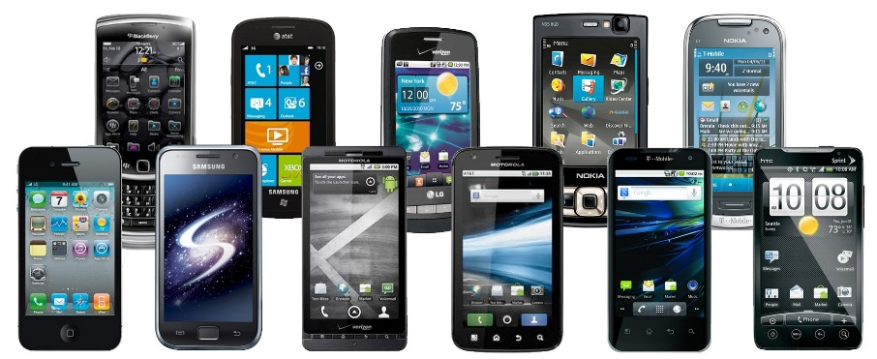

Low-Power Cores
Are everywhere…
1 Billion smartphones in 20141,2
[1] http://www.gartner.com/newsroom/id/2665715
[2] http://www.gartner.com/newsroom/id/2665715
http://www.dialaphone.co.uk/blog/2008/06/17/a-funny-look-back-at-some-old-cell-phones/
http://www.businesskorea.co.kr/article/1687/local-market-saturation-korea%E2%80%99s-smartphone-market-forecast-negative-growth-year

Slide 31
Cites
M. Horowitz, T. Indermaur, and R. Gonzalez, “Low-power digital design,” in IEEE Symp. Low Power Electron. (ISLPE’94) Digest of Tech. Papers, Oct. 1994, pp. 8–11.
Kumar, R., Farkas, K. I., Jouppi, N. P., Ranganathan, P., & Tullsen, D. M. (2003, December). Single-ISA heterogeneous multi-core architectures: The potential for processor power reduction. In Microarchitecture, 2003. MICRO-36. Proceedings. 36th Annual IEEE/ACM International Symposium on (pp. 81-92). IEEE.
[1] https://software.intel.com/sites/default/files/ftalat.pdf
[2] http://www.arm.com/files/downloads/big_LITTLE_Final_Final.pdf
[3] “A fully-integrated 3-level dc-dc converter for nanosecond-scale dvfs”
[4] “Composite cores: pushing heterogeneity within a core”

