Slide 1


Mirage Cores: The Illusion of Many Out-of-order Cores Using In-order Hardware
Shruti Padmanabha, Andrew Lukefahr*, Reetuparna Das, Scott Mahlke
Micro-50, Boston
Oct 18, 2017
University of Michigan
Electrical Engineering and Computer Science
*Now at Indiana University

Slide 2
General purpose computer architectures
System
throughput
Energy
efficiency
Single-thread
performance

Slide 3

Heterogeneous CMP architectures
OoO
System
throughput
Out-of-order Core
High performance
Dynamically reorders instructions
Large, complex, one-size fits all design
Low energy efficiency
Energy
efficiency
Single-thread
performance
CMP Area

Slide 4
Heterogeneous CMP architectures
OoO
InO
In-Order Core
Smaller, simplistic design
Low area
Low power
Issues instructions in program order
Low performance
System
throughput
Energy
efficiency
Single-thread
performance
Chip Area

Slide 5
Heterogeneous CMP architectures
OoO
InO
InO
System
throughput
InO
InO
OoO
InO
InO
Energy
efficiency
InO
InO
Single-thread
performance
Chip Area

Slide 6
Mirage Cores - Objective
Single-thread
performance
System
throughput
More InO cores
More cores
More OoO-like InO cores
Energy
efficiency

Slide 7
Background: DynaMOS “More OoO-like InO cores”
OoO
Program
Traces
Sched$
InO
Memoize!
OinO HW
70% of the traces have equivalent schedules for most of their lifetimes
OinO vs InO
Performance: 1.4X
Area: 1.2X
Energy: 1.4X
Notes:
More overhead details in the paper

Slide 8
Mirage Cores: Motivations
Memoization opportunities vary based on program/phase characteristics
InO cores can utilize memoized traces for phases of millions of instructions
OinO
OinO
OoO
OinO
OinO
Notes:
Bzip and astar

Slide 9
Mirage Cores: Concept
OoO
InO+OinO
InO+OinO
OoO+
Schedule producer
InO
InO
System
throughput
InO
InO
InO+OinO
InO+OinO
Energy
efficiency
OoO
InO+OinO
OoO
InO+OinO
InO+OinO
InO+OinO
InO+OinO
Single-thread
performance
Chip Area

Slide 10
Mirage Cores: Challenges
OoO
InO+OinO
InO+OinO
OoO+
Schedule producer
Efficiently time-share the OoO
Architecture
# OinOs per OoO
Minimize overheads
Effectively arbitrate between applications
Metrics?
Goals?
InO+OinO
InO+OinO
InO+OinO
InO+OinO
InO+OinO
InO+OinO
InO+OinO
Notes:
1. Benefits : we need to find a good

Slide 11
Mirage Cores: Architecture
OoO
Arbitrator
L1i$
Sched$
L1d$
To Shared L2
Interconnect
To Shared L2
L1i$
Sched$
L1d$
L1i$
Sched$
L1d$
L1i$
Sched$
L1d$
L1i$
Sched$
L1d$
…
InO+OinO
InO+OinO
InO+OinO
InO+OinO

Slide 12
Arbitration Between Applications
OoO Candidate
App0
Arbitrator
??
Execution
metrics
App0
App1
App2
App3
…
Time
1 Million cycles
Notes:
Note that we have 4 apps running, while the ooo is waiting for the next app to memoize for

Slide 13
Metrics for arbitration
Execution metric | Determines | Measure
Memoizability | Single-application speedup | ∆Sched$-MPKI

Slide 14
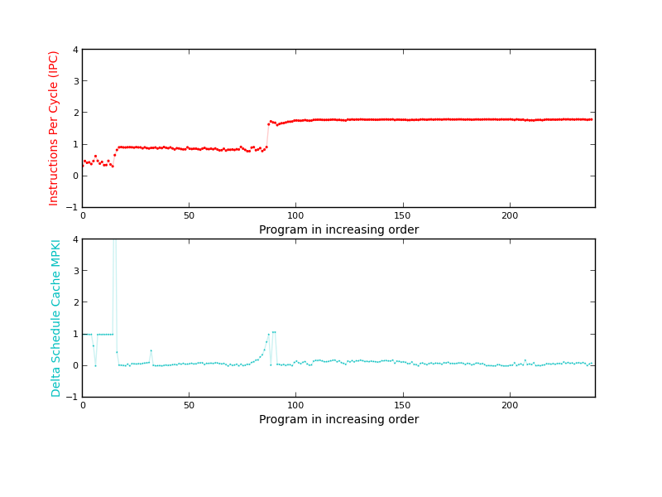
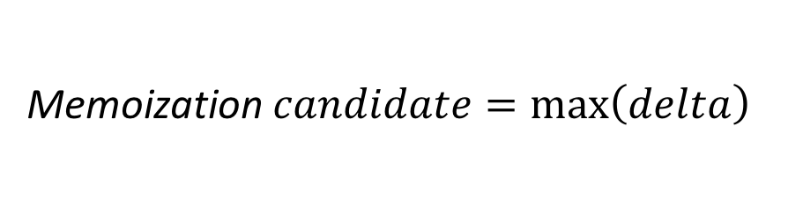

Memoizability - ∆Sched$-MPKI
.
Relationship between performance and Sched$-MPKI for bzip2
..
$$\frac{\text{S}\text{ched}\text{\$−}\text{MPKI}\text{InO} \text{− }\text{S}\text{ched}\text{\$−}\text{MPKI}\text{schedProduction}}{\text{S}\text{ched}\text{\$−}\text{MPKI}\text{schedProduction}}$$
delta =
IPC
Memoization $candidate=\max\left(delta\right)$
∆Sched$-MPKI
Program in increasing order of 1M cycle intervals

Slide 15
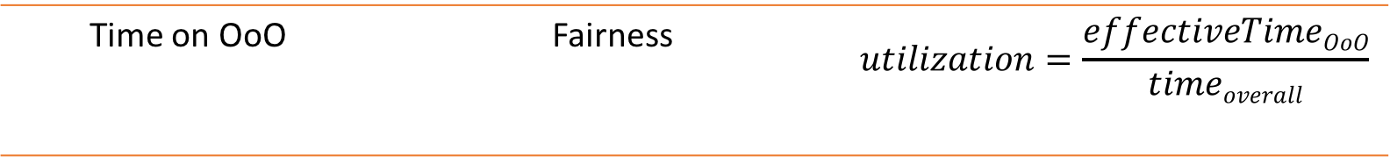
Metrics for arbitration
Execution metric | Determines | Measure
Memoizability | Single-application speedup | ∆Sched$-MPKI
Slowdown | System throughput | Slowdown = $\frac{\text{IPC}\text{InO}}{\text{IPC}\text{OoO}}$
Time on OoO | Fairness | $$utilization=\frac{effectiveTimeOoO}{timeoverall}$$

Slide 16


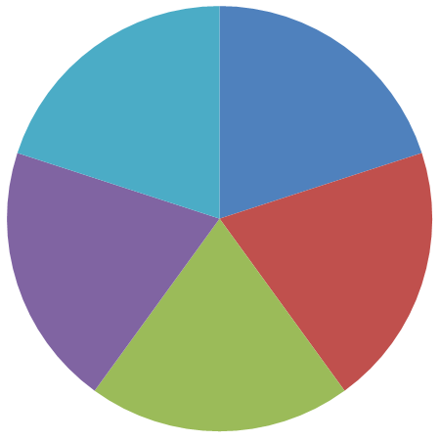
Goals for arbitration
OoO
Maximize energy efficiency
OoO
2. Maximize system throughput
Traditional Heterogeneous CMP
OoO
3. Guarantee fair/priority based resource allocation
Notes:
These can be combined

Slide 17
Evaluation Methodology
Architectural Feature | Parameters
OoO Core | 3 wide O3 @ 2GHz 12 stage pipeline 128 ROB Entries 128 entry PRF, 32 entry LSQ
InO Core | 3 wide InOrder @ 2GHz 8 stage pipeline 128 entry PRF, 32 entry LSQ
Memory System | 32 KB L1 i/d cache, 2 cycle access 8KB Schedule cache, 1 cycle access 1MB L2 cache, 15 cycle access 1GB Main Mem, 100 cycle access
Simulator | Gem5
Energy Model | McPAT

Slide 18
Evaluation
Experimental parameters | Parameters
Number of cores | n-InO + 1 OoO
Baseline | n-OoO
Workloads | Random mixes of n-benchmarks from spec2k6 Each run for a 1 billion instruction simpoint

Slide 19
Architectures for comparison
8:1 configuration
Traditional
Heterogeneous CMP
Mirage Core CMP
Homogeneous OoO
CMP
Homogeneous InO
CMP
OInO
OInO
OoO
OoO
InO
InO
InO
InO
InO
InO
OInO
OInO
InO
InO
OoO
OoO
OoO
(booster)
OoO +
Sched
Producer
InO
InO
OoO
OoO
InO
InO
InO
InO
OInO
OInO
InO
InO
OInO
OInO
OoO
OoO
Notes:
Overall it’s still lesser than ooo homo
But can it keep up with its perf
In our eval we compare against the following cmps

Slide 20
8 InOs with 1 OoO
App7
App0
App1
App6
App2
App5
App4
App3
Traditional Het-CMP
(no memoization)
Mirage Cores
54% energy savings over homogeneous OoO CMP with 16% STP loss
OR
24% STP gains over homogeneous InO CMP with 14% energy overhead
Homo-OoO
Homo-OoO
Homo-InO
Homo-InO
Notes:
Another way to think about it

Slide 21
Size of cluster
Traditional Het-CMP
(no memoization)
Mirage Cores
Homo-OoO
Homo-InO
Number of OinO cores per OoO
OoO is oversubscribed for n >=12

Slide 22
Conclusion
Reordered
schedules
System
throughput
OoO
InO+OinO
InO+OinO
OoO+
Schedule producer
InO+OinO
Energy
efficiency
InO+OinO
InO+OinO
InO+OinO
InO+OinO
Single-thread
performance
InO+OinO
InO+OinO
Achieve > 80% of a homogeneous OoO CMP with > 20% area and > 50% energy savings

Slide 23
Mirage Cores: The Illusion of Many Out-of-order Cores Using In-order Hardware
Questions?
Shruti Padmanabha, Andrew Lukefahr, Reetuparna Das, Scott Mahlke
Micro-50, Boston
Oct 18, 2017
University of Michigan
Electrical Engineering and Computer Science

