Slide 1
How to use this template.
Start most slides from Title Only (white, sand or black): a header, the logo and the page number. Build the rest with elements
Elements live on the last slide, the Element Library. Copy, paste, move, resize and recolour them freely
The slides after this one are examples of how common content looks in the new style. Duplicate and edit them, or rebuild from Title Only
Fonts: install Plus Jakarta Sans and Instrument Serif, then save once with File › Options › Save › Embed fonts › Embed all characters
One serif italic phrase per headline, set in Instrument Serif Italic
Colour jobs: sky = insight, forest = action, lime = outcome. Sand for cards and context
Logos and screenshots in photo spaces: Picture Format › Crop › Fit

Slide 2

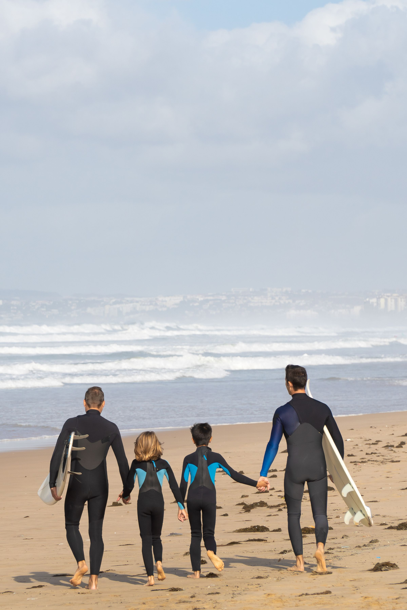

FY27 media recommendation.
x
Prepared for [Client] · October 2026

Slide 3

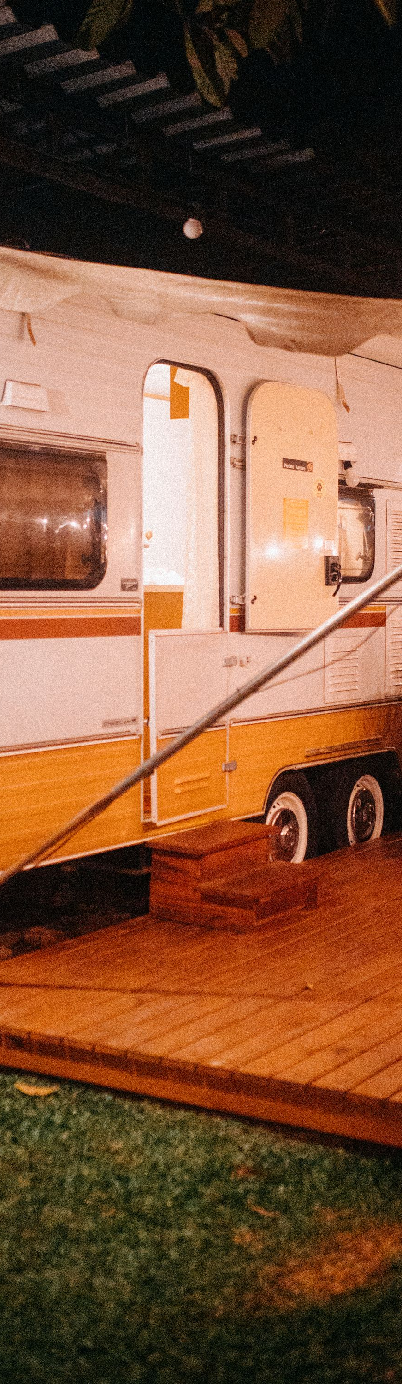

Quarterly review.
x
[Client] · Search, social and programmatic

Slide 4
What we will run through.
01
Decoding the task
02
Developing the strategy
03
Delivering real results
The plan for the next 12 months, and how we will measure it.
04
Measurement and reporting
05
Team and ways of working
06
Commercials and next steps

Slide 5
Decoding the task.
01

Slide 6
Developing the strategy.
02

Slide 7
All while tackling the perception problem: it is only for affluent buyers.
[Source]

Slide 8
We stress-tested this, and the data says the story is changing.
[Source or supporting line]

Slide 9
The brief, at a glance.
Objective
Audiences
Drive awareness and attendance
Avid fans and event seekers
[Target metric and date]
[Sizes or priorities]
Timing
Budget
1 Sep to 7 Dec
[$] including fees
[Key moments]
[Split or notes]

Slide 10
Where we are. Where we are going.
Today
In 12 months
Spend spread across nine channels
Reporting lags by four weeks
Creative refreshed twice a year
Five channels doing the heavy lifting
Live dashboard in AssembledView
Creative tested and rotated monthly

Slide 11
Three things set us apart.
Behaviour first
Built to act
Measured outcomes
We plan around why people buy, not only where they scroll.
Every insight comes with a clear action and an owner.
Results reported live in AssembledView, not in a monthly PDF.

Slide 12
Four services. One goal.
Search
Social
Programmatic
Data
Paid and organic search built on demand signals.
Paid social and creators that earn attention.
Video, display and audio bought on quality.
Measurement, dashboards and insight in AssembledView.

Slide 13
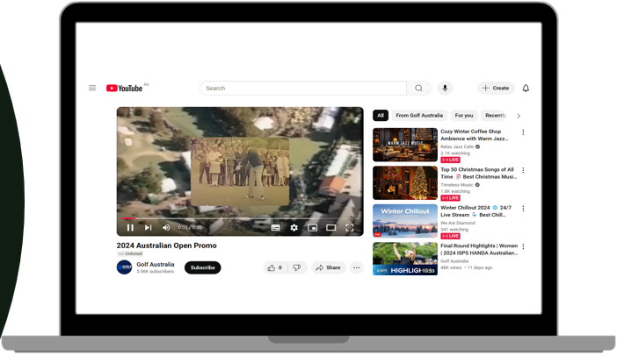
YouTube implementation.
YouTube
Awareness
Drive awareness with event seekers through a contextually aligned YouTube buy, placing skippable pre-rolls before event-aligned content.
Content
15s landscape, 6s vertical
Timing
October to November
Targeting
Event seekers
Format
Skippable pre-roll, Shorts
Budget
[$]
Delivery
[Views]

Slide 14
The value we secure.
+70%
+50%
$8m
Delivery in impressions
Delivery in inventory
Value delivered
Cuisine Pro
Strength Meals
Bowel Cancer Australia
Outcome

Slide 15





Introducing your team.
[Name]
[Name]
[Name]
[Name]
[Name]
Managing Director
Strategy Director
Head of Digital
Media Director
Data Lead
[Experience and what they look after]
[Experience and what they look after]
[Experience and what they look after]
[Experience and what they look after]
[Experience and what they look after]

Slide 16
Peak pet parents.
Cares more about giving their pet the best than about price. Researches ingredients and trusts proof.
71%
52%
46
Metro based
Skews female
Average age
Insight
Action
Premium is the default, not a splurge
High ingredient literacy
Wants proof, not promises
Social and creators
Online video
Retail media

Slide 17
Decode. Develop. Deliver. Optimise.
Decode
Develop
Deliver
Optimise
We understand your goals, audience and the why.
We create the behavioural plan.
We execute with precision and agility.
We adapt, learn and optimise in flight.

Slide 18
Cost per new customer fell every month.
Insight
62% of spend reached existing customers.
Action
Budget moved to in-market demand in March.
Outcome
Cost per new customer down 40% by June.
Example figures.

Slide 19
Next steps.
26 August
27 August
29 August
ASAP
Feedback on the media direction from [Client]
Revised plan and MBA from Assembled Media
Sign-off so we can source specs
Campaign live, reported in AssembledView
Let's get started

Slide 20
Not where to find them. Why they buy.
We decode the why behind consumer behaviour using ethnographic insight and psychographic profiling, then plan media around genuine demand drivers.

Slide 21
Built to change behaviour.
hello@assembledmedia.com.au
Level 1, 71 Palmerston Crescent, South Melbourne 3205
Level 2, 97 Rose St, Chippendale NSW 2008

Slide 22
Header only: build anything here

Slide 23
Header only: build anything here

Slide 24
Header only: build anything here

Slide 28
Element library.
Copy and paste. Every item is a normal shape you can move, resize or recolour.
PILLS
ARCHES
PHOTO IN ARCH
FOCUS RING
CIRCLES
CARDS
TAGS
JOURNEY LINE
ARCH TRIO
LINES
Insight
Action
Outcome
Label
BUTTONS
NUMBER DOTS AND ARROWS
Start a project
See our work
1
2
3
FLIGHT BAR

