Slide 13

Brad

Slide 30
Big agencies aren’t built for today’s speed, complexity,
or accountability.

Slide 61
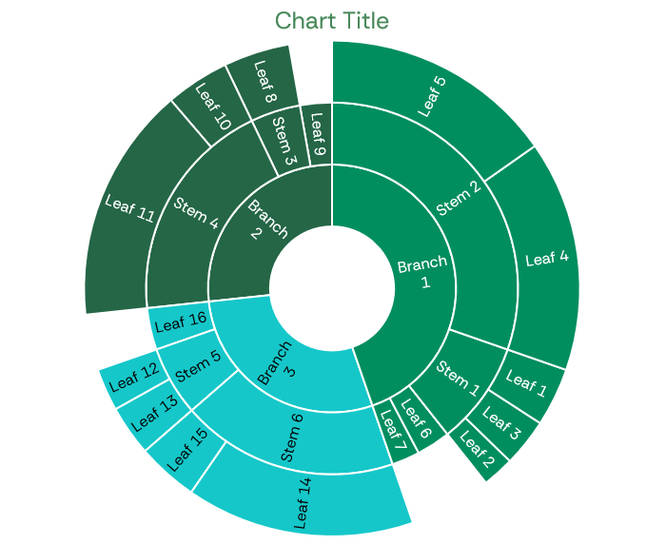

Slide 62
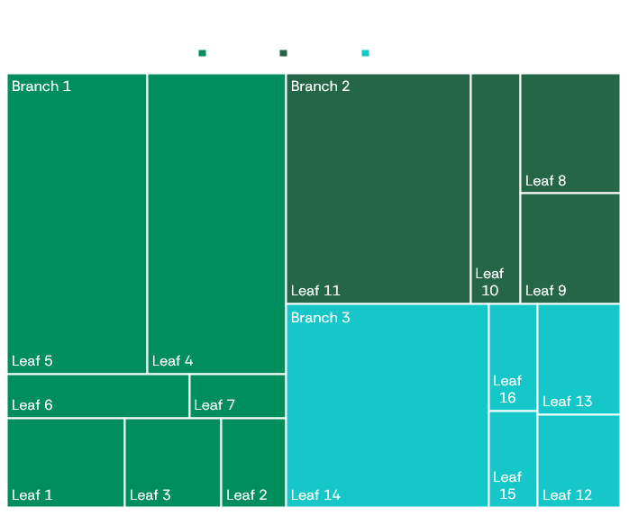

Slide 64
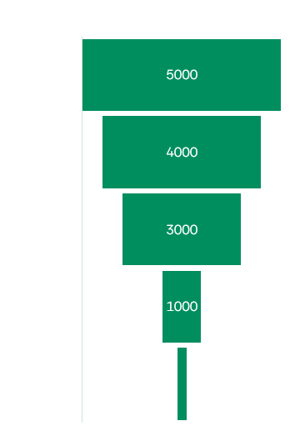
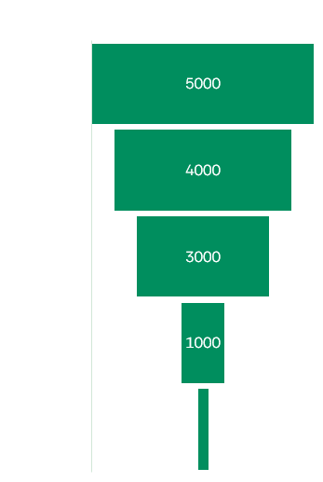

Slide 65
