Slide 1
The ICAT permissions and authorisation rules system
Tom Griffin, STFC ISIS Facility
NOBUGS 2012 ICAT Workshop
tom.griffin@stfc.ac.uk

Slide 2
Overview
Why rules
Data policy
Open tables
Administration and Data Ingestion
Facility staff
Experiment Team (Investigators)
Principal Investigator
Embargo

Slide 3
Why Rules
ICAT 3.3
Explicit authorisation table + triggers
>5,000,000 million entries for 150,000 investigations
Limited in scope – Investigation & Dataset
No mechanism for delegation
Hard to change when staff move
Addition of ‘Groups’
Default deny

Slide 4
Data Policy
http://www.isis.stfc.ac.uk/user-office/data-policy11204.html
tiny.cc/isisdp

Slide 5
Data Policy
Data Policy
ISIS data management policy
1. General principles
1.1 This data management policy pertains to the curation of and access to experimental raw data and metadata collected and / or stored at the ISIS facility.
1.2 Acceptance of this policy is a condition of the award of beamtime at ISIS.
1.3 Users must not attempt to access, exploit or distribute raw data or metadata unless they are entitled to do so under the terms of this policy.
1.4 Deliberate infringements of the policy may lead to denial of access to ISIS raw data or metadata.
2. Definitions
For the purposes of this policy:
2.1 ‘raw data’ are data collected from experiments performed on ISIS instruments. This definition includes data that are created automatically or manually by Facility-specific software and/or ISIS staff expertise in order to facilitate subsequent analysis of the experimental data, unless otherwise agreed.
2.2 ’metadata’ is information pertaining to data collected from experiments performed on ISIS instruments, including (but not limited to) the context of the experiment, the experimental team (in accordance with the Data Protection Act), experimental conditions and other logistical information.
2.3 the term ‘principal investigator’ (PI) pertains to the PI identified on the ISIS experiment proposal.
2.4 the term ‘experimental team’ includes the PI and any other person to whom the PI designates the right to access resultant raw data and associated metadata.
2.5 the term ‘on-line catalogue’ pertains to a computer database of metadata containing links to raw data files, that can be accessed by a variety of methods, including (but not limited to) www-based browsers.
2.6 the term ‘results’ pertains to data, intellectual property, and outcomes arising from the analysis of raw data.
2.7 the term ‘long-term’ means a minimum of ten years.
2.8. the term ‘public domain’ means belonging to the community at large, unprotected by copyright or patent and subject to appropriation by anyone.
3. Raw data and associated metadata
3.1 Free and commercial access to ISIS
3.1.1 All raw data and the associated metadata obtained as a result of free (non-commercial) access to ISIS, reside in the public domain, with ISIS acting as the custodian.
3.1.2 All raw data and the associated metadata obtained as a result of ‘commercial-in-confidence’ access to ISIS will be owned exclusively by the commercial user. Commercial users must agree with their relevant instruments scientists how they wish their raw data and metadata to be managed before the start of any experiment.
3.2 Curation of raw data and associated metadata
3.2.1 All raw data will be curated in well-defined formats, for which the means of reading the data will be made available by the Facility.
3.2.2 Metadata that is automatically captured by instruments will be curated either within the raw data files, within an associated on-line catalogue, or within both.
3.2.3 Data will be stored initially on instrument-related computers, and will be migrated or copied to archival facilities for long-term curation.
3.3 Access to raw data and metadata
3.3.1 Access to raw data and metadata beyond the period that it is stored on instrument-related computers will be via a searchable on-line catalogue.
3.3.2 Access to the on-line catalogue will be restricted to those who register with STFC/ISIS as users of the on-line catalogue.
3.3.3 Access to raw data and the associated metadata obtained from an experiment is restricted to the experimental team for a period of three years after the end of the experiment. Thereafter, it will become publicly accessible. Any PI that wishes their data to remain ‘restricted access’ for a longer period will be required to make a special case to the Director of ISIS.
3.3.4 It is the responsibility of the PI to ensure that the experiment number (RB number) is correctly entered into the metadata for each raw data set, in order to correctly associate each data set with the PI. If this is not done, the experimental team will not be able to access the data via the on-line catalogue and other users may inadvertently be given access rights to the data.
3.3.5 Appropriate STFC staff (e.g. instrument scientists, computing group members) may be given access to any Facility-curated data or metadata for Facility-related purposes. ISIS undertakes that they will preserve the confidentiality of such data.
3.3.6 The on-line catalogue will enable the linking of experimental data to experimental proposals. Access to proposals will only ever be provided to the experimental team and appropriate STFC staff, unless otherwise authorized by the PI.
4. Results
4.1 Ownership of results
4.1.1 Ownership of all results derived from the analysis of the raw data is determined by the contractual obligations of the person(s) performing the analysis.
4.2 Curation of results
4.2.1 ISIS will provide a facility for users to upload results and associated metadata to the facility and enable them to associate these results with raw data collected from the Facility.
4.2.2 The upload of results and metadata are subject to volume restrictions.
4.2.3 These results will be stored long-term by the Facility. It will not be the responsibility of the Facility to fully curate this data e.g. to ensure that software to read / manipulate this data is available.
4.3 Access to results
4.3.1 Access to the results of analyses performed on raw data and metadata is restricted to the person or persons performing the analyses, unless otherwise requested by those persons.
5. Good practice for metadata capture and results storage
5.1 The experimental team is encouraged to ensure that experimental metadata are as complete as possible, as this will enhance the possibilities for them to search for, retrieve and interpret their own data in the future.
5.2 ISIS undertakes to provide facilities for the capture of such metadata items that are not automatically captured by an instrument, in order to facilitate recording the fullest possible description of the raw data.
5.3 Researchers who aim to carry out analyses of raw data and metadata which are publicly accessible should, where possible, contact the original PI to inform them and suggest a collaboration if appropriate.
5.4 PIs and researchers who carry out analyses of raw data and metadata are encouraged to link the results of these analyses with the raw data / metadata using the facilities provided by the on-line catalogue. Furthermore, they are encouraged to make such results publicly accessible.
6. Publication information
6.1 References for publications related to experiments carried out at ISIS must be deposited in the STFC e-Pubs system http://epubs.cclrc.ac.uk/ within six months of the publication date, or during any new application for beamtime, whichever is the earlier.

Slide 6
Data Policy
3. Raw data and associated metadata
3.1 Free and commercial access to ISIS
3.1.1 All raw data and the associated metadata obtained as a result of free (non-commercial) access to ISIS, reside in the public domain, with ISIS acting as the custodian.
3.1.2 All raw data and the associated metadata obtained as a result of ‘commercial-in-confidence’ access to ISIS will be owned exclusively by the commercial user. Commercial users must agree with their relevant instruments scientists how they wish their raw data and metadata to be managed before the start of any experiment.
3.2 Curation of raw data and associated metadata
3.2.1 All raw data will be curated in well-defined formats, for which the means of reading the data will be made available by the Facility.
3.2.2 Metadata that is automatically captured by instruments will be curated either within the raw data files, within an associated on-line catalogue, or within both.
3.2.3 Data will be stored initially on instrument-related computers, and will be migrated or copied to archival facilities for long-term curation.
3.3 Access to raw data and metadata
3.3.1 Access to raw data and metadata beyond the period that it is stored on instrument-related computers will be via a searchable on-line catalogue.
3.3.2 Access to the on-line catalogue will be restricted to those who register with STFC/ISIS as users of the on-line catalogue.
3.3.3 Access to raw data and the associated metadata obtained from an experiment is restricted to the experimental team for a period of three years after the end of the experiment. Thereafter, it will become publicly accessible. Any PI that wishes their data to remain ‘restricted access’ for a longer period will be required to make a special case to the Director of ISIS.
3.3.4 It is the responsibility of the PI to ensure that the experiment number (RB number) is correctly entered into the metadata for each raw data set, in order to correctly associate each data set with the PI. If this is not done, the experimental team will not be able to access the data via the on-line catalogue and other users may inadvertently be given access rights to the data.
3.3.5 Appropriate STFC staff (e.g. instrument scientists, computing group members) may be given access to any Facility-curated data or metadata for Facility-related purposes. ISIS undertakes that they will preserve the confidentiality of such data.
3.3.6 The on-line catalogue will enable the linking of experimental data to experimental proposals. Access to proposals will only ever be provided to the experimental team and appropriate STFC staff, unless otherwise authorized by the PI.

Slide 7
Data Policy
4. Results
4.1 Ownership of results
4.1.1 Ownership of all results derived from the analysis of the raw data is determined by the contractual obligations of the person(s) performing the analysis.
4.2 Curation of results
4.2.1 ISIS will provide a facility for users to upload results and associated metadata to the facility and enable them to associate these results with raw data collected from the Facility.
4.2.2 The upload of results and metadata are subject to volume restrictions.
4.2.3 These results will be stored long-term by the Facility. It will not be the responsibility of the Facility to fully curate this data e.g. to ensure that software to read / manipulate this data is available.
4.3 Access to results
4.3.1 Access to the results of analyses performed on raw data and metadata is restricted to the person or persons performing the analyses, unless otherwise requested by those persons.

Slide 8
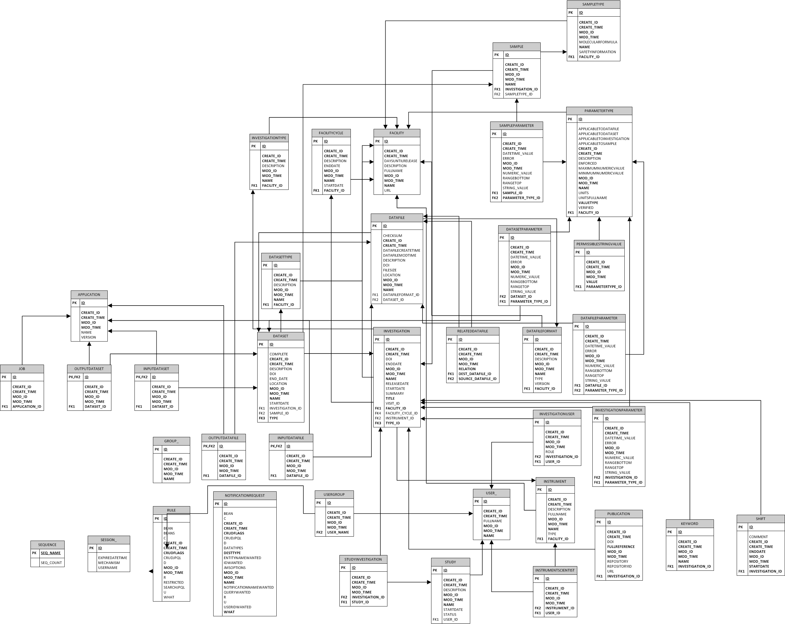

Slide 9
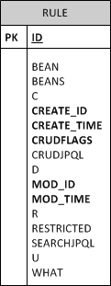
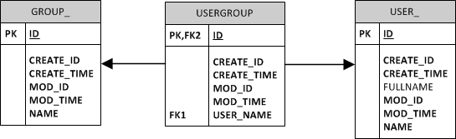
Special Tables
“root” group

Slide 10
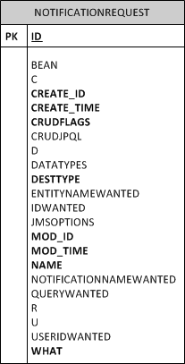
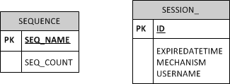
Very Special Tables

Slide 11
Rules Syntax
Group
CRUD Flags
‘What’
Rule myRule = new Rule();
myRule.group = facilityAdmins;
myRule.crudFlags = "CRUD";
myRule.what = “Facility”;

Slide 12
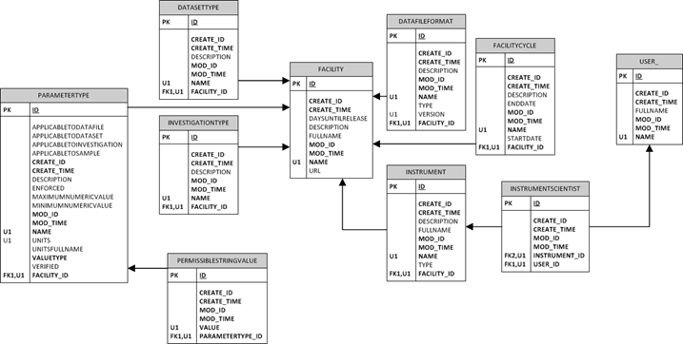
Open Tables
Allow any authenticated reader to read all values

Slide 13
Open Tables
Rule rule = new Rule();
rule.crudFlags = "R";
rule.what = table;
rule.setGroup(null);
port.create(sessionId, rule);

Slide 14
Open Tables
List<String> publicTables = new ArrayList<>();
publicTables.add("Application");
publicTables.add("DatafileFormat");
publicTables.add("DatasetType");
publicTables.add("Facility");
publicTables.add("FacilityCycle");
publicTables.add("Instrument");
publicTables.add("InstrumentScientist");
publicTables.add("InvestigationType");
publicTables.add("ParameterType");
publicTables.add("PermissibleStringValue");
publicTables.add("Publication");
publicTables.add("Shift");
for(String table : publicTables)
{
Rule rule = new Rule();
rule.crudFlags = "R";
rule.what = table;
rule.setGroup(null);
port.create(sessionId, rule);
}

Slide 15
Facility Admin Access
Group facilityAdmins = (Group)port.search(sessionId, "Group[name='FacilityAdmins']" ).get(0);
List<String> adminTables = new ArrayList<String>();
adminTables.add("Application");
adminTables.add("Datafile");
...
...
adminTables.add("DatafileFormat");
adminTables.add("User");
adminTables.add("UserGroup");
for(String table : adminTables)
{
Rule rule = new Rule();
rule.group = facilityAdmins;
rule.crudFlags = "CRUD";
rule.what = table;
port.create(sessionId, rule);
}

Slide 16
Data Ingest Account
Assume a group – “DataIngestors”
Very similar to admin rules – just no delete
Application
Datafile
DatafileFormat
DatafileParameter
Dataset
DatasetParameter
DatasetType
InputDatafile
InputDataset
Investigation
InvestigationParameter
InvestigationUser
Job
Keyword
ParameterType
Publication
RelatedDatafile
Sample
SampleParameter
SampleType
Study
StudyInvestigation
User

Slide 17
Data Ingest Account
Group dataIngestors = (Group)port.search(sessionId, "Group[name='DataIngestors']" ).get(0);
List<String> ingestorTables = new ArrayList<String>();
ingestorTables.add("Application");
...
...
ingestorTables.add("User");
for(String table : ingestorTables)
{
Rule rule = new Rule();
rule.group = dataIngestors;
rule.crudFlags = "CRU"; //no delete permission for ingestors
rule.what = table;
port.create(sessionId, rule);
}

Slide 18
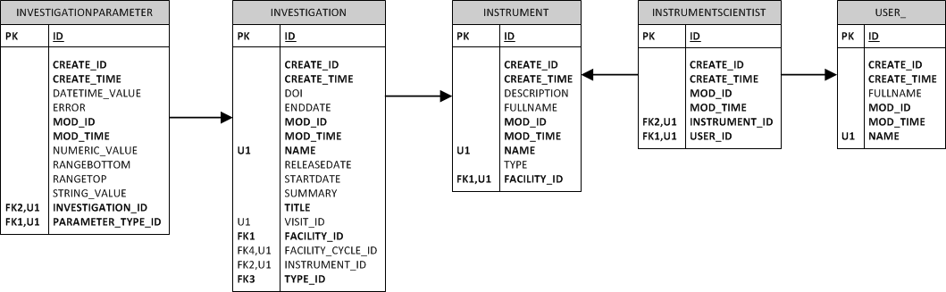
Instrument Scientists
Rule isInv = new Rule();
isInv.crudFlags = "CRU";
isInv.what = "Investigation <-> Instrument <-> InstrumentScientist <-> User [name = :user]";
isInv.group = null; //rules applies regardless of group membership (not explicitly needed)
port.create(sessionId, isInv);
Rule isInvParam = new Rule();
isInvParam.crudFlags = "CRU";
isInvParam.what = "InvestigationParameter <-> Investigation <-> Instrument <-> InstrumentScientist <-> User [name = :user]";
port.create(sessionId, isInvParam);

Slide 19
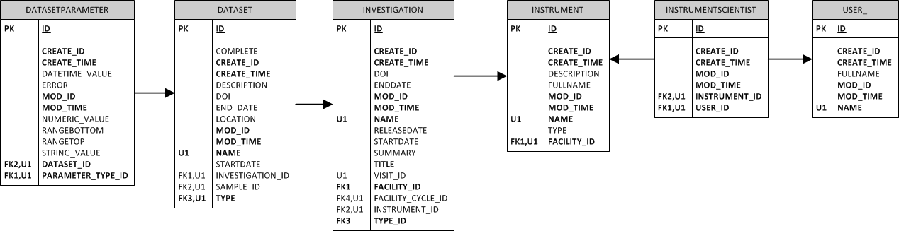
Instrument Scientists
Rule isDs = new Rule();
isDsParam.crudFlags = "CRU";
isDsParam.what = "DatasetParameter <-> Dataset <-> Investigation <-> Instrument <-> InstrumentScientist <-> User [name = :user]";
port.create(sessionId, isDsParam);
Rule isDsParam = new Rule();
isDsParam.crudFlags = "CRU";
isDsParam.what = "DatasetParameter <-> Dataset <-> Investigation <-> Instrument <-> InstrumentScientist <-> User [name = :user]";
port.create(sessionId, isDsParam);

Slide 20
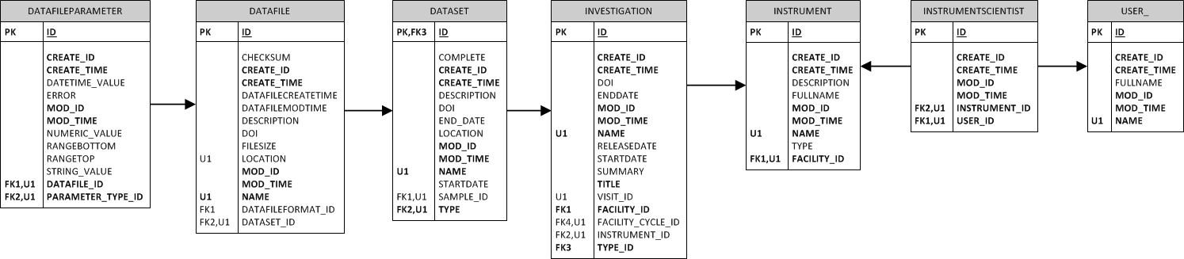
Instrument Scientists
Rule isDf = new Rule();
isDf.crudFlags = "CRU";
isDf.what = "Datafile <-> Dataset <-> Investigation <-> Instrument <-> InstrumentScientist <-> User [name = :user]";
port.create(sessionId, isDf);
Rule isDfParam = new Rule();
isDfParam.crudFlags = "CRU";
isDfParam.what = "DatafileParameter <-> Datafile <-> Dataset <-> Investigation <-> Instrument <-> InstrumentScientist <-> User [name = :user]";
port.create(sessionId, isDfParam);

Slide 21
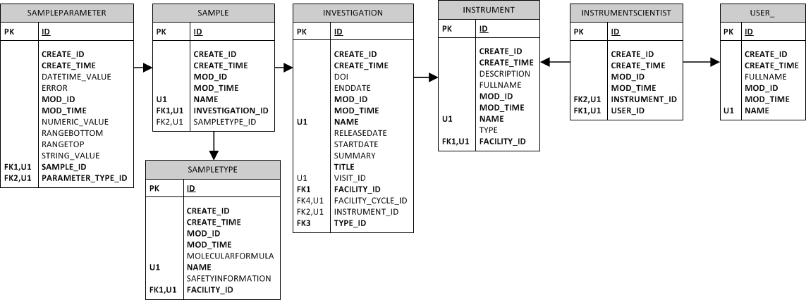
Instrument Scientists
Rule isSampleInv = new Rule();
isSampleInv.crudFlags = "CRU";
isSampleInv.what = "SampleType <-> Sample <-> Investigation <-> Instrument <-> InstrumentScientist <-> User [name = :user]";
port.create(sessionId, isSampleInv);
Rule isSampleParamInv = new Rule();
isSampleParamInv.crudFlags = "CRU";
isSampleParamInv.what = "SampleParameter <-> Sample <-> Investigation <-> Instrument <-> InstrumentScientist <-> User [name = :user]";
port.create(sessionId, isSampleParamInv);

Slide 22
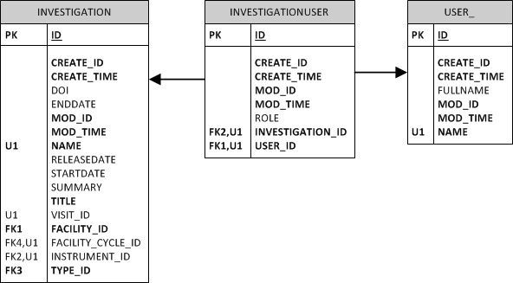
Experiment Team
Rule coiInv = new Rule();
coiInv.crudFlags = "R";
coiInv.what = "Investigation <-> InvestigationUser <-> User [name = :user]";
port.create(sessionId, coiInv);
Rule coiInvParam = new Rule();
coiInvParam.crudFlags = "R";
coiInvParam.what = "InvestigationParameter <-> Investigation <-> InvestigationUser
<-> User [name = :user]";
port.create(sessionId, coiInvParam);

Slide 23
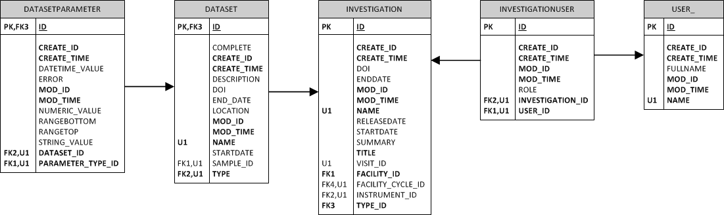
Experiment Team
Rule coiDs = new Rule();
coiDs.crudFlags = "R";
coiDs.what = "Dataset <-> Investigation <-> InvestigationUser <-> User [name = :user]";
port.create(sessionId, coiDs);
Rule coiDsParam = new Rule();
coiDsParam.crudFlags = "R";
coiDsParam.what = "DatasetParameter <-> Dataset <-> Investigation <-> InvestigationUser
<-> User [name = :user]";
port.create(sessionId, coiDsParam);

Slide 24
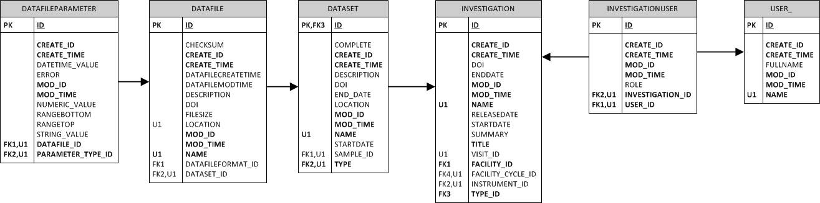
Experiment Team
Rule coiDf = new Rule();
coiDf.crudFlags = "R";
coiDf.what = "Datafile <-> Dataset <-> Investigation <-> InvestigationUser <-> User [name = :user]";
port.create(sessionId, coiDf);
Rule coiDfParam = new Rule();
coiDfParam.crudFlags = "R";
coiDfParam.what = "DatafileParameter <-> Datafile <-> Dataset <-> Investigation
<-> InvestigationUser <-> User [name = :user]";
port.create(sessionId, coiDfParam);

Slide 25
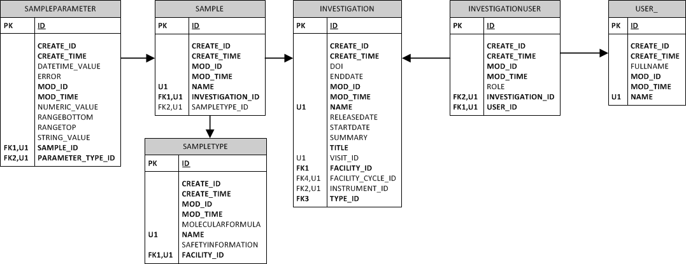
Experiment Team
Rule coiSampleInv = new Rule();
coiSampleInv.crudFlags = "R";
coiSampleInv.what = "Sample <-> Investigation <-> InvestigationUser <-> User [name = :user]";
port.create(sessionId, coiSampleInv);
Rule coiSampleParamInv = new Rule();
coiSampleParamInv.crudFlags = "R";
coiSampleParamInv.what = "SampleParameter <-> Sample <-> Investigation <-> InvestigationUser
<-> User [name = :user]";
port.create(sessionId, coiSampleParamInv);

Slide 26
Principal Investigator
Rule coiInv = new Rule();
coiInv.crudFlags = "R";
coiInv.what = "Investigation <-> InvestigationUser [role = 'Principal Investigator']
<-> User [name = :user]";
port.create(sessionId, coiInv);
Rule coiInvParam = new Rule();
coiInvParam.crudFlags = "R";
coiInvParam.what = "InvestigationParameter <-> Investigation <-> InvestigationUser [role = 'Principal Investigator']
<-> User [name = :user]";
port.create(sessionId, coiInvParam);

Slide 27
Principal Investigator
Rule coiDs = new Rule();
coiDs.crudFlags = "R";
coiDs.what = "Dataset <-> Investigation <-> InvestigationUser [role = 'Principal Investigator']
<-> User [name = :user]";
port.create(sessionId, coiDs);
Rule coiDsParam = new Rule();
coiDsParam.crudFlags = "R";
coiDsParam.what = "DatasetParameter <-> Dataset <-> Investigation
<-> InvestigationUser [role = 'Principal Investigator'] <-> User [name = :user]";
port.create(sessionId, coiDsParam);

Slide 28
Principal Investigator
Rule coiDf = new Rule();
coiDf.crudFlags = "R";
coiDf.what = "Datafile <-> Dataset <-> Investigation
<-> InvestigationUser [role = 'Principal Investigator'] <-> User [name = :user]";
port.create(sessionId, coiDf);
Rule coiDfParam = new Rule();
coiDfParam.crudFlags = "R";
coiDfParam.what = "DatafileParameter <-> Datafile <-> Dataset <-> Investigation
<-> InvestigationUser [role = 'Principal Investigator'] <-> User [name = :user]";
port.create(sessionId, coiDfParam);

Slide 29
Principal Investigator
Rule coiSampleInv = new Rule();
coiSampleInv.crudFlags = "R";
coiSampleInv.what = "Sample <-> Investigation <-> InvestigationUser [role = 'Principal Investigator']
<-> User [name = :user]";
port.create(sessionId, coiSampleInv);
Rule coiSampleParamInv = new Rule();
coiSampleParamInv.crudFlags = "R";
coiSampleParamInv.what = "SampleParameter <-> Sample <-> Investigation
<-> InvestigationUser [role = 'Principal Investigator'] <-> User [name = :user]";
port.create(sessionId, coiSampleParamInv);

Slide 30
Delegating Permission
Allow a data owner to grant other users access to their data
4.3.1 Access to the results of analyses performed on raw data and metadata is restricted to the person or persons performing the analyses, unless otherwise requested by those persons.

Slide 31
Delegating Permission
Not currently possible with a single rule
Create a group and a rule per investigation
rule.setCrudFlags("CRUD");
rule.setGroup(oneControllers);
rule.setWhat("InvestigationUser <->
Investigation [name = 'InvestigationOne']");
Scalable?

Slide 32
Embargo
rule.setCrudFlags("R");
rule.setWhat("Investigation [InvestigationType IN (‘calibration’, ‘commissioning’);
rule.setCrudFlags("R");
rule.setWhat(“Dataset <->
Investigation [InvestigationType IN (‘calibration’, ‘commissioning’);
rule.setCrudFlags("R");
rule.setWhat(“DataFile <-> Dataset <->
Investigation [InvestigationType IN (‘calibration’, ‘commissioning’);
+ parameters x3 + samples

Slide 33
Embargo
rule.setCrudFlags("R");
rule.setWhat("Investigation [enddate + Facility.daysuntilrelease] < Now ");
AND InvestigationType <> ‘commercial’");
3.3.3 Access to raw data and the associated metadata obtained from an experiment is restricted to the experimental team for a period of three years after the end of the experiment. Thereafter, it will become publicly accessible. Any PI that wishes their data to remain ‘restricted access’ for a longer period will be required to make a special case to the Director of ISIS.

Slide 34
Embargo
rule.setCrudFlags("R");
rule.setWhat("Investigation [releasedate] < Now AND InvestigationType <> ‘commercial’");
Must set Investigation.releasedate as part of data ingest
Rules would need to consider non-facility owned data
dataset.type = ‘raw’

Slide 35
Summary
Rules syntax
How to implement a PaNdata like policy in Rules
All tables need to be considered
Limitations and scalability
Must be carefully thought out

Slide 36
Questions?
Should ICAT ship with some rules/scripts?
www.icatproject.org
code.google.com/p/icatproject
http://groups.google.com/group/icat-developers/
http://groups.google.com/group/icatgroup/
icat-developers@googlegroups.com
icatgroup@googlegroups.com

