Slide 1
The ICAT pluggable authentication system
Tom Griffin, STFC ISIS Facility
NOBUGS 2012 ICAT Workshop
tom.griffin@stfc.ac.uk

Slide 2
History
ICAT 3 – compile time changeable user single plug-in
ICAT 4.0/4.1 – deploy time changeable single plug-in
ICAT 4.2 – new ‘Authenticator’ interface. New login method signature. Multiple plugins. ‘Live’ configurable. IP address parameter

Slide 3
3.3 ‘Login’ method
String sessionId = port.login(“tom", “mypassword");

Slide 4
4.2 ‘Login’ method
String sessionId = port.login(“tom", “mypassword");
Login.Credentials.Entry usernameEntry = new Login.Credentials.Entry();
usernameEntry.setKey("username");
usernameEntry.setValue("tom");
Login.Credentials.Entry passwordEntry = new Login.Credentials.Entry();
passwordEntry.setKey("password");
passwordEntry.setValue(“mypassword");
Login.Credentials creds = new Login.Credentials();
creds.getEntry().add(usernameEntry);
creds.getEntry().add(passwordEntry);
String sessionId = port.login("db", creds);

Slide 5
4.2 ‘Login’ method
Login.Credentials.Entry certEntry = new Login.Credentials.Entry();
usernameEntry.setKey(“certificate");
usernameEntry.setValue(“24854854642516545487865465487465487…");
Login.Credentials creds = new Login.Credentials();
creds.getEntry().add(certEntry);
String sessionId = port.login(“certificate", creds);

Slide 6
4.2 ‘Login’ method
Login.Credentials.Entry certEntry = new Login.Credentials.Entry();
usernameEntry.setKey(“certificate");
usernameEntry.setValue(“24854854642516545487865465487465487…");
Login.Credentials creds = new Login.Credentials();
creds.getEntry().add(certEntry);
String sessionId = port.login(“certificate", creds);

Slide 7
Authenticator Interface
public interface Authenticator {
Authentication authenticate(Map<String, String> credentials, String remoteAddr)
throws IcatException;
}
Also provides ‘AddressChecker’
Validates calling IP address against a pattern
Can be optionally called by Authenticator implementation

Slide 8
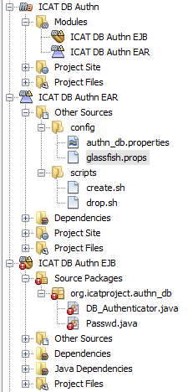
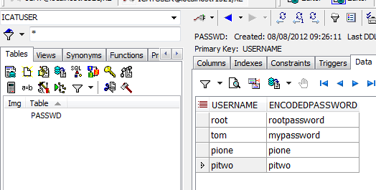
Example – ‘db’
Simple classes, packages as JAR then EAR

Slide 9
Example – ‘db’
@PostConstruct
private void init() {
File f = new File("authn_db.properties");
Properties props = null;
props = new Properties();
props.load(new FileInputStream(f));
String authips = props.getProperty("ip");
if (authips != null) {
addressChecker = new AddressChecker(authips);
}
mechanism = props.getProperty("mechanism");
log.debug("Initialised DB_Authenticator");
}

Slide 10
Example – ‘db’
@Override
public Authentication authenticate(Map<String, String> credentials, String remoteAddr) throws IcatException {
if (addressChecker != null) {
if (!addressChecker.check(remoteAddr)) {
throw new IcatException(IcatException.IcatExceptionType.SESSION,
"authn_db does not allow log in from your IP address " + remoteAddr);
}
}
String username = credentials.get("username");
String password = credentials.get("password");
Passwd passwd = this.manager.find(Passwd.class, username);
if (!passwd.getEncodedPassword().equals(password)) {
throw new IcatException(IcatException.IcatExceptionType.SESSION,
"The username and password do not match");
}
log.info(username + " logged in succesfully");
return new Authentication(username, mechanism);
}

Slide 11
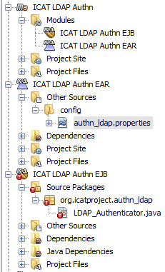
Example – ‘LDAP’
Simple classes, packages as JAR then EAR

Slide 12
Example – ‘LDAP’
@PostConstruct
private void init() {
File f = new File("authn_ldap.properties");
Properties props = null;
props = new Properties();
props.load(new FileInputStream(f));
//same IP address checker stuff as before
String providerUrl = props.getProperty("provider_url");
if (providerUrl == null) {
String msg = "provider_url not defined in " + f.getAbsolutePath();
log.fatal(msg);
throw new IllegalStateException(msg);
}
String securityPrincipal = props.getProperty("security_principal");
if (securityPrincipal == null) {
String msg = "security_principal not defined in " + f.getAbsolutePath();
log.fatal(msg);
throw new IllegalStateException(msg);
}
...
...

Slide 13
Example – ‘LDAP’
...
...
if (securityPrincipal.indexOf('%') < 0) {
String msg = "security_principal value must include a % to be substituted by the user name "
+ f.getAbsolutePath();
log.fatal(msg);
throw new IllegalStateException(msg);
}
this.providerUrl = providerUrl;
this.securityPrincipal = securityPrincipal;
// Note that the mechanism is optional
mechanism = props.getProperty("mechanism");
log.debug("Initialised LDAP_Authenticator");
}

Slide 14
Example – ‘LDAP’
@Override
public Authentication authenticate(Map<String, String> credentials, String remoteAddr) throws IcatException {
if (addressChecker != null) {
if (!addressChecker.check(remoteAddr)) {
throw new IcatException(IcatException.IcatExceptionType.SESSION,
"authn_db does not allow log in from your IP address " + remoteAddr);
}
}
String username = credentials.get("username");
String password = credentials.get("password");
log.info("Checking username/password with ldap server");

Slide 15
Example – ‘LDAP’
Hashtable<Object, Object> authEnv = new Hashtable<Object, Object>();
authEnv.put(Context.INITIAL_CONTEXT_FACTORY, "com.sun.jndi.ldap.LdapCtxFactory");
authEnv.put(Context.PROVIDER_URL, providerUrl);
authEnv.put(Context.SECURITY_AUTHENTICATION, "simple");
authEnv.put(Context.SECURITY_PRINCIPAL, securityPrincipal.replace("%", username));
authEnv.put(Context.SECURITY_CREDENTIALS, password);
try {
new InitialDirContext(authEnv);
} catch (NamingException e) {
throw new IcatException(IcatException.IcatExceptionType.SESSION,
"The username and password do not match");
}
log.info(username + " logged in succesfully");
return new Authentication(username, mechanism);
}

Slide 16
Example – ‘UO Web service’
@Override
public Authentication authenticate(Map<String, String> credentials, String remoteAddr) throws IcatException {
if (addressChecker != null) {
if (!addressChecker.check(remoteAddr)) {
throw new IcatException(IcatException.IcatExceptionType.SESSION,
"authn_db does not allow log in from your IP address " + remoteAddr);
}
}
String username = credentials.get("username");
String password = credentials.get("password");
try{
String sessionId = uoPort.login(username, password);
}
catch (Exception e) {
thrown new IcatException(IcatException.IcatExceptionType.SESSION,
"The username and password do not match");
}
if (sessionId == null {
throw new IcatException(IcatException.IcatExceptionType.SESSION,
"The username and password do not match");
}
log.info(username + " logged in succesfully");
return new Authentication(username, mechanism);
}

Slide 17
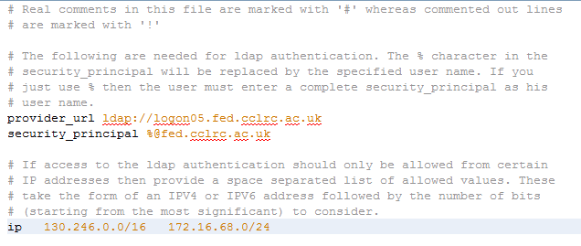
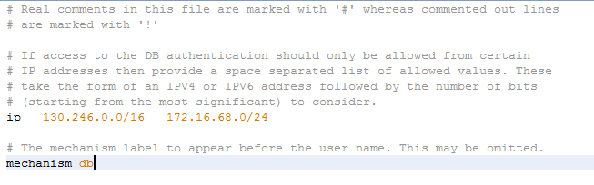
Configuration
Each mechanism can define it’s own config file

Slide 18
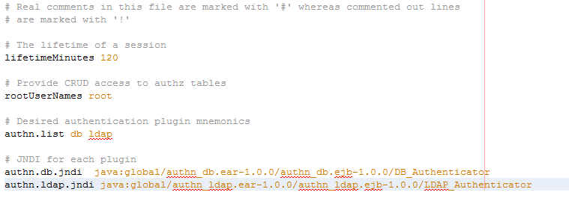
Configuration - ICAT

Slide 19
Questions?
www.icatproject.org
code.google.com/p/icatproject
http://groups.google.com/group/icat-developers/
http://groups.google.com/group/icatgroup/
icat-developers@googlegroups.com
icatgroup@googlegroups.com

