Slide 1
Using the ICAT API to ingest business and experiment metadata
Tom Griffin, STFC ISIS Facility
NOBUGS 2012 ICAT Workshop
tom.griffin@stfc.ac.uk

Slide 2
Overview
Assumes the user has permissions (see later)
Basic process
‘Business’ metadata
‘Experiment’ metadata
Tools for ingesting Nexus and XML
‘Post experiment’ file
Exceptions

Slide 3
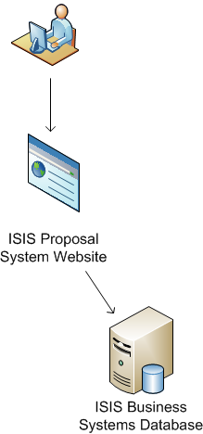

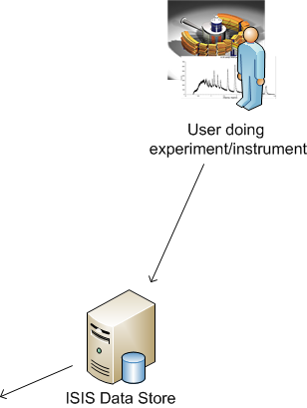
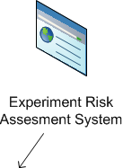


Basic data flow
Business metadata
Experiment metadata

Slide 4
‘Business’ metadata - Sources
Proposal system
User database
Risk assessment / COSHH / Sample tracking
Visits system

Slide 5
‘Business’ metadata - Creation
Investigation
InvestigationParameters
(Users)
Sample
SampleParameters

Slide 6
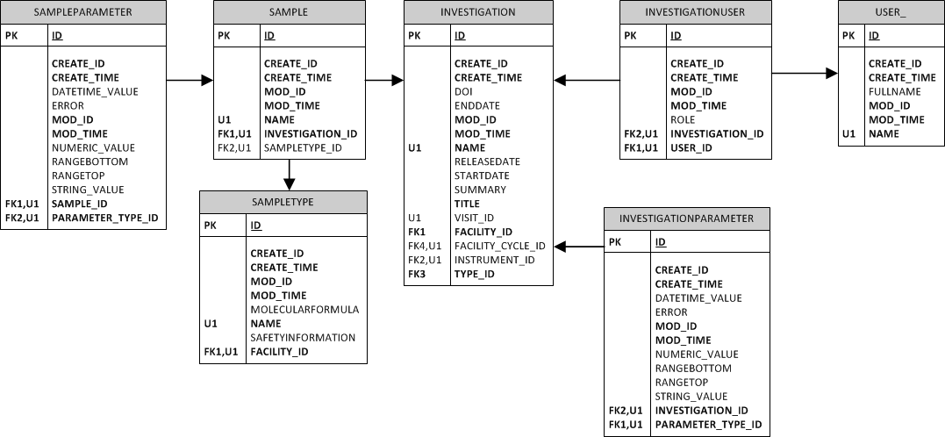
‘Business’ metadata - Creation

Slide 7
‘Business’ metadata - Creation
Code will be mainly facility specific
Probably a common general flow
Will assume users are in the User table already

Slide 8
‘Business’ metadata - Creation
Investigation invOne = new Investigation();
inv.instrument = (Instrument)port.search(sessionId, "Instrument[name=‘” + proposal.instrument + “']").get(0);
inv.title = proposal.title
inv.facility = (Facility)port.search(sessionId, "Facility[name='ISIS']").get(0);
inv.type = (InvestigationType)port.search(sessionId, "InvestigationType[name='experiment']").get(0);
inv.name = investigationTitle
inv.releaseDate = Now + inv.facility.daysUntilRelease;
inv.id = port.create(sessionId, invOne);
for (User proposalUser : experimenters)
{
InvestigationUser iu= new InvestigationUser();
iu.investigation = inv;
iu.user = (User)port.search(sessionId, "User[name='" + proposalUser .name + "']").get(0);
iu.role = proposalUser.role ; //e.g. Principal Investigator
iu.id = port.create(sessionId, iu);
}

Slide 9
‘Business’ metadata - Creation

Slide 10
‘Business’ metadata - DOIs
See talk by Brian Matthews/Micheal Wilson
Issued by DataCite/British Library
Previously issued on demand
Now issued at start of experiment
Defined by DOI issuer – us
doi:10.5286/ISIS.E.24088959
Prefix (STFC)
Object ID
E = Experiment
D = Dataset
F = DataFile

Slide 11
Experiment metadata - Sources
Datafiles
Nexus
Binary

Slide 12
Experiment metadata - Extraction
ISIS – ‘WriteRaw’
Custom binary reader – outputs ICAT friendly XML
ISIS – ‘NXIngest’
Flexible Nexus reader – outputs ICAT friendly XML
SNS – ‘ingestNexus’
Simple Python script – direct input to ICAT

Slide 13
Experiment metadata - Creation
Investigation update
Dataset
Datafile
Dataset and Datafile Parameters
Updates to Sample
Notes:
e.g. Dates
Adding new samples

Slide 14
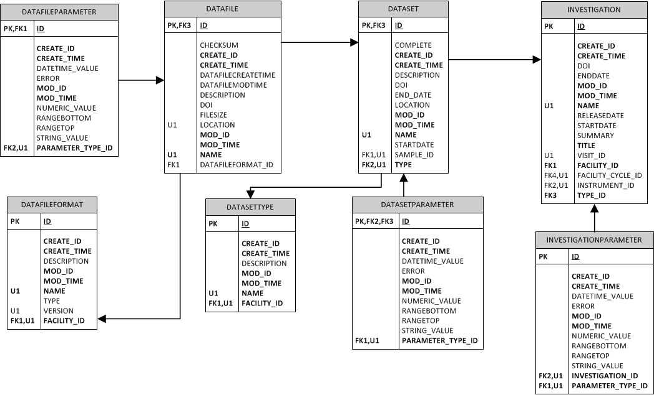
Experiment metadata - Creation

Slide 15
Python - ingestNexus
Go to code….
http://code.google.com/p/icatproject/source/browse/#svn%2Fcontrib%2Fscripts

Slide 16
XMLIngest – a good idea?
ICAT 3.3 exposed an XML schema
ingestMetadata(string sessionId, string xml)
Removed in ICAT 4.0

Slide 17
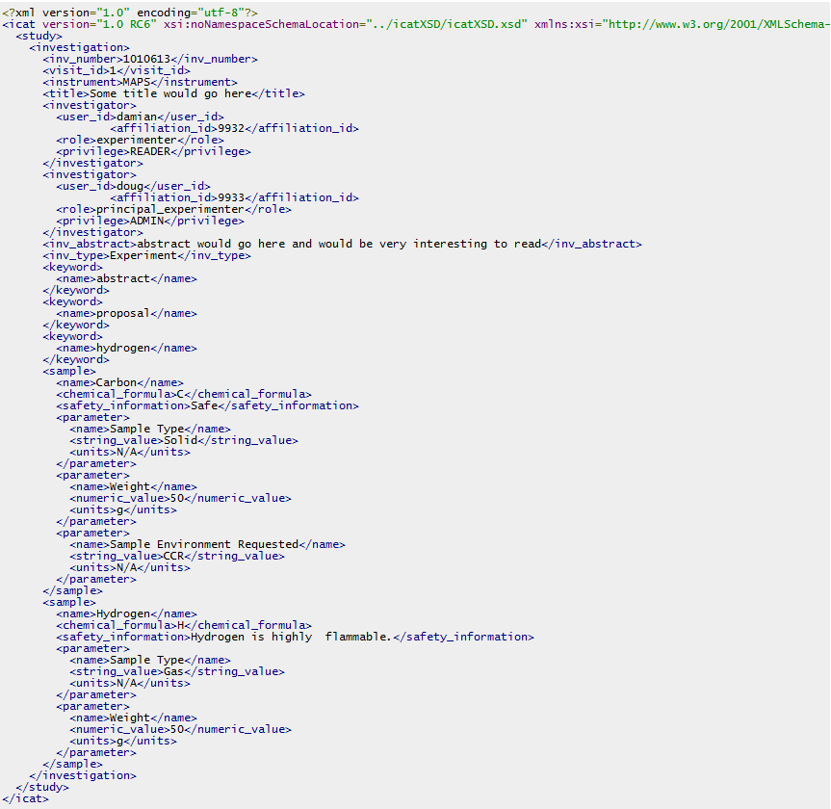

Slide 18
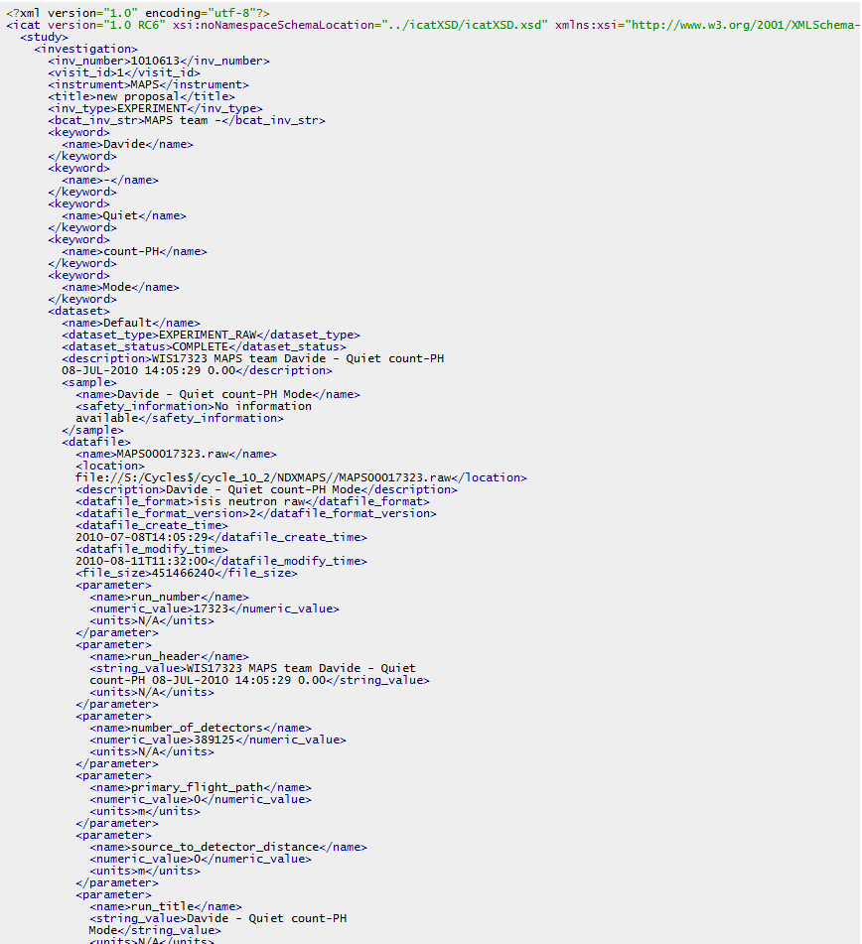

Slide 19
NXIngest
Part of the nexus package
Highly customizable by a mapping file
Different mapping file per nexus ‘style’
Go to XML files…..

Slide 20
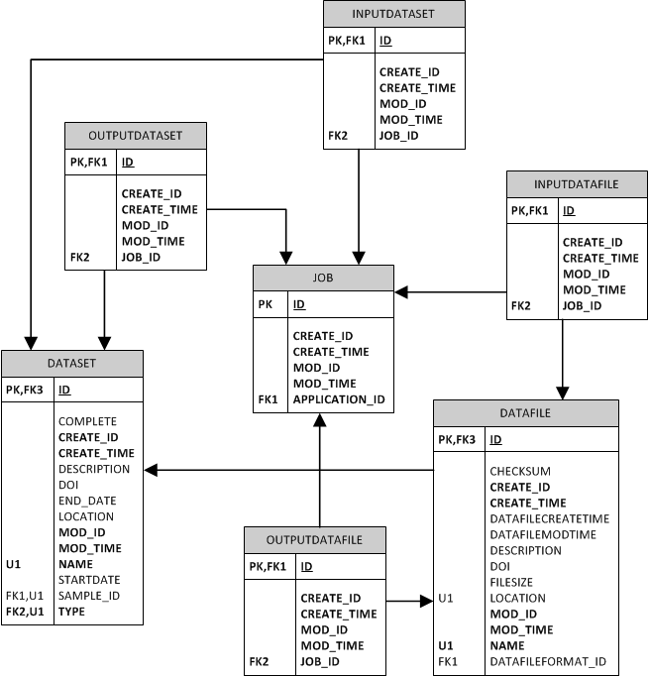
Post-Experiment
Reduced, Derived, Analysed Data
All can be created in the same way as raw data/metadata

Slide 21
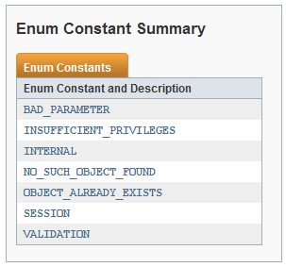
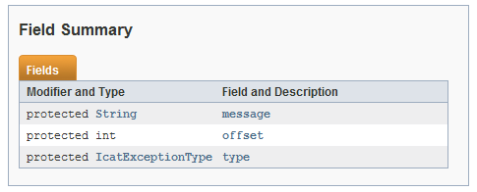
Exceptions
Single exception: IcatException_Exception
A wrapper around the real exception which in turn includes an enumerated code to identify the kind of exception and the usual message.

Slide 22
Exceptions
BAD_PARAMETER
generally indicates a problem with the arguments made to a call.
INTERNAL
may be caused by network problems, database problems, glassfish problems or bugs in ICAT.
INSUFFICIENT_PRIVILEGES
indicates that the authorization rules have not matched your request.
NO_SUCH_OBJECT_FOUND
thrown when something is not found.
OBJECT_ALREADY_EXISTS
thrown when type to create something but there is already one with the same values of the constraint fields.

Slide 23
Exceptions
SESSION
is used when the sessionId you have passed into a call is not valid or if you are unable to authenticate.
VALIDATION
marks an exception which was thrown instead of placing the database in an invalid state.

Slide 24
Exceptions
Operations which work on a list of objects, such as createMany, may fail because of failure to process one of the objects.
In this case the state of the database will be rolled back
offset is set to the index of the entry in the list causing the error

Slide 25
Exceptions
String sessionId;
try {
sessionId = icat.login("db", credentials); }
catch (IcatException_Exception e) { IcatException ue = e.getFaultInfo(); System.out.println("IcatException " + ue.getType() + " " + ue.getMessage() + (ue.getOffset() >= 0 ? " at offset " + ue.getOffset() : "")); }

Slide 26
Summary
Explained my ingest process (typical?)
Creating Investigations, Parameters, Samples
Creating Datasets, Datafiles, Parameters
Existing tools available to help
Consider XML ingest
Post experiment data
Exceptions

Slide 27
Questions?
www.icatproject.org
code.google.com/p/icatproject
http://groups.google.com/group/icat-developers/
http://groups.google.com/group/icatgroup/
icat-developers@googlegroups.com
icatgroup@googlegroups.com

