Slide 1
ICAT Workshop: Introduction
Brian Matthews
and Steve Fisher
Scientific Computing Department

Slide 2
Overview of workshop
A look at the ICAT facilities Information CATalogue
Relatively straightforward to install
Much harder to set up so that the full value can be gained
An in-depth look at the features of ICAT 4.2
How to configure it to work in a particular environment
Add on tools around ICAT
What is planned for future developments

Slide 3
Contents
Time | Topic | Presenter
13:00 | Introduction to ICAT 4.2 | Brian Matthews
13:30 | Getting started - how to set up the common data tables | Kevin Phipps
14:00 | Using the API to ingest metadata | Tom Griffin
14:30 | The pluggable authentication system | Tom Griffin
14:40 | The permissions/authorisation rules | Tom Griffin
15:00 | Coffee break
15:15 | Look at the notifications system | Antony Wilson
15:30 | TopCAT configuration | Antony Wilson
16:00 | Data download | Kevin Phipps
16:15 | Discussion, requests and promises for 4.3 and beyond. | Brian Matthews

Slide 4
Assumptions
You have some familiarity with the aims of ICAT
You want to know how it is practically used in a facility
You know a little about its architecture
You have some knowledge of programming and setting up systems

Slide 5

A Word from our Sponsors
ICAT team from STFC
ISIS Neutron Source
Scientific Computing Department
Also support from the PaN-Data Open Data Infrastructure project
WP4: Data Catalogues
Promoting the use of data catalogues within European facilities
Using ICAT as the reference catalogue

Slide 6
What is ICAT?
A metadata catalogue to manage data
Database (any JPA supported e.g. Oracle, MySql)
Web Service API (developed in Java, running Glassfish)
To allow high-quality
Registration of data as it is collected in experiments
Discovery of data based on what it was collected for
Access to the data, according to some policy
Association of data with other resources
Moving towards the ICAT Toolkit
Pluggable component architecture
Supporting different tasks

Slide 7
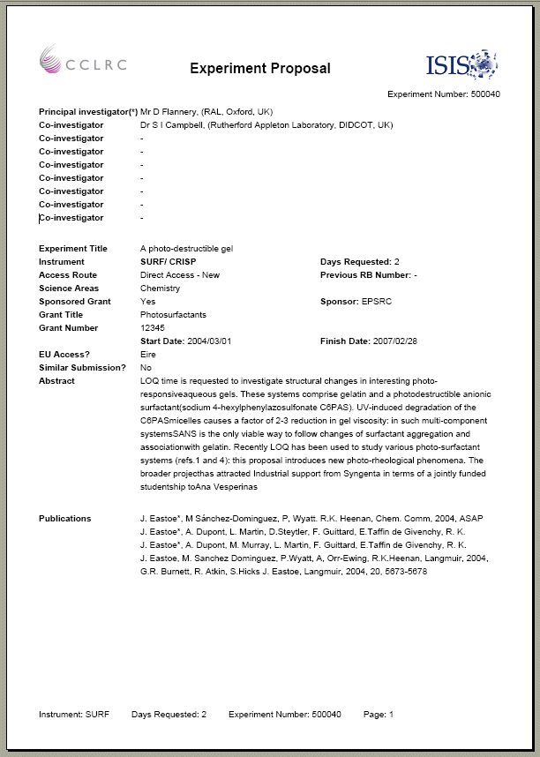
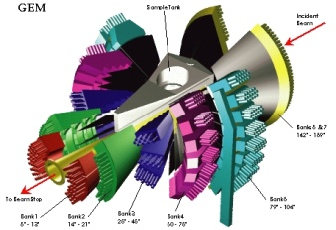
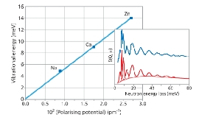




ICAT Vision
Damian Flannery
What is ICAT ?
ICAT is a database (with a well defined API) that provides a uniform interface to experimental data and a mechanism to link all aspects of research from proposal through to publication.
Access data anywhere via the web
Annotate your data
Search for data in a meaningful way e.g. taxonomy, Sample, temperature, pressure etc
Share data with colleagues
Access data via your own programs (C++, Fortran, Java etc.) via the ICAT API
Identify potential collaborations
Utilise integrated e-Science High-Performance Computing and Visualisation resources
Link to data from your publications
Etc.
Example ISIS Proposal
GEM – High intensity, high resolution neutron diffractometer
H2-(zeolite) vibrational
frequencies vs polarising
potential of cations
B-lactoglobulin protein
interfacial structure
Proposals
Once awarded beamtime at ISIS, an entry will be created in ICAT that describes your proposed experiment.
Experiment
Data collected from your experiment will be indexed by ICAT (with additional experimental conditions) and made available to your experimental team
Analysed Data
You will have the capability to upload any desired analysed data and associate it with your experiments.
Publication
Using ICAT you will also be able to associate publications to your experiment and even reference data from your publications.

Slide 8
History
2001: First rapid prototype (“Data Portal”)
2005: ICAT 2.0 – ISIS back catalogue
2008: ICAT 3.3 - production version released open source (Oracle, EJB, Glassfish)
2009: deployed in ISIS, DLS
2009-12: ESRF, ORNL, ILL, PSI, CLF, LSF, ELETTRA ...
2011: ICAT 4.0 – revisit the API
2012: ICAT 4.2 – pluggable authentication
http://www.icatproject.org/
http://code.google.com/p/icatproject/

Slide 9
Release summary
Release | Comments | Status
3.x.x | Big API - many variants | A number of deployments
4.0 | Small API - Never intended to be deployed for production use. | Should no longer be used
4.1 | Intended for production use for new users. | Released June 2012
4.2 | Pluggable authentication | Released August 2012
4.3 | Under discussion | Planned for next 6 months

Slide 10
ICAT Workshop: ICAT 4.2: Architecture and Schema Overview
Brian Matthews
and Steve Fisher
Scientific Computing Department

Slide 11
Architecture
Client object
Server object
XML
JAXB
JPA
SQL
All objects have representation in RDBMS on the server and in the client.
Any Eclipselink supported RDMS
4.1 Tested with Oracle, MySQL and Derby
With a information model schema tailored to represent facilities data collection
Schema can be adjusted very easily
only "special" objects are: User, Group, UserGroup, Rule, NotificationMessage
objects with special behaviour: Rule, NotificationMessage and Parameter
A facility could easily add concepts such as Proposal, Run etc
should be coordinated by the ICAT project
otherwise working across facilities becomes difficult.

Slide 12
Schema - main components
Sample
*
1
1
*
Facility
1
*
Investigation
1
*
Dataset
1
*
Datafile
Many objects take arbitrary parameters as an extensibility mechanism
- type identified by a:
(name, value, unit, facility)
Also user management components
http://www.icatproject.org/mvn/site/icat/4.2.0/icat.core/schema.html

Slide 13
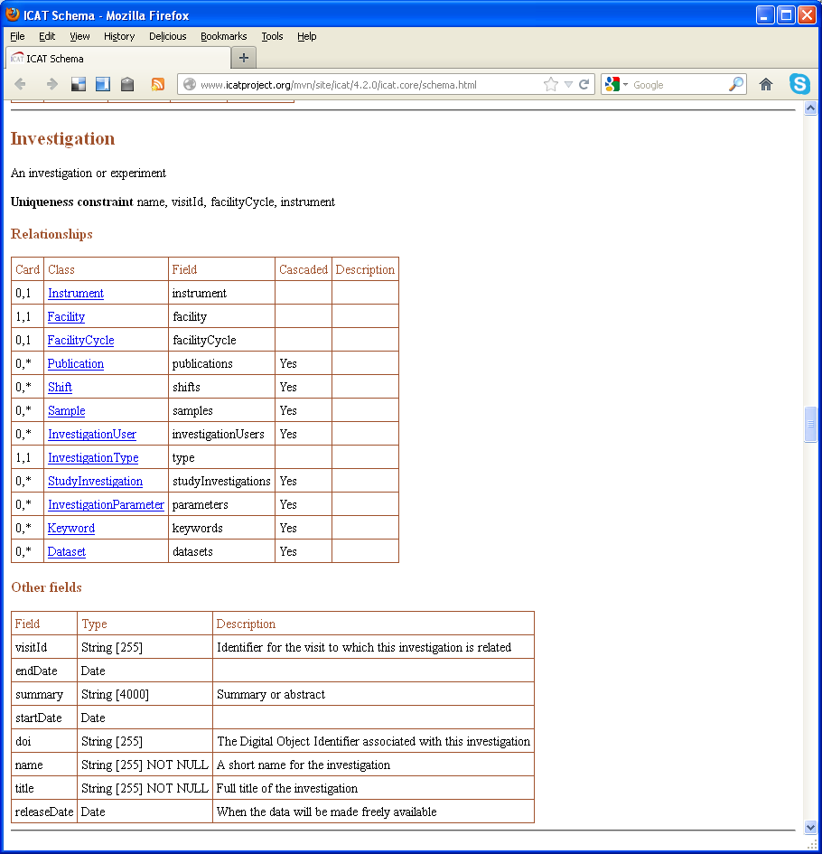

Slide 14
Schema changes (4.2)
All entities have an id value as primary key
Remove attributes that are not of general utility
use xxxParameters instead
Those entities which represent many to many relationships now formed by concatenating the names of the related entities
“Investigator” has now become "InvestigationUser"
All relationships may now be navigated in both directions
Relationship fields follow normal convention
Harmonised names of the various string fields
Reduce number of non-optional fields
Added notification request
Added job etc. for provenance

Slide 15
More Schema (4.2) changes
Permit mixing data from more than one facility
Particularly interesting for an institutional or personal ICAT
Requires that a number of unique constraints would need to include the facility. This would affect the various “Type” and “Status” entities.
Add restrictions to ParameterTypes to define:
possible values for strings
upper and lower limits for numbers
boolean to indicate whether or not ICAT should respect the constraint
Get rid of Topic
Still have keyword
Add DOI support
Publication, Investigation, Dataset, Datafile

Slide 16
Simple representation of provenance
Application
1
*
Job
*
*
*
*
1
1
1
1
InputDataset
OutputDataset
InputDatafile
OutputDatafile
1
1
1
1
*
*
*
*
1
*
Dataset
Datafile

Slide 17
ICAT 4.x: The new API
A much simplified and consistent API
No Schema Specific operations
Easier to change the schema without side effects
A small set of core operations
Which can be applied to all entities.
login
returns a sessionId to identify you for a finite period
Create
for the various Schema Entities
Read
actually search and get
Update
Delete

Slide 18
Getting started
Initialise and configure ICAT
Set the credentials to log in to ICAT
Start the Session
String sessionId = icat.login("db", credentials);
Start creating entities in the Data Model
Investigation inv = new Investigation();
inv.setName("Fred");
inv.setFacility(f);
More on these topics later in the day.

Slide 19
Getting started
Initialise and configure ICAT
URL hostUrl = new URL("http://localhost:8080")
URL icatUrl = new URL(hostUrl, "/ICATService/ICAT?wsdl");
QName qName = new QName("client.icat3.uk", "ICATService");
ICATService service = new ICATService(icatUrl, qName);
ICAT icat = service.getICATPort();
Set the credentials to log in to ICAT
Credentials credentials = new Credentials();
List<Entry> entries = credentials.getEntry();
Entry e;
e = new Entry();
e.setKey("username");
e.setValue("root");
entries.add(e);
e = new Entry();
e.setKey("password");
e.setValue("secret");
entries.add(e);
Start the Session
String sessionId = icat.login("db", credentials);

Slide 20
A bit more on create ...
Create a new Facility
Facility f = new Facility();
f.setName ("Some facility");
f.setDaysUntilRelease(90);
f.setId(icat.create(sessionId, f));
Create a new Investigation
Investigation inv = new Investigation();
inv.setName("Fred");
inv.setFacility(f);
Dataset ds = new Dataset();
ds.setName("A dataset");
ds.setType(type);
inv.getDatasets().add(ds);
inv.setId(icat.create(sessionId, inv));
Do ingestion this way.
Build tree as defined by "cascade" and make one call.
Don't set backwards reference
Causes a loop

Slide 21
get …
Call to retrieve the object for a particular entity:
Parameterised by the ENTITY Name
This is now a general pattern in ICAT 4.x
This is useful if you already know the ID of the entity from when it was created or as a result of a search:
String pk = "Some facility";
Facility f = (Facility) icat.get(sessionId, "Facility", pk);
Long dsid = 76347;
Dataset ds = (Dataset) icat.get(sessionId, "Dataset", dsid);

Slide 22
The INCLUDE keyword
Get (and Search - later) only retrieve the entity you request with no related entities
To get a tree of related entities list them with INCLUDE: Dataset ds = (Dataset) icat.get(sessionId, "Dataset INCLUDE Datafile,DatasetParameter,DatafileParameter", dsid);
Can then do:
for (Datafile datafile : dataset.getDatafiles()) {
System.out.println(datafile.getId() + " " + datafile.getParameters().size()
}
but dataset.getType() will always be null as DatasetType not included
Included entities must be linked via a graph without loops - i.e. only one route.

Slide 23
update ...
First obtain the object that you wish to update using search or get.
It is important to obtain it using "INCLUDE 1" where the "1" means to get all many to one relationships
Listing individual related entities is error prone and may not work if the schema is modified. Facility f = (Facility) icat.get
(sessionId, "Facility INCLUDE 1", facilityId);
f.setDaysUntilRelease(30); icat.update(sessionId, f);

Slide 24
and delete ...
This call takes an entity object but only the value of its id actually matters so the following are equivalent: Facility f = (Facility)
icat.get(sessionId, "Facility", facilityId); icat.delete(sessionId, f); Facility f = new Facility(); f.setId(facilityId); icat.delete(sessionId, f); In all cases cascaded relationships are followed - currently all 0-many and 1-many relationships are cascaded but no others. Check the current schema to be sure. For example: http://www.icatproject.org/mvn/site/icat/4.2.0/icat.core/schema.html
Again, "cascades" are followed so this delete would have a major effect.

Slide 25
A Domain Language for Searching
We have added a language based on the ICAT model to search
String query = "Dataset"
List<?> results = icat.search(sessionId, query);
query = "Dataset.name";
query = "DISTINCT Dataset.name"
query = "Dataset.id ORDER BY id";
query = "MAX (Dataset.id) ";
query = "3,5 Dataset.id ORDER BY id" ;
query = "3, Dataset.id ORDER BY id";
query = " ,5 Dataset.id ORDER BY id";

Slide 26
Search restrictions
"Dataset [type.name = 'GS' OR type.name = 'GQ']"
"Dataset [type.name IN ('GS', 'GQ')]"
"Dataset <-> DatasetParameter[type.name = 'TEMP' AND numericValue > 300] "
"Dataset <-> DatasetParameter[(type.name = 'TEMP' AND numericValue > 300) AND (type.name = 'PRESSURE' AND numericValue > 1020)] "
" Dataset [type.name IN ('GS', 'GQ')] INCLUDE Datafile, DatasetParameter, DatafileParameter "
The restriction in the square brackets can be as complex as required - but must only refer to attributes of the object being restricted
Q .Why the specialized query language?
A. To support authz

Slide 27
Summary
ICAT 4.2 includes
Schema changes
Made more consistent
Adding support for Provenance
Major change to API
CRUD calls consistent across all entities
Search Language
Also some other changes
Security model
Notifications
Error messages
Covered in later talks

