Slide 1
PA0 – Hello CUDA

Slide 2
CUDA
Compute Unified Device Architecture
Defines much more than an API
A language
Hardware Specifications

Slide 3
PA0
Let’s look into your first assignment and figure some things out.

Slide 4
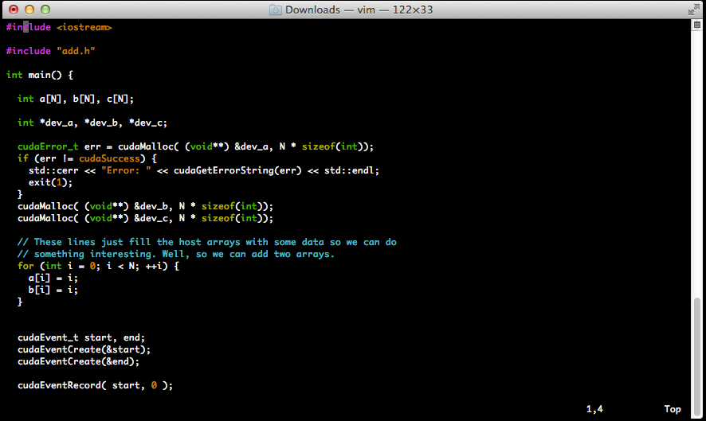
HELLOCUDA.CU

Slide 5
HELLOCUDA.CU
Pointers to GPU land
dev_a, dev_b, dev_c
cudaMalloc allocates space on the GPU
Events:
Allow you to monitor completion of kernel runs, time runs, and synchronize execution
In this case it is being used to time the execution

Slide 6
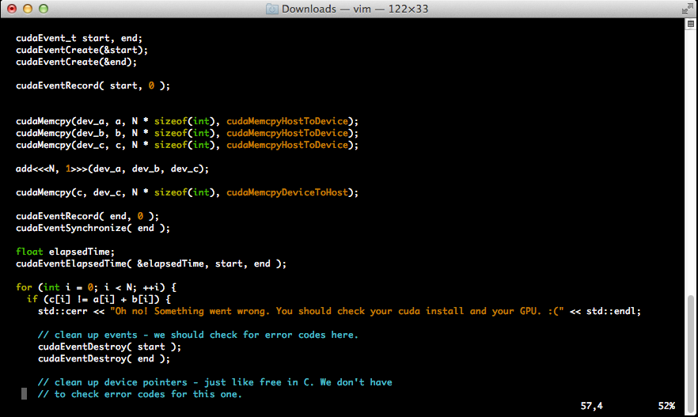
HELLOCUDA.CU

Slide 7
HELLOCUDA.CU
cudaEventSynchronize and cudeEventElapsedTime
Finishing up the timing
Use a timer like this for your homework
DO NOT TIME I/O
DO NOT TIME I/O
DO NOT TIME I/O

Slide 8
HELLOCUDA.CU
cudaMemcpy moves data onto and off of the GPU
cudaMemcpyHostToHost
cudaMemcpyHostToDevice
cudaMemcpyDeviceToHost
cudaMemcpyDeviceToDevice
cudaMemcpyDefault (Only with Compute 2.0)

Slide 9
HELLOCUDA.CU
add<<<N,I>>>(…args…)
<<< blocks, threads in each block >>>
There are limits on how many of each can be made.

Slide 10
Thread Organization
Thread
Warp
The SIMT group of 32 threads
Block
Grid

Slide 11
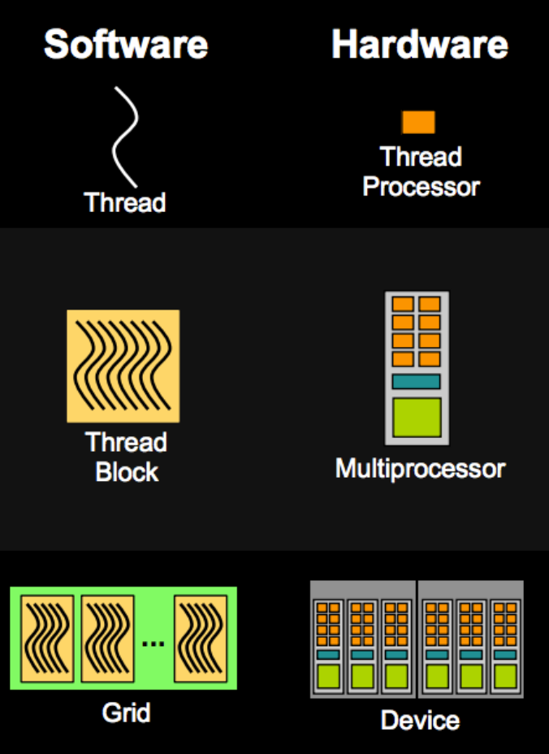
Thread Organization

Slide 12
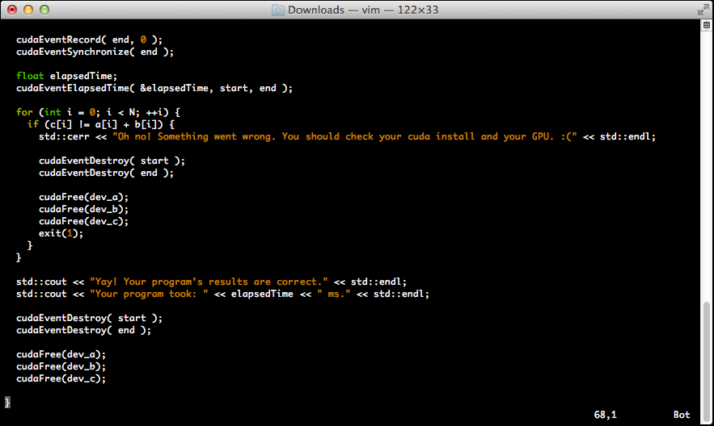
HELLOCUDA.CU

Slide 13
HELLOCUDA.CU
Much like cudaMalloc mirrors malloc
cudaFree mirrors free
Events should also be destroyed.

Slide 14
ADD.CU

Slide 15
__GLOBAL__
CUDA signifier
__global__
Host callable, runs on the device
__device__
Device callable, runs on the device
__host__
Host callable, runs on the host

