Slide 1
Agricultural robots
By Luke Frey and Sam Simos

Slide 2
overview
History
Plan and Implantation
Pros for Agricultural Robots
Cons for Agricultural Robots
Summary
References

Slide 3
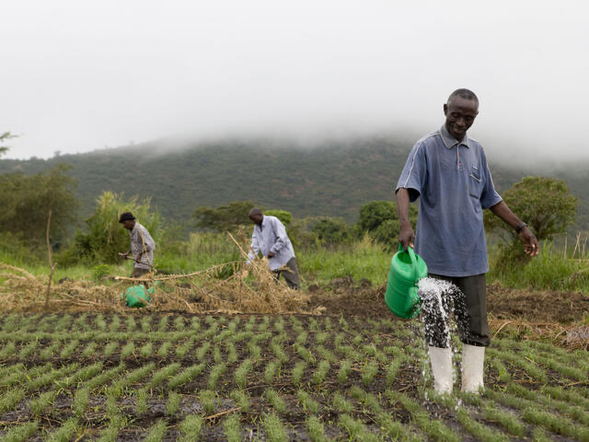
history
Agricultural farming has been a fundamental practice in human history, developed in the Fertile Crescent due to its rich soil and favorable climate. It started in the 80s.
Notes:
The history of agricultural robots can be traced back to the 1980s, when the first robotic systems were developed for tasks such as crop spraying and harvesting. In the 1990s and early 2000s, researchers and engineers began to explore new ways to apply robotics and automation to agriculture, leading to the development of more sophisticated systems. One of the earliest and most successful agricultural robots is the dairy cow milking robot, which uses sensors and robotic arms to automatically milk cows without human intervention. In recent years, advances in artificial intelligence and machine learning have opened up new possibilities for agricultural robots, allowing them to analyze vast amounts of data on soil conditions, weather patterns, and crop growth to make more informed decisions about planting, fertilizing, and harvesting.

Slide 4
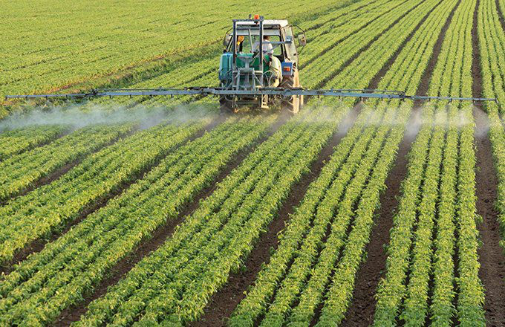
History
Farmers developed different techniques and technologies to adapt to their environments, allowing them to work more efficiently and produce greater yields.

Slide 5
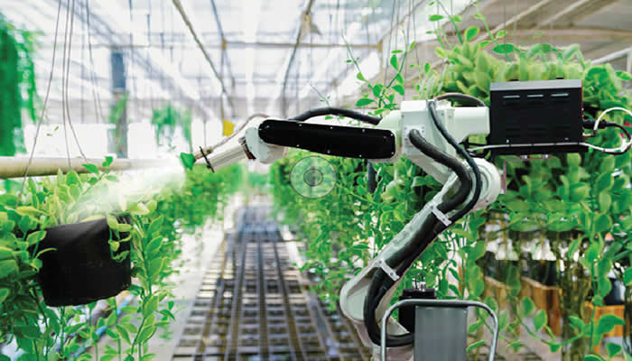
History
Today, agriculture has become increasingly mechanized, but environmental concerns have led to more sustainable and organic practices.

Slide 6
Plan and implantation
This impacts many farmers and workers of the farm and is more efficient than manual work. Planning and implementing agricultural robots can improve efficiency, reduce waste, and increase yields.
Notes:
Planning and implementing agricultural robots requires careful planning and consideration of various factors, such as identifying the tasks to be automated, evaluating the farm layout, assessing costs and benefits, researching available technologies, developing a timeline for implementation, training staff and operators, and monitoring and evaluating performance. With careful planning and execution, agricultural robots can help improve efficiency, reduce waste, and increase yields on farms of all sizes.

Slide 7
Pros for Agricultural Robots
Increased efficiency
Improved accuracy
Reduced labor costs
24/7 Monitoring
Notes:
Increased efficiency: Agricultural robots can work quickly and accurately, reducing the time and labor required for tasks such as planting, weeding, and harvesting.
Lower labor costs: By automating tasks, farmers can save money on labor costs and reduce their reliance on human labor.
Improved crop quality: Agricultural robots can perform tasks with precision and consistency, leading to improved crop quality and higher yields.
Reduced environmental impact: By using sensors and AI, agricultural robots can reduce the amount of chemicals and water used in farming, minimizing the environmental impact.
Enhanced data collection and analysis: Agricultural robots can collect data about soil, weather, and crop conditions, which can be analyzed to make better decisions about planting, harvesting, and other farming operations.

Slide 8
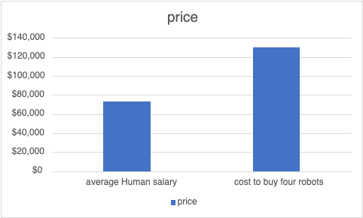
Cons for Agricultural Robots
High initial costs
Job displacement
Data privacy concerns
Dependence on technology
Environmental concerns
Notes:
High upfront costs: The initial investment in agricultural robots can be high, making it difficult for small farmers to afford.
Limited adaptability: Agricultural robots are designed for specific tasks and may not be able to adapt to changes in crop conditions or weather.
Lack of human interaction: The use of agricultural robots may result in less human interaction on farms, potentially leading to a loss of traditional farming skills and knowledge.
Technical expertise required: Farmers may need specialized technical skills to operate and maintain agricultural robots.
Dependence on technology: Dependence on technology may increase the risk of system failures or security breaches, which could disrupt farming operations.

Slide 9
Summary
With all these points made, it is safe to say that agriculture robots have helped many people. But they also take many jobs from many people.
At the beginning, Agricultural robots sound like a great idea. But once I started to research it more and more, I realized that Agricultural robots are going to take away many people's jobs. My opinion is that I am against this.

Slide 10
references
“Agricultural Robots, Advantages, Disadvantages and Uses” by Heba Soffar
“Agricultural Robots Advantages, Automation, History,Future” by Jagdish

