Slide 1
PHOENIX · ASH · BPMN · DMN · RULES
The Vet Clinic Capstone
Maximal Code
Every moving part is a declaration. Everything the users see, the engine executes,
and the operator is refused by — is generated from it.
7 frameworks, one thin shim. The demo after this deck is live — everything shown exists in the tree at HEAD.

Slide 2
THE THESIS
Not “no code.” Maximal code.
DECLARE
GENERATE
RUN
Small DSL blocks read like policy: a surface, a state machine, a rule, a process. One breath each.
UI, diagrams, refusals, guards, tokens — derived from the declarations. No second artifact to drift.
The declarations ARE the running system: policies gate, bundles guard, tokens advance, diagrams stay true.
The rule: nothing generated that isn’t declared — and nothing declared that doesn’t generate. When the schedule refuses a check-in, the message quotes the operator’s rule id. When the state machine diagram changes, it changed because the four transition lines changed.

Slide 3
THE STACK
Seven repos, one thin shim
ash_a2ui
ash_bpmn
ash_decisions
Surfaces from DSL — forms, tables, panels, actor, presence & composer
Processes as BPMN documents — durable tokens over Postgres
Decisions as DMN tables — versioned, evaluated, verifiable
ash_rules
ash_compliance
ash_agent_tools
Rule bundles — facts, outcomes, compile-to-hash
The control plane — drafts, approvals, activations, evidence
Agent introspection — describe, can, evaluate, edit
clinic-demo — the capstone shim. A handful of resource files, surface modules and two documents (BPMN + DMN). The frameworks do the rest — that’s the point of the demo.

Slide 4
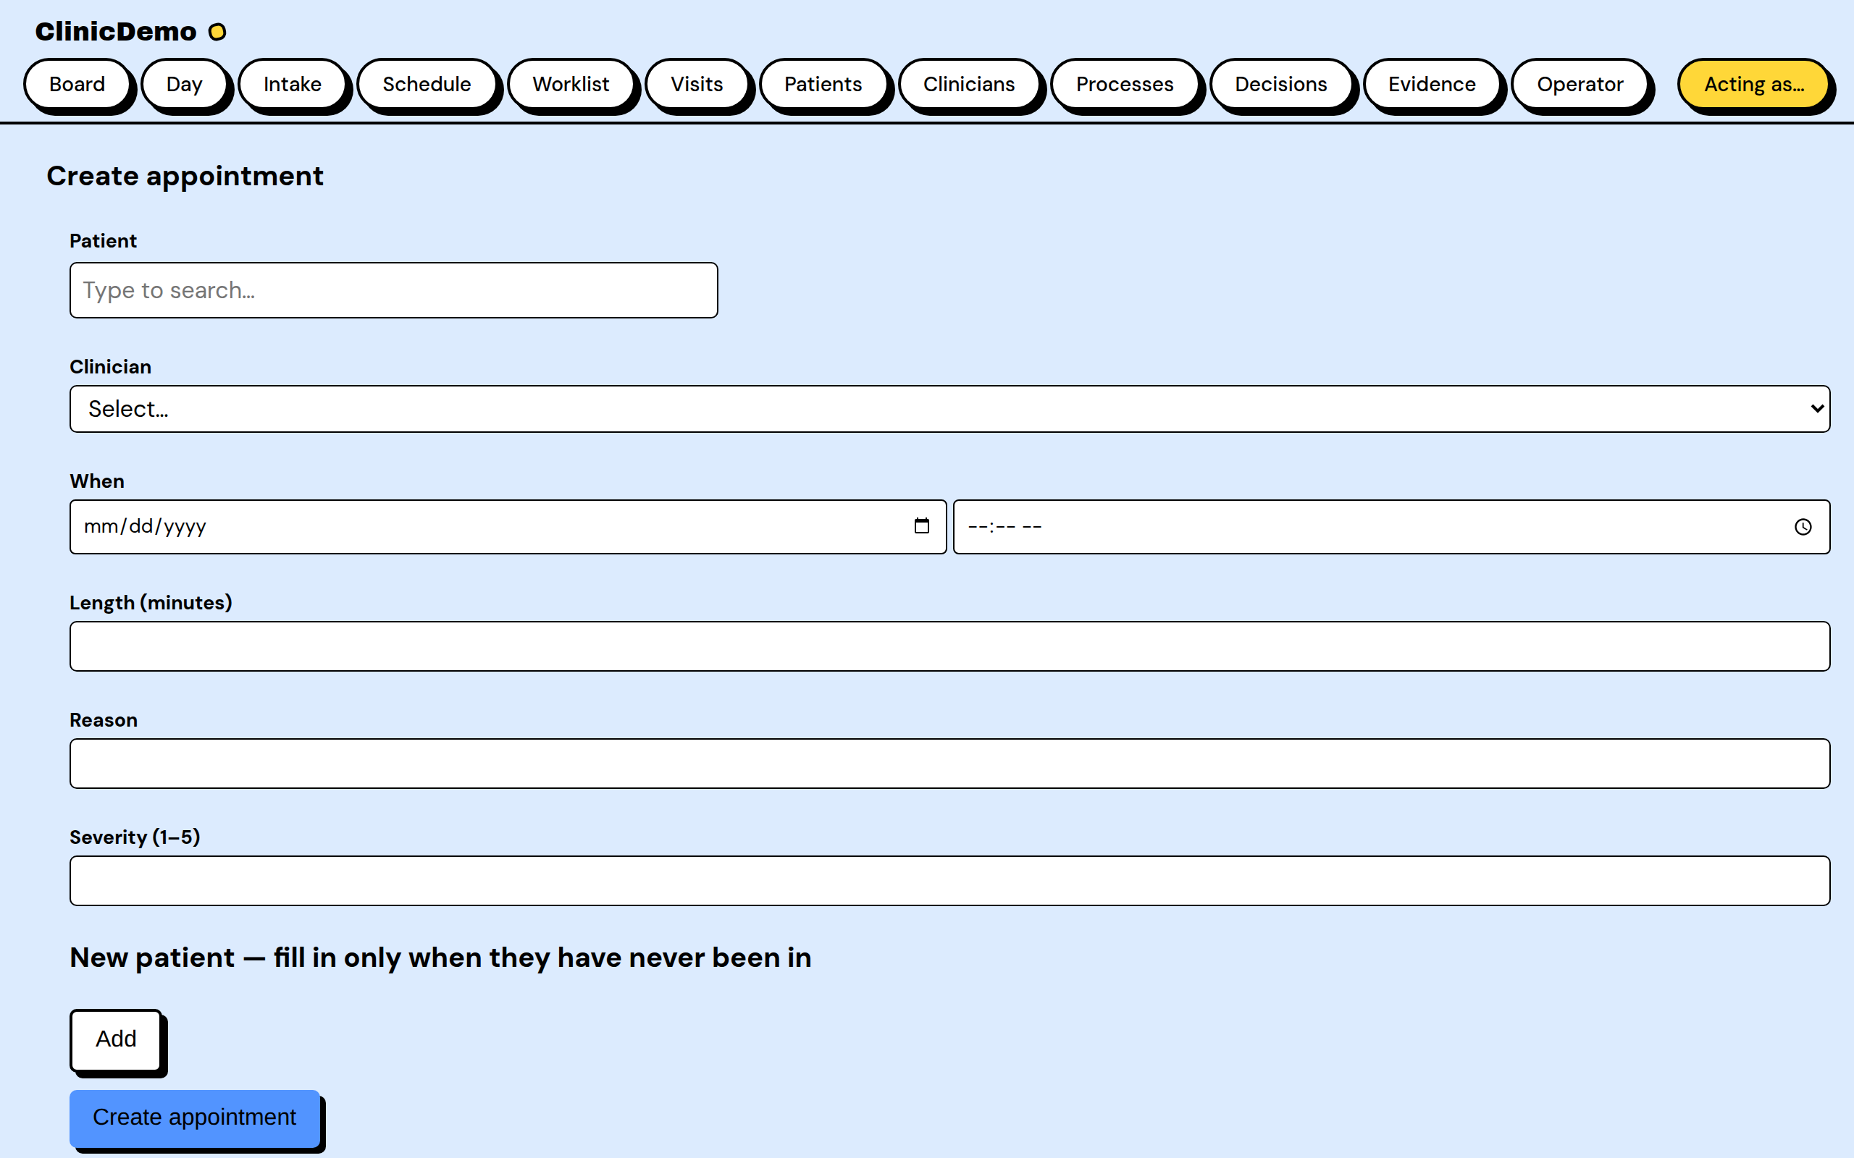
01 · SURFACE → UI
A form and a table, declared
lib/clinic_demo_web/a2ui/intake_ui.ex
use AshA2ui.Standalone
a2ui do
for_resource ClinicDemo.Scheduling.Appointment
component :form do
fields [:patient_id, :clinician_id,
:scheduled_at, :reason, :severity]
create_action :book
nested_form :patient do # new patients,
fields [:name, :species, # right here
:owner_email, ...]
end
end
component :table, :recent do
fields [:patient_label, :status,
:triage_urgency]
row_layout do
badge :triage_urgency
end
end
end
live at /intake
No template was written for this page. The gated create panel opens front-and-center; the picker, the nested new-patient section, loading states and skeletons are the framework’s, themed through tokens.

Slide 5
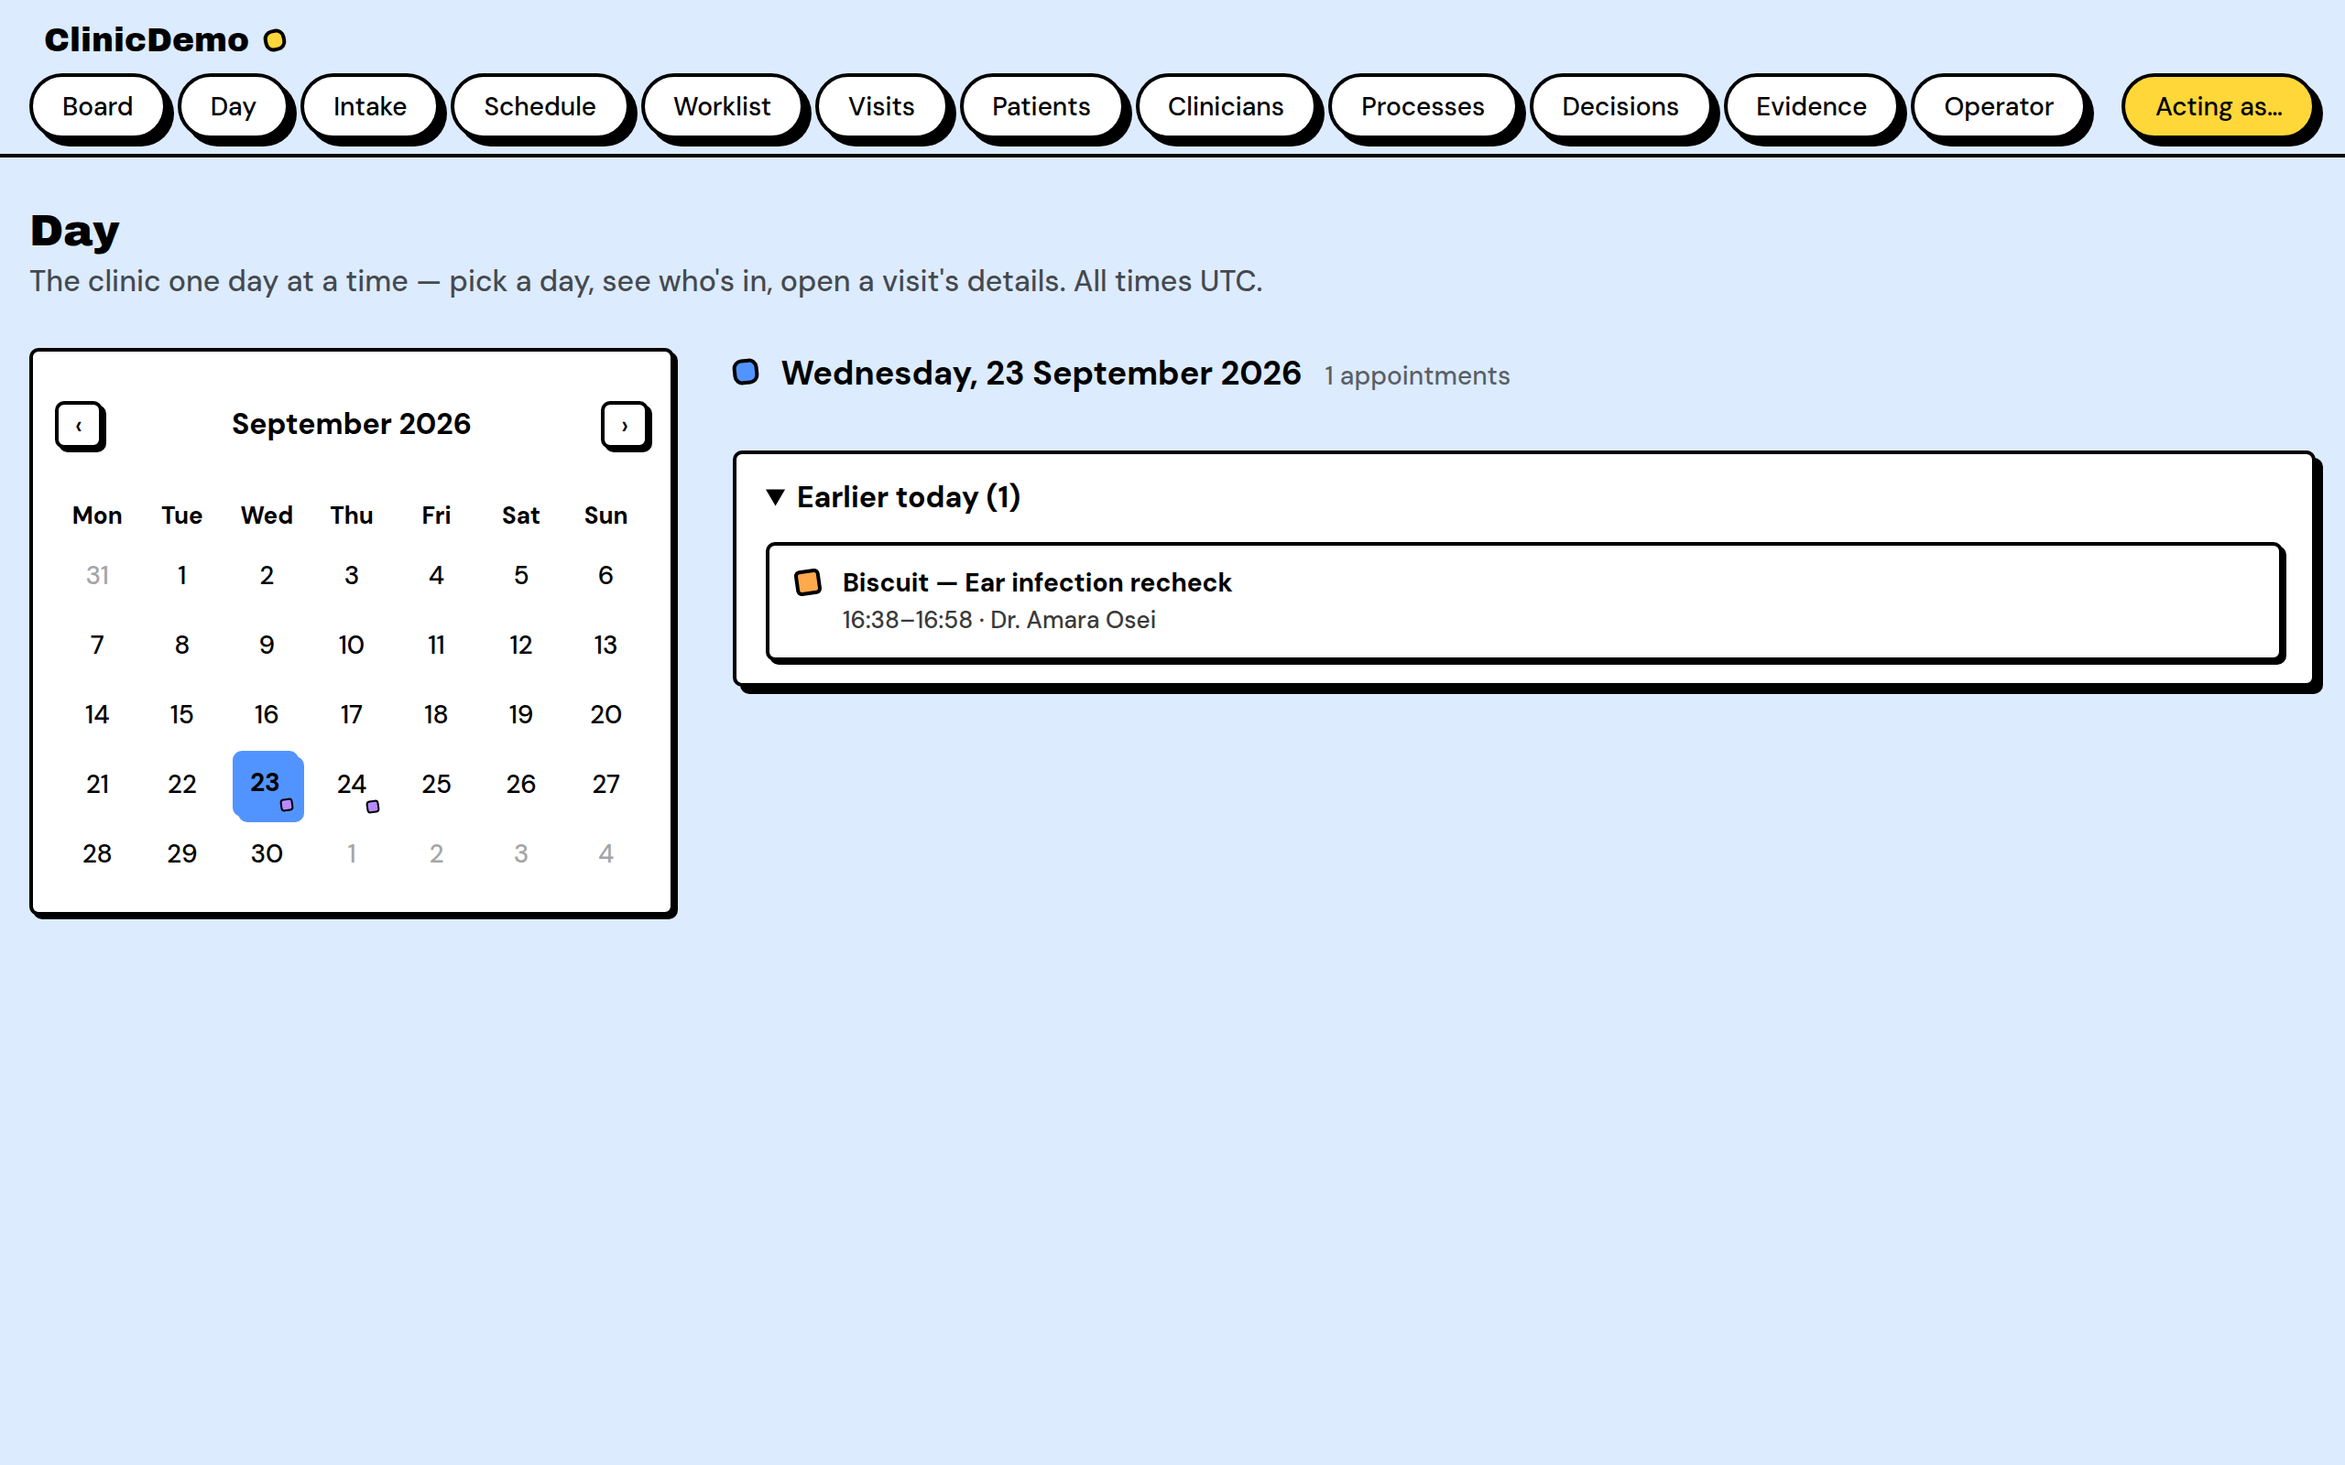
01B · HOST COMPONENTS → THE DAY VIEW
Chrome around the data, hosted
lib/clinic_demo_web/live/day_live.ex
# not an a2ui surface — the NB layer
# (ash_a2ui's Lane D), themed by the
# same --a2ui-* tokens, no overrides:
<nb-calendar phx-hook="DayCalendar"
month={@month}
selected={Date.to_iso8601(@selected_day)}
items={@item_dates} />
<nb-item phx-click="open_detail"
status={status_vocab(@appointment)}
label={"#{@appointment.patient_label}
— #{@appointment.reason}"}
meta={time_range(@appointment)}
selectable />
<%!-- the day's tail folds natively --%>
<details :if={@earlier != []}>
<summary>
Earlier today ({length(@earlier)})
</summary>
...
</details>
live at /day — earlier half unfolded
The Day view is chrome around the data, so it hosts the NB component layer: a month grid, status-dotted visit rows, a read-only nb-sheet. The day's tail folds into a native <details> — and the seeds plant one earlier-today visit, so the fold always has a real past item to collapse.

Slide 6
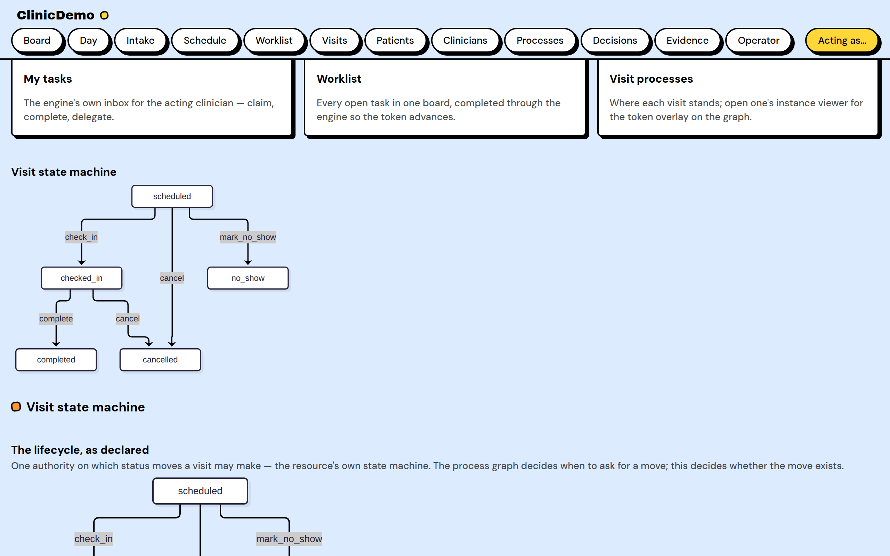
02 · STATE MACHINE → DIAGRAM
Four lines; the picture cannot drift
lib/clinic_demo/scheduling/appointment.ex
extensions: [AshStateMachine]
state_machine do
state_attribute(:status)
default_initial_state(:scheduled)
transitions do
transition(:check_in,
from: :scheduled, to: :checked_in)
transition(:complete,
from: :checked_in, to: :completed)
transition(:cancel,
from: [:scheduled, :checked_in],
to: :cancelled)
transition(:mark_no_show,
from: :scheduled, to: :no_show)
end
end
operator hub
The operator hub renders this declaration as a Mermaid diagram — derived, never drawn by hand. Illegal transitions are refused by name: “from scheduled to completed” is what the error says.

Slide 7
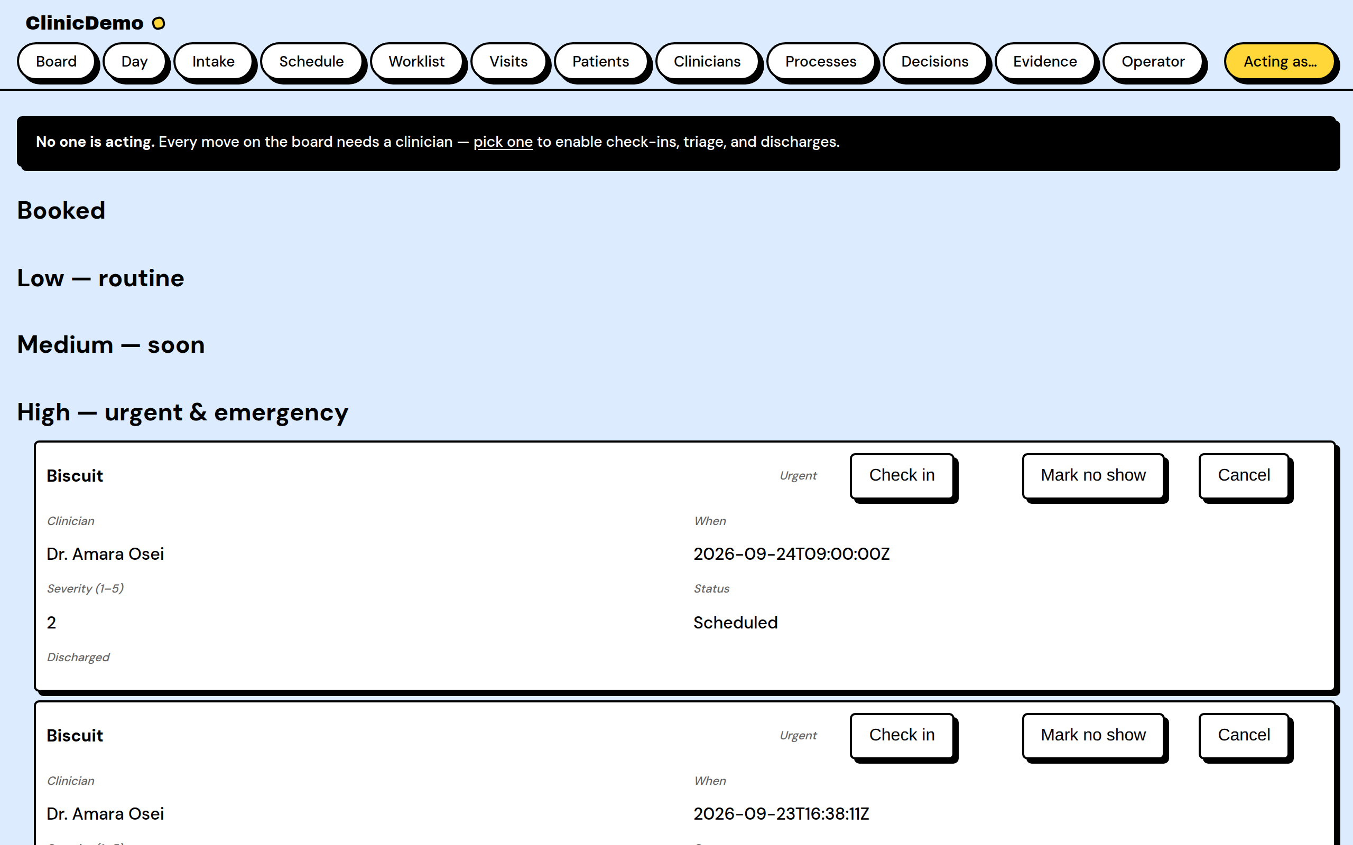
03 · POLICY → AUTHORIZATION
Two policies gate the whole app
lib/clinic_demo/scheduling/appointment.ex
policies do
policy action_type(:read) do
authorize_if always()
end
policy action_type([
:create, :update, :destroy]) do
authorize_if actor_present()
end
end
# config :ash_a2ui, actor: [
# resource: ClinicDemo.Scheduling.Clinician,
# label: :full_name]
the board
Without a clinician picked at /acting-as, every write is refused — the board leads with the banner. The same declaration answers “why forbidden?” per policy, for agents and auditors alike.

Slide 8
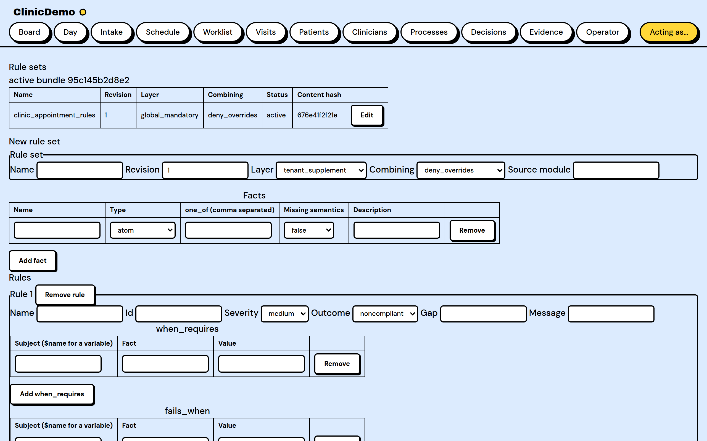
04 · RULES → GUARD
The rulebook is data, not code
lib/clinic_demo/compliance/appointment_rules.ex
use AshRules
rule "check-in requires a recorded weight",
id: "appt.checkin_requires_weight",
severity: :high do
when_requires(
has(:appointment, :transition_to,
:checked_in))
fails_when(
neg(:appointment,
:patient_weight_recorded, true))
outcome(:noncompliant,
gap: "record the patient's weight
before check-in")
end
# riding the transition:
change {ComplianceGuard,
transition_to: :checked_in}
rule editor
The module compiles to a content-hashed bundle; the guard evaluates the activated bundle — rules in force are rows, drafted and approved through the lifecycle. Blocked actions quote the gap text verbatim.

Slide 9
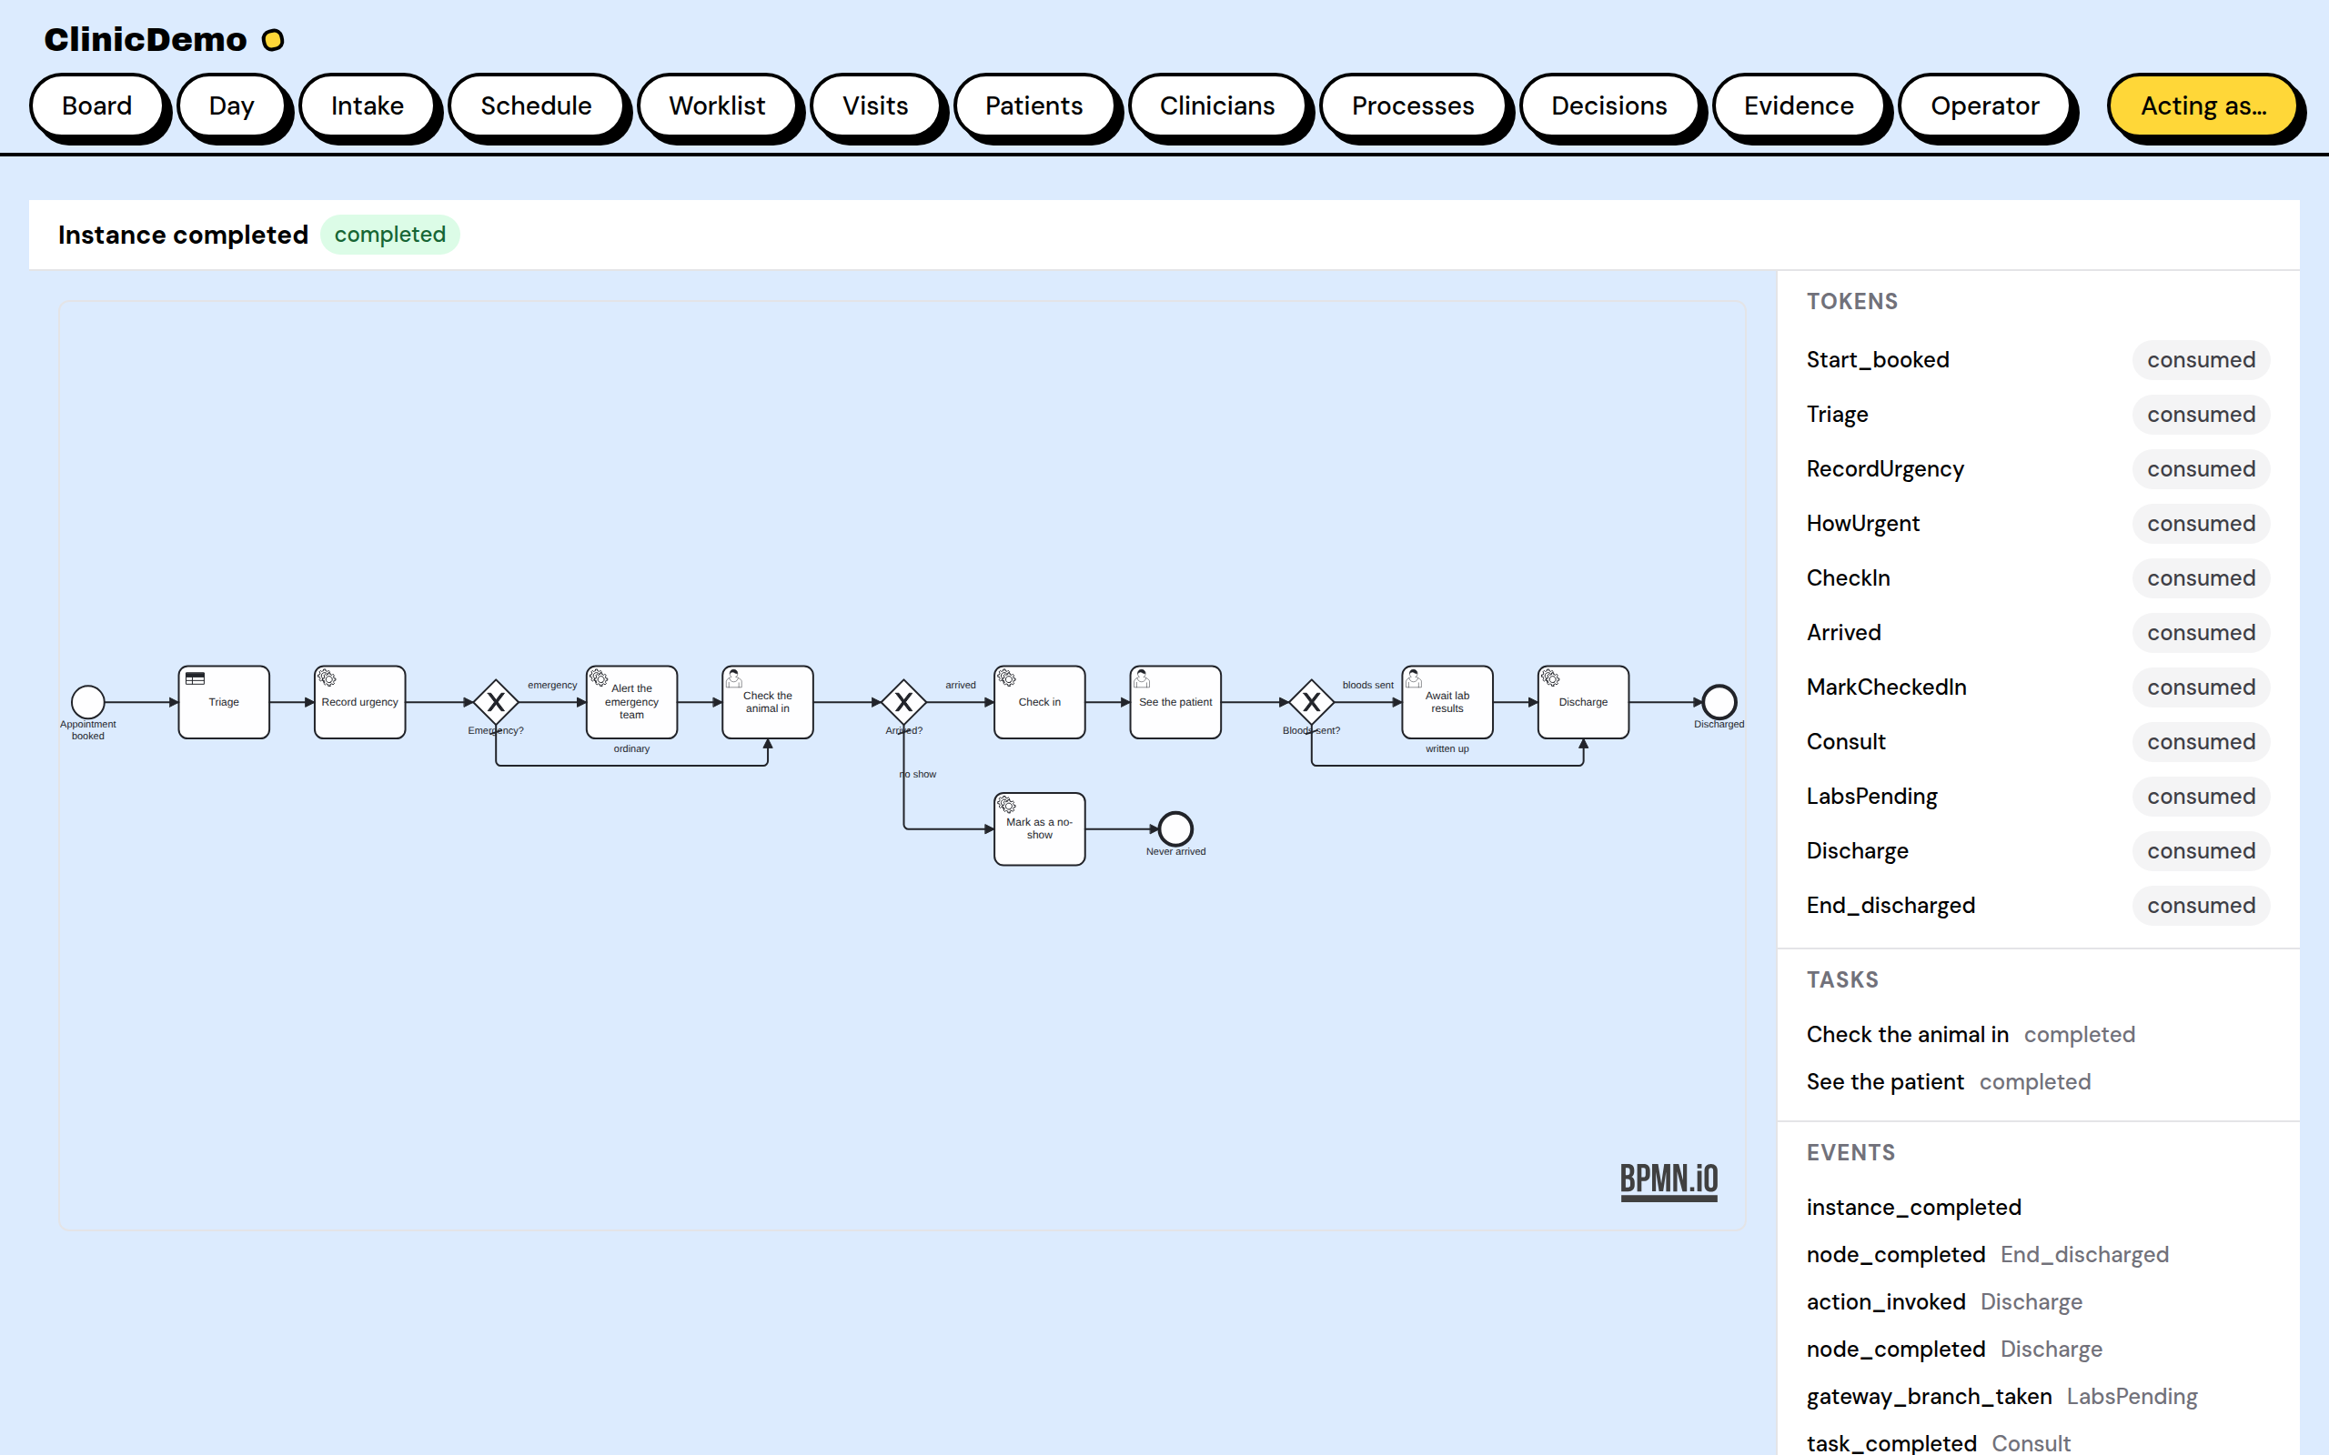
05 · PROCESS → TOKEN
A document, executed as rows
priv/processes/appointment_visit.bpmn
Start_booked
→ Triage (business rule → DMN)
→ RecordUrgency (service → record_triage)
→ CheckIn (user task, nurses)
→ Consult (user task)
→ Discharge (service)
# service tasks name the Ash action
# they call; the engine invokes it.
create :book do
change StartVisitProcess # in-txn
end
instance viewer
Booking starts the process inside the transaction. Open any visit from the hub: the diagram draws with the current node highlighted — waiting dashed, executing pulsing — and every guarded decision lands in the evidence trail.

Slide 10
THE AGENT STORY
The stack is agent-native, end to end
ash_agent_tools
describe / can / evaluate / edit — the contract, readable by machines; semantic edits with compile gates
Tidewave MCP
project_eval in the running app — Ash reflection, logs, SQL; get_docs at exact lockfile versions
Serena-grade editing
create ops + batch apply + formatter contract — agents author Ash DSL safely
The agent console
in-app: ask for an interface, it composes and verifies a surface live (LLM-backed, works keyless for browsing)

Slide 11
AFTER THIS DECK
What to watch in the live demo
1
Intake — one form books the visit; the row lands with triage already decided (the DMN answered in-transaction).
2
Pick a clinician, check the patient in on the board — the weight rule REFUSES it, quoting its rule id.
3
Record the weight; check in again — it passes, the token advances, the instance viewer shows where the visit is.
4
Open /operator/rules — the same rule, as data: draft, validate, approve, activate. The editor is the lifecycle.
5
Ask the agent console for an interface — it composes and verifies a surface on the fly.
6
/dev/dashboard — the running system: telemetry the app was born with, not wired up for the demo.

Slide 12
Nothing generated
that isn’t declared.
Nothing declared that doesn’t generate.
The vet clinic capstone · Phoenix · Ash · ash_a2ui · ash_bpmn · ash_decisions · ash_rules · ash_compliance · ash_agent_tools

