Slide 1
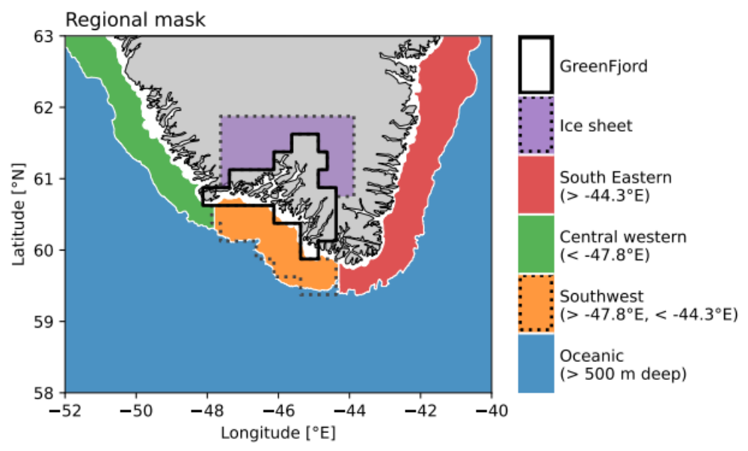

Slide 2
West
Greenland
Current
East
Greenland Current
North Atlantic

Slide 3
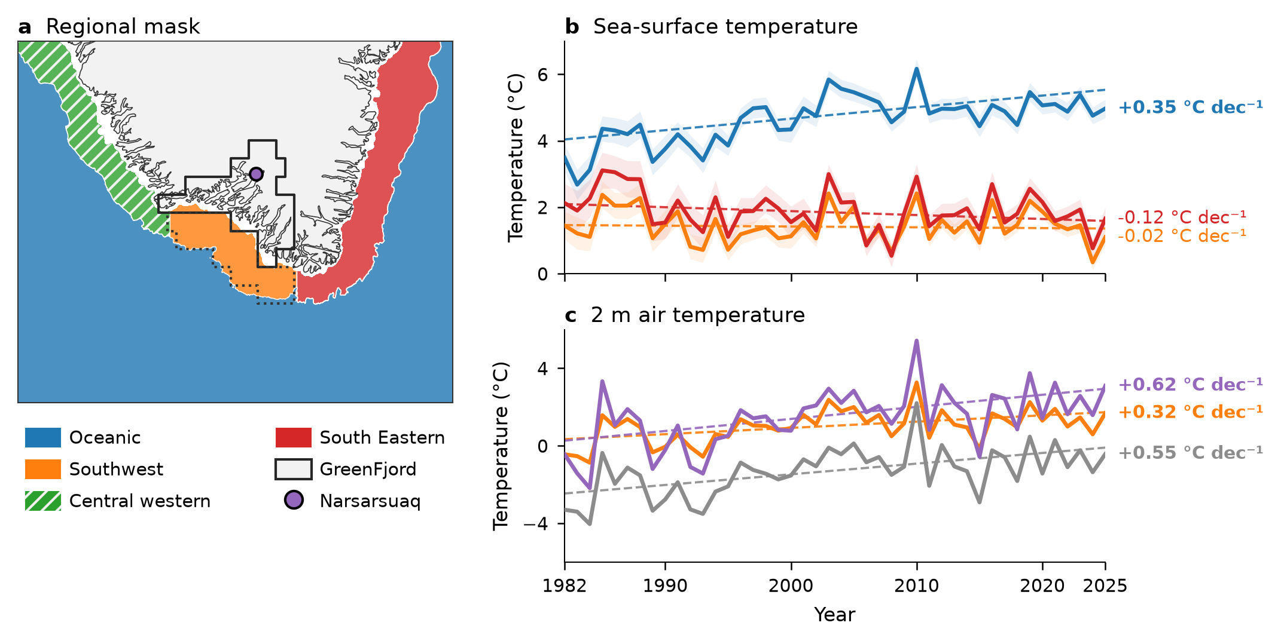
West
Greenland
Current
East
Greenland
Current
Labrador Sea
North Atlantic

