Slide 1
SOP • TEAM TRAINING
In-Room Jotform Sales Process
✅ Onboarding Process After Purchase
Every client. Every time. Same simple flow.
1

Slide 2
🔹 STEP 1
Step 1: Fill Out the JotForm
Every client must first complete the JotForm to proceed. Link to all Jotforms:
🏢 IN PERSON
In-room assisted Jotform (AUD) 🇦🇺
https://pci.jotform.com/form/252998741221867
In-room assisted Jotform (USD) 🇺🇲
https://pci.jotform.com/form/260675831638870
In-room self-service QR code Jotform (AUD) 🇦🇺
https://pci.jotform.com/form/251951019685867
🌐 ONLINE
Online self-service Jotform (AUD) 🇦🇺
https://pci.jotform.com/form/242967831977880
Online self-service Jotform (USD) 🇺🇲
https://pci.jotform.com/form/260685894235873
2

Slide 3
🔹 STEP 2
Choose Your Payment Method & Follow the Correct Sequence
💳
Bank Transfer / Physical Debit Card / PayPal
Pay inside the Jotform
🟦
Square Tapper
In-person payment — use the correct iPad
🟦
‘Split-it’ Financing
Monthly credit card payments
3

Slide 4
💳 PAYMENT ROUTE 1
For Payments via Bank Transfer / Physical Debit Card / PayPal
➤ If Paid in Full
➤ If On a Payment Plan
➤ If On a Custom Payment Plan
1. Make full payment in Jotform.
2. Sign the agreement.
(see down below for how to language this)
3. Book a 15-minute onboarding call with Blessing via Calendly.
1. Make your first payment in Jotform.
2. Sign the agreement.
3. Book a 15-minute onboarding call with Kristine (Finance Team) via Calendly.
1. Make the custom-agreed payment in Jotform.
2. Sign the agreement.
3. Book a 15-minute onboarding call with Blessing via Calendly.
4

Slide 5
🟦 PAYMENT ROUTE 2
For Payments Using Square Tapper (In-Person Payment)
⚠️ Important: Always use the correct iPad for processing payments.
➤ If Paid in Full
➤ If On a Payment Plan
➤ If On a Custom Payment Plan
1. Make full payment using Square.
2. Sign the agreement.
3. Book a 15-minute onboarding call with Blessing via Calendly.
1. Make your first payment using Square.
2. Sign the agreement.
3. Book a 15-minute onboarding call with Kristine via Calendly.
1. Make the custom-agreed payment using Square.
2. Sign the agreement.
3. Book a 15-minute onboarding call with Blessing via Calendly.
5

Slide 6
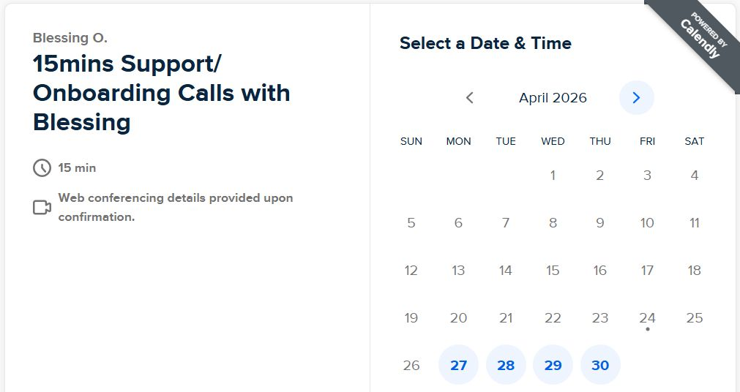
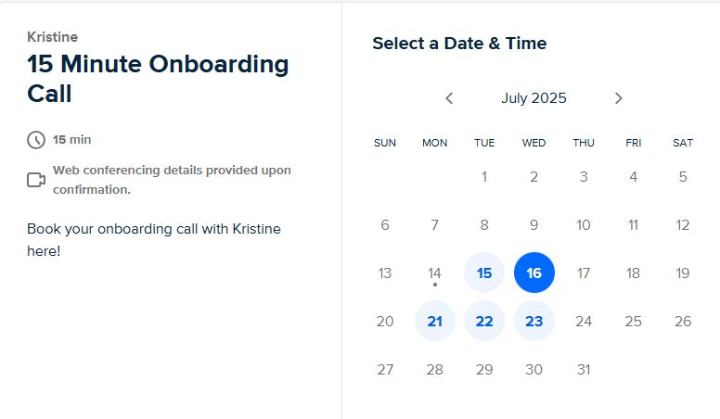
📅 BOOKING THE CALL
Calendly Booking Form Instructions
Only collect:
✔ First Name
✔ Last Name
✔ Email
Blessing — 15 min Support / Onboarding Calls
When it's time to sign —
You say “Just need your autograph here”.
6
Kristine — 15 Minute Onboarding Call

Slide 7
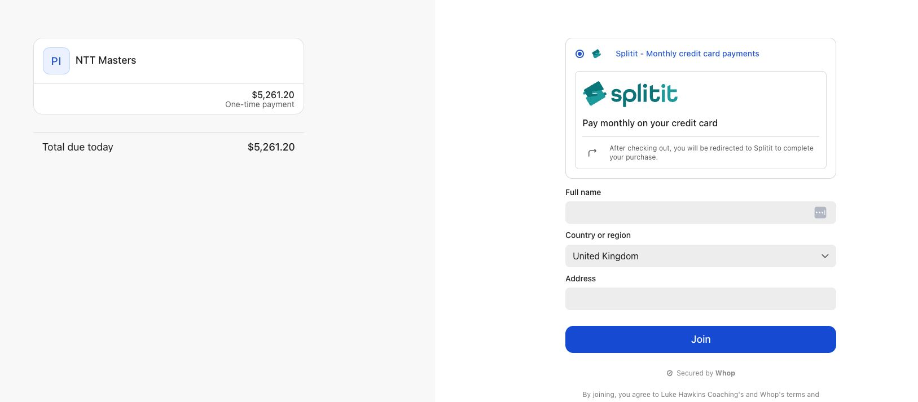
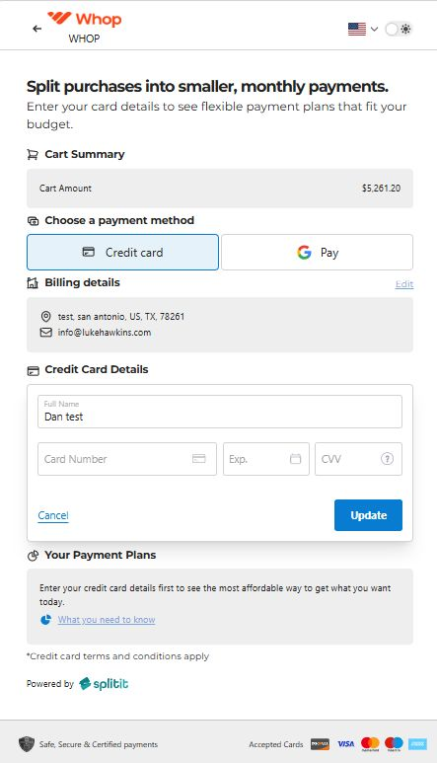
🟦 PAYMENT ROUTE 3
For Payments Using ‘Split-it’ Financing (1 of 2)
1. Fill out Jotform.
2. Click the link in jotform to take you to the “Split-it” financing page.
3. Have them input their details
4. Click on “Join.”
5. Add credit card details and click update
6. Select which payment option they want in the “your payment plans” section.
Steps 3–4: enter details, then click “Join”
7
Step 5: add card details → update

Slide 8
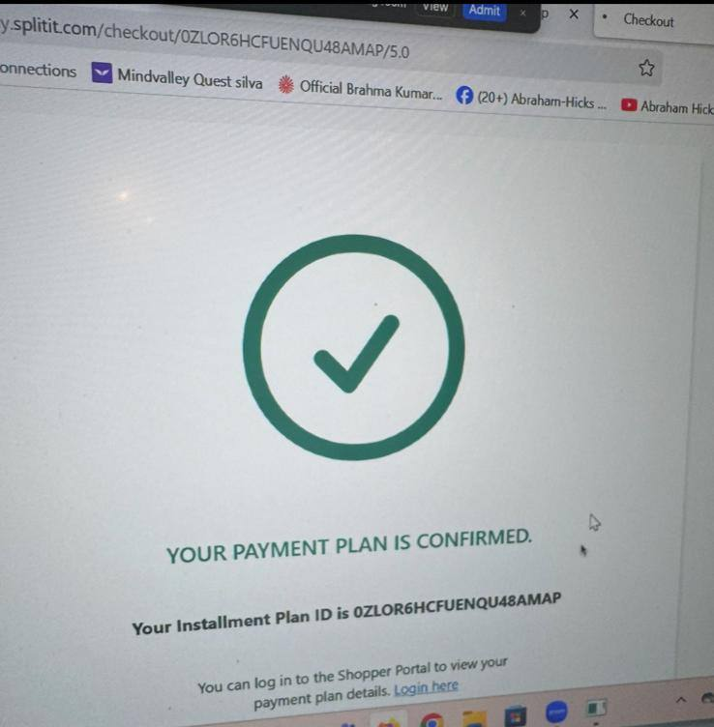
🟦 PAYMENT ROUTE 3
For Payments Using ‘Split-it’ Financing (2 of 2)
7. Click the proceed/confirm button.
8. It will take 2-4 mins max for approval.
9. Once successful you will see this screen. →
10. Then go back to jotform and follow the normal process.
11. Sign the agreement.
12. Book a 15-minute onboarding call with Blessing via Calendly.
✅ “Your payment plan is confirmed.”
8

Slide 9
🗣️ WORD-FOR-WORD SCRIPT
EXTRA NOTES — How to Language the Agreement
For step 2: “Sign the agreement.” You say “Just need your autograph here”.
If they say “what does it say?”
Your response (downward tonality):
“Just saying you’re happy to come along and do the payments (if on a payment plan) and the other main bits were what we covered on the first page together on the form (i.e. 75% of course got to be paid before attending the 7FA bootcamp or NTT Masters event, you get 12 months access to the online portal and all the bonuses)”
9

Slide 10
🔗 QUICK REFERENCE
Agreement Links
NTT Masters
Link to agreement for NTT Masters:
https://form.jotform.com/251947416259870
NTT Masters + 7FA
Link to agreement for NTT Masters + 7FA:
https://form.jotform.com/251947469715875
7FA
Link to agreement for 7FA:
https://form.jotform.com/251948252023858
10

Slide 11
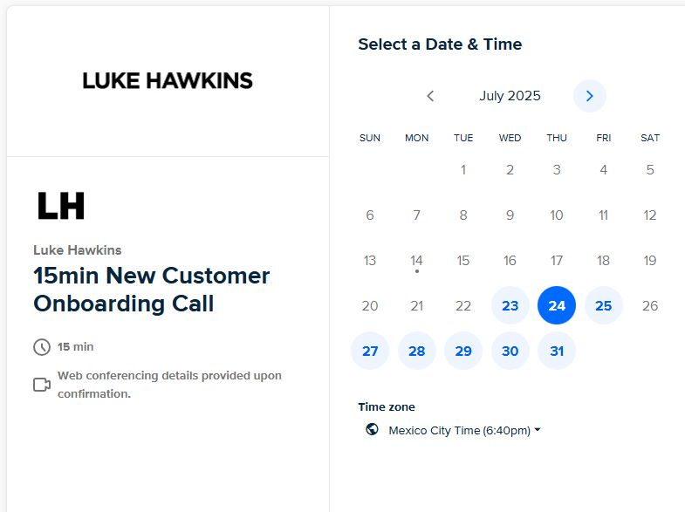
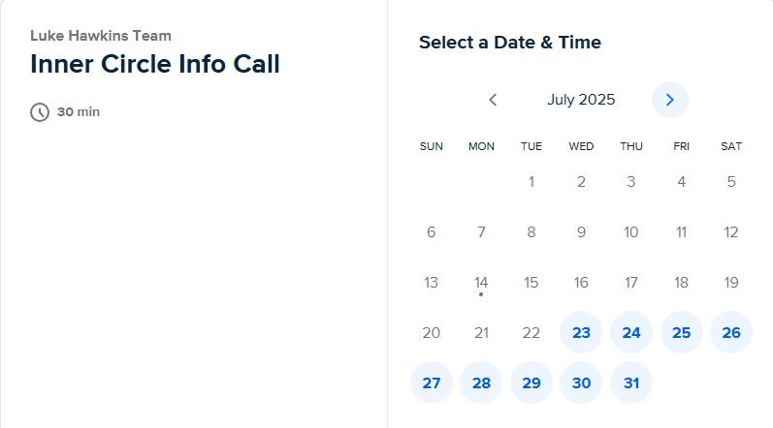
📸 VISUAL REFERENCE
Calendly Booking Pages — What You'll See
Luke Hawkins Team — Inner Circle Info Call (30 min)
Luke Hawkins — 15min New Customer Onboarding Call
11

Slide 12
🚀 RECAP
The Flow — Every Client, Every Time
1
Jotform
Client completes the form
2
Payment
Full / plan / custom — via Jotform, Square, or Split-it
3
Agreement
“Just need your autograph here”
4
Calendly
15-min onboarding call — Blessing or Kristine
→
→
→
Questions? Grab your team lead. Now go make it smooth. 💪
12

