Slide 1
Neuro Transformation Therapy™ Prac Course
CREW SALES SCRIPT
to sell 7FA & NTT Masters
Tab 1 • NTT PRAC JULY 2026

Slide 2
BEFORE YOU CREW
Training
• Part 1 (40 mins): The sales script to use for closing: Neurotransformation Therapy Practitioner Sales Script
– https://www.loom.com/share/5b6c9f913b8b47989ede61b9b9447142
• Part 2 (15 mins): Objections training: How to Handle Common Coaching Objections
– https://www.loom.com/share/395edb2fd1a3474cbdd2a5b7fe13a9f3
• Part 3 (24 mins) Jotform training: Job Form Sales Process SOP, Step by Step
– https://www.loom.com/share/79fa50552a7049b8a6c9d749e021f185
Link to “How to fill out Jotform” process:
https://docs.google.com/document/d/1kj-CcTXKJd4BRI_eBQfAGawCGLRpK4Vfk0nhAbnHR_I/edit?tab=t.0
CREW SALES SCRIPT • NTT PRAC JULY 2026

Slide 3
QUICK REFERENCE
All team Call Booking Links
Bernice Support call:
https://calendly.com/bernicelukehawkins/15-minute-support-call-with-bernice
Paid In Full Onboarding call (Kate/blessing):
https://calendly.com/lh-event-calls/live-event-onboarding-call
Kristine Payment Plan Onboarding Call:
https://calendly.com/finance-kristine/15min
Luke Custom Payment Plan Onboarding Call:
https://calendly.com/lh-event-calls/live-event-onboarding-call-cpp
CREW SALES SCRIPT • NTT PRAC JULY 2026

Slide 4
QUICK REFERENCE
All team Call Booking Links (continued)
Sarah Inner Circle Sales Call (Online):
https://calendly.com/lh-event-calls/inner-circle-application-call-online
Sarah Inner Circle Sales Talk (In Person):
https://calendly.com/lh-event-calls/inner-circle-application-call-in-person
Zoe Catch Up Call on whatever content is missed For Inner Circle Applications:
https://calendly.com/lh-event-calls/ntt-prac-catch-up-call
CREW SALES SCRIPT • NTT PRAC JULY 2026

Slide 5
QUICK REFERENCE
Link to all Jotforms: IN PERSON
In-room assisted Jotform (AUD) 🇦🇺:
https://pci.jotform.com/form/252998741221867
In-room assisted Jotform (USD)🇺🇲:
https://pci.jotform.com/form/260675831638870
In-room self-service QR code Jotform (AUD)🇦🇺:
https://pci.jotform.com/form/251951019685867
CREW SALES SCRIPT • NTT PRAC JULY 2026

Slide 6
QUICK REFERENCE
Link to all Jotforms: ONLINE
Online self-service Jotform (AUD) 🇦🇺:
https://pci.jotform.com/form/242967831977880
Online self-service Jotform (USD)🇺🇲:
https://pci.jotform.com/form/260685894235873
CREW SALES SCRIPT • NTT PRAC JULY 2026

Slide 7
QUICK REFERENCE
Link to all Payment Agreements: Paid in Full
NTT Masters Payment Agreement (PIF)
https://form.jotform.com/251947416259870
NTT Masters + 7FA Payment Agreement (PIF)
https://form.jotform.com/251947469715875
7FA Payment Agreement (PIF)
https://form.jotform.com/251948252023858
Inner Circle Payment Agreement:
https://form.jotform.com/231372322671450
CREW SALES SCRIPT • NTT PRAC JULY 2026

Slide 8
QUICK REFERENCE
Link to all Payment Agreements: Payment Plan
NTT Masters Payment Agreement (Payment Plan)
https://form.jotform.com/242966301928867
NTT Masters + 7FA Payment Agreement (Payment Plan)
https://form.jotform.com/242965709101861
7FA Payment Agreement (Payment Plan)
https://form.jotform.com/242966082493870
CREW SALES SCRIPT • NTT PRAC JULY 2026

Slide 9
QUICK REFERENCE
NTT July students payment data
List to all NTT July students payment data:
NTT Prac July Student payment data
https://docs.google.com/spreadsheets/d/1dBi_8vasunCJMLA9e8NZs9bksofmg2y5q4r6iGTz5R0/edit?gid=0#gid=0
CREW SALES SCRIPT • NTT PRAC JULY 2026

Slide 10
SOP
Custom Payment Plan option
*If a student is unable to commit to one of the official payment plan options, then a custom payment plan option is possible as described below.
Minimum Deposit: $500
• If the full deposit isn’t paid upfront, the remaining balance must be settled within 2 weeks — ideally within 4 days.
• Payment arrangements are made during a scheduled onboarding call with Luke, where the client can either agree on paying the balance on the call or choose from the available payment plans and that includes paying the difference for the deposit amount owing where applicable.
• Exception: If a client has a guaranteed incoming payment (e.g. divorce settlement, property settlement, or tax rebate), the balance may be deferred — provided the funds are confirmed to arrive before the NTT Masters training in November or May, depending on which one they selected.
CREW SALES SCRIPT • NTT PRAC JULY 2026

Slide 11
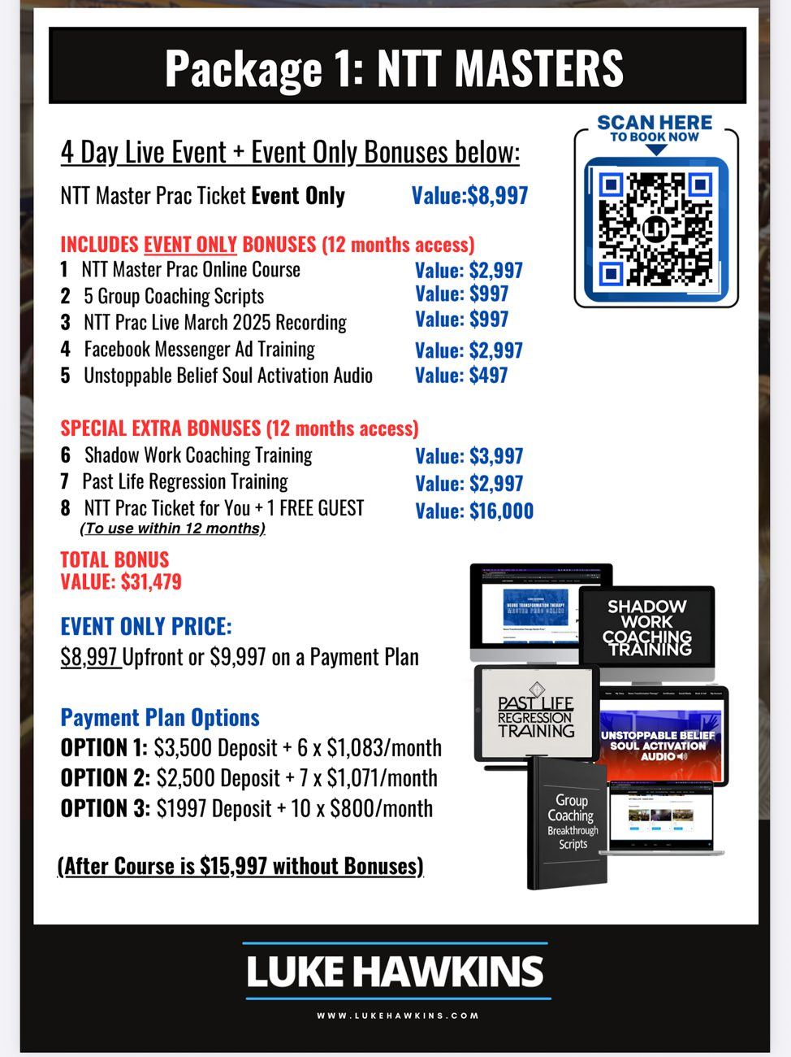
PACKAGES:
Package 1: NTT Masters
CREW SALES SCRIPT • NTT PRAC JULY 2026

Slide 12
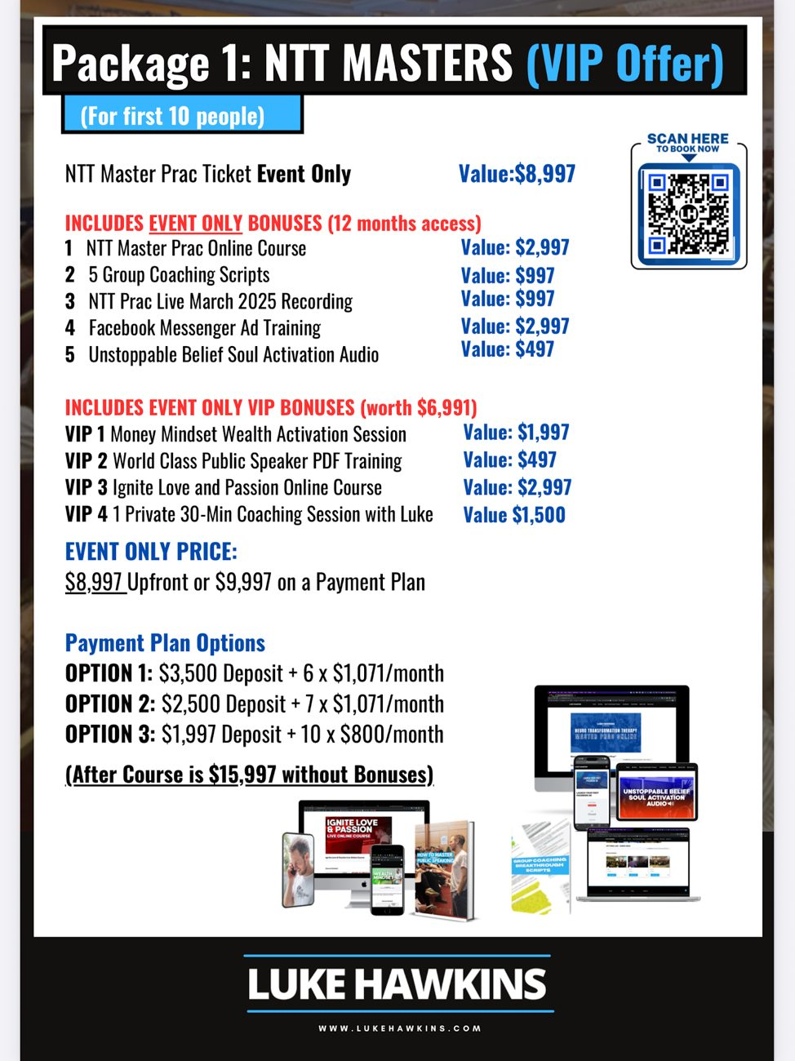
CREW SALES SCRIPT • NTT PRAC JULY 2026

Slide 13
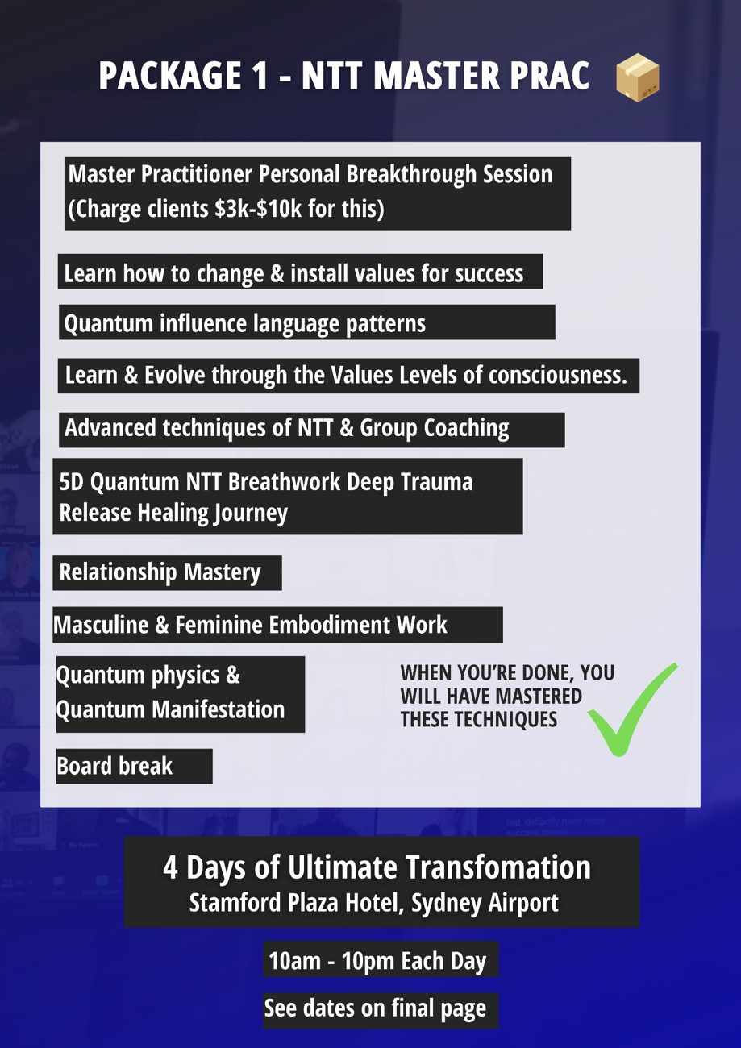
CREW SALES SCRIPT • NTT PRAC JULY 2026

Slide 14

CREW SALES SCRIPT • NTT PRAC JULY 2026

Slide 15
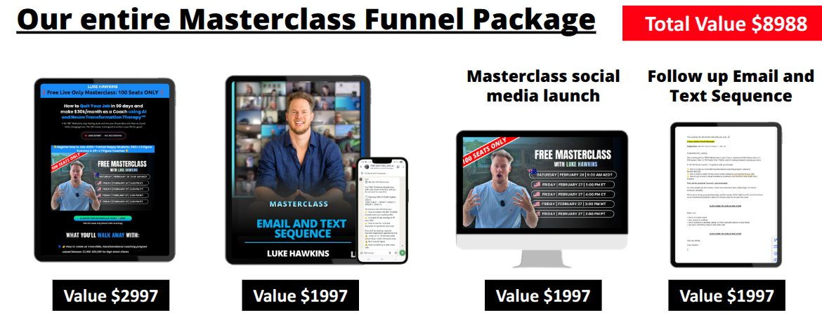
7FIGURE ACADEMY PACKAGE + VIP BONUS
(First 10 people only)
CREW SALES SCRIPT • NTT PRAC JULY 2026

Slide 16
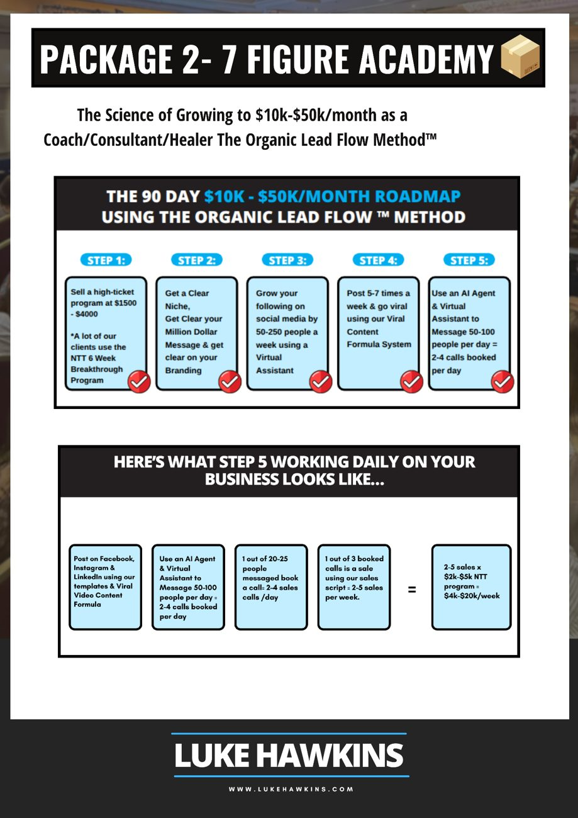
CREW SALES SCRIPT • NTT PRAC JULY 2026

Slide 17
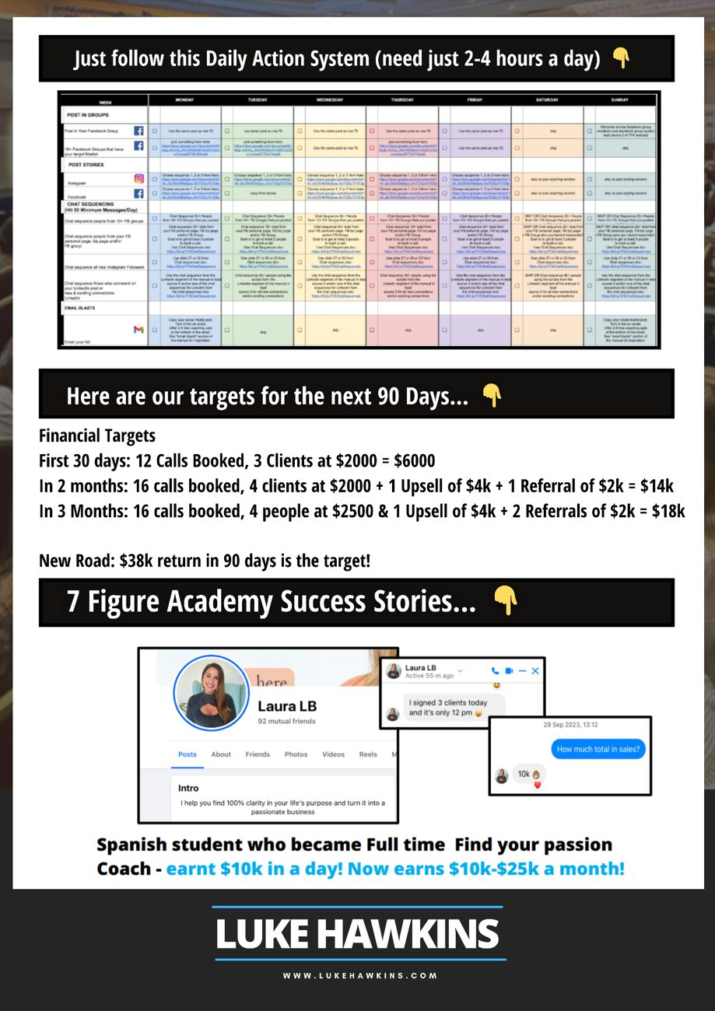
CREW SALES SCRIPT • NTT PRAC JULY 2026

Slide 18
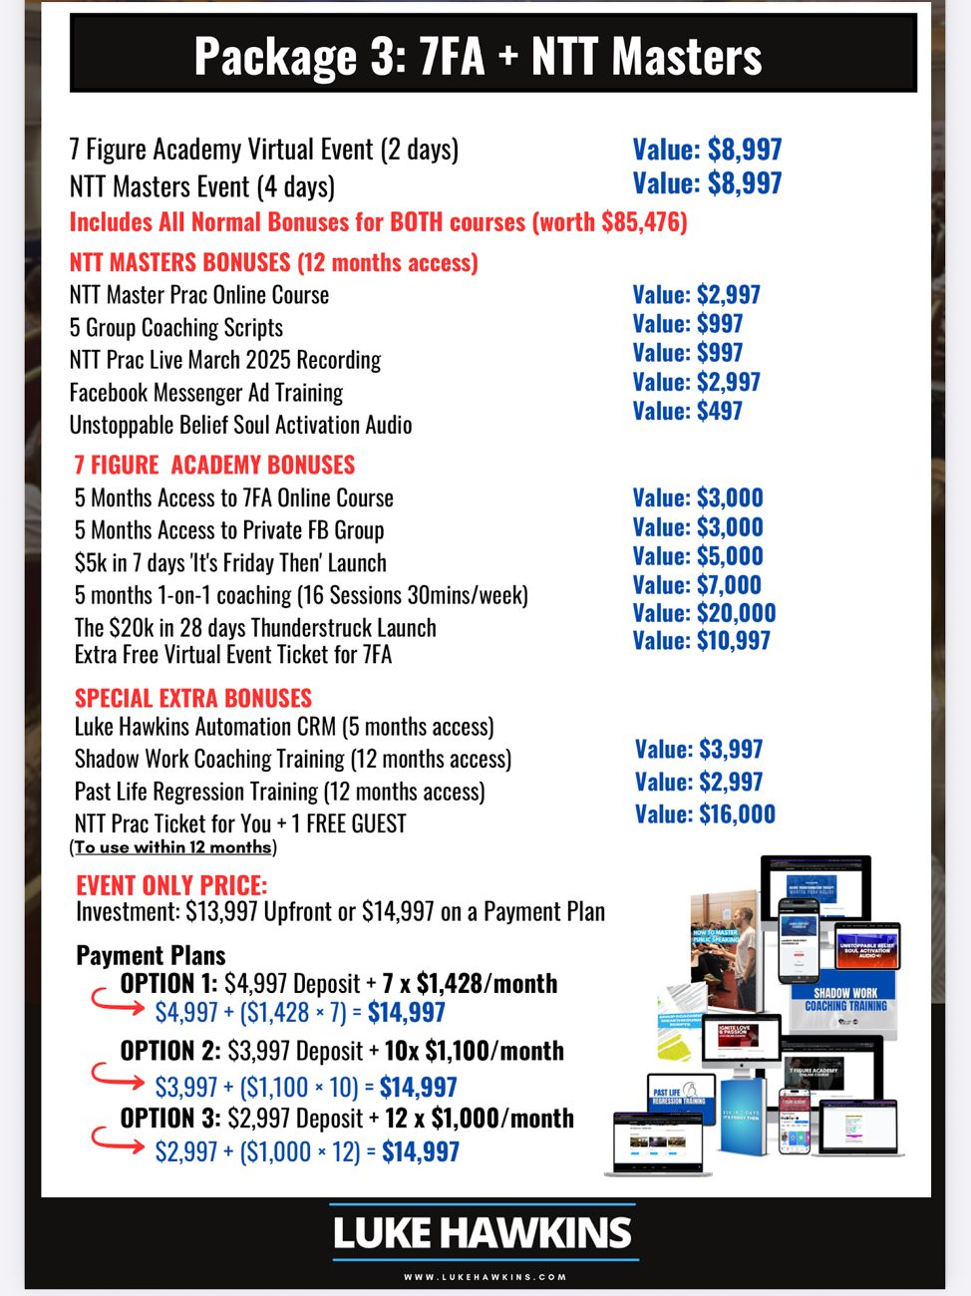
CREW SALES SCRIPT • NTT PRAC JULY 2026

Slide 19
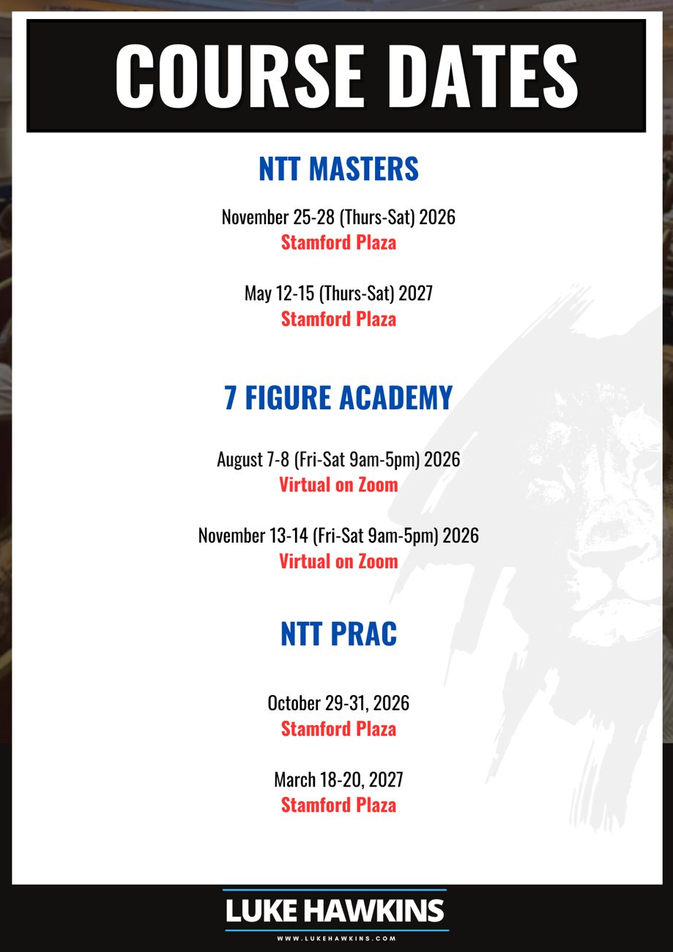
CREW SALES SCRIPT • NTT PRAC JULY 2026

Slide 20
THE SCRIPT
SALES SCRIPT FOR NTT MASTERS & 7 Figure Academy (and Lions Inner Circle)
Step 1: Ask open-ended questions & match and mirror
CREW SALES SCRIPT • NTT PRAC JULY 2026

Slide 21
BEFORE YOU OPEN
Reminders
• Pay attention to nonverbal body language as you’re talking to the student. The body language and tonality will tell you more than their words ever will.
• Know the power of calling them out on their tonality and body language. For example, you can say things like:
“What are you thinking right now? You don’t sound too certain.”
“Looks like you feel something might be missing for you.”
“I see your ________(Call out what they’re doing with their body or eyes or gestures here), What are you thinking/feeling?”
CREW SALES SCRIPT • NTT PRAC JULY 2026

Slide 22
BEFORE YOU OPEN
Reminders (continued)
• Once you see body language that you’ve called out that is incongruent with what they’re saying, or you can see its stopping them from buying chunk down and find out:
– what the thought is
– where it comes from
– why it’s there
– does it help them
– is it true
• Selling is solving a problem. It is a disservice to not sell something that’s going to make somebody’s life better.
• Focus on your goal of how many sales you want to get each day. This is a sign that whatever you set your mind to, you can do. If you can do it here, you do it in your own business to transform more lives.
CREW SALES SCRIPT • NTT PRAC JULY 2026

Slide 23
STEP 1
Step 1: Open the conversation
Soft open
• “How are you finding the course so far?”
• “What have been the biggest takeaways for you?”
• “What brought you here?”
• “What are some of your goals you’ve got now?”
• “Do you have plans for what you want to do beyond here?”
Medium open
• “So what do you think about continuing the journey with the NTT?”
• “What do you think about coming to the next one?”
• “What do you think about the value of the next one?’
Hard open
• “Have you booked in for NTT Masters & 7-figure academy yet?”
*Take them to the table as early as you can in the interaction. Utilise when they are in a peak state, after they laugh at a joke, or are being really responsive to you.
CREW SALES SCRIPT • NTT PRAC JULY 2026

Slide 24
STEP 2
Step 2: Ask about goals
• “What are your goals beyond here?”
• “What’s your vision for the next 6-12 months?”
CREW SALES SCRIPT • NTT PRAC JULY 2026

Slide 25
STEP 3
Step 3: Find challenges (create the need)
Ask any of the following:
• “What do you think has been the biggest blocks you’ve noticed come up for you?”
• “What has been your biggest challenge/unwanted pattern that you’ve noticed play out for you?”
• “What do you struggle with most?”
For any challenge/struggle/unwanted pattern:
• “Where do you think that comes from?” “Why do you think you have that (pattern)?”
• Have you got an example of that of how thats played out for you?
• “What have been the biggest blocks or challenges that have prevented you from achieving this vision?”
CREW SALES SCRIPT • NTT PRAC JULY 2026

Slide 26
STEP 3
Step 3: Find challenges (continued)
• Have you had any paid clients already? How many? How much do you charge? What stops you from charging more?
• Have you ever thought about the Masters where you get a second bigger programme to sell? I know Luke recommends to always have at least two high-ticket programs, and the Masters one you should sell that for $4,000 to $8,000 is about the average.
Chunk down on whatever need or challenge or block they tell you that you think is most valuable to solve. Find out where it comes from. Find examples of where it plays out, and then link it to it being solved by NTT Masters or 7 Figure Academy.
CREW SALES SCRIPT • NTT PRAC JULY 2026

Slide 27
STEP 3
Common needs for NTT Masters
• Wants another higher ticket program to sell clients at $4k-$8k (NTT Masters breakthrough)
• Wants to do group coaching, workshops, or retreats (Will use the group tools and group transformation processes in NTT Masters for this)
• Has relationship issues or just needs more inner work
• Wants to just become a master level coach to get clients greater results & more referrals
CREW SALES SCRIPT • NTT PRAC JULY 2026

Slide 28
STEP 3
Common Needs for 7 figure academy
• Does not have clarity on their message/niche -needs to language it in a compelling way online & have clarity on content topics
• Hasn’t been taught on how to do viral video content and social media posts that get good reach and engagement that generates leads
• Has small or no following/audience on social media (teach content marketing and Use VA to grow their following too)
• Would benefit from 1 on 1 coaching for accountability
• Does not know how to get leads on social media
• Needs further sales training to close leads
• Sees value in knowing how to hire the right VA to help message people online and use AI as well to get leads for them
CREW SALES SCRIPT • NTT PRAC JULY 2026

Slide 29
STEP 4
Step 4: Links goals & challenges to 7FA or NTT masters or Both (point to the posters if it helps)
• “What do you think of the value of 7FA/NTT Masters to help with that?”
• “Have you enrolled in 7FA already? NTT Masters?”
• “What would you need to get out of it for it for 7 figure academy/masters to be worth it?”
• “What’s holding you back from doing 7FA or Masters?”
Explain the value and how it helps! Find what they value most.
CREW SALES SCRIPT • NTT PRAC JULY 2026

Slide 30
STEP 4
To gain more rapport:
• Tell your relatability story that relates to them and their challenges and goals and how the course helped you.
• If they shut it down and get triggered, you need more rapport.
• Ask more questions and start giving them tips to achieve their goals to get back rapport. Share vulnerable things about myself to get rapport back as well.
• Trust is built by giving free value and helping them to see you have their best interests at heart and by sharing vulnerable things!
CREW SALES SCRIPT • NTT PRAC JULY 2026

Slide 31
STEP 4
The best interest frame
If someone believes that everything you say or do is in their best interests, then they will trust you. If not, they won’t.
They ask themselves 2 core questions when you are speaking
• Is this person hearing me and seeing me?
• Can I trust this person?
CREW SALES SCRIPT • NTT PRAC JULY 2026

Slide 32
STEP 5
Step 5: Take them to the table & ask qualifying questions
Crew member: “Let me show you what you get in the Masters/7FA and how it can help”
• Talk about what they get in the program that they’re interested in
• If you need leverage, as a last resort, say you would be happy to throw in the bonuses of the first 10 people VIP Bonuses.
General Qualifying Questions (optional)
• “How soon do you want these changes? Why?”
• “Why do you want these changes to happen? Why do you want to heal these things”
• “How motivated are you to change this?”
CREW SALES SCRIPT • NTT PRAC JULY 2026

Slide 33
STEP 5
Buying Qualifying Questions
• “If we invited you in, could you make those dates?”
• “If we invited you in, do you have the funds to do it?”
• “Would you pay it up front to save $1000 for ntt masters or save $1000 for package 3 (NTT Masters & 7FA) in one go to get the discount?”
*Take them through the ipad to enrol
CREW SALES SCRIPT • NTT PRAC JULY 2026

Slide 34
STEP 6
Step 6: Close
Option 1: Use closing statements
“Great! Congratulations! Lets get you started”
Option 2: Use a “yes set”
Ask 3 undeniable questions they would say yes to:
• “Do you see the value in it?”
• “Are you willing to take action on the value you are receiving?”
• “Are you going to come in self honest to give 100% to clear what has held you back?..... Great youve got this! lets enrol!”
Option 3: Isolate what is stopping them & chunk down if needed:
• “What is holding us back that we need to overcome?/What are you thinking?”
• “Just so i understand, What specifically do you mean?” OR
• (Repeat back the objection they said)
CREW SALES SCRIPT • NTT PRAC JULY 2026

Slide 35
STEP 7
Step 7: Handle Objections
There is only 4 Main Objections:
• There’s not enough value
• They don't believe it will work
• Not believing in themselves
• They are genuinely not the only decision maker.
Follow these steps when there is ANY objection:
V.A.L.U.E.S Objection Handling Framework
CREW SALES SCRIPT • NTT PRAC JULY 2026

Slide 36
V.A.L.U.E.S FRAMEWORK
✅ Step 1: V – Value Check (Address Not seeing enough Value)
“Before we go over that, how do you feel about things in a value sense first; how do you feel about the value you are getting? Do you think it's worth it?”
Allow them to respond.
• Go into what it has cost them in the past so far in different life areas such as health/body, relationships, finances, business/career, etc.
• What will happen if they don't fix this: Go into what it will cost them in the future in different life areas such as health/body, relationships, finances, business/career, etc.
• Explain the science of why it works.
Check they see the value.
CREW SALES SCRIPT • NTT PRAC JULY 2026

Slide 37
V.A.L.U.E.S FRAMEWORK
✅ Step 2: A – Assurance It Works (Address ‘It Doesn't Work’)
Crew member: “So how do you feel about this working? Do you believe it works? Or not really?”
The science
• We're going to bring up more stored, unconscious, unfelt, unprocessed trauma that's holding you back and controlling you
• We are going to do deeper and do even more impactful mind, heart, and spirit level healing and transformation processes to release it out.
• We're going to install the lessons, the beliefs, the truths, the values, the identity. Connect you to your purpose. Everything takes you to a much deeper level of knowing of who you are, in your power, in your true self so you can bring your goals to life.
• And we hold you accountable for everything that happens in the room to make sure you transform and heal and make sure you're the best trained coach for others.
CREW SALES SCRIPT • NTT PRAC JULY 2026

Slide 38
V.A.L.U.E.S FRAMEWORK
✅ Step 2: A – Assurance It Works (continued)
If they don't believe it works, explain the science of why it does as mentioned above. As you are sharing the science of why it works, get them to agree and say yes as you are going (pacing & leading):
Crew member: “Is this okay?”
Prospect: “yes”
Share your story if needed. You want them to say, “yes” to the things you want them to believe. This is called a “yes set.”
CREW SALES SCRIPT • NTT PRAC JULY 2026

Slide 39
V.A.L.U.E.S FRAMEWORK
✅ Step 3: L – Likelihood of Their Own Success (Address Not Believing in Themselves / ‘I Can’t Succeed’)
Crew member: “okay this requires real depth of honesty, which you have been, coz this is the biggest thing that holds us back….How do you feel about your ability to succeed? Do you believe you can change & succeed with this program?
Find out specifically what their fear/limiting belief is about why they can't get the result they want with the program; this is the unspoken objection that has to be found.
Once you find the thing holding them back, use the “Mini objection crusher” framework below and isolate it by asking…
CREW SALES SCRIPT • NTT PRAC JULY 2026

Slide 40
V.A.L.U.E.S FRAMEWORK
The “Mini objection crusher” framework
• 1) what specifically does that mean
• 2) Where do you think that comes from?
• 3) Why do you think you have that?
• 4) Give me an example of where that's played out for you?
• 5) What happens if you don't let that go and you don't let that get in the way anymore of bringing your dream life vision to life? What happens if we don't overcome this? What is it going to cost us? What does it destroy? What does it cause us to miss out on?
• 6) reframe them into a new empowering meaning one by one and
• 7) tell a metaphor on each if you need to.
CREW SALES SCRIPT • NTT PRAC JULY 2026

Slide 41
V.A.L.U.E.S FRAMEWORK
✅ Step 4: U – Uncover Commitment Level
“Okay so knowing all this, What's your commitment level to achieving these goals and bringing this vision to life, you mentioned…10 being totally committed, 0 not at all?
If less than 10:
• “What do you need to know to be a 10?”
• “Can you decide to know that to be a 10?”
Reaffirm and give reasons why if needed to get them to be a 10.
If still stuck use “The mini objection crusher” framework
Optional: Then Yes Set again:
“Okay great…
• “So we see enough value now?”
• “We believe it works?”
• “We believe we can succeed?”
• “And we’re committed?”
Now they’re emotionally and mentally aligned.
CREW SALES SCRIPT • NTT PRAC JULY 2026

Slide 42
V.A.L.U.E.S FRAMEWORK
✅ Step 5: E – Explore Finances
Only after the above 4 are handled.
Now move to the practical:
5.1 “Cool, so if there was a way to do this without setting off a fire alarm or putting anyone on the street, would we like to explore if there's a way to make this work?”
If yes: proceed to 5.2
If no: “What's missing? How are you feeling?”
• Option 1: *Use mini objection crusher framework
• Option 2: start back at step 1 in the handling objections section where you get them to see more value
• Option 3: Start at step 3 of the sales script where you have to find more of a need and ask more of the reasons why they want to change their life.
CREW SALES SCRIPT • NTT PRAC JULY 2026

Slide 43
V.A.L.U.E.S FRAMEWORK
✅ Step 5: E – Explore Finances — 5.2
5.2 “Great, you're able to pay it up front to get the $1,000 discount and all the in-room bonuses?”
If they can pay up front: Enrol
If no: “Which payment plan out of those did you like the most? And remember, if you want to make the November one, it just has to be paid in full before the date. Otherwise, they just push you back to the May one next year.”
*Enrol Using one of the pre-selected payment plans.
If they would have to do a custom payment plan: Go to 5.3.
CREW SALES SCRIPT • NTT PRAC JULY 2026

Slide 44
V.A.L.U.E.S FRAMEWORK
5.3 Financial deep dive
Crew member: “So money aside, you want to do it?”
Prospect: “Yes”
Crew member: “So if we can find a way to do this financially without setting off a fire alarm you’re happy to do that?”
Prospect: “Yes”
If no: “What is it other than money we need to overcome?” Is that the only thing? Anything else? *use Mini objection crusher framework if needed
Prospect: “nothing else, just the money”
CREW SALES SCRIPT • NTT PRAC JULY 2026

Slide 45
V.A.L.U.E.S FRAMEWORK
5.3 Financial deep dive (continued)
Crew member: Thats okay, we are still getting an in room discount, you’re saving $7k by doing it in the room, so what is the best deposit we could do without setting off the fire alarm?
Prospect: I would be able to do $1k
Crew member: That’s the best you can do? Or “That's a bit less than what I know Luke normally does or would allow. Is there any way you do a little bit more/ could push it to _______(add $500 or $1k)”
Prospect: Yep
Crew member: Okay great so you have the deposit now of $______ . Whats best monthly repayments you can do without setting off a fire alarm?
Prospect: Ah $______ per month
Crew member: Cool so that would start a month from now, is the date the _____/____ of _______ ( 1 month from now) okay?
Prospect: yep that works
CREW SALES SCRIPT • NTT PRAC JULY 2026

Slide 46
V.A.L.U.E.S FRAMEWORK
If they say they don’t know how much money they have
If they say they don’t know how much money they have or I can use or I don't know what I'm currently paying for my current course or courses and how much is left.: “Can I ask some questions about finances to see how we can help because if we can great if we cant we cant?”
Income:
“Can I ask what is coming in per month as an estimate (from all sources)?” $______
*It is good to use paper to write these answers down.
Expenses:
“And can I ask what is the estimate of your expenses per month?” $______
CREW SALES SCRIPT • NTT PRAC JULY 2026

Slide 47
V.A.L.U.E.S FRAMEWORK
If they dont know: You can write out expenses if you like:
• “health insurance?
• car insurance?
• fuel?
• food?
• going out?
• Mobile phone bill?
• gas bill?
• electricity bill?
• water bill?
• and school fees?
• Or any other subscriptions?"
CREW SALES SCRIPT • NTT PRAC JULY 2026

Slide 48
V.A.L.U.E.S FRAMEWORK
If they can’t make a decision without knowing their current payment plan
*If they can't make a decision without knowing the current payment plan for their current course or courses they're enrolled in, then click on the shortcut to find the payment plan data for each student. You'll be able to see all their financial information, in terms of:
• their name
• what they've paid
• what they owe
• how much is left
And then add that to their expenses.
Amount cashflow positive per month: $______”
CREW SALES SCRIPT • NTT PRAC JULY 2026

Slide 49
V.A.L.U.E.S FRAMEWORK
Confirm & enrol
Crew member: So if we do this deposit of $_____ and $_____ per month starting 1 month from now that works for you?
Prospect: Yep
Crew member: “Great, congratulations, lets get you enrolled!”
CREW SALES SCRIPT • NTT PRAC JULY 2026

Slide 50
V.A.L.U.E.S FRAMEWORK
Special Scenario
Special Scenario: The client is currently on a payment plan for the courses they are enrolled in or have enrolled in Masters already and wants to combine their payment plan or adjust their payment plan so they can make the repayments of everything combined. In this case Click on the shortcut, or if you're crewing online, then go to the payment plan data spreadsheet, which will give you and you can see the payment plan they have there.
CREW SALES SCRIPT • NTT PRAC JULY 2026

Slide 51
ENROLMENT
BEGIN JOTFORM ENROLLMENT PROCESS & GET AGREEMENT SIGNED
Click here for jotform process:
https://docs.google.com/document/d/1e4Ro4p4K7tRCVO_OBO8e5cUy78ZpLtX9glndGb0jutQ/edit?tab=t.0#heading=h.x6dwp14nrhs
CREW SALES SCRIPT • NTT PRAC JULY 2026

Slide 52
KEEP IN MIND
Miscellaneous Notes:
• Always validate what they say
• Use “we” language instead of “you” as much as possible
• Your story creates connection with them
• In 95% of cases, let them “empty out”
• Watch for facial and body language certainty - dont go too early and dont go to late for the close
• If they get triggered, ask open ended questions that change their focus and give value. Then swing back to the program if you know there’s enough rapport to do it
• Have fun in the interaction and be yourself
CREW SALES SCRIPT • NTT PRAC JULY 2026

Slide 53
KEEP IN MIND
Miscellaneous Notes (continued)
• Project total certainty and own yourself and your story
• You must get people to tell you the truth and be honest
• Stay in your heart for connection
• They are not buying because of what they are not telling you
• Making a point and backing it up with a metaphor story and then following up with a question to gain agreement is the most powerful way to change belief systems
• If they are silent or not buying you can also ask “what are you thinking now”? Are you imaging it not working or working? Looks not working?
CREW SALES SCRIPT • NTT PRAC JULY 2026

Slide 54
WORD-FOR-WORD RESPONSES
Objection handling responses
CREW SALES SCRIPT • NTT PRAC JULY 2026

Slide 55
OBJECTION 1
Objection 1 – “I just don’t think it’s the right timing”
“You mentioned you wanted this because (list reasons) did you still want that? Why are those reasons important to you? What happens if you fix that or solve that?
“I know if something is important enough to us, we will always find the way. It's just we don’t use all our potential inside of us to find a way either because we are not in enough pain about the problem yet or we simply do not want it enough. And this is changeable if we connect to our reasons for change. When we have a big enough why, we can find the how.
CREW SALES SCRIPT • NTT PRAC JULY 2026

Slide 56
OBJECTION 1
Objection 1 (continued)
“Let me ask you this, I want you to imagine God forbid a family member became unwell. And they needed $2000 for life saving surgery. Would you want to help them? Great! And now imagine if God forbid that happened and your family said to you, ______(their name), I need $2000 for life saving surgery and you have 3 days to find it, what would you do? Where would you get that money? As you can see its not a money issue, its about making this change a must, if this has enough value to you, because the life we want is on the other side of the obstacle. It requires more courage, it requires more creativity and it requires more commitment. and i can tell you our dream life is on the other side of that.”
Because you finding a way to make this happen is an example of when you see an obstacle or challenge in your life it is not going to stop you any more, that you are going to find a way to solve or rise above anything that comes your way. This is a symbol that whatever you set your mind to you can do.”
CREW SALES SCRIPT • NTT PRAC JULY 2026

Slide 57
OBJECTION 2
Objection 2 – “Maybe I should wait until later”
“Yes waiting is one of the brain's favourite ways to avoid discomfort, it convinces you that later will feel safer instead of just acting now but what happens for most people is they create a pattern of procrastination and later just becomes another indoctrinated pattern.
And if you don’t do something to break that pattern now, the mind will get more comfortable, that neurological pathway will become more rigid, do you think it will be easier to change if you reinforce it, or harder to change if you reinforce it now? Harder to change!
So don’t let the mind indoctrinate you into the old familiar, this is an opportunity for you to step into not only the unknown but step into the next level of your growth, because that's what you want isn't it.
CREW SALES SCRIPT • NTT PRAC JULY 2026

Slide 58
OBJECTION 3
Objection 3: There's no way to get the money
“Can I ask you a question? I want you to imagine god forbid a family member/your favorite family pet became unwell. And they needed $2000 for life saving surgery. Would you want to help them? Great and imagine if God forbid that happened right now and that family said to you, ______(their name), I need $2000 for life saving surgery and you have 3 days to find it, what would you do? As you can see its not a money issue, its about making this change a must, not a should. that opens up a whole new level of creativity and commitment and i can tell you our dream life is on the other side of that.”
CREW SALES SCRIPT • NTT PRAC JULY 2026

Slide 59
OBJECTION 4
Objection 4: I dont know if i should spend this money on myself
Reframe: “Do you pay taxes?”
Do you pay taxes? Do you pay the ATO? You give them money each year, why don’t you give it to yourself. At least give it to someone you like. And it’s not even your money any way you got it from somewhere else. This is someone else’s money. So let’s use someone else’s money that you got from someone else and invest it in you. You are only temporarily borrowing it from somewhere until you get the return and then this course was free, or better than free. Coz you made more money than what you invested, and you can do this.
CREW SALES SCRIPT • NTT PRAC JULY 2026

Slide 60
OBJECTION 5
Objection 5: I just don't make decisions quickly
1. “I hear you, I understand that. Lets just put the speed of the decision to the side because regardless of speed, we want this to be the right decision don't we? I only want you to do if this is right for you . not wrong for you, if its wrong we shouldnt do it at all. Because if we make the wrong decision slowly it was still the wrong decision, you get what I mean? So we want to make sure if it’s right.
2. So tell me, money aside , what do you want this to do for you? Why do you want that? What do you think of _______(mention some specific value point that you think that will help them)? Do you think that would help?
Insert painful financial consequence of not acting and use 1, 5 or 10 years from now)
CREW SALES SCRIPT • NTT PRAC JULY 2026

Slide 61
OBJECTION 5
Objection 5 (continued)
3. What will happen if we dont fix this?
4. What do you think, in the space of total self honesty, as we have been, what are are fearing or imagining in our mind that we dont want to happen? Is that real?
5. What gives you so much certainty this future worst case scenario will happen? Where does that come from? Does that help you? So is it real? It doesnt cost you any more to imagine the positive scenario does it? Its free.
6. What do you think you would focus on instead if we just pretended that this fear that is not you didn’t exist, and after doing this you created ______(Insert their dream scenario) how does that feel?
CREW SALES SCRIPT • NTT PRAC JULY 2026

Slide 62
OBJECTION 5
Objection 5 (continued)
7. Tell a story if needed of how you used to think that and how you changed it. Back it up with a metaphor.
Or just reframe and tell them the truth. Give them sincere compliments about what gifts and attributes they have that you have noticed.
8. Then ask “Why must we do this?”
Then do a yes set, E.g. “So you want to change? You know its important? And you know this needs to change now? Great lets enroll!”
CREW SALES SCRIPT • NTT PRAC JULY 2026

Slide 63
OBJECTION 6
Objection 6: “I want to ask my partner” — Step 1
Step 1: “I understand, What do you think your partner will say? You know them better than I do. Would they be happy you did this for yourself and for the relationship to bring the next best version of you to the relationship?
Before we look at that, first…are we certain of the value?
• That this is worth it?
• Do we believe we can succeed and it will work?”
• What do you like about this?
• If you were to be totally honest, what don’t you like about it? (this can be the real objection)
Go to step 7 “handling objections” to address these unspoken objections first if you need to Because of getting a different real objection.
Once they are addressed go to Step 2 below…
CREW SALES SCRIPT • NTT PRAC JULY 2026

Slide 64
OBJECTION 6
Objection 6 — Step 2: Assess if their partner will genuinely be upset or not.
Note: This will help identify if it's their fear or if they actually have to ask their partner as that’s how they make decisions.
Okal cool, now I need to ask you, and we just want to be really real about the actual scenario, for yourself …you want to do this right?
Great, so if we did this now, and you called them and said hey honey omg im so excited I just enrolled for NTT Masters/7FA, im really looking forward to healing more of my trauma and just being a better version of myself for me and for us and for our kids(if they have kids).
Its going to really help me bring my coaching business to life. Cant wait for the future ahead with you!
If you said that, What would they say?
CREW SALES SCRIPT • NTT PRAC JULY 2026

Slide 65
OBJECTION 6
Objection 6 — Reading their response
If their response is: “they would actually be happy for me and us”
Then enrol them.
If their response is: “they would be really upset with me and it would really affect the relationship negatively”:
Your response: Is it because you are using your money…. the money you earn? or their money that they earn for this?
• Option 1: If its their own money and they can make the decision without the partner: Then use the response at step 2 and reinforce to check they could make the decision without them.
• Option 2: If they are not allowed to spend their own money without approval / they know it would really create damage in the relationship: Use the response below.
CREW SALES SCRIPT • NTT PRAC JULY 2026

Slide 66
OBJECTION 6
Objection 6 — Option 3: Teach them how to frame it to their partner
Option 3: If its their partners money/ negative response to option 2: Then teach them how to frame it to their partner.:
“I’ve got a next level breakthrough task for you, are you ready? The reason why this is a good thing that this has come up is because this is forcing you to believe and trust in yourself so much that you can get the people closest to you to buy into your vision. If you can do this, you're going to be able to get the world to buy into your vision, but it starts here.
I want you to call them and say “hey honey I wanted to let you know im so grateful for all of the support you've given me so far and I just want you to know I really value that, and it means so much to me.”
CREW SALES SCRIPT • NTT PRAC JULY 2026

Slide 67
OBJECTION 6
Objection 6 — The script they say to their partner
“ I want to ask you, as you know my goal is/ dream is ______(insert dream here) , and I just feel what I need to work on is ______ (insert things they need to work on/ change from their heart and soul with certainty). And this course has helped me get to a certain place, but i just know in my soul i need more. Can I ask for your support on this?
Because it would be an investment of $_____ and deposit of $_____ and repayments of $______, I can really see how i can make the money back with coaching clients, is this something you can support me with that I do? It would really mean a lot to me!
Great while we are in state we should never set a goal without doing something that commits us to grow, so we have to do it.”
CREW SALES SCRIPT • NTT PRAC JULY 2026

Slide 68
OBJECTION 6
Objection 6 — Follow through now
Then set a time and task them to call the partner now and report back to you in the same break within x mins (shortest possible) or in the next break you organize to meet somewhere in the next break.
If needed: “Sometimes you need to express i can see you are really good at giving, but now its your time to recieve., thats what has blocked abundance.”
Note: If they don’t do it now the fear will build and it will reinforce they dont have enough value to act on what they want and they dont deserve to receive. They must break this pattern for good now with your support.
If its their own money and they are not allowed to spend a certain amount without permission:
Use the Option 3 response above.
CREW SALES SCRIPT • NTT PRAC JULY 2026

Slide 69
OBJECTION 6
Optional side response to use at any time as a pattern interrupt:
“Have you ever made a decision without your partner before? Any decision? Have you ever bought them a present without them knowing? ____ (allow response). Then lets give you and them the gift of your happiness and unlimited potential starting now!”
CREW SALES SCRIPT • NTT PRAC JULY 2026

Slide 70
OBJECTION 6
Masculine reframe for men
If its a masculine wound pattern that is keeping them stuck
“Do you know what the core essence of masculinity is? its directionality. masculinity at its core, if we have awakened it, it's about decisiveness and directionality. If you don't decisively go in the direction you want in your life, then as a man, our fear starts to take over. and we start to let fear control us.
If we want to take charge of our life, we must honor our true masculinity and that is being directional, and by you trusting yourself to do this now, she will trust you because you have trusted yourself.
The feminine wants to be guided, it wants to be led, it wants to let go, but it can't let go and be led when you are uncertain. You have to crush your uncertainty. The way we do that is being decisive in our direction and taking out the mind and listening to the spirit, which knows there's only one time we always need to trust yourself, which is in the only moment that truly does exist in our lives, and that is now. Do you want this goal? Are you committed to this goal? Are you committed to being the leader and example? Then let's do this!
CREW SALES SCRIPT • NTT PRAC JULY 2026

Slide 71
OBJECTION 6
Feminine reframe if they are a woman
If its a feminine wound pattern that is keeping them stuck
“Do you know what the core essence of femininity is? its radiance. radiance meaning we are openly radiating love from our heart. and so if we want to influence the man we have to remove the fearful patterns in the mind that get in the way of us being that. and the way we do that is by letting go of fear, trusting ourselves, trusting this moment, surrending to our higher prupose, trusting in the gifts that we have, and saying yes to ourselves.
By trusting yourself here and saying yes to yourself you are saying yes to life, and you are saying yes to your heart, and that will bring deeper happiness to you, which will bring deeper happiness to your family, and to your partner and it strengthen him because you have trusted yourself. his belief in you will go up, his certainty will go up. so it's time to say yes to the gifts you have been given.”
CREW SALES SCRIPT • NTT PRAC JULY 2026

Slide 72
OBJECTION 7
Objection 7: I don’t think its worth it if i have to pay 100% before i attend the 7FA bootcamp and get my other 15 coaching sessions, how will i make money
“I hear you, so the main concern is that you can actually make money doing this until you have paid in full?
CREW SALES SCRIPT • NTT PRAC JULY 2026

Slide 73
OBJECTION 7
Objection 7 (continued)
Okay so what i recommend is you do the onboarding call with the team, then they will have you do the niche and message exercise that will take about an hour, you do that to the best of your ability, then you will book in with Sheree, she is going to give you clarity on your niche and message and tell you the exact social media launches to do in the right order so you book at least 4-8 calls a month so you can make a minimum of 1-2 sales at $2k-$3k per program which is $4k - $6k total we want you to do per month, is that okay? Because it is all documented step by step what to do with a back up video training and its done very simply to follow.
And if you get stuck you just ask in the telegram chat group the business chat so you can always be moving forward, is that okay?
CREW SALES SCRIPT • NTT PRAC JULY 2026

Slide 74
OBJECTION 7
Objection 7 (continued)
Then you are going to use that money to pay it off quicker so you can attend the next bootcamp and get the other 15 coaching sessions so we can really ramp it up to $10k a month and beyond, seem fair?
Great! Excited to see your journey!”
CREW SALES SCRIPT • NTT PRAC JULY 2026

Slide 75
Go get it, team! 🦁
Selling is solving a problem. Whatever you set your mind to, you can do.
CREW SALES SCRIPT • NTT PRAC JULY 2026

