Slide 1
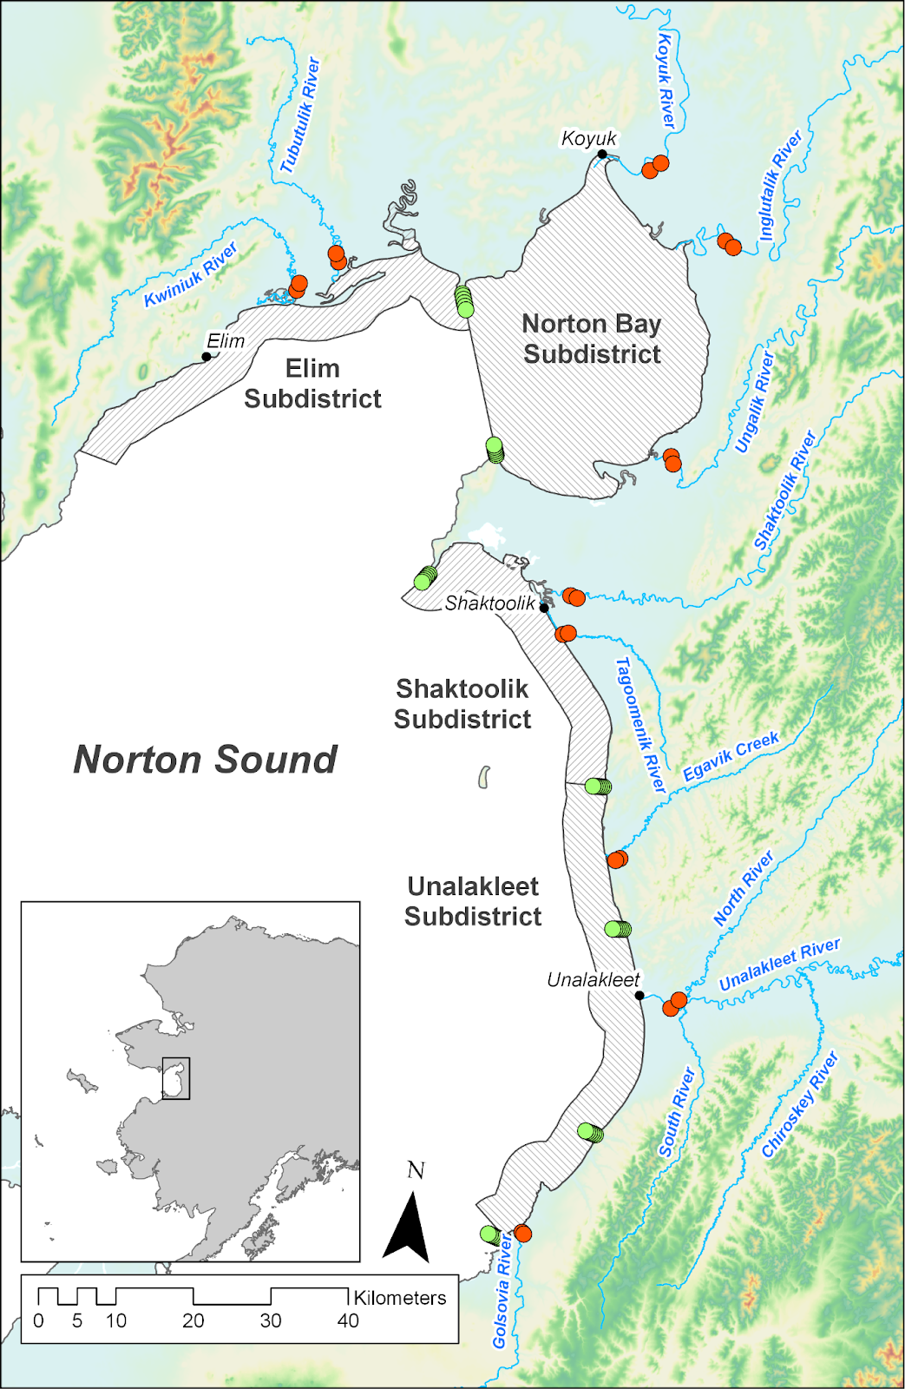
Bald Head
Point Dexter
Cape Denbeigh
Junction Creek
Blueberry Creek
Point Creek
Black Point

