Slide 1
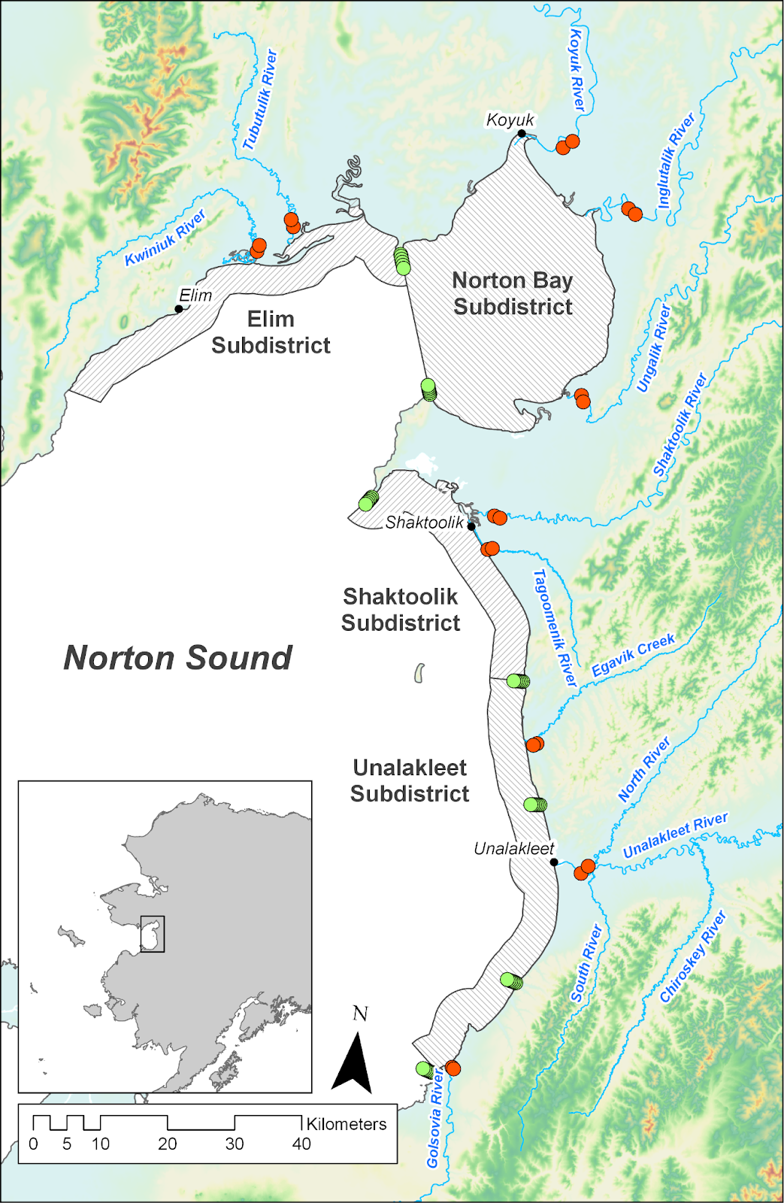
Bald Head
Point Dexter
Cape Denbeigh
Junction Creek
Blueberry Creek
Point Creek
Black Point

Slide 2
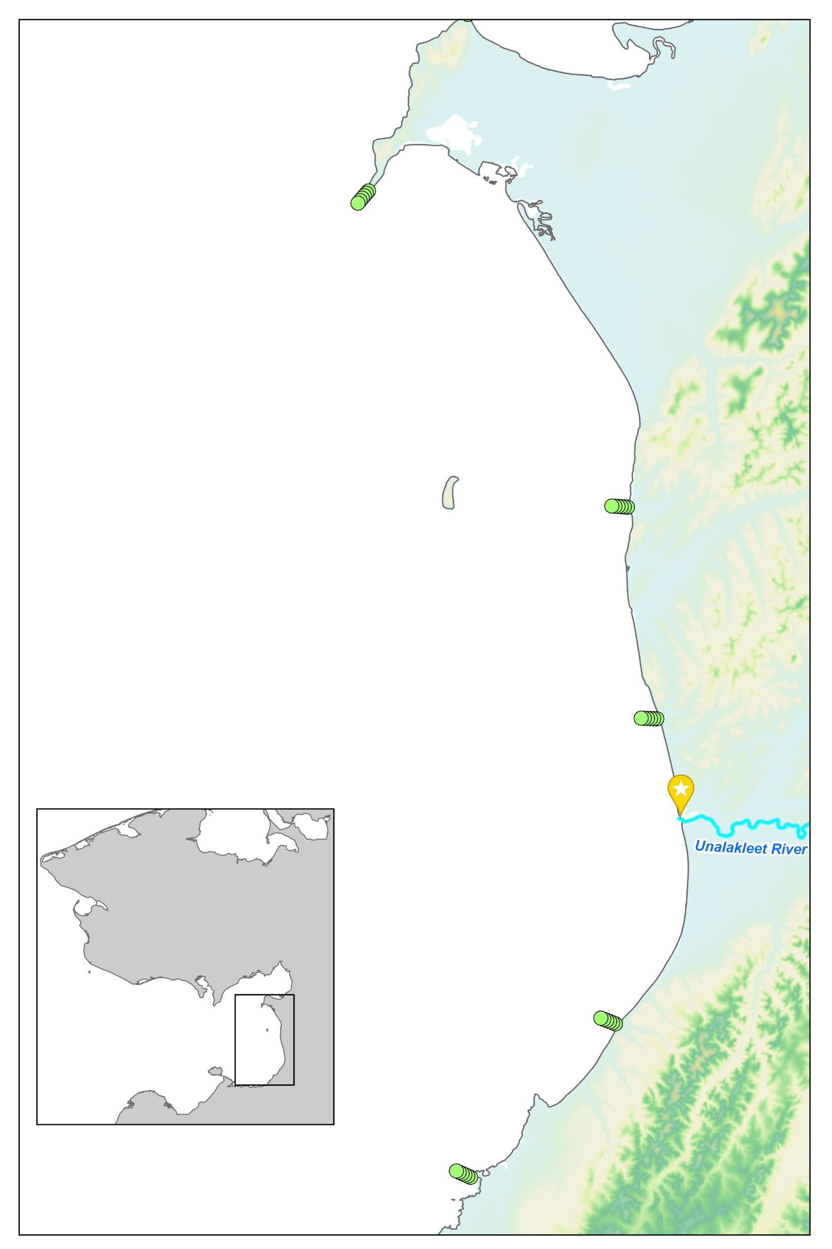
close

Slide 4
mid
close
mid

Slide 5
far
mid
close
mid

Slide 6
far
mid
close

Slide 7
