Slide 1
Programming language for AI agents

Slide 2
One definition of “agent”
Program which combines deterministic computation (harness) with intelligent computation (LM)
Traditionally:
LM partially controls harness via tool calling
Harness partially controls LM by determining context (“context engineering”) and actually calling it

Slide 3
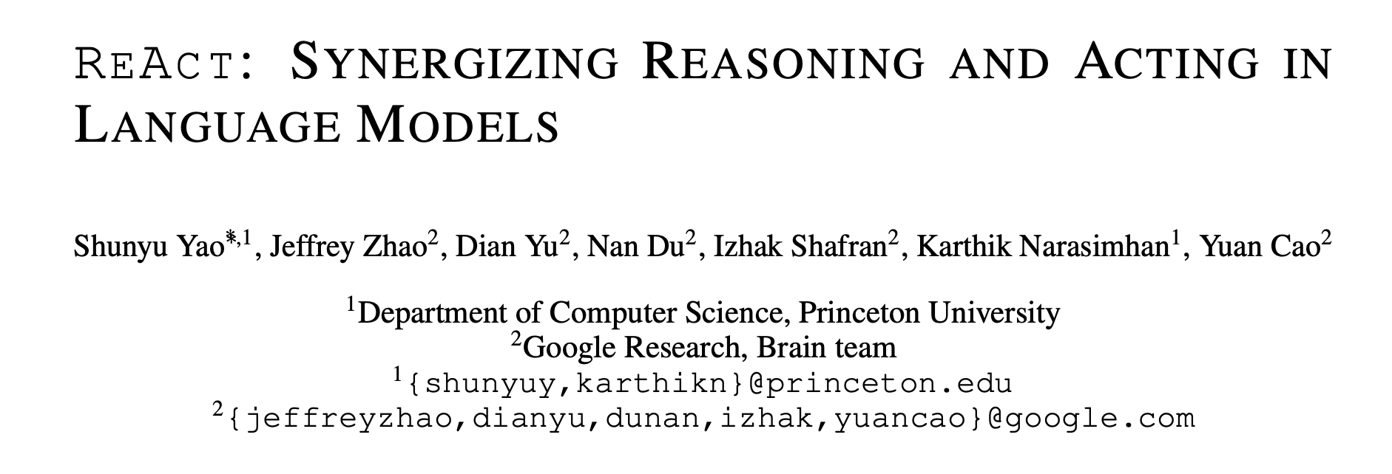
2023
Invocation: call the model with some prefix
Generation: model thinks and responds with tool call or program
Execution: execute tool call
Prefix building: produce new prefix and return to (1)

Slide 4
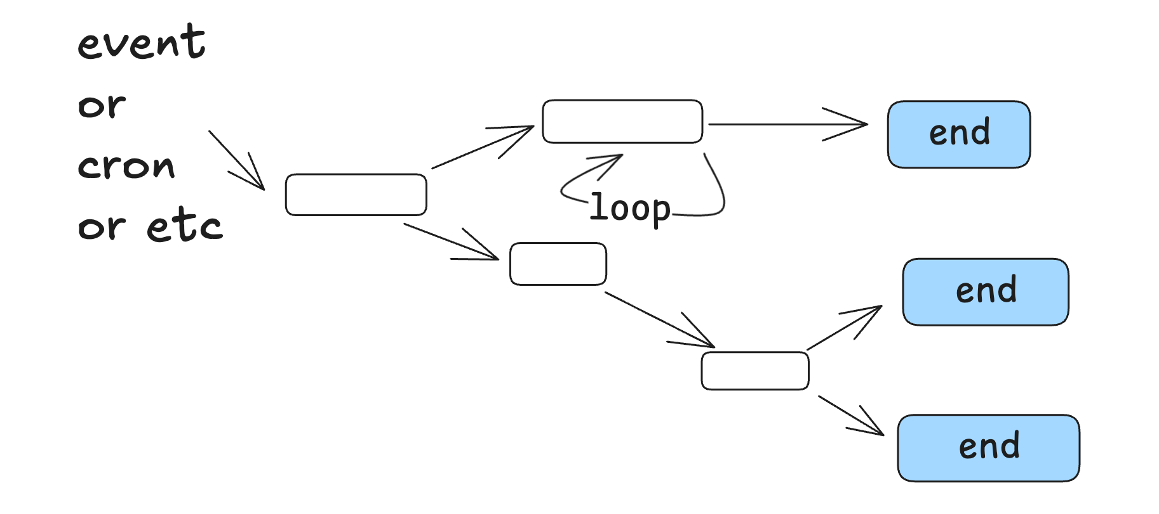
Traditional control flow
Dex Horthy “12 factor agents”, 2025

Slide 5
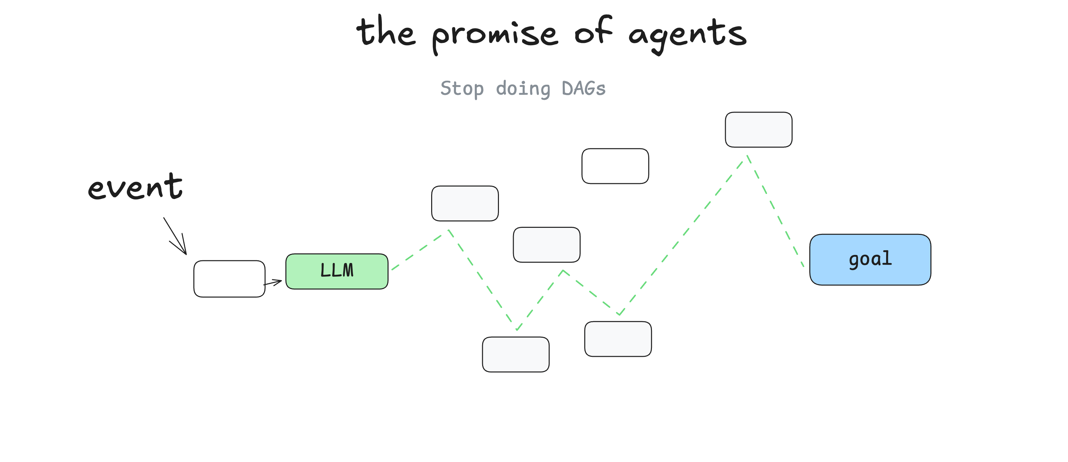
Dex Horthy “12 factor agents”, 2025

Slide 6
Dex Horthy, 12 factor agents

Slide 7
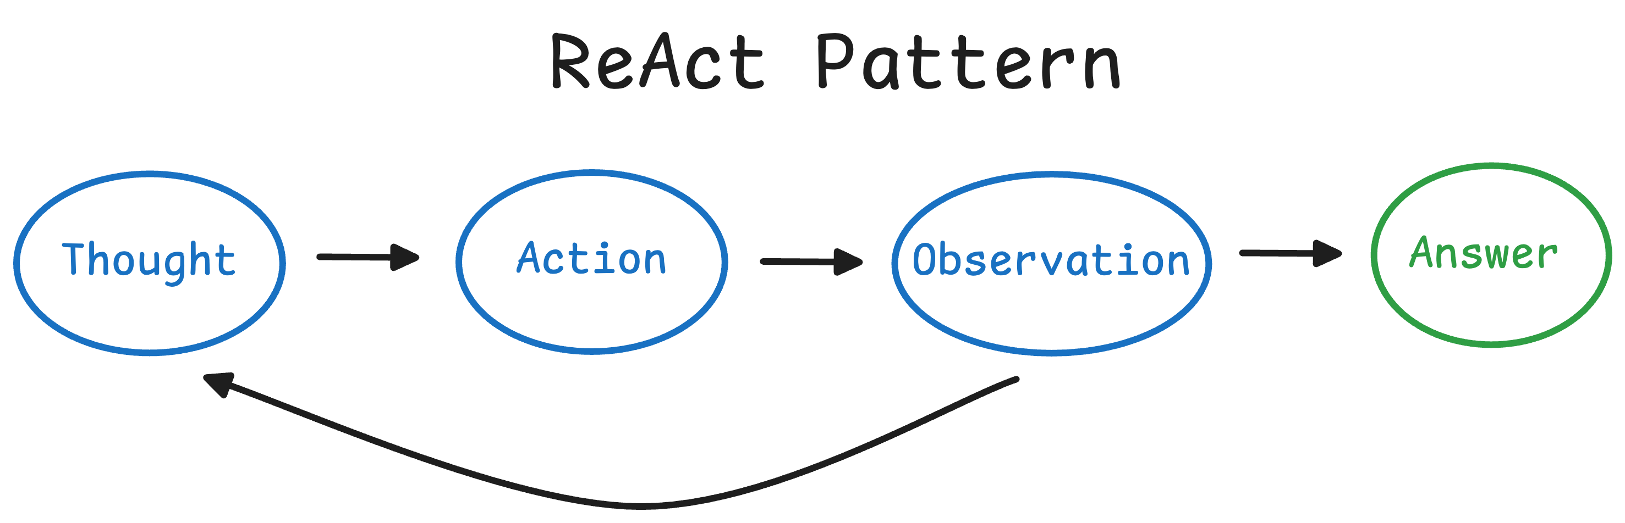
ReAct loop
prefix ← prompt
loop:
response, tool-call ← llm(prefix)
tool-result ← eval(tool-call) completion ← prefix + response+ tool-result
if response.is-final:
return completion
prefix ← completion
Yao et al. 2023 ICLR

Slide 8
Prompt
Prompt
Response
Prompt
Response
Tool output
Prompt
Response
Tool output
Response
Prompt
Response
Tool output
Response
Tool output
Prompt
Response
Tool output
Response
Tool output
Response
…

Slide 9
Prompt
Response
ls some-dir
10,000 files in directory

Slide 10
“Progressive disclosure”
Principle: let agent choose its own context
Old approach: harness decides context relevant to prompt
Progressive disclosure: agent finds relevant context itself
Prompt
Harness-chosen context
Response
Tool output
Response
…
Prompt
Response
ls some-dir
Response
grep some-file
Response
…

Slide 11
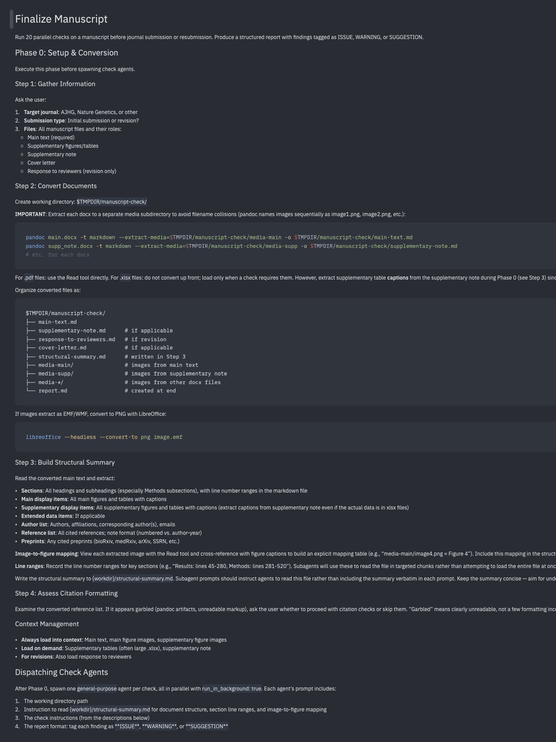
Skill with 20 to-do items

Slide 12
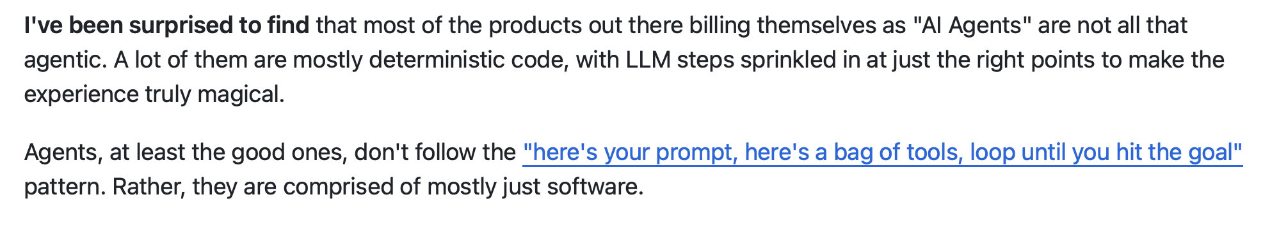
Dex Horthy “12 factor agents”, 2025

Slide 13
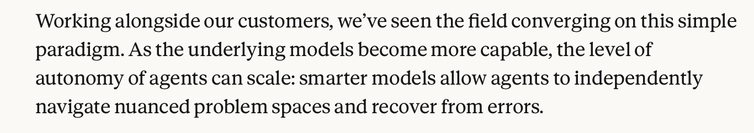
Get out of the agent’s way
Anthropic, 2025

Slide 14
Intricate context engineering
Engineer harness to:
Avoid including unneeded data (“progressive disclosure”)
Split data among subagents
Use “frequent intentional compaction”
Tension with “get out of the agent’s way”

Slide 15
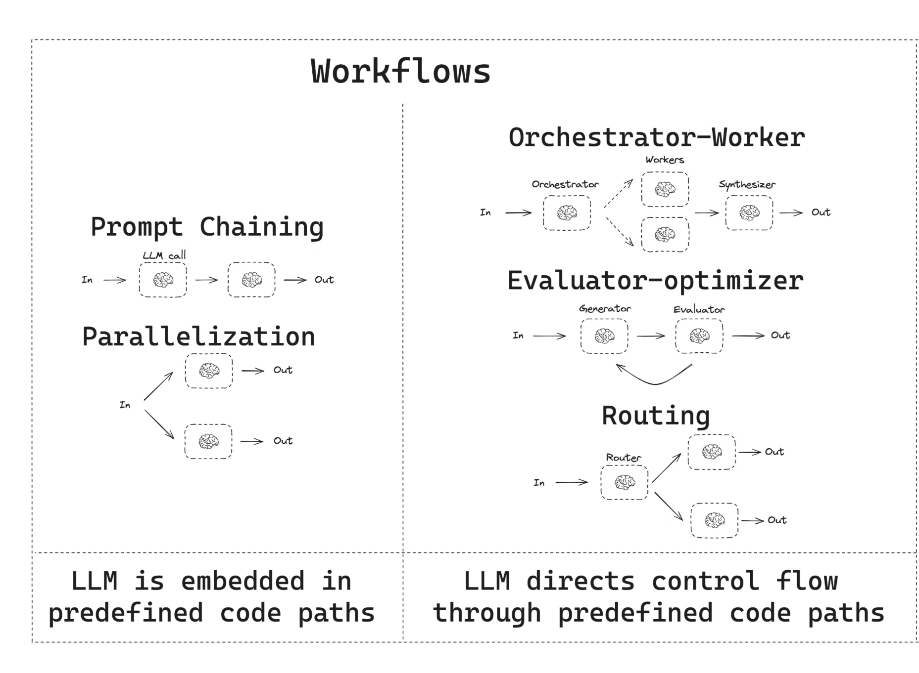
Intricate orchestration
Tension with “get out of the agent’s way”
LangChain

Slide 16
12FA
Intricacy
ReAct
2023 chatbot
Autonomy

Slide 17
What is the maximum degree to which an agentic system can be controlled by the language model autonomously?

Slide 18
ReAct loop
Invocation: call the model with some prefix
Generation: model thinks and responds with tool call or program
Execution: execute tool call
Prefix building: produce new prefix and return to (1)
Controlled by harness
Controlled by model
S. Yao et al. 2023 ICLR

Slide 19
ReAct loop
Self-programmed execution
Invocation: call the model with some prefix
Generation: model thinks and responds with tool call or program
Execution: execute tool call
Prefix building: produce new prefix and return to (1)
Generation: model thinks and responds with a program
Execution: evaluate the program

Slide 20
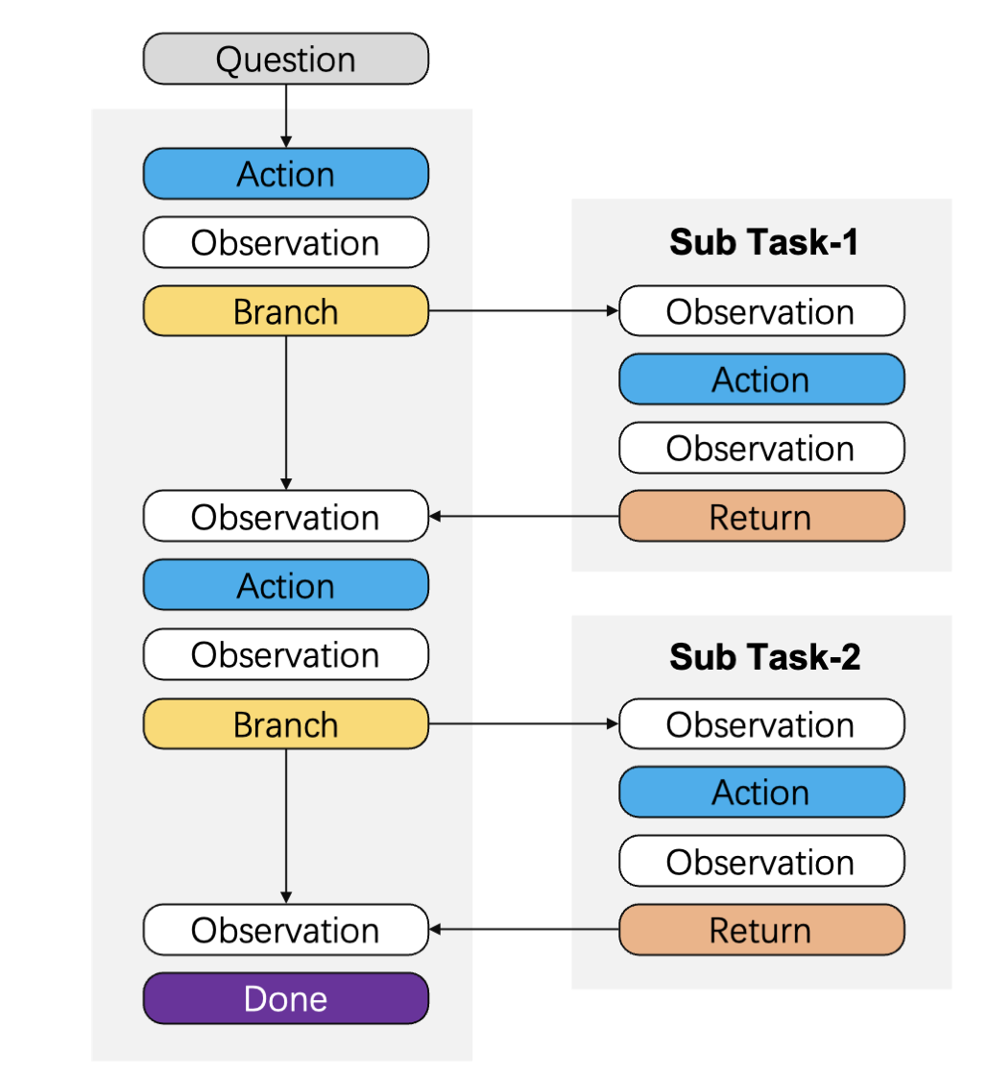
Related: context folding / subagent recursion
FoldGRPO W. Sun et al. 2025 arXiv

Slide 21
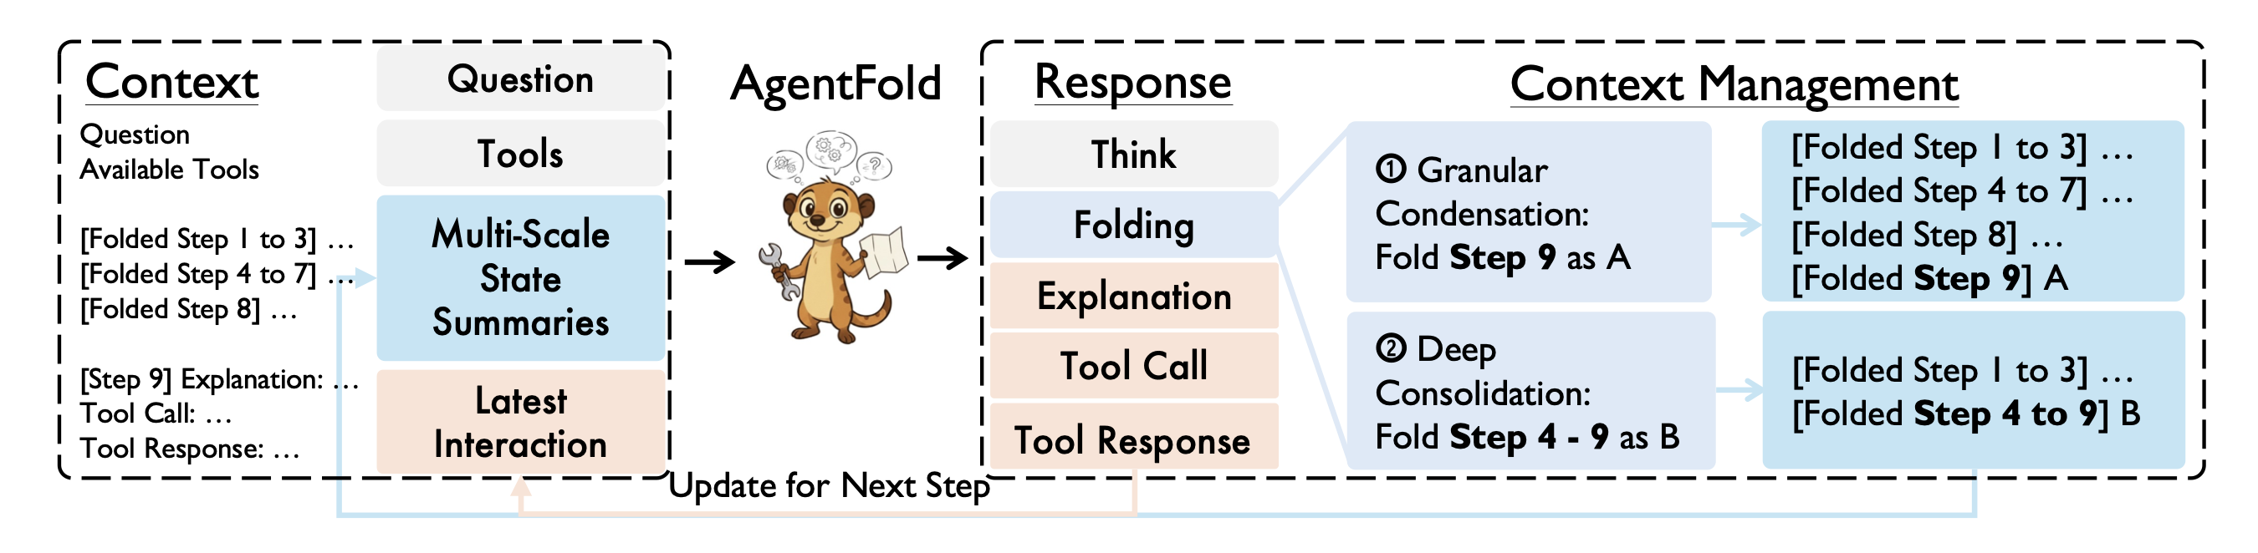
Related: context folding / subagent recursion
FoldGRPO W. Sun et al. 2025 arXiv
AgentFold R. Ye et al. 2025 arXiv

Slide 22
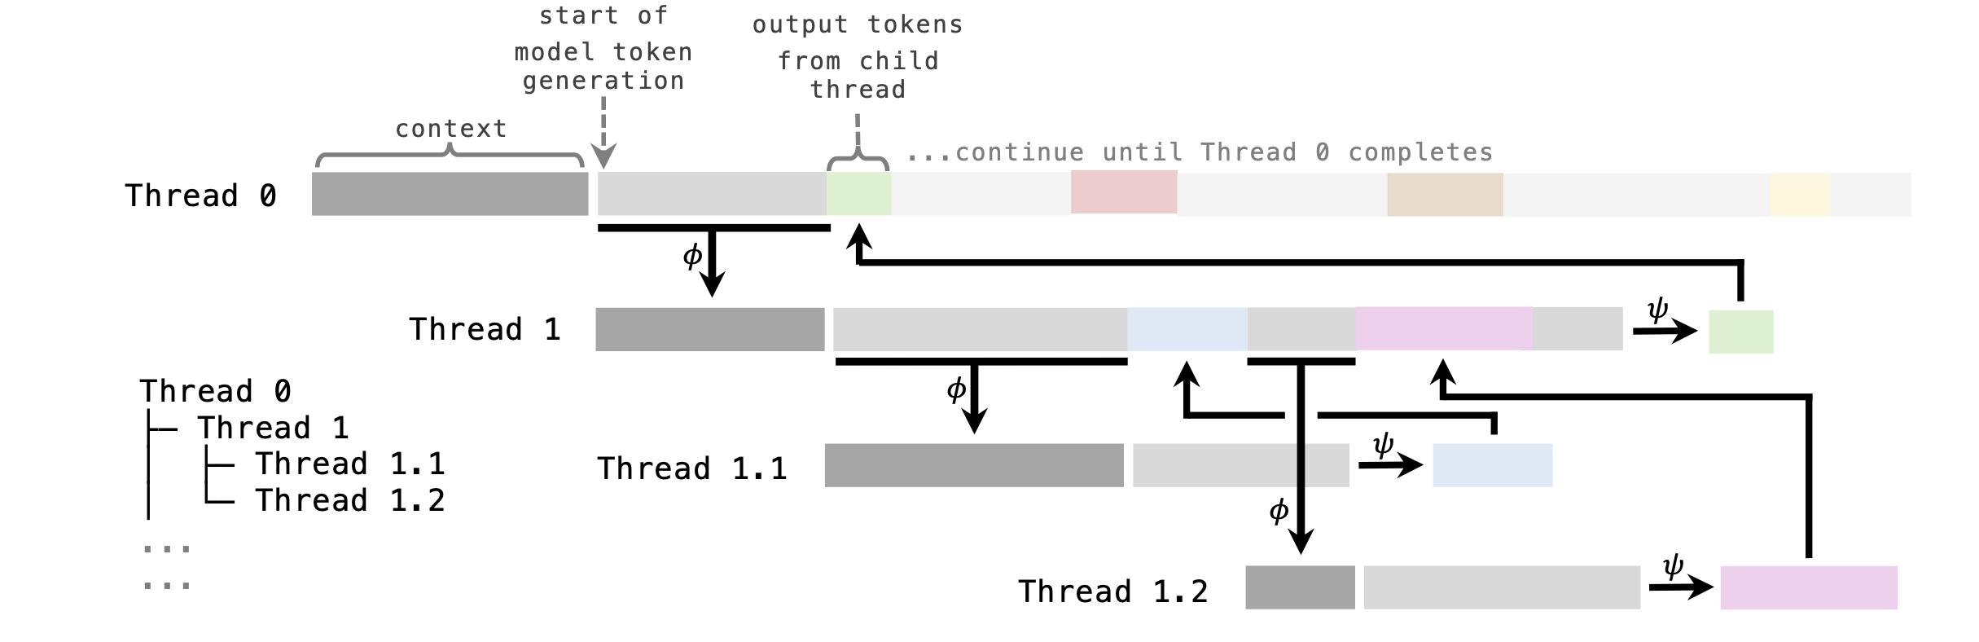
Related: context folding / subagent recursion
FoldGRPO W. Sun et al. 2025 arXiv
AgentFold R. Ye et al. 2025 arXiv
THREAD Schroeder et al. 2025 arXiv

Slide 23
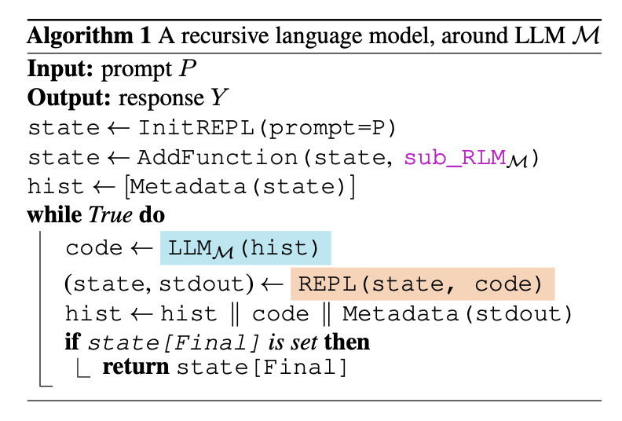
Related: context folding / subagent recursion
FoldGRPO W. Sun et al. 2025 arXiv
AgentFold R. Ye et al. 2025 arXiv
THREAD Schroeder et al. 2025 arXiv
RLMs A. Zhang et al. 2026 arXiv
Delegation via code execution

Slide 24
Related: context folding / subagent recursion
FoldGRPO W. Sun et al. 2025 arXiv
AgentFold R. Ye et al. 2025 arXiv
THREAD Schroeder et al. 2025 arXiv
RLMs A. Zhang et al. 2026 arXiv
Invocation
Prefix building

Slide 25
Orchestration: hot topic
Kimi 2.5: train LLM to dispatch swarms (PARL); still basically ReAct
Cursor browser experiment: planner/worker/checker pattern
Claude Code: viral “ralph” pattern
Claude code: parallelize to-do lists while respecting dependencies
“Recursive language model”: subagents gather context; still ReAct

Slide 26
Early findings
Nontrivial orchestration can make a big difference on long tasks (Cursor experiment, anecdotal from “Ralph”)
Divide-and-conquer mitigates context limitations (RLMs, “progressive disclosure” pattern)
Agents can be trained on orchestration using RL (Kimi)

Slide 27
What this motivates
A self-orchestrating agent should:
Have access to complex control flow – more complex than Kimi and RLMs
Tightly control context for itself and its subagents
Be trained at self-orchestration using RL

Slide 28
What this motivates
A self-orchestrating agent should:
Have access to complex control flow – more complex than Kimi and RLMs
Tightly control context for itself and its subagents
Be trained at self-orchestration using RL
Programming language for self-orchestration
Manipulate context using this language
Out of scope

Slide 29
Self-programmed execution
Generation: model thinks and responds with a program
Execution: evaluate the program
What should be the language of the program?
Call the LLM to generate new code
Manipulate source code as data

Slide 30
Lisp and homoiconicity
Lisp: “code is data”
Code parses into expressions
Abstract syntax tree is explicit
(do
(def f
(fn x
(+ x 1)
)
)
(f 41)
)

Slide 31
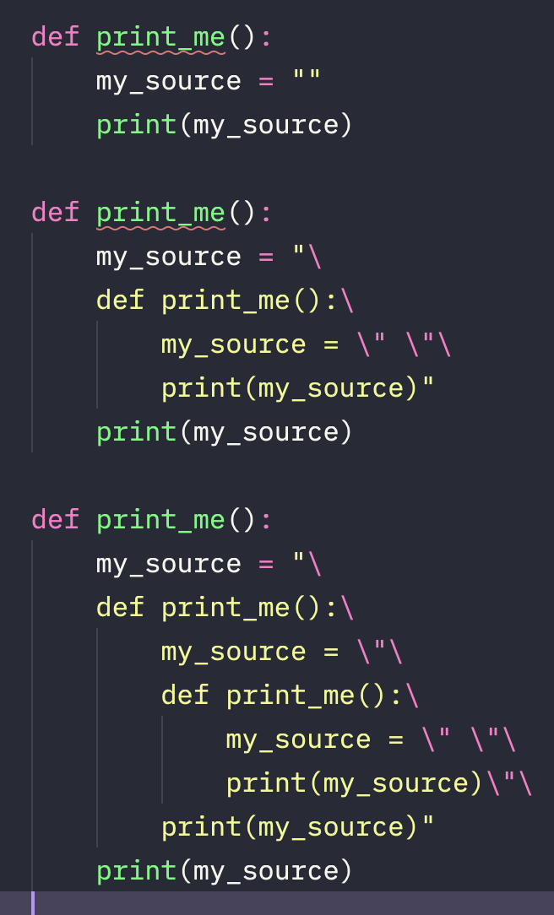
How do you reference source code as data?

Slide 32
How do you reference source code as data?

Slide 33
How do you reference source code as data?

Slide 34
Spell (self-programmed execution language for LMs)
Dialect of Lisp (specifically Clojure)
Lisp: “Code is data”
Spell:
Prompt/context: string literals with bindings
(def prompt “You are a helpful assistant…”)

Slide 35
Spell (self-programmed execution language for LMs)
Dialect of Lisp (specifically Clojure)
Lisp: “Code is data”
Spell:
Prompt/context: string literals with bindings
Reasoning traces: string literals with bindings
(def thought “I am a helpful assistant…”)

Slide 36
Spell (self-programmed execution language for LMs)
Dialect of Lisp (specifically Clojure)
Lisp: “Code is data”
Spell:
Prompt/context: string literals with bindings
Reasoning traces: string literals with bindings
Tool calls: function calls that are evaluated before next turn
(!print (io/read-file “my-file.txt”))

Slide 37
Spell (self-programmed execution language for LMs)
Dialect of Lisp (specifically Clojure)
Lisp: “Code is data”
Spell:
Prompt/context: string literals with bindings
Reasoning traces: string literals with bindings
Tool calls: function calls that are evaluated before next turn
Tool call results: string literals with bindings
(def file “lorum ipsum…”)

Slide 38
Spell (self-programmed execution language for LMs)
Dialect of Lisp (specifically Clojure)
Lisp: “Code is data”
Spell:
Prompt/context: string literals with bindings
Reasoning traces: string literals with bindings
Tool calls: function calls that are evaluated before next turn
Tool call results: string literals with bindings
Self-calls: function calls which produce the next turn
(!llm-self completion)

Slide 39
Internalized context management
Spell
Prompt
Response
Tool call
Prompt
Response
Self call
Prompt
Response
Tool output
Whole context window
LLM controls only what is appended
LLM fully controls its context next turn

Slide 40
Internalized control flow
Prompt
Response
Arbitrary control flow
Success
Re-prompt

Slide 41
Internalized control flow
Main
Todo 1
Todo 2
Todo 3
Todo 4
Checker
Program logic written by main

Slide 42
Related approaches
Baseline – e.g. Claude Code
grep
Harness-triggered compaction
Subagent delegation/swarms

Slide 43
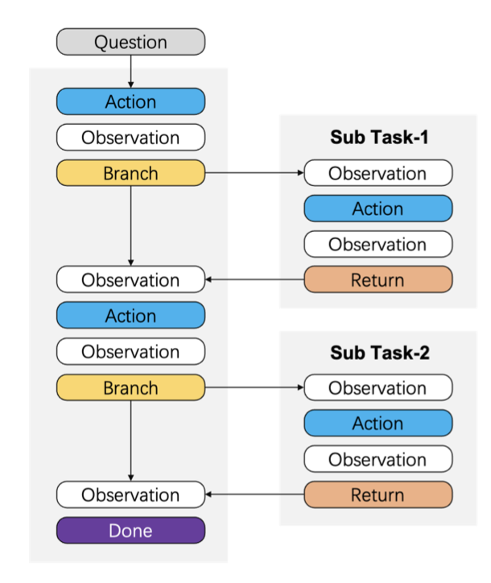
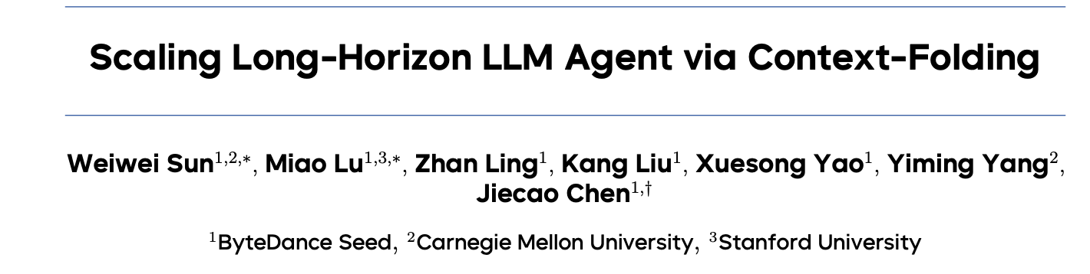
Related approaches
October 2025

Slide 44
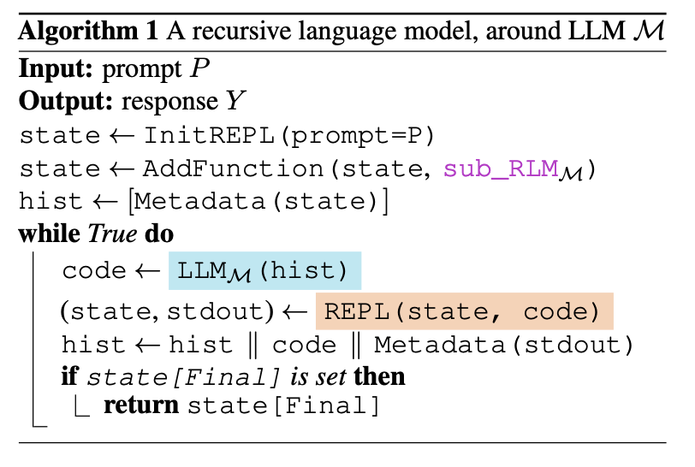

Related approaches
January 2026

Slide 45
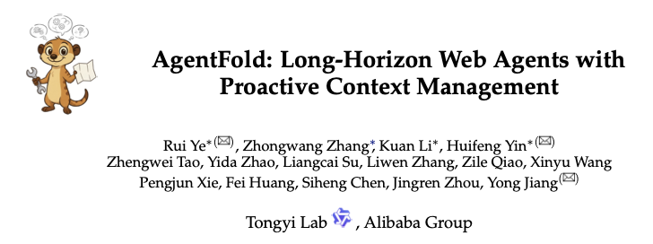
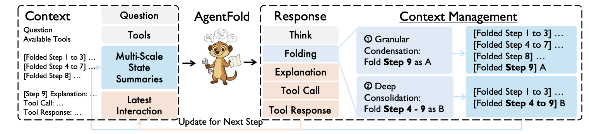
Related approaches
October 2025

Slide 46
ReAct
Spell
prefix ← prompt
loop:
response, tool-call ← llm(prefix)
tool-result ← eval(tool-call) completion ← prefix + response+ tool-result
if response.is-final:
return completion
prefix ← completion
initial-program ← wrap(prompt)
return eval(initial-program)

Slide 47
ReAct
Spell
prefix ← prompt
loop:
response, tool-call ← llm(prefix)
tool-result ← eval(tool-call) completion ← prefix + response+ tool-result
if response.is-final:
return completion
prefix ← completion
prefix ← prompt
response ← llm(prefix)
completion ← prefix + response
return eval(completion)
What happened to the loop?

Slide 48
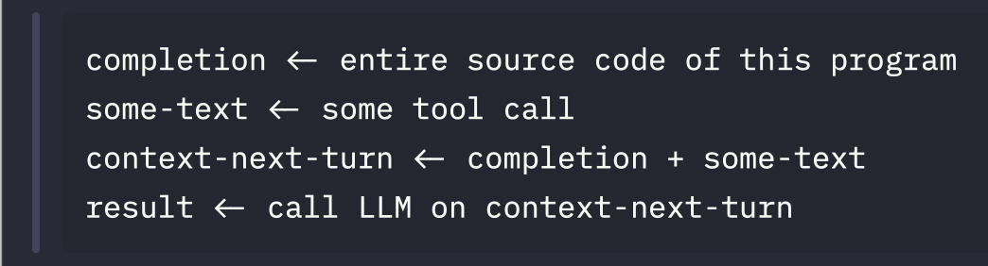
ReAct
Spell
prefix ← prompt
loop:
response, tool-call ← llm(prefix)
tool-result ← eval(tool-call) completion ← prefix + response+ tool-result
if response.is-final:
return completion
prefix ← completion
prefix ← prompt
response ← llm(prefix)
completion ← prefix + response
return eval(completion)
What happened to the loop?
Loop

Slide 49
Harness-
computed
Harness-
computed
Human-written
LLM written
LLM written
Prompt
Self-call
Prompt
Self-call
Response + tool call
Self-call
Prompt
Self-call
Response + tool call
Self-call
Tool output
Response + tool call
Self-call
Prompt
Self-call
Response + tool call
Self-call
Tool output
Response + tool call
Self-call
Tool output
Response + tool call

Slide 50
Harness-
computed
Human-written
LLM written
LLM written
Prompt
Self-call
Prompt
Self-call
Response + tool call
Self-call
Prompt
Self-call
Response + tool call
Self-call
Tool output
Response + tool call
Self-call
Prompt

Slide 51
1. How does this work?

Slide 52
2. How does the recursion avoid re-evaluation?

Slide 53
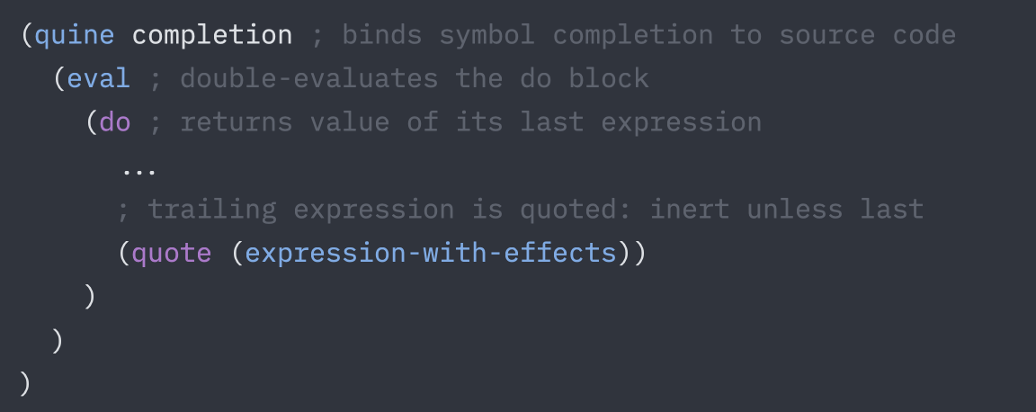
Structure of every completion

Slide 54

ReAct loop in Spell
=
LLM(
)
Prompt
Response
Tool output

Slide 55
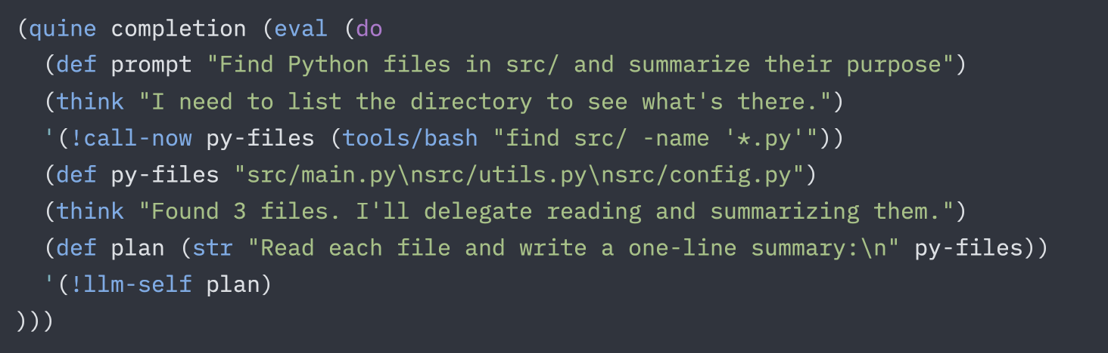
Own-context engineering

Slide 56
Self-orchestration
Create a future
Spawn agent with prompt
Block for response
Response satisfies condition?
Break or goto 2
Message parent agent with response
Entirely written in Spell

Slide 57
Does it work?
Coding
Terminal-Bench 2.0 (challenging computer use, e.g. “build linux kernel”)
SWE-bench lite and SWE-bench pro (fix real github issues)
Math
AIME 2025-2026
Omni-Math Hard (most challenging)
MathConstruct (requires code execution)
Retrieval/multi-hop
LongBench (long docs)
GAIA (web search)
Orchestration games

Slide 58
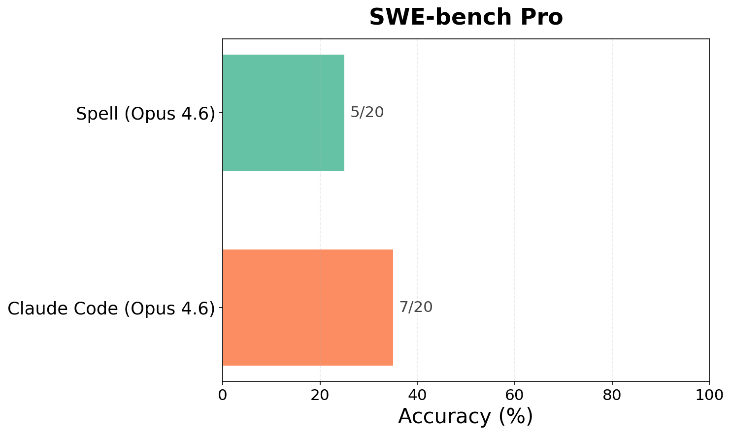
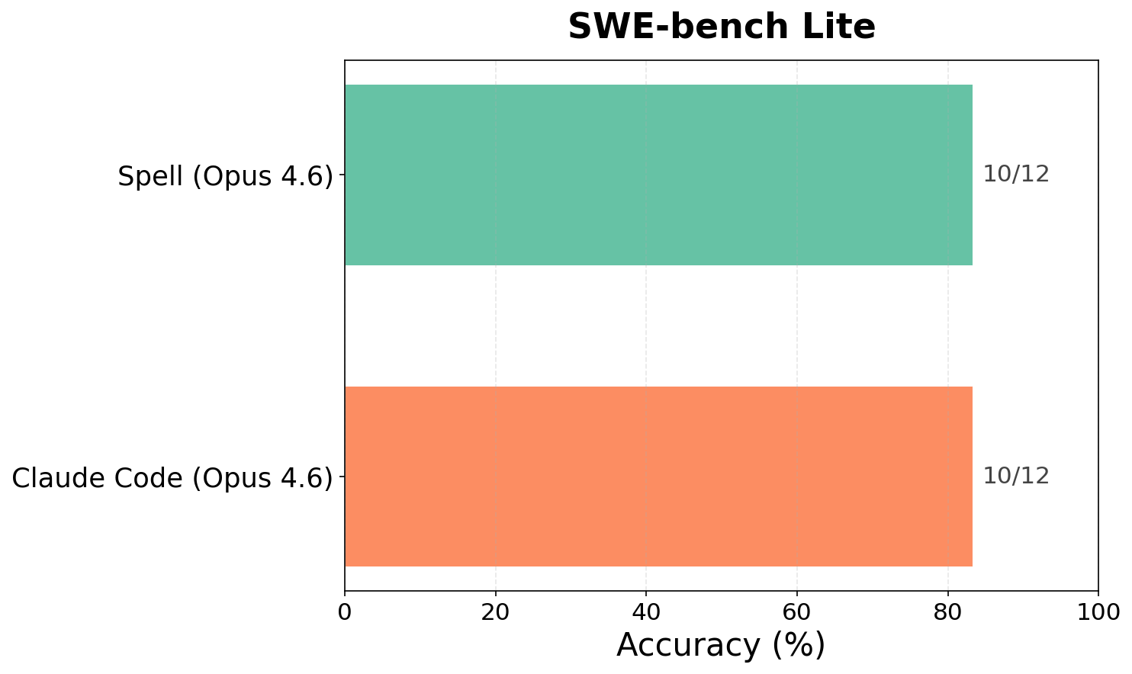
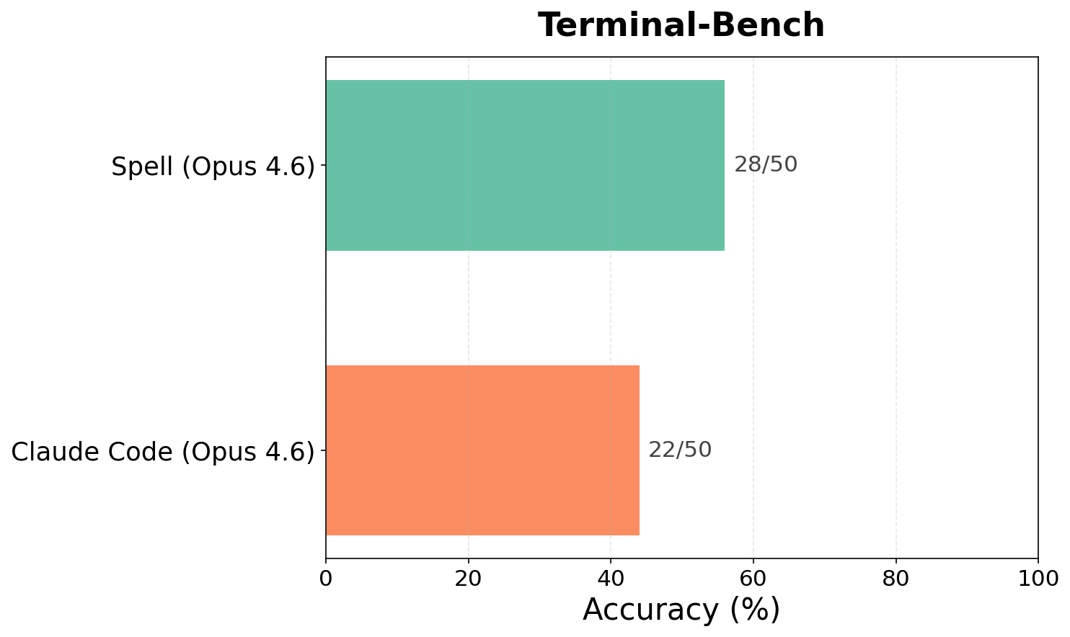

Slide 59
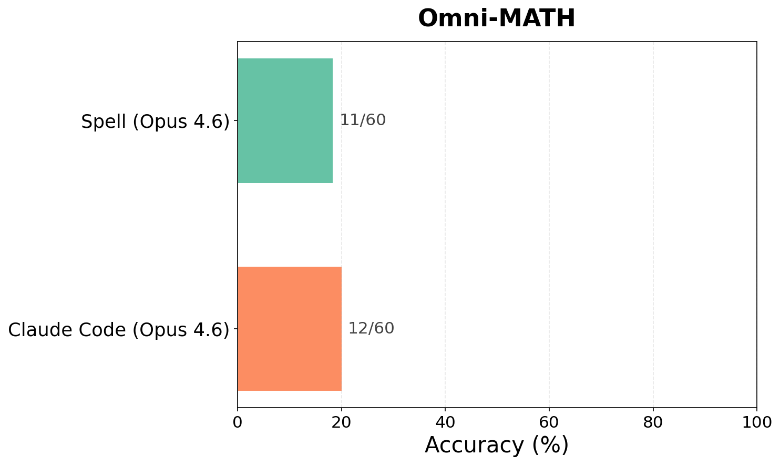
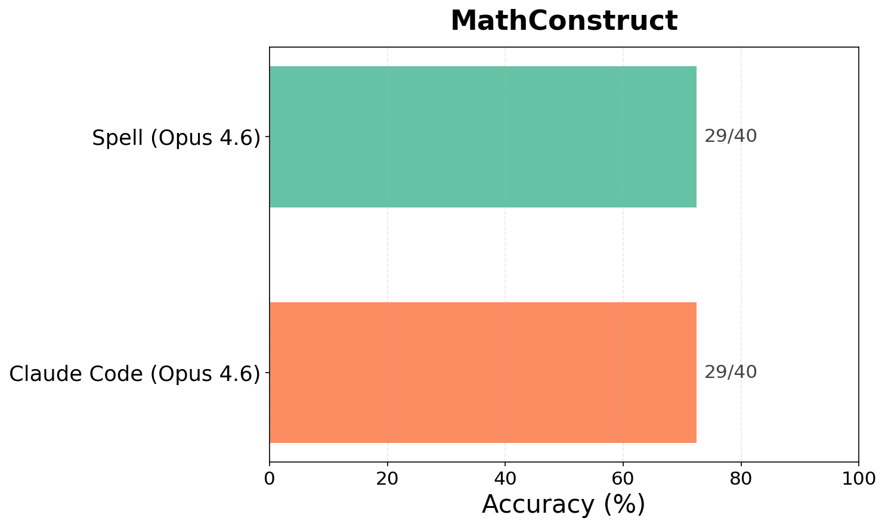
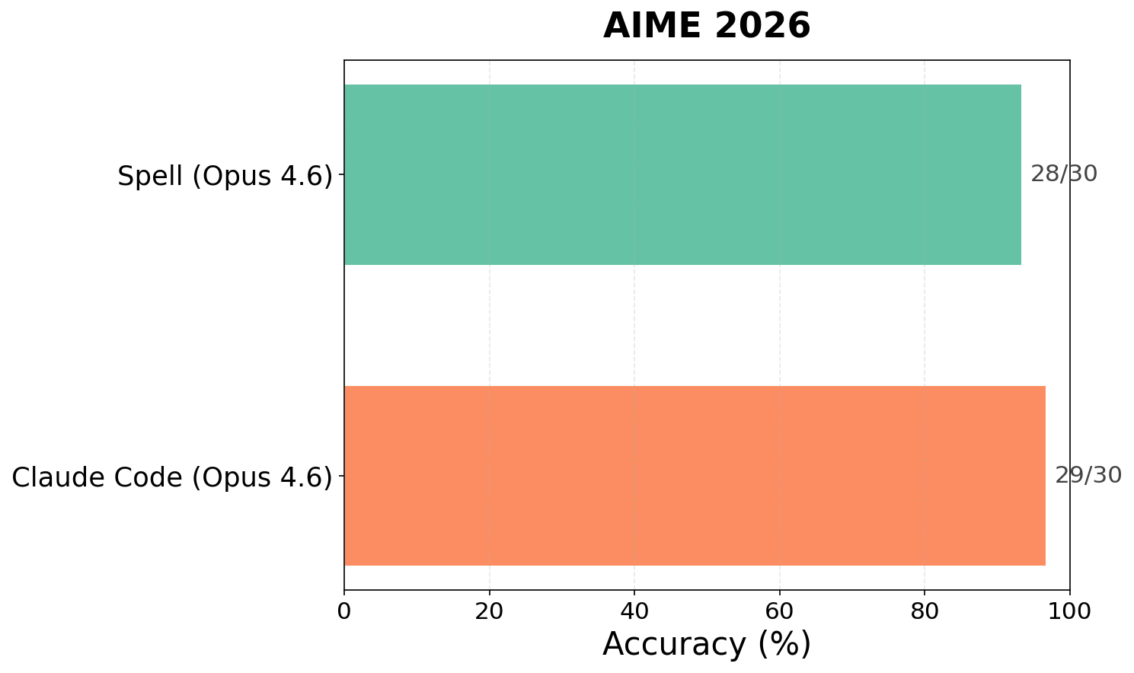
*
*Spell did much better with manual scoring

Slide 60
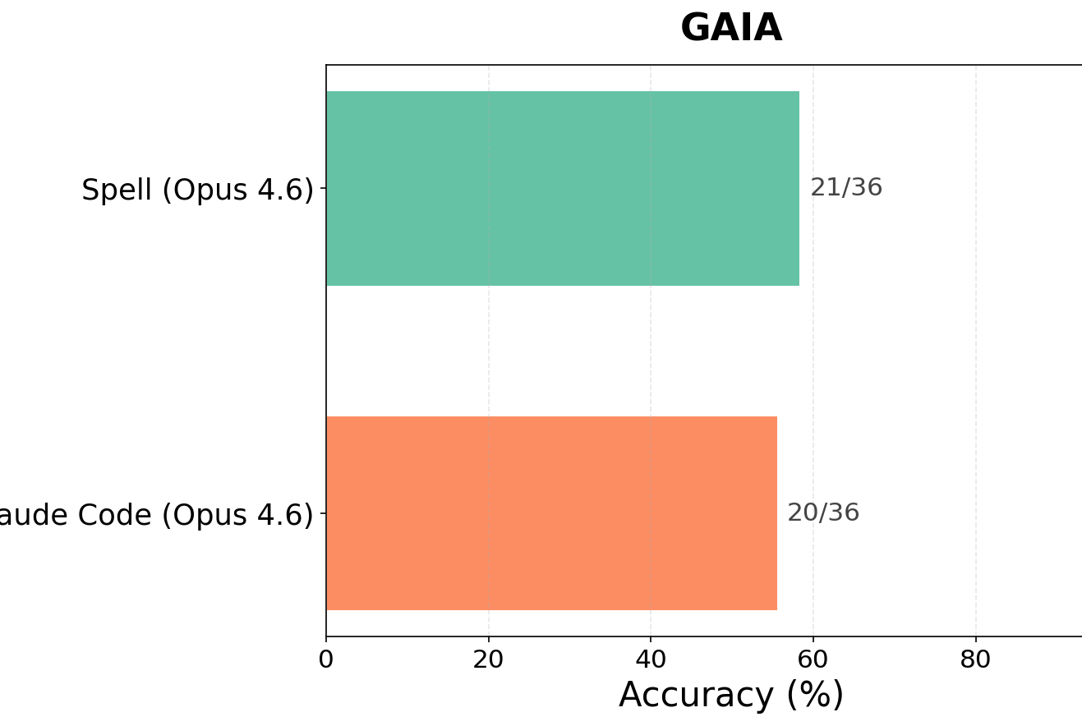
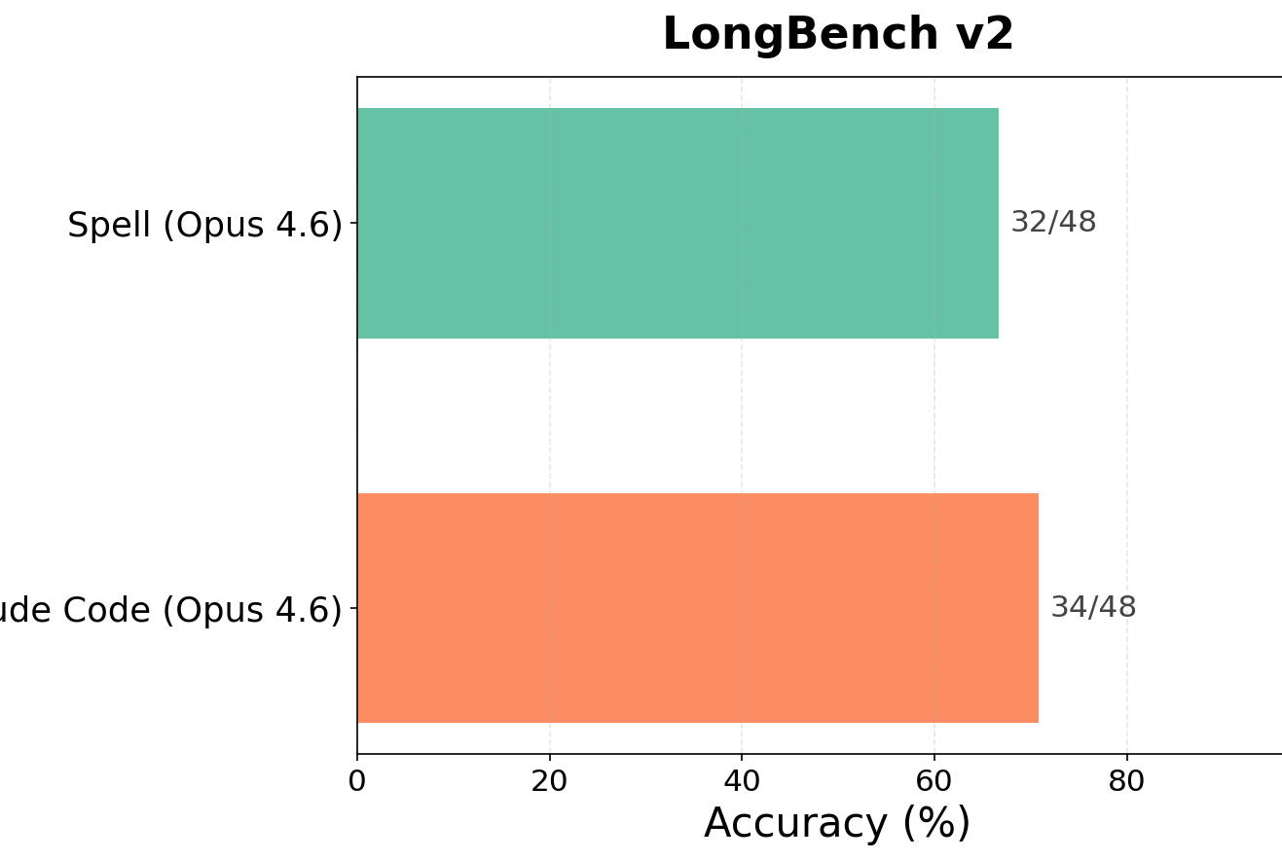

Slide 61
Examples
Problem: place 120 points on a unit square boundary to extremize sum of
pairwise distances; find the threshold t.
a. Wrote defn numerical-integrate (trapezoidal rule, 10k points)
b. Ran 500×500 double Riemann sum over boundary×boundary
c. Tested 6+ point configurations (30-per-corner, equally spaced, asymmetric)
d. Discovered from the numerical data that the min of one configuration exactly equals the max of another → t = 30(1+√5) via IVT with dual bounding
Pattern: Computation as discovery — numerical search revealed a structural fact the model couldn’t derive symbolically, then used it to construct the proof

Slide 62
20 questions
Play 20 questions. You are the orchestrator who picks a secret word. Create two subagent roles: (1) a CHECKER who knows the secret and answers yes/no honestly, (2) a WORKER who does NOT know the secret and must guess by asking questions. The worker should adapt its questions based on previous answers. Loop until the worker guesses correctly or runs out of guesses.

Slide 63
(def interior (do (def completion (cat \"(def interior \" (pr-str (uneval 'interior)) \")\")) (def prompt \"Play 20 questions...\")
(do
(def secret "octopus")
(defn checker-respond [question]
(let [q (trim question)]
(cond
(or (= q "Is it an animal?")
(= q "Animal?"))
"yes"
…
;; Fallback: ask an LLM to answer yes/no based on the secret.
:else
(let [resp (trim (leaf-llm
(cat "You are CHECKER in 20 questions. Secret word: " secret
". Answer ONLY 'yes' or 'no' (no punctuation). "
"Question: " q)))]
(if (or (= resp "yes") (= resp "no")) resp "no")))))
(defn worker-next [history]
(leaf-llm
(cat
"You are WORKER playing 20 questions. …

Slide 64
(def interior (do (def completion (cat \"(def interior \" (pr-str (uneval 'interior)) \")\")) (def prompt \"Play 20 questions...\")
(do
(def secret "octopus")
(defn checker-respond [question]
(let [q (trim question)]
(cond
(or (= q "Is it an animal?")
(= q "Animal?"))
"yes"
…
;; Fallback: ask an LLM to answer yes/no based on the secret.
:else
(let [resp (trim (leaf-llm
(cat "You are CHECKER in 20 questions. Secret word: " secret
". Answer ONLY 'yes' or 'no' (no punctuation). "
"Question: " q)))]
(if (or (= resp "yes") (= resp "no")) resp "no")))))
(defn worker-next [history]
(leaf-llm
(cat
"You are WORKER playing 20 questions. …

Slide 65
(def interior (do (def completion (cat \"(def interior \" (pr-str (uneval 'interior)) \")\")) (def prompt \"Play 20 questions...\")
(do
(def secret "octopus")
(defn checker-respond [question]
(let [q (trim question)]
(cond
(or (= q "Is it an animal?")
(= q "Animal?"))
"yes"
…
;; Fallback: ask an LLM to answer yes/no based on the secret.
:else
(let [resp (trim (leaf-llm
(cat "You are CHECKER in 20 questions. Secret word: " secret
". Answer ONLY 'yes' or 'no' (no punctuation). "
"Question: " q)))]
(if (or (= resp "yes") (= resp "no")) resp "no")))))
(defn worker-next [history]
(leaf-llm
(cat
"You are WORKER playing 20 questions. …

Slide 66
(defn loop-game [n history]
(if (> n 20)
(cat "Out of questions.\nSecret was: " secret "\n\nTranscript:\n" history)
(let [q (trim (worker-next history))
a (checker-respond q)
history2 (cat history "Q" n ": " q "\nA" n ": " a "\n")
g (worker-guess history2)]
(if (= (trim g) "NO_GUESS")
(loop-game (+ n 1) history2)
(if (= (trim g) secret)
(cat "WORKER guesses: " g "\nResult: correct.\n\nTranscript:\n" history2)
(loop-game (+ n 1) (cat history2 "WORKER guesses: " g "\nResult: incorrect.\n"))))))) (loop-game 1 ""))

Slide 67

Transcript:
Q1: Is it a physical object?
A1: yes
Q2: Is it something typically found indoors?
A2: no
Q3: Is it a natural object (not man-made)?
A3: yes
Q4: Is it a living thing (like a plant or animal)?
A4: yes
Q5: Is it an animal?
A5: yes
Q6: Is it a vertebrate (does it have a backbone)?
A6: no
Q7: Is it an insect (has six legs and three body segments)?
A7: no
WORKER guesses: spider
Result: incorrect.
Q8: Is it a mollusk (like a snail, slug, clam, or octopus)?
A8: yes
WORKER guesses: octopus
Result: correct.

Slide 68
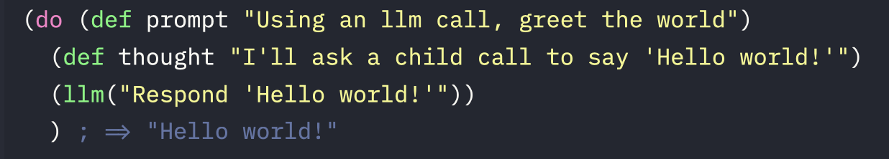
Spell (self-prompting execution language for LLMs)

Slide 69
Context = code
LLM should be able to manipulate context programmatically Motivates:
Lisp (“code is data”)
Quining via ‘uneval’

Slide 70
Environment = context
LLM cannot reason about anything not in its context window
Motivates:
Dynamic scoping (no function closures)
‘Expand’ free variables passed to child LLMs

Slide 71
Why not Python?
Quotes -> strings; escaping nightmare
Quining with ‘uneval’ – totally unclear how to do this
Custom evaluator -

