Slide 1
Programming language for AI agents

Slide 2
What is an agent?
LLM alternates between:
Reasoning using natural language
Taking actions using tools (code)
Agentic “harness”:
Executes tool call
Invokes LLM again with result

Slide 3
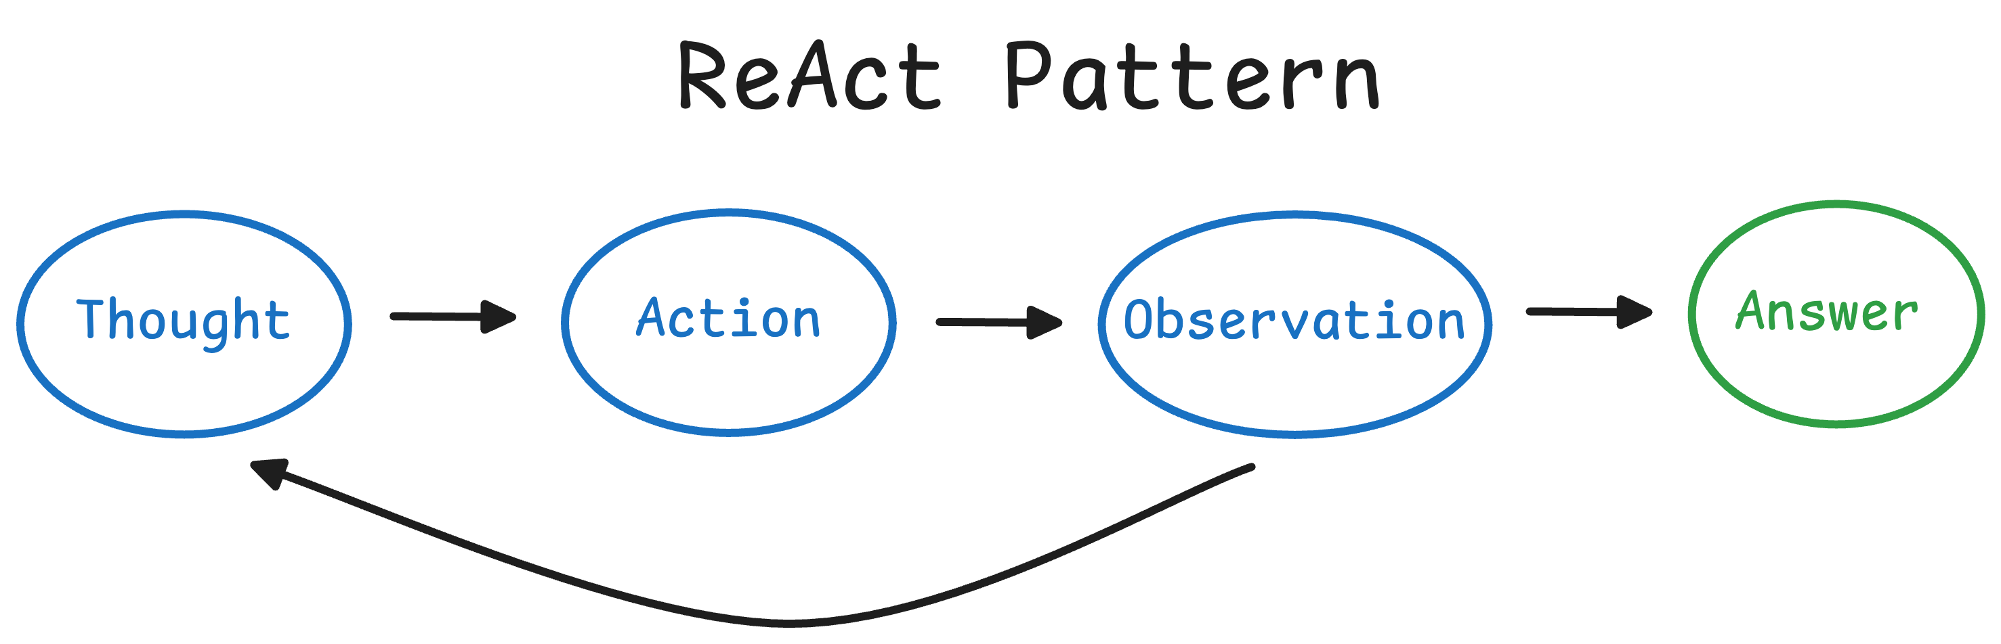
ReAct loop
prefix ← prompt
loop:
response, tool-call ← llm(prefix)
tool-result ← eval(tool-call) completion ← prefix + response+ tool-result
if response.is-final:
return completion
prefix ← completion
Yao et al. 2023 ICLR

Slide 4
Prompt
Prompt
Response
Prompt
Response
Tool output
Prompt
Response
Tool output
Response
Prompt
Response
Tool output
Response
Tool output
Prompt
Response
Tool output
Response
Tool output
Response
…

Slide 5
“Progressive disclosure”
Principle: let agent choose its own context
Old approach: harness decides context relevant to prompt
Progressive disclosure: agent finds relevant context itself
Prompt
Harness-chosen context
Response
Tool output
Response
…
Prompt
Response
ls some-dir
Response
grep some-file
Response
…

Slide 6
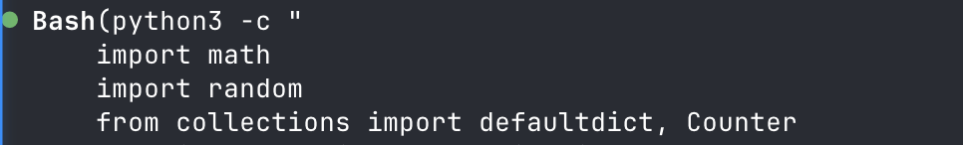
Limitations
Agent controls what context comes in, but not what goes out
Agent copy text “by hand”: file contents, URLs, subagent prompts
Tool calls are non-reusable, non-composable
Prompt
Response
ls some-dir
10,000 files in directory
read some-file
Response
text-replace exact-quote new-text

Slide 7
Orchestration: hot topic
Kimi 2.5: train LLM to dispatch swarms (PARL); still basically ReAct
Cursor browser experiment: planner/worker/checker pattern
Claude Code: viral “ralph” pattern
Claude code: parallelize to-do lists while respecting dependencies
“Recursive language model”: subagents gather context; still ReAct

Slide 8
Early findings
Nontrivial orchestration can make a big difference on long tasks (Cursor experiment, anecdotal from “Ralph”)
Divide-and-conquer mitigates context limitations (RLMs, “progressive disclosure” pattern)
Agents can be trained on orchestration using RL (Kimi)

Slide 9
What this motivates
A self-orchestrating agent should:
Have access to complex control flow – more complex than Kimi and RLMs
Tightly control context for itself and its subagents
Be trained at self-orchestration using RL

Slide 10
What this motivates
A self-orchestrating agent should:
Have access to complex control flow – more complex than Kimi and RLMs
Tightly control context for itself and its subagents
Be trained at self-orchestration using RL
Programming language for self-orchestration
Manipulate context using this language
Out of scope

Slide 11
Spell (self-prompting execution language for LLMs)
Dialect of Lisp (resembles Clojure)
Lisp: “Code is data”
Spell: “Entire context window is code”
Prompt
Reasoning
Tool calls
Tool call results
Response

Slide 12
ReAct
Spell
prefix ← prompt
loop:
response, tool-call ← llm(prefix)
tool-result ← eval(tool-call) completion ← prefix + response+ tool-result
if response.is-final:
return completion
prefix ← completion
prefix ← prompt
response ← llm(prefix)
completion ← prefix + response
return eval(completion)
What happened to the loop?

Slide 13
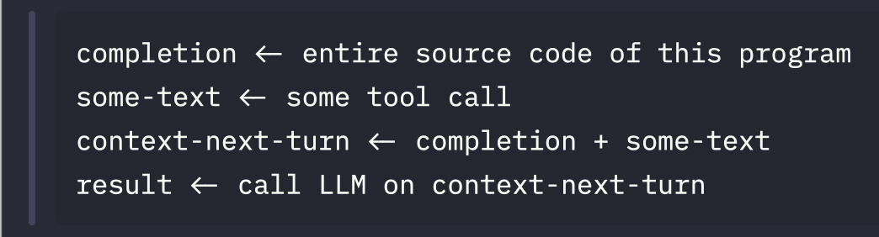
ReAct
Spell
prefix ← prompt
loop:
response, tool-call ← llm(prefix)
tool-result ← eval(tool-call) completion ← prefix + response+ tool-result
if response.is-final:
return completion
prefix ← completion
prefix ← prompt
response ← llm(prefix)
completion ← prefix + response
return eval(completion)
What happened to the loop?
Loop

Slide 14
Harness-
computed
Harness-
computed
Human-written
LLM written
LLM written
Prompt
Self-call
Prompt
Self-call
Response + tool call
Self-call
Prompt
Self-call
Response + tool call
Self-call
Tool output
Response + tool call
Self-call
Prompt
Self-call
Response + tool call
Self-call
Tool output
Response + tool call
Self-call
Tool output
Response + tool call

Slide 15
Harness-
computed
Human-written
LLM written
LLM written
Prompt
Self-call
Prompt
Self-call
Response + tool call
Self-call
Prompt
Self-call
Response + tool call
Self-call
Tool output
Response + tool call
Self-call
Prompt

Slide 17
1. How does this work?

Slide 18
2. How does the recusion avoid re-evaluation?

Slide 19
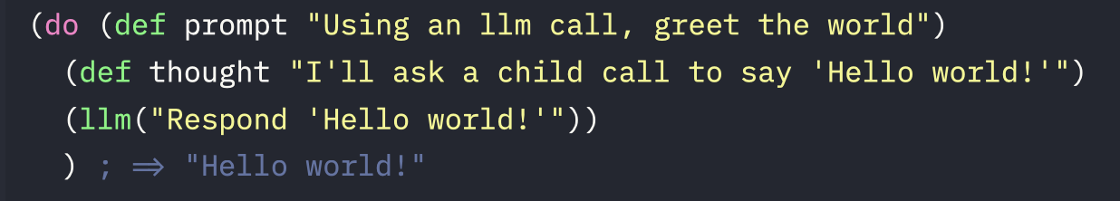
Spell (self-prompting execution language for LLMs)

Slide 20
Context = code
LLM should be able to manipulate context programmatically Motivates:
Lisp (“code is data”)
Quining via ‘uneval’

Slide 21
Environment = context
LLM cannot reason about anything not in its context window
Motivates:
Dynamic scoping (no function closures)
‘Expand’ free variables passed to child LLMs

Slide 22
Why not Python?
Quotes -> strings; escaping nightmare
Quining with ‘uneval’ – totally unclear how to do this
Custom evaluator -

Slide 23
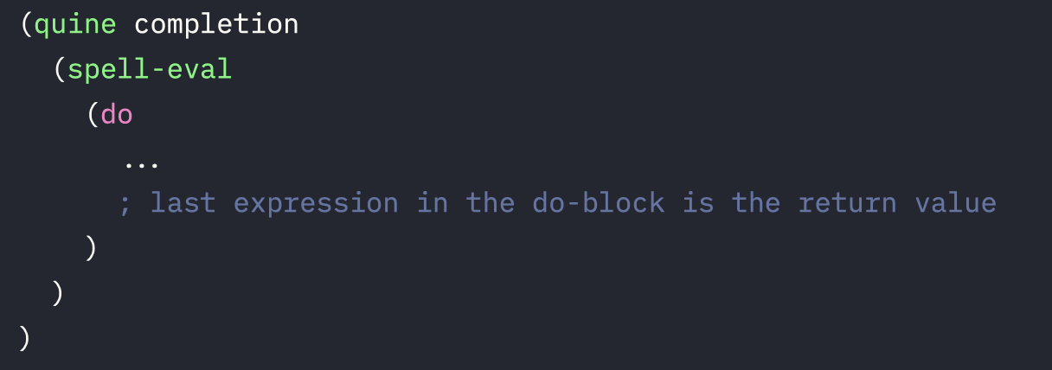
Structure of every completion

Slide 24

ReAct loop in Spell
=
LLM(
)
Prompt
Response
Tool output

Slide 25
Games impossible with ReAct

Slide 26
Coin flip game
Flip a coin programmatically. If it lands heads, print an h and pass this exact prompt onto a child LLM, using its binding, so that they can do the same thing. If it lands tails, print a t. Think about your solution before you write it; plan it, check its correctness in your head before implementing it.

Slide 27
(def interior (do (def completion (cat \"(def interior \" (pr-str (uneval 'interior)) \")\")) (def prompt \"Flip a coin programmatically. If it lands heads, print an h and pass this exact prompt onto a child LLM, using its binding, so that they can do the same thing. If it lands tails, print a t. Think about your solution before you write it; plan it, check its correctness in your head before implementing it.\")
(do
(def thought
(str
"Plan: generate a fair coin with (rand). If <0.5 => heads.\n"
"If heads: return (cat \"h\" (llm prompt)) so we both emit 'h' and delegate the same prompt via the prompt binding.\n"
"If tails: return \"t\".\n"
"Correctness: rand ∈ [0,1); threshold 0.5 gives 50/50. Child receives same prompt string; it has its own prompt binding from its preamble, so we pass the exact prompt value explicitly."))
(if (< (rand) 0.5)
(cat "h" (llm prompt))
"t")))))
ChatGPT 5.2

Slide 28
(def interior (do (def completion (cat \"(def interior \" (pr-str (uneval 'interior)) \")\")) (def prompt \"Flip a coin programmatically. If it lands heads, print an h and pass this exact prompt onto a child LLM, using its binding, so that they can do the same thing. If it lands tails, print a t. Think about your solution before you write it; plan it, check its correctness in your head before implementing it.\")
(do
(def thought
(str
"Plan: generate a fair coin with (rand). If <0.5 => heads.\n"
"If heads: return (cat \"h\" (llm prompt)) so we both emit 'h' and delegate the same prompt via the prompt binding.\n"
"If tails: return \"t\".\n"
"Correctness: rand ∈ [0,1); threshold 0.5 gives 50/50. Child receives same prompt string; it has its own prompt binding from its preamble, so we pass the exact prompt value explicitly."))
(if (< (rand) 0.5)
(cat "h" (llm prompt))
"t")))))
ChatGPT 5.2

Slide 29
(def interior (do (def completion (cat \"(def interior \" (pr-str (uneval 'interior)) \")\")) (def prompt \"Flip a coin programmatically. If it lands heads, print an h and pass this exact prompt onto a child LLM, using its binding, so that they can do the same thing. If it lands tails, print a t. Think about your solution before you write it; plan it, check its correctness in your head before implementing it.\")
(do
(def thought
(str
"Plan: generate a fair coin with (rand). If <0.5 => heads.\n"
"If heads: return (cat \"h\" (llm prompt)) so we both emit 'h' and delegate the same prompt via the prompt binding.\n"
"If tails: return \"t\".\n"
"Correctness: rand ∈ [0,1); threshold 0.5 gives 50/50. Child receives same prompt string; it has its own prompt binding from its preamble, so we pass the exact prompt value explicitly."))
(if (< (rand) 0.5)
(cat "h" (llm prompt))
"t")))))
ChatGPT 5.2

Slide 30
20 questions
Play 20 questions. You are the orchestrator who picks a secret word. Create two subagent roles: (1) a CHECKER who knows the secret and answers yes/no honestly, (2) a WORKER who does NOT know the secret and must guess by asking questions. The worker should adapt its questions based on previous answers. Loop until the worker guesses correctly or runs out of guesses.

Slide 31
(def interior (do (def completion (cat \"(def interior \" (pr-str (uneval 'interior)) \")\")) (def prompt \"Play 20 questions...\")
(do
(def secret "octopus")
(defn checker-respond [question]
(let [q (trim question)]
(cond
(or (= q "Is it an animal?")
(= q "Animal?"))
"yes"
…
;; Fallback: ask an LLM to answer yes/no based on the secret.
:else
(let [resp (trim (leaf-llm
(cat "You are CHECKER in 20 questions. Secret word: " secret
". Answer ONLY 'yes' or 'no' (no punctuation). "
"Question: " q)))]
(if (or (= resp "yes") (= resp "no")) resp "no")))))
(defn worker-next [history]
(leaf-llm
(cat
"You are WORKER playing 20 questions. …

Slide 32
(def interior (do (def completion (cat \"(def interior \" (pr-str (uneval 'interior)) \")\")) (def prompt \"Play 20 questions...\")
(do
(def secret "octopus")
(defn checker-respond [question]
(let [q (trim question)]
(cond
(or (= q "Is it an animal?")
(= q "Animal?"))
"yes"
…
;; Fallback: ask an LLM to answer yes/no based on the secret.
:else
(let [resp (trim (leaf-llm
(cat "You are CHECKER in 20 questions. Secret word: " secret
". Answer ONLY 'yes' or 'no' (no punctuation). "
"Question: " q)))]
(if (or (= resp "yes") (= resp "no")) resp "no")))))
(defn worker-next [history]
(leaf-llm
(cat
"You are WORKER playing 20 questions. …

Slide 33
(def interior (do (def completion (cat \"(def interior \" (pr-str (uneval 'interior)) \")\")) (def prompt \"Play 20 questions...\")
(do
(def secret "octopus")
(defn checker-respond [question]
(let [q (trim question)]
(cond
(or (= q "Is it an animal?")
(= q "Animal?"))
"yes"
…
;; Fallback: ask an LLM to answer yes/no based on the secret.
:else
(let [resp (trim (leaf-llm
(cat "You are CHECKER in 20 questions. Secret word: " secret
". Answer ONLY 'yes' or 'no' (no punctuation). "
"Question: " q)))]
(if (or (= resp "yes") (= resp "no")) resp "no")))))
(defn worker-next [history]
(leaf-llm
(cat
"You are WORKER playing 20 questions. …

Slide 34
(defn loop-game [n history]
(if (> n 20)
(cat "Out of questions.\nSecret was: " secret "\n\nTranscript:\n" history)
(let [q (trim (worker-next history))
a (checker-respond q)
history2 (cat history "Q" n ": " q "\nA" n ": " a "\n")
g (worker-guess history2)]
(if (= (trim g) "NO_GUESS")
(loop-game (+ n 1) history2)
(if (= (trim g) secret)
(cat "WORKER guesses: " g "\nResult: correct.\n\nTranscript:\n" history2)
(loop-game (+ n 1) (cat history2 "WORKER guesses: " g "\nResult: incorrect.\n"))))))) (loop-game 1 ""))

Slide 35

Transcript:
Q1: Is it a physical object?
A1: yes
Q2: Is it something typically found indoors?
A2: no
Q3: Is it a natural object (not man-made)?
A3: yes
Q4: Is it a living thing (like a plant or animal)?
A4: yes
Q5: Is it an animal?
A5: yes
Q6: Is it a vertebrate (does it have a backbone)?
A6: no
Q7: Is it an insect (has six legs and three body segments)?
A7: no
WORKER guesses: spider
Result: incorrect.
Q8: Is it a mollusk (like a snail, slug, clam, or octopus)?
A8: yes
WORKER guesses: octopus
Result: correct.

