Slide 1
Agent self-orchestration with Spell

Slide 2
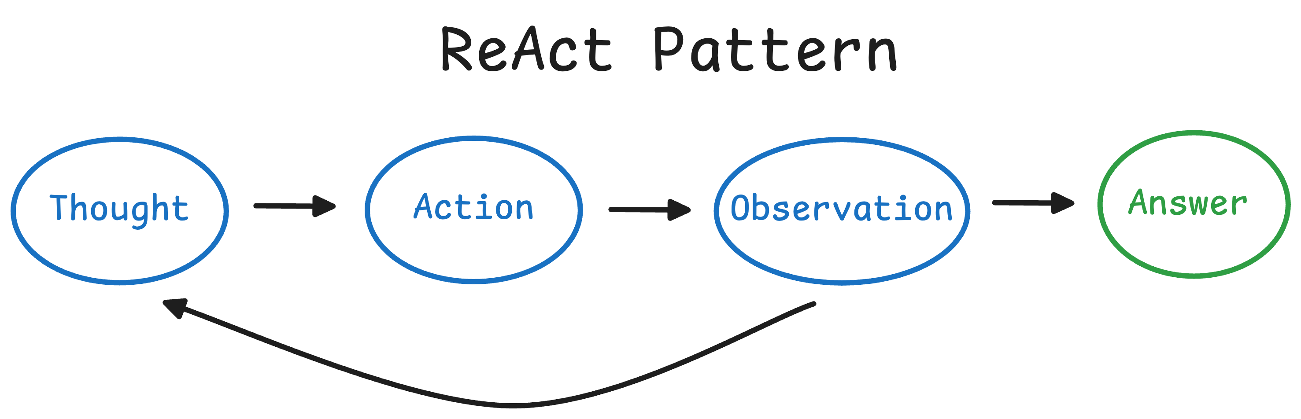
Prompt
Prompt
Response
Prompt
Response
Tool output
Prompt
Response
Tool output
Response
Prompt
Response
Tool output
Response
Tool output
Prompt
Response
Tool output
Response
Tool output
Response

Slide 3
Prompt
Prompt
Response
Prompt
Response
Subagent
Prompt
Response
Subagent
Response
Prompt
Response
Subagent
Response
Tool output
Prompt
Response
Subagent
Response
Tool output
Response

Slide 4
Limitations
Context grows forever
No parallelism
Fine for short tasks, bad for long ones

Slide 5
Orchestration: hot topic
Kimi 2.5: train LLM to dispatch swarms (PARL); still basically ReAct
Cursor browser experiment: planner/worker/checker pattern
Claude Code: viral “ralph” pattern
Claude code: parallelize to-do lists while respecting dependencies
“Recursive language model”: subagents gather context; still ReAct

Slide 6
Early findings
Nontrivial orchestration can make a big difference on long tasks (Cursor experiment, anecdotal from “Ralph”)
Divide-and-conquer mitigates context limitations (RLMs, “progressive disclosure” pattern)
Agents can be trained on orchestration using RL (Kimi)

Slide 7
What this motivates
A self-orchestrating agent should:
Have access to complex control flow – more complex than Kimi and RLMs
Tightly control context for itself and its subagents
Be trained at self-orchestration using RL

Slide 8
What this motivates
A self-orchestrating agent should:
Have access to complex control flow – more complex than Kimi and RLMs
Tightly control context for itself and its subagents
Be trained at self-orchestration using RL
Programming language for self-orchestration
Manipulate context using this language
Out of scope

Slide 9
Spell (self-prompting execution language for LLMs)
Embedded within Clojure
Lisp: “Code is data”
Spell: “Data [prompt, response, context] is code”
LLM receives incomplete program and completes it
The program is evaluated
Program can include long text strings, tool calls, and LLM calls

Slide 10
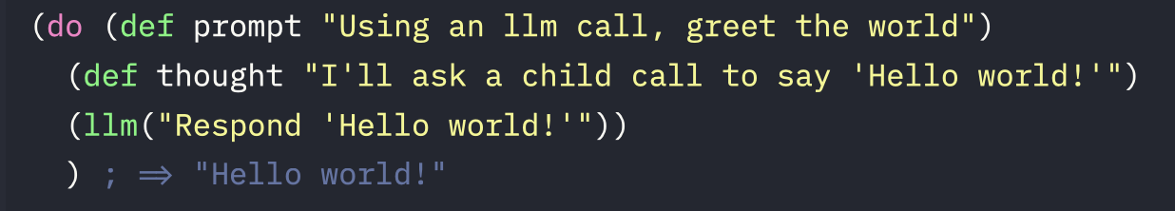
Spell (self-prompting execution language for LLMs)

Slide 11
Context = code
LLM should be able to manipulate context programmatically Motivates:
Lisp (“code is data”)
Quining via ‘uneval’

Slide 12
Environment = context
LLM cannot reason about anything not in its context window
Motivates:
Dynamic scoping (no function closures)
‘Expand’ free variables passed to child LLMs

Slide 13
Why not Python?
Quotes -> strings; escaping nightmare
Quining with ‘uneval’ – totally unclear how to do this
Custom evaluator -

Slide 14
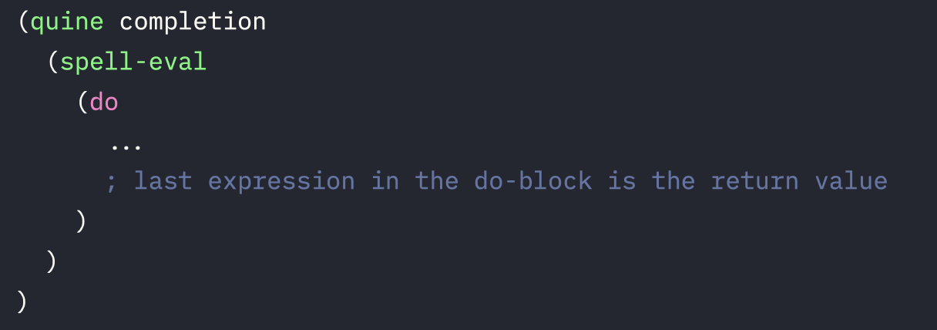
Structure of every completion

Slide 15

ReAct loop in Spell
=
LLM(
)
Prompt
Response
Tool output

Slide 16
Games impossible with ReAct

Slide 17
Coin flip game
Flip a coin programmatically. If it lands heads, print an h and pass this exact prompt onto a child LLM, using its binding, so that they can do the same thing. If it lands tails, print a t. Think about your solution before you write it; plan it, check its correctness in your head before implementing it.

Slide 18
(def interior (do (def completion (cat \"(def interior \" (pr-str (uneval 'interior)) \")\")) (def prompt \"Flip a coin programmatically. If it lands heads, print an h and pass this exact prompt onto a child LLM, using its binding, so that they can do the same thing. If it lands tails, print a t. Think about your solution before you write it; plan it, check its correctness in your head before implementing it.\")
(do
(def thought
(str
"Plan: generate a fair coin with (rand). If <0.5 => heads.\n"
"If heads: return (cat \"h\" (llm prompt)) so we both emit 'h' and delegate the same prompt via the prompt binding.\n"
"If tails: return \"t\".\n"
"Correctness: rand ∈ [0,1); threshold 0.5 gives 50/50. Child receives same prompt string; it has its own prompt binding from its preamble, so we pass the exact prompt value explicitly."))
(if (< (rand) 0.5)
(cat "h" (llm prompt))
"t")))))
ChatGPT 5.2

Slide 19
(def interior (do (def completion (cat \"(def interior \" (pr-str (uneval 'interior)) \")\")) (def prompt \"Flip a coin programmatically. If it lands heads, print an h and pass this exact prompt onto a child LLM, using its binding, so that they can do the same thing. If it lands tails, print a t. Think about your solution before you write it; plan it, check its correctness in your head before implementing it.\")
(do
(def thought
(str
"Plan: generate a fair coin with (rand). If <0.5 => heads.\n"
"If heads: return (cat \"h\" (llm prompt)) so we both emit 'h' and delegate the same prompt via the prompt binding.\n"
"If tails: return \"t\".\n"
"Correctness: rand ∈ [0,1); threshold 0.5 gives 50/50. Child receives same prompt string; it has its own prompt binding from its preamble, so we pass the exact prompt value explicitly."))
(if (< (rand) 0.5)
(cat "h" (llm prompt))
"t")))))
ChatGPT 5.2

Slide 20
(def interior (do (def completion (cat \"(def interior \" (pr-str (uneval 'interior)) \")\")) (def prompt \"Flip a coin programmatically. If it lands heads, print an h and pass this exact prompt onto a child LLM, using its binding, so that they can do the same thing. If it lands tails, print a t. Think about your solution before you write it; plan it, check its correctness in your head before implementing it.\")
(do
(def thought
(str
"Plan: generate a fair coin with (rand). If <0.5 => heads.\n"
"If heads: return (cat \"h\" (llm prompt)) so we both emit 'h' and delegate the same prompt via the prompt binding.\n"
"If tails: return \"t\".\n"
"Correctness: rand ∈ [0,1); threshold 0.5 gives 50/50. Child receives same prompt string; it has its own prompt binding from its preamble, so we pass the exact prompt value explicitly."))
(if (< (rand) 0.5)
(cat "h" (llm prompt))
"t")))))
ChatGPT 5.2

Slide 21
20 questions
Play 20 questions. You are the orchestrator who picks a secret word. Create two subagent roles: (1) a CHECKER who knows the secret and answers yes/no honestly, (2) a WORKER who does NOT know the secret and must guess by asking questions. The worker should adapt its questions based on previous answers. Loop until the worker guesses correctly or runs out of guesses.

Slide 22
(def interior (do (def completion (cat \"(def interior \" (pr-str (uneval 'interior)) \")\")) (def prompt \"Play 20 questions...\")
(do
(def secret "octopus")
(defn checker-respond [question]
(let [q (trim question)]
(cond
(or (= q "Is it an animal?")
(= q "Animal?"))
"yes"
…
;; Fallback: ask an LLM to answer yes/no based on the secret.
:else
(let [resp (trim (leaf-llm
(cat "You are CHECKER in 20 questions. Secret word: " secret
". Answer ONLY 'yes' or 'no' (no punctuation). "
"Question: " q)))]
(if (or (= resp "yes") (= resp "no")) resp "no")))))
(defn worker-next [history]
(leaf-llm
(cat
"You are WORKER playing 20 questions. …

Slide 23
(def interior (do (def completion (cat \"(def interior \" (pr-str (uneval 'interior)) \")\")) (def prompt \"Play 20 questions...\")
(do
(def secret "octopus")
(defn checker-respond [question]
(let [q (trim question)]
(cond
(or (= q "Is it an animal?")
(= q "Animal?"))
"yes"
…
;; Fallback: ask an LLM to answer yes/no based on the secret.
:else
(let [resp (trim (leaf-llm
(cat "You are CHECKER in 20 questions. Secret word: " secret
". Answer ONLY 'yes' or 'no' (no punctuation). "
"Question: " q)))]
(if (or (= resp "yes") (= resp "no")) resp "no")))))
(defn worker-next [history]
(leaf-llm
(cat
"You are WORKER playing 20 questions. …

Slide 24
(def interior (do (def completion (cat \"(def interior \" (pr-str (uneval 'interior)) \")\")) (def prompt \"Play 20 questions...\")
(do
(def secret "octopus")
(defn checker-respond [question]
(let [q (trim question)]
(cond
(or (= q "Is it an animal?")
(= q "Animal?"))
"yes"
…
;; Fallback: ask an LLM to answer yes/no based on the secret.
:else
(let [resp (trim (leaf-llm
(cat "You are CHECKER in 20 questions. Secret word: " secret
". Answer ONLY 'yes' or 'no' (no punctuation). "
"Question: " q)))]
(if (or (= resp "yes") (= resp "no")) resp "no")))))
(defn worker-next [history]
(leaf-llm
(cat
"You are WORKER playing 20 questions. …

Slide 25
(defn loop-game [n history]
(if (> n 20)
(cat "Out of questions.\nSecret was: " secret "\n\nTranscript:\n" history)
(let [q (trim (worker-next history))
a (checker-respond q)
history2 (cat history "Q" n ": " q "\nA" n ": " a "\n")
g (worker-guess history2)]
(if (= (trim g) "NO_GUESS")
(loop-game (+ n 1) history2)
(if (= (trim g) secret)
(cat "WORKER guesses: " g "\nResult: correct.\n\nTranscript:\n" history2)
(loop-game (+ n 1) (cat history2 "WORKER guesses: " g "\nResult: incorrect.\n"))))))) (loop-game 1 ""))

Slide 26

Transcript:
Q1: Is it a physical object?
A1: yes
Q2: Is it something typically found indoors?
A2: no
Q3: Is it a natural object (not man-made)?
A3: yes
Q4: Is it a living thing (like a plant or animal)?
A4: yes
Q5: Is it an animal?
A5: yes
Q6: Is it a vertebrate (does it have a backbone)?
A6: no
Q7: Is it an insect (has six legs and three body segments)?
A7: no
WORKER guesses: spider
Result: incorrect.
Q8: Is it a mollusk (like a snail, slug, clam, or octopus)?
A8: yes
WORKER guesses: octopus
Result: correct.

