Slide 1
Self-Programmed Execution
Theoretical Foundations
Luke O'Connor
Group Meeting · April 24, 2026

Slide 2
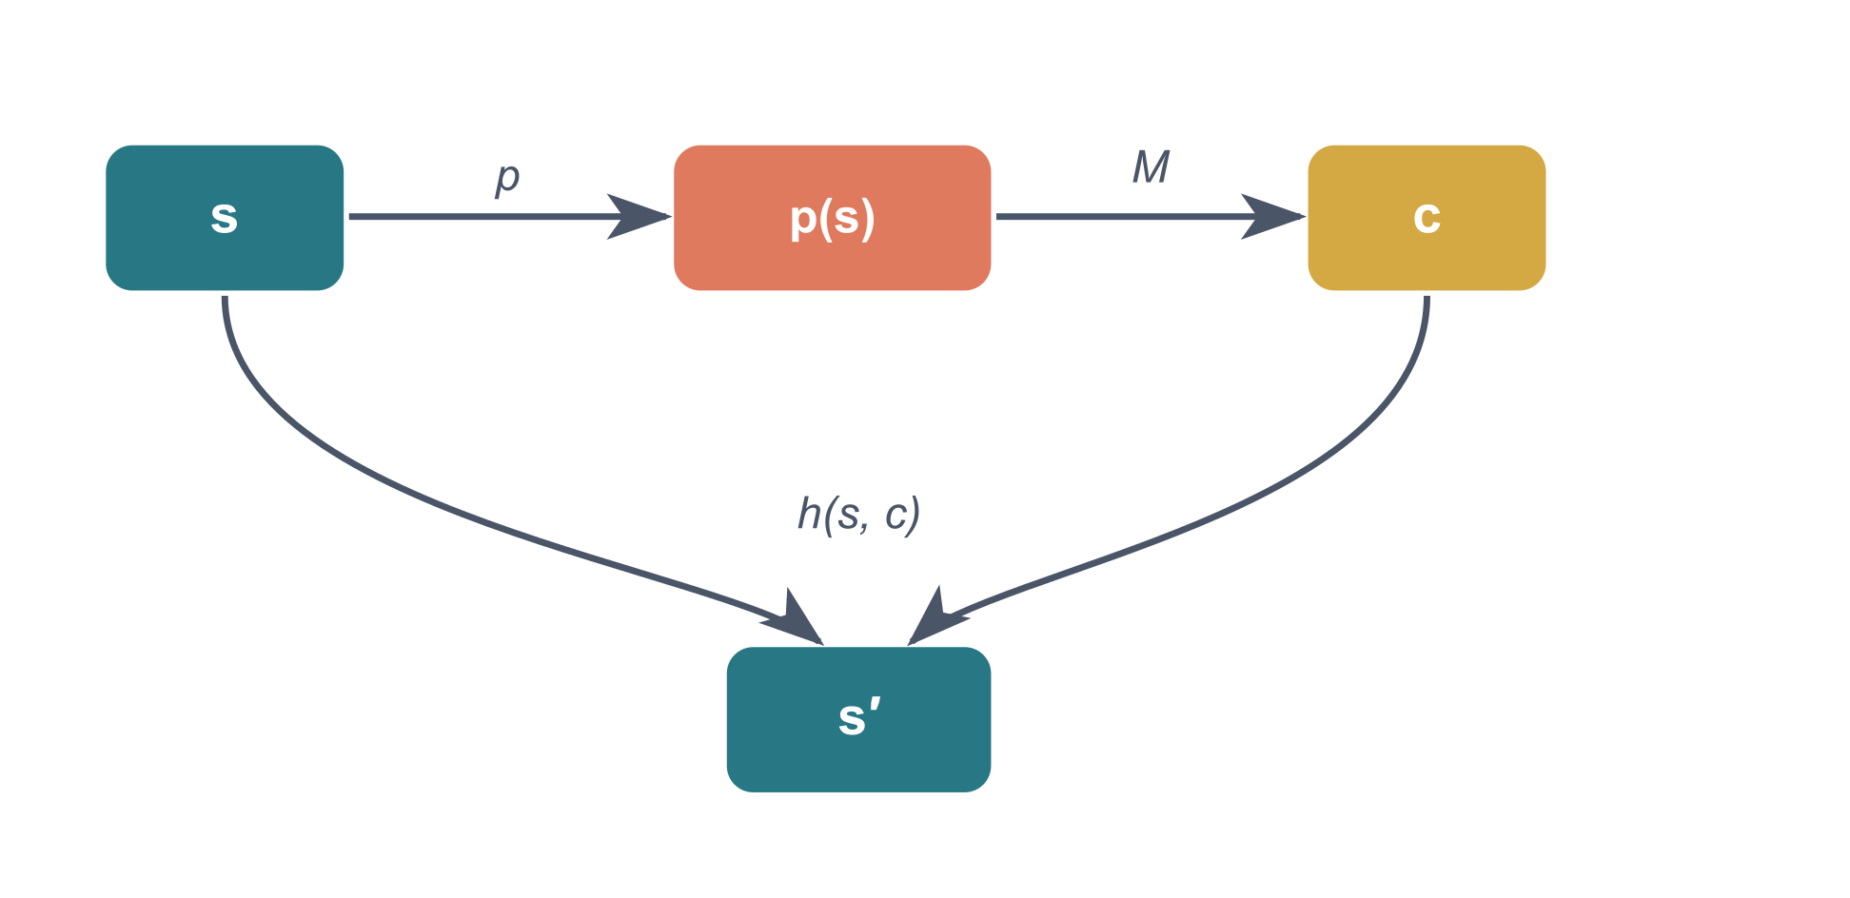
Agentic Machines
Definition. An agentic machine X = (S, p, h):
State space S
Prompt function p : S → P
Harness function h : S × C → S ∪ {halt, ↑}
Exactly one model call per state transition. The machine constructs a prompt, the model returns a completion, and the harness computes the next state.

Slide 3
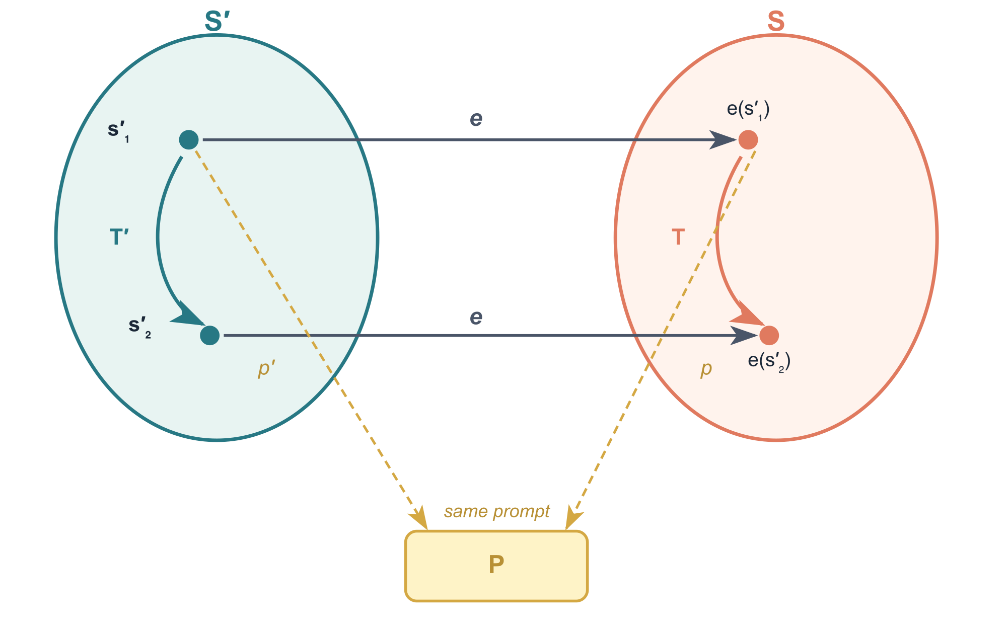
Embeddings
Definition. An embedding e : S′ → S is an injection with: prompt preservation p(e(s′)) = p′(s′) and transition commutation h(e(s′), c) = e(h′(s′, c))

Slide 4
Invisible Embeddings
Theorem C.3.3. Embeddings are invisible to the language model.
If e embeds X′ into X, then for every state s′ and every sequence of future completions, the model sees exactly the same prompts whether it interacts with X′ from s′ or with X from e(s′).
Formally: (X′, s′) ~ (X, e(s′)) where ~ is LM-indistinguishability — identical prompt traces under all completion sequences.

Slide 5
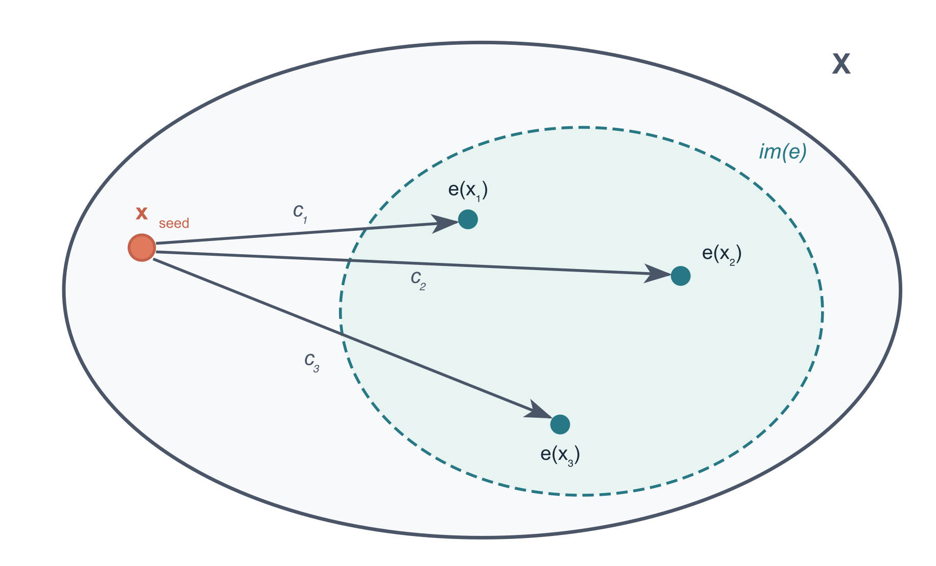
Completion-Generation
Definition C.3.6.
A state xseed of X completion-generates X′ if there exists an embedding e of X′ in X such that every embedded state is reachable via some completion:
∀ s′ ∈ S′ : ∃ c ∈ C : h(xseed, c) = e(s′)

Slide 6
The Agentic Evaluator
Take a standard program evaluator (the CEK machine) and add a special primitive lm that calls the language model.
Definition. The CEK agentic evaluator is an agentic machine whose states are boundary states of the CEK machine at which the next step is to evaluate lm:
let y = lm q in ...

Slide 7
SPE States
Definition. A state x is an SPE state of X if (X, x) completion-generates X itself. From one state, the model can reach an embedded copy of any state of the machine.
Theorem C.5.2. The CEK agentic evaluator contains an SPE state.
The seed state is produced by evaluating:
let y = lm q in eval y
Ask the model for a completion y, then evaluate y as code.

Slide 8
Universality
Corollary.
The SPE state of the agentic evaluator completion-generates “any” computable harness.
Because the CEK machine is Turing complete, every agentic machine whose prompt function and harness functions are computable, and which shares the same LM interface, can be embedded in the CEK agentic evaluator and therefore completion-generated by an SPE state.

Slide 9
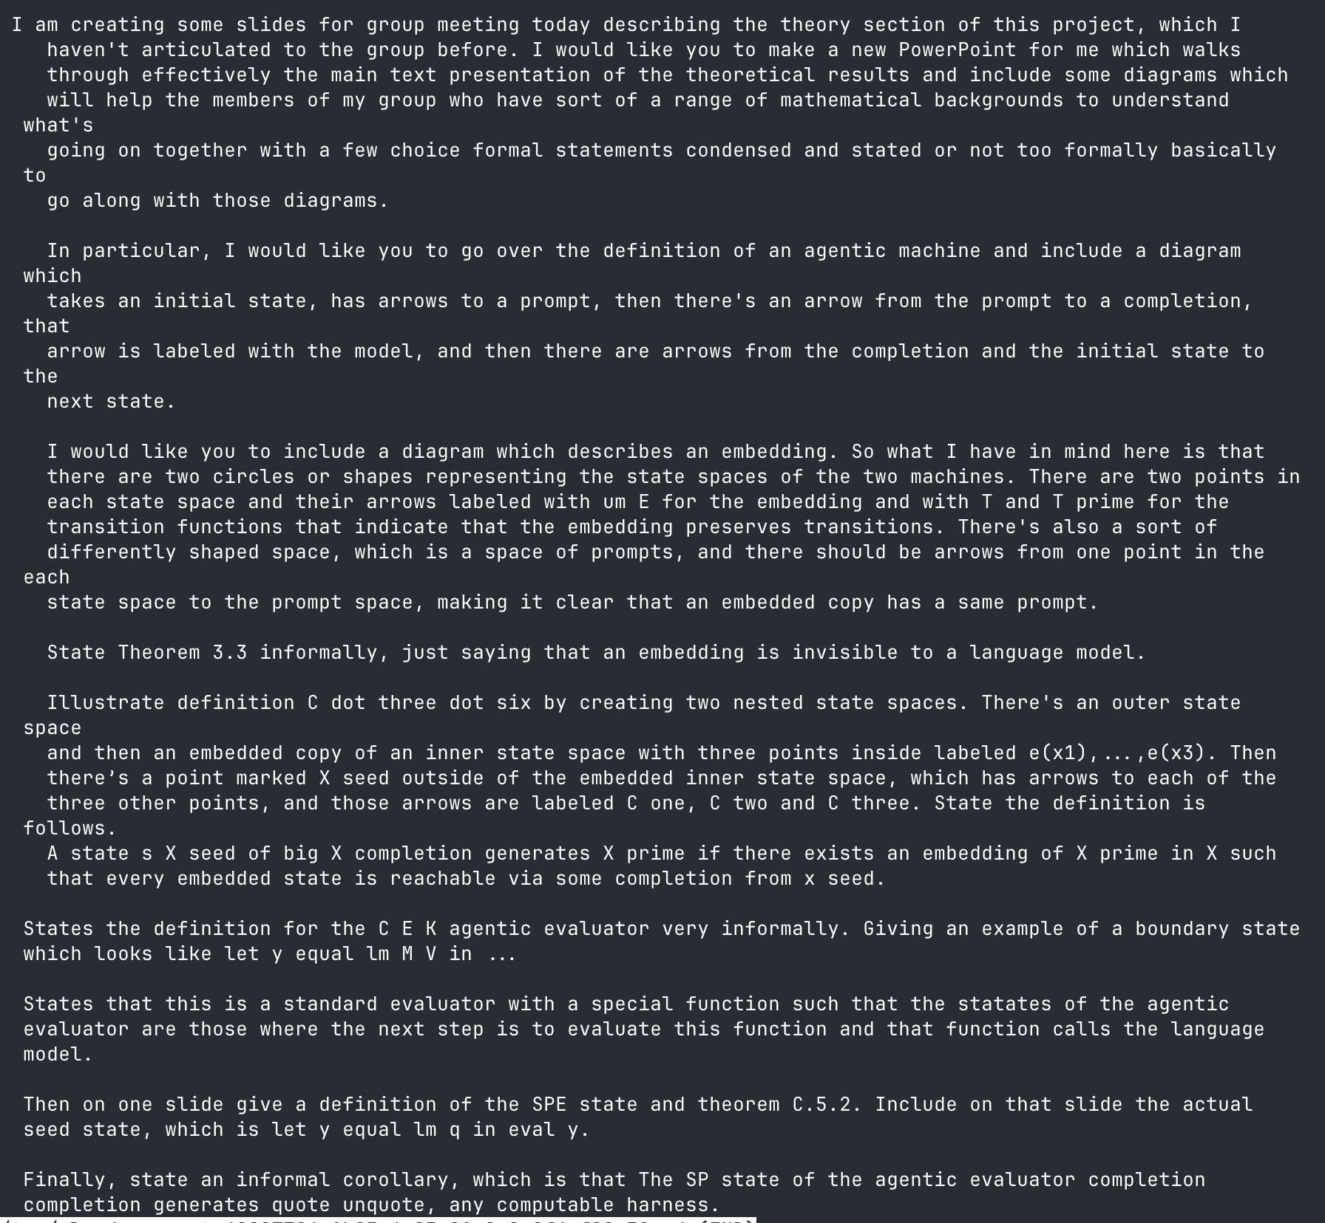
Making these slides

Slide 10
Doing math with GPT-5.4 pro
Genuinely nontrivial work
Lots of iteration, probably ~50 turns, ~20 minutes thinking per turn
Consistently understands what is written so far
Lacks intuition for the right statements + definitions
Easily formalizes a definition or statement given a sketch of the right intuition; sketch can be very informal, but intuition must actually be good
Gives proofs which are straightforward but not trivial
Occasionally hand-waves, but only two clear instances in this project
GPT-5.4 pro is dramatically stronger than Opus-4.6

